Slide 1
Privacy & cloud
Henning Schulzrinne

Slide 2
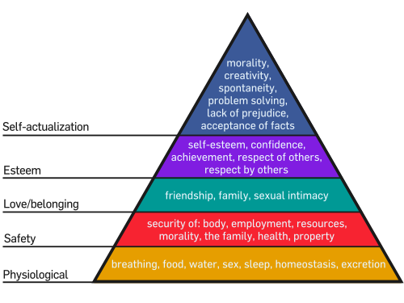
Privacy threats
fear of exploration
embarrassment
family secrets
“we regret to inform you”
pre-existing condition
vacation burglary
stalking

Slide 3
Risks
Direct
usage for price discrimination
news filter
Accidental (risk)
theft
(OPM, Anthem)
de-anonymization
Indirect
Sale of data + aggregation
(data brokers)
Sale of company + data
(Radio Shack)

Slide 4
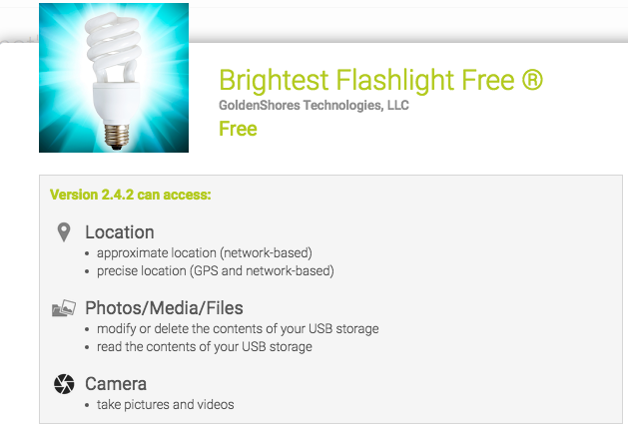
Old model: permissions & privacy statements

Slide 5
Old model: consumer fraud model
FTC can pursue companies for violating Section 5
generic privacy policies

Slide 6
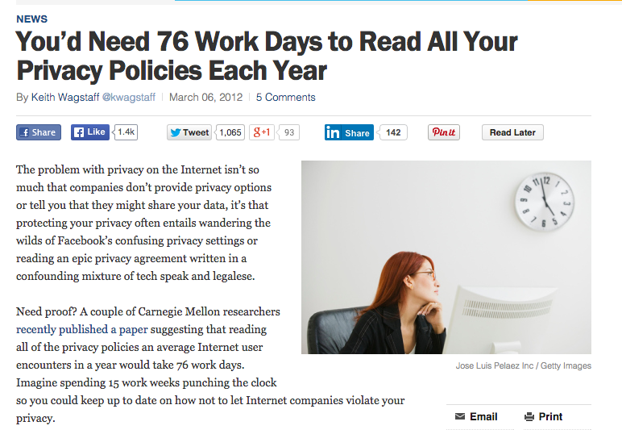
Privacy policies
classical approach: disclosure to reduce information asymmetry
allow informed consumer choice
assumes competition, understanding, rational trade-off

Slide 7
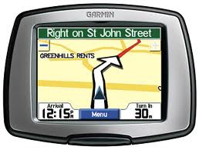

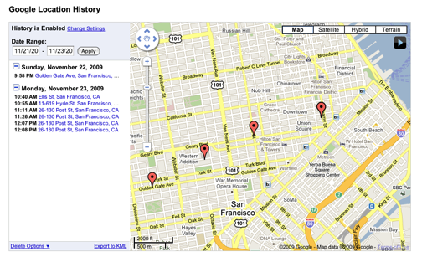
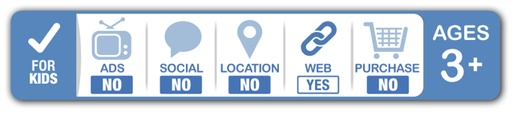
Privacy difficulties
Difficulty of defining privacy
  specific threats vs. just fear of threat
  current vs. future (e.g., job search)
Emphasis on data gathering alone unhelpful
  → same information can be used for low-risk and high-risk activities
  but can be part of risk minimization
IETF GEOPRIV approach:
  how long is data stored?
  is it shared with third parties?
    (but what are third parties?)
Notes:
http://www.ftc.gov/os/2013/02/130201mobileprivacyreport.pdf

Slide 8
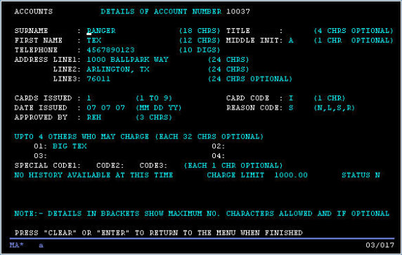
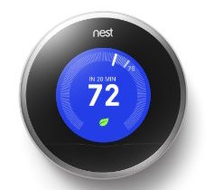
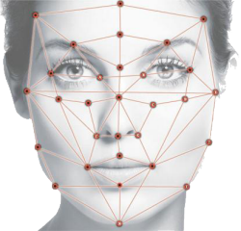
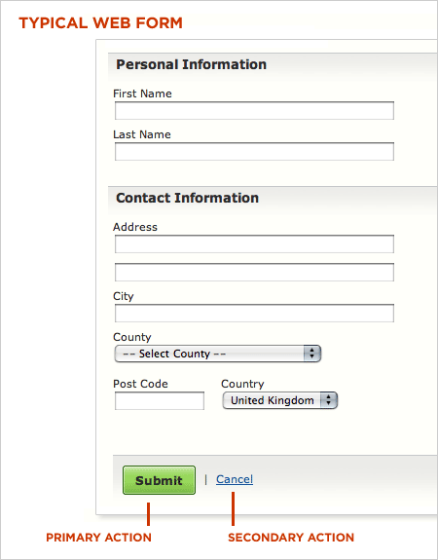
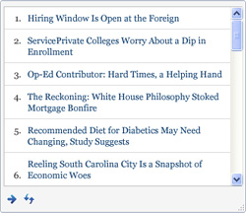
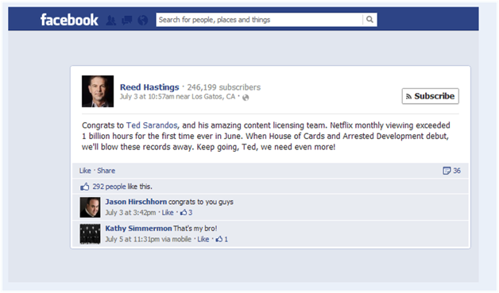
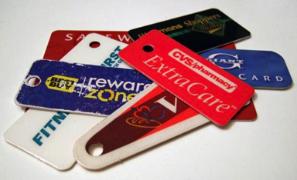
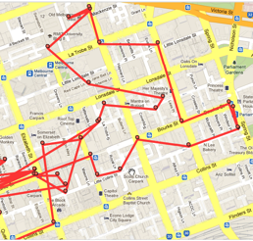
Old vs. new data
explicit, textual, episodic
implicit, sensors, continuous

Slide 9
Other practical problems
What laws apply when data about a Dutch citizen are processed by a US company and stored in Switzerland?
Treatment of different kinds of data
  medical and educational records
  financial records
  content vs. meta data
But limited usefulness
  meta data may reveal as much as content
  medical searches may reveal more than medical records
Hard to estimate harm
  who has what data on me? Can I correct the data?
  what it is being used for?
Should I have real economic choices?
  value of privacy (see AT&T U-Verse model)
  can I buy an ad-free version of Facebook?

Slide 10
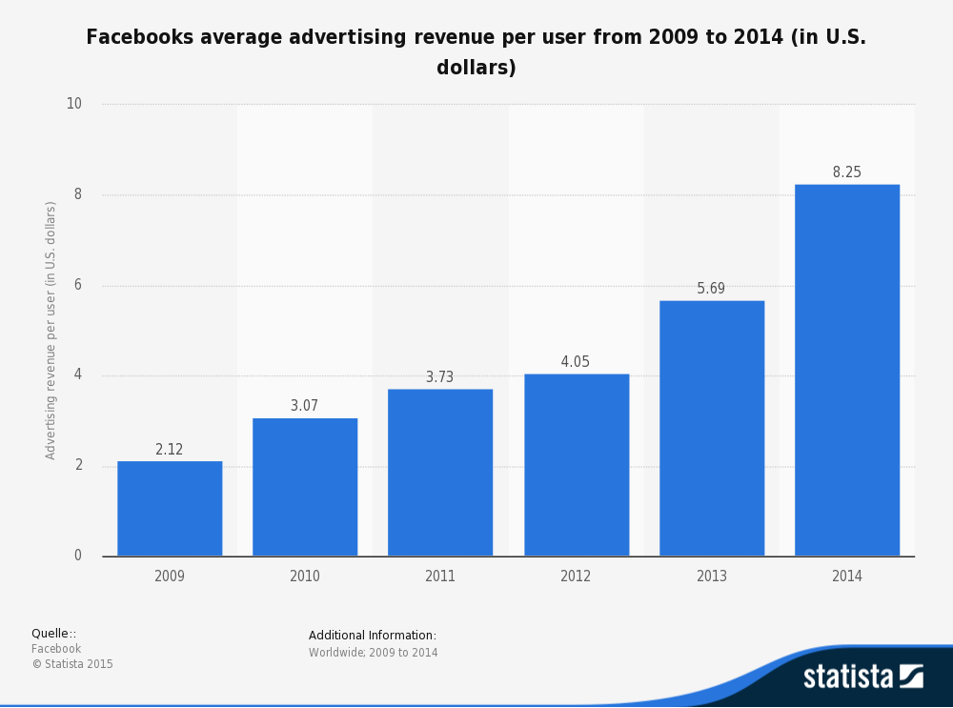
How much is a user worth?
per year
(global)

Slide 11
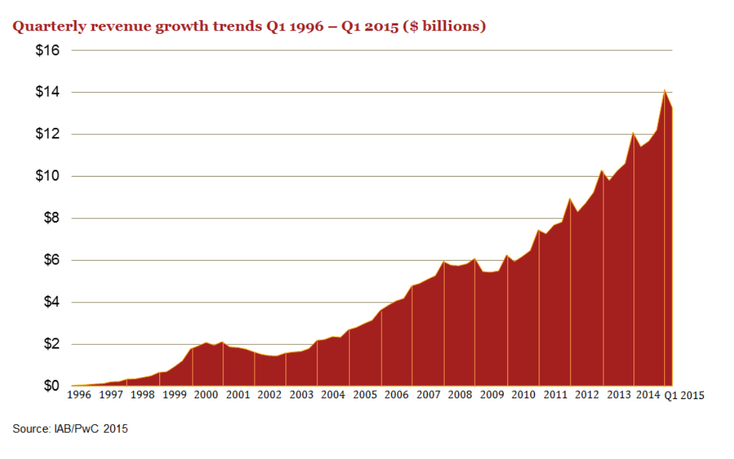
But replacing ad revenue is tough
app. 80 M US Internet households → $700/year ad-free Internet
(ignoring B2B advertising)

