Slide 1
5G: What can we learn from the previous four generations?
Henning Schulzrinne
Columbia University

Slide 2
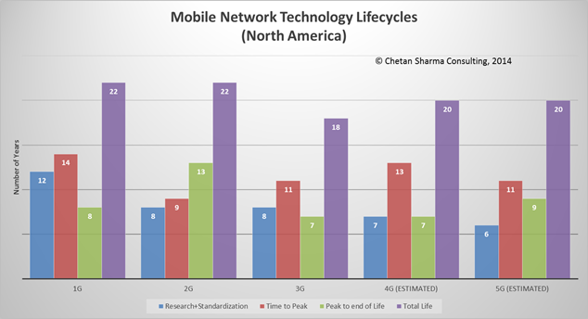
Design for 20 years

Slide 3
Generational surprises
Generation | Expectation | Surprise
2G | better voice quality (“digital!”) | SMS
3G | WAP | web
4G | IMS | YouTube, WhatsApp
5G | IoT (low latency) | ?
underestimated cost and fixed-equivalence as drivers

Slide 4
Lessons, in brief
Experience | Lessons
VoLTE, IMS | avoid complexity avoid entanglement plan intercarrier interfaces
Wi-Fi | don’t trust the RAN/AP
disaggregation of functions | clear & simple interfaces don’t assume trust between elements
app stores | keep it application-neutral
FTTH, backhaul cost | re-use backhaul where you can find it

Slide 5
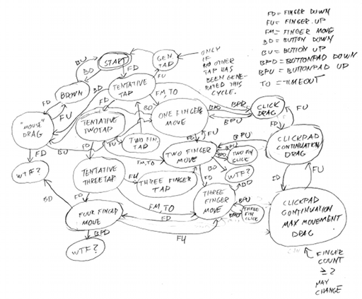
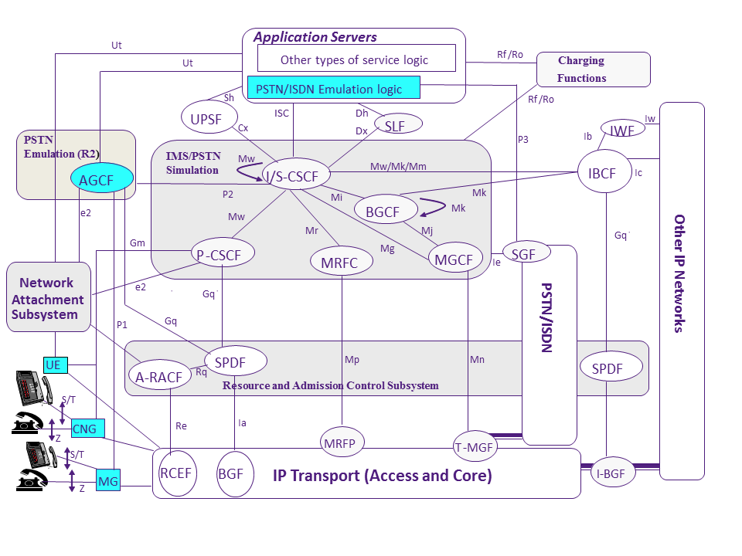
Complexity kills
IMS
Notes:
http://voices.canonical.com/jussi.pakkanen/files/2012/01/synaptics-statemachine.png
http://upload.wikimedia.org/wikipedia/en/9/9c/TISPAN_IMS_Reference_Architecture.png

Slide 6
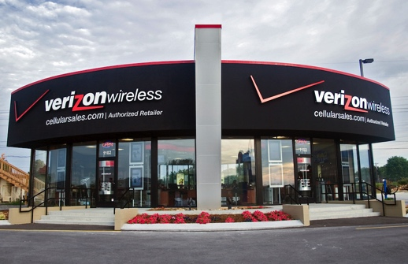

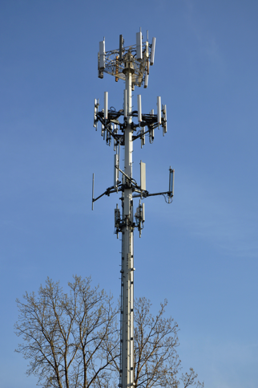
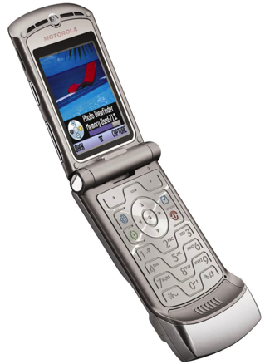
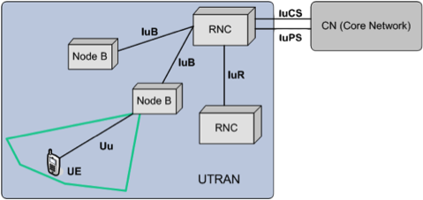
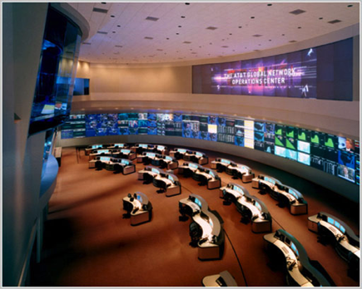
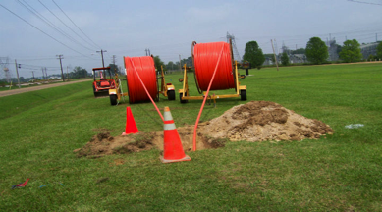
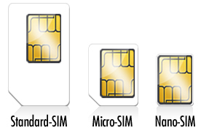
Networks 1G through 4Gish
national carrier
one subscriber,
one phone,
one provider

Slide 7
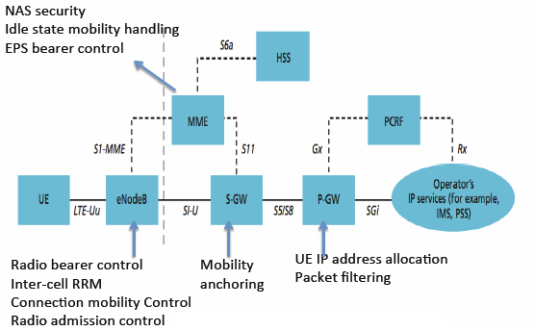
LTE – one carrier, plus roaming

Slide 8




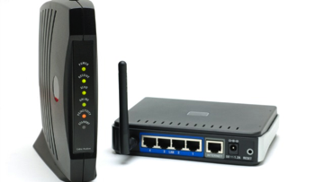
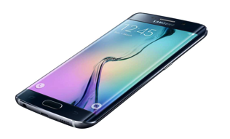

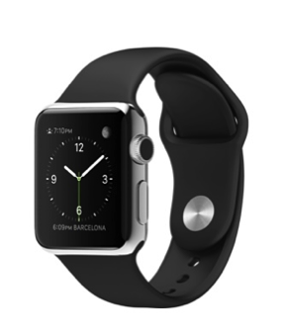
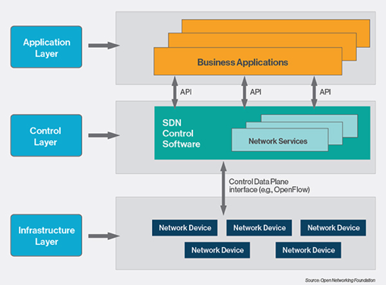




5G – what exactly is a carrier?
Spectrum DB
Spectrum DB
40k towers each (US)
Level3
Cogent
LTE-U
802.11n
LTE

Slide 9
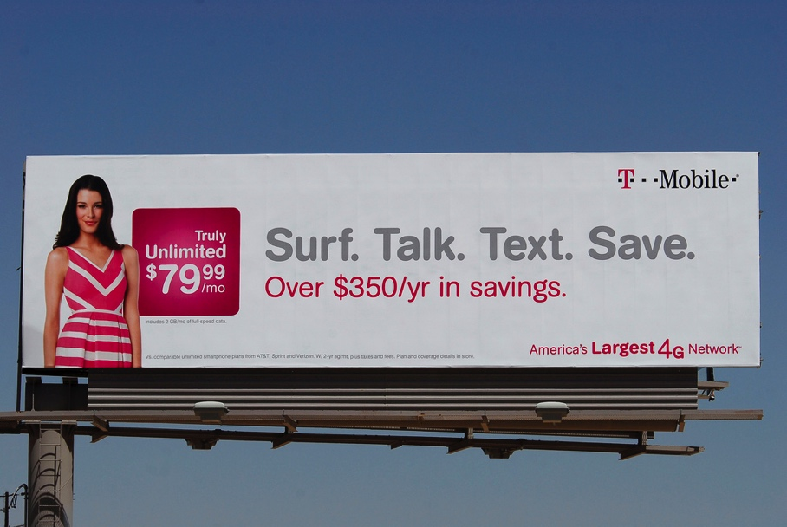
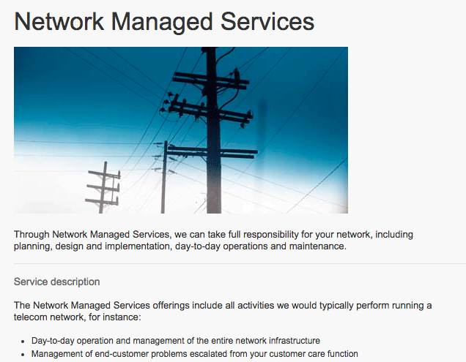
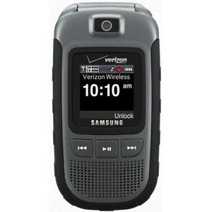
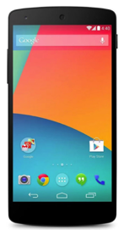
5G: Carriers as consumer brand
Outside
Inside

Slide 10

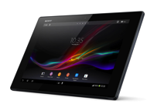
What’s the simplest network?
AAA
HLR
(?)
network characteristics (QoS)
IP address
AAA (incl. payment)
discovery
registrar
IPv6 access
(any network)
DHCP
network
resources
one subscriber, multiple devices, multiple providers

Slide 11


Where do we need mobility?
likely to have access provider diversity
  what is expected lifetime of IP address?
PMIP and MIP complex
  need to re-create application-layer security at L3
not really needed for HTTP video
  use mTCP?
  or HTTP restart?
maybe not even for real-time media
  registrar for new-call reachability
  application layer (SIP) mobility for mid-call hand-off?
or tunnels, tunnels everywhere?

Slide 12
Make the network location-aware
2G/3G/4G are location-ignorant: “I only know your cell sector”
All mobile devices will be location-aware to the ~5 m
Some know where they will likely be in the near future
  public transit
  road navigation systems
  ➔ predict access and hand-off
All devices will have multiple radios
  use macro cell network to query for local access

Slide 13
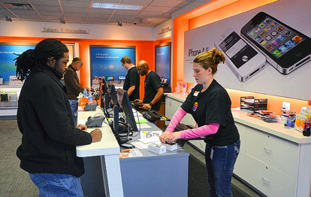
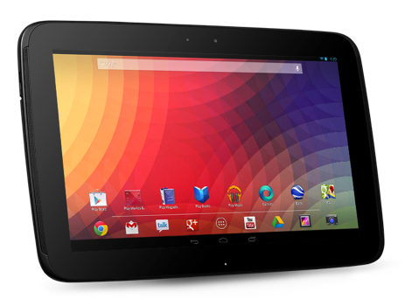
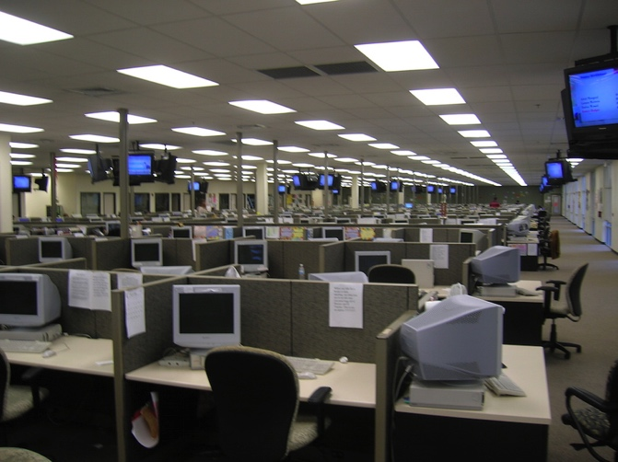
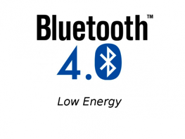

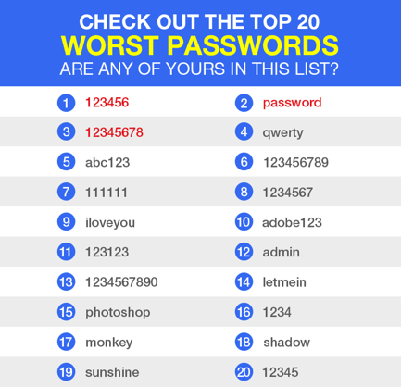
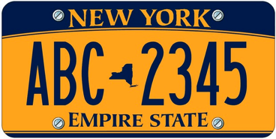
Simplify enrollment
enable access

Slide 14
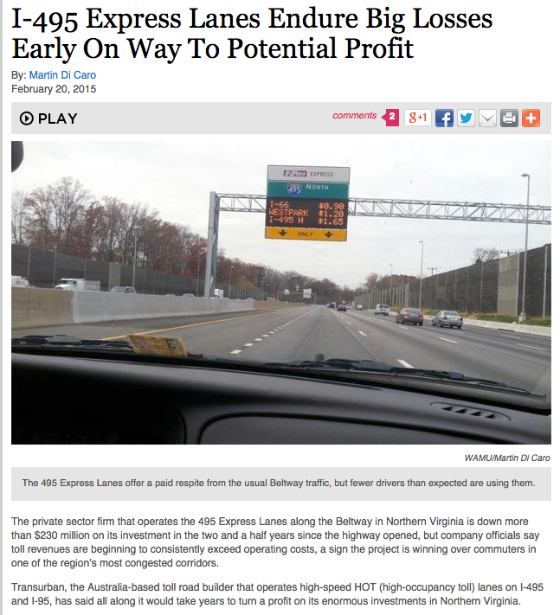
The law of new networks
“Any new network technology will be justified on (finally) providing QoS”
To succeed, they have to provide good-enough QoS for best effort
  at least with competition
The business model for QoS is difficult
  see bypass toll roads
QoS is usually not accessible to applications
  or not end-to-end

Slide 15
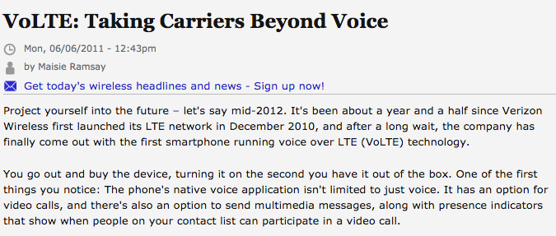
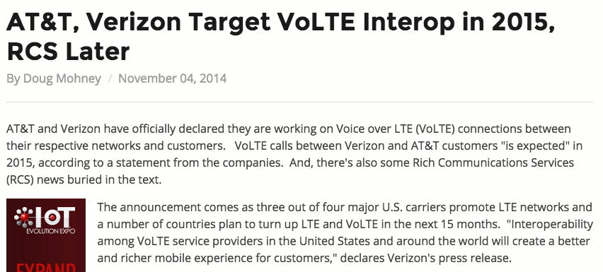
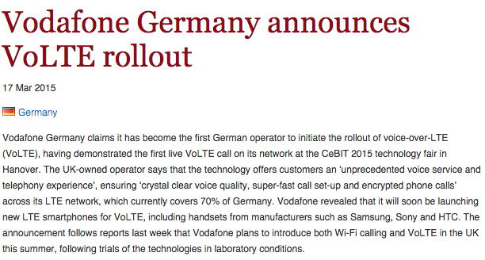
IMS /VoLTE
IMS = It Mostly Speaks
VoLTE = Voice-Only Later than Expected

Slide 16
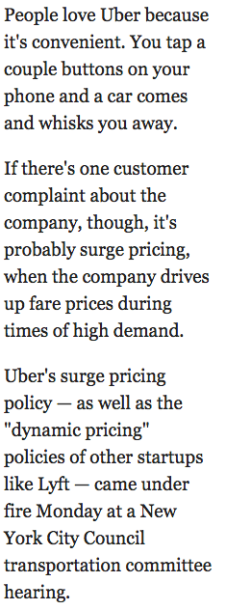
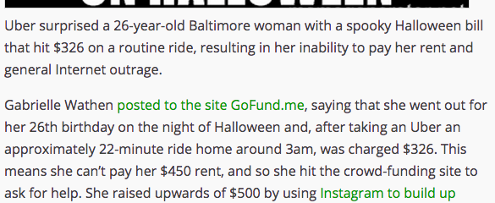


Surge pricing – non-telecom
BI, 1/13/2015
Notes:
Techcrunch

Slide 17
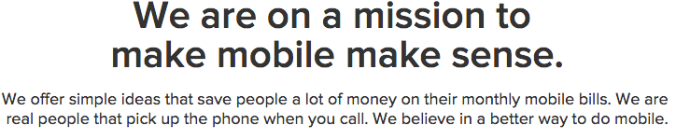
Aggressive competitors compete on simplicity

Slide 18
Capital investment
Company | Revenue | Capital expenditures | %
Comcast (US) [3Q14] | $11.04B | $1.644B | 14.9
Telekom (DE) [3Q14] | €15.6B | $2.58B | 16.5
Safaricom (KE) [H1FY15] | Ksh 79.34B | Ksh 12.37 | 15.5

Slide 19
The value of bits
Technologist: A bit is a bit is a bit
Economist: Some bits are more valuable than other bits
  e.g., $/bit(email) >> $/bit(video)
  no-QoS bits dominate in volume
Application | Volume | Cost per unit | Cost / MB | Cost / TB
Cable video | 660 GB |  | $0.06 | $60
Voice (13 kb/s GSM) | 97.5 kB/minute | 10c | $1.02 | $1M
Mobile data | 5 GB | $40 | $0.008 | $8,000
MMS (pictures) | < 300 KB, avg. 50 kB | 25c | $5.00 | $5M
SMS | 160 B | 10c | $625 | $625M
Notes:
T-Mobile 2010
AT&T data
http://www.nowsms.com/discus/messages/12/8500.html

Slide 20
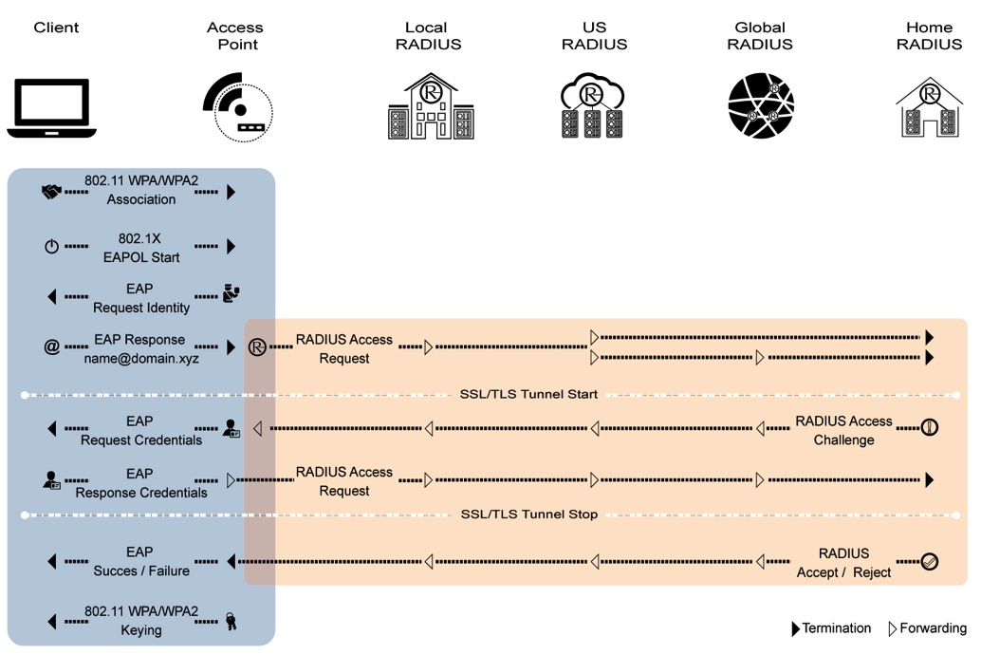

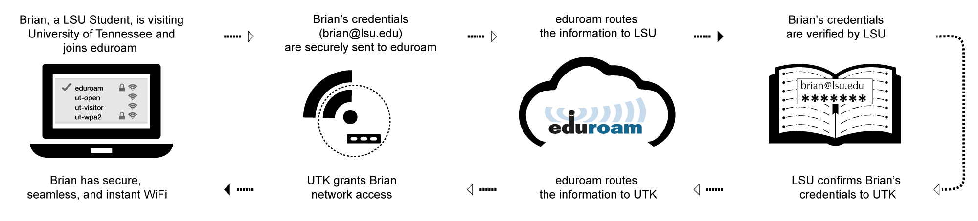
5G prototype: Eduroam

Slide 21

Growing-up lessons
Complexity kills
Play fair
CapEx is once, OpEx is forever
Know where you are
Share everything
Don’t trust strangers

Slide 22
Backup

Slide 23
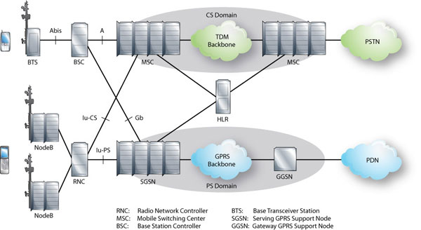
LTE architecture
Notes:
http://alcatel-lucent.com/enrich/v1i12007/article_c4a4.html

Slide 24
Cell towers
Tower owner | Number of towers
Crown Castle | 39,739
American Tower | 40,000 (with VZW)
SBA Communications | 15,151
United Cellular Co. | 4,802
Verizon Wireless | 1,400
T-Mobile Towers | 1,003
Time Warner | 950
Mediacom Communications | 750
Charter Communications | 650
Diamond Communications | 637
Trillion Partners | 635
cost/tower: $150k
total US: 205k
Notes:
http://www.statisticbrain.com/cell-phone-tower-statistics/
http://ir.sbasite.com/releasedetail.cfm?ReleaseID=908348

Slide 25
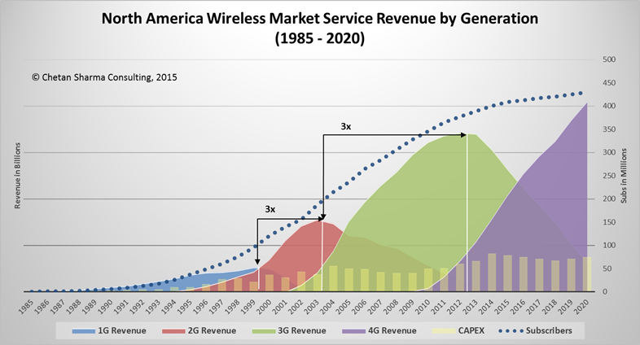
Wireless market evolution

