Slide 1
Internet in the Small & Large: The Internet of Things and the Open Internet
H. Schulzrinne
(+ Jan Janak & other CUCS IRT contributors)
WTS 2015 (New York City)
April 15, 2015

Slide 2
Overview
The Internet of Things is many things
  Most of them aren’t new or exciting
  and that’s a good thing
The network part isn’t (all that) exciting, but…
How do we name IoT devices?
How do we secure them?
How do we program them?
A quick recap of the Open Internet

Slide 3
Internet of Things
Mostly about embedded devices that interact with the physical world, not the Internet
  “humans optional”
Network part not really new or exciting
Software-controlled networked devices
Challenges:
  lack of UI → usability
  lack of UI → usable security
  integration (service & APIs)
  programming – beyond a single device

Slide 4
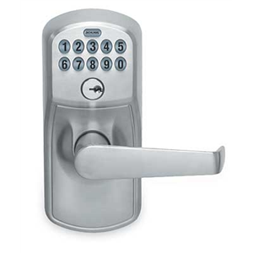

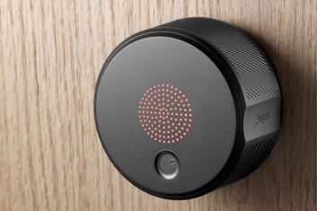
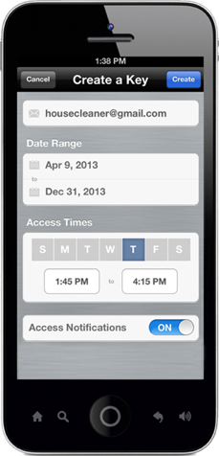


Natural evolution

Slide 5
CPS, WSN & IoT challenges
 | Node | Network | Program | Example
IoT | re-usability | interoperability | heterogeneous & loosely coupled | VoIP thermostat
CPS | real-time guarantees | predictability & redundancy | model verification | avionics industrial control
WSN | energy efficiency | minimize communication | homogeneous minimal OS | structural monitoring (bridge)

Slide 6
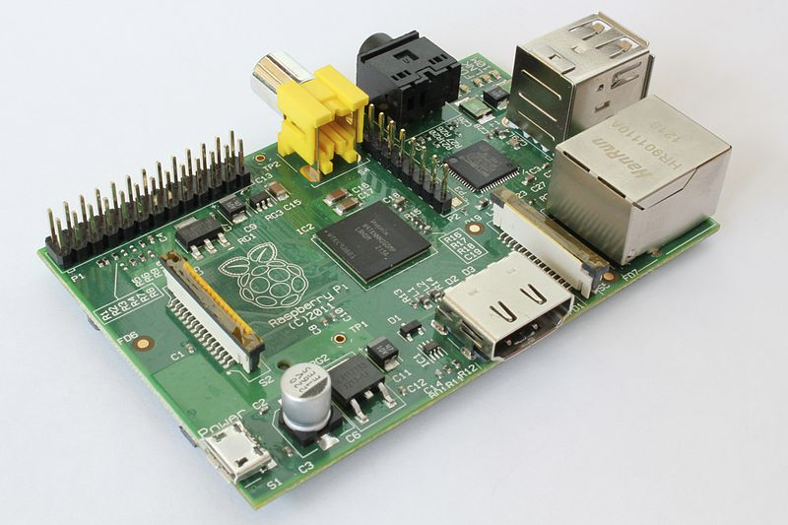

Key enablers
IoT
Cheap SOCs
Mature Internet protocols
Cellular connectivity
Unlicensed
Analytics
(“big data”)
Applications
Cloud-hosted applications & data

Slide 7

The killer app
with energy-harvesting
Notes:
http://www.pcworld.com/article/221086/article.html

Slide 8
Where does IoT make sense?
Automate manual data extraction
  health, car, electric/gas meter, …
Remote maintenance
  vending machines, appliances, cars & trucks, trains, pumps, …
Incorporate additional information
  thermostats, light switches, traffic lights, parking meters, …
SDM = Software-Defined Mechanics
  locks, light switches
But where does it solve more than 1st world problems?
  commercial maintenance and OpEx savings
  in-home customizable assistive technology

Slide 9

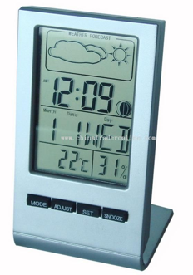
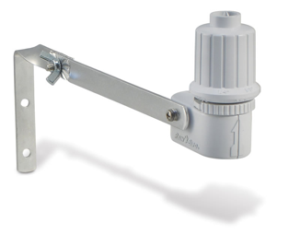
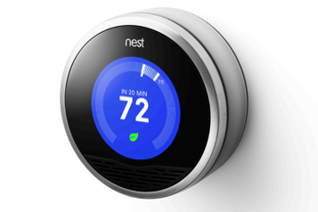

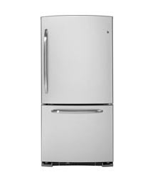
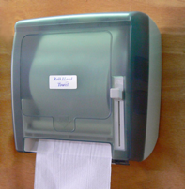
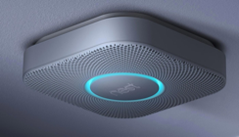
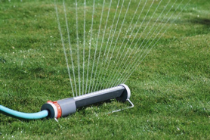


IoT islands vs. IoT eco system

Slide 10
IoT: more than programmable light bulbs
public sensors & actuators
semi-private
private

Slide 11

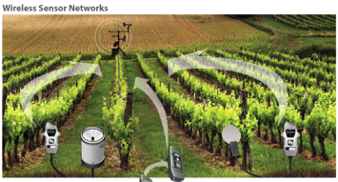
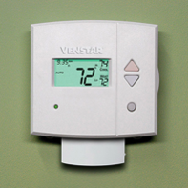

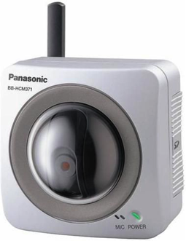
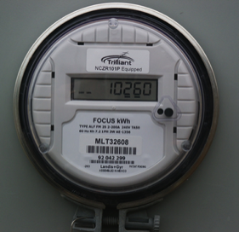
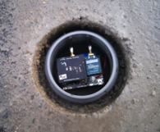


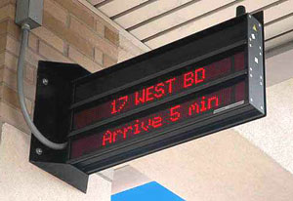
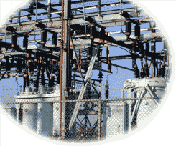
IoT varies in communication needs
sensors
CPS
1/hour
1/minute
1/second
10/second
actuators
IoT
Example: SIGFOX (902 MHz, 100 bps) is a connectivity solution that focuses on low throughput devices. On SIGFOX you can send between 0 and 140 messages per day and each message can be up to 12 bytes of actual payload data.
Notes:
http://www.nytimes.com/2012/10/02/world/europe/device-sends-message-to-swiss-farmer-when-cow-is-in-heat.html?pagewanted=all

Slide 12
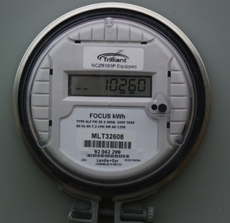

Network challenges
Unlicensed
  How do I attach and authenticate a device to a (home) network?
  Credentials?
Licensed
  Reliability → multiple simultaneous providers
  Mobility → different providers in different regions
  Charging → often low, intermittent usage, sometimes deferrable (Kindle “Whispernet”)
    From $50/device/month → < $1/month?

Slide 13
Communication identifiers
Property | URL owned | URL provider | E.164 | Service-specific
Example | alice@smith.name sip:alice@smith.name | alice@gmail.com sip:alice@ilec.com | +1 202 555 1010 | www.facebook.com/alice.example
Protocol-independent | no | no | yes | yes
Multimedia | yes | yes | maybe (VRS) | maybe
Portable | yes | no | somewhat | no
Groups | yes | yes | bridge number | not generally
Trademark issues | yes | unlikely | unlikely | possible
Privacy | Depends on name chosen (pseudonym) | Depends on naming scheme | mostly | Depends on provider “real name” policy
→ IoT will likely be assigned local IP address space and owner-based names (meter17.pseg.com) [if any]
Notes:
http://findmyfacebookid.com

Slide 14


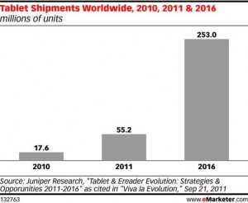

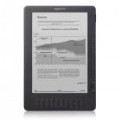
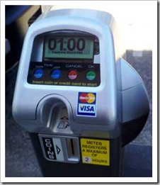

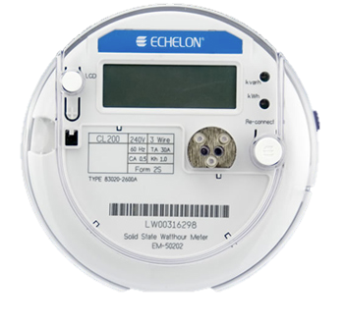
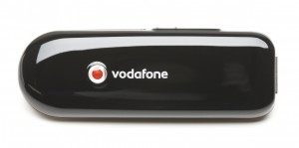

Phone numbers for machines?
< 2010
254 mio.
212 555 1212
500 123 4567
(and geographic numbers)
12% of adults
500 123 4567
533, 544
5 mio.
311,000
64 mio.
now: one 5XX code a year…
(8M numbers)
10 billion +1 #’s available
44.9 mio.
see Tom McGarry, Neustar
Notes:
http://blog.neustar.biz/neustar-insights/telephone-numbers-are-for-people-not-machines/
http://www.parking.org/media/overview-of-the-us-parking-industry.aspx
http://www.statisticbrain.com/e-reader-statistics/
http://www.ite.org/reportcard/TechnicalReport.pdf – 311k signals
www.aceee.org/files/proceedings/2012/data/papers/0193-000144.pdf – 44.9 M street lights

Slide 16
Post-spectrum world
Old (pre-2000)
Now
Mostly single-use, application-specific allocations (“radar”, “LMR”, “paging”)
Mostly federal OR non-federal use
Each band its own world
Static usage
Limited spectral efficiency concerns
Go west (up), young application!
No more unallocated bands (below 30+ GHz) →multi-use, generic transport
Shared federal & non-federal use
Neighbor “issues” (GPS, TV)
Usage may change (satellite → mobile)
Spectral efficiency – but how measured? (bits/s/Hz/km²?)
Limited ability to go to higher frequencies

Slide 17
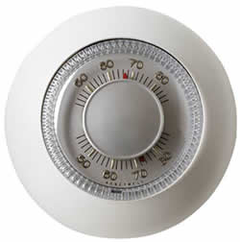
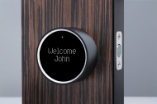
Challenge: enabling discovery & access control
Devices should be discoverable & re-usable
  e.g., provide audio interface to bus display
  environmental probes (temperature, noise, rain, …)
  location (iBeacon) → 911
Layers of functionality
  anybody in vicinity can read
  anyone in family can change
  parents can re-program
Allow delegation
  grant temporary access to somebody or something else
  by message or physical proximity
Currently, all one-off solutions
  OAuth? NFC?

Slide 18
Device lifecycle
T. Heer et al., “Security Challenges in the IP-based Internet of Things”, 2011.

Slide 19

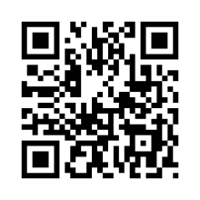
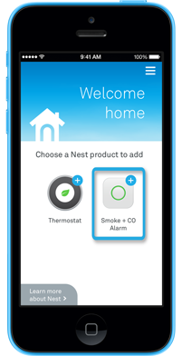
Challenge: enrollment
Commercial buildings → enroll 1,000s of devices at once
Home → enroll one device at a time
  current model: one app per device (class)
  re-do if Wi-Fi password changes
  common options:
    QR code
    P2P Wi-Fi (Wi-Fi Direct)
  possibilities
    “hi, I’m a Philips light bulb – add me!” (PKI)

Slide 20
IoT good-citizen rules
FCC TAC recommendations +
Implement current best practices
  no plain-text data or commands
    low-power CPUs are no excuse – long-payback or infrequent crypto operations
  no default passwords
Do not assume that your (cellular) network is around in > 8 years
  short-range unlicensed bands more likely a safe harbor
Update yourself securely
Don’t trust random APs → PassPoint, 802.1x?
  matters mainly for DNS and denial-of-service
Go into fail-safe mode if no updates
Be nice to cellular network (signaling, white spaces, …)
  and maybe “kill switch” if misbehaving (or stolen!)
Don’t ask for special spectrum
  except maybe if you’re a health-and-safety device (but share nicely)
  or maybe low-bandwidth narrowband spectrum
Notes:
http://www.sigfox.com/en/#!/technology

Slide 21


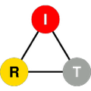

SECE
Sense Everything, Control Everything

Slide 22
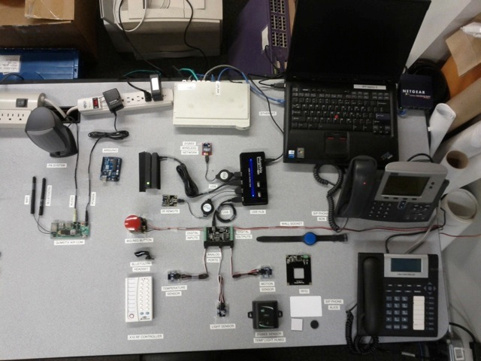
Goal: An operating system for IoT
OS = abstract devices & networks
virtual devices act like physical devices
program stays the same even as physical properties change
abstract naming: by location, property, …
manage shared access: permissions, logging, updates, …
not a node OS
= one logical abstraction

Slide 23
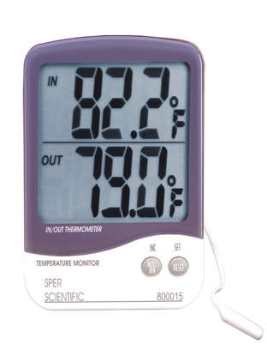
Local processing for privacy
node
publicly visible script
cloud storage and access
fuzz
anonymize
average
rate limit
observable storage
indoor
thermometer

Slide 24

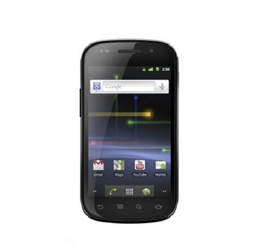
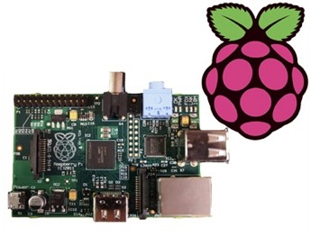
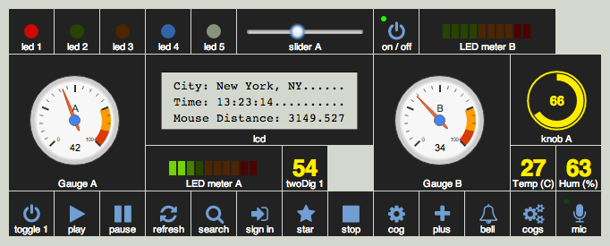
Challenge: integrate embedded, mobile & virtual
magnetometer
accelerometer
location
gyroscope

Slide 25








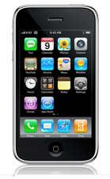


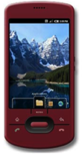







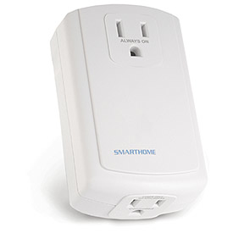

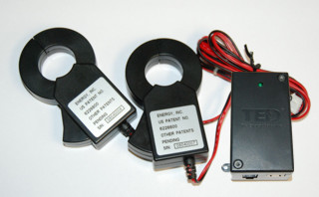
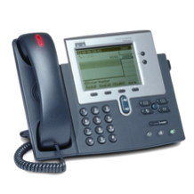
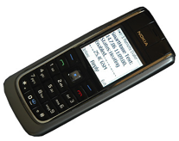
SECE: The glue for Internet applications
GW
next appt.
RFID
Alice → a@b.com,
+1 212 555 1234
geocoding
travel time
SUB/NOT
PIDF-LO, RPID,
others
SECE
PUBLISH
PIDF-LO
update SNs, , email…
GW
GW
call state
Call events, VM, SMS
monitor energy
usage
B2BUA
control appliances

Slide 26
IOT - Conclusion
IoT of things as natural progression of ever-smaller Internet devices
  but limited mainstream in-home applications so far
  boring commercial applications not another X10!
Network is (relatively) easy
  naming, security and software are much harder
Reaching beyond connectivity and software islands
  plug-and-program

Slide 27
Open internet – in brief
http://www.fcc.gov/openinternet

Slide 28
What is network neutrality?
“The principle advocates no restrictions by Internet service providers and governments on content, sites, platforms, the kinds of equipment that may be attached, and the modes of communication.” (Wikipedia)
2005 FCC statement (Powell “Internet freedoms”):
  “access the lawful Internet content of their choice.
  run applications and use services of their choice, subject to the needs of law enforcement.
  connect their choice of legal devices that do not harm the network.
  competition among network providers, application and service providers, and content providers.”
= Any lawful content, any lawful application, any lawful device, any provider

Slide 29
Brief timeline
2005 | Powell Internet freedoms
Dec. 21, 2010 | Open Internet order
Jan. 14, 2014 | DC Circuit remands 2010 OI R&O
May 15, 2014 | OI NPRM
Feb. 26, 2015 | OI R&O voted
March 12, 2015 | OI R&O released

Slide 30
Open Internet R&O 2010 + DC Circuit
Transparency. Fixed and mobile broadband providers must disclose the network management practices, performance characteristics, and terms and conditions of their broadband services;
No blocking. Fixed broadband providers may not block lawful content, applications, services, or non-harmful devices; mobile broadband providers may not block lawful websites, or block applications that compete with their voice or video telephony services
No unreasonable discrimination. Fixed broadband providers may not unreasonably discriminate in transmitting lawful network traffic.
remanded
remanded

Slide 31
What has changed?
Inclusion of mobile services
Retains exclusion of specialized services
No blocking + transparency similar
No unreasonable discrimination → no paid prioritization, no throttling
Transparency: in consistent format, promotional rates, fees and surcharges and data caps.
  packet loss as a measure of network performance
  provide notice of network management practices that can affect service.
Authority: Section 706 → Title II + 706
  defines Internet access as telecommunication service rather than information service
  applies subset of Title II (“forbearance”)

Slide 32
Title II overview
Para | Title | Summary | Relevance
201 | Service & charges | “reasonable request”, “just and reasonable” | umbrella
202 | Discriminations & preferences | “unjust or unreasonable discrimination in charges, practices, classifications, regulations, facilities, or services” | OI?
203 | Schedule of charges | tariffs | NECA
204 | Hearings on new charges; suspension pending hearing; refunds; duration of hearing; appeal of order concluding hearing | tariff hearings | rare
205 | Commission authorized to prescribe just and reasonable charges; penalties for violations | tariff setting | rare

Slide 33
Title II overview
Para | Title | Summary | Relevance
206 | Carriers’ liability for damages | “shall do, or cause or permit to be done, any act, matter, or thing in this chapter prohibited” | uncommon
207 | Recovery of damages | complain OR sue | protects carriers
208 | Complaints to Commission; investigations; duration of investigation; appeal of order concluding investigation | “Any person, any body politic, or municipal organization, or State commission, complaining of anything done” | consumer complaints
209 | Orders for payment of money | “Commission shall make an order directing the carrier to pay to the complainant” | consumer complaints
210 | Franks and passes; free service to governmental agencies in connection with national defense | “giving franks to, or exchanging franks with each other for the use of, their officers” | employee benefits

Slide 34
Title II overview
Para | Title | Summary | Relevance
221 | Consolidations and mergers of telephone companies
222 | Privacy of customer information | “has a duty to protect the confidentiality of proprietary information” | CPNI
223 | Obscene or harassing telephone calls in the District of Columbia or in interstate or foreign communications
224 | Pole attachments | “shall regulate the rates, terms, and conditions for pole attachments” | competition, Google Fiber
225 | Telecommunications services for hearing-impaired and speech-impaired individuals | “the Commission shall ensure that interstate and intrastate telecommunications relay services are available, to the extent possible and in the most efficient manner, to hearing-impaired and speech-impaired individuals” | relay services

Slide 35
Title II overview
Para | Title | Summary | Relevance
251 | Interconnection | “duty … to interconnect directly or indirectly with the facilities and equipment of other telecommunications carriers” | traffic exchange
252 | Procedures for negotiation, arbitration, and approval of agreements | “Upon receiving a request for interconnection” | negotiation; arbitration
253 | Removal of barriers to entry | “No State or local statute or regulation, or other State or local legal requirement, may prohibit or have the effect of prohibiting the ability of any entity to provide any interstate or intrastate telecommunications service.” | competition
254 | Universal Service | “Access to advanced telecommunications and information services should be provided in all regions of the Nation.” | USF

Slide 36
Open Internet/network neutrality
Conceptualized by Tim Wu (Columbia U.) and others
  general notion of non-discrimination (“neutrality”)
  details differ
Economic arguments
  foreclosure of new entrants
  vertical integration
Non-economic arguments
  participation, personal expression, …
Counter arguments
  free market interference
  disincents investment (uncertainty, implicit or explicit price regulation)
  lack of demonstrated harm
  anti-trust law as alternative
  1st amendment arguments (ISP as speaker)

Slide 37
Common questions
Different charges for different types of content?
Block competing services (e.g., video or voice)?
Provide quality of service?
  paid by content provider vs. paid by subscriber
Block spam or denial-of-service traffic?
Prevent tethering except for a fee?
Usage-based charging ($/GB)?
Charge content providers?

Slide 38
Some high-profile cases
Madison River (2005)
  DSL provider blocked SIP ports
  fined $15,000 by FCC
  based on Section 201 “just and reasonable”
Comcast (late 2007)
  insert TCP RST into BitTorrent traffic
  later overturned on appeal in DC Circuit Court
RCN (2009): P2P
Various mobile operators: payment, FaceTime
Comcast vs. Level 3 (2010, in dispute) - interconnection
Comcast, Verizon, AT&T, … vs. Netflix
Notes:
http://hraunfoss.fcc.gov/edocs_public/attachmatch/DA-05-543A1.pdf
http://www.zeropaid.com/news/88573/comcast-prevails-in-bittorrent-throttling-case/

Slide 39
Background definitions
Telecommunications = the transmission, between and among points specified by the user, of information of the user's choosing, without change in the form or content of the information as sent and received. (47 U.S.C. § 153(43))
Telecommunications service = “the offering of telecommunications for a fee directly to the public, or to such classes of users as to be effectively available directly to the public, regardless of the facilities used." 47 USC § 153(46) (1999)
Information service = users of telecommunication services
cf. Basic vs. enhanced service (CI)
  Basic telecommunications: "the offering of a pure transmission capability over a communications path that is virtually transparent in terms of its interaction with customer supplied information.”
  Enhanced: everything else

Slide 40
OI rules: definition
Broadband Internet access service. A mass-market retail service by wire or radio that provides the capability to transmit data to and receive data from all or substantially all Internet endpoints, including any capabilities that are incidental to and enable the operation of the communications service, but excluding dial-up Internet access service.
Public Switched Network. The network that includes any common carrier switched network, whether by wire or radio, including local exchange carriers, interexchange carriers, and mobile service providers, that uses the North American Numbering Plan, or public IP addresses, in connection with the provision of switched services.

Slide 41
OI rules: no blocking, no throttling
A person engaged in the provision of broadband Internet access service, …, shall not block lawful content, applications, services, or non-harmful devices, subject to reasonable network management.
…, shall not impair or degrade lawful Internet traffic on the basis of Internet content, application, or service, or use of a non-harmful device, subject to reasonable network management.

Slide 42
OI rules: no paid prioritization
A person engaged in the provision of broadband Internet access service, …, shall not engage in paid prioritization.
“Paid prioritization” refers to the management of a broadband provider’s network to directly or indirectly favor some traffic over other traffic, including through use of techniques such as traffic shaping, prioritization, resource reservation, or other forms of preferential traffic management, either (a) in exchange for consideration (monetary or otherwise) from a third party, or (b) to benefit an affiliated entity.
The Commission may waive the ban on paid prioritization only if the petitioner demonstrates that the practice would provide some significant public interest benefit and would not harm the open nature of the Internet.

Slide 43
OI: general conduct rule
Any person engaged in the provision of broadband Internet access service, …, shall not unreasonably interfere with or unreasonably disadvantage (i) end users’ ability to select, access, and use broadband Internet access service or the lawful Internet content, applications, services, or devices of their choice, or (ii) edge providers’ ability to make lawful content, applications, services, or devices available to end users. Reasonable network management shall not be considered a violation of this rule.

