Slide 1
Technology Update: The Future of Call Blocking and Caller ID Authentication
NO-CALL
LAW ENFORCEMENT
SUMMIT
Henning Schulzrinne – FCC & Columbia University
Bikram Bandy – Federal Trade Commission

Slide 2
Stopping Unwanted Calls
Technology has increased the complexity of the problem
Volume of calls is substantially higher
Costs are lower
Easier to hide – spoofing, multi-network routing, and international
Law enforcement alone cannot solve the problem
Consumers are frustrated

Slide 3
Delivering on the Promise of DNC
Technology is the problem – technology must be part of the long-term solution
Allow consumers and carriers to play defense
Analogous to e-mail spam
Spam filter for the Phone

Slide 4
October 2012
Results –
Received 798 Submissions
Named 2 winners for the Individual Category and 1 winner for the Organization Category (Google)
One of the winners, “Nomorobo,” was on the market and available to consumers by October 2013 - just 6 months after being named one of the winners.

Slide 5
Current Weaknesses
Data collection
Availability
Caller ID Spoofing

Slide 6
Current Data Collection
Consumer driven
Human error
Delayed
Limited

Slide 7
Improving Data Collection: Honeypots
Honeypots
Real-time data collection
Larger amount of data collected
Improved accuracy
Easier for consumers to report illegal calls – mark as “spam”

Slide 8
Improving Data Collection
DEFCON 2014 – Zapping Rachel
Build and analyze data from honeypots
www.ftc.gov/zaprachel
DetectaRobo – June 6-7, 2015
Analyze honeypot data and create algorithms that identify robocalls based on calling pattern
www.ftc.gov/detectarobo
DEFCON 2015 -- Robocalls: Humanity Strikes Back
Create a solution that allows consumers to block and forward robocalls to a honeypot
Qualifying round due June 15, 2015, and Final round August 5-8, 2015
www.ftc.gov/strikeback

Slide 9
Improving Availability
Encourage carrier adoption and marketing of blocking technology
FCC Public Notice for Comment on legal impediments to carrier-offered call blocking
https://www.ftc.gov/news-events/press-releases/2015/01/comment-federal-communications-commission-ftc-says-no-legal
Increasing public awareness through consumer education

Slide 10
Combatting Spoofing
Spoofing reduces effectiveness of filters
Is there a technological solution to combat spoofing?

Slide 11
Email spam vs. robocalls
 | Email spam | Robocalls
Legality | CAN SPAM Canadian effort (CASL) | TCPA
Originated by | bot nets | pink carriers
Origin spoofing | phishing | for some
Prevent spoofing | DKIM, SPF | STIR (tbd)
Analyze content | common | not possible
Rate originator | DNS blacklists | no equivalent of IP address
Statistical methods | email volume & patterns | harder due to distribution

Slide 12
Two modes of caller ID spoofing
Impersonation
spoof target number
Helpful for
vishing
stolen credit card validation
retrieving voicemail messages
SWATting
disconnect utilities
unwanted pizza deliveries
retrieving display name (CNAM)
premium number fraud
Anonymization
pick more-or-less random #
including unassigned numbers
Helpful for
robocalling
intercarrier compensation fraud
TDOS

Slide 13
The economics of robocalls
success ratio * payoff * time to shutdown
cost of calls
cost of boiler room staff
-
-
probability of getting caught * liability
blocking
enforcement
no more “free”
numbers
-
increase probability
of apprehension
spoof
prevention

Slide 14
Legitimate caller ID spoofing
Doctor’s office
call from personal physician cell phone should show doctor’s office number
Call center
airline outbound contract call center should show airline main number, not call center
Multiple devices, one number
provide single call-back number (e.g., some VoIP services) from all devices
anonymity is distinct problem (caller ID suppression)

Slide 15
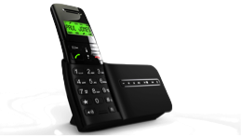
Signing calls
PSTN
“caller is authorized to use
212 555 1234”
public-private
key
LEAP
212 555 1234
Notes:
http://www.npac.com/the-npac/access/law-enforcement-agencies-psaps

Slide 16
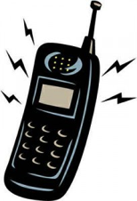
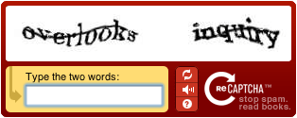
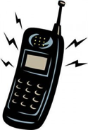
What happens at the receiving carrier?
signed?
N
Y
should be signed?
validates?
N
Y
N
Y
known caller?
N
Y
generate special caller ID:
666-666-xxxx → “Spoofed number”
N
Y

Slide 17
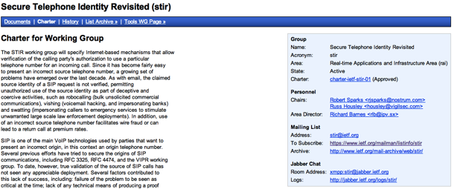
What needs to happen?
call signaling
obtaining public keys
late 2015?
operational guidelines
key generation and distribution
new contract
in progress
implement signing & validation
1 year?
sign & validate
incrementally;
with “encouragement”

Slide 18
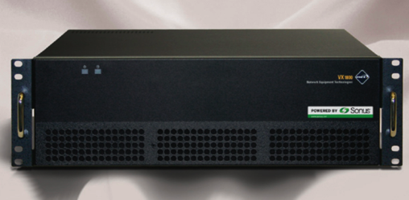
Do Not Originate (DNO)
Premise: almost all illegal robo-calls originate on VoIP
Thus, gateways as filter for numbers that shouldn’t be there (e.g., IRS or banks)
SS7
VoIP
“legacy” carriers that don’t interconnect via VoIP
“Do not originate” list
of numbers
(e.g., PSAP DNC list)

Slide 19
DNO: How do numbers get onto the list?
911 DNC list
Financial institutions
Government agencies
NANPA: unassigned numbers
TDM carrier numbers
Facilities-based VoIP (with own gateways)
OTT VoIP (except for contracted GWs)

Slide 20
Automated call blocking
for vulnerable populations, allow only:
address book entries
government agencies
medical providers
emergency alerts
multiple 3rd party
providers
in black list?
in white list?
N
maintain
lists
Y
Y
N
designated trusted
third party
report
illegal robocalls

Slide 21
Improving caller name reliability
Textual caller ID used more than number by recipients
Generation of caller name varies:
Various CNAM/LIDB databases: CPN → name
Some from caller carrier, some third-party (reduce dip fees)
Can be generated by third party
Change with VoIP: end-to-end delivery
basic name, with attribution (“based on business record”, “self-asserted”)
additional information (“FDIC-registered”, “accredited health care facility”, “registered charity”

Slide 22
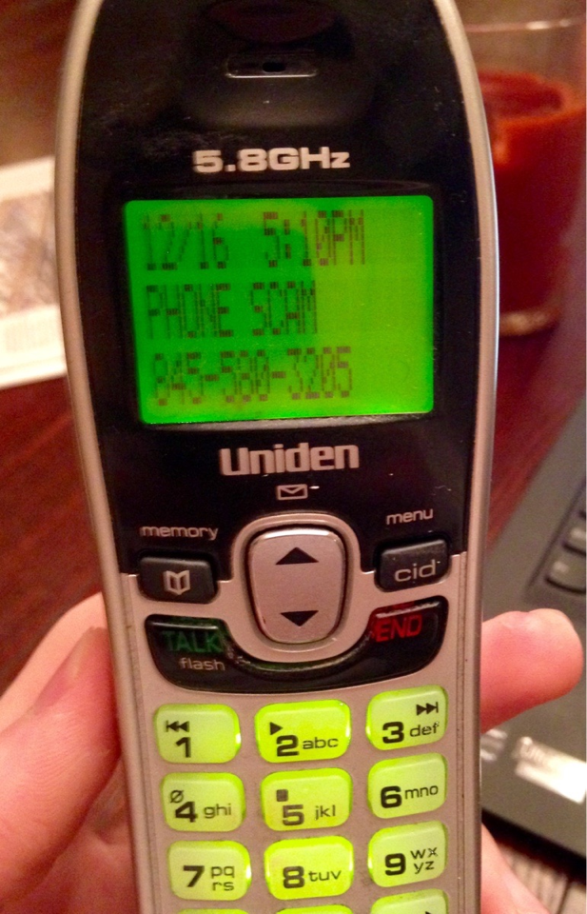
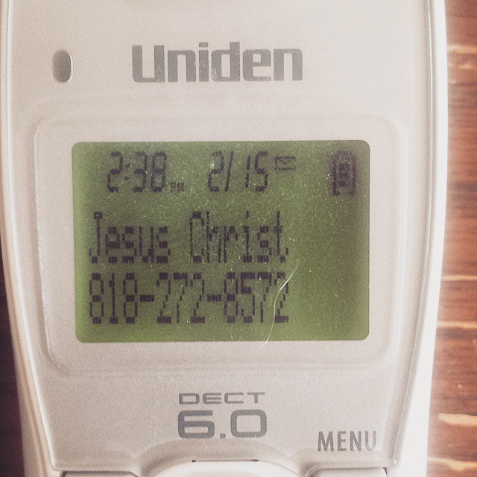
Caller name (CNAM) improvements
15 character limit
mostly due to legacy displays and Bell 202 1200 baud modems?
signaling allows larger data elements
Disallows
full names → awkward abbreviations
more information – caller name and affiliation (“John Doe, Acme Corp., Chicago”)
no credentials (license, registration)
Architecture issues
multiple providers → difficult to correct errors or prevent impersonation
CNAM dip fees → kickback schemes that enable robocalling
unclear provenance of information

Slide 23
Technology assist - summary
Automated capture (“honeypots”)
Prevent number spoofing
Short term: “Do not originate”
Allow third-party number filtering
Improve caller name (CNAM) reliability

