Slide 1
Internet of Things – Internet in the small
H. Schulzrinne
(+ Jan Janak & other CUCS IRT contributors)
Bell Labs, April 2015

Slide 2
Overview
The Internet of Things is many things
  Most of them aren’t new or exciting
The network part isn’t (all that) exciting
  but usable security, software and system integration are
It’s a software thing → multi-devices services, APIs, IFTTT, SECE, …
About being a nice IoT citizen
ShellShock for light switches?

Slide 3
Internet of Things (IoT)
Also sometimes called
  “industrial Internet” (subset)
  “machine-to-machine” (M2M)
  “cyber-physical systems” (NSF)
  “smart city” (IBM)
Concept dates to late 90’s
  Initially, tag physical objects (RFID)
  Now, networked sensors and control of previously mechanical or electrical objects

Slide 4
M2M/IoT/CPS is not…
isn’t just about fancy thermostats and $199 door bells
doesn’t always uses cellular networks
is not always energy-constrained
is not always cost-constrained
doesn’t always use puny microcontrollers
is not always run by large organizations
  many small & mid-sized providers
  usually embedded into other products

Slide 5
Internet of Things
Mostly about devices, not the Internet
Network part not really new or exciting
Software-controlled networked devices
Challenges:
  lack of UI → usability
  lack of UI → usable security
  integration (service & APIs)
  programming – beyond a single device

Slide 6
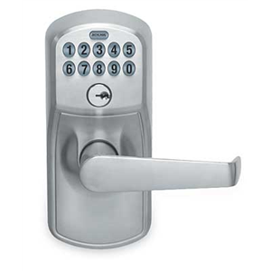
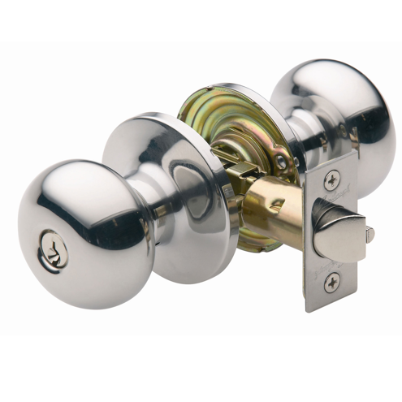
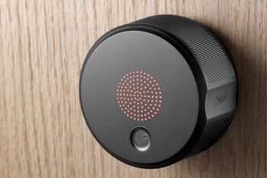
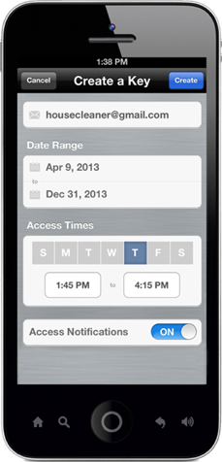
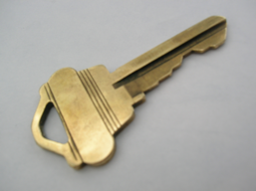

Natural evolution

Slide 7

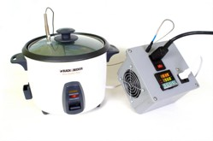

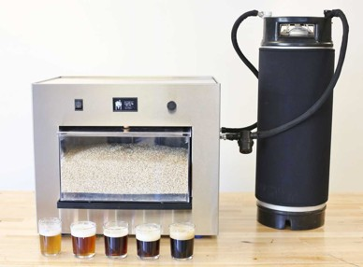

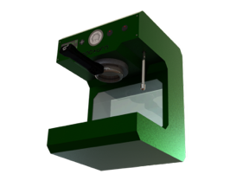
Software Defined Devices
Sous vide cooking
Picobrew
PID Controlled Espresso Machine
7

Slide 8
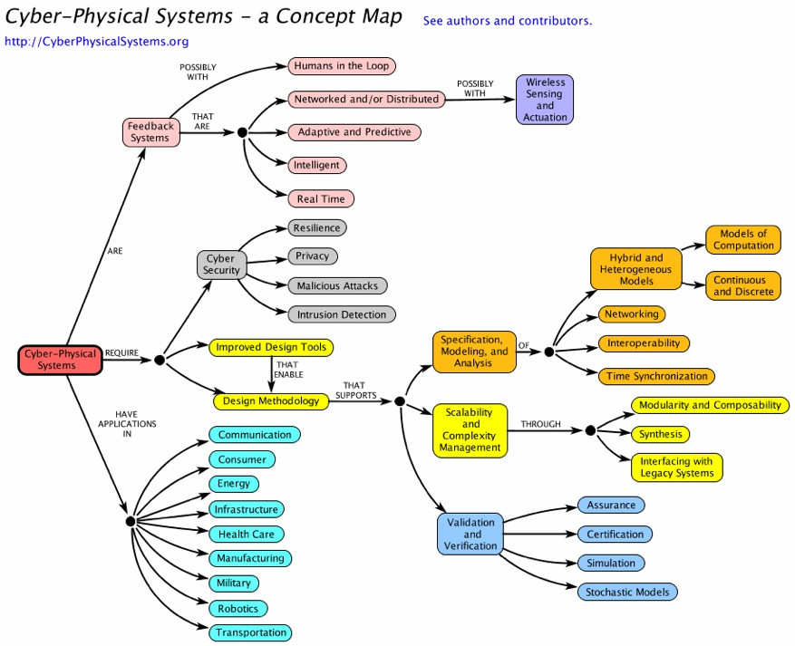
8

Slide 9
CPS, WSN & IoT challenges
 | Node | Network | Program | Example
IoT | re-usability | interoperability | heterogeneous & loosely coupled | VoIP thermostat
CPS | real-time guarantees | predictability & redundancy | model verification | avionics industrial control
WSN | energy efficiency | minimize communication | homogeneous minimal OS | structural monitoring (bridge)

Slide 10
Key enablers
IoT
Cheap SOCs
Mature Internet protocols
Cellular connectivity
Unlicensed
Analytics
(“big data”)
Applications
Cloud-hosted applications & data

Slide 11
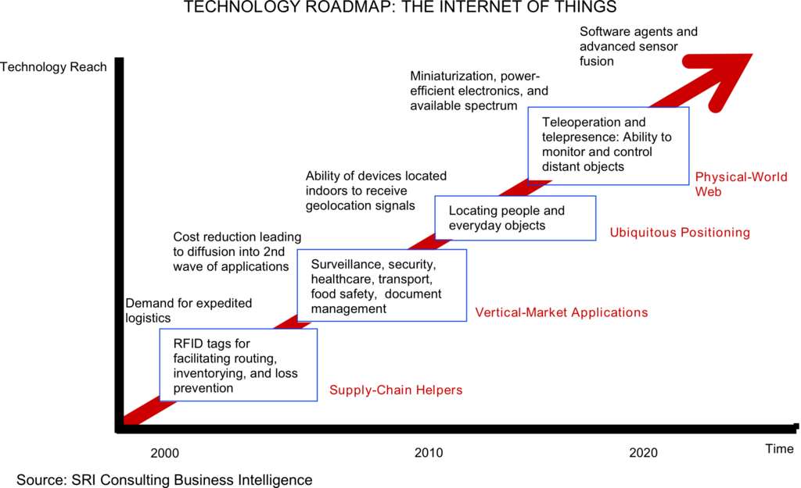
Internet of Things roadmap

Slide 12
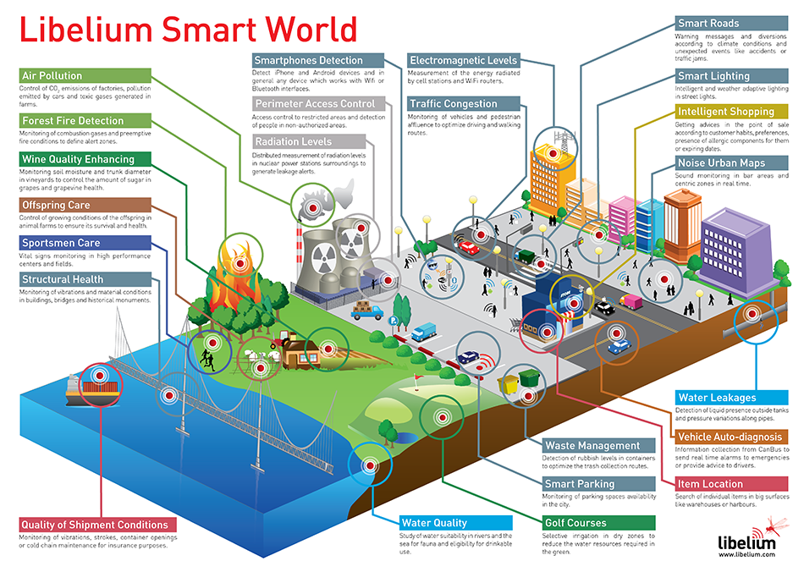
Environmental sensing
Notes:
http://www.libelium.com/top_50_iot_sensor_applications_ranking/#show_infographic

Slide 13
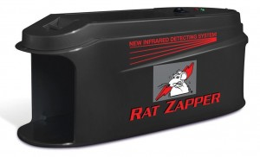
The killer app
with energy-harvesting
Notes:
http://www.pcworld.com/article/221086/article.html

Slide 14
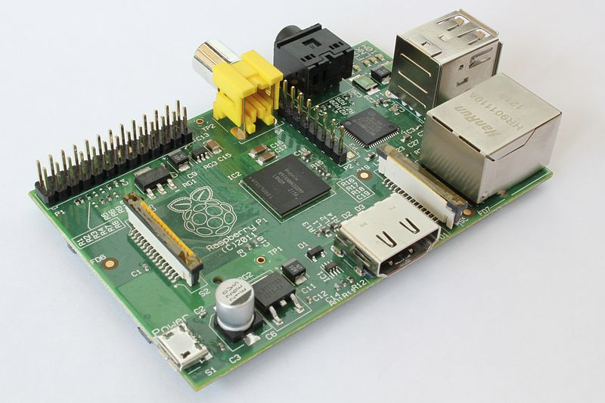
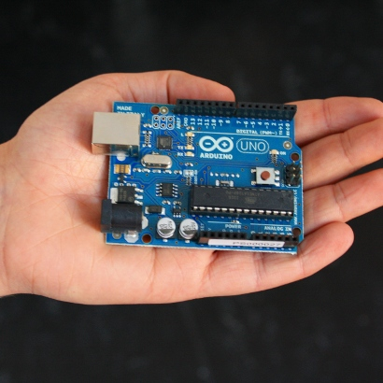

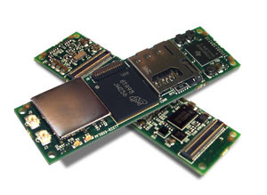
IoT = cheap microcontrollers + network interfaces
Raspberry PI ($35)
Arduino Uno, €20
Gumstix (WiFi, BT): 58 mm, $199

Slide 15
Where does IoT make sense?
Automate manual data extraction
  health, car, electric/gas meter, …
Remote maintenance
  vending machines, appliances, cars & trucks, trains, pumps, …
Incorporate additional information
  thermostats, light switches, traffic lights, parking meters, …
Software-Defined Mechanics
  locks, light switches
But where does it solve more than 1st world problems?
  commercial maintenance savings?
  in-home customizable assistive technology

Slide 16
A taxonomy
Bill Morelli, IHS

Slide 17
Connectivity Framework
Three dominant classes of wireless IoT links (there are others)
Thing to Thing (vehicles, sensors/actuators, etc.)
  LAN/PAN range; use spectrum suited to short distances; extensive spatial reuse
Thing to Proxy (e.g., gateways, hubs, hubs within vehicles, etc.)
  LAN/PAN* range; use spectrum suited to short distances; extensive spatial reuse
  IoT adds significant load to existing services, such as WiFi and BT
  Traffic upstream from proxies shares allocations and adds significant load to existing services used to link WiFi, etc. to core Internet.
Thing to Internet (e.g., direct connection to 4G networks, WISPs, TVWS, etc.)
  last mile range; share spectrum with and/or use other wide area services
  IoT adds load to 4G/TVWS services and poses challenges wrt long-lived things
* Personal Area Network -- typically operates within a range < 10M

Slide 18
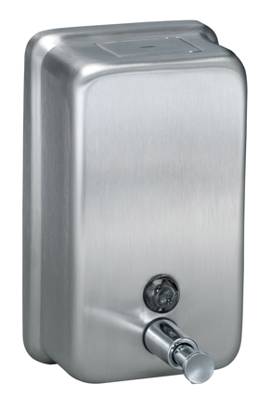
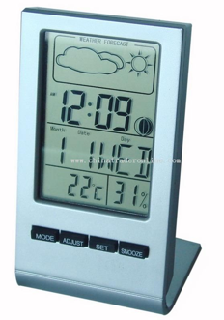
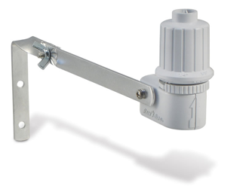
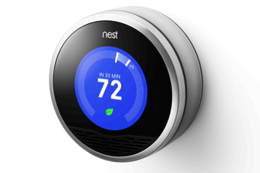

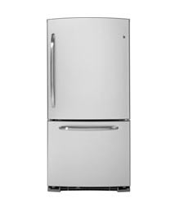
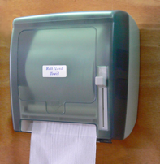
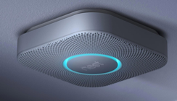
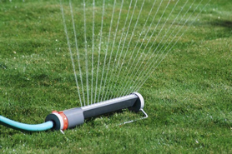
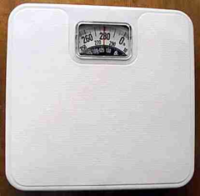

IoT islands vs. IoT eco system

Slide 19
IoT: more than programmable light bulbs
public sensors & actuators
semi-private
private

Slide 20
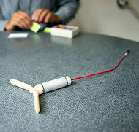
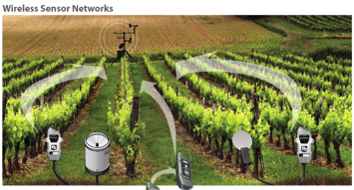
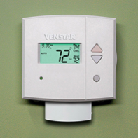
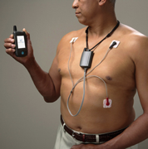
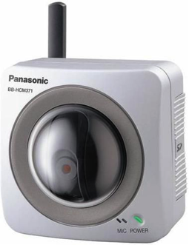
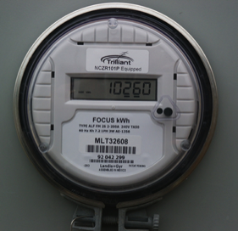
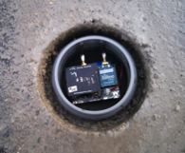

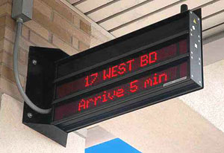
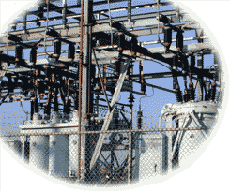
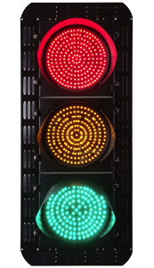
IoT varies in communication needs
sensors
CPS
1/hour
1/minute
1/second
10/second
actuators
IoT
Notes:
http://www.nytimes.com/2012/10/02/world/europe/device-sends-message-to-swiss-farmer-when-cow-is-in-heat.html?pagewanted=all

Slide 21

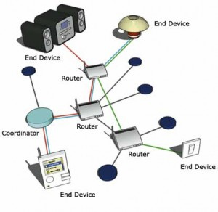

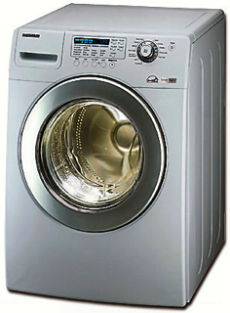
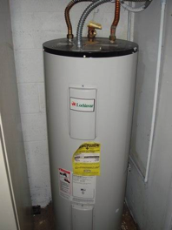
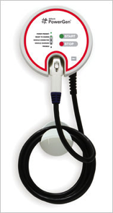
Not just cellular or unlicensed

Slide 22
M2M communication models
dispersed | Smart grid, meter, city Remote monitoring | Car automation eHealth Logistics Portable consumer electronics
concentrated | smart home factory automation eHealth | on-site logistics
 | fixed | mobile
Source: OECD (2012), “Machine-to-Machine Communications: Connecting Billions of Devices”, OECD Digital Economy Papers, No. 192, OECD Publishing. http://dx.doi.org/10.1787/5k9gsh2gp043-en

Slide 23
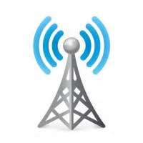

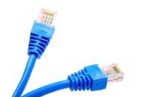

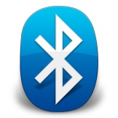
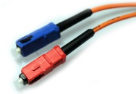
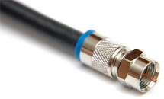



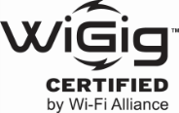




IoT Connectivity Technologies
Wired
WPAN
WLAN
WWAN
Ethernet, Coax, Fiber, etc. considered as a single category
ANT+
Bluetooth – Classic & Smart Ready
Bluetooth Smart
ZigBee PRO
ZigBee RF4CE
ZigBee Multi-Protocol
EnOcean
ISA100.11a
WirelessHART
Z-Wave
Other 802.15.4
802.11a/b/g
802.11n
802.11ac
802.11ad
Other 802.11
DECT ULE
Other 2.4GHz
Other Sub-GHz
2G Cellular
3G Cellular
4G Cellular
Bill Morelli, IHS Technologies

Slide 24
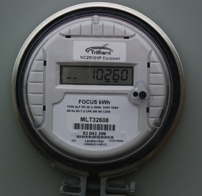

Network challenges
Unlicensed
  How do I attach and authenticate a device to a (home) network?
  Credentials?
Licensed
  Reliability → multiple simultaneous providers
  Mobility → different providers in different regions
  Charging → often low, intermittent usage, sometimes deferrable (“Whispernet”)
    From $50/device/month → < $1/month?
Authentication
  Which devices can be used by whom and how?
    “Any employee can monitor the room temperature in any public space, but only Facilities staff can change it”

Slide 25

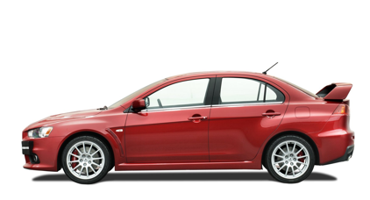
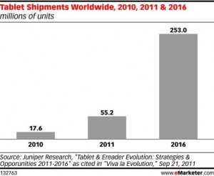

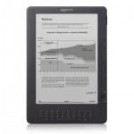
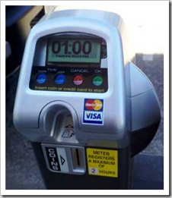

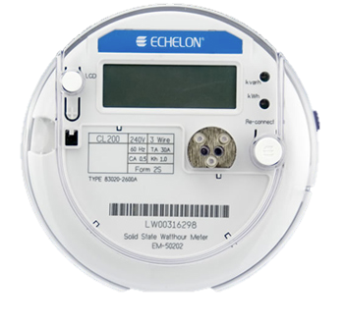


Phone numbers for machines?
< 2010
254 mio.
212 555 1212
500 123 4567
(and geographic numbers)
12% of adults
500 123 4567
533, 544
5 mio.
311,000
64 mio.
now: one 5XX code a year…
(8M numbers)
10 billion +1 #’s available
44.9 mio.
see Tom McGarry, Neustar
Notes:
http://blog.neustar.biz/neustar-insights/telephone-numbers-are-for-people-not-machines/
http://www.parking.org/media/overview-of-the-us-parking-industry.aspx
http://www.statisticbrain.com/e-reader-statistics/
http://www.ite.org/reportcard/TechnicalReport.pdf – 311k signals
www.aceee.org/files/proceedings/2012/data/papers/0193-000144.pdf – 44.9 M street lights

Slide 26
Communication identifiers
Property | URL owned | URL provider | E.164 | Service-specific
Example | alice@smith.name sip:alice@smith.name | alice@gmail.com sip:alice@ilec.com | +1 202 555 1010 | www.facebook.com/alice.example
Protocol-independent | no | no | yes | yes
Multimedia | yes | yes | maybe (VRS) | maybe
Portable | yes | no | somewhat | no
Groups | yes | yes | bridge number | not generally
Trademark issues | yes | unlikely | unlikely | possible
Privacy | Depends on name chosen (pseudonym) | Depends on naming scheme | mostly | Depends on provider “real name” policy
→ IoT will likely be assigned local IP address space and owner-based names (meter17.pseg.com) [if any]
Notes:
http://findmyfacebookid.com

Slide 27

The age of application-specific {sensors, spectrum, OS, protocol …} is over
Computing system: dedicated function → OS
  → abstract into generic components
  e.g., USB human interface device (HID)
What are the equivalent sensor and actuator classes?
Networks: generic app protocols
  request/response → HTTP
  event notification → SMTP, SIP, XMPP
Spectrum: from new application = new spectrum to generic data transport

Slide 29
Post-spectrum world
Old (pre-2000)
Now
Mostly single-use, application-specific allocations (“radar”, “LMR”, “paging”)
Mostly federal OR non-federal use
Each band its own world
Static usage
Limited spectral efficiency concerns
Go west (up), young application!
No more unallocated bands (below 30+ GHz) →multi-use, generic transport
Shared federal & non-federal use
Neighbor “issues” (GPS, TV)
Usage may change (satellite → mobile)
Spectral efficiency – but how measured? (bits/s/Hz/km²?)
Limited ability to go to higher frequencies

Slide 30

Current unlicensed spectrum
+ TV white spaces (in 476-692 MHz range) – availability varies

Slide 31


Challenge: enabling discovery & access control
Devices should be discoverable & re-usable
  e.g., provide audio interface to bus display
  environmental probes (temperature, noise, rain, …)
  location (iBeacon) → 911
Layers of functionality
  anybody in vicinity can read
  anyone in family can change
  parents can re-program
Allow delegation
  grant temporary access to somebody or something else
  by message or physical proximity
Currently, all one-off solutions
  OAuth? NFC?

Slide 32
Device lifecycle
T. Heer et al., “Security Challenges in the IP-based Internet of Things”, 2011.

Slide 33



Challenge: enrollment
Commercial buildings → enroll 1,000s of devices at once
Home → enroll one device at a time
  current model: one app per device (class)
  re-do if Wi-Fi password changes
  common options:
    QR code
    P2P Wi-Fi (Wi-Fi Direct)
  possibilities
    “hi, I’m a Philips light bulb – add me!” (PKI)

Slide 34





Other introduction models
please admit 74FA…
challenge
42
E_{PK}(challenge)
Belkin light bulb #42 wants to join
light pattern with public key
sound pattern
Avoid single password → allow device transfer

Slide 35
IoT good-citizen rules
FCC TAC recommendations +
Implement current best practices
  no plain-text data or commands
    low-power CPUs are no excuse – long-payback or infrequent crypto operations
  no default passwords
Do not assume that your (cellular) network is around in > 8 years
  short-range unlicensed bands more likely a safe harbor
Update yourself securely
Don’t trust random APs → PassPoint, 802.1x?
  matters mainly for DNS and denial-of-service
Go into fail-safe mode if no updates
Be nice to cellular network (signaling, white spaces, …)
  and maybe “kill switch” if misbehaving (or stolen!)
Don’t ask for special spectrum
  except maybe if you’re a health-and-safety device (but share nicely)
  or maybe low-bandwidth narrowband spectrum
Example: SIGFOX (902 MHz, 100 bps) is a connectivity solution that focuses on low throughput devices. On SIGFOX you can send between 0 and 140 messages per day and each message can be up to 12 bytes of actual payload data.
Notes:
http://www.sigfox.com/en/#!/technology

Slide 36


ShellShock for light switches
IoT risks: privacy, DDOS, extortion, …
Securely field updateable or no connection to Internet
  still vulnerable if malware on home network
Lifetime of devices > lifetime of company
Insurance model:
  source code escrow + maintenance for N years
UL listing

Slide 37
Theses: Internet lessons
The Internet is about more than the Internet protocol
Reliability multiplies, costs add
Quality is no substitute for quantity
Data links layers come & go, IP stays
The age of application-specific {sensors, spectrum, OS, protocol …} is over
Protocols matter, but programmability matters more

Slide 38













Technology changes, interfaces are forever
110/220V
1901
1904
1878
1993
1992
1982
1830

Slide 39

The Internet is about more than the Internet protocol
email WWW phone...
SMTP HTTP RTP...
TCP UDP…
IP
ethernet PPP…
CSMA async sonet...
copper fiber radio...
Protocol hour glass
But ignores important (late) lessons:
  naming matters: no consumer Internet without DNS
  support auto-configuration: DHCP, DNS, netconf
  network management & diagnostics: ICMP, traceroute, SNMP
Common data coding layers:
  initially ASN.1
  then XML
  now JSON

Slide 40


Reliability multiplies, cost adds
Pre-Internet (e.g., phone system):
  Single switch, 5-nines reliability, $3M dollars
  mostly hardware
  specialty components
Internet:
  assume that components fail → compensate by redundancy
    cost for high-reliability components increases >> linear
    e.g., two paths with 99% reliability each
    → generic transport (e.g., multiple 4G, fiber, DSL, cable, satellite)
  build control loops and protocols that expect failure
    retry, graceful degradation, adaptation, …
    end-to-end argument
  as much software as possible → software-defined networks & infrastructure, IoT
    late bindings in functionality
Notes:
http://www.sis.pitt.edu/~mweiss/papers/itelv3b.pdf

Slide 41

Quality is no substitute for quantity
Hypothesis: every new networking area breeds QoS research
Outcome so far:
  QoS helps only when the network is modestly overloaded
    but then YouTube doesn’t work, either
  downed trees don’t respect reserved resources
  adds complexity and security vulnerabilities
  simple priority (e.g., for latency-sensitive applications)
  → avoid buffer bloat
  shared networks are better → faster links → low queuing delays

Slide 42
Protocols matter, but programmability matters more
Nobody wants to program raw protocols
Most significant network application creation advances:
  1983: socket API → abstract data stream or datagram
  1998: Java network API → mostly names, HTTP, threads
  1998: PHP → network input as script variables
  2005: Ruby on Rails → simplify common patterns
Many fine protocols and frameworks failed the programmer hate test
  e.g., JAIN for VoIP, SOAP for RPC

Slide 43
Building Internet applications
80% care about this level
extensible CMS, Wiki
(Drupal, Mambo, Joomla, ...)
Ruby on Rails, Spring, ...
Ajax, SOAP
PHP, Java w/libraries
Java RMI, HTTP
taught in Networking 101
C/C++ with sockets
custom protocols on UDP, TCP

Slide 44


The IoT integration problem
Too many online services to use
Too many devices to interact with
Online and physical worlds disconnected
M2M communication with a human in the middle
→ SECE (Sense Everything, Control Everything)

Slide 45




SECE
Sense Everything, Control Everything

Slide 46

Goal: An operating system for IoT
OS = abstract devices & networks
virtual devices act like physical devices
program stays the same even as physical properties change
abstract naming: by location, property, …
manage shared access: permissions, logging, updates, …
not a node OS
= one logical abstraction

Slide 47

Local processing for privacy
node
publicly visible script
cloud storage and access
fuzz
anonymize
average
rate limit
observable storage
indoor
thermometer

Slide 48




Challenge: integrate embedded, mobile & virtual
magnetometer
accelerometer
location
gyroscope

Slide 49





















SECE overview
Deploy
SECE App
Servers
SECE
app
repository
SECE
Connect
Online Services
Connect
User Interface
Personal
Smart Object
Cloud
SECE
Private
SECE
App
Server
SECE
SECE
SECE
SECE
Activity
Sensors
Actuators

Slide 50
























SECE: The glue for Internet applications
GW
next appt.
RFID
Alice → a@b.com,
+1 212 555 1234
geocoding
travel time
SUB/NOT
PIDF-LO, RPID,
others
SECE
PUBLISH
PIDF-LO
update SNs, , email…
GW
GW
call state
Call events, VM, SMS
monitor energy
usage
B2BUA
control appliances

Slide 51








SECE hardware
BeagleBoard
ZigBee
Phidgets
Arduino

Slide 52



Available Platforms
BeagleBoard
Raspberry PI
OveroAir
Android Devices
Arduino
19

Slide 53

SECE system architecture

Slide 54

SECE system architecture
Application server
  Python + coroutines
  Custom object model
  App management via git
Smart object daemon
  time-series data management
  discovery + configuration
  network APIs
  platform drivers (Android, OSX, ZigBee, Phidgets
HTML5 user interface
  virtual devices
  visual programming
Overlay router
  link setup and management
  addressing + discovery
Semantic naming
  knowledge base + query language
Service gateways
  Facebook, Twilio, Google, Twitter

Slide 55

smobd: Subsystems & Interfaces on Linux

Slide 56

Smart Object Model
Network interface
  connects the object to an IP-based overlay network
  communication protocols and interfaces
  node discovery, capability negotiation, configuration
Data storage
  time-series (history) of sensor data
  collection of named structured documents
  contents accessible over the network
Runtime environment
  data processing, programmatic filtering, feedback loops
  high-level scripting language (Lua, JavaScript)
  Smart Object Model (SOM) (~ HTML DOM)
Sensing and actuation points
  addressable components connected via a system bus
  internal: I2C, SPI, UART (smartphones)
  external: field bus, BACnet, X-10, XBee, Z-Wave

Slide 57

Smart object runtime environment
A built-in framework for end-device programmability
Programs installed over-the-network by a cloud application
Application domains: signal processing, control loops, distributed control, programmatic notification filtering
Application model: Lightweight cooperative processes in a sandbox
Network Interface:
  Manage program life cycle (install, start, stop, uninstall)
  Subscribe-notify interface to program output
Internal APIs:
  Smart Object Model (SOM), inspired by HTML DOM access to sensors and actuators
  Setup RTP session
  Push / pull data transfer to / from other smart objects
Prototype implementation:
  Embedded devices: Lua coroutines
  Android: JavaScript sandbox

Slide 58

Programmatic notification filters
Goal: “Notify when edge(ewma(sensorC, coeff) > threshold)”
SECE app subscribes to sensor data
Smart object installs included program
Program setups callbacks for sensor updates
Program generates notifications on significant events only (received by SECE app)
Program is automatically uninstalled when subscription terminates

Slide 59


PLC: Internet style
PID controller implemented on a programmable smart object
  JavaScript / Lua application installed by SECE
SECE requests persistent app installation on smart object
Smart object returns app URI
App continuously adjusts actuator based on history and sensor data.
The app keeps running until explicitly uninstalled

Slide 60

Direct Object-to-object communication
Goal: “object1.actuatorB = avg(object2.sensorC)”
SECE install a JS/Lua app into a smart object
The app requests access to the network
The app initiates a pull session, pushing sensor data to a remote smart object
Runs until explicitly uninstalled
Once installed, the system requires no central entity

Slide 61




SECE UI: Visual programming
in progress
User-friendly UI for programming smart objects
Inspired by MIT Scratch
Blocks represent devices or programs on an application server
Different latch-socket shapes represent different types of data
Drag&drop HTML UI
Suitable for simple add-hoc applications

Slide 62


SECE UI: web

Slide 63


SECE UI: Programmable control panel
Virtual JavaScript smart objects
Emulate physical devices in browser (buttons, LEDs, switches, gauges)
Create via drag&drop
Customizable IoT control panels
Programmable in JavaScript

Slide 64



SECE smart object cloud
IPv6 overlay network architecture
Automatic tunnel links setup by router nodes
Spans multiple networks and sites of a SECE user (home office)
Supports shared local links (can coexist with other networks)
Similar to an IPv6 VPN

Slide 65
SECE naming (in progress)
Identified | Changes | Example
Specific hardware | when replaced | MAC address or UUID
Specific device | new owner or location | sece://nest42.pseg.com/
Logical device | new location | sece://co.kitchen.schulzrinne.org
Function | constant (may not exist or may have multiple instances) | sece://cn=us;pr=nj;type=smoke

Slide 66

Semantic naming
Knowledge base
  abstract representations of objects
    sensors, actuators, appliances
  through human readable query language
Objects can be referenced
  through unique IDs
  properties or context (e.g., location, point of network attachment)
Unlike SQL, semantic name resolver can infer new information
  queries return results incorporating the inferred information

Slide 67
Room
7lw2
isLocatedIn
Board
MAC: B8:27:EB:FE:10:A2
URL: http://raspi.local
webcam_port: 8080
USB
RasPi01
hasConnector
USB1-RasPi01
Camera
SoC
hasSoC
attachedToConnector
SecurityCam01
BCM2835-RasPi01
RAM: 512 MB
CPU: ARM1176JZFS

Slide 68
Room
7lw2
isLocatedIn
Board
contains
USB
hasComponent
isLocatedIn
URL: http://raspi.local
RasPi01
hasConnector
MAC: B8:27:EB:FE:10:A2
contains
webcam_port: 8080
RAM: 512 MB
isConnectorOf
USB1-RasPi01
CPU: ARM1176JZFS
isComponentOf
isComponentOf
Camera
hasSoC
attachedToConnector
SoC
isSoCOf
hasComponent
connectorHasAttached
connectedTo
SecurityCam01
BCM2835-RasPi01
hasConnected
URL: http://raspi.local
RAM: 512 MB
webcam_port: 8080
CPU: ARM1176JZFS

Slide 69
Conclusion
IoT of things as natural progression
  but limited mainstream in-home applications so far
  boring commercial applications!
Network is (relatively) easy, security and software are much harder
Reaching beyond connectivity and software islands
  plug-and-program

