Slide 1

Numbering workshop
Henning Schulzrinne
FCC
March 25, 2014
http://www.cs.columbia.edu/~hgs/papers/2014/

Slide 2
Overview
Meta-assumptions
Architecture
Data
Operations
Testbed structure & logistics

Slide 3
Meta-assumptions
“We’ve always done it this way”
Old: policy(t₁) ➔ implementation(t₁+T)
New: technology platform(t) → policy(t₁), policy(t₂), policy(t₃)
discussion: technology 😄✅ policy 😱
All +1 numbers, including 800#
  but avoid being too +1 specific
Possibly others: SMS short codes, CICs
Scalable, reliable, trustworthy, neutral, …
Where can multiple (protocol, data, architecture) solutions avoid philosophical arguments and speed progress?
Presentation meant to foster discussion and gather possibilities, not preclude alternatives or prejudge outcomes

Slide 4
Non-goals
Short-term changes to numbering administration
Change numbering policies, contracts, …
Agree on solution

Slide 5
Reconsider assumptions?
NANPA, LNP, LERG, RespOrg, … separation?
  NANP Administration System (NAS)
  Pooling Administration System (PAS)
  Number Portability Administration Center (NPAC)
  ➔ Number Administration Database?
numerous separate databases with often unclear data flows and opaque business models (e.g., CNAM)
“Golden root” databases → can the technology support a federated, competitive model similar to the white space databases?
  roughly 10 operators that exchange data to ensure consistency

Slide 6
Sample policy variables (beyond workshop scope)
Who can get what kind of +1 numbers?
  carriers and other telecommunication providers
  organizational end users
  individuals
In what units?
  1, 100, 1000?
Are numbers restricted (in use or portability)?
  by geography (NPA? LATA? rate center?)
  by service (mobile, SMS, “freephone”)?
Who pays for what?
What attributes are associated with a number?
  Who can read & write those attributes?

Slide 7
Who are the actors?
Service providers: carriers, hosted providers (“cloud”), self-provisioned large enterprises, RespOrgs, …
  some obtain numbers for their customers
  some just route to them
Number management entities
  registrars, registries
Third-party verifiers [TPV] (e.g., for porting)
Property validators (for numbering meta data)
  Experian, Dun & Bradstreet, Neustar, government agencies, …
Consumers
Regulators
Others?

Slide 8
Additional numbering uses?
Validated or asserted attributes
  “extended validation”
  e.g., geographic location, registered name, licenses
Numbering administrators as identity providers
  phone number as login credential
  possibly with return path validation?

Slide 9
Goal: stop (or reduce) illegal robocalls
Consumer fraud
Nuisance
  impact on landline higher than cell phone → increase abandonment of landlines?
Loss of phone numbers (personal & small business)
Impact on legitimate mass-calling services (e.g., alerts)
Cost to carriers:
  Customer service calls with no good resolution
  ICC fraud

Slide 10
Stop spoofing → stop robocalls
If numbers can be trusted, filters work:
  industry-wide fraudulent number list (e.g., DoNotCall violators)
  crowd-sourcing “bad” numbers by other consumers and services
Filter options:
  opt-in service by terminating carrier (e.g., using consumer-chosen source of numbers)
  app on Android smartphones
  corporate PBX and hosted VoIP services
Enable consumer choice
Note: initially, only some calls will be validated
Type of call | Validated? | Sample action
Personal friend (in address book) | Maybe | answer
“Good” robocaller (e.g., alert service, airline) | Yes | answer
“Lazy” robocaller (legal) | No | voicemail
“Bad” robocaller | No | voicemail

Slide 11
Three parts of phone number identity
Phone number (CNG)
Textual caller ID
Properties
nuisance call backs
vishing
impersonation (“IRS”)
Citibank & Citybank
registered charity
political candidate
gov’t agency
bank

Slide 12
Caller validation requirements
Multiple legitimate users of number → multiple private-public key pairs
  Carrier, (large) customer, agent of customer (call center)
  Avoid interruptions if (say) agent changes
Incremental deployment with at least proportional value
  protect high-value targets first
Work with existing number management systems
  may have separate interfaces
  but not too strongly tied – may evolve slowly
Avoid single high-value key store targets
  don’t want to revoke all +1 numbers
Avoid religious arguments about DNS vs. HTTP
numbering authority
carrier with OCN
reseller
telecom customer
agent

Slide 13

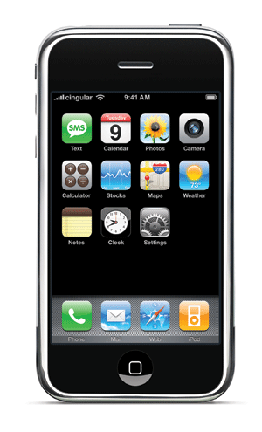
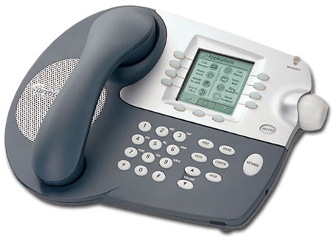

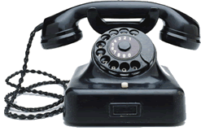
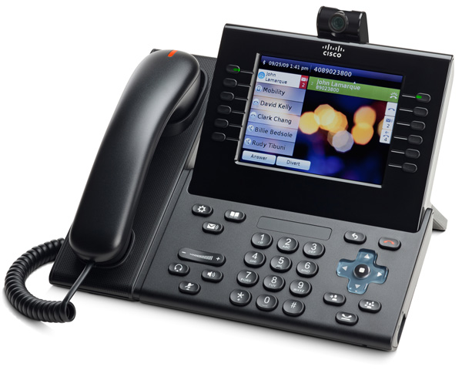
Basic caller-ID validation architecture
cert or public key
validate
validate
validate
local carrier
LD carrier
signs number
after normalization
may tunnel
as UUI
SS7
rendezvous mechanism

Slide 14
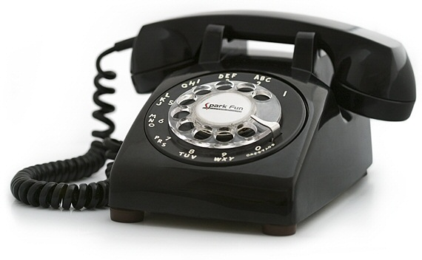
Architecture 1: tree
registry
registrar
# assignee

Slide 15

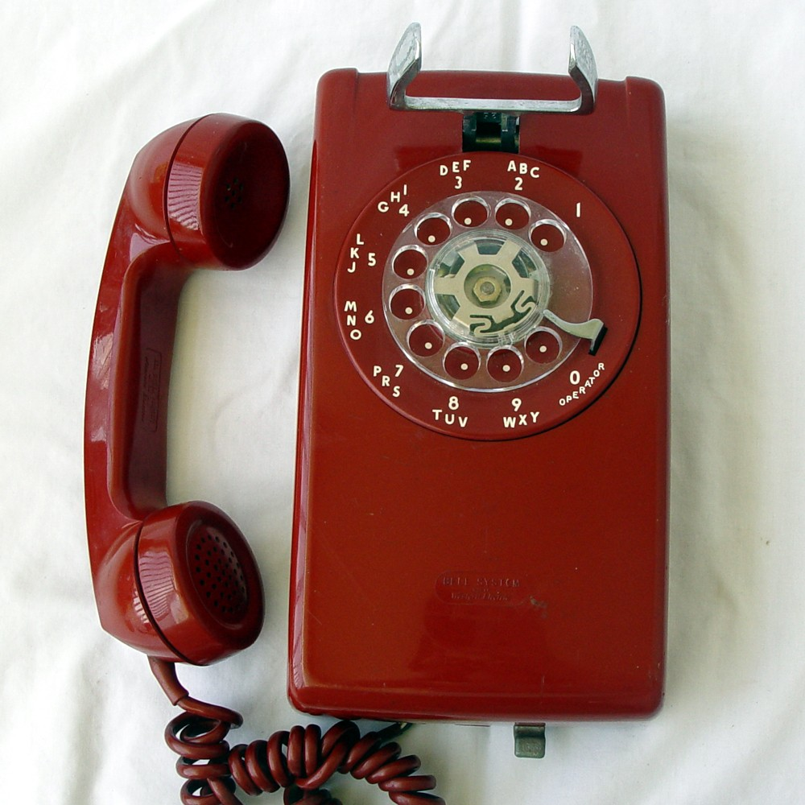
Architecture 2: mesh + tree
global
time
registry
assumed to be cooperative
example: TV whitespace DB, LoST (NG911)
registry
registry
registrar
registry
# assignee

Slide 16
Protocol interactions
registrar
registry
# assignee
EPP?
EPP?
create
delete
transfer
update
renew
info
public or private
HTTP + JSON
DNS
number → NAPTR
DNS
number + credentials → properties

Slide 17
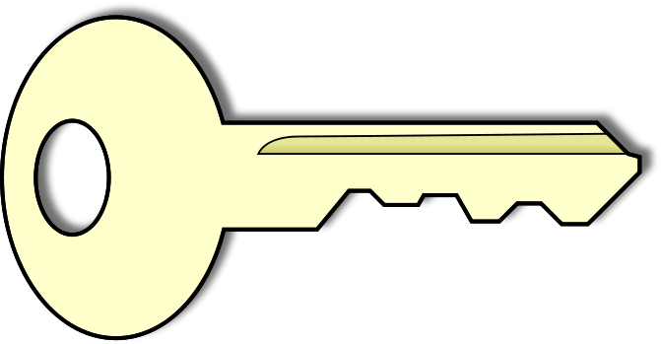
Validation: assignment with delegation
Reseller
Carrier
web
service
web
service
private key
{1544, PuK_{1,} gov}
{1544, PuK_{1,} gov}
{1544, PuK_{1,} gov}
public key
PuK₁
Reseller authenticates
Customer using normal auth (cert, HTTP Basic, API key, …)
same for carrier
Customer generates key pair, doesn’t share private key with anyone
registry
Number | PuK | Prop
202 418 1544 | PuK₁ | .gov
212 939 7042 | PuK₂ | .edu
similar for certificate → CSR

Slide 18
Record granularity
(1) Single record for each number
(2) Split records by
  geography → separate carrier by NPA or geographic region?
    allow geographic splitting of 800#
  service → separate carriers for audio, video, text, …
(3) Others?

Slide 19
Number meta-data
Data element | Comments
E.164 number | key
OCN | several for different media & geographic scope?
Expiration date | if records expire
Public key | for STIR
whois record | similar to domain name?
Log entries (who, what, when) | need to be visible?
?

Slide 20
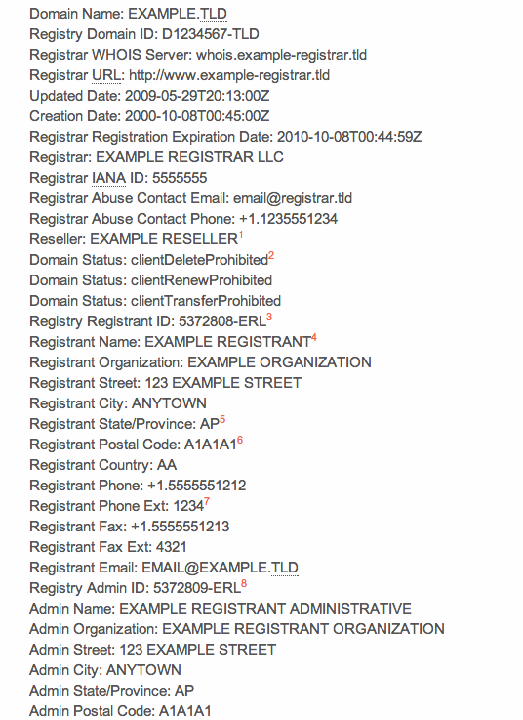
Whois record
Domain names
  creation, expiration dates
Registrant (assignee) information
Contacts: tech, billing, admin
Name server information → NS record
Currently, retrieved by simple TCP request → WEIRDS
  RESTful + XML
Notes:
http://www.icann.org/en/resources/registrars/raa/approved-with-specs-27jun13-en.htm#whois

Slide 21
Protocol ops: allocation
Example: EPP operations (RFC 5730, 5731)
  ENUM: RFC 4114
  separate “contact” definition
EPP operations
  session <login>, <logout>
  query <check>, <info>, <poll>, <transfer>
  object <create>, <delete>, <renew>, <transfer>, <update>
Additional authorization via HTTPS client certs or similar?
Is EPP sufficient as-is, extensible enough or structurally deficient?

Slide 22

Number porting models: token
registry
Transfer:
  registrar 1 → registrar 2
Porting:
  provider 1 → provider 2 (in EPP, that’s an <update>)
Token model (“AuthInfo” in EPP)
  current registrar provides secret token to assignee
  assignee provides token to gaining registrar/carrier
example.com
pw123
<transfer>
pw123
losing registrar
gaining registrar
pw123
Notes:
http://hraunfoss.fcc.gov/edocs_public/attachmatch/FCC-10-85A1.pdf (2010)

Slide 23
Porting: other models
Add neutral third party (TPV)
  gaining registrar/carrier transfers request to neutral 3rd party
  3rd party validates request
  passes validated request to carrier (registrar? registry?)
User certificate: sign transfer request
OAuth
Others?

Slide 24
Caching
Caching can improve performance and increase resiliency
But: porting and other change events need to be visible quickly
  how quickly – seconds? minutes? hours?
  1.48 million porting events / day (10% user-initiated)
    ➔ 1.7 user events/second or (roughly) 136 bps
    very roughly 0.1% of all assigned numbers
Caching approaches:
  Passive: explicit expiration time
  Active: publish-subscribe notification of registrars and other entities for numbers they care about → cache invalidation
    can “push” cache invalidation scale?
Notes:
http://www.neustar.biz/corporate/docs/yankee-transition-pstn-to-ip.pdf

Slide 25
Role of caller location in numbering
800# allow location-specific (shared) use
Does the architecture need to support this?
At what granularity?
Can this be used to simplify nationwide 211, 311 & 511?

Slide 26
Testbed

Slide 27
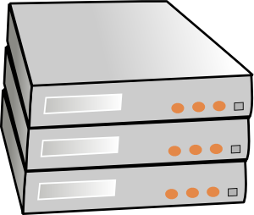


Test bed for exploring numbering issues
MOADB, JIT, ENUM, STIR, … → move from reports to prototypes and testing
neutral, non-production, collaborative, non-legacy
enable many parallel approaches
REST + JSON?
protocol
(“API”)
DB
implement API
(server side)
emulate NANPA-NG
legacy
DBs
client
(emulate providers)
ENUM

Slide 28
Test bed issues
Mainly need common data store
  just SQL access?
Who operates the test bed?
  gov: NSF GENI, DHS DETER, FCC
  industry sponsor(s)
“Code of conduct” (AUP)?
Technical requirements
“Governance” – e.g., schema changes
Notes:
http://deter-project.org/

Slide 29
Next steps
Summary report for workshop
Mailing list?
Regular group meetings?
Hand-off to SDO processes?

Slide 30
Backup

Slide 31
Key management options
Number validation
Public key only (e.g., DNS)
public
private
X.509 cert
single certifier (per CC)
multiple certifiers per CC
single cert store (hierarchy)
any cert anywhere
separate delivery (URL)
single “CDN”
number-based access (no URL)
almost all of these could interoperate in single system

Slide 32
Certificate models
Integrated with number assignment
  assignment of number includes certificate: “public key X is authorized to use number N”
  issued by number assignment authority (e.g., NPAC), possibly with delegation chain
    allocation entity → carrier (→ end user)
separate proof of ownership
  similar to web domain validation
  e.g., similar to Google voice validation by automated call back
    “Enter the number you heard in web form”
  Automate by SIP OPTIONS message response?

Slide 33
Legitimate caller ID spoofing
Doctor’s office
  call from personal physician cell phone should show doctor’s office number
Call center
  airline outbound contract call center should show airline main number, not call center
Multiple devices, one number
  provide single call-back number (e.g., some VoIP services) from all devices
anonymity is distinct problem (caller ID suppression)

Slide 34
EPP Command Example
<?xml version="1.0" standalone="no"?>
<epp xmlns="urn:iana:xmlns:epp"
xmlns:xsi="http://www.w3.org/1999/XMLSchema-instance"
xsi:schemaLocation="urn:iana:xmlns:epp epp.xsd">
<command>
<ping>
<domain:ping xmlns:domain="urn:iana:xmlns:domain"
xsi:schemaLocation="urn:iana:xmlns:domain domain.xsd">
<domain:name>example1.com</domain:name>
<domain:name>example2.com</domain:name>
<domain:name>example3.com</domain:name>
</domain:ping>
</ping>
<trans-id>
<date>2000-06-08</date>
<client-id>ClientX</client-id>
<code>ABC-12345-XYZ</code>
</trans-id>
</command>
</epp>

Slide 35
EPP Response Example
<?xml version="1.0" standalone="no"?>
<epp xmlns="urn:iana:xmlns:epp"
xmlns:xsi="http://www.w3.org/1999/XMLSchema-instance"
xsi:schemaLocation="urn:iana:xmlns:epp epp.xsd">
<response>
<result code="1000">
<text>Command completed successfully</text>
</result>
<response-data>
<domain:ping-data xmlns:domain="urn:iana:xmlns:domain"
xsi:schemaLocation="urn:iana:xmlns:domain domain.xsd">
<domain:name result="known">example1.com</domain:name>
<domain:name result="unknown">example2.com</domain:name>
<domain:name result="known">example3.com</domain:name>
</domain:ping-data>
</response-data>
<trans-id>
<date>2000-06-08</date>
<client-id>ClientX</client-id>
<code>ABC-12345-XYZ</code>
</trans-id>
</response>
</epp>

