Slide 1
The Internet is a series of tubes
Henning Schulzrinne
Columbia University & FCC

Slide 2
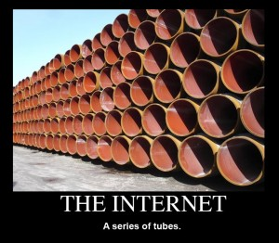
The Internet – A series of tubes
They want to deliver vast amounts of information over the Internet. And again, the Internet is not something that you just dump something on. It's not a big truck. It's a series of tubes. And if you don't understand, those tubes can be filled and if they are filled, when you put your message in, it gets in line and it's going to be delayed by anyone that puts into that tube enormous amounts of material, enormous amounts of material
R-Stevens, Alaska (2006)
Notes:
http://en.wikipedia.org/wiki/Series_of_tubes

Slide 3
Overview
Problem space
It’s about civil engineering, not computer science
Lessons from US approach: universal service, high-cost support, LifeLine
Economic network segmentation
Open (research) issues

Slide 4
US broadband adoption
NTIA 2014

Slide 5
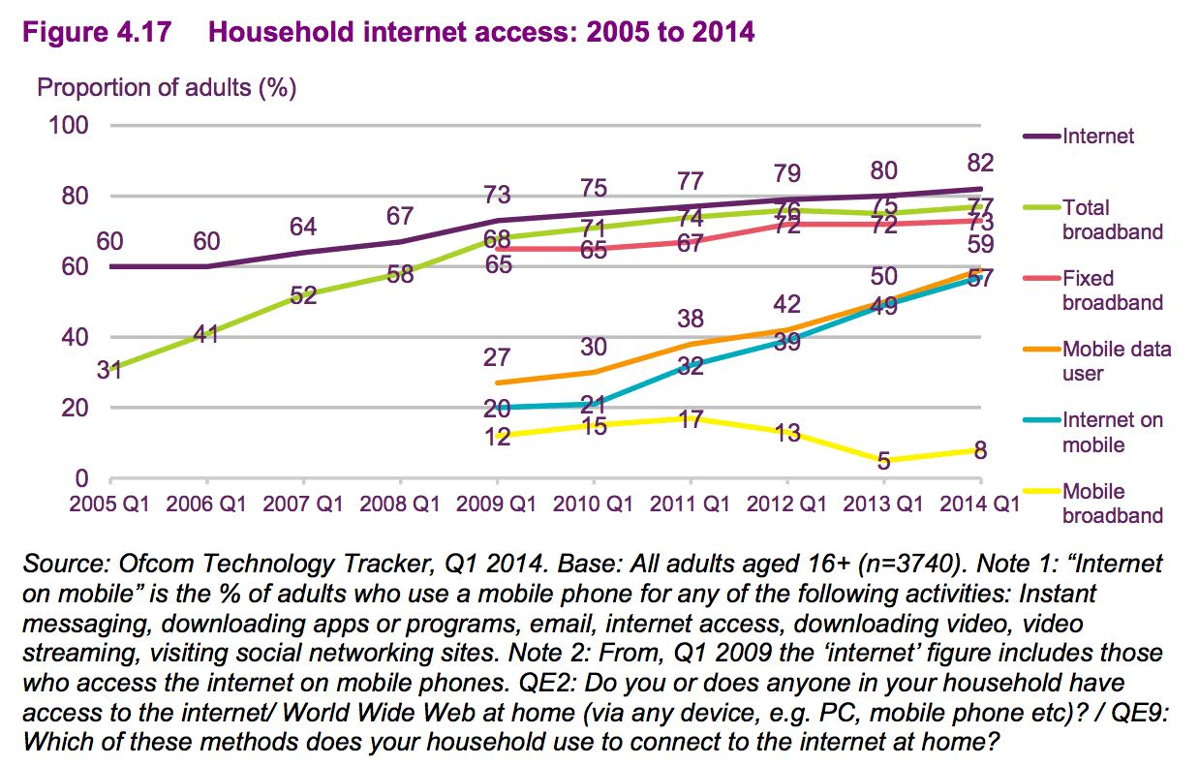
UK
http://stakeholders.ofcom.org.uk/binaries/research/cmr/cmr14/UK_4.pdf

Slide 6
Non-adoption
NTIA 2014

Slide 7
The three corners
Availabillity
Relevance
Affordability

Slide 8
Pattern 1: The dependency cycle
Technology & speed
Consumer behavior
Regulatory environment
Industry structure

Slide 9
What kind of Internet do we want?
100 Mb/s
1 TB
100 GB
10 Mb/s
10 GB
4G
1 Mb/s
1 GB
3G
100 kb/s
100 MB
2G
10 kb/s
1 MB
msg.
(SMS)
text
email
rich
web
replace radio
short-form video
TV + SVOD
replace TV

Slide 10
building networks

Slide 11

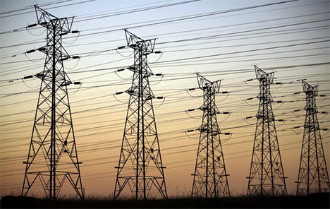
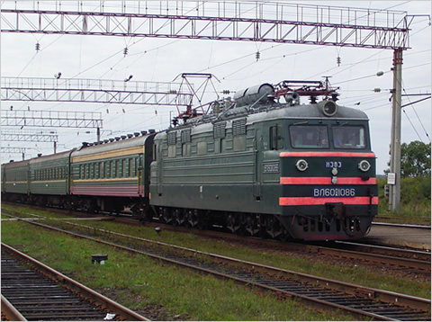
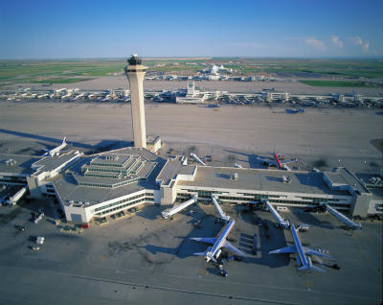
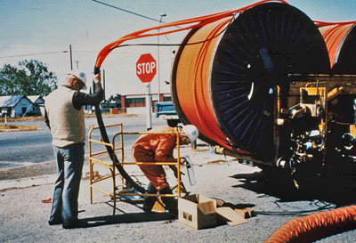
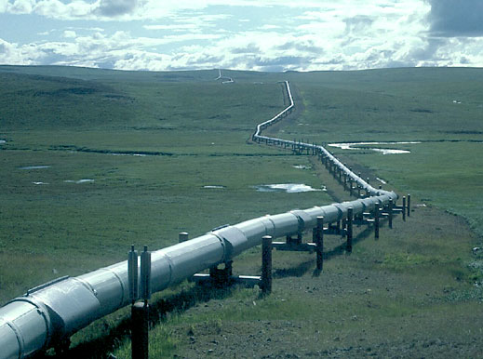
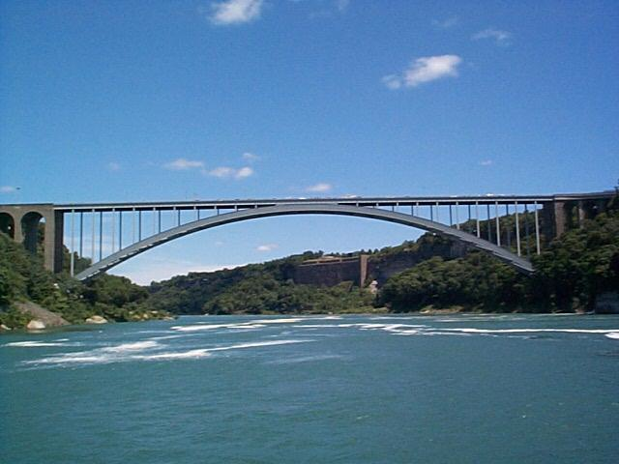
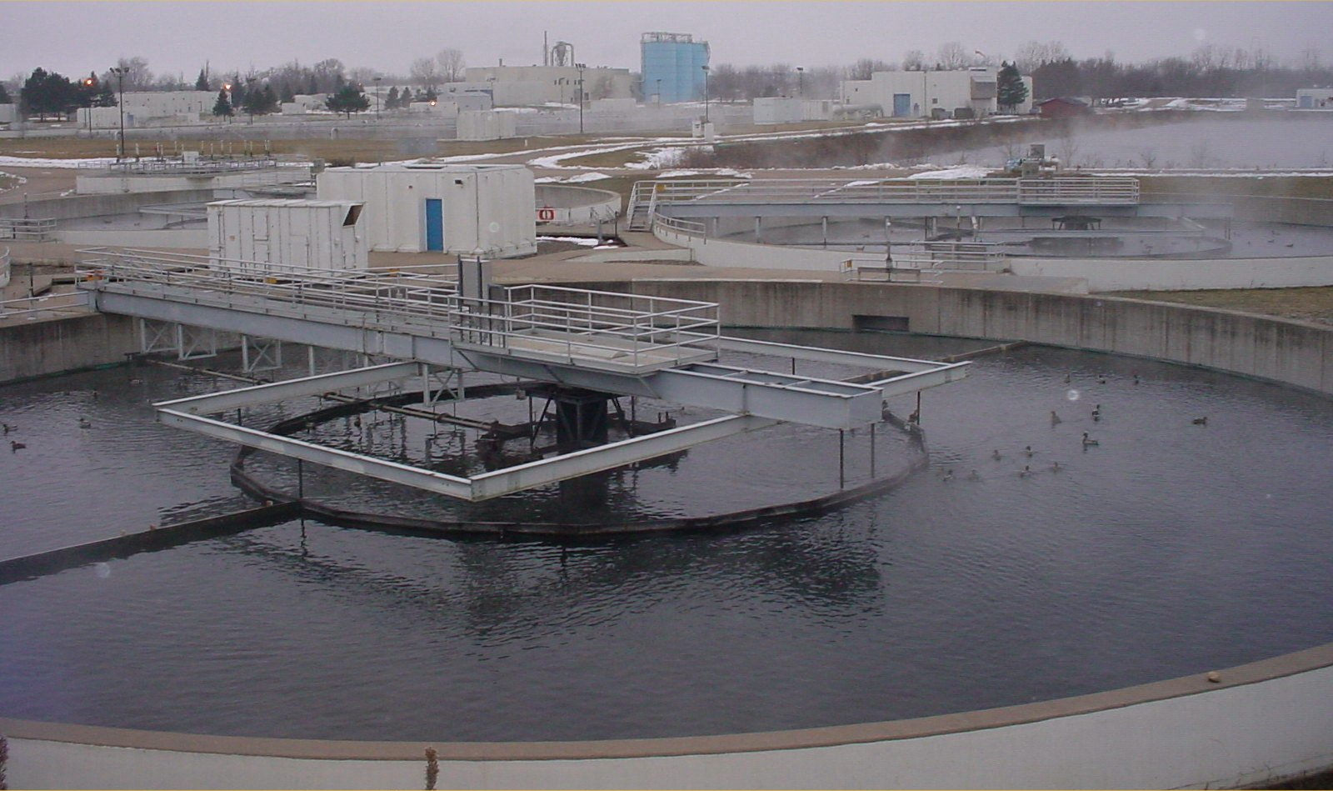
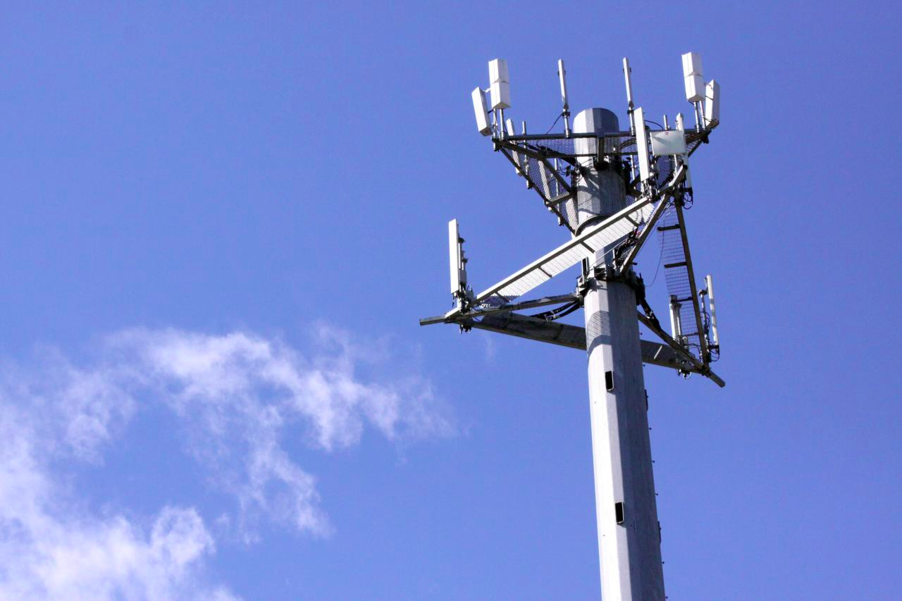
The great infrastructure
Technical structures that support a society → “civil infrastructure”
  Large
  Constructed over generations
  Not often replaced as a whole system
  Continual refurbishment of components
  Interdependent components with well-defined interfaces
  High initial cost
water
energy
transportation
communication

Slide 12
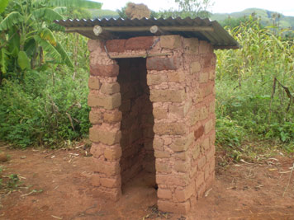
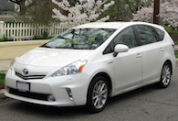
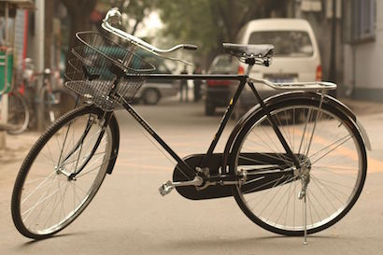


Centralized vs. distributed infrastructure
centralized
more coordination
distributed
less coordination

Slide 13

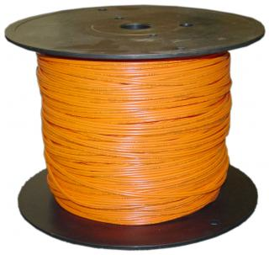
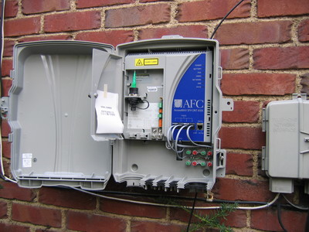
Broadband cost
30%
70%

Slide 14
Broadband network cost - FTTP
Category | Details | Outside plant
FTTP in existing right-of-way | All underground, not including drops or electronics | $1,200…$1,300 per passing
 | 40% aerial, 60% underground, not including drops or electronics | $1,000…$1,100 per passing
FTTP drops | Range of distances and complexity | $300…$700 per connected home
Crown Fibre Holdings (Govt. of New Zealand); provided by CTC

Slide 15
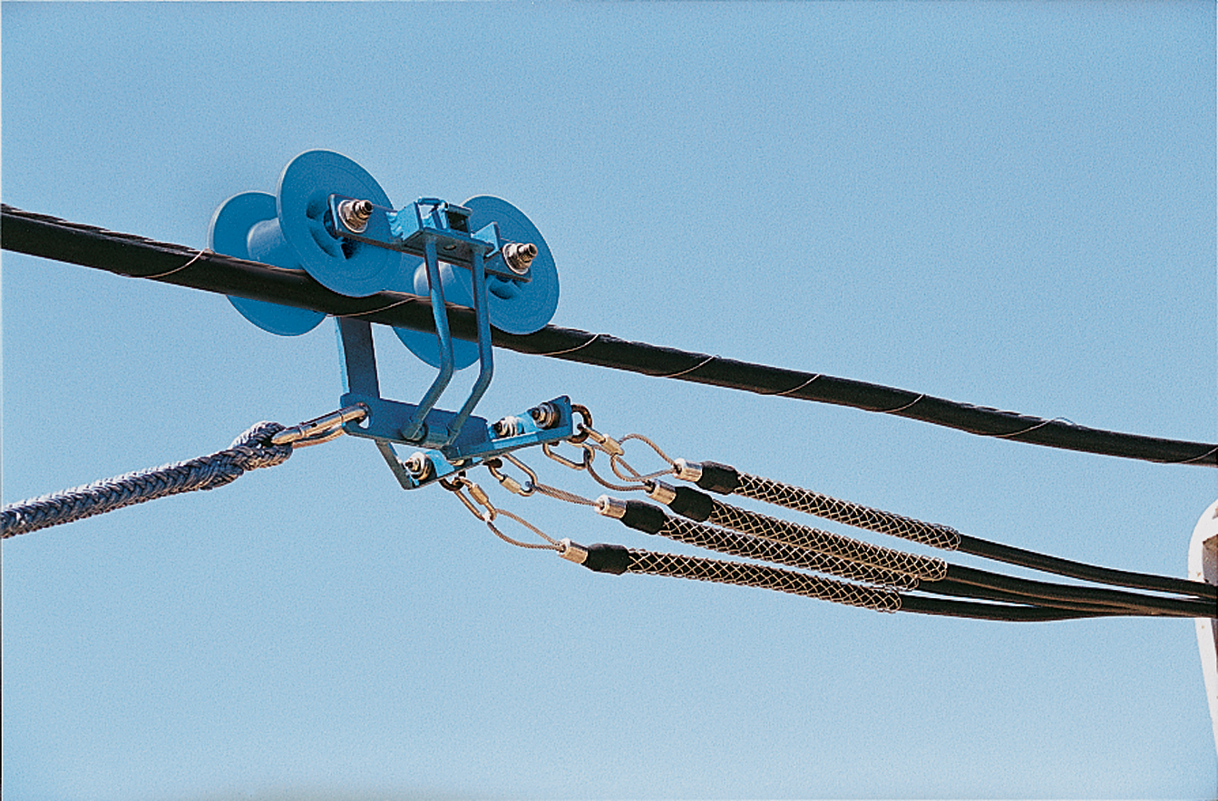
Broadband network cost – Fiber middle mile
Category | Details | Outside plant | Source
aerial, new attachment | Northeastern city municipal utility; 96% aerial, 4% underground; 87.6 miles | $30,000/mile | Public utility (actual cost)
aerial overlash | Major metropolitan area (U.S. east coast) | $15,000/mile
buried | Mixed suburban/urban locations and pot/bore construction | $89,000/mile | Washington, D.C.-area BTOP project (actual cost)
Data provided by CTC

Slide 16
Middle mile cost example
CTC, 2009 (“Brief Engineering Assessment: Efficiencies available through simultaneous construction and co-location of communications conduit and fiber”)

Slide 17
More fiber observations
Fiber middle-mile cost: $50-70k/mile
Fiber cost: 144 strands = $10k/mile, 48 strands = $4.7k/mile
Common characteristics:
  avoid active elements in network → power, maintenance → PON
  recently: avoid anything except fiber (including splitters)
    cf. wireless last mile approach
  fiber home run, even if PON (Google Fiber, Stockholm)
Fiber cost higher for buried, but cheaper if conduit or aerial
Recent FTTH:
  avoid indoor installation (cf. Verizon FiOS)
  one box in home (ONT + 802.11ac), not ONT + MoCa STB

Slide 18
FTTH estimates
Bell Alliant in Western Canada has now passed over half a million homes with fiber home, the largest deployment in North America after Verizon. Their latest financial report showed capex of less than $500 per home passed.
Verizon reported costs fell below $700/home passed several years ago and headed to $600. Add the cost of actually installing a large fraction of those homes, and your cost per home passed by the network comes closer to $1,000.
Installing each home at Verizon added $500-600. Digging lawns and drilling holes into the homes is labor intensive.
Includes equipment whose price is rapidly dropping. Early Verizon gear cost $300-400/home, but today they are probably paying half that.
  Very large fiber builds in China are paying less than $100/home.

Slide 19
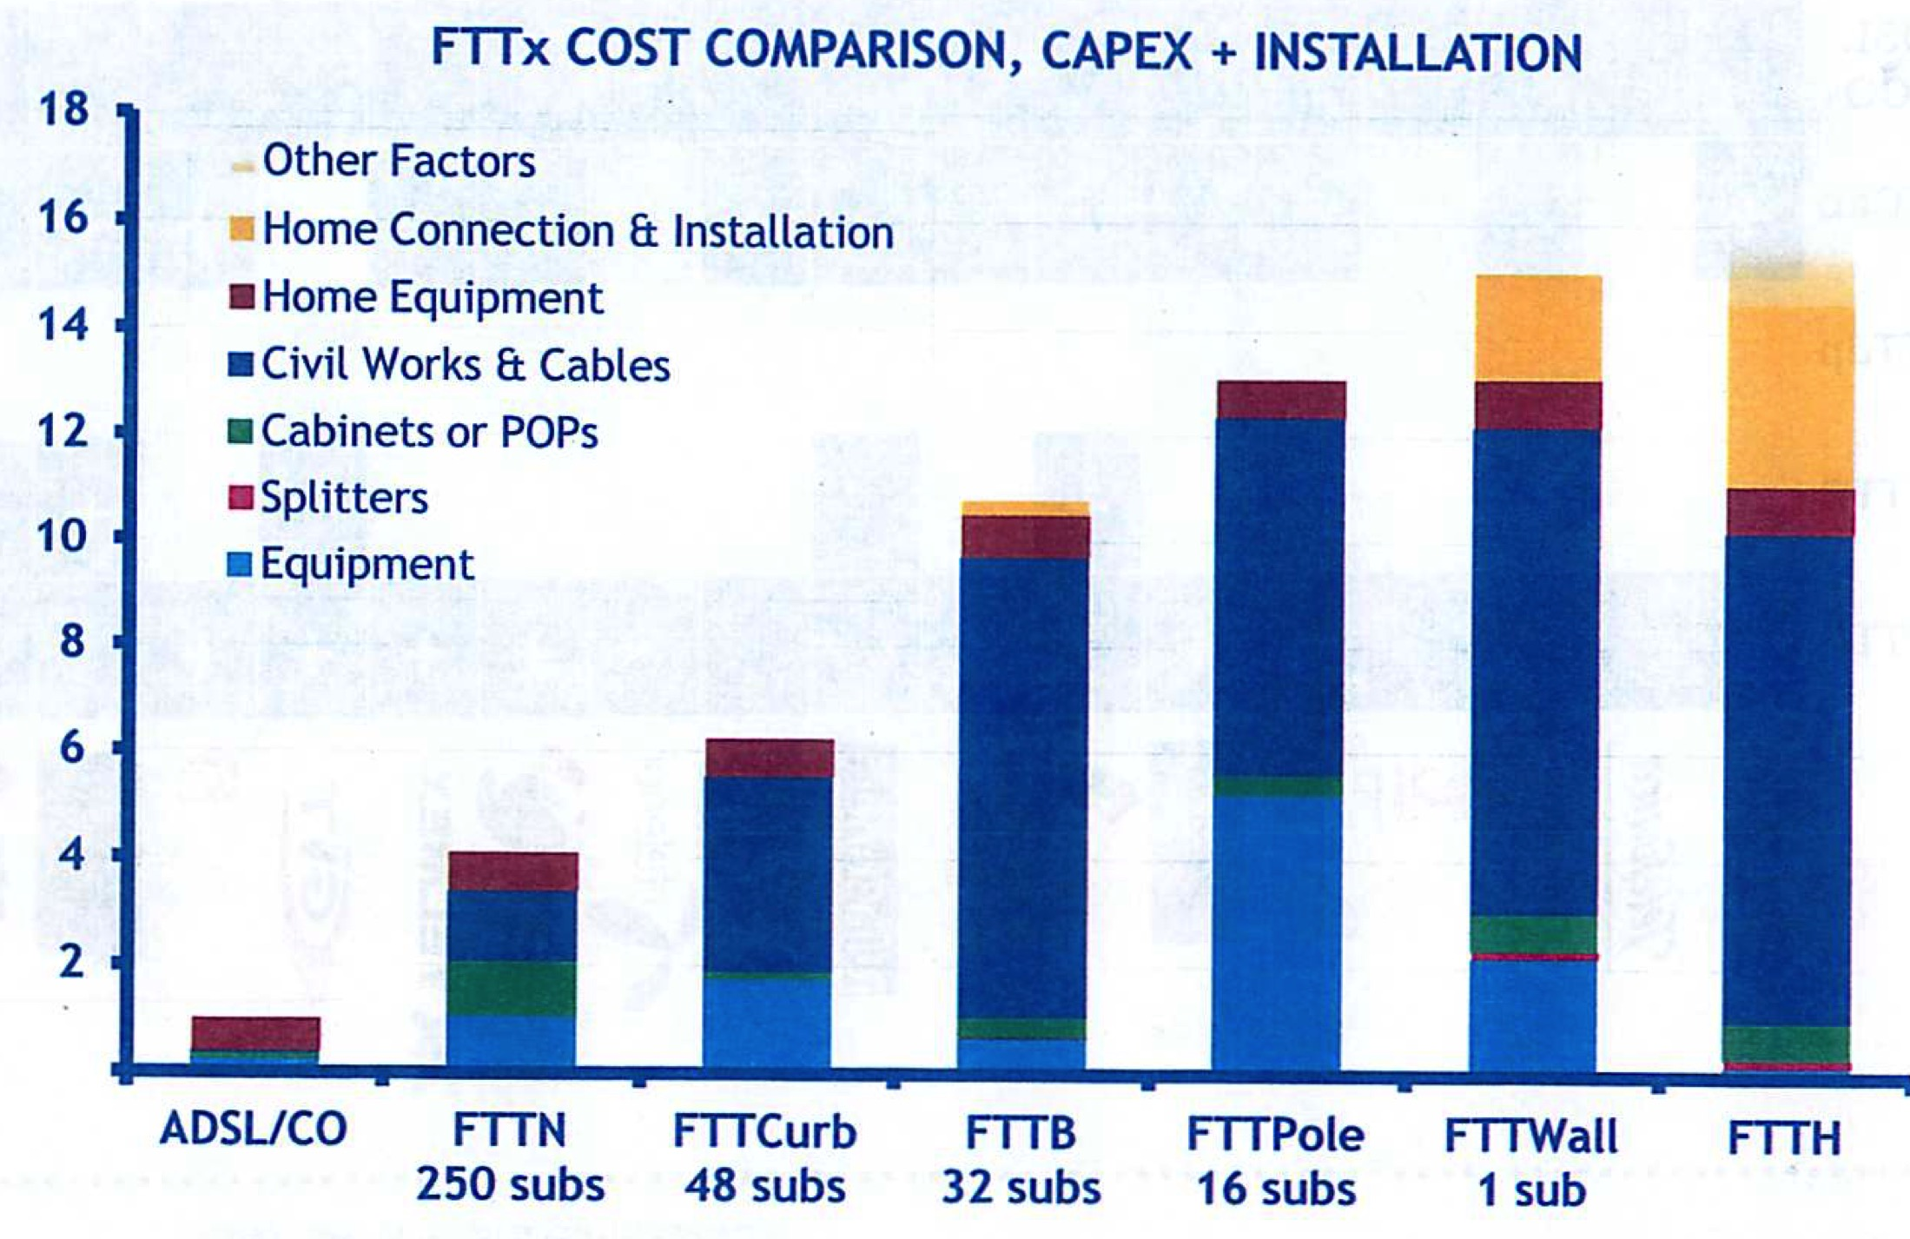
FTTx cost vs. DSL
Alcatel-Lucent, 2013

Slide 20
Engineering and business opportunities
Capital investment surprisingly small
Academic and industry research focuses on 15%, rather than 85%
Three likely models in different countries:
  public conduits (& fiber) + private Internet access
    community & electric utilities
  structurally-separated into transmission, interconnection & connect
  vertically integrated (monopoly & duopoly) provider
Opportunities and predictions:
  like retail → franchising, “SolarCity” capital model
  local network, central administration
  self-administered networks

Slide 21
Capital investment
Company | Revenue | Capital expenditures | %
Comcast (US) [3Q14] | $11.04B | $1.644B | 14.9
Telekom (DE) [3Q14] | €15.6B | $2.58B | 16.5
Safaricom (KE) [H1FY15] | Ksh 79.34B | Ksh 12.37 | 15.5

Slide 22
Network costs
yes, but mostly
electronics
middle mile
last mile
backbone
CDN
largely unaffected
by video
ISP-owned
vs. leased!
DSL | no
HFC | homes/service node
fiber | no
cellular | densification
lack of IXPs in LDCs!

Slide 23



Bandwidth costs
Amazon EC2
  $50 - $120/TB out, $0/TB in
CDN (Internet radio)
  $600/TB (2007)
  $7-20/TB (Q1 2014 – CDNpricing.com)
NetFlix (7 GB DVD)
  postage $0.70 round-trip → $100/TB
FedEx – 2 lb disk
  5 business days: $6.55
  Standard overnight: $43.68
  Barracuda disk: $91 - $116/TB
DVD-R (7 GB)
  $0.25/disk → $35/TB
Notes:
FedEx and EC2 prices as of 09/15/09
CDN: http://www.mindbranch.com/listing/product/R678-29.html
http://www.cdnpricing.com/

Slide 24
Transit prices
http://drpeering.net/white-papers/Internet-Transit-Pricing-Historical-And-Projected.php

Slide 25
cost recovery

Slide 26
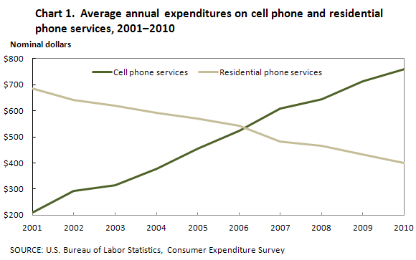
Consumer expenditures
“Americans spent $116 more a year on telephone services in 2011 than they did in 2007, according to the Labor Department, even as total household expenditures increased by just $67.
Meanwhile, spending on food away from home fell by $48, apparel spending declined by $141, and entertainment spending dropped by $126. The figures aren't adjusted for inflation.” (WSJ 2012)
Notes:
Morgan Stanley, Macro Meets Micro: A Five- Year View of the Telecom Services Industry, July 2014.
http://online.wsj.com/articles/SB10000872396390444083304578018731890309450
http://www.bls.gov/opub/btn/archive/consumer-spending-in-2010-pdf.pdf

Slide 27
The value of bits
Technologist: A bit is a bit is a bit
Economist: Some bits are more valuable than other bits
  e.g., $(email) >> $(video)
Application | Volume | Cost per unit | Cost / MB | Cost / TB
Voice (13 kb/s GSM) | 97.5 kB/minute | 10c | $1.02 | $1M
Mobile data | 5 GB | $40 | $0.008 | $8,000
MMS (pictures) | < 300 KB, avg. 50 kB | 25c | $5.00 | $5M
SMS | 160 B | 10c | $625 | $625M
Notes:
T-Mobile 2010
AT&T data
http://www.nowsms.com/discus/messages/12/8500.html

Slide 28
The challenges of service differentiation
Method | Used by | Advantage | Drawbacks | Customer dislike estimate
Speed tiers | C, DSL | Differentiates basic usage modes | Less effective above 10 Mb/s | 😦
Usage-based charging (caps, metered) | M, (C, DSL), LD | heavy vs. light users encourages Wi-Fi use | complaints about meter accuracy adaptive applications (4G bill shock) pay for ads hard to predict | 😦😦😦
Application-based charging | M | Easier to predict Business model | Affects content competition barriers to entry | 😦😦😦
Differentiated privacy | AT&T, NetZero | Full functionality | Low-income users may not be attractive to advertisers | 😦 or 😦😦😦

Slide 29
The challenges of service differentiation
Method | Used by | Advantage | Drawbacks | Customer dislike estimate
Priority | ? | Better experience for VoIP | Other experience must be bad → economy class in airline | ?
Time-of-day | LD, Sat | Approximates congestion Easy to understand | Not optimally efficient Possible bill shock | 😦😦
Congestion-based | ? | Encourages time shifting | Limited shift Unpredictability | 😦😦😦😦
The words you won't say on your deathbed are, "If only I had spent more time watching the bandwidth meter (or phone bill)."

Slide 30
Cable TV vs. Internet
Lots of advocates of “fairness” for metering
Very few advocate scaling the monthly TV fee (Europe) or the cable TV fee by hours watched
  eminently feasible with STBs
  content tiers but not viewing tiers
“but cost of cable TV does not depend on viewers”
not really: content cost to MVPD is based on popularity

Slide 31
What about zero-rating?
Income
Cost
CPM for video: US$8.18 → ~1c/video
  part of CPM goes to the content creator or publisher (55% for YouTube)
  → 0.5c/video
Video size
  LD 360p 4G Mobile @ H.264 main profile 700 kbps (6 MB/minute)
  HD 720p @ H.264 high profile 2500 kbps (20 MB/minute)
CDN cost: $10/TB
  → 1c/GB
$10/GB typical consumer rate → 1c/MB

Slide 32
universal service

Slide 33
Models
Demand aggregation:
  Physical: Internet cafes, phone stores, libraries, schools, community centers
  Temporal: Fiberhood
Capital aggregation:
  US rural electric cooperatives
  community networks
Lease models:
  transform one-time (capital) expenses into amortized payments
  US “equipment installment plan” (EIP) model for smartphones

Slide 34
Universal service – explicit and implicit subsidies
Explicit = cash transfers to support service
Implicit = built into rates by regulation
  lower residential and rural rates
  higher long-distance rates
  higher urban rates through geographic rate averaging between urban and rural areas
  higher business line rates
  higher custom calling rates (e.g., call waiting, voice mail)
  intercarrier compensation (ICC)
+ US Carrier of Last Resort (COLR) in local areas

Slide 35
Your phone/Internet bill
911 fee (by county)
subsidy (high-cost, low-income, e-Rate)
Verizon long distance
funds the FCC
state video franchise (NJ)

Slide 36
US Universal Service Fund
rural areas
$9.25 for low-income

Slide 37
Universal service – recurring issues
Who receives and for what?
  must be eligible telecommunications carrier (ETC)
Who contributes (pays)?
Relationship of universal service, local competition and access reform
→ transition from voice support to broadband
  broadband: FCC currently 4 (down)/1 (up) Mb/s
  proposed: 10/1 Mb/s

Slide 38
USF high-cost fund

Slide 39
New models for high-cost support
Old model: hard to tell how money is being spent
  little incentive to be cost-efficient
Alternatives:
  vouchers → demand aggregation (difficult in timing)
  model-based support (CAF)
  build support vs. operations support
  reverse auctions by lowest (relative or absolute) cost to serve
    $100M experiment ($75M for 100/25 Mb/s)
Nov. 2014

Slide 40
Lifeline eligibility
Medicaid
Food Stamps
Supplemental Security Income (SSI)
Federal Public Housing Assistance (Section 8)
Low-Income Home Energy Assistance Program (LIHEAP)
Temporary Assistance to Needy Families (TANF); or
The National School Lunch Program (Free Lunch Program)
or 135 or 150% of poverty limit (2014: $23,850 for family of 4)
Notes:
http://mercatus.org/sites/default/files/Ellig_FCC-phone-subsidy_MOP_101813.pdf

Slide 41
Conclusion
Expanding Internet availability is not about cheap hardware or magic new hardware
Separate solutions for affordability, availability and relevance
Realistic expectations for not-quite-Internet solutions
  DTNs
  one-way satellite
  two-way satellite
Can’t count on sustained volunteer labor for scalable solutions
  distinguish one-off “hero” experiments from country-wide approaches

