Slide 1
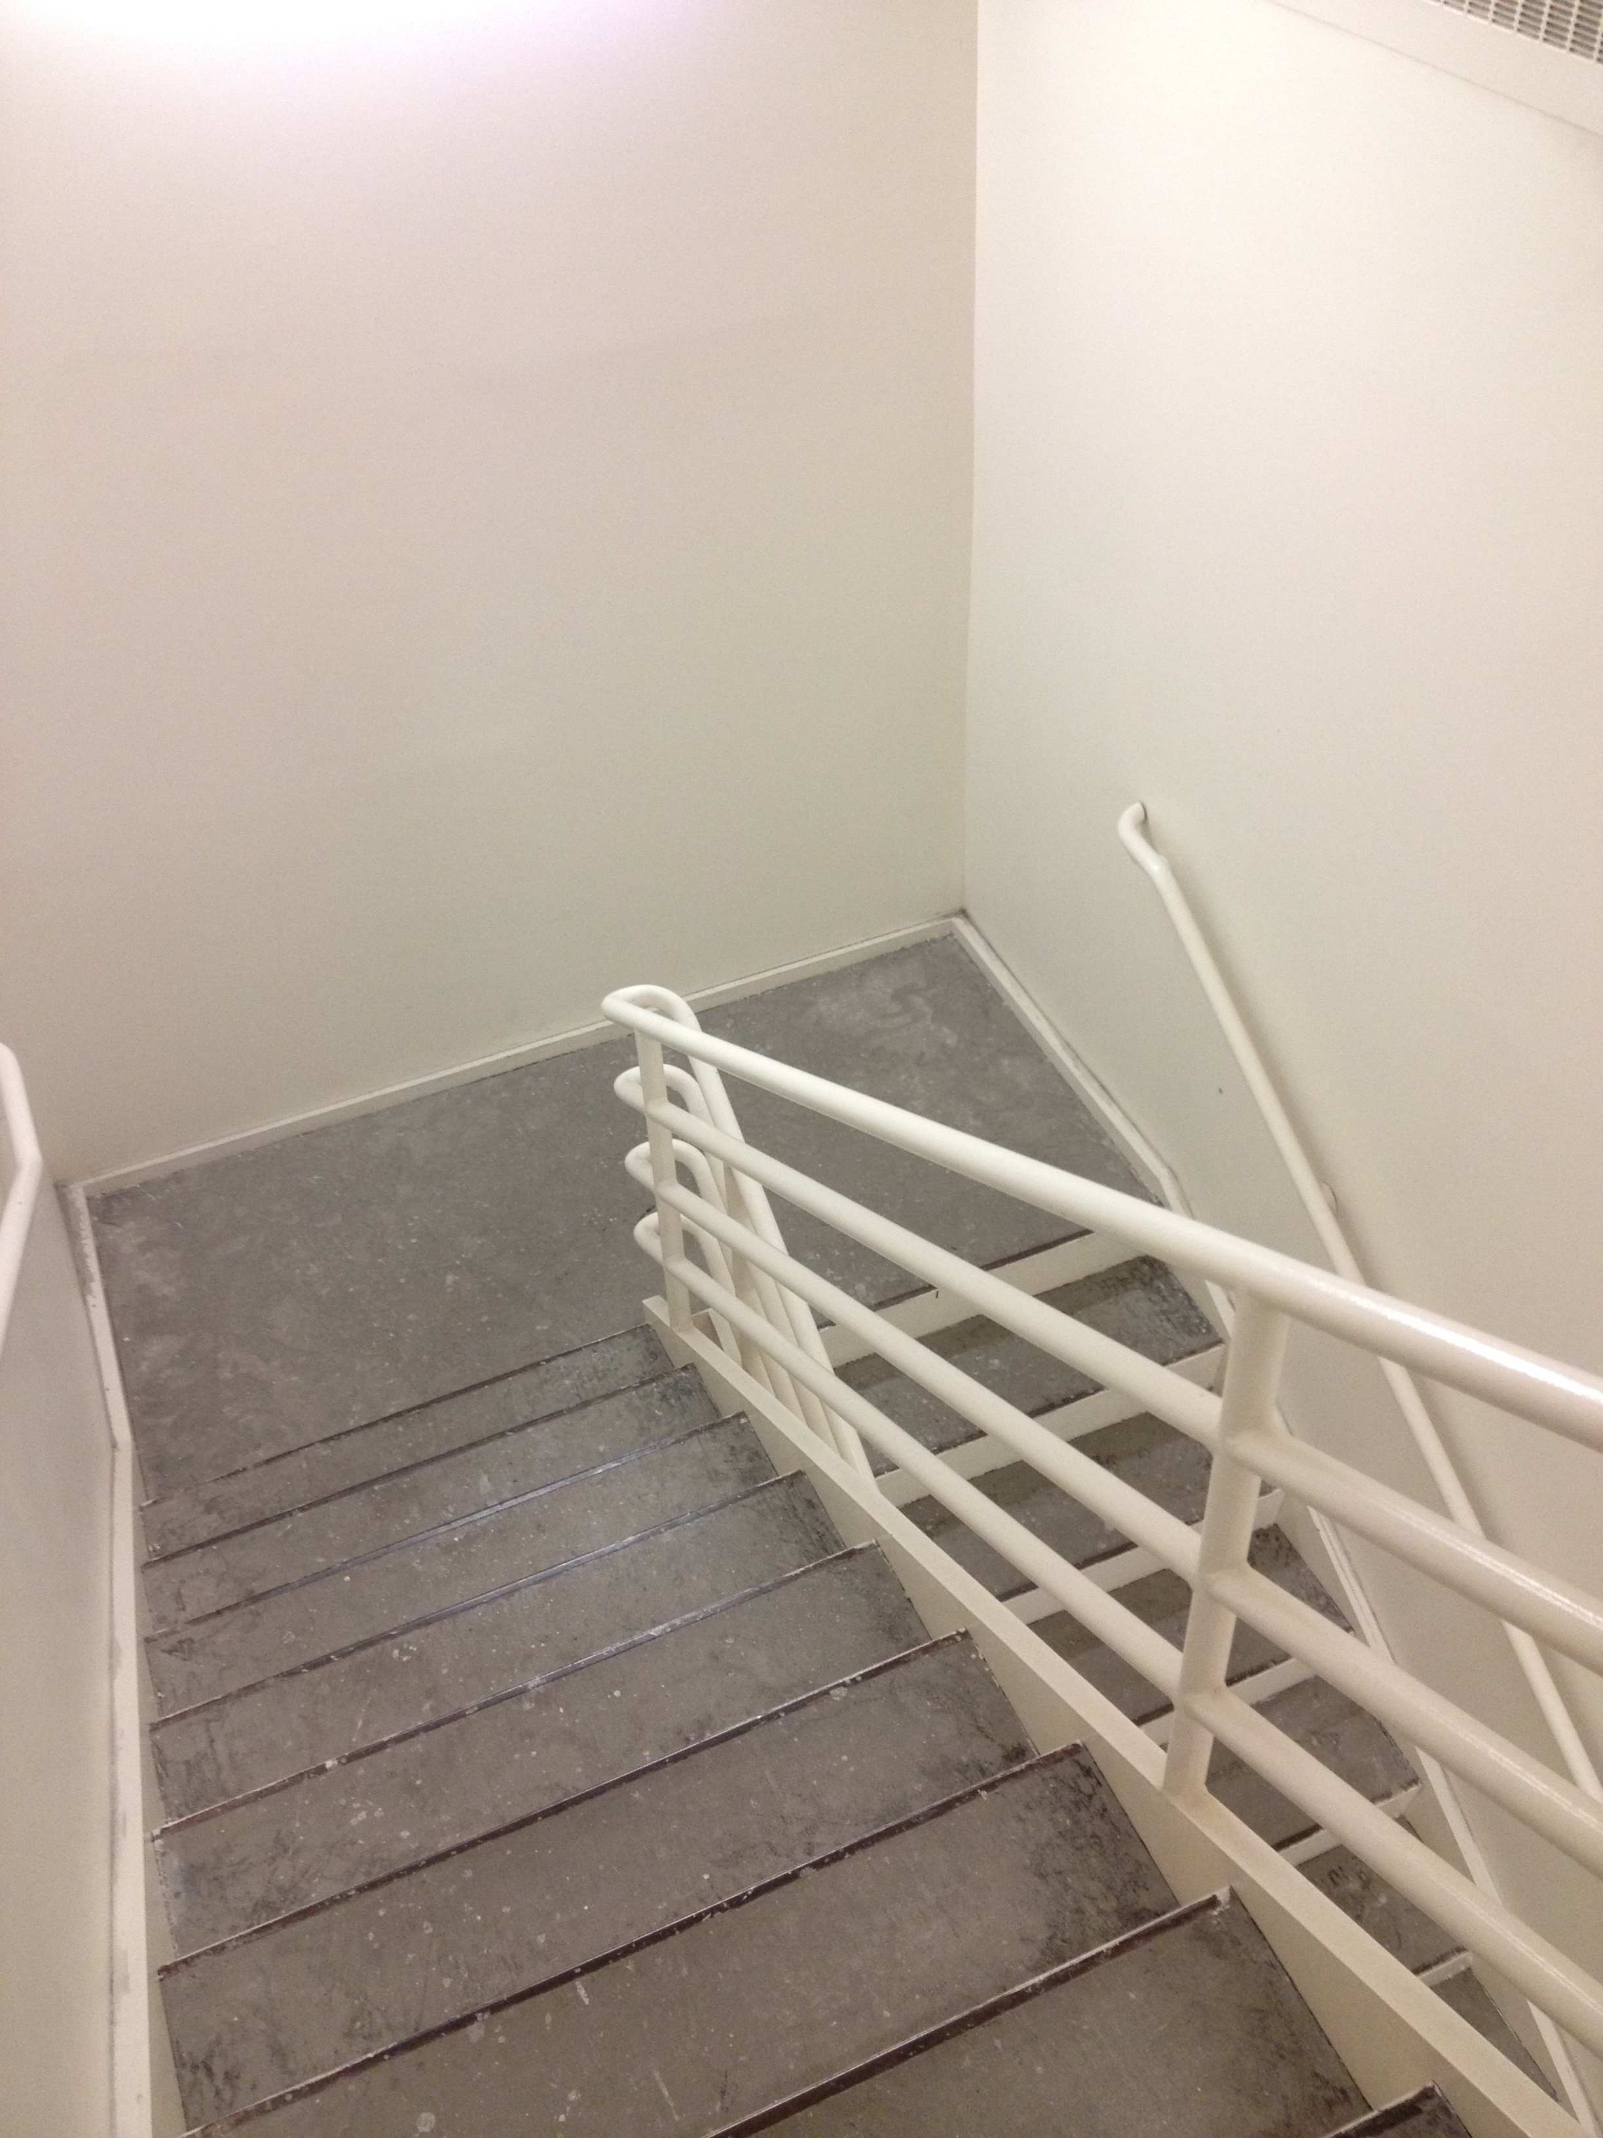
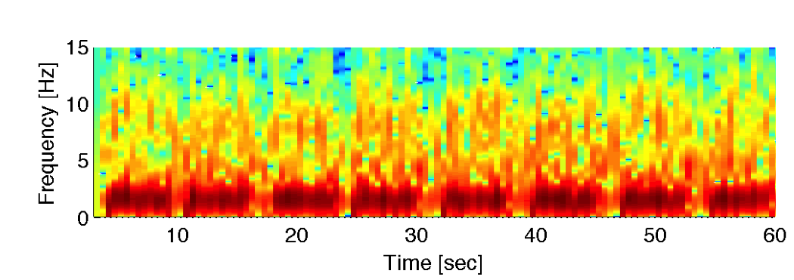

Slide 2
Floor Localization
A person’s movement on a stairway is captured by a smartphone’s accelerometer and analyzed to determine how many floors the person has traveled on the stairway. The example shows the vertical acceleration, the magnitude spectrogram, and the power level of human walking in 0.5-2Hz when a person walks down four floors passing by eight landings. The system counts dips in the power level to calculate the traveled floors.
Internet Real Time Lab (2012)

