Slide 1
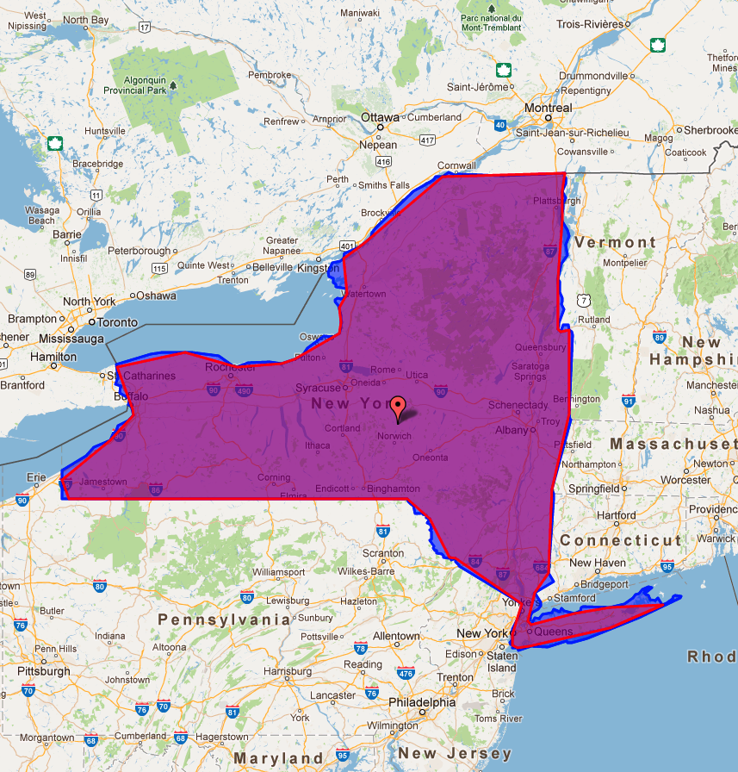
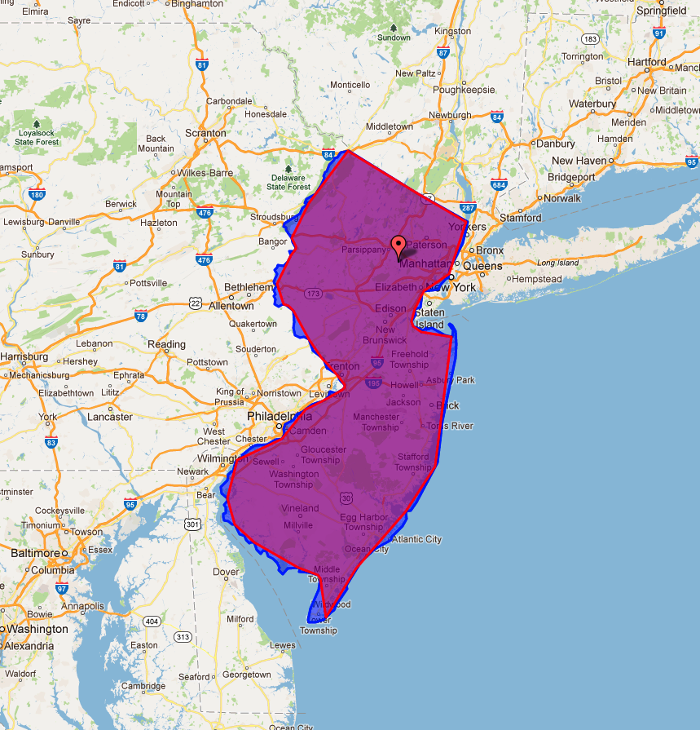

Slide 2
Polygon Simplification
Geographic boundaries for location-based services are simplified by a new algorithm named GeoPS-PD to minimize the data size. When simplifying boundaries, GeoPS-PD tries to include densely populated regions by consulting census data. For example, New York state boundary, which originally consists of 3,093 points, is simplified to a polygon with 100 points (3%), yet covers 95% of the original area. Most parts of New York City are also included in the result.
Internet Real Time Lab (2011)

