Slide 1
Source identity (origin authentication)
Henning Schulzrinne
May 31, 2013
draft-peterson-secure-origin-ps-00

Slide 2
Communication identifiers
Property | URL owned | URL provider | E.164 | Service-specific
Example | alice@smith.name sip:alice@smith.name | alice@gmail.com sip:alice@ilec.com | +1 202 555 1010 | www.facebook.com/alice.example
Protocol-independent | no | no | yes | yes
Multimedia | yes | yes | maybe (VRS) | maybe
Portable | yes | no | somewhat | no
Groups | yes | yes | bridge number | not generally
Trademark issues | yes | unlikely | unlikely | possible
Privacy | Depends on name chosen (pseudonym) | Depends on naming scheme | mostly | Depends on provider “real name” policy
Notes:
http://findmyfacebookid.com

Slide 3
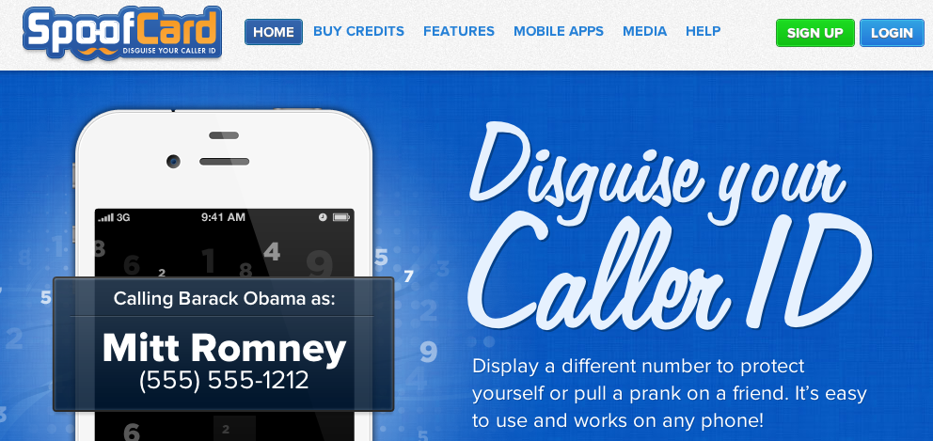
Caller ID spoofing
Easily available on (SIP) trunks
US Caller ID Act of 2009: Prohibit any person or entity from transmitting misleading or inaccurate caller ID information with the intent to defraud, cause harm, or wrongfully obtain anything of value.
Also: FCC phantom traffic rules

Slide 4
Two modes of caller ID spoofing
Impersonation
  spoof target number
  Helpful for
    vishing
    stolen credit card validation
    retrieving voicemail messages
    SWATting
    disconnect utilities
    unwanted pizza deliveries
    retrieving display name (CNAM)
Anonymization
  pick more-or-less random #
    including unassigned numbers
  Helpful for
    robocalling
    intercarrier compensation fraud
    TDOS

Slide 5
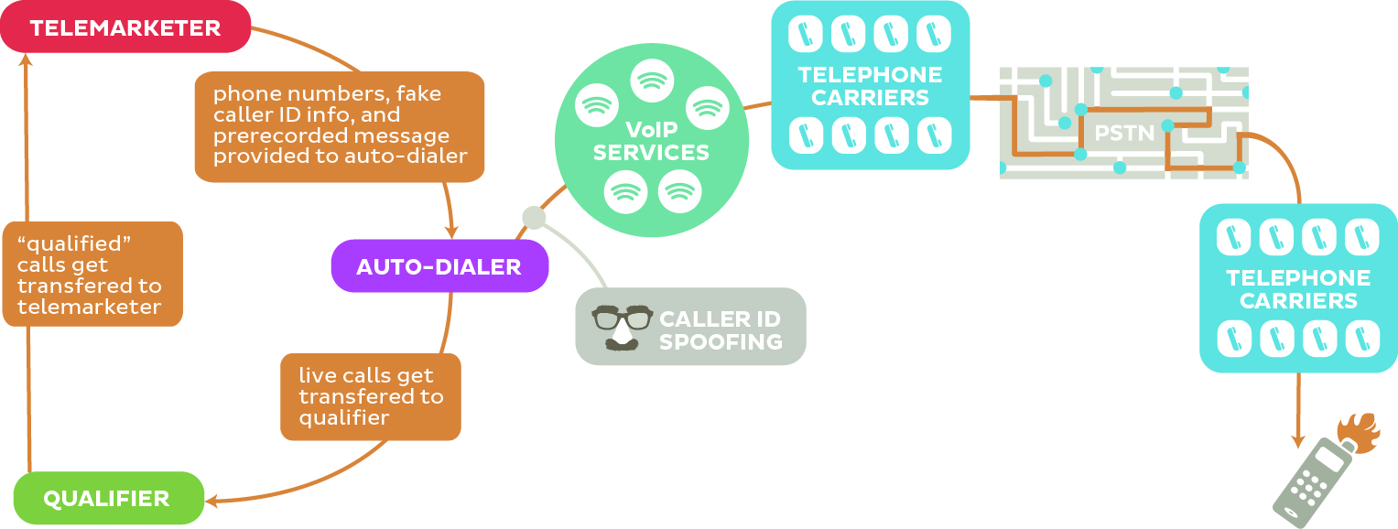
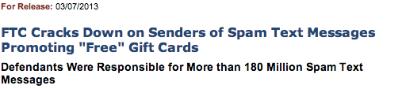
Robocalling
“pink carriers”

Slide 6
Legitimate caller ID spoofing
Doctor’s office
  call from personal physician cell phone should show doctor’s office number
Call center
  airline outbound contract call center should show airline main number, not call center
Multiple devices, one number
  provide single call-back number (e.g., Google Voice) from all devices
anonymity is distinct problem (caller ID suppression)

Slide 7
Spoofing & robocall investigations
Destination number and time
  “who called N at T?”
Use CDRs by iteration
  “who did you receive call N/T from?”
  each iteration requires legal subpoena
  limited CDR retention time
  single call may traverse 5+ hops
  some providers may be located abroad → may not respond to US subpoena
➔create standard provider trace mechanism across SBCs
  possibly signed
  helpful even if only helpful providers add trace
  not each proxy hop, just logical hops
  Trace: urn:ocn:7679
  Trace: urn:itad:318
Notes:
https://www.neca.org/Code_Administration.aspx

Slide 8
Operator identifiers
OCN (Operating Company Number)
  assigned by NECA ($250)
  requires proof of status
  example: AT&T DC = 7679
ITAD (TRIP IP Telephony Administrative Domain (ITAD) Numbers)
  assigned by IANA (FCFS, $0)
  example: Columbia University = 318
ICC (ITU Carrier Codes) – M.1400
  assigned by ITU via national registrar
  example: Deutsche Telekom = DTAG

Slide 9
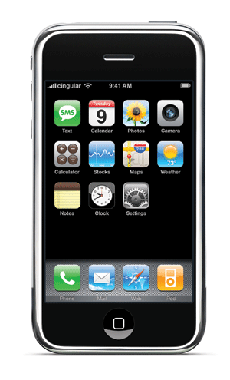
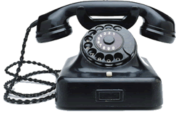

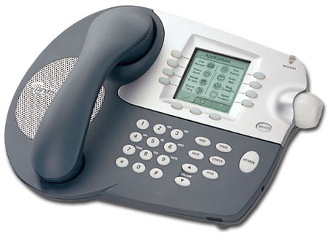
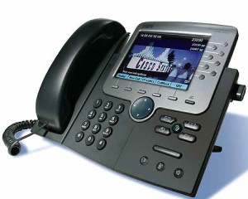
Goals: Interconnection models
cannot be modified
SS7
signaling
out-of-band
validation
Internet
textual
caller ID
lookup
CNAM
VoIP

Slide 10
Evil caller vs. man-in-the-middle
Evil caller
  spoof source identity
  currently, the dominant problem
Man-in-the-middle
  modify call signaling
    primarily, for media intercept
  copy for later replay
  more plausible on end system

Slide 11
Requirements
E.164 number source authenticity
Complete solution (but not necessarily one mechanism)
  number assignment to validation
  validate caller ID
  extended caller information (e.g., EV?)
Functionality
  must work without human intervention at caller or callee
  minimal
  must survive SBCs
  must allow partial authorized & revocable delegation
    doctor’s office
    third-party call center for airline
  must allow number portability among carriers (that sign)

Slide 12
Requirements
Privacy
  e.g., third parties cannot discover what numbers the callee has dialed recently
Efficiency
  minimal expansion of SIP headers (= suitable for UDP)
  caching of certs
Simplicity
  minimize overall complexity
  incremental deployment

Slide 13
Non-goals
Validate other identifiers
  might or might not translate (assignment hierarchy)
Cross-national
  calls from +234 codes are not a major problem (right now)
Content (media) protection or integrity
  → SRTP

Slide 14
P-Asserted-Identity (RFC 3325)
P-Asserted-Identity: "Cullen Jennings" <sip:fluffy@cisco.com>
P-Asserted-Identity: tel:+14085264000
RFC 3325 assumptions:
  originating end systems cannot alter SIP headers (or intermediate entities can be trusted to remove PAI headers)
  trusted chain of providers

Slide 15
RFC 4474 (SIP Identity)
INVITE sip:bob@biloxi.example.org SIP/2.0
Via: SIP/2.0/TLS pc33.atlanta.example.com;branch=z9hG4bKnashds8
To: Bob <sip:bob@biloxi.example.org>
From: Alice <sip:alice@atlanta.example.com>;tag=1928301774
Call-ID: a84b4c76e66710
CSeq: 314159 INVITE
Max-Forwards: 70
Date: Thu, 21 Feb 2002 13:02:03 GMT
Contact: <sip:alice@pc33.atlanta.example.com>
Identity: “KVhPKbfU/pryhVn9Yc6U=“
Identity-Info: <https://atlanta.example.com/atl.cer>;alg=rsa-sha1
Content-Type: application/sdp
Content-Length: 147
v=0
o=UserA 2890844526 2890844526 IN IP4 pc33.atlanta.example.com
s=Session SDP
…
changed by
SBC

Slide 16
Problems with RFC 4474
see rosenberg-sip-rfc4474-concerns
Cannot identify assignee of telephone number
Intermediate entity re-signs request
B2BUAs re-originate call request
  replace everything except method, From & To (if lucky)

Slide 17
VIPR concerns
draft-jennings-vipr-overview
Uses PSTN for reachability validation
  “own” number → proof of previous PSTN call (start/stop time, …)
First call via PSTN
  doesn’t deal with robocalls
  “A domain can only call a specific number over SIP, if it had previously called that exact same number over the PSTN.”
Single, worldwide P2P network
  deployment challenging
Allows impersonator to find out who called specific number

Slide 18
Changes in environment
Mobile, programmable devices
  IP connectivity
  allows (some) end system validation
Failure of public ENUM
PKI developments, e.g., DANE
B2BUA deployment
Stickiness of infrastructure
  SS7 will be with us, unchanged, for decade+
Number assignment
  certificated carriers → interconnected VoIP providers (trial)
  geographic assignment (LATA, area code) → non-geographic assignment
  1000 blocks → individual assignment?

Slide 19

Strawman “Public” PSTN database
e.g., IETF TERQ effort
Now: LIDB & CNAM, LERG, LARG, CSARG, NNAG, SRDB, SMS/800 (toll free), do-not-call, …
Future:
1 202 555 1234
HTTPS
DB
carrier code or SIP URLs
type of service (800, …)
owner
public key
…
extensible set of fields
multiple interfaces (legacy emulation)
multiple providers

Slide 20
Goal
Validate that originator of call is authorized to use From identifier
Maybe goals:
  ensure integrity of call signaling components

Slide 21
Certificate models
Integrated with assignment
  assignment of number includes certificate: “public key X is authorized to use number N”
  issued by number assignment authority, possibly with delegation chain
    allocation entity → carrier → end user
separate proof of ownership
  similar to web domain validation
  e.g., Google voice validation by automated call back
    “Enter the number you heard”
  SIP OPTIONS message response?

Slide 22
Possible goals
Short term?
  Trace call path by provider
  Update RFC 4474 (tel:, SBCs)
  Source validation for SS7 networks
Longer term
  Display name validation
  Attribute validation
  Number assignment and delegation

