Slide 1
Transitioning the PSTN to IP
        Henning Schulzrinne

Slide 2
The retirement of the circuit-switched network
What is happening and why does it matter?
What are the technical challenges we need to address?
  reliability & quality
  public safety (“911”, “112”)
  numbering & trustable identifiers
  universal service
  service stagnation → beyond voice?
  copper loops → competition, legacy services
It’s technical + economics + policy
US-centric, but similar elsewhere

Slide 3
FCC’s Technology Transition Policy Task Force
  The Task Force’s work will be guided by the insight that, technological changes do not alter the FCC’s core mission, including protecting consumers, ensuring public safety, enhancing universal service, and preserving competition.
  The Task Force will conduct a data-driven review and provide recommendations to modernize the Commission’s policies in a process that encourages continued investment and innovation in these new technologies, empowers and protects consumers, promotes competition, and ensures network resiliency and reliability.

Slide 4
Technology trials (Public Notice)
VoIP interconnection
  standards, metrics & process
NG911
  end-to-end, hand-off
Wireless “local loop” for voice (and data)
  quality, reliability, cost, …
Geographic trial
  special TDM services?
Numbering & databases
Access for people with disabilities
Copper retirement
Universal service
Notes:
http://transition.fcc.gov/Daily_Releases/Daily_Business/2013/db0510/DA-13-1016A1.pdf

Slide 5
The three transitions
From |  | to | motivation | issues
Copper | → | fiber | capacity maintenance cost | competition (“unbundled network elements”)
Wired | → | wireless | mobility cost in rural areas | capacity quality
Circuits | → | packets (IP) | flexibility cost per bit | line power
VoIP, VoLTE

Slide 6
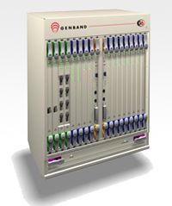
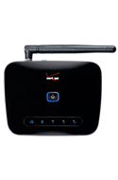
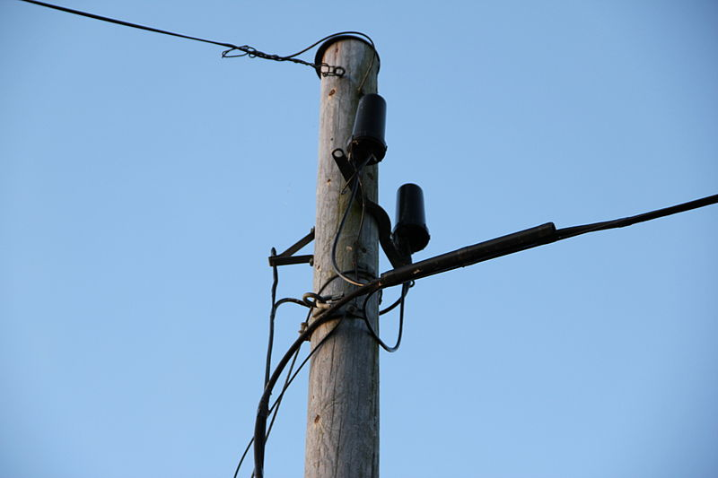
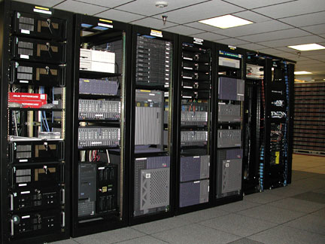

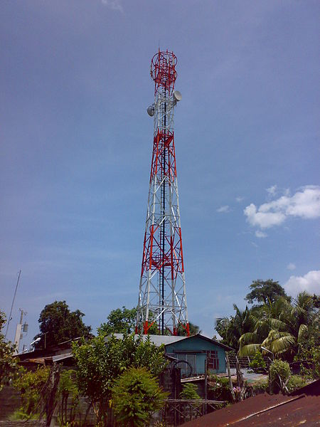
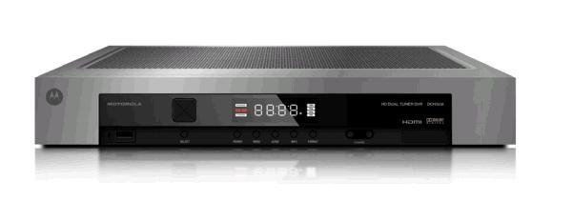
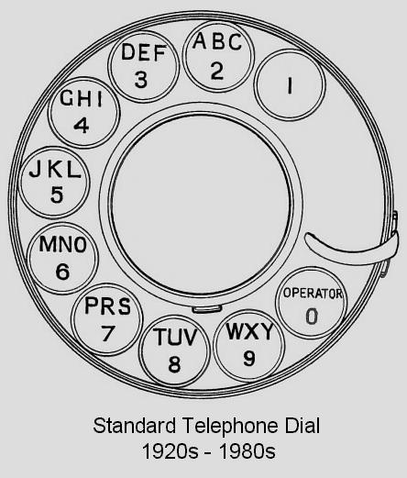
When?
no single transition date!
2013
switching
(core)
TDM
VoIP
“wireless network is 99% wired”
fixed 4G
access
E.164
numbering
human-visible
hidden

Slide 7
The transition of the PSTN
User behavior changes
  more text, less voice
  video conferencing for personal & business use (telepresence)
  landline → mobile
  OTT VoIP (for international calls)
Core network technology changes
  IMS
  SIP trunking
Access and end system changes
  large PBX all VoIP
  voice as app
  WebRTC

Slide 8
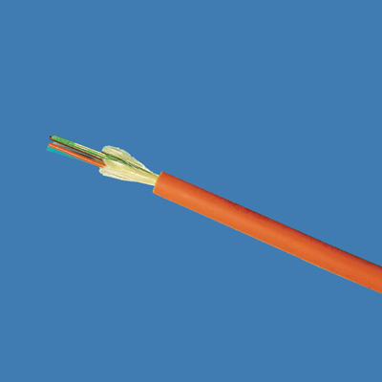
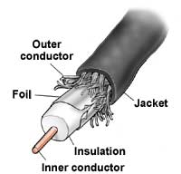
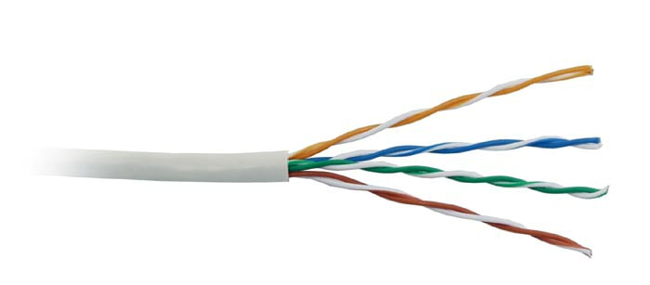

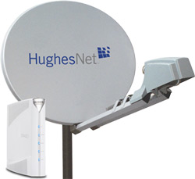
Available access speeds
common now – future capability
100 Mb/s+
10 Gb/s
20 Mb/s
marginal VOIP
1 Gb/s
5 Mb/s
10 Mb/s
2 Mb/s
1 Mb/s
avg. sustained
throughput
18%
80%
95%
97%
100%
99% by 2023?
of households

Slide 9
Interstate switched access minutes

Slide 10
Access transitions (US)
networks go hybrid:
4G
unlicensed
wireless
⊕
fiber
copper
coax
last 500-3000 ft

Slide 11
Lines are disappearing, but maintenance costs are constant
JSI Capital Advisors projection
voice only
(DSL: 20 M)
per-line monthly
maintenance
cost
$2.72
$17.57
voice revenue/line: $50
dis
Notes:
See http://jsicapitaladvisors.com/the-ilec-advisor/2011/10/20/communications-industry-forecast-2011-2020-ilec-and-clec-acc.html
See also NRRI Report 12-12, Oct. 2012

Slide 12
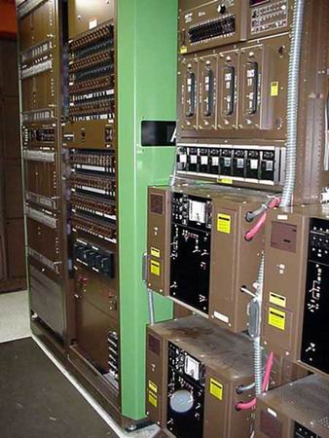
Switches are ageing
1979
Nortel DMS-100
http://www.phworld.org/switch/ntess.htm

Slide 13
What are some of the “keeper” attributes?
Universality
  reachability → global numbering & interconnection
  media → HD audio, video, text
  availability → universal service regardless of
    geography
    income
    disability
  affordability → service competition + affordable standalone broadband
Public safety
  citizen-to-authority: emergency services (911)
  authority-to-citizen: alerting
  law enforcement
  survivable (facilities redundancy, power outages)
Quality
  media (voice + …) quality
  assured identity: telephone numbers
  assured privacy (CPNI)
  accountable reliability
initial list – not exhaustive

Slide 14
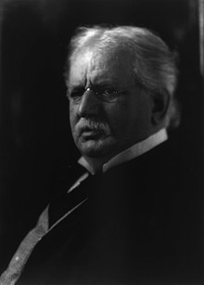
Universal service
One Policy, One System, Universal Service
For the purpose of regulating interstate and foreign commerce in communication by wire and radio so as to make available, so far as possible, to all the people of the United States, without discrimination on the basis of race, color, religion, national origin, or sex, a rapid, efficient, Nation-wide, and world-wide wire and radio communication service with adequate facilities at reasonable charges, for the purpose of the national defense, for the purpose of promoting safety of life and property through the use of wire and radio communications, … (47 USC § 151, 1934)
T. Vail
(1907)
Eligible Telecommunications Carriers
Carrier of Last Resort (COLR)
Universal Service Fund

Slide 15
Numbers: Disappearance of the old constraints

Slide 16
Communication identifiers
Property | URL owned | URL provider | E.164 | Service-specific
Example | alice@smith.name sip:alice@smith.name | alice@gmail.com sip:alice@ilec.com | +1 202 555 1010 | www.facebook.com/alice.example
Protocol-independent | no | no | yes | yes
Multimedia | yes | yes | maybe (VRS) | maybe
Portable | yes | no | somewhat | no
Groups | yes | yes | bridge number | not generally
Trademark issues | yes | unlikely | unlikely | possible
Privacy | Depends on name chosen (pseudonym) | Depends on naming scheme | mostly | Depends on provider “real name” policy
Notes:
http://findmyfacebookid.com

Slide 17
It’s just a number
Number | Type | Problem
201 555 1212 | E.164 | same-geographic different dial plans (1/no 1, area code or not) text may or may not work
#250, #77, *677 | voice short code | mobile only, but not all no SMS
12345 | SMS short code | SMS only unclear where (country?) it works
211, 311, 411, 911 | N11 codes | Distinct call routing mechanism Mostly voice-only May not work for VoIP or VRS
800, 855, 866, 877, 888 | toll free | not toll free for cell phone may not work internationally
900 | premium | voice only unpredictable cost

Slide 18
Numbers vs. DNS & IP addresses
 | Phone # | DNS | IP address
Role | identifier + locator | identifier | locator (+ identifier)
Country-specific | mostly | optional | no
# of devices / name | 1 (except Google Voice) | any | 1 (interface)
# names /device | 1 for mobile | any | any
controlled by | carrier, but portability unclear (800#) and geo. limited | any entity, with trademark restrictions | any entity (ISP, organization)
who can obtain? | geographically-constrained, currently carrier only | varies (e.g., .edu & .mil, vs. .de) | enterprise, carrier
porting | complex, often manual; wireless-to-wireline may not work | about one hour (DNS cache) | if entity has been assigned PIAs
delegation | companies (number range) | anybody | subnets
identity information | carrier (OCN), billing name only → LERG, LIDB | WHOIS data (unverified) | RPKI, whois
Notes:
http://www.nanpa.com/reports/faq.html#g1

Slide 19
Number usage
FCC 12-46

Slide 20
Area codes (NPAs)
634

Slide 21
FCC “Numbering” order April 2013
NPRM: allow interconnected VoIP providers to obtain numbers
R&O: waiver petitioners can get small pool of numbers directly from NANPA or PA
NOI: geographic assignment of numbers still relevant?
Doesn’t directly address databases
Notes:
http://transition.fcc.gov/Daily_Releases/Daily_Business/2013/db0418/FCC-13-51A1.pdf

Slide 22

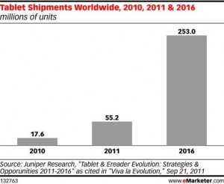

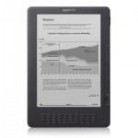
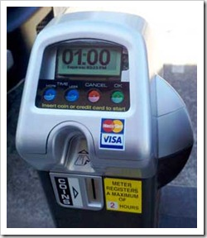

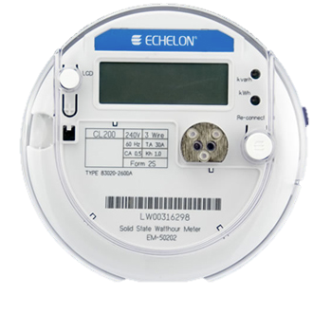
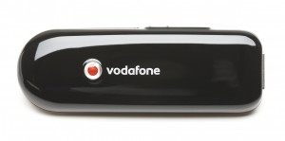
Phone numbers for machines?
< 2010
212 555 1212
500 123 4567
(and geographic numbers)
12% of adults
500 123 4567
533, 544
5 mio.
311,000
64 mio.
now: one 5XX code a year…
(8M numbers)
10 billion available
see Tom McGarry, Neustar
Notes:
http://blog.neustar.biz/neustar-insights/telephone-numbers-are-for-people-not-machines/
http://www.parking.org/media/overview-of-the-us-parking-industry.aspx
http://www.statisticbrain.com/e-reader-statistics/
http://www.ite.org/reportcard/TechnicalReport.pdf

Slide 23


Future numbers
Should numbers be treated as names?
  see “Identifier-Locator split”
  “multi-homing”
Should numbers have a geographic component?
  Is this part of a region’s cultural identity?

Slide 24
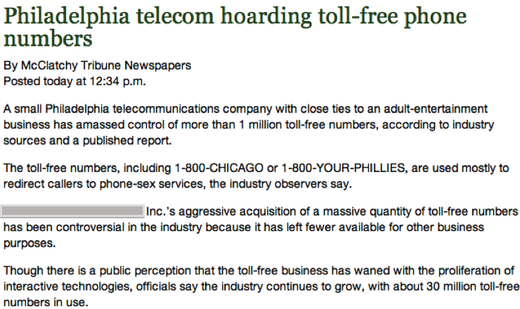
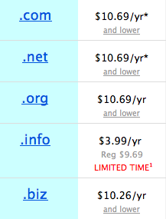
Phone numbers: hoarding
How to prevent hoarding?
  By pricing
    DNS-like prices ($6.69 - $10.69/year for .com)
      takes $100M to buy up (212)…
      1626: 60 guilders
    e.g., USF contribution proposals
      $8B/year, 750 M numbers → $10.60/year
      but significant trade-offs
  By demonstrated need
    see IP address assignment
    1k blocks
    difficult to scale to individuals
15c/month
100 million .COM
Notes:
Manhattan purchase Peter Minuit

Slide 25

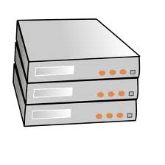

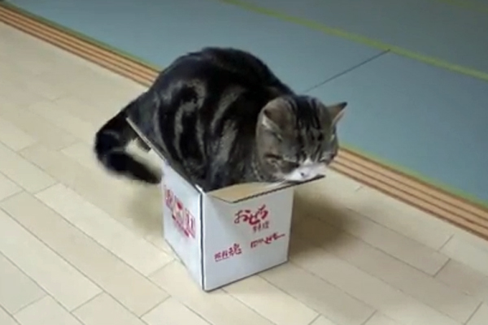
Internet identifier management: Domain name registration
$0.18/year
.edu registry
+ registrar
.gov registry
+ registrar
.com registry
.net registry
$7.85/year
$5.11/year
registrar
registrar
web hosting
registrar
DNS hosting
$10-$15/year

Slide 26
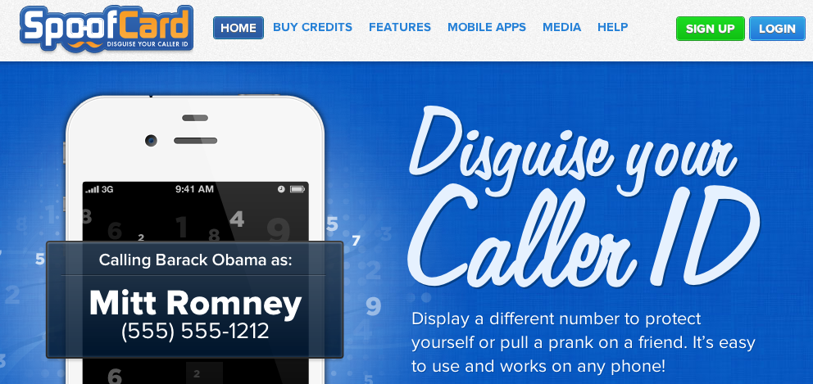
Caller ID spoofing
Easily available on (SIP) trunks – can be legitimate
Used for vishing, robocalling, swatting, anonymity breaking, …
Caller ID Act of 2009: Prohibit any person or entity from transmitting misleading or inaccurate caller ID information with the intent to defraud, cause harm, or wrongfully obtain anything of value.
Also: phantom traffic rules

Slide 27
Caller ID spoofing
A. Panagia, AT&T
enhances theft and sale of customer information through pretexting
harass and intimidate (bomb threats, disconnecting services)
enables identity theft and theft of services
compromises and can give access to voice mail boxes
can result in free calls over toll free dial-around services
facilitates identification of the name (CNAM) for unlisted numbers
activate stolen credit cards
causes incorrect billing because the jurisdiction is incorrect
impairs assistance to law enforcement in criminal and anti-terrorist investigations
FCC rules address caller ID spoofing, but enforcement challenging

Slide 28
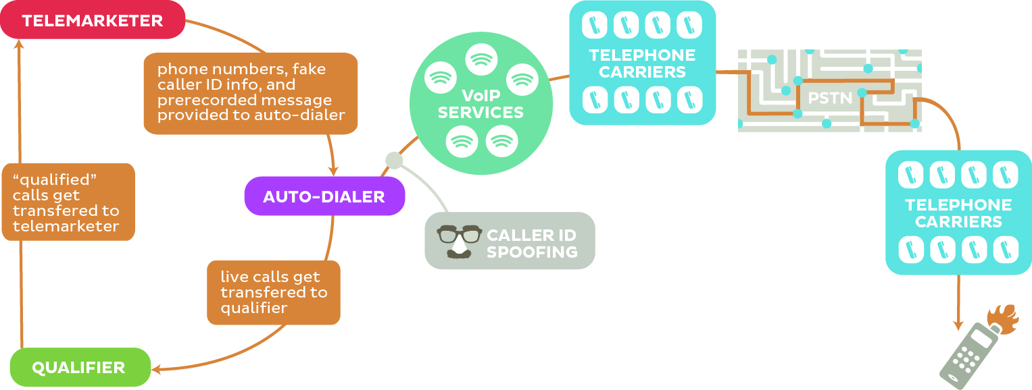
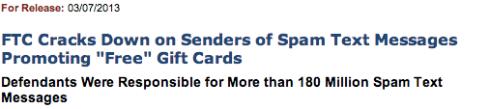
Robocalling
“pink carriers”

Slide 29
Security (trustworthiness)
Practically, mostly about identity, not content
Old model: “trust us, we’re the phone company”
Need cryptographically-verifiable information
  Is the caller authorized to use this number?
    not necessarily “ownership”
    RFC 4474 (SIP identity) doesn’t deal (well) with phone numbers
    Must also support SS7 transport
  Has the caller ID name been verified?
    cf. TLS

Slide 30
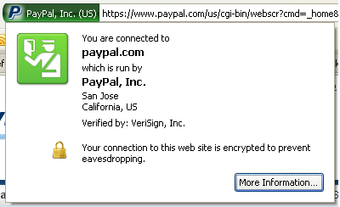
Who assures identity?
Web:
  plain-text → rely on DNS, path integrity
    requires on-path intercept
  X.509 certificate: email ownership
    no attributes
  EV (“green”) certificate
PSTN
  caller ID
  display name: CNAM database, based on caller ID
Notes:
http://www.cnamcallerid.com
https://www.opencnam.com
Truth in Caller ID Act of 2009

Slide 31


Strawman “Public” PSTN database
e.g., IETF TERQ effort
Now: LIDB & CNAM, LERG, LARG, CSARG, NNAG, SRDB, SMS/800 (toll free), do-not-call, …
Future:
1 202 555 1234
HTTPS
DB
carrier code or SIP URLs
type of service (800, …)
owner
public key
…
extensible set of fields
multiple interfaces (legacy emulation)
multiple providers

Slide 32
VoIP interconnection, public safety, universal access

Slide 33
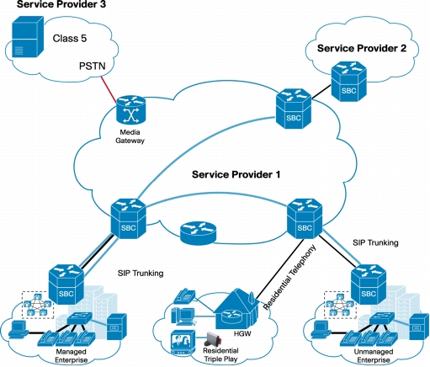
VoIP Interconnection
“VoIP interconnection” ≠ IP peering
Are there technical stumbling blocks?
  SIP features?
  Media codecs & conversion?
Separation application layer & transport
$0.001 / minute for IP transport ($0.10/GB) → location not relevant
Cisco
Notes:
http://www.cisco.com/en/US/prod/collateral/routers/ps9343/data_sheet_c78-491738.html

Slide 34
Interconnection
PSTN: general interconnection duty
  requires physical TDM trunks and switch ports
VoIP:
  VPN-like arrangements
  MPLS
  general Internet
  may require fewer points-of-interconnect
  only relatively small number of IXPs
  transition to symmetric billing (cellular minutes, flat-rate) rather than caller-pays

Slide 35
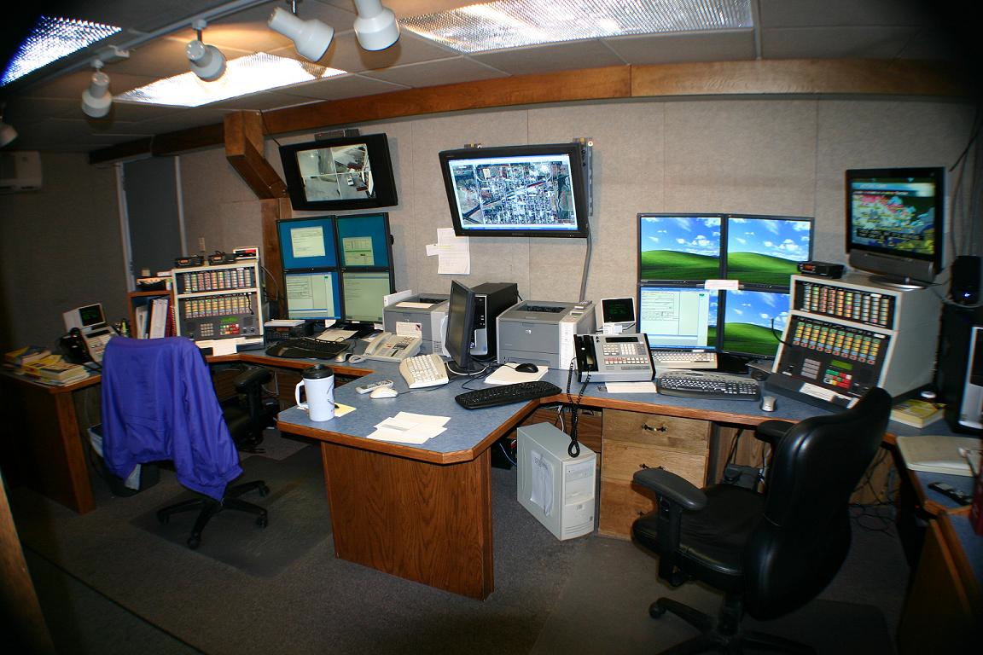
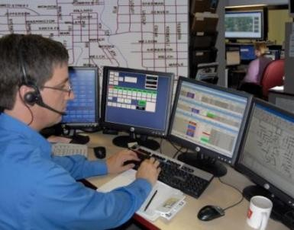
Public Safety (NG911 & NG112)
Transition to NG911 & NG112 underway
  NGxxx = all-IP (SIP + RTP) emergency calling
Key issues:
  Indoor location for wireless
    location accuracy of 50/150m may not be sufficient
    need apartment-level accuracy, including floor
    civic (Apt. #800, 1050 N. Stuart), not geo
    beacon-based technology unlikely to suffice
  Cost, scaling and transition
Notes:
Pictures: http://www.ksapco.net/psaps

Slide 36
More than point-to-point voice
VoIP = Voice + Video + Vords (text)
  → Real-time communication as base-level service?
Accommodate new media codecs (e.g., AMR)
See also “advanced communication systems” in U.S. Communications and Video Accessibility Act (CVAA)
Just point-to-point? or multipoint?
Services beyond call forwarding → web API model
  e.g., for robocall prevention

Slide 37


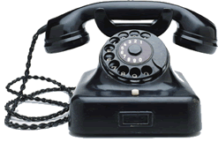
Video relay service (VRS) reform
Serves about 125k-200k people who use sign language
CAs
access platform
SIP + RTP
neutral video communications
service provider

Slide 38
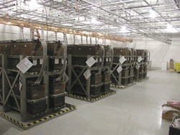
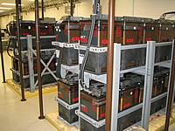
Reliability
5 nines → 5 minutes/year unavailable
How do we measure reliability & QoS?
  E.g., FCC Measuring Broadband America project?
  → IETF LMAP
Can we improve power robustness?
  Circuit-switched: -48V @ 20-50 mA (~ 1 W)
  e.g., DOCSIS modem consumes ~7W (idle)
  Li-Ion battery = 2.5 Wh/$ ➔ 3$/hour of standby time
Can we simplify multihoming to make new PSTN more reliable than old?
  e.g., cable + 4G

Slide 39
QoS measurements

Slide 40
FCC measurement history
FCC has acquired and analyze data on legacy PSTN
More recent and evolving broadband interest
  Section 706 of 1996 Telecommunications Act ➔ annual report on availability of advanced telecommunications services to all Americans
    Resulted in information on deployment of broadband technology (“Form 477”)
    but not its performance
  FCC’s National Broadband Plan – March 2010
    Proposed performance measurements of broadband services delivered to consumer households
    Work plan evolved from recommendations of National Broadband Plan

Slide 41


The role of network measurements
Measurement infrastructure
ISP diagnostics
“my Interwebs are just beach balls”
User diagnostics & validation
hard failures → soft failures
Public policy
BB evolution?
Informed consumer choice
Universal service

Slide 42
Principles
The FCC Measuring Broadband America program is based on principles of openness, transparency and partnership with diverse stakeholders.
We are committed to:
  Ensuring that commonly accepted principles of scientific research, good engineering practices, and transparency guide the program;
  Encouraging collaboration of industry, academia and government;
  Publishing the comprehensive technical methodology used to collect the data, including the source code for the tests as open source;
  Releasing data used to produce each report coincident with the report’s release, and releasing all data for each collection cycle within one year of collection.

Slide 43

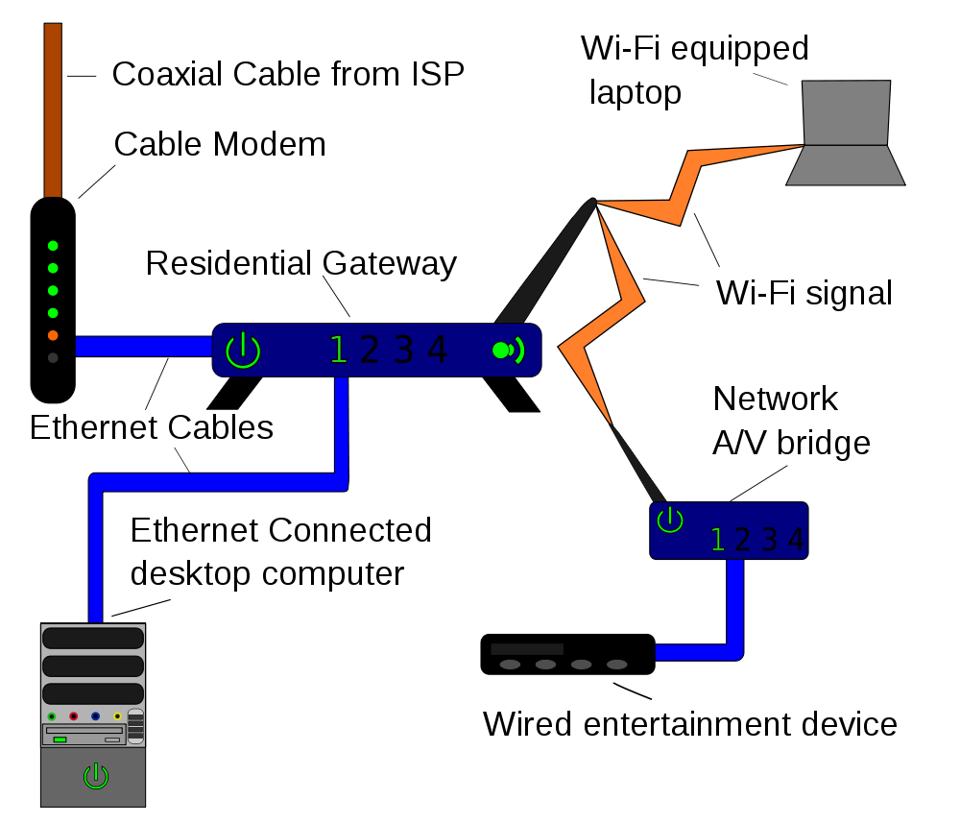
Measurement architecture
broadband Internet
access provider (ISP)
backbone
ISP
Measuring Broadband America 2011 & 2012
Measuring Broadband America future?
Lucid
Notes:
http://commons.wikimedia.org/wiki/File:Homenet.svg

Slide 44
The MBA project - logistics
Enlisted cooperation:
  13 ISPs covering 86% of US population
  vendors, trade groups, universities and consumer groups
Reached agreement reached on what to measure and how to measure it
Enrolled roughly 9,000 consumers as participants
  6,800 (7,782) active during March 2011 (April 2012)
  A total of 9,000 active over the data collection period

Slide 45
What was measured
Sustained Download | Burst Download
Sustained Upload | Burst Upload
Web Browsing Download | UDP Latency
UDP Packet Loss | Video Streaming Measure
VoIP Measure | DNS Resolution
DNS Failures | ICMP Latency
ICMP Packet Loss | Latency Under Load
Total Bytes Downloaded | Total Bytes Uploaded

Slide 46
What was released
Measuring Broadband America reports
  Main section describing conclusions and major results
  Technical appendix describing tests and survey methodology
Spreadsheet providing standard statistical measures of all tests for all ISPs and speed tiers measured
Report period data set with 4B data elements from over 100M tests
  Data set presented as used with anomalies removed
  Documentation provided on how data set was processed
  All data, as recorded
Geocoded data on test points recently released
Information available at http://www.fcc.gov/measuring-broadband-america

Slide 47
2011: Most ISPs deliver close to advertised during peak hours

Slide 48
2012: You improve what you measure…

Slide 49
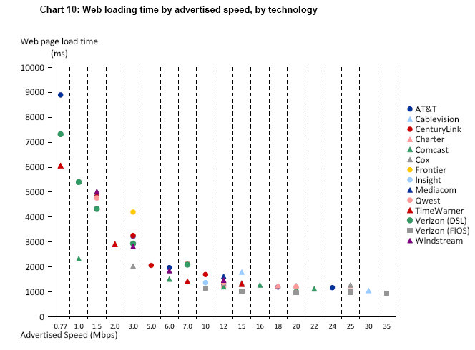
Web page downloading

Slide 50
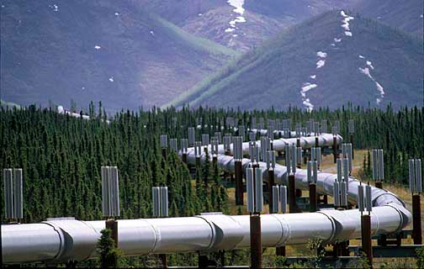
The Internet is not a series of (fixed-width) tubes
Some cable companies advertise burst speed
  Quota based technique providing temporary speed increase of < 15 seconds
    Also affected by other household activity
  Can’t be applied generally to DSL where sync rate often limiting factor
  Marginal value to fiber where each subscriber has potentially available 37 Mb/s to 75 Mb/s provisioned bandwidth
  → Links are no longer constant-size bit pipes
Measured both burst and sustained speed

Slide 51
Conclusion
Three simultaneous technology transitions:
  copper → fiber, wired → wireless, circuit → packet
But no cut-over date
Need to “grow up” quickly
  no more second network for reporting & fixing things
  universal service → Internet access for everyone
  single network → suitable for demanding services
  life-and-safety network
  measure all aspects of performance

