Slide 1
Machine-TO-MACHINE or the INTERNET of THINGS
Henning Schulzrinne
FCC & Columbia University
with slides from Harish Viswanathan, Alcatel-Lucent

Slide 2
Overview
M2M: more than cellular or unlicensed
Technical challenges for M2M
Spectrum – the lifeblood of M2M
Columbia U. research examples:
  SECE: unifying diverse networks into a user-programmable system
  EnHANTS: environment-powered nodes

Slide 3
Key enablers
IoT
Cheap SOCs
Mature Internet protocols
Cellular connectivity
Unlicensed
Analytics
(“big data”)
Applications

Slide 4
M2M is not…
does not always uses cellular networks
is not always energy-constrained
is not always cost-constrained
only uses puny microcontrollers
is not always run by large organizations
  many small & mid-sized providers
  usually embedded into other products

Slide 5
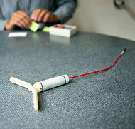
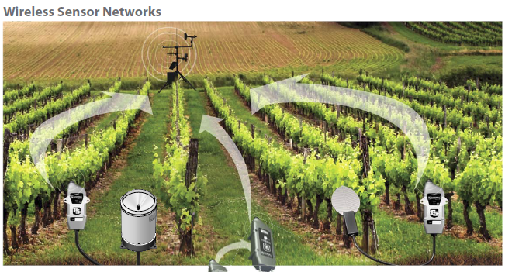
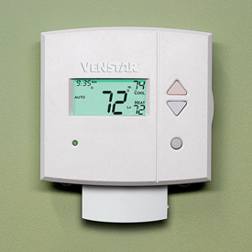
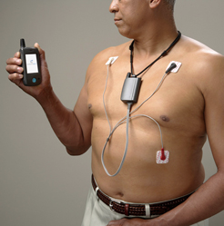
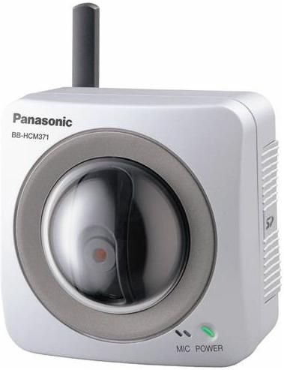
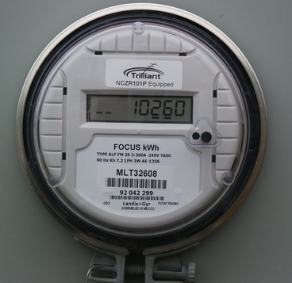
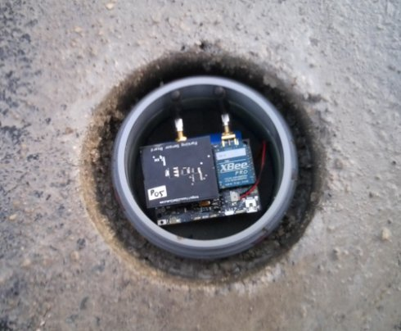

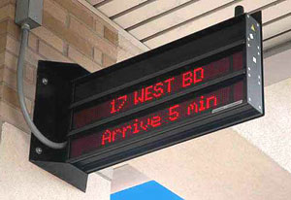
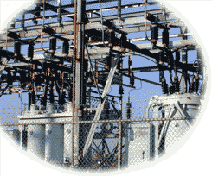
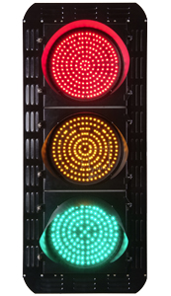
M2M varies in communication needs
sensors
1/hour
1/minute
1/second
10/second
actuators
Notes:
http://www.nytimes.com/2012/10/02/world/europe/device-sends-message-to-swiss-farmer-when-cow-is-in-heat.html?pagewanted=all

Slide 6

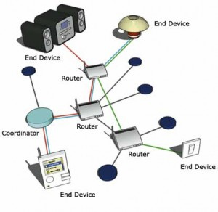

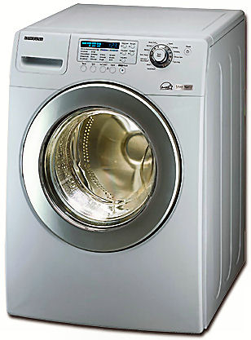
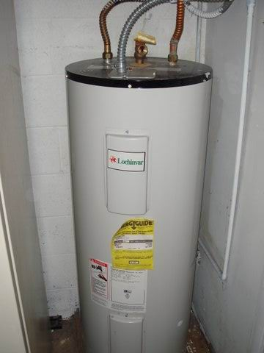
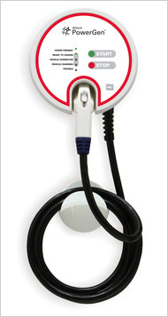
Not just cellular or unlicensed

Slide 7
Technical challenges
Application
secure upgrades
software quality
XML
SensorML
Zigbee profile
HTTP,
CoAP,
SIP,
XMPP
Session, control
event notification (pub/sub)?
common abstractions?
firewalls & NATs
UDP
TCP
SCTP
Transport
reliability
complexity (SCTP)
IPv4,
IPv6
6LowPAN
ROLL
Network
IPv4 address exhaustion
security?
resource control
802.15.4
802.11
GSM
LTE
PHY & L2
E.164 numbers
signaling load
authentication
radio diversity

Slide 8
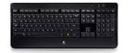
Network challenges
Unlicensed
  How do I attach and authenticate a device to a (home) network?
  Credentials?
Licensed
  Reliability → multiple simultaneous providers
  Mobility → different providers in different regions
  Charging → often low, intermittent usage, sometimes deferrable (“Whispernet”)
    From $50/device/month → < $1/month?
Authentication
  Which devices can be used by whom and how?
    “Any employee can monitor the room temperature in any public space, but only Facilities staff can change it”

Slide 9
Signaling increases 30-50% faster than data
Data Plane
Isolate M2M traffic from regular traffic
Flexible scaling requirements because of bulk contracts
Signaling traffic management
Low Power, short payloads, bursty traffic
Low cost but also low performance requirements
In network monitoring
< 1% of data plane capacity is consumed by M2M but more than 30% of signaling capacity is consumed
Control Plane
33 %
M2M traffic modeling shows disproportionately large signaling
5 %
Cellular capacity
M2M peak (hourly) traffic
Harish Viswanathan, Alcatel-Lucent, 2012
Notes:
**

Slide 10
FCC TAC preliminary recommendations
R1: Additional M2M unlicensed band (1.2 – 1.4, 2.7 – 3.1 GHz)
R2: M2M service registration
R3: Numbering and addressing plan
  IPv4 → IPv6
R4: M2M center-of-excellence at FCC
R5: Certification lite
R6: 2G sunset roadmap
  2G re-farming, security issues → LTE with IPv6
R7: Encourage 3G/4G module building

Slide 11
Recommendation 3: Create a numbering and addressing plan
Situation
  Currently there are tens of millions of devices latched onto 2G networks with IPv4 addresses in place. As IPv4 approaches depletion, the M2M ecosystem will be looking for a solution for a new addressing schemes for the millions of additional devices scheduled to hit the market.
Complication
  A solution is required soon before Carriers decide on their own proprietary solution making it even more complicated for M2M devices to be introduced in the market and have broad acceptance across carriers.
Recommendation
  Develop an IPv6 migration path for the near, medium, and long term to meet requirements for M2M fixed and mobile applications (On-Net, Off-Net (i.e. Roaming).
Complexity to Implement
  Medium Term
Notes:
OECD report – “Connecting Billions of Devices” states that there are currently anywhere between 80 to 100 million devices connected and projected 190m more devices by 2015.
Comments from Kevin:
Recommendation 3 (numbering and address plan) - Certainly agree with this one. One potential correction - the number of 2G GSM M2M devices in the US is pegged by ABI at 21M (out of 38M total), so unless there are other good sources with higher numbers, it might be more accurate to say "… tens of millions of devices latched on to 2G networks …"
To tie back to the discussion on Recommendation 6 - an interesting data point to consider - for each $B needed to support a dedicated 2G network each year (I don't know how many $B's would be needed per year), the 20M+ 2G GSM M2M endpoints would need to cover $45-50. Gives pause.
My apologies, again, for the late comments. I’m glad to discuss any of this on our 4ET call today.

Slide 12
Recommendation 6: Create a 2G sunset roadmap for migration to 3G / 4G
Situation
  National carriers have announced that they will be shutting down 2G existing wireless networks in the coming years. Some will be shut down as soon as 2016.
Complication
  Since there are tens of millions of 2G devices connected to these networks, existing devices will be forced to upgrade to 3G/4G modules. This will have a significant impact on the ROI for device manufactures who will be required to upgrade current device set. For many M2M players the 2G module prices have finally hit a point where they are seeing ROI (~$20.00 per module). The module prices for 3G/4G prices are double and quadruple (~$40.00 to ~$80.00) in some cases.
Recommendation
  Create a 2G roadmap for transitioning from 2G to 3G/4G. This will allow current M2M 2G device OEMs to plan accordingly.
  FCC recommended window of time supporting legacy 2G infrastructure with migration guidance to LTE with IPv6 addressing. The desired result being to return spectrum while upgrading infrastructure, eliminating legacy.
Complexity to Implement
  Medium Term

Slide 13
cellular = about 500 MHz in total

Slide 14

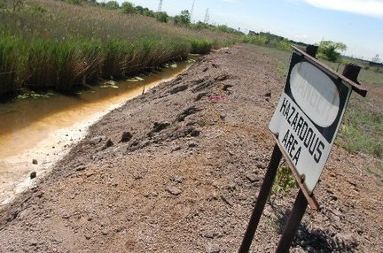
From beachfront spectrum to brownfield spectrum
no interference!
guard bands!

Slide 15
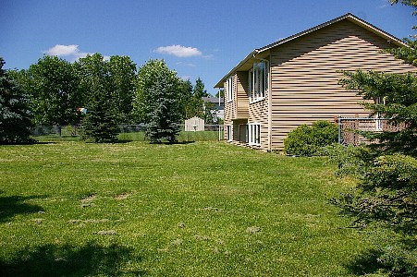
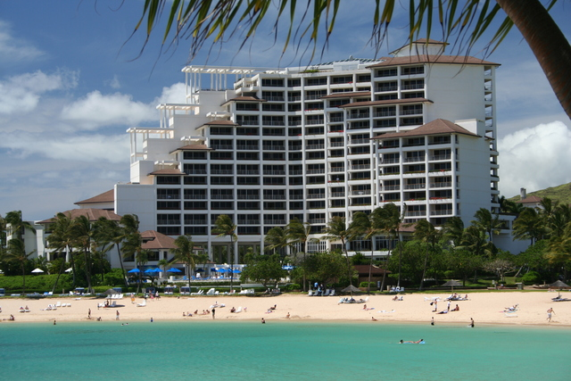
From empty back yard to time share condo
high tower, high power
2G
small cells
4G
DSA

Slide 16
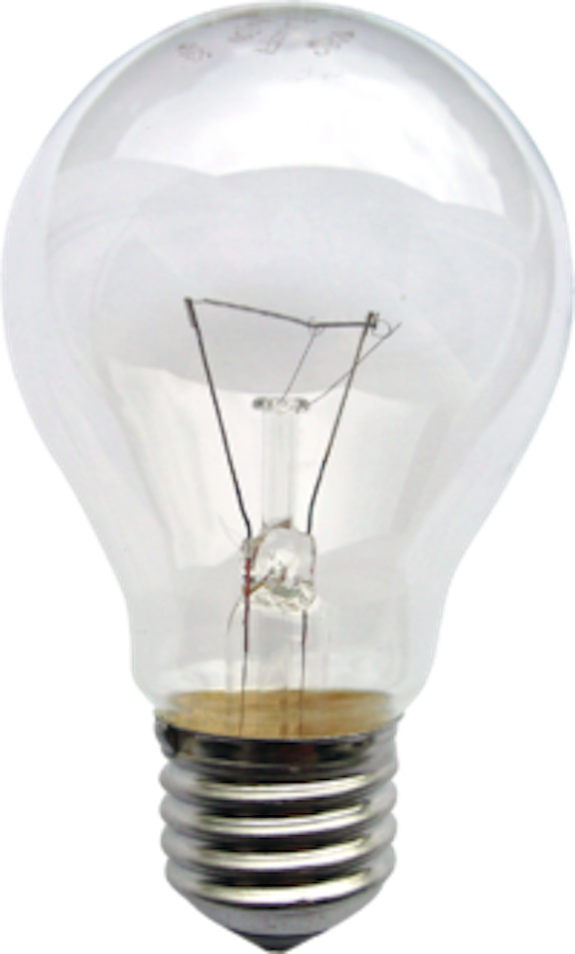
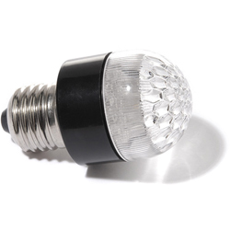
Don’t be a resource hog!
2 G spectrum waste
  0.17 b/s/Hz vs. >= 2 b/s/Hz for 4G
E.164 numbering
  500 numbers (PCS)
  one new area code a year!
Shared & scarce public resources

Slide 17
Spectral efficiency
b/s/Hz: modulation, FEC, MIMO, …
but also total spectral efficiency
  guard bands
  restrictions on adjacent channel usage
  “high power, high tower” → small cells → higher b/s/Hz
data efficiency
  e.g., H.264 is twice as good as MPEG-2/ATSC
  and H.265 twice as good as H.264
distribution efficiency
  unicast vs. multicast
protocol efficiency
  avoid polling → need server mode
mode efficiency
  caching
  side loading
  pre-loading

Slide 18
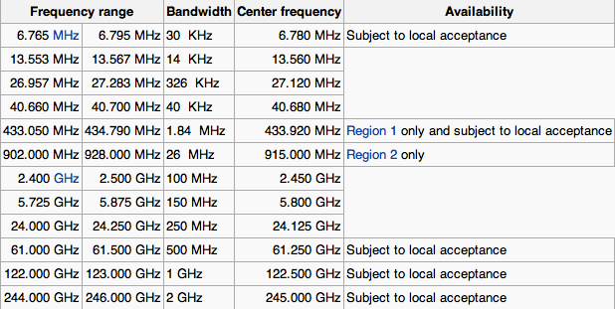
Current unlicensed spectrum
+ TV white spaces (in 476-692 MHz range) – availability varies

Slide 19
FCC actions for (M2M) spectrum
More than 300 MHz of additional spectrum in pipeline
Encourage unlicensed & lightly-licensed spectrum
  TV white spaces (600 MHz) → geographical databases
  3.5 GHz “small cells” (3550-3700 MHz), 200 mW (1 W EIRP)
  4.9 GHz (20 dBm/MHz)
  incentive auction guard bands as new unlicensed UHF spectrum (600 MHz)
Experimental licensing revision
Medical body area networks: 2360 – 2400 MHz
Notes:
http://transition.fcc.gov/Daily_Releases/Daily_Business/2012/db1219/FCC-12-148A1.pdf

Slide 20

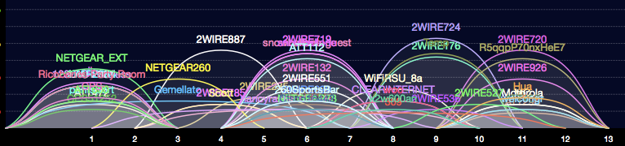
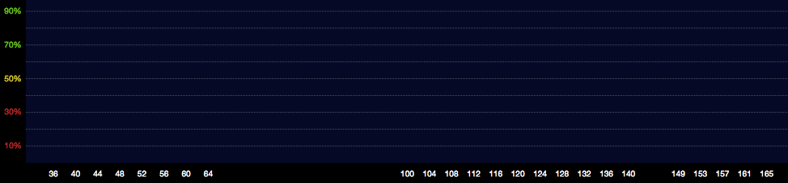
2.4 vs. 5.8 GHz

Slide 21


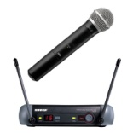

TV white spaces
TV channels are “allotted” to cities to serve the local area
Other licensed and unlicensed services are also in TV bands
“White Spaces” are the channels that are “unused” at any
given location by licensed devices
2
4
Non-
Broadcast
spectrum
5
7
9
White
Space
Low
Power TV
Wireless
Microphones
New York City
Full Power
TV Stations
Etc.
Only for illustrative purposes
3
Non-
Broadcast
spectrum
6
8
10
White
Space
White
Space
White
Space
Low
Power TV
Wireless
Microphones
Philadelphia
Full Power
TV Stations
Etc.

Slide 22
Freeing spectrum: incentive auctions
Incentive auctions will share auction proceeds with the current occupant to motivate voluntary relocation of incumbents
  Otherwise, no incentive for current occupant to give back spectrum
  Stations keep current channel numbers
    via DTV map
Adjacent Channel
Interference
TV
TV
BB
TV
BB
TV
Without Realignment:
Reduced Broadband Bandwidth
Adjacent Channel
Interference
TV
TV
TV
TV
BB
With Realignment: Accommodates Increased Broadband Bandwidth

Slide 23
Spectrum tool kit
licensed
“lite”
sensing
(auctioned)
license
DSA: geo database
unlicensed
mandated sharing
unlicensed
wide-area
coverage
WISPs (rural)
in-building
in-room

Slide 24
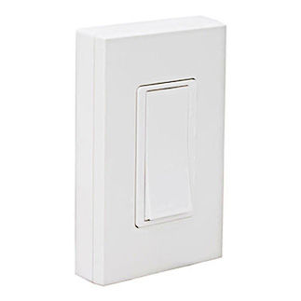
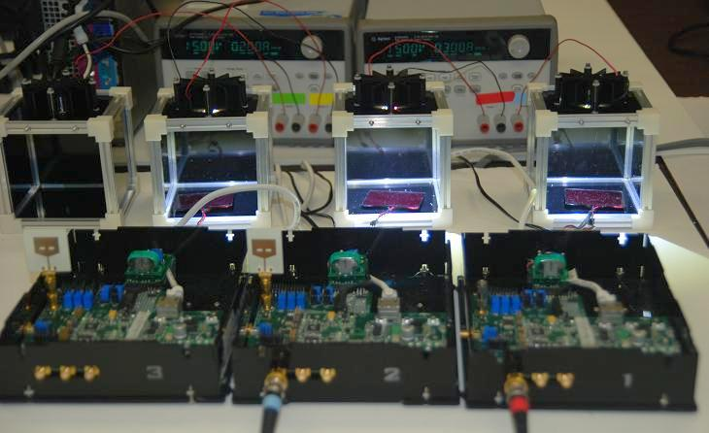
Extreme M2M: self-powered devices
Leviton WSS0S - Remote Switch
EnHANT project (Columbia U.)
indoor lighting → 10 kb/s

Slide 25
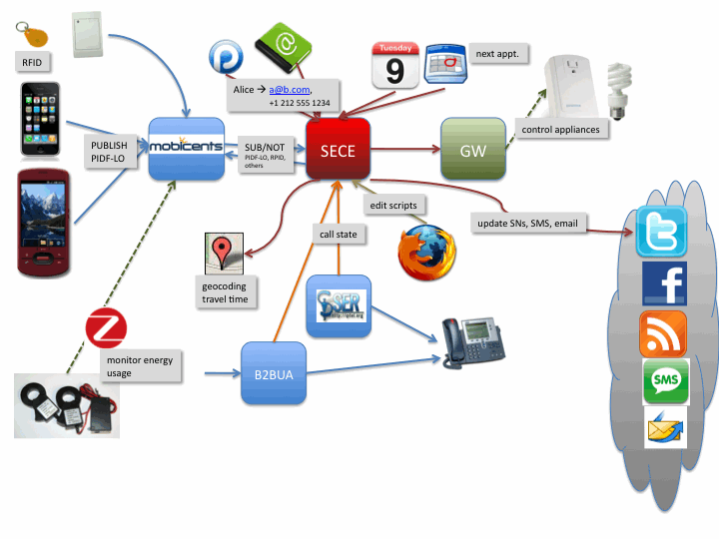
Example: SECE (Sense Everything, Control Everything)
Web-based user interface
Rules in domain specific language
Interface to online services
Interface to communication devices
Sensor and actuator infrastructure

Slide 26
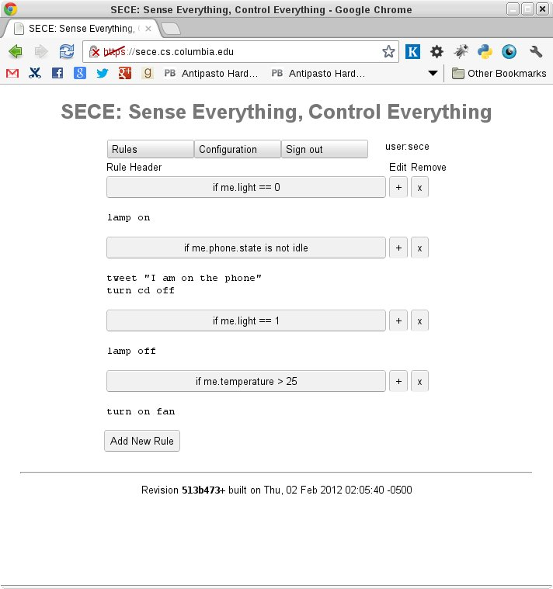
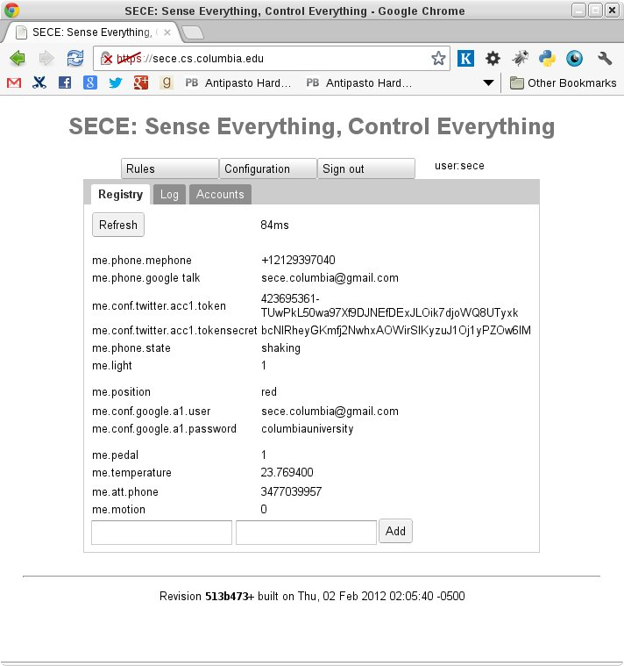
SECE User Interface

Slide 27
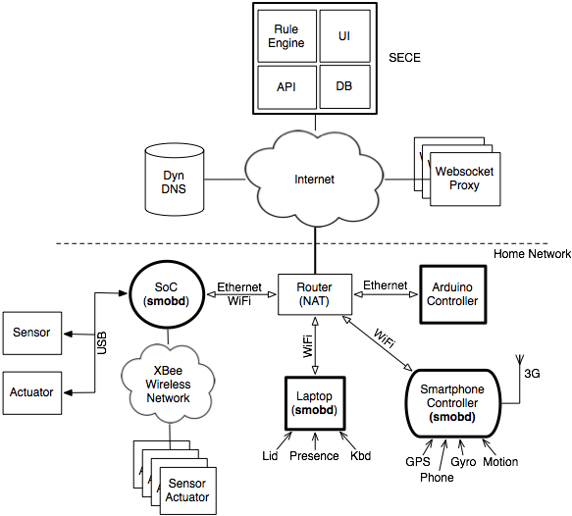
Infrastructure for Sensors and Actuators
Conventional Devices
USB (Phidgets)
Wireless (XBee)
Tiny (Arduino)
Communication
VoIP phone
Skype
Legacy (X10)

Slide 28
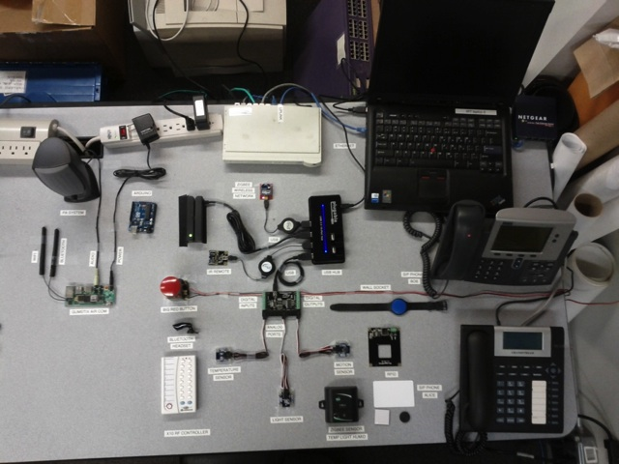
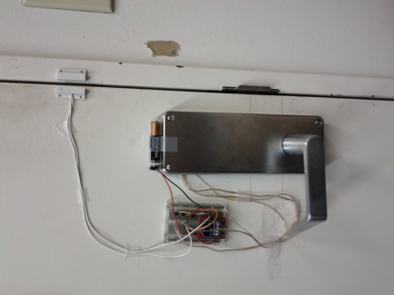
Sensors and Actuators in IRT lab
What it really looks like
Sensor and actuator testbed
XBee door lock

Slide 29
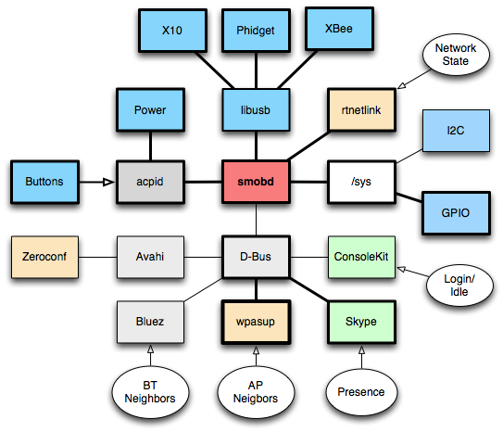
smobd: Subsystems & Interfaces on Linux

Slide 30
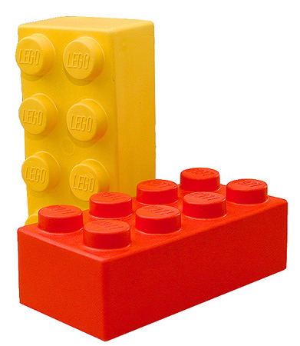
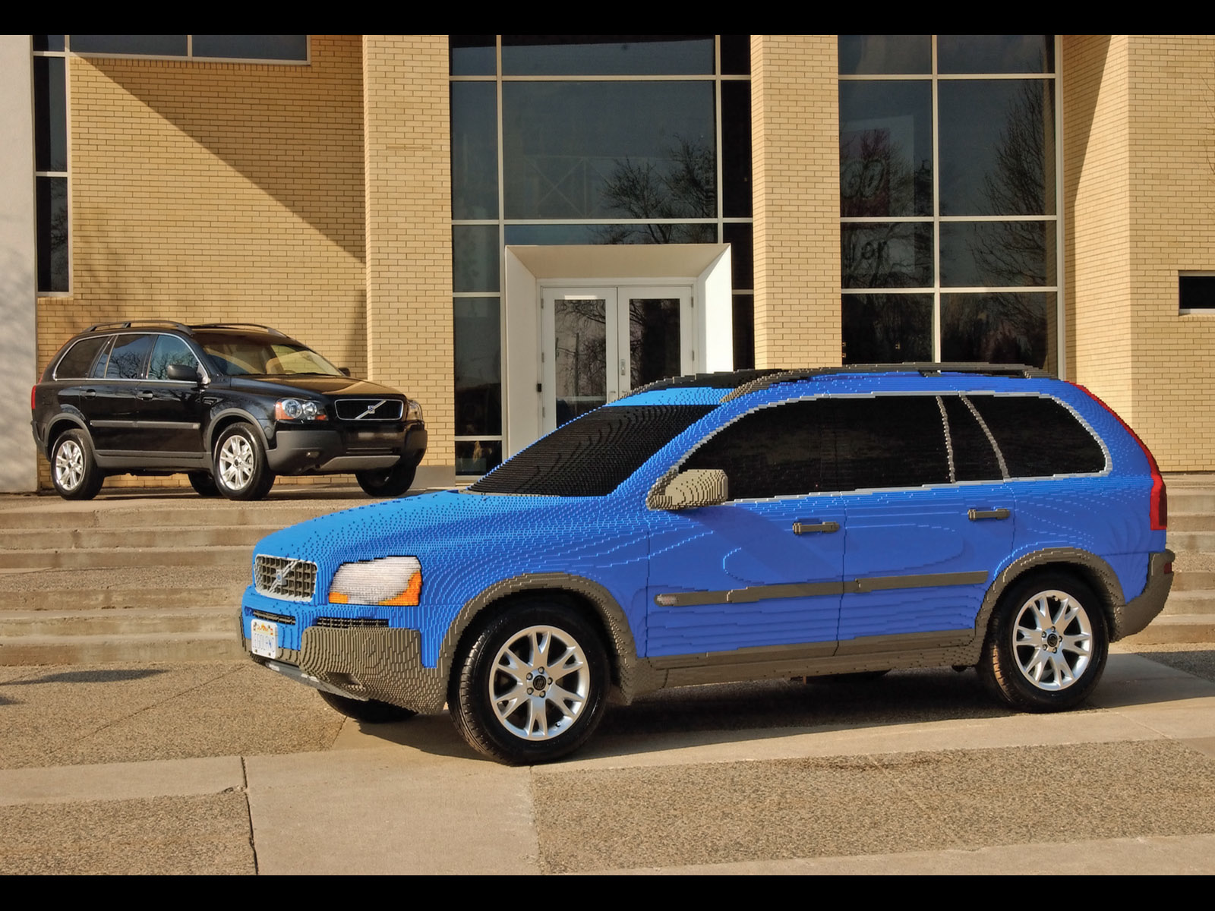
Conclusion
M2M is not a single technology → technology enabler
Build on secret of Internet: simple protocol building blocks that can be combined
  accommodate wide
Address key infrastructure challenges:
  flexible network access
  in-field upgrades
  scalable security models

