Slide 1
Source identity (origin authentication)
Henning Schulzrinne
August 2013
draft-peterson-secure-origin-ps-01
+ mailing list discussion

Slide 2
Overview
Phone numbers will be with us for 10++ years
Their lack of validation is the main cause of phone-related criminality and nuisance
Related to domain name validation, but significant differences
each country code has one (regulatory) root
Validate that originator of call is authorized to use From number
Earlier attempts have failed
The problem is well-scoped
competing ideas are generally compatible
Known unknowns

Slide 3
Two modes of caller ID spoofing
Impersonation
Anonymization
spoof target number
personal or 800 number
Helpful for
vishing
stolen credit card validation
retrieving voicemail messages
SWATting
disconnect utilities
unwanted pizza deliveries
retrieving display name (CNAM)
pick more-or-less random number
including unassigned numbers
Helpful for
robocalling
intercarrier compensation fraud
TDOS

Slide 4
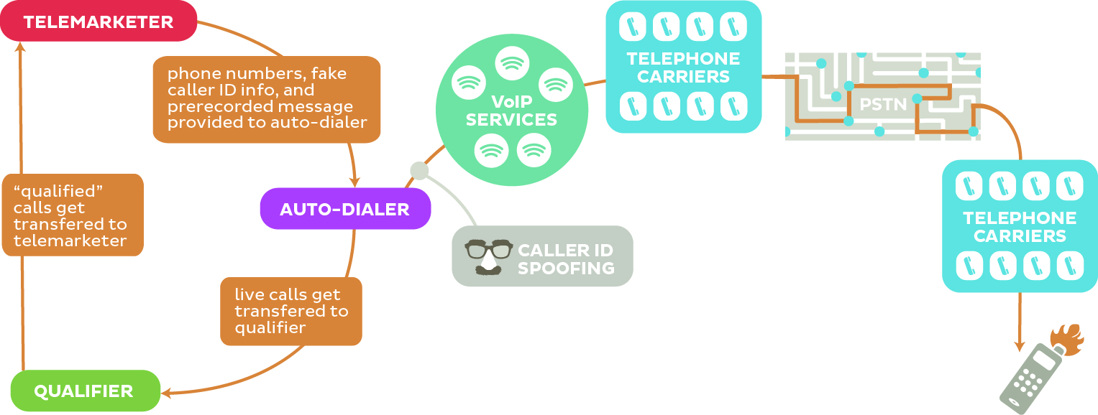
Robocalling
“pink carriers”

Slide 5
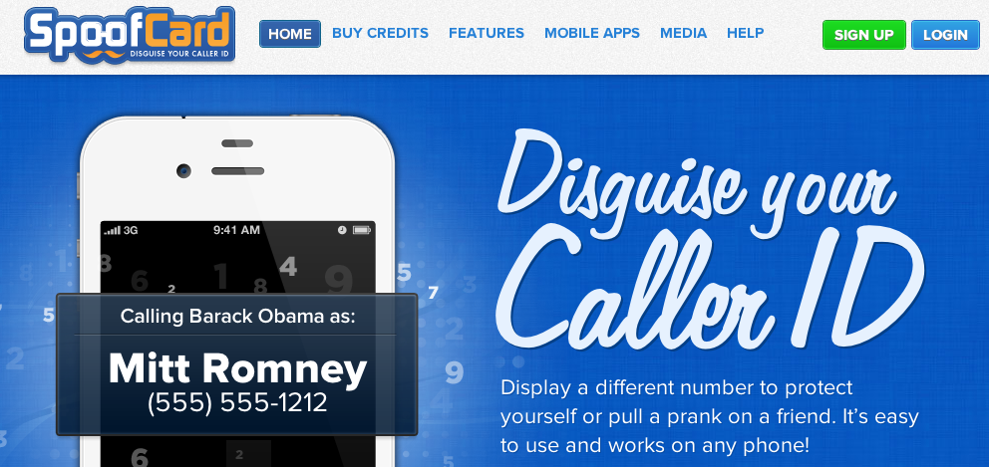
Caller ID spoofing
Easily available on (SIP) trunks
US Caller ID Act of 2009: Prohibit any person or entity from transmitting misleading or inaccurate caller ID information with the intent to defraud, cause harm, or wrongfully obtain anything of value.
Also: FCC phantom traffic rules

Slide 6
Legitimate caller ID spoofing
Doctor’s office
call from personal physician cell phone should show doctor’s office number
Call center
airline outbound contract call center should show airline main number, not call center
Multiple devices, one number
provide single call-back number (e.g., Google Voice) from all devices
anonymity is distinct problem (caller ID suppression)

Slide 7
Requirements
E.164 number source authenticity
E.164 taken loosely (N11, P-ANI, non-reachable numbers, …)
assume that numbers can be canonicalized for signing
seems to work for VM, CDRs, SS7 translation, …
Complete solution (but not necessarily one mechanism)
number assignment to validation
validate caller ID
later?: extended caller information
Functionality
must work without human intervention at caller or callee
minimal changes to SIP
must survive SBCs
must allow partial authorized & revocable delegation
doctor’s office
third-party call center for airline
must allow number portability among carriers (that sign)

Slide 8
Requirements
Privacy
e.g., third parties cannot discover what numbers the callee has dialed recently
Efficiency
will need a mode that causes minimal expansion of SIP headers (= suitable for UDP)
e.g., caching of certs or public keys
Simplicity
minimize overall complexity
incremental deployment

Slide 9
Not in scope
Validate other identifiers (e.g., sip:alice@example.com)
might or might not translate (assignment hierarchy)
Validate textual caller ID (“CNAM”)
anybody can call themselves “CARD HOLDER SVC”
Cross-national
calls from +234 codes are not a major problem (right now)
Content (media) protection or integrity
→ SRTP
Most man-in-the-middle signaling attacks
e.g., evil proxy retargets call to grandma into selling Medicare supplements
content (media) protection or integrity

Slide 10
P-Asserted-Identity (RFC 3325)
P-Asserted-Identity: "Cullen Jennings" <sip:fluffy@cisco.com>
P-Asserted-Identity: tel:+14085264000
RFC 3325 assumptions:
originating end systems cannot alter SIP headers (or intermediate entities can be trusted to remove PAI headers)
trusted chain of providers

Slide 11
RFC 4474 (SIP Identity)
INVITE sip:bob@biloxi.example.org SIP/2.0
Via: SIP/2.0/TLS pc33.atlanta.example.com;branch=z9hG4bKnashds8
To: Bob <sip:bob@biloxi.example.org>
From: Alice <sip:alice@atlanta.example.com>;tag=1928
Call-ID: a84b4c76e66710
CSeq: 314159 INVITE
Max-Forwards: 70
Date: Thu, 21 Feb 2002 13:02:03 GMT
Contact: <sip:alice@pc33.atlanta.example.com>
Identity: “KVhPKbfU/pryhVn9Yc6U=“
Identity-Info: <https://atlanta.example.com/atl.cer>;alg=rsa-sha1
Content-Type: application/sdp
Content-Length: 147
v=0
o=UserA 2890844526 2890844526 IN IP4 pc33.atlanta.example.com
s=Session SDP
…
SBC may change
domains
changed by
SBC

Slide 12
Problems with RFC 4474
see rosenberg-sip-rfc4474-concerns
Cannot identify assignee of telephone number
Intermediate entity re-signs request
B2BUAs re-originate call request
replace everything except method, From & To (if lucky)

Slide 13
VIPR concerns
draft-jennings-vipr-overview
Uses PSTN for reachability validation
“own” number → proof of previous PSTN call (start/stop time, …)
First call via PSTN
doesn’t deal with robocalls
“A domain can only call a specific number over SIP, if it had previously called that exact same number over the PSTN.”
Single, worldwide P2P network
deployment challenging
Allows impersonator to find out who called specific number

Slide 14
Changes in environment
Old (pre-2000) | new
Small number of carriers serving customers with fixed number pools (residential, inbound) | carriers that provide services to non-carriers (e.g., Google Voice, VRS) voice service providers (via APIs)
Carriers either larger or rural → trusted | “Pink” carriers (robocalls = lots of minutes)
Carriers with deep engineering skills | Telecom engineers fired or retired
Call routing determined by physical transport (MF or SS7) | logical routing via SIP proxies
Domestic calls stay within the country | call from NJ to NY may visit Berlin
#’s only for certificated carriers (~ 1000) | interconnected VoIP providers (trial)
1000 block assignment | individual numbers?
Geographic assignment (LATA, area code) | no direct relationship to geography (800#, mobile, VoIP, M2M, …)

Slide 15
What makes solutions harder than in 2002?
Mostly E.164 numbers, not domain-based SIP URIs
Failure of public ENUM → no central database
B2BUA deployment
→ SDP rewritten for most calls
Stickiness of infrastructure
SS7 will be with us, unchanged, for decade+
Lots of non-SIP interconnection
for both technical and non-technical reasons
note: regulators typically encourage VoIP interconnection

Slide 16
Changes: opportunities
Mobile, programmable devices
IP connectivity
allows (some) end system validation
IP-enabled PBX & SIP trunking
PKI developments, e.g., DANE

Slide 17
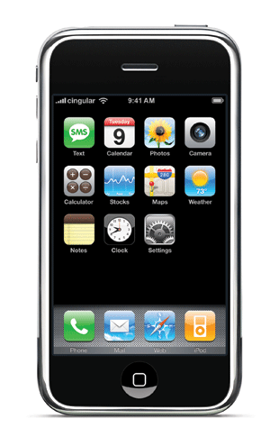
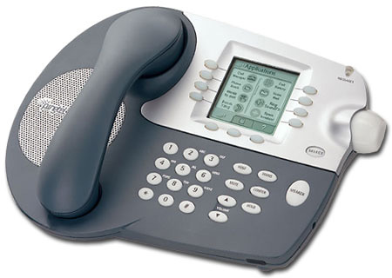
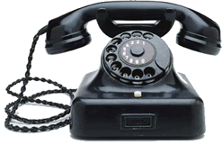
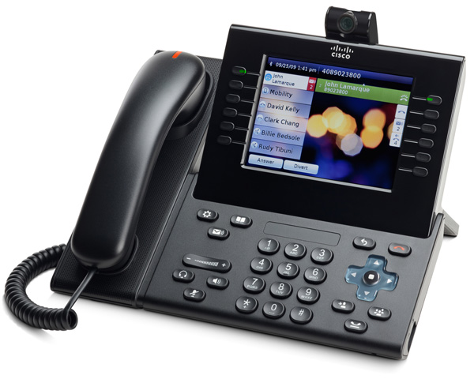
Basic architecture
cert or public key
validate
validate
validate
LD carrier
local carrier
signs number
after normalization
may tunnel
as UUI
SS7
rendezvous mechanism

Slide 18
Options
almost all of these could interoperate in single system
Number validation
Public key only (e.g., DNS)
public
private
X.509 cert
single certifier (per CC)
multiple certifiers per CC
single cert store (hierarchy)
any cert anywhere
separate delivery (URL)
single “CDN”
number-based access (no URL)

Slide 19
Certificate models
Integrated with assignment
assignment of number includes certificate: “public key X is authorized to use number N”
issued by number assignment authority, possibly with delegation chain
allocation entity → carrier → end user
separate proof of ownership
similar to web domain validation
e.g., Google voice validation by automated call back
“Enter the number you heard”
SIP OPTIONS message response?

Slide 20
Delegation options
Official holder of number block interacts with registry
“My customer TheDoctorIsOut can use 212-555-1234 out of my number block”
requires database interaction
X.509 certificate delegation chain
reveals relationship of carriers and customers

Slide 21
Known unknowns
Who will sign first, by choice or mandate?
large carriers (“get rid of robocall complaints”)
legitimate outbound call centers (“I want my snow day alert to be received”)
high-value users (“I want to prevent identity theft”)
smartphone end users
Who will validate first?
carriers concerned about intercarrier compensation fraud
carriers sick of customer complaint calls
new entrants looking for differentiator (“switch and no more robocalls!”)

Slide 22
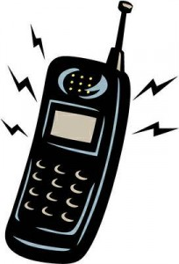
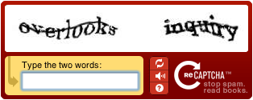
Incremental deployment
signed?
N
Y
should be signed?
validates?
N
Y
N
Y
known caller?
N
Y
N
Y

Slide 23
Conclusion
Number spoofing is root of (almost) all phone evil
Number spoofing may accelerate decay of PSTN
Centralized number assignment makes problem tractable
Solution approaches based on different assumptions
who is willing to do what & when?
All in for one approach or multiple solutions?
reduce risk by multiple approaches?
cost to central entities vs. cost to signers & validators
or increase confusion, cost and non-adoption?

