Slide 1
Transitioning the PSTN to IP
        Henning Schulzrinne

Slide 2
The retirement of the circuit-switched network
What is happening and why does it matter?
What are the technical challenges we need to address?
  reliability & quality
  public safety (“911”, “112”)
  numbering & trustable identifiers
  universal service
  service stagnation → beyond voice?
  copper loops → competition, legacy services
It’s technical + economics + policy
US-centric, but similar elsewhere

Slide 3
FCC’s Technology Transition Policy Task Force
  The Task Force’s work will be guided by the insight that, technological changes do not alter the FCC’s core mission, including protecting consumers, ensuring public safety, enhancing universal service, and preserving competition.
  The Task Force will conduct a data-driven review and provide recommendations to modernize the Commission’s policies in a process that encourages continued investment and innovation in these new technologies, empowers and protects consumers, promotes competition, and ensures network resiliency and reliability.

Slide 4
The three transitions
From |  | to | motivation | issues
Copper | → | fiber | capacity maintenance cost | competition (“unbundled network elements”)
Wired | → | wireless | mobility cost in rural areas | capacity quality
Circuits | → | packets (IP) | flexibility cost per bit | line power
VoIP, VoLTE

Slide 5
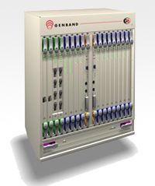
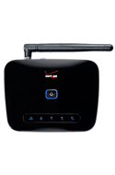
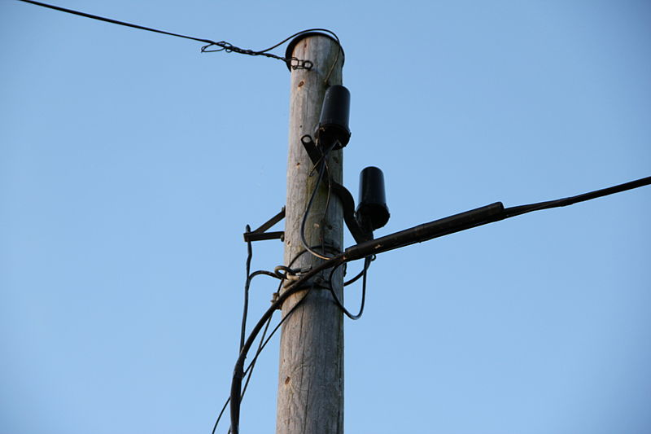
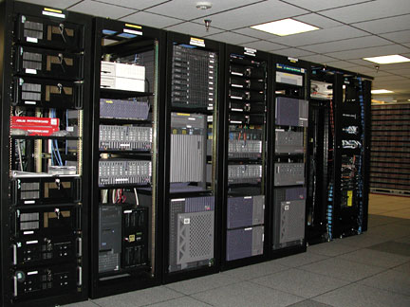

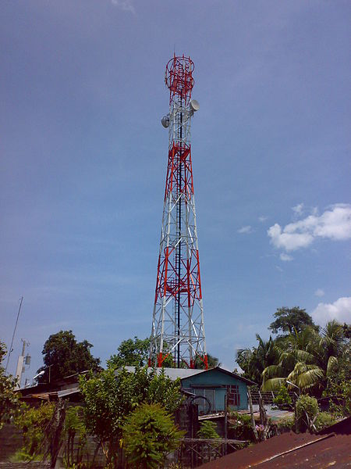
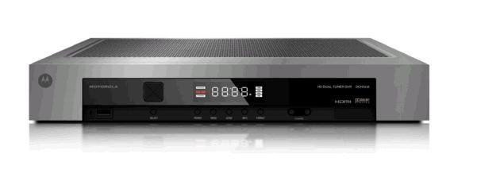
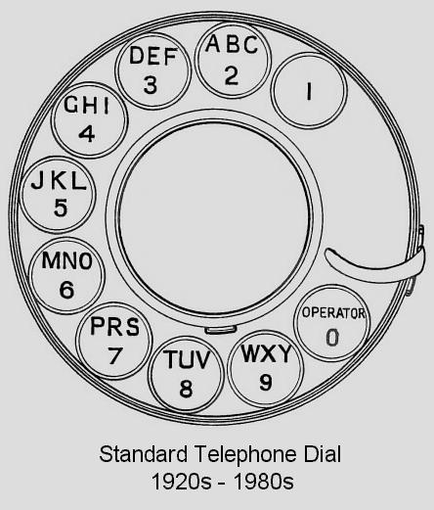
When?
no single transition date!
2013
switching
(core)
TDM
VoIP
“wireless network is 99% wired”
fixed 4G
access
E.164
numbering
human-visible
hidden

Slide 6
The transition of the PSTN
User behavior changes
  more text, less voice
  video conferencing for personal & business use (telepresence)
  landline → mobile
  OTT VoIP (for international calls)
Core network technology changes
  IMS
  SIP trunking
Access and end system changes
  large PBX all VoIP
  voice as app
  WebRTC

Slide 7
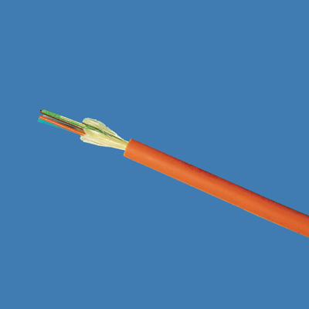
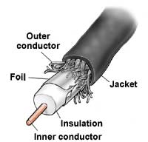
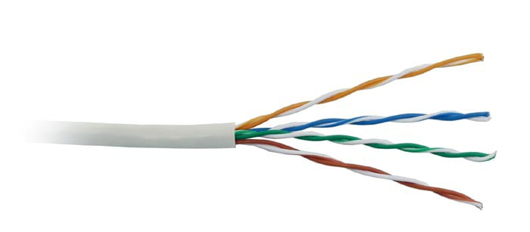

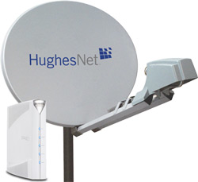
Available access speeds
common now – future capability
100 Mb/s+
10 Gb/s
20 Mb/s
marginal VOIP
1 Gb/s
5 Mb/s
10 Mb/s
2 Mb/s
1 Mb/s
avg. sustained
throughput
18%
80%
95%
97%
100%
99% by 2023?
of households

Slide 8
Access transitions (US)
networks go hybrid:
4G
unlicensed
wireless
⊕
fiber
copper
coax
last 500-3000 ft

Slide 9
Landline → mobile

Slide 10
Lines are disappearing, but maintenance costs are constant
JSI Capital Advisors projection
voice only
(DSL: 20 M)
per-line monthly
maintenance
cost
$2.72
$17.57
voice revenue/line: $50
dis
Notes:
See http://jsicapitaladvisors.com/the-ilec-advisor/2011/10/20/communications-industry-forecast-2011-2020-ilec-and-clec-acc.html
See also NRRI Report 12-12, Oct. 2012

Slide 11
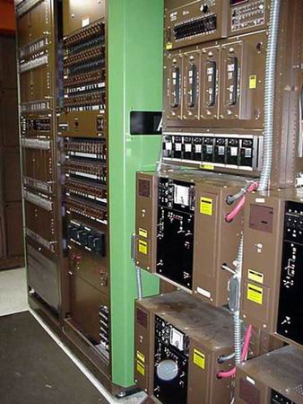
Switches are ageing
1979
Nortel DMS-100
http://www.phworld.org/switch/ntess.htm

Slide 12
PSTN: The good & the ugly
The good | The ugly
Global Connectivity (across devices and providers) | Minimalist service
High reliability (engineering, power) | Limited quality (4 kHz)
Ease of use | Hard to control reachability (ring at 2 am)
Emergency usage | Operator trunks!
Universal access (HAC, TTY, VRS) | No universal text & video
Mostly private (protected content & CPNI) | Limited authentication Security more legal than technical (“trust us, we’re a carrier”)
Relatively cheap (c/minute) | Relatively expensive ($/MB)

Slide 13
What are some of the “keeper” attributes?
Universality
  reachability → global numbering & interconnection
  media → HD audio, video, text
  availability → universal service regardless of
    geography
    income
    disability
  affordability → service competition + affordable standalone broadband
Public safety
  citizen-to-authority: emergency services (911)
  authority-to-citizen: alerting
  law enforcement
  survivable (facilities redundancy, power outages)
Quality
  media (voice + …) quality
  assured identity: telephone numbers
  assured privacy (CPNI)
  accountable reliability
initial list – not exhaustive

Slide 14
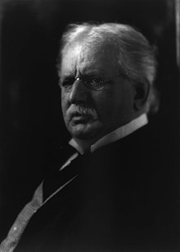
Universal service
One Policy, One System, Universal Service
For the purpose of regulating interstate and foreign commerce in communication by wire and radio so as to make available, so far as possible, to all the people of the United States, without discrimination on the basis of race, color, religion, national origin, or sex, a rapid, efficient, Nation-wide, and world-wide wire and radio communication service with adequate facilities at reasonable charges, for the purpose of the national defense, for the purpose of promoting safety of life and property through the use of wire and radio communications, … (47 USC § 151, 1934)
T. Vail
(1907)
Eligible Telecommunications Carriers
Carrier of Last Resort (COLR)
Universal Service Fund

Slide 15
Numbers: Disappearance of the old constraints

Slide 16
The number is part of the problem
Geographically assigned (“area codes”)
  except for VoIP and cellular (US)
Separate numbering for SMS, voice, wireless, …
Only traditional carriers can obtain numbers
Complex local number portability
  limited wireless ➔ wireline porting (“wire centers”)’
Service tied to number → makes 3rd party services difficult

Slide 17
It’s just a number
Number | Type | Problem
201 555 1212 | E.164 | same-geographic different dial plans (1/no 1, area code or not) text may or may not work
#250, #77, *677 | voice short code | mobile only, but not all no SMS
12345 | SMS short code | SMS only country unclear
211, 311, 411, 911 | N11 codes | Distinct call routing mechanism Mostly voice-only May not work for VoIP or VRS
800, 855, 866, 877, 888 | toll free | not toll free for cell phone may not work internationally
900 | premium | voice only unpredictable cost

Slide 18
Communication identifiers
Property | URL owned | URL provider | E.164 | Service-specific
Example | alice@smith.name sip:alice@smith.name | alice@gmail.com sip:alice@ilec.com | +1 202 555 1010 | www.facebook.com/alice.example
Protocol-independent | no | no | yes | yes
Multimedia | yes | yes | maybe (VRS) | maybe
Portable | yes | no | somewhat | no
Groups | yes | yes | bridge number | not generally
Trademark issues | yes | unlikely | unlikely | possible
Privacy | Depends on name chosen (pseudonym) | Depends on naming scheme | mostly | Depends on provider “real name” policy
Notes:
http://findmyfacebookid.com

Slide 19
Numbers vs. DNS & IP addresses
 | Phone # | DNS | IP address
Role | identifier + locator | identifier | locator (+ identifier)
Country-specific | mostly | optional | no
# of devices / name | 1 (except Google Voice) | any | 1 (interface)
# names /device | 1 for mobile | any | any
controlled by | carrier, but portability unclear (800#) and geo. limited | any entity, with trademark restrictions | any entity (ISP, organization)
who can obtain? | geographically-constrained, currently carrier only | varies (e.g., .edu & .mil, vs. .de) | enterprise, carrier
porting | complex, often manual; wireless-to-wireline may not work | about one hour (DNS cache) | if entity has been assigned PIAs
delegation | companies (number range) | anybody | subnets
identity information | carrier (OCN), billing name only → LERG, LIDB | WHOIS data (unverified) | RPKI, whois
Notes:
http://www.nanpa.com/reports/faq.html#g1

Slide 20
Number usage
FCC 12-46

Slide 21
Area codes (NPAs)
634

Slide 22

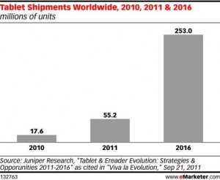

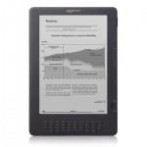
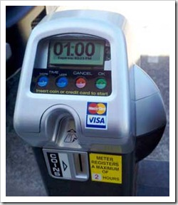
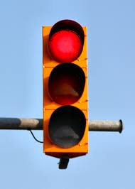
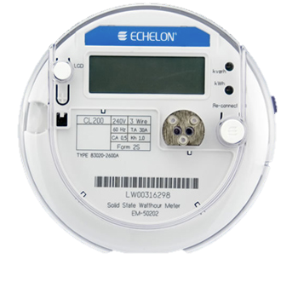
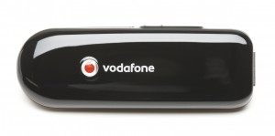
Phone numbers for machines?
< 2010
212 555 1212
500 123 4567
(and geographic numbers)
12% of adults
500 123 4567
533, 544
5 mio.
311,000
64 mio.
now: one 5XX code a year…
(8M numbers)
10 billion available
see Tom McGarry, Neustar
Notes:
http://blog.neustar.biz/neustar-insights/telephone-numbers-are-for-people-not-machines/
http://www.parking.org/media/overview-of-the-us-parking-industry.aspx
http://www.statisticbrain.com/e-reader-statistics/
http://www.ite.org/reportcard/TechnicalReport.pdf

Slide 23


Future numbers
Should numbers be treated as names?
  see “Identifier-Locator split”
  “multi-homing”
Should numbers have a geographic component?
  Is this part of a region’s cultural identity?

Slide 24
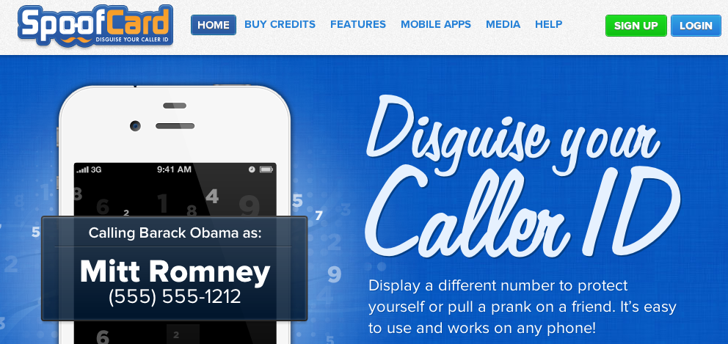
Caller ID spoofing
Easily available on (SIP) trunks – can be legitimate
Used for vishing, robocalling, swatting, anonymity breaking, …
Caller ID Act of 2009: Prohibit any person or entity from transmitting misleading or inaccurate caller ID information with the intent to defraud, cause harm, or wrongfully obtain anything of value.
Also: phantom traffic rules

Slide 25
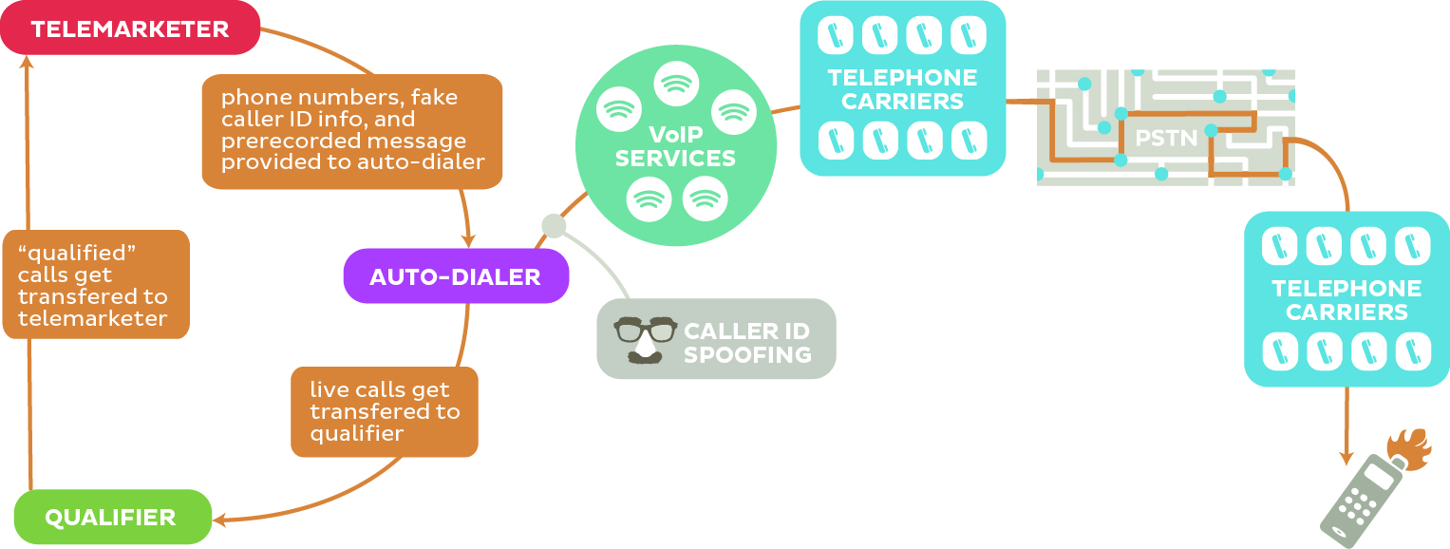
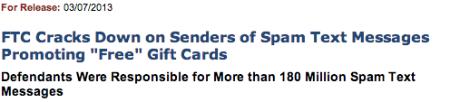
Robocalling
“pink carriers”

Slide 26
Security (trustworthiness)
Practically, mostly about identity, not content
Old model: “trust us, we’re the phone company”
Need cryptographically-verifiable information
  Is the caller authorized to use this number?
    not necessarily “ownership”
  Has the caller ID name been verified?
    cf. TLS

Slide 27
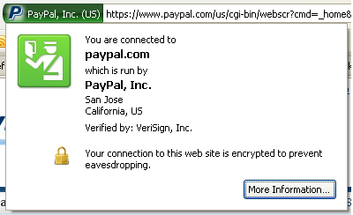
Who assures identity?
Web:
  plain-text → rely on DNS, path integrity
    requires on-path intercept
  X.509 certificate: email ownership
    no attributes
  EV (“green”) certificate
PSTN
  caller ID
  display name: CNAM database, based on caller ID
Notes:
http://www.cnamcallerid.com
https://www.opencnam.com
Truth in Caller ID Act of 2009

Slide 28


Strawman “Public” PSTN database
Now: LIDB & CNAM, LERG, LARG, CSARG, NNAG, SRDB, SMS/800 (toll free), do-not-call, …
Future:
1 202 555 1234
HTTPS
DB
carrier code or SIP URLs
type of service (800, …)
owner
public key
…
extensible set of fields
multiple interfaces (legacy emulation)
multiple providers

Slide 29
VoIP interconnection, public safety, universal access

Slide 30
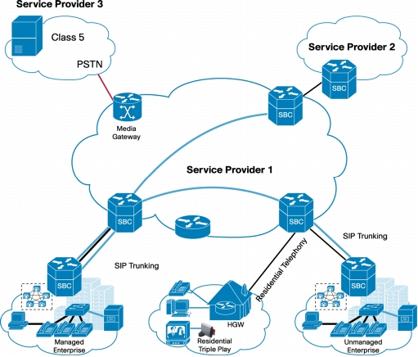
VoIP Interconnection
“VoIP interconnection” ≠ IP peering
Are there technical stumbling blocks?
  SIP features?
  Media codecs & conversion?
Separation application layer & transport
$0.001 / minute for IP transport ($0.10/GB) → location not relevant
Cisco
Notes:
http://www.cisco.com/en/US/prod/collateral/routers/ps9343/data_sheet_c78-491738.html

Slide 31
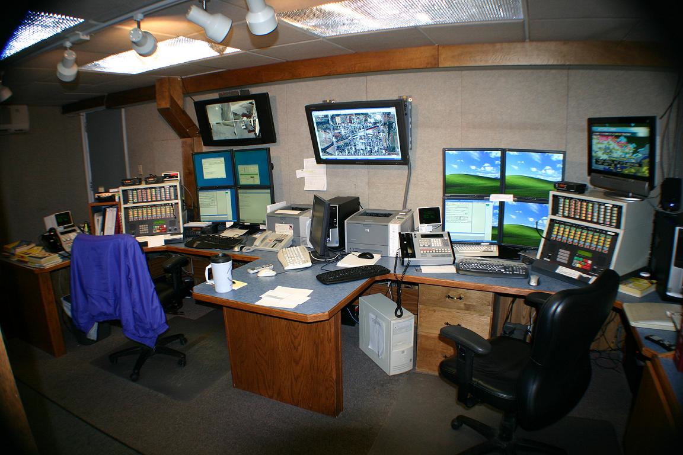
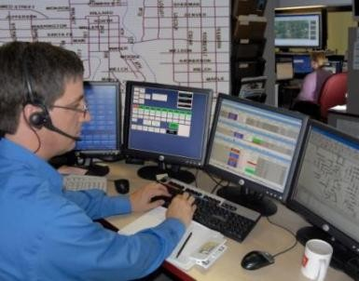
Public Safety (NG911 & NG112)
Transition to NG911 & NG112 underway
  NGxxx = all-IP (SIP + RTP) emergency calling
Key issues:
  Indoor location for wireless
    location accuracy of 50/150m may not be sufficient
    need apartment-level accuracy, including floor
    Civic (Apt. 9C, 5 W Glebe), not geo
  Cost, scaling and transition
Notes:
Pictures: http://www.ksapco.net/psaps

Slide 32
More than point-to-point voice
VoIP = Voice + Video + Vords (text)
  → Real-time communication as base-level service?
Accommodate new media codecs (e.g., AMR)
See also “advanced communication systems” in U.S. Communications and Video Accessibility Act (CVAA)
Just point-to-point? or multipoint?
Services beyond call forwarding → web API model
  e.g., for robocall prevention

Slide 33
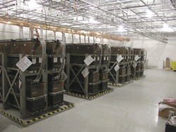
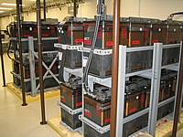
Reliability
5 nines → 5 minutes/year unavailable
How do we measure reliability & QoS?
  E.g., FCC Measuring Broadband America project?
  → IETF LMAP
Can we improve power robustness?
  Circuit-switched: -48V @ 20-50 mA (~ 1 W)
  e.g., DOCSIS modem consumes ~7W (idle)
  Li-Ion battery = 2.5 Wh/$ ➔ 3$/hour of standby time
Can we simplify multihoming to make new PSTN more reliable than old?
  e.g., cable + 4G

Slide 34
Conclusion
Three simultaneous technology transitions:
  copper → fiber, wired → wireless, circuit → packet
But no cut-over date
Need to “grow up” quickly
  no more second network for reporting & fixing things
  universal service → Internet access for everyone
  single network → suitable for demanding services
  life-and-safety network
The Internet – your life will depend on it…

Slide 35
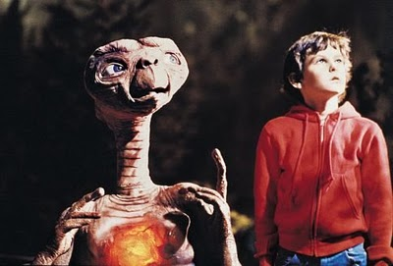

Slide 36
Backup

Slide 37
Cost vs. distance
Notes:
http://www.mcleanbrown.com/pdf_docs/mandb_091709.pdf

Slide 38
Interstate switched access minutes

Slide 39
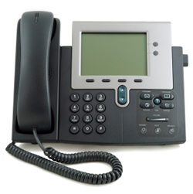
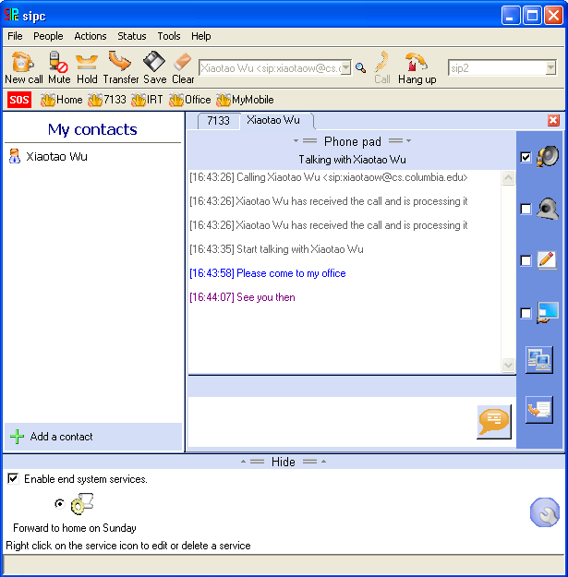
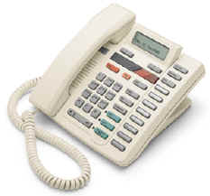

Evolution of VoIP
“Can it really replace the phone system?”
“How can I make it stop ringing?”
long-distance calling,
ca. 1930
“does it do
call transfer?”
replacing the
global phone system
“amazing – the phone rings”
going beyond
the black phone
catching up
with the digital PBX
1996-2000
2000-2003
2004-2005
2006-

Slide 40
Telephone Social Policies
Universal service (Lifeline, high cost, …) | Necessary to function (call doctor, call school, …)
Basic service price regulation | Ensure widespread availability
911 | Report emergencies for self and others
Power backup | Ensure emergency communications
Outage reporting | Ensure reliability
Lawful intercept (CALEA) | Phone as tool for criminals
Disability access (ringers, HAC) | Ensure participation in society
CPNI | Phone as private medium

Slide 41
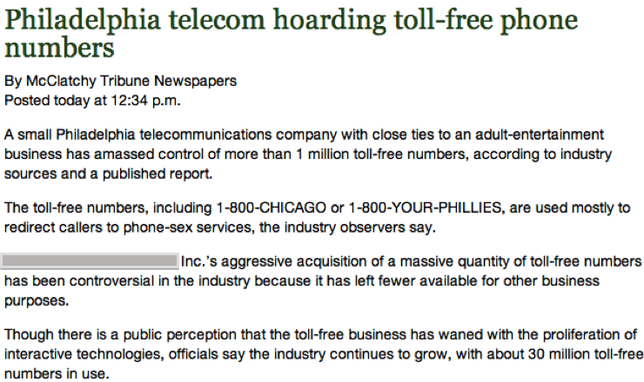
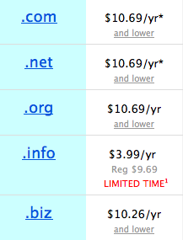
Phone numbers: hoarding
How to prevent hoarding?
  By pricing
    DNS-like prices ($6.69 - $10.69/year for .com)
      takes $100M to buy up (212)…
      1626: 60 guilders
    e.g., USF contribution proposals
      $8B/year, 750 M numbers → $10.60/year
      but significant trade-offs
  By demonstrated need
    see IP address assignment
    1k blocks
    difficult to scale to individuals
15c/month
100 million .COM
Notes:
Manhattan purchase Peter Minuit

Slide 42
Robocalls – the enablers
Robocalling
Cheap VoIP
Number spoofing
Cheap labor

Slide 43
Copper loops
high-speed DSL
DSL loop lengths
Copper loops → large-scale data competition (“unbundled network elements”)

Slide 44
Interconnection
PSTN: general interconnection duty
  requires physical TDM trunks and switch ports
VoIP:
  VPN-like arrangements
  MPLS
  general Internet
  may require fewer points-of-interconnect
  only relatively small number of IXPs
  transition to symmetric billing (cellular minutes, flat-rate) rather than caller-pays

Slide 45
FCC USF/ICC reform
Federal Communications Commission FCC 11-161
42. IP-to-IP Interconnection. We recognize the importance of interconnection to competition and the associated consumer benefits. We anticipate that the reforms we adopt will further promote the deployment and use of IP networks, and seek comment in the accompanying FNPRM regarding the policy framework for IP-to-IP interconnection. We also make clear that even while our FNPRM is pending, we expect all carriers to negotiate in good faith in response to requests for IP-to-IP interconnection for the exchange of voice traffic
Technical problem
  where and how
  just voice?
Money problem
  who pays for what (conversion, transport, …)
John Barnhill, GenBand

Slide 46
QoS is not just an Internet problem…
7400 test calls to 115 locations
NECA ExParte 05/21/2012

Slide 47
Rural call completion
Problems:
  manual error tracing
  complicated least-cost routing arrangements
  termination charge incentives
Requirements for new PSTN:
  automated call flow tracing
  end-to-end call quality evaluation (→ MBA)

