Slide 1
Practical Economics of Networks
Henning Schulzrinne
FCC & Columbia University
SDP (Turin, Italy) - April 2013

Slide 2
Overview
What questions do policy makers ask?
What data sources are available?
Access network issues
  capex & opex
  competition
The pitfalls of QoS
Open Internet principles in the US

Slide 3
Policy questions

Slide 4
Policy questions
Should content and service providers pay access networks for access?
How do content and service providers relate to CDNs, transit providers and access providers?
What are some of the pitfalls when talking about QoS in the context of network economics?
What real-world economic data sources are available to analyze network performance and pricing and what are some of their limitations?
How is interconnection handled in the non-IP world, e.g., for interconnecting voice (PSTN) networks?
What are some of the economics of building access networks?

Slide 5
Why policy & regulators?
Market failure
  private monopoly
    e.g., pre-divestiture BOCs as local phone companies
  competitive market failures (e.g., duopoly, consumer rights)
    → merger reviews (e.g., Comcast + NBC, AT&T + T-Mobile, T-Mobile + MetroPCS)
  social policy objectives (e.g., disability rights, universal access)
Law enforcement
  illegal conduct (consumer/subsidy fraud, misrepresentation, …)
  unsafe conduct (“no fence around antenna”)
Consumer education
  information asymmetry (e.g., “lemon laws”)
Economic development
  “public goods” (e.g., scientific research)

Slide 6
Policy inputs
Policy
Law
(1934 & 1996 Act)
Prior actions (e.g., VoIP definition)
Court cases (Brand X, Comcast, …)
Economic analysis
(competition, investment, consumers)
Other impacts (social policy objectives, fraud risk, …)

Slide 7




Telecom policy tool kit
gov’t monopoly
price-regulated utility
structural
separation
unbundled network elements
facilities-based competition + interconnection
laissez faire
network neutrality
disability access
public safety
CALEA
anti-trust
gov’t grants
(USF)
high cost + low income

Slide 8
Telephone Social Policies
Universal service (Lifeline, high cost, …) | Necessary to function (call doctor, call school, …)
Basic service price regulation | Ensure widespread availability
911 | Report emergencies for self and others
Power backup | Ensure emergency communications
Outage reporting | Ensure reliability
Lawful intercept (CALEA) | Phone as tool for criminals
Disability access (ringers, HAC) | Ensure participation in society
CPNI | Phone as private medium

Slide 9
Telecom regulation
Local, state and federal
  local: CATV franchise agreements
  state: Public Utility Commission
    responsible for all utilities – gas, water, electricity, telephone
  federal: FCC, FTC (privacy), DOJ (monopoly)
Elsewhere: gov’t PTT → competition
  vs. US: regulated private monopolies
Based on 1934 Telecommunications Act
Amended in 1996

Slide 10

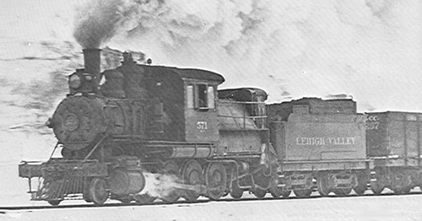
Before the Internet, Before the Phone… Common Carrier
Content
Coal
Common Carrier
Trains
Right-of-way

Slide 11
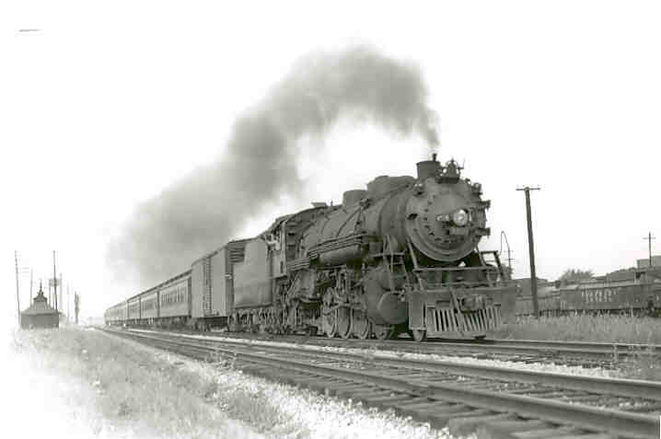
Communications Carriers
Characteristics:
  Carrier of third parties’ goods / Bailment
  Market power / infrastructure
  Vital economic Input: goods carried are important
Policy:
  Non-discrimination
  Just & reasonable rates
  Liability
    Not liable for what content is
    Liable for damage to content
  Benefit from sovereign
    Access to right of way
  Privacy / security
Importance and value of information – stocks, elections, agriculture.
Notes:
In typical western dialectic – the literature struggles with an either / or. Either it is market power – or it is bailment.
Since each justification on its own is vulnerable to criticism – we oscillate between the two without a firm policy foundation for common carriage.
I would suggest rather that it is both / and. It is both market power and bailment. A truly competitive market is one where, if the bailor harms us, we can switch to another service – the bailor loses for the bailor’s negligence.
However, the bailor carrier remains in a power position in the market as a carrier and can easily put us in harms way. I think a little market power is amplified by the ability of the bailor to use that market power.
My take is that both of these are important to understanding the WHY of common carriage.
(Liability for damaged to goods while in care; But no liability for damaged caused by goods - Trains not liable for transporting Al Capone)
Telegraph
Importance and Value of transmitted information – stocks, elections, agriculture. Importance to the economy and to the country well recognized.
Access, reliability, non discrimination
States
Granted access to Right of Way
Imposed Common Carrier Obligations
Serve all customers without discrimination
Transmit messages in order received
Keep content of messages private
Interconnection between networks
Telephone
Precedent: telephone is just voice telegraph; therefore common carrier
State and local authority
Authorize Service and grant access to Rights of Way and eminent domain
Impose Common Carriage Obligations
Ban discrimination in line installations
Rate regulation
Interconnection
Non Discrimination
Originally regulated by the US Interstate Commerce Commission
Regulated all common carriers: Railroads, shipping, telegraph, telephone

Slide 12
The US hierarchy of laws
Constitution
Commerce clause
Law
Telecom Act 1934 & 1996
47 CFR
Narrative
reasonable network management
Section 8: To regulate Commerce with foreign Nations, and among the several States, and with the Indian Tribes (1787)
SEC. 706. ADVANCED TELECOMMUNICATIONS INCENTIVES. (a) IN GENERAL- The Commission … shall encourage the deployment on a reasonable and timely basis of advanced telecommunications capability to all Americans (including, in particular, elementary and secondary schools and classrooms) by utilizing, in a manner consistent with the public interest, convenience, and necessity, …, or other regulating methods that remove barriers to infrastructure investment.

Slide 13

Example: CFR 47
§ 15.5 General conditions of operation.
(a) Persons operating intentional or unintentional radiators shall not be deemed to have any vested or recognizable right to continued use of any given frequency by virtue of prior registration or certification of equipment, or, for power line carrier systems, on the basis of prior notification of use pursuant to §90.35(g) of this chapter.
(b) Operation of an intentional, unintentional, or incidental radiator is subject to the conditions that no harmful interference is caused and that interference must be accepted that may be caused by the operation of an authorized radio station, by another intentional or unintentional radiator, by industrial, scientific and medical (ISM) equipment, or by an incidental radiator.

Slide 14
Process
NOI
NPRM
R&O
Notice of Inquiry
Notice of Proposed Rule Making
Report & Order
Petition for reconsideration
Federal court review
comments,
replies & ex parte
rarely

Slide 15
FCC
Chairman (D)
4 Commissioners (2 D, 2 R)
Consumer and Governmental Affairs
Enforcement
International
Media
Public Safety & Homeland Security
Wireless Telecommunications
Wireline Competition
Independent federal agency
About 1,600 employees

Slide 16
Open Internet Principles
Transparency. Fixed and mobile broadband providers must disclose the network management practices, performance characteristics, and terms and conditions of their broadband services;
No blocking. Fixed broadband providers may not block lawful content, applications, services, or non-harmful devices; mobile broadband providers may not block lawful websites, or block applications that compete with their voice or video telephony services
No unreasonable discrimination. Fixed broadband providers may not unreasonably discriminate in transmitting lawful network traffic.

Slide 17
FCC Data - examples

Slide 18
FCC data sets and reports of (Internet) interest
Measuring Broadband America (Internet performance measurements)
Broadband Progress Report (“706 report”)
  Broadband deployment data (“Form 477”)
International Broadband Data Report
Mobile Wireless Competition Report
Universal Service Monitoring Report (telephone service)
Telephone Subscribership in the United States
Report on Cable Industry Prices
Trends in Telephony Service
Not available:
  detailed price & subscription data
  outage and reliability information
Notes:
http://www.fcc.gov/encyclopedia/trends-telephone-service

Slide 19
What Was Measured
Sustained Download | Burst Download
Sustained Upload | Burst Upload
Web Browsing Download | UDP Latency
UDP Packet Loss | Video Streaming Measure
VoIP Measure | DNS Resolution
DNS Failures | ICMP Latency
ICMP Packet Loss | Latency Under Load
Total Bytes Downloaded | Total Bytes Uploaded

Slide 20
Advertised vs. actual 2012

Slide 21
Significantly better than 2011

Slide 22
Access to broadband
Eighth Broadband Progress Report, August 2012

Slide 23
State of competition (US)
FCC: Internet Access Services Status as of December 31, 2009
Notes:
http://www.fcc.gov/Daily_Releases/Daily_Business/2010/db1208/DOC-303405A1.pdf: Internet Access Services: Status as of December 31, 2009

Slide 24
Residential broadband penetration (US)

Slide 25
International comparison: fixed
3rd International Broadband Data Report (IBDR), August 2012

Slide 26
International data pricing - mobile
3rd International Broadband Data Report (IBDR), August 2012
http://www.fcc.gov/document/international-broadband-data-report

Slide 27
International data pricing - mobile
http://www.fcc.gov/document/international-broadband-data-report

Slide 28
The cost of networks

Slide 29
Broadband virtuous cycle
fixed broadband
cellular broadband
applications
(e-learning, telemedicine, telework, …)
adoption
(relevance)
broadband availability

Slide 30
Cost of bandwidth (2011)
Service | Speed (Mb/s) | Average price/month | $/Mb/s
DS1 (T1) | 1.54 | $450 | $292.20
DS3 | 45 | $5,000 | $111.11
Ethernet over Copper | 10 | $950 | $95.00
Fast Ethernet | 100 | $5,000 | $50.00
Metro Ethernet | 1000 | $25,000 | $25.00
Notes:
http://www.shopforethernet.com/, September 2011

Slide 31
The value of bits
Technologist: A bit is a bit is a bit
Economist: Some bits are more valuable than other bits
  e.g., $(email) >> $(video)
Application | Volume | Cost per unit | Cost / MB | Cost / TB
Voice (13 kb/s GSM) | 97.5 kB/minute | 10c | $1.02 | $1M
Mobile data | 5 GB | $40 | $0.008 | $8,000
MMS (pictures) | < 300 KB, avg. 50 kB | 25c | $5.00 | $5M
SMS | 160 B | 10c | $625 | $625M
Notes:
T-Mobile 2010
AT&T data
http://www.nowsms.com/discus/messages/12/8500.html

Slide 32

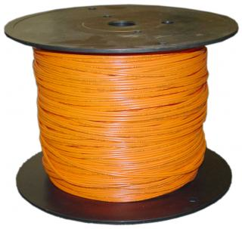
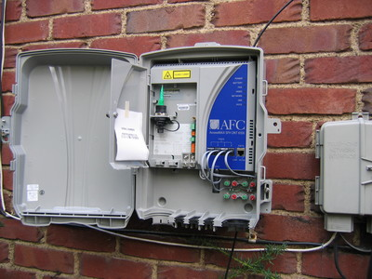
Broadband cost
30%
70%
e.g., CenturyLink: capital investment = 15% of revenues

Slide 33
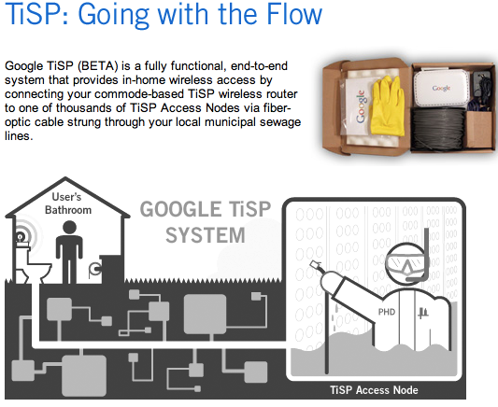
Maybe revisit?
Google
April 1, 2007

Slide 34

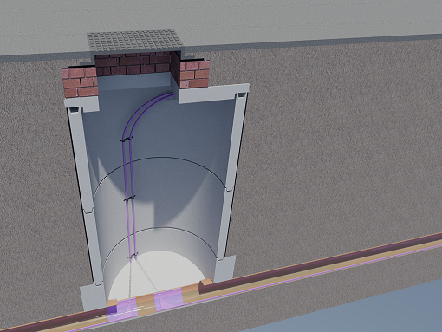
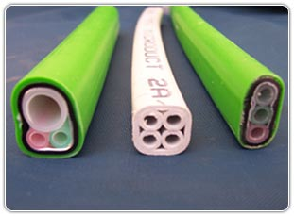
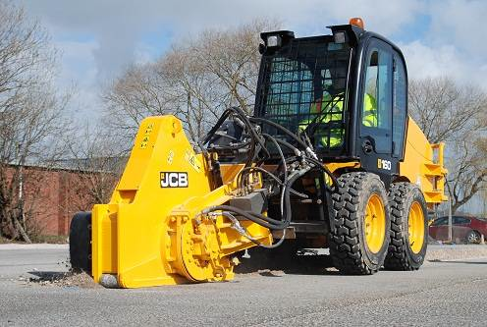
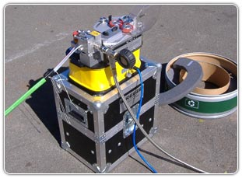
Fiber deployment
wastewater pipe
(3-5 km/week)

Slide 35
Broadband network cost - FTTP
Category | Details | Outside plant
FTTP in existing right-of-way | All underground, not including drops or electronics | $1,200…$1,300 per passing
 | 40% aerial, 60% underground, not including drops or electronics | $1,000…$1,100 per passing
FTTP drops | Range of distances and complexity | $300…$700 per connected home
Crown Fibre Holdings (Govt. of New Zealand); provided by CTC

Slide 36
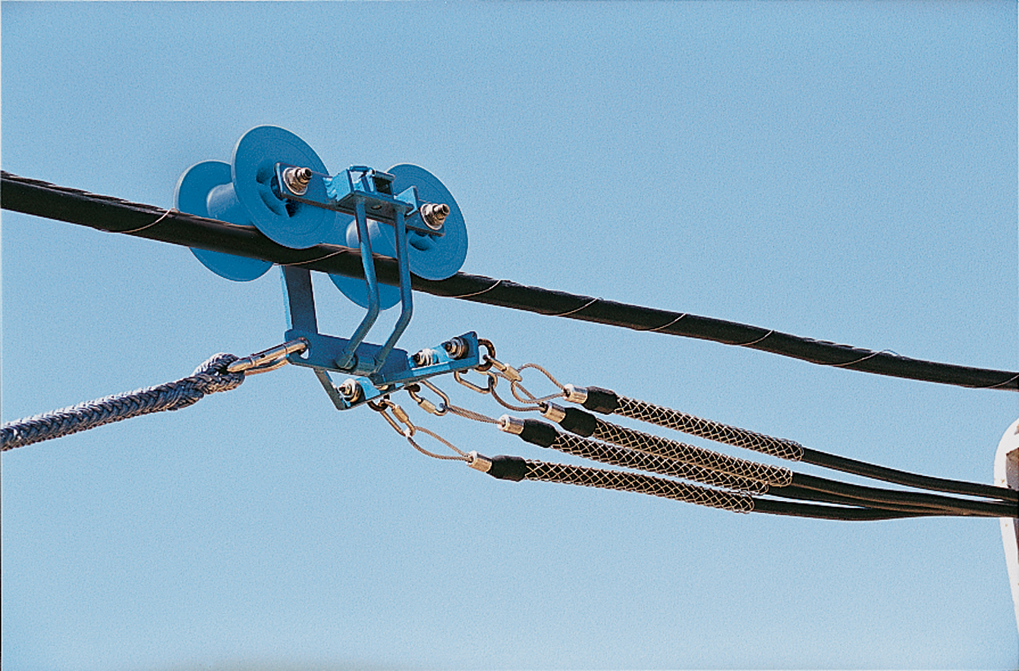
Broadband network cost – Fiber middle mile
Category | Details | Outside plant | Source
aerial, new attachment | Northeastern city municipal utility; 96% aerial, 4% underground; 87.6 miles | $30,000/mile | Public utility (actual cost)
aerial overlash | Major metropolitan area (U.S. east coast) | $15,000/mile
buried | Mixed suburban/urban locations and pot/bore construction | $89,000/mile | Washington, D.C.-area BTOP project (actual cost)
Data provided by CTC

Slide 37
Middle mile cost example
CTC, 2009 (“Brief Engineering Assessment: Efficiencies available through simultaneous construction and co-location of communications conduit and fiber”)

Slide 38
Broadband network cost – TV white spaces
Rural Appalachian community
3,000-passing service area
30% taking service
$2.4 million capital cost for all towers and electronics
  site, user, and backhaul
➔$800/passed
CTC design study for Garrett County, Maryland

Slide 39
Concluding remarks

Slide 40
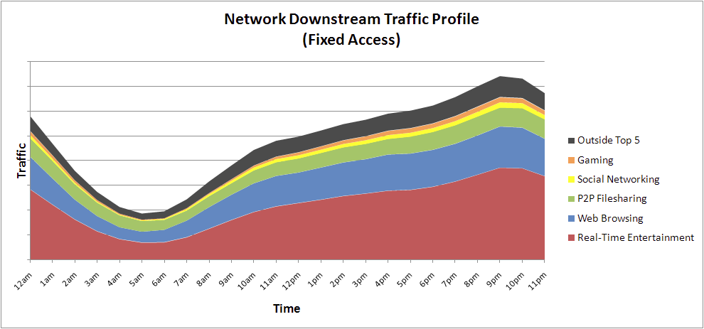
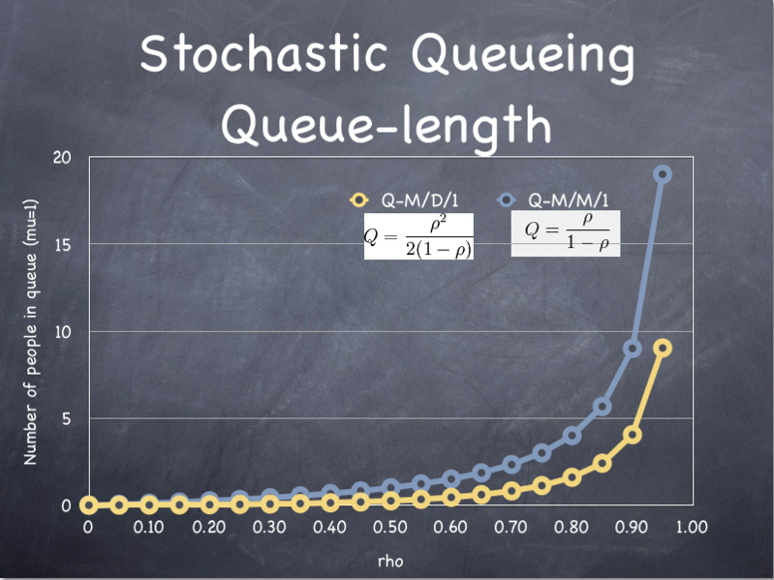
Common fallacies in economic analysis
Assume perfect competition
  or ability to have multiple access providers
  or zero switching costs
Assume QoS = ATM or phone circuit
  rather than per-packet choice
Assume QoS for voice >> data
  TCP: 5% packet loss → 500 kb/s max.
  Marginal cost difference between 80% and 100%-loaded network
Assume variable bandwidth demand
  Human-driven, with a bit of video quality adaptation
Ignore real-world profitability of entities
  non-existing profits shuffled to other parties
differentiated goods
Notes:
Sandvine http://www.sandvine.com/downloads/documents/2010%20Global%20Internet%20Phenomena%20Report.pdfhttp://upload.wikimedia.org/wikipedia/commons/9/94/StochasticQueueingQueueLength.png

Slide 41
Things policy makers might like to know…
Why is wireless/wireline broadband in my country more expensive or cheaper than in country X?
How can I ensure continued investment in network infrastructure?
What drives new network applications?
What is the impact of metered broadband?
  Will there be only one speed tier?
What is keeping 20-30% from adopting broadband?
Are there economic incentives to make networks more secure?

Slide 42
Mobile data pricing

Slide 43
Differentiation – classical models
Speed differentiation
  Residential broadband model
  European LTE plans (usually combined with volume)
  = rough division into non-video (web, email) & video customers
Volume metering
  Mobile model
  = rough division into video & non-video customers
  harder to visualize – discourages experimentation
  room for surprise
    mid-month cut-off
    bill shock
Commonly combined

Slide 44
Differentiation – new models
Application restrictions
  “business” vs. personal use
  e.g., restrict tethering
  Open Internet concerns
Priority-based pricing
Content provider pays
  “like 800 numbers”
  potential for confusion? Which links are “free” and which aren’t?
  transaction costs – how to collect from millions of content providers?
  revenue potential?

Slide 45
Example: vodafone.de
Plan | Speed | Volume
€ 17.99 | ≤ 3.6 Mb/s | 1 GB
€ 26.99 | ≤ 21.6 Mb/s | 3 GB
€ 35.99 | ≤ 42.2 Mb/s | 6 GB
€ 44.99 | ≤ 50.0 Mb/s | 10 GB
“unlimited” at 64 kb/s
http://shop.vodafone.de/Shop/internet/mobile-internet-flat/

Slide 46
What about consumers?
Predictability – no “bill shock”
  “When did I download 1 GB and why?”
  What about teenagers?
Allow for a simple mental model
  Can users predict direct usage costs for activities?
  Do they want to know that the YouTube cat video costs $1.45?
  How close is day/night model to optimal model?
Minimize mental load
  Anticipating consequences
    It’s April 15 – am I going to run out by April 30? Or leave bytes on the table?
    Byte budgeting?
Perception of fairness
  Airline pricing?
  Why should I pay for my provider’s bugs?
Allow comparison between plans and providers
  Should I switch providers given my usage profile?
Notes:
http://deborahstrickland.sys-con.com/node/1803559/mobile

Slide 47
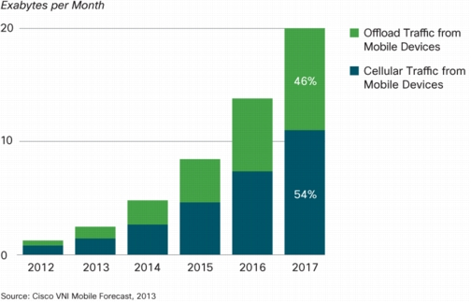
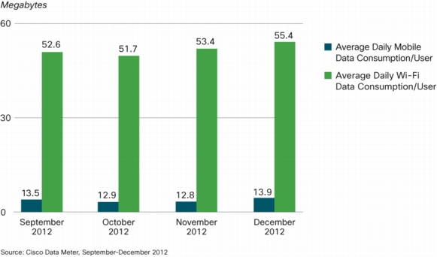
WiFi off-load
Cisco Visual Networking Index: Global Mobile Data Traffic Forecast 2012-2017
Notes:
http://www.cisco.com/en/US/solutions/collateral/ns341/ns525/ns537/ns705/ns827/white_paper_c11-520862.html

Slide 48
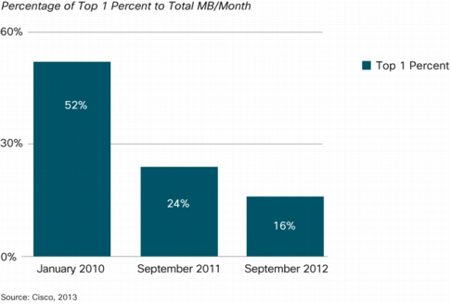
The 1% are becoming less dominant

Slide 49
ARPU across providers
Provider | ARPU (month), US-based | Net income (1Q2013)
Verizon | $146.80* | $1.95B
AT&T | $65.20
Google | $2.38 | $3.35B
Facebook | $0.74 | $64M
Netflix | $11.65 | $8M
Pandora (mobile) | $3.87 | $2.2M
*VZ is ARPA (per account)
Notes:
http://www22.verizon.com/investor/news_verizon_reports_strong_revenue_and_customer_growth_for_verizon_wireless_and_fios_services_in_4q_2012.htm
http://www.fool.com/investing/general/2012/08/27/how-much-is-a-user-worth.aspx
http://www.forbes.com/sites/georgeanders/2012/07/26/facebook-ratio/
http://money.cnn.com/2012/05/16/technology/facebook-arpu/index.htm

Slide 50
Demand shifting
time-flexible
time-rigid
search
transactions
voice & video call
email
software
updates
IM
navigation
video
(sideloading)
web
(FB, news)
augmented
reality
app store

Slide 51
Advertising and two-sided markets
eCPM: $3.50 for PC, $0.75 for mobile
one click cost $0.84 on average (PPC)
one hour of higher-quality video: 1 GB = $10
  mobile: 10 MB / minute
→ one minute commercial costs user $0.10
thus, plausible two-sided market for clicking on video ads
YouTube: Gangnam Style generated $0.0065 per play
  video is 4.2 minutes long → cost is $0.43
not so much for supporting video content
Notes:
http://seekingalpha.com/article/717551-online-advertising-and-the-small-screen-problem
http://www.hochmanconsultants.com/articles/je-hochman-benchmark.shtml
http://www.theblaze.com/stories/2013/01/23/gangnam-style-video-earns-8-million-in-ad-revenue-on-youtube/

Slide 52
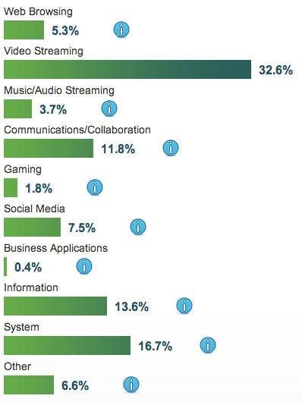
Application usage
scalable
deferable
unclear which fraction is WiFi vs. cellular
http://ciscovni.com/data_meter/

Slide 53
SINE: automated policy
Goal: make hetnets user-friendly
  primarily, $0 WiFi vs. $10/GB cellular
  but can accommodate variable cellular pricing
Policy engine:
  for each application, express value and delay tolerance
    “best network available, keep to $N/hour”
    “delay for N minutes” → email
    “user confirmation if cost > $X”
  willing to pay more as delay increases
    eventually, may pay for software download
Need better sideloading support for apps
  video queue, maps
Mapping database for predictive demand shifting
  “reaching WiFi in one hour”

Slide 54
Conclusion
Economics of networks – more than micro economics
  = longer-term congestion control
    demand shifting in time (and space)
    realistic expectations for gain
    video already largely WiFi
  = price differentiation
Needs to take consumer behavior into account
  do users want to constantly watch the meter?
  realistic expectation of take-up – is 10% improvement worth the hassle as the smartphone novelty wears off?
  can we automate this?
Public policy concerns
  transparency
  non-discrimination
  effects on competition – carrier-carrier & vertical

