Slide 1
Wireless networks in a post-spectrum world
Henning Schulzrinne
FCC/Columbia University

Slide 2
Overview
A bit about the FCC
The role of research: another broader impact vector?
What has changed in the last ten years?
What questions do policy makers ask?
The FCC incentive auction
New frontiers for spectrum sharing: 3.5 GHz
What data sources are available?

Slide 3
The FCC in 5 minutes

Slide 4
Why policy & regulators?
Market failure
  private monopoly
    e.g., pre-divestiture BOCs as local phone companies
  competitive market failures (e.g., duopoly, consumer rights)
    → merger reviews (e.g., Comcast + NBC, AT&T + T-Mobile, T-Mobile + MetroPCS)
  social policy objectives (e.g., disability rights, universal access)
Law enforcement
  illegal conduct (consumer/subsidy fraud, misrepresentation, …)
  unsafe conduct (“no fence around antenna”)
Consumer education
  information asymmetry (e.g., “lemon laws”)
Economic development
  “public goods” (e.g., scientific research)

Slide 5
The US hierarchy of laws
Constitution
Commerce clause
Law
Telecom Act 1934 & 1996
47 CFR
Narrative
reasonable network management
Section 8: To regulate Commerce with foreign Nations, and among the several States, and with the Indian Tribes (1787)
SEC. 706. ADVANCED TELECOMMUNICATIONS INCENTIVES. (a) IN GENERAL- The Commission … shall encourage the deployment on a reasonable and timely basis of advanced telecommunications capability to all Americans (including, in particular, elementary and secondary schools and classrooms) by utilizing, in a manner consistent with the public interest, convenience, and necessity, …, or other regulating methods that remove barriers to infrastructure investment.

Slide 6
FCC
Chairman (D) – Tom Wheeler
4 Commissioners (2 D, 2 R)
Consumer and Governmental Affairs
Enforcement
International
Media
Public Safety & Homeland Security
Wireless Telecommunications
Wireline Competition
Independent federal agency
About 1,700 employees

Slide 7
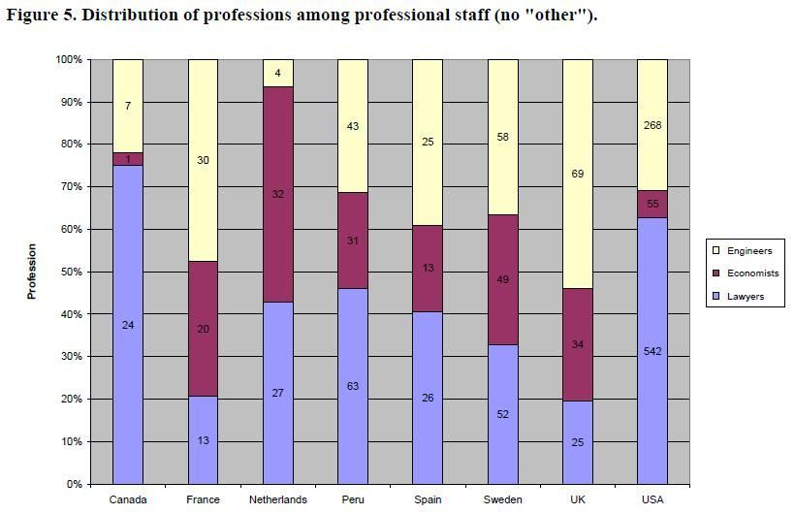
Staffing at National Regulatory Agencies

Slide 8
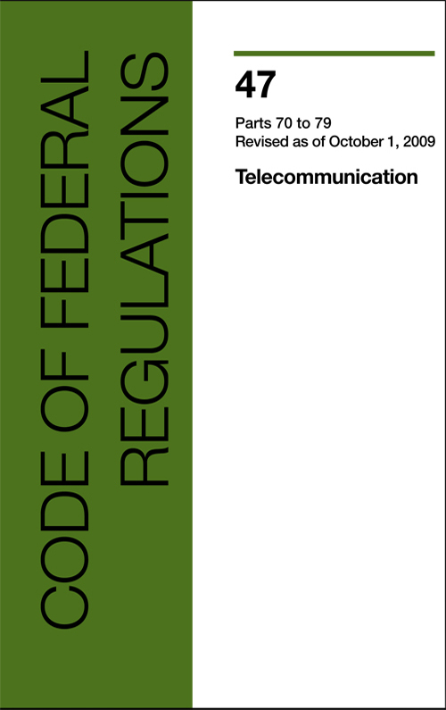
Example: CFR 47
§ 15.5 General conditions of operation.
(a) Persons operating intentional or unintentional radiators shall not be deemed to have any vested or recognizable right to continued use of any given frequency by virtue of prior registration or certification of equipment, or, for power line carrier systems, on the basis of prior notification of use pursuant to §90.35(g) of this chapter.
(b) Operation of an intentional, unintentional, or incidental radiator is subject to the conditions that no harmful interference is caused and that interference must be accepted that may be caused by the operation of an authorized radio station, by another intentional or unintentional radiator, by industrial, scientific and medical (ISM) equipment, or by an incidental radiator.

Slide 9
Policy inputs
Policy
Law
(1934 & 1996 Act)
Prior actions (e.g., VoIP definition)
Court cases (Brand X, Comcast, …)
Economic analysis
(competition, investment, consumers)
Other impacts (social policy objectives, fraud risk, …)

Slide 10
Process
NOI
NPRM
R&O
Notice of Inquiry
Notice of Proposed Rule Making
Report & Order
Petition for reconsideration
Federal court review
comments,
replies & ex parte
rarely

Slide 11
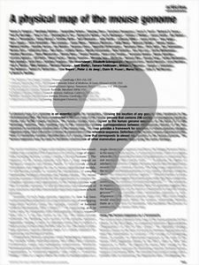
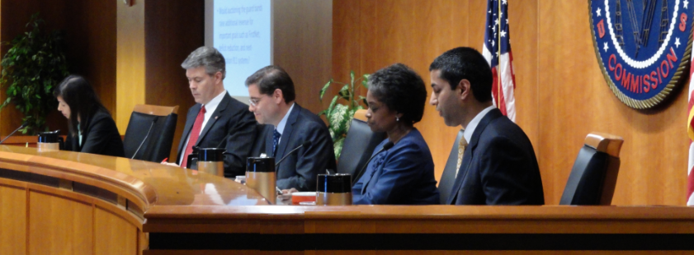
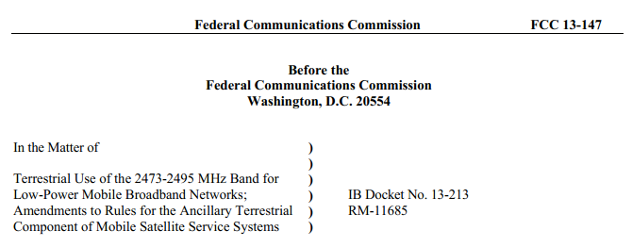
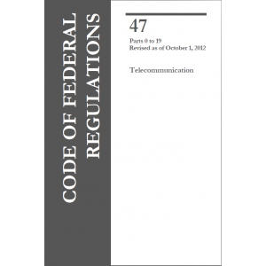
CS research: new avenues
what’s happening in the real world?
how well does X really work?
what are the downsides of X?
how much can future technology help?
what are fundamental limits?

Slide 12
The post-spectrum world

Slide 13
100% of research on narrow part of spectrum
Scientific Uses
Medical Devices
Public Safety; Homeland and National Security
Private Fixed
and Mobile
Transportation
Radio Spectrum
(3 kHz - 300 GHz)
Wireless
LANs
4G Mobile
Broadband
Unlicensed
Devices
Critical Infrastructure
Broadcasting
Satellite Services
Machine to Machine
13
Notes:
A Large amount of spectrum is co-allocated in the U.S. to federal and non-federal users
- 93.8% between 9 kHz and 300 GHz
- 54.2% of the spectrum below 3 GHz is co-allocated,
- 14.1% is federal exclusive and 31.7% is non-Federal exclusive*
However, for the co-allocated spectrum in the range 225 MHz to 3.7 GHz, much of the spectrum is predominantly used to meet federal requirements
Most “prime spectrum” has already been assigned to one or more parties, and it is becoming increasingly difficult to find spectrum that can be made available either for new services or to expand existing ones
Careful management can help realize the greatest benefit from the radio frequency spectrum resource.
Spectrum Management is the scientific evaluation, engineering processes, and administrative procedures which permit a variety of telecommunications stations to operate effectively, and share the radio spectrum without interference
See http://www.ntia.doc.gov/osmhome/roosa5.html (site last visited in April 2009).

Slide 14
Post-spectrum world
Old (pre-2000)
Now
Mostly single-use, application-specific allocations (“radar”, “LMR”, “paging”)
Mostly federal OR non-federal use
Each band its own world
Static usage
Limited spectral efficiency concerns
Go west (up), young application!
No more unallocated bands (below 30+ GHz) →multi-use, generic transport
Shared federal & non-federal use
Neighbor “issues” (GPS, TV)
Usage may change (satellite → mobile)
Spectral efficiency – but how measured? (bits/s/Hz/km²?)
Limited ability to go to higher frequencies

Slide 16
Licensing Methods
Commercial Mobile Radio Services: Auctions
  FCC has auctioned spectrum licenses since mid-90s
  Enhanced competition & growth of wireless services
  Spectrum auction receipts to U.S. Treasury
    Over $50 billion since 1993
    Over $30 billion in past 5 years
Various other licensing methods (examples):
  Licensed by rule
    Public safety spectrum
    Citizen’s band
    Medical devices
    Family radio service
  First-Come-First Served
    Private Land Mobile Services
    Point-to-Point Microwave Services
Notes:
NTIA authorizes on first-come-first-served basis to meet federal (military and civilian) mission requirements

Slide 17
What are Spectrum Incentive Auctions?
Incentive auctions are a voluntary, market-based means of repurposing spectrum by encouraging licensees to voluntarily relinquish spectrum usage rights in exchange for a share of the proceeds from an auction of new licenses to use the repurposed spectrum.
Currently:
  TV in VHF (54-88 MHz, 174-216 MHz) & UHF (476-698 MHz) → 298 MHz
  Cellular in 700 MHz, 800 MHz, 1.7 GHz, 2.1 GHz, 2.5 GHz → ~500 MHz
  Unlicensed data use mainly in 2.4, 5.8, 60 GHz

Slide 18

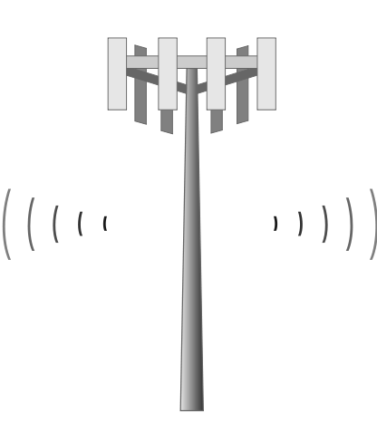
Broadcast Incentive Auction: Key Components
Broadcaster Options
Reverse Auction Design
Repacking of Broadcast Stations
Forward Auction Design
600 MHz Band Plan
Integration of Forward and Reverse Auctions
Unlicensed Use/TV Whitespaces
Broadcasters
Offer to relinquish spectrum usage rights
5
1
Mobile Broadband Providers
Offer to purchase spectrum licenses
Reverse Auction
Forward Auction
2
3
4
Integration
6
7

Slide 19
Band plan – general idea
TV Channel Number
14
37
51
600
MHz
600
MHz
700
MHz
LMR
TV Channels
Lower Guard Band
Channel 37
TV Channels
Downlink
Upper Guard Band
Uplink
Uplink
X cleared
Y cleared
Frequencies in MHz
470
608
-
X
608
614
698
-
Y
698
Amount of spectrum available is auction-dependent:
“X cleared” (downlink) and “Y cleared” (uplink)
Uplink located at channel 51 (698 MHz) and expands downward
Downlink located at channel 36 (608 MHz) and expands downward
5 MHz blocks proposed, paired wherever possible
6 MHz guard bands proposed, available for unlicensed use

Slide 20
Effect of Repacking
ChannelChange
21
50
Station on Ch 50 receives new allotment on Ch 21
21
21
Potential for service loss from co-channel interference
Service Impacts
Service POP A
(Old)
Service POP B
(Old)
Interference (POP C)
Service POP A (New)
Service POP B (New)
New interference must not reduce population coverage by more than 0.5%
Notes:
20

Slide 21
Thoughts on spectrum sharing
Predictable, accountable, securable, generalizable, manageable
  efficiency and elegance is nice, but may not be first
But need to better understand all the pieces can fit together
  not just sensing, but management and prediction
  what’s the value of spectrum that’s only available sometimes?
What happens if a federal user complains about interference?
  How can we find whether the problem is real?
  What happens if indoor-only devices migrate outdoors?
  Can we truly make some bands “add ons”, “best effort” only? → multi-band future
  Not: band management by Congress

Slide 22
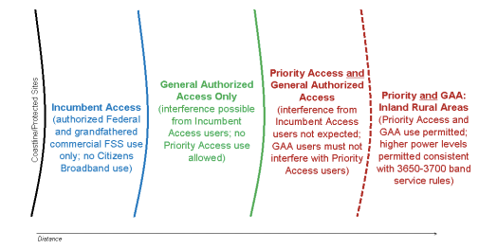
Example: 3.5 GHz
see also TVWS, MBAN
100 MHz at 3.550 GHz + (maybe) 3.65-3.7 GHz
incumbents: DoD radars + fixed satellite service (FSS) receive-only
exclusion zones: 60% pop. unsuitable for macrocell
access: incumbent, priority, general authorized
  hospitals, utilities, state/local gov’t

Slide 23
Measuring Broadband America - Mobile
Accurately measure US mobile broadband performance
In collaboration with 4 major carriers
Data will be public (after summarization to remove identity)
Gathers:
  phone identity, carrier, …
  location (cell, GPS)
  HTTP GET, HTTP POST, UDP latency
https://github.com/FCC/mobile-mba-androidapp

Slide 24
Conclusion
Need research input – but closed loop works better than publish-and-pray
Need more “what’s really out there” research
  what’s the actual spectral efficiency?
  where and how is mobile data used?
  how well does 802.11 work outside the home?
  how much of the unlicensed spectrum is used where?
  what kind of systems can co-exist?
  location services for emergency calling – indoors & outdoors
From components to systems at scale
Questions & data at http://www.fcc.gov/blog/researchers-useful-datasets-and-potential-questions

