Slide 1
Technology Transition: Numbering
Henning Schulzrinne
FCC

Slide 2
Overview
Technology Transition Policy Task Force (TTTF)
FCC technological advisory council (TAC) on numbering
M2M issues for phone numbers
Comparing Internet names and phone numbers
  may provide relevant experiences
Possible technical considerations for an all-IP environment

Slide 3
FCC’s Technology Transition Policy Task Force
  The Task Force’s work will be guided by the insight that, technological changes do not alter the FCC’s core mission, including protecting consumers, ensuring public safety, enhancing universal service, and preserving competition.
  The Task Force will conduct a data-driven review and provide recommendations to modernize the Commission’s policies in a process that encourages continued investment and innovation in these new technologies, empowers and protects consumers, promotes competition, and ensures network resiliency and reliability.

Slide 4
TAC: Database and Identifiers - 2012
Recommendation | Near Term | Longer Term
Sponsor industry workshops on the full range and scope of the impacts to routing databases as transition to IP occurs LNP and ENUM integration Toll Free Services | Initially focus on specific routing database issues ENUM model for sharing routing data for carrier interconnection Toll Free, identify issues related to current dependence on LATA-based routing and called party based charging | Set schedule for nationwide 10 digit dialing Align LATAs and rate centers elimination with “Bill and Keep” implementation date Implement non-geographic number portability which becomes possible with elimination of LD specific charges to consumers
Sponsor Multi-Stakeholder industry forum to address the future of identifiers in support of industry trends beyond the e.164 numbering plan. | Identify Key implementation areas to facilitate the transition to the new public communications Consider identifiers outside e.164 numbering plan Determine M2M impact (if any) for identifiers Create International Database Strategy Team | Identify limitations requiring additional development to address and propose solutions Security, anti-spoofing, Privacy (Identity) Use of location data Role of IPv6 and DNS in emerging identifiers
Notes:
LNP
As VoIP interconnection evolves, use LRN to define peering point for bilateral information exchange
Expand access to NPDB to all VoIP service providers
ENUM
Directory Service that allows domains to “publish” the mapping of telephone numbers to IP addresses or Peering Points
Transition – Encourage use of existing NPAC (LNP) and LERG data / processes for creating ENUM VoIP Peering*
As VoIP interconnect involves, continue to use LERG and LNP data as a method to provide “logical” groupings of PSTN TNs that are advantageous in creating VoIP Peering networks
Transition Workshop for Toll Free in an all VoIP PSTN
As VoIP Peering expands, establish a workshop on transitional issues associated with toll free service*
Consider elimination of access charges due to current Access Reform.
Toll Free really becomes “vanity” numbers, not an IXC service
LATA routing rules may not be valid when PSTN fully transitions to VoIP
Toll Free issues to consider: Near end drop off of the call vs. Far end delivery. What is the peering point for TF calls? With PSTN, we can continue using the “geographic” model associated with the 10D TN to have the Service Provider (or Network Provider) of record for the TN as the defining “Desitinaton Group” POI for ingress of the call to the service provider.
But, for TF numbers, is it“fair” for the calling network to transport the call to the Far End, and what is the Far End.?

Slide 5
TAC: Potential Commission Actions
“A clear national policy on the Future of Numbering is... an essential precondition for further progress on the National Broadband Plan, SIP/VoIP Interconnection and the inevitable transition to all IP networks.” Shockey, Ex Parte, 9/4/2012
Initiate rulemaking on the full range and scope of issues with numbers/identifiers – relationship of Numbering to SIP/VoIP Interconnection and the PSTN Transition
Consider setting a schedule to implement nationwide 10 digit dialing
  – Align LATA’s and rate center elimination with “Bill and Keep” implementation date
  – Fully decouple geography from number and Implement non-geographic number portability
Sponsor multi-stakeholder forum to define requirements for E.164 real-time communications and for new databases that map E.164 to IP data.
Sponsor a series of Technical Workshops involving network operations experts to address technical transition issues moving to an all IP network.
Review approach with major IP to IP providers “Google, Skype, Sidecar and others” and work with ATIS, IETF and ARIN to stay aligned with Internet and industry initiatives.
From September 2012 TAC

Slide 6
It’s just a number
Number | Type | Problem
201 555 1212 | E.164 | same-geographic different dial plans (1/no 1, area code or not) text may or may not work
#250, #77, *677 | voice short code | mobile only, but not all no SMS
12345 | SMS short code | SMS only country unclear
211, 311, 411, 911 | N11 codes | Distinct call routing mechanism Mostly voice-only May not work for VoIP or VRS
800, 855, 866, 877, 888 | toll free | not toll free for cell phone may not work internationally
900 | premium | voice only unpredictable cost

Slide 7
Numbers vs. DNS & IP addresses
 | Phone # | DNS | IP address
Role | identifier + locator | identifier | locator (+ identifier)
Country-specific | mostly | optional | no
# of devices / name | 1 (except Google Voice) | any | 1 (interface)
# names /device | 1 for mobile | any | any
controlled by | carrier, but portability unclear (800#) and geo. limited | any entity, with trademark restrictions | any entity (ISP, organization)
who can obtain? | geographically-constrained, currently carrier only | varies (e.g., .edu & .mil, vs. .de) | enterprise, carrier
porting | complex, often manual; wireless-to-wireline may not work | about one hour (DNS cache) | if entity has been assigned PIAs
delegation | companies (number range) | anybody | subnets
identity information | carrier (OCN), billing name only → LERG, LIDB | WHOIS data (unverified) | RPKI, whois
Notes:
http://www.nanpa.com/reports/faq.html#g1

Slide 8
Communication identifiers
Property | URL owned | URL provider | E.164 | Service-specific
Example | alice@smith.name sip:alice@smith.name | alice@gmail.com sip:alice@ilec.com | +1 202 555 1010 | www.facebook.com/alice.example
Protocol-independent | no | no | yes | yes
Multimedia | yes | yes | maybe (VRS) | maybe
Portable | yes | no | somewhat | no
Groups | yes | yes | bridge number | not generally
Trademark issues | yes | unlikely | unlikely | possible
Privacy | Depends on name chosen (pseudonym) | Depends on naming scheme | mostly | Depends on provider “real name” policy
Notes:
http://findmyfacebookid.com

Slide 9

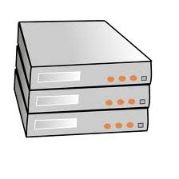

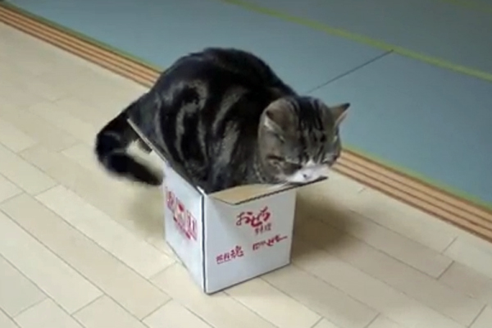
Internet identifier management: Domain name registration
$0.18/year
.edu registry
+ registrar
.gov registry
+ registrar
.com registry
.net registry
$7.85/year
$5.11/year
registrar
registrar
web hosting
registrar
DNS hosting
$10-$15/year

Slide 10
Number usage
FCC 12-46

Slide 11
Area codes (NPAs)
634

Slide 12
Dialing plans can be confusing
NANPA report 2011

Slide 13

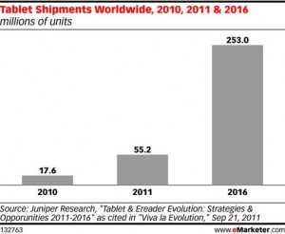

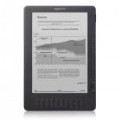
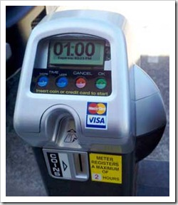
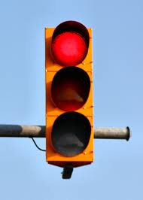
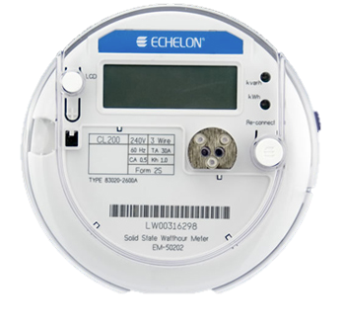
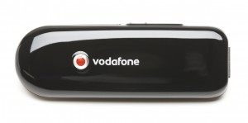
Phone numbers for machines?
< 2010
212 555 1212
500 123 4567
(and geographic numbers)
12% of adults
500 123 4567
533, 544
5 mio.
311,000
64 mio.
now: one 5XX code a year…
(8M numbers)
10 billion available
see Tom McGarry, Neustar
Notes:
http://blog.neustar.biz/neustar-insights/telephone-numbers-are-for-people-not-machines/
http://www.parking.org/media/overview-of-the-us-parking-industry.aspx
http://www.statisticbrain.com/e-reader-statistics/
http://www.ite.org/reportcard/TechnicalReport.pdf

Slide 14
Why phone numbers for M2M?
Customer & billing records
3GPP and similar standards → routing
SMS wake-up
Lack of alternatives
  IP address is not a user or device identifier!

Slide 15
Very rough projection
2050: 439 million US residents
  @ 2.5 numbers/person → 1.1 B
250 million vehicles
2015: 64 million smart meters
  114 million households, 7.4 million businesses
Other large-scale users
  signs and traffic lights (0.3 M)
  medical monitors
  vending machines (8 M) and ATMs (2.4 M)
Many others only use WiFi or similar
10 billion available
Notes:
http://www.edisonfoundation.net/iee/Documents/IEE_SmartMeterRollouts_0512.pdf

Slide 16


Future numbers
Should numbers be treated as names?
  see “Identifier-Locator split” in Internet architecture
Should numbers have a geographic component?
  Is this part of a state’s cultural identity?

Slide 17
More number questions…
In progress: separate device & number
  APIs and forwarding services
Should numbers be licensed to individuals?
  → separate service from number
  Simplify number portability
  Similar to Internet DNS model
  But: Can you put a 212 number in your will?
  But: Will somebody buy up all the local numbers?
    How do you constrain number hoarding?
  Role of government administrator?

Slide 18
Security (trustworthiness)
Practically, mostly about identity, not content
Old model: “trust us, we’re the phone company”
New reality: spoofed numbers & non-carrier entities
  both domestic and international
  → SMS and voice spam
Need cryptographically-verifiable information
  Is the caller authorized to use this number?
  Has the caller ID name been verified?
    cf. TLS

Slide 19
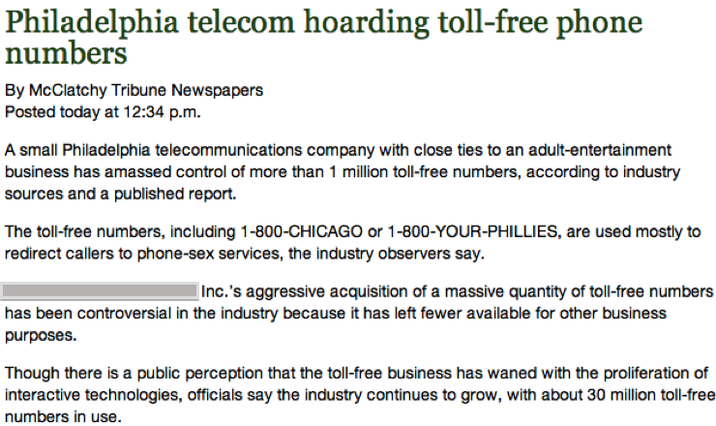
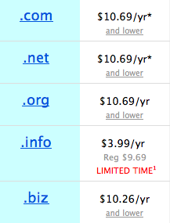
Phone numbers: hoarding
How to prevent hoarding?
  By pricing
    DNS-like prices ($6.69 - $10.69/year for .com)
      takes $100M to buy up (212)…
      1626: 60 guilders
    e.g., USF contribution proposals
      $8B/year, 750 M numbers → $10.60/year
      but significant trade-offs
  By demonstrated need
    see IP address assignment
    1k blocks
    difficult to scale to individuals
15c/month
100 million .COM
Notes:
Manhattan purchase Peter Minuit

Slide 20
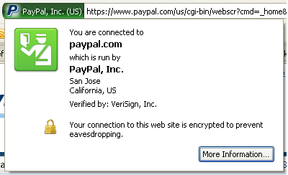
Who assures identity?
Web:
  plain-text → rely on DNS, path integrity
    requires on-path intercept
  X.509 certificate: email ownership
    no attributes
  EV (“green”) certificate
PSTN
  caller ID
  display name: CNAM database, based on caller ID
Notes:
http://www.cnamcallerid.com
https://www.opencnam.com
Truth in Caller ID Act of 2009

Slide 21
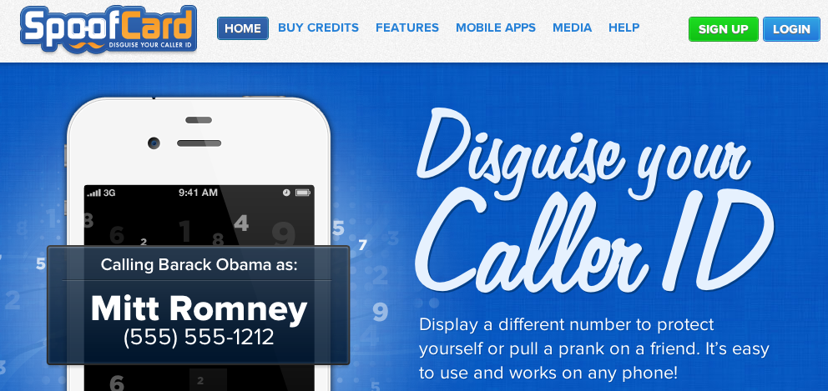
Caller ID spoofing
Caller ID Act of 2009: Prohibit any person or entity from transmitting misleading or inaccurate caller ID information with the intent to defraud, cause harm, or wrongfully obtain anything of value.

Slide 22
Caller ID spoofing
A. Panagia, AT&T
enhances theft and sale of customer information through pretexting
harass and intimidate (bomb threats, disconnecting services)
enables identity theft and theft of services
compromises and can give access to voice mail boxes
can result in free calls over toll free dial-around services
facilitates identification of the name (CNAM) for unlisted numbers
activate stolen credit cards
causes incorrect billing because the jurisdiction is incorrect
impairs assistance to law enforcement in criminal and anti-terrorist investigations
FCC rules address caller ID spoofing, but enforcement challenging

Slide 23


Strawman “Public” PSTN database
Now: LIDB & CNAM, LERG, LARG, CSARG, NNAG, SRDB, SMS/800 (toll free), do-not-call, …
Future:
1 202 555 1234
HTTPS
DB
carrier code or SIP URLs
type of service (800, …)
owner
public key
…
extensible set of fields
multiple interfaces (legacy emulation)
multiple providers

Slide 24
Conclusion
Opportunity & need to think strategically
  technology transition
  non-human users
Numbering opportunities & challenges:
  more efficient usage → 100% usability
    1 k blocks → “blocks” of 1
  improve porting efficiency across all classes of use
  better consumer experience
  prevent illegal number spoofing
Largely independent of who can “own” numbers

