Slide 1
caller ID spoofing – technical challenges & Standards
Henning Schulzrinne
FCC

Slide 2
Introduction
What is number (callerID) spoofing?
Is there “good” spoofing?
What happens with spoofing?
How does this relate to (illegal) robocalling?
How can we reduce (and maybe eliminate) spoofing?
What are on-going standardization activities?
Are there short-term improvements?
What about caller name display?

Slide 3
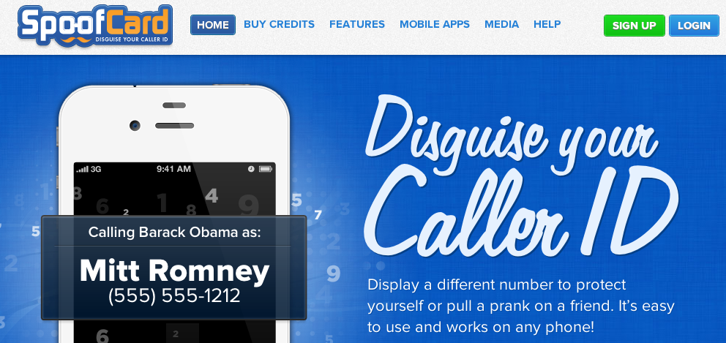
Caller ID spoofing
Easily available on (SIP) trunks
US Caller ID Act of 2009: Prohibit any person or entity from transmitting misleading or inaccurate caller ID information with the intent to defraud, cause harm, or wrongfully obtain anything of value.
Also: FCC phantom traffic rules

Slide 4
Two modes of caller ID spoofing
Impersonation
spoof target number
Helpful for
vishing
stolen credit card validation
retrieving voicemail messages
SWATting
disconnect utilities
unwanted pizza deliveries
retrieving display name (CNAM)
Anonymization
pick more-or-less random #
including unassigned numbers
Helpful for
robocalling
intercarrier compensation fraud
TDOS

Slide 5
Who gets spoofed?
Unassigned numbers
Numbers assigned to innocent (random) third parties
consumers may have to change phone numbers
Numbers assigned to vishing targets
credit card fraud numbers
system administrators

Slide 6
Impact of illegal robocalls
Consumer fraud
Nuisance
impact on landline higher than cell phone → increase abandonment of landlines?
Loss of phone numbers (personal & small business)
Impact on legitimate mass-calling services (e.g., alerts)
Cost to carriers:
Customer service calls with no good resolution
ICC fraud

Slide 7
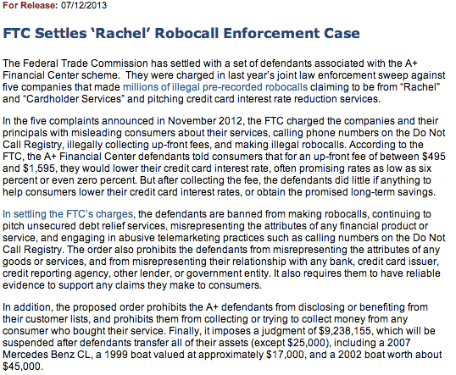
FTC enforcement

Slide 8
Spoofing & robocalling complaints
FTC gets 200,000 complaints a month (2012Q4)
Consumers usually can’t tell spoofed robocalls

Slide 9
Changes in environment
Old (pre-2000) | new
Small number of carriers serving customers with fixed number pools (residential, inbound) | carriers that provide services to non-carriers (e.g., Google Voice, VRS) voice service providers (via APIs)
Carriers either larger or rural → trusted | “Pink” carriers (robocalls = lots of minutes)
Carriers with deep engineering skills | Telecom engineers fired or retired
Call routing determined by physical transport (MF or SS7) | logical routing via SIP proxies
Domestic calls stay within the country | call from NJ to NY may visit Berlin
#’s only for certificated carriers (~ 1000) | interconnected VoIP providers (trial)
1000 block assignment | individual numbers?
Geographic assignment (LATA, area code) | no direct relationship to geography (800#, mobile, VoIP, M2M, …)

Slide 10
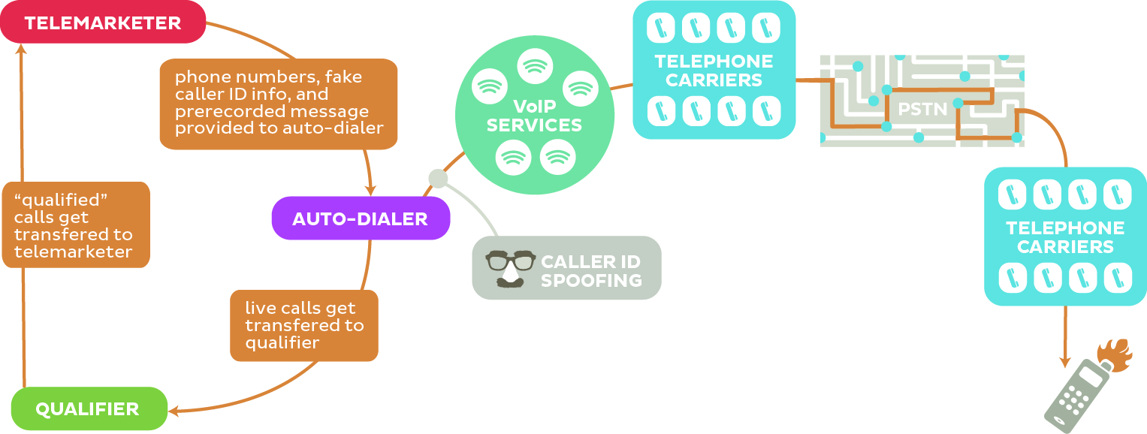
Robocalling
Often laundered through multiple providers
“pink carriers”
(often abroad)

Slide 11
Legitimate caller ID spoofing
Doctor’s office
call from personal physician cell phone should show doctor’s office number
Call center
airline outbound contract call center should show airline main number, not call center
Multiple devices, one number
provide single call-back number (e.g., some VoIP services) from all devices
anonymity is distinct problem (caller ID suppression)

Slide 12
Stop spoofing → stop robocalls
If numbers can be trusted, filters work:
industry-wide fraudulent number list (e.g., DoNotCall violators)
crowd-sourcing “bad” numbers by other consumers and services
Filter options:
opt-in service by terminating carrier (e.g., using consumer-chosen source of numbers)
app on Android smartphones
corporate PBX and hosted VoIP services
Enable consumer choice
Note: initially, only some calls will be validated
Type of call | Validated? | Sample action
Personal friend (in address book) | Maybe | answer
“Good” robocaller (e.g., alert service, airline) | Yes | answer
“Lazy” robocaller (legal) | No | voicemail
“Bad” robocaller | No | voicemail

Slide 13
Making numbers trustworthy (again)
Carriers get cryptographic certificates for number ranges they have been assigned
May delegate to customers (e.g., BPO call centers, individuals with legitimate needs)
Originating caller or carrier signs CPN in VoIP signaling
Any entity in call path can validate whether caller is entitled to use number as CPN
typically, terminating carrier or VoIP-to-SS7 gateway
Can be used to mark SS7 GAP fields

Slide 14
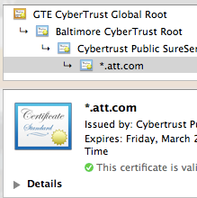
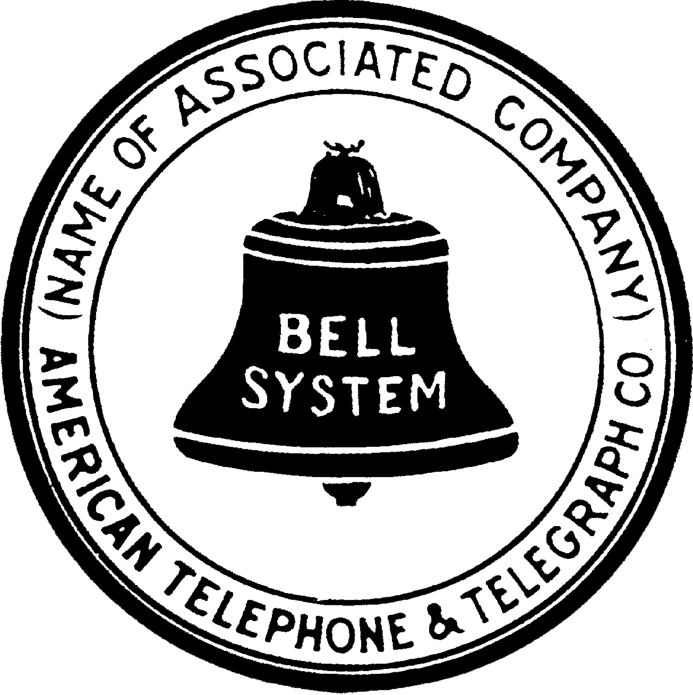
Strawman operation: number assignment
②
①
cert for 555-1200?
public key = PA
db.att.com
③
private
ENUM
future numbering DB

Slide 15
Requirements
E.164 number source authenticity
E.164 taken loosely (N11, P-ANI, non-reachable numbers, …)
assume that numbers can be canonicalized for signing
seems to work for VM, CDRs, SS7 translation, …
Complete solution (but not necessarily one mechanism)
number assignment to validation
validate caller ID
later?: extended caller information
Functionality
must work without human intervention at caller or callee
minimal changes to SIP
must survive SBCs
must allow partial authorized & revocable delegation
doctor’s office
third-party call center for airline
must allow number portability among carriers (that sign)

Slide 16
Certificate models
Integrated with number assignment
assignment of number includes certificate: “public key X is authorized to use number N”
issued by number assignment authority (e.g., NPAC), possibly with delegation chain
allocation entity → carrier (→ end user)
separate proof of ownership
similar to web domain validation
e.g., similar to Google voice validation by automated call back
“Enter the number you heard in web form”
Automate by SIP OPTIONS message response?

Slide 17
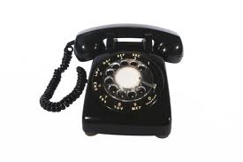
Strawman: call signing for VoIP
②
(555-1200,555-1800,17:21:09)_{PrA} = gbUre8Rps1
INVITE
From: 555-1200
To: 555-1800
Date: 17:21:09
Identity: gbUre8Rps1
URL: db.att.com/5551200
INVITE
From: 555-1200
To: 555-1800
Date: 17:21:09
①
carrier

Slide 18
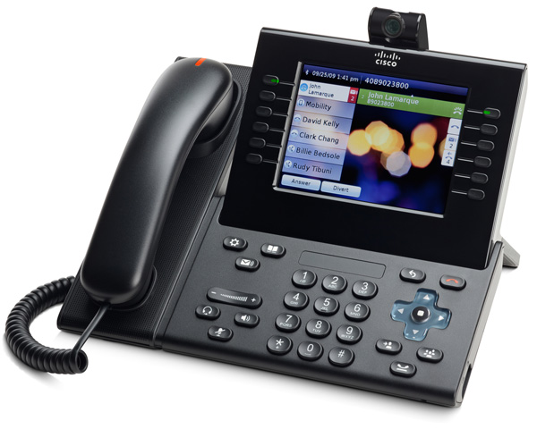
Strawman: validation
⑤
Decrypt Identity using public key → H
Hash(From, To, Date) = H?
③
INVITE
From: 555-1200
To: 555-1800
Date: 17:21:09
Identity: gbUre8Rps1
URL: db.att.com/5551200
⑥
validates?
“555-1200”
db.att.com
④
Y
N
⑦
deliver call
flag as unvalidated
“unvalidated call rejection”
works also if trusted non-VoIP termination (e.g., domestic SS7)

Slide 19
Options
almost all of these could interoperate in single system
Number validation
Public key only (e.g., DNS)
public
private
X.509 cert
single certifier (per CC)
multiple certifiers per CC
single cert store (hierarchy)
any cert anywhere
separate delivery (URL)
single “CDN”
number-based access (no URL)

Slide 20
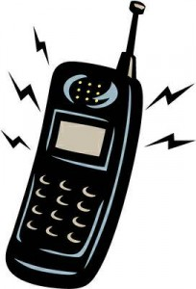
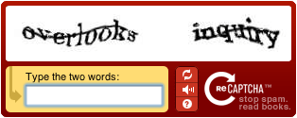
Incremental deployment
signed?
N
Y
should be signed?
validates?
N
Y
N
Y
known caller?
N
Y
N
Y

Slide 21
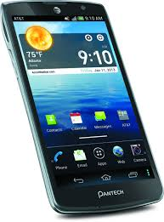
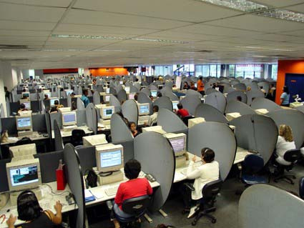
Non-SIP paths
5551200: goodcall.com
5551201: norobo.com
SS7
legitimate call center
goodcall.com
INVITE
From: 555-1200
To: 555-1800
Date: 17:21:09
Identity: gbUre8Rps1
URL: goodcall.com/5551200

Slide 22
Status
March 2013: IETF plenary talk in Orlando
May 2013: IETF-sponsored industry meeting in DC
~30 attendees (Neustar, AT&T, Verizon, ALU, Genband, Cisco, Google, ISOC, …)
July 2013: Initial “birds-of-a-feather” (BOF) meeting in Berlin
Sept. 2013: IETF STIR [Secure Telephone Identity Revisited] working group formed
Multiple initial drafts on problem statement and initial solution proposals
Oct 2013: MAAWG meeting in Montreal

Slide 23
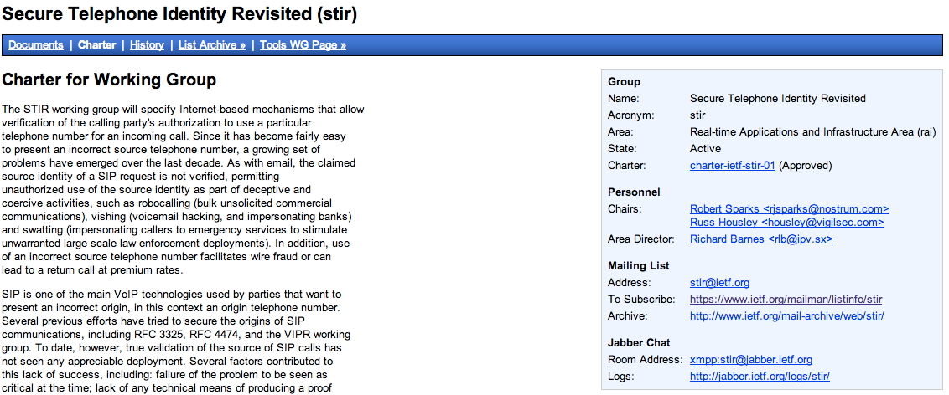
IETF STIR working group
http://datatracker.ietf.org/wg/stir/charter/
FAQ at http://tools.ietf.org/internet-drafts/draft-kaplan-stir-fried-00.txt

Slide 24
Known unknowns
Who will sign first, by choice or mandate?
large carriers (“get rid of robocall complaints”)
legitimate outbound call centers (“I want my snow day alert to be received”)
high-value users (“I want to prevent identity theft”)
smartphone end users
Who will validate first?
carriers concerned about intercarrier compensation fraud
carriers sick of customer complaint calls
new entrants looking for differentiator (“switch and no more robocalls!”)

Slide 25
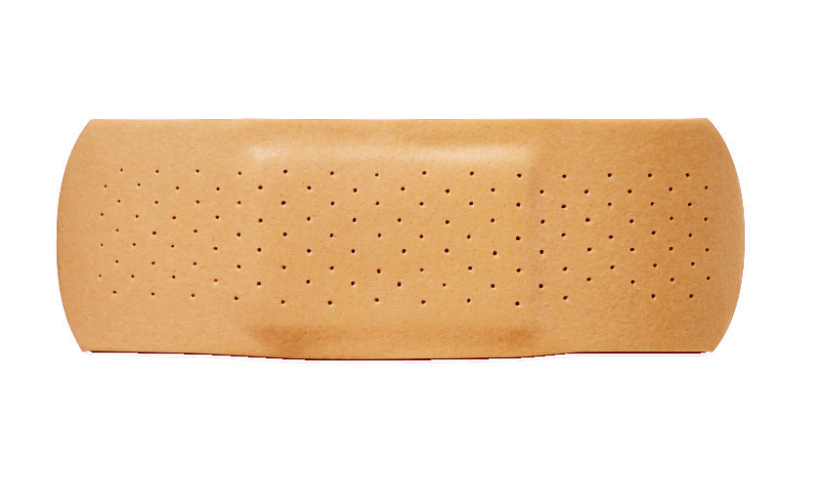
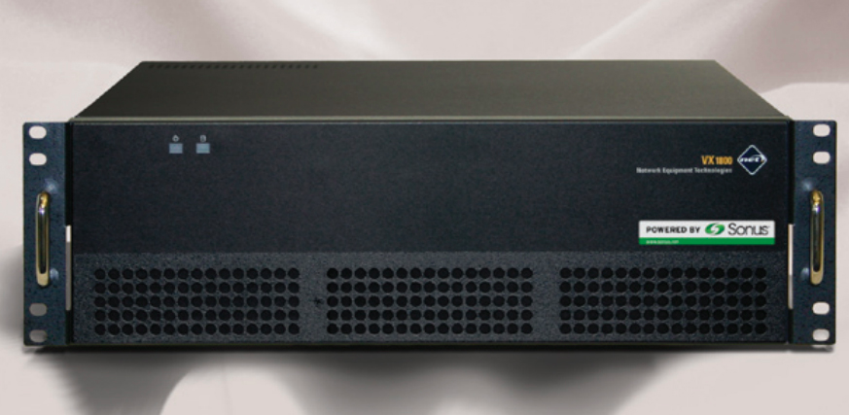
Short-term band-aids
Premise: almost all illegal robo-calls originate on VoIP
Thus, gateways as filter for numbers that shouldn’t be there
SS7
VoIP
“legacy” carriers that don’t interconnect via VoIP
“Do not originate” list
of numbers

Slide 26
Improving caller name reliability
Textual caller ID used more than number by recipients
Generation of caller name varies:
Various CNAM/LIDB databases: CPN → name
Some from caller carrier, some third-party (reduce dip fees)
Can be generated by third party
Change with VoIP: end-to-end delivery
basic name, with attribution (“based on business record”, “self-asserted”)
additional information (“FDIC-registered”, “accredited health care facility”, “registered charity”)
Initial discussion mail list at IETF: CNIT

Slide 27
Conclusion
Robocalls generate the most telephone-related complaints
and cause significant financial harms to consumers & carriers
enabled by low-cost international and mass VoIP calling
Stopping spoofing will greatly reduce robocalls
and allow consumer choice
with operational benefits for carriers
Initial efforts at technical solutions
2-3 year implementation horizon
May need interim solutions
Need industry, numbering administrator & state regulator help & input, i.e., you!

Slide 28
RFC 4474 (SIP Identity)
INVITE sip:bob@biloxi.example.org SIP/2.0
Via: SIP/2.0/TLS pc33.atlanta.example.com;branch=z9hG4bKnashds8
To: Bob <sip:bob@biloxi.example.org>
From: Alice <sip:alice@atlanta.example.com>;tag=1928
Call-ID: a84b4c76e66710
CSeq: 314159 INVITE
Max-Forwards: 70
Date: Thu, 21 Feb 2002 13:02:03 GMT
Contact: <sip:alice@pc33.atlanta.example.com>
Identity: “KVhPKbfU/pryhVn9Yc6U=“
Identity-Info: <https://atlanta.example.com/atl.cer>;alg=rsa-sha1
Content-Type: application/sdp
Content-Length: 147
v=0
o=UserA 2890844526 2890844526 IN IP4 pc33.atlanta.example.com
s=Session SDP
…
SBC may change
domains
changed by
SBC

Slide 29
Problems with RFC 4474
see rosenberg-sip-rfc4474-concerns
Cannot identify assignee of telephone number
Intermediate entity re-signs request
B2BUAs re-originate call request
replace everything except method, From & To (if lucky)

