Slide 1
Telecommunications Policy at the FCC
Henning Schulzrinne

Slide 2
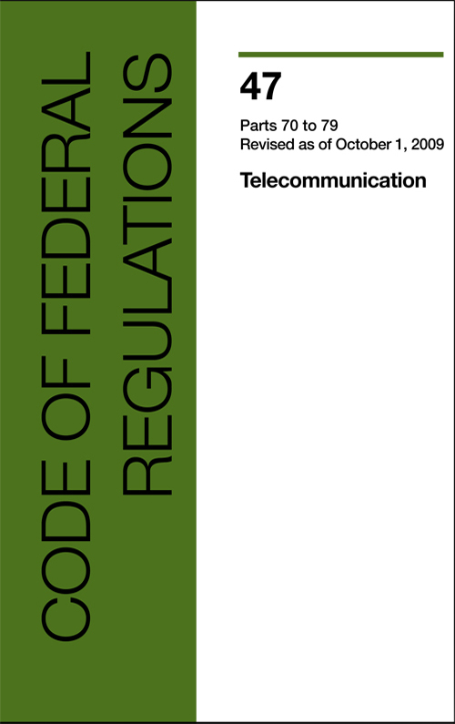
Example: CFR 47
§ 15.5 General conditions of operation.
(a) Persons operating intentional or unintentional radiators shall not be deemed to have any vested or recognizable right to continued use of any given frequency by virtue of prior registration or certification of equipment, or, for power line carrier systems, on the basis of prior notification of use pursuant to §90.35(g) of this chapter.
(b) Operation of an intentional, unintentional, or incidental radiator is subject to the conditions that no harmful interference is caused and that interference must be accepted that may be caused by the operation of an authorized radio station, by another intentional or unintentional radiator, by industrial, scientific and medical (ISM) equipment, or by an incidental radiator.

Slide 3
FCC
Chairman (D)
4 Commissioners (2 D, 2 R)
Consumer and Governmental Affairs
Enforcement
International
Media
Public Safety & Homeland Security
Wireless Telecommunications
Wireline Competition
Independent federal agency
About 1,600 employees

Slide 4
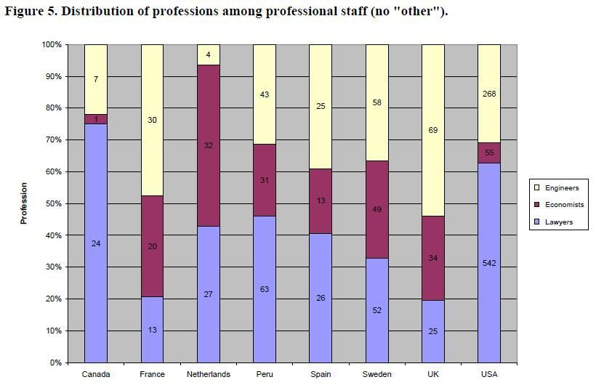
Staffing at National Regulatory Agencies

Slide 5
Process
NOI
NPRM
R&O
Notice of Inquiry
Notice of Proposed Rule Making
Report & Order
Petition for reconsideration
Federal court review
comments,
replies & ex parte
rarely

Slide 6
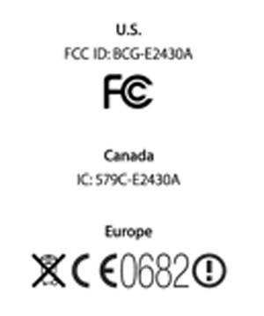
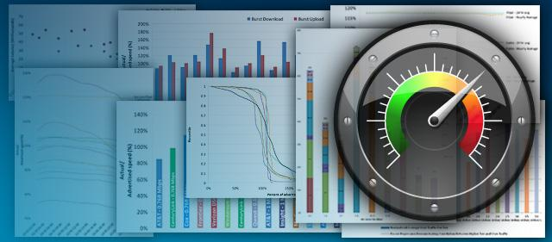
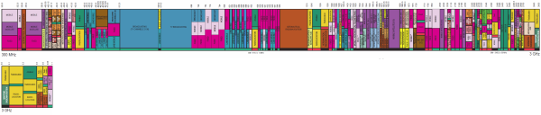
Responsibilities (examples)
Operational:
  Equipment authorization
  Outage reporting
  Consumer complaints
  Enforcement
Spectrum
  operating parameters
  licenses, incl. auctions
Notes:
http://www.nist.gov/director/sco/upload/2_3_Hurst.pdf

Slide 7
Responsibilities (examples)
Policy
  wireline & wireless (circuit & packet-switched) public networks
  special access networks
  cable TV, radio, TV, satellite
  public safety, cybersecurity
Measurement & data
  e.g., Measuring Broadband America
Fund administration
  Universal Service Fund (USF)
  Relay (VRS, IPCTS, …)
Notes:
http://www.nist.gov/director/sco/upload/2_3_Hurst.pdf

Slide 8
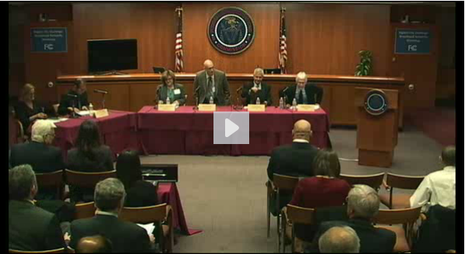
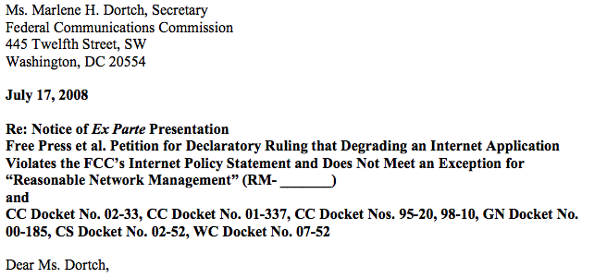
Interacting with the Commission
Workshops
  by invitation
Advisory committees
Comments and reply comments
Ex-parte filings
  in-person and by phone
Informal presentations
  if not an active docket

Slide 9
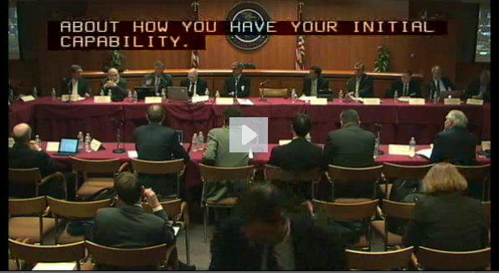
FCC Advisory Councils & Committees
Operate (mostly) under FACA
  sometimes mandated by Congress
Examples:
  Technological Advisory Council (TAC)
  Emergency Access Advisory Committee (EAAC)
  Open Internet Advisory Committee (OIAC)
  Communications Security, Reliability, and Interoperability Council (CSRIC)
  Diversity Committee
  Consumer Advisory Committee
  …
often industry or organization members
academics as Special Government Employees

Slide 10
Working temporarily at the Commission
Student interns
  law, economics, engineering
  unpaid & paid
IPAs
  Chief Economist
  Chief Technologist/CTO
  others

Slide 11
Personal perspective
Two stints:
  Engineering Fellow (sabbatical+) 2010-2011
  CTO 2012-2013 (leave-of-absence from Columbia U.)
Parachute in vs. in-the-field model
Goals:
  contribute (match of interests & FCC activities)
  learn (“how does policy making work?”)
  inform research (“what are real-world problems?”)

Slide 12
Challenges
Engineer: designing & building
Lawyer: listening & adjudicating (APA process)
Long lead times
  most projects take 2-3 years, sometimes 10
  thus, unlikely to participate idea-to-R&O
  the dreaded PRA
Follow-through
  goal speech vs. action
    convening, coordinating, rule making, funding
  change is incremental
    constrained by 1934/1996 Telecom Act & Congress
    constrained by constituencies (e.g., USF recipients)
Role under-defined
  does not follow classical “chief” hierarchy

Slide 13

Logistical challenges for IPAs
IPA doesn’t cover additional costs
Second home (if outside Beltway)
  with or without family
Family dislocation
  difficult depending on profession of spouse

