Slide 1
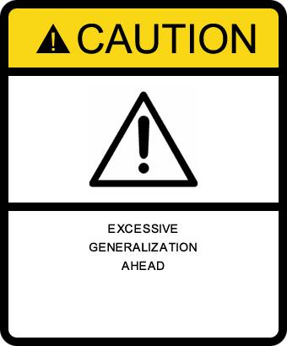
CS – a Phase change
Henning Schulzrinne
Columbia University & FCC

Slide 2
5 phase changes in CS
Boxes & hobby → critical infrastructure
Deterministic → probabilistic
CS stovepipe devices → all-CS-hands-on-deck
Translation into practice: waterfall → multi-faceted
CS impact: conferences → public

Slide 3
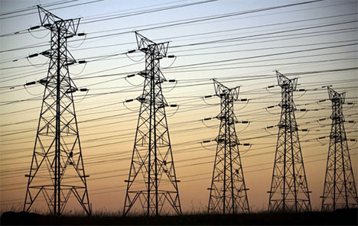
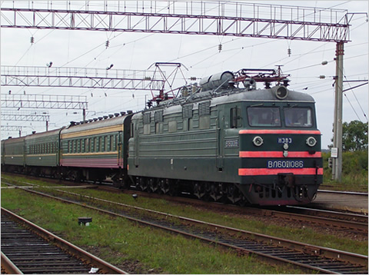
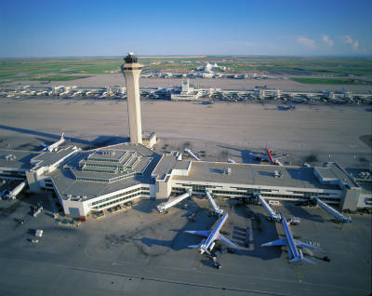
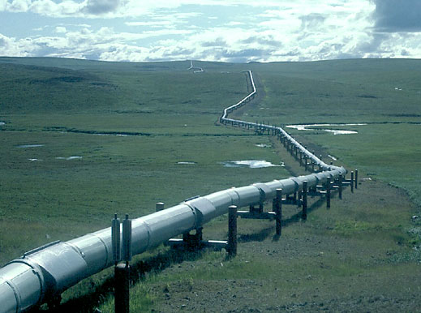
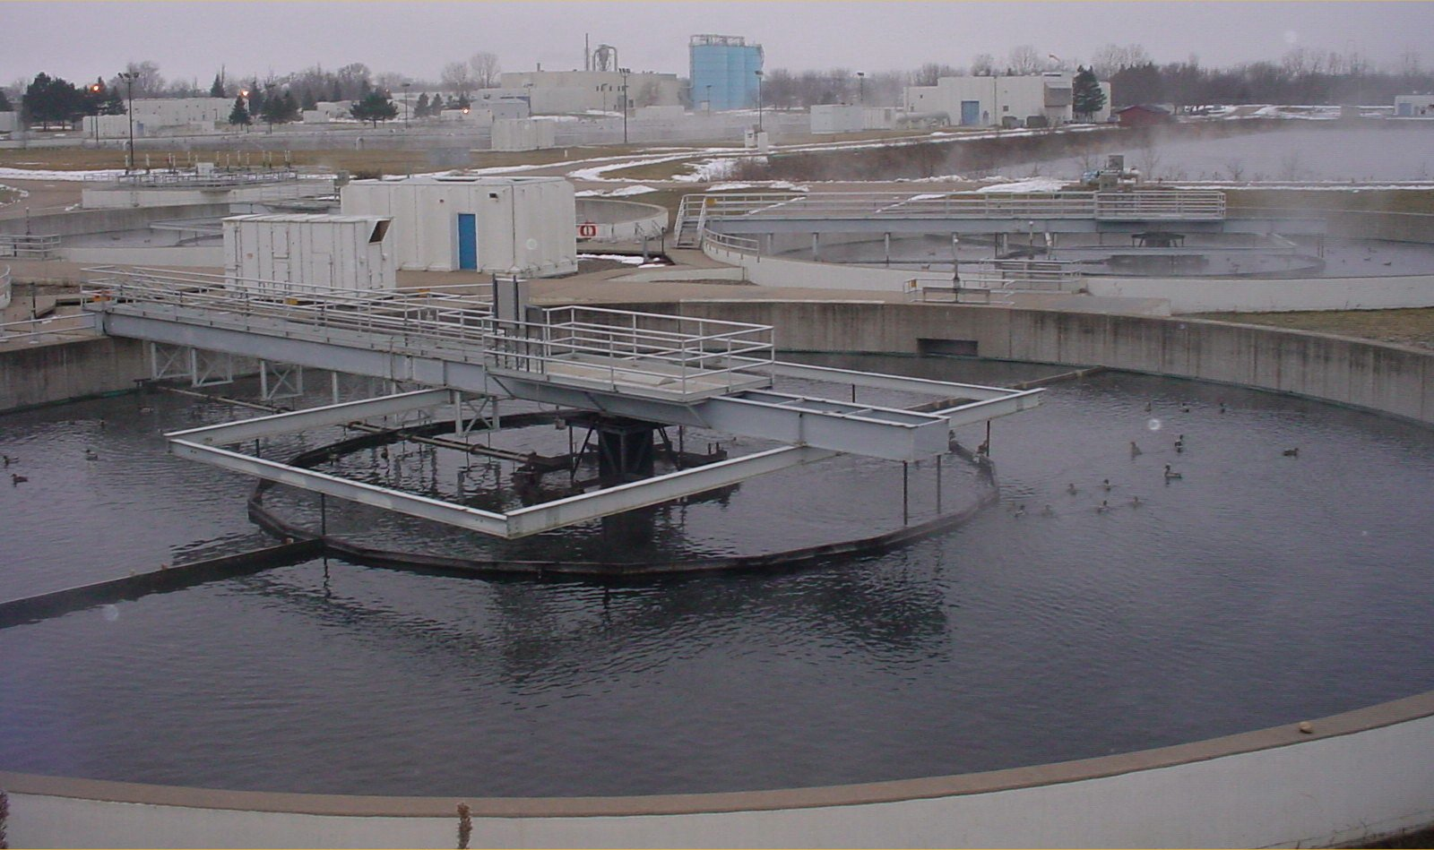
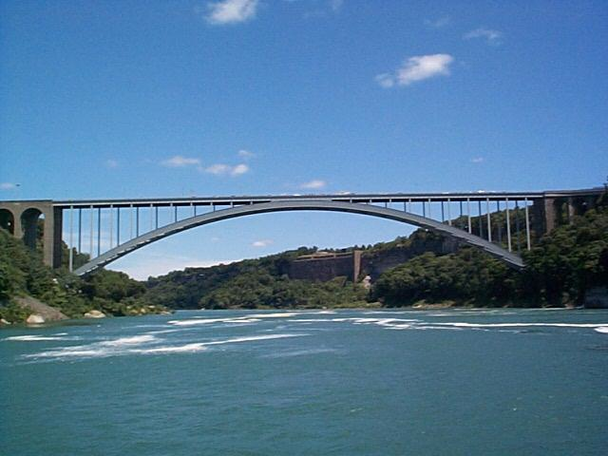
The great infrastructure
Technical structures that support a society → “civil infrastructure”
Large
Constructed over generations
Not often replaced as a whole system
Continual refurbishment of components
Interdependent components with well-defined interfaces
High initial cost
water
energy
transportation

Slide 4
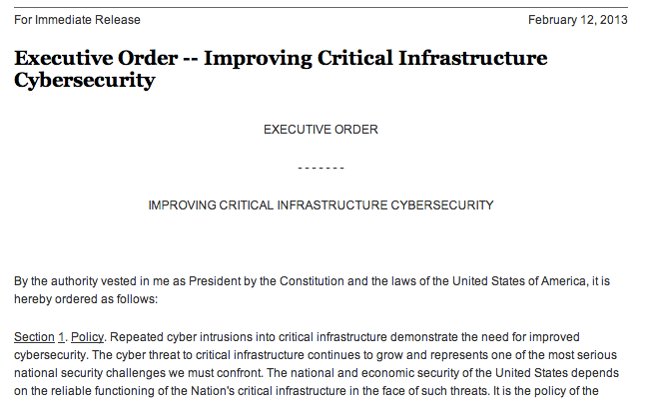
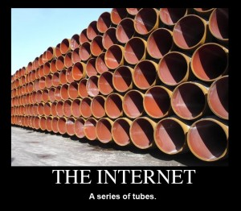
The Internet (and CS) as core civil infrastructure

Slide 5
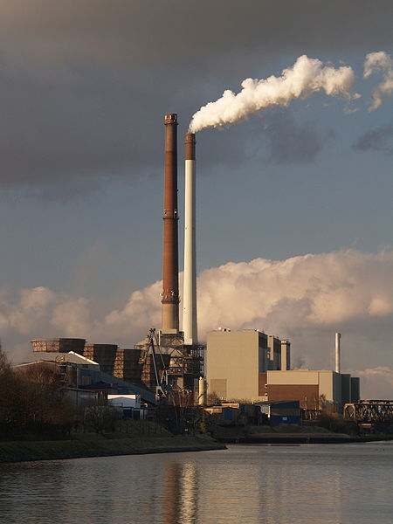
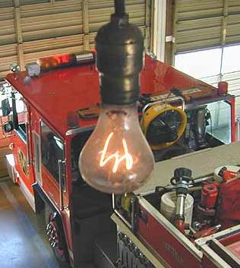
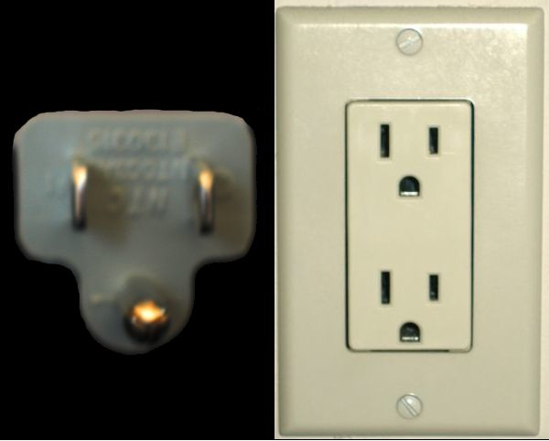
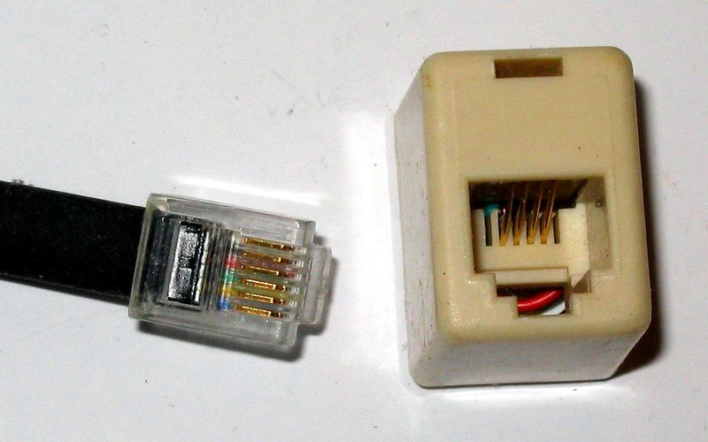
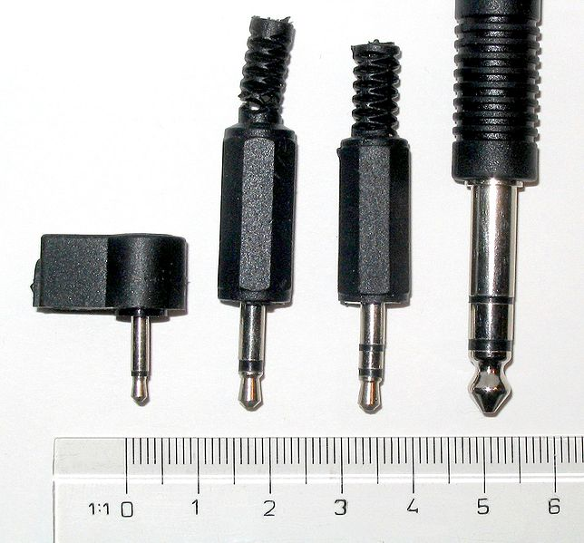
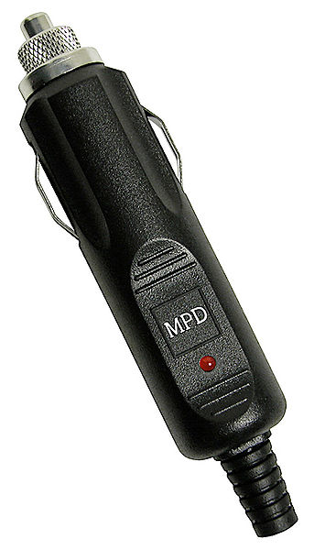
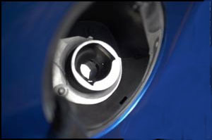
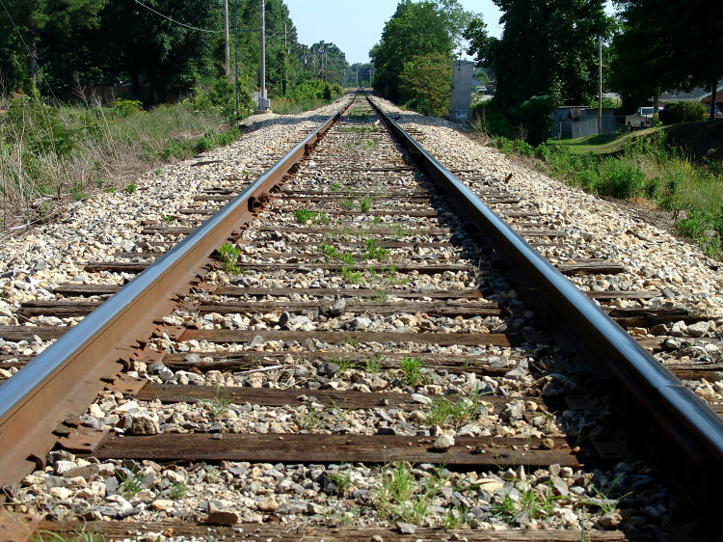
Technology changes, interfaces are forever
110/220V
1901
1904
1878
1993
1992
1982
1830

Slide 6
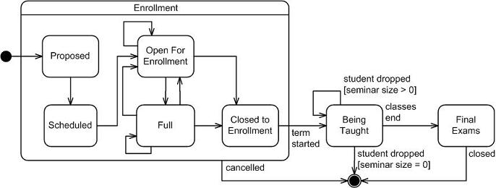
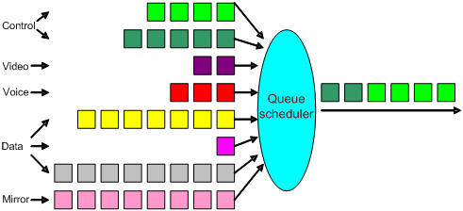
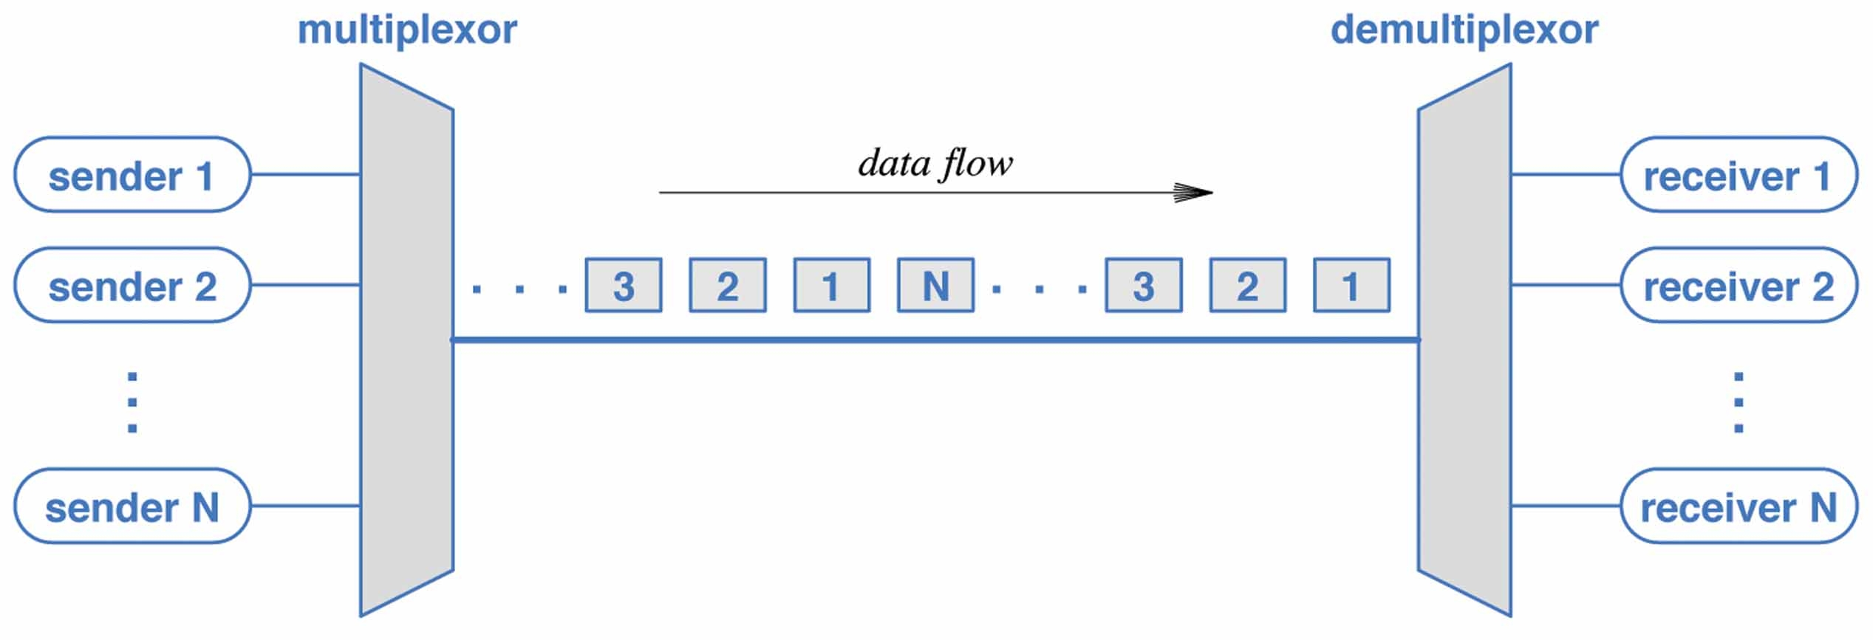
CS: deterministic → statistical
TDM
packet switching

Slide 7
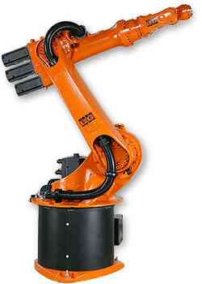
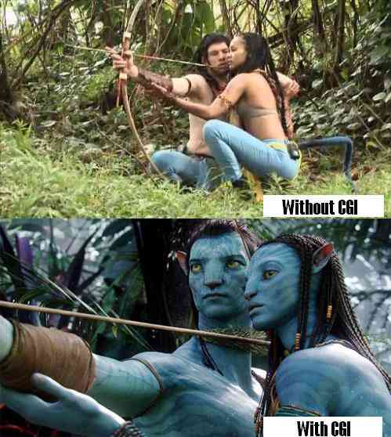
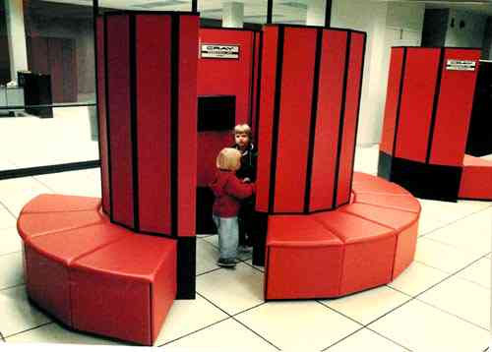
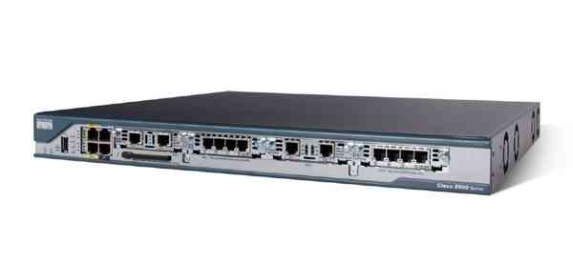
Old CS: one box, one specialty

Slide 8
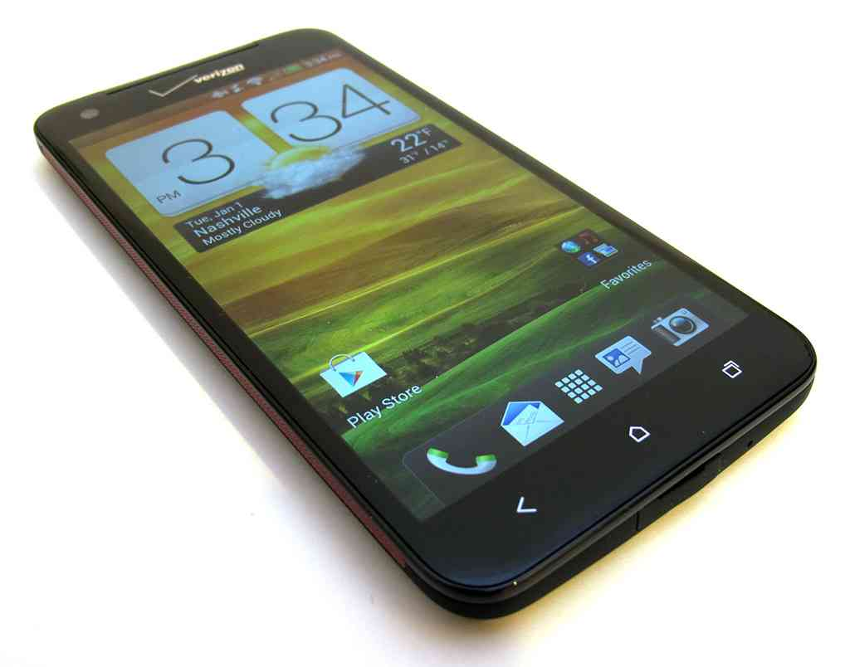
New CS: all hands on deck
SQL
database
image processing
crypto
JIT compilers (browser)
speech-to-text
network
protocols
text-to-speech
AI
mechanical sensor
UI design
OS
computer arch.

Slide 9
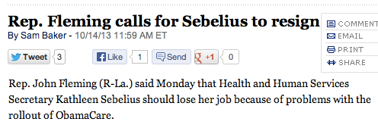
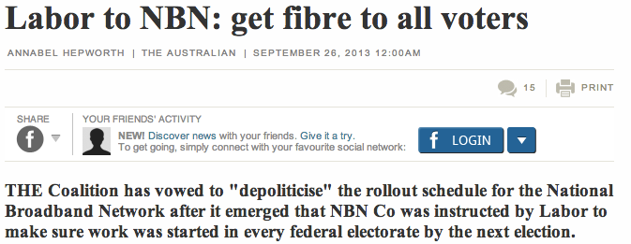
CS as headline news

Slide 10
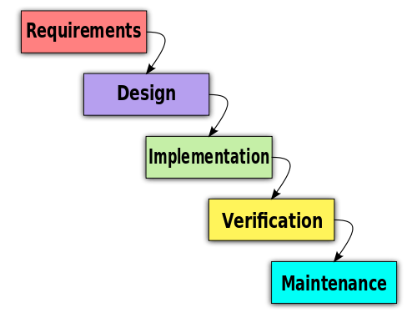
Classical CS R&D model
DARPA & NSF programs
universities
Bell Labs
AT&T Labs
IBM Research
Research & publication
tech companies
Field testing

Slide 11
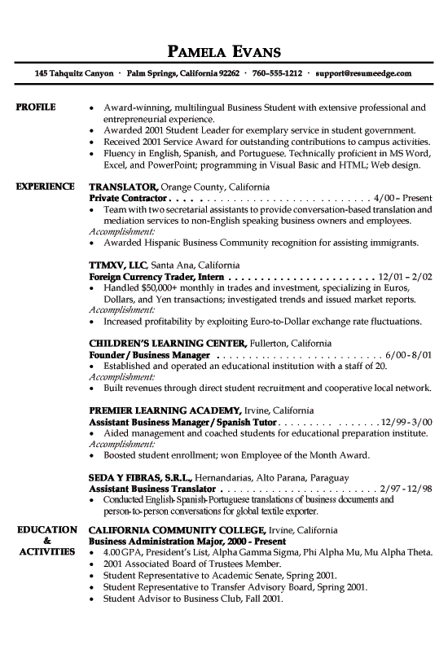
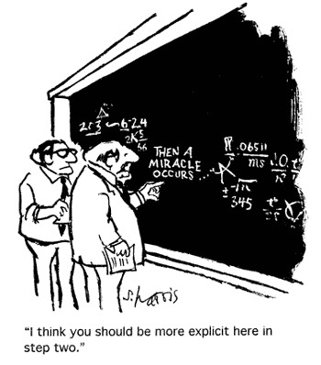
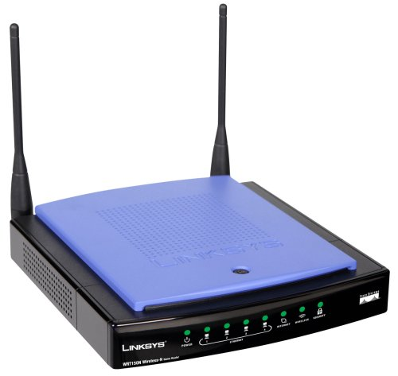
CS research: classical

Slide 12
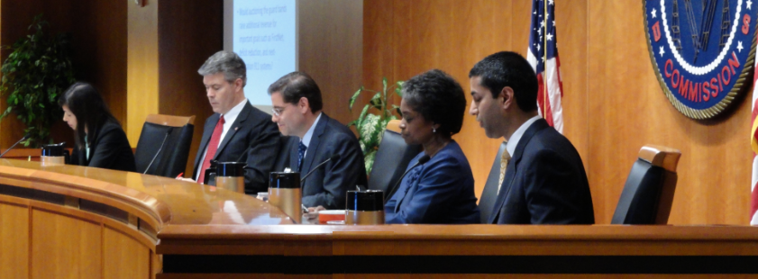
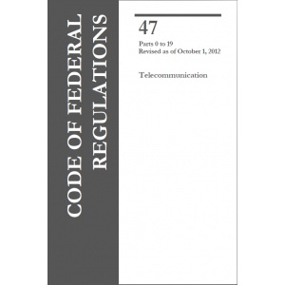
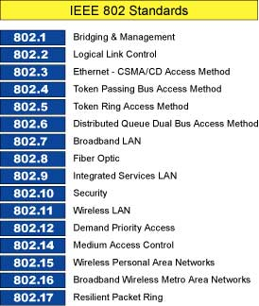
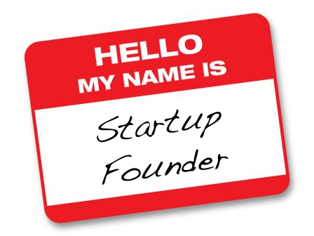
CS research: new avenues

Slide 13
New CS impact: public policy
Laws and (particularly) state & federal rules depend on notice-and-comment
Open to all – no need to be a lawyer or lobbyist
preference for peer-reviewed academic research, not paid-for advocacy
Measurements, data & comparison, not (just) novel ideas
e.g., http://www.fcc.gov/blog/researchers-useful-datasets-and-potential-questions
Random examples:
Evaluation of educational achievement in MOOCs
Broadband quality & economics
Spectrum usage and properties
Indoor location for 911
Usability of security & privacy
Digital literacy & broadband adoption

Slide 14
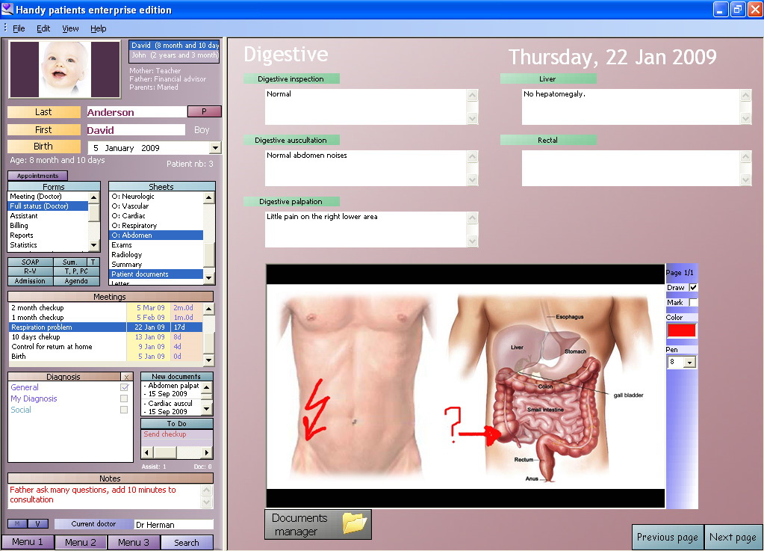
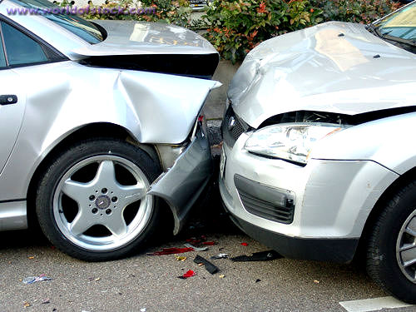
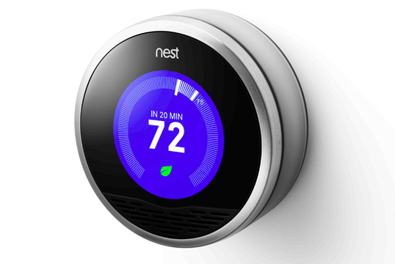
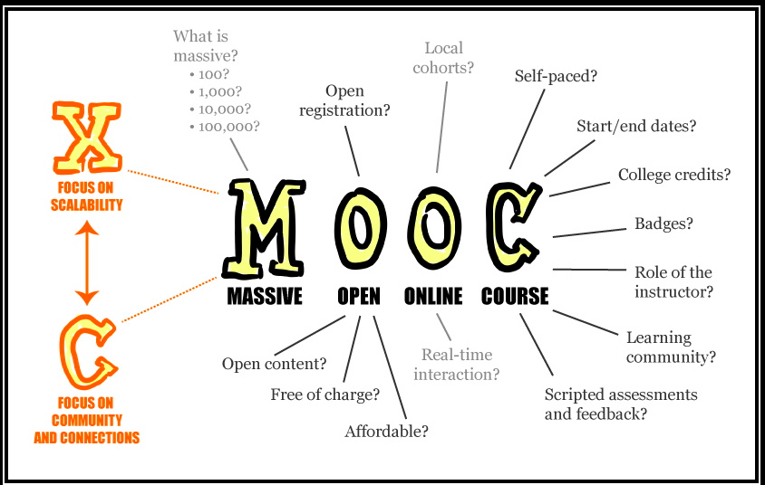
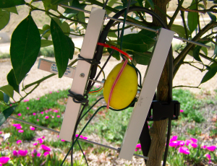
CS as the 10%-better solution
Miracle transformation → 10% better/cheaper/…

Slide 15
Conclusion: more Q than A
How does education and research change when CS is critical infrastructure?
What is your plan beyond the paper submission?
How can CS research become relevant to public policy?
How do you demonstrate impact beyond citation counts?

