Slide 1
Video as a Public policy challenge
Henning Schulzrinne

Slide 2
Overview
The next convergence
More than entertainment
Impacts on consumers and industry structure
Old goals, new challenges
Notes:
online video
http://news.cnet.com/8301-1023_3-57437204-93/americans-watched-37-billion-online-videos-last-month/

Slide 3
It’s still mostly linear TV

Slide 4
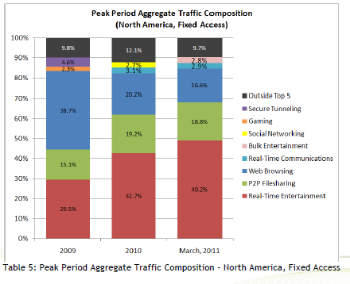
Video is half of the Internet

Slide 5
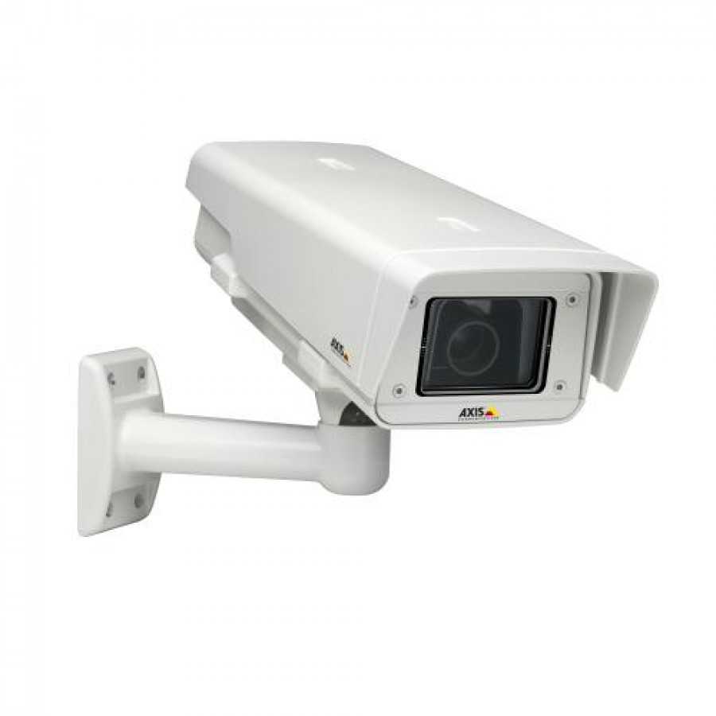
But also other applications
Focus not just on download
Interactive video
  telemedicine
  MOOCs
  video conferencing
  remote monitoring (security cameras)
Likely will require more upstream bandwidth

Slide 6
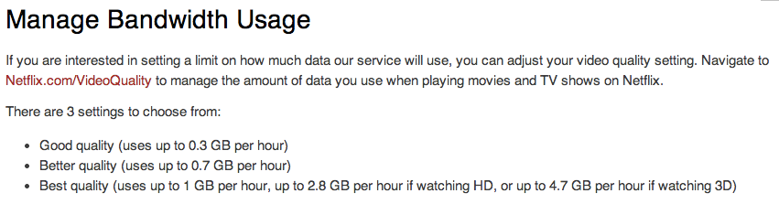
What happens if this moves to IP?
Thus, for 146 hours/month of HD → 410 GB/month
(does not count separate viewing among household members)

Slide 7
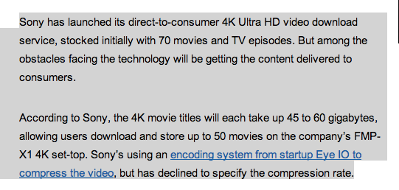
But what about 4K?
H.265 may reduce by half

Slide 8
Bandwidth cost (very rough)
Access modality | Effective cost per GB | but…
Cable (20 GB median) | $2.50 | but no incremental cost below cap (250-300 GB typical)
Satellite ($130 for 25 GB) | $5.20 | 5-12 Mb/s
4G | $5-15 | roughly 10 Mb/s

Slide 9
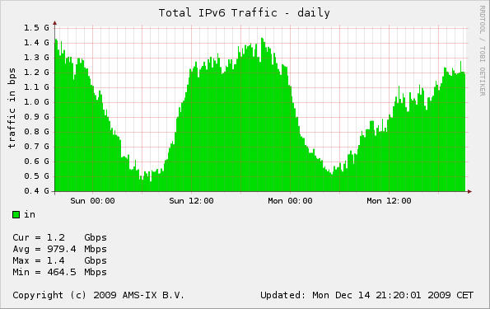
The death of distance (revised)
1st gen Internet: content hauled across the whole Internet
  but mostly national (for US)
2nd gen Internet: content close by (caching, CDNs)
  in cable headend or near DSLAM
  maybe in software-defined network boxes
    cell towers
    WiFi basestations
    remote units for DSL
Two efficiencies:
  one download, many retrievals → only for popular content or large subscriber bases
  time shifting: re-stock server during low usage periods

Slide 10
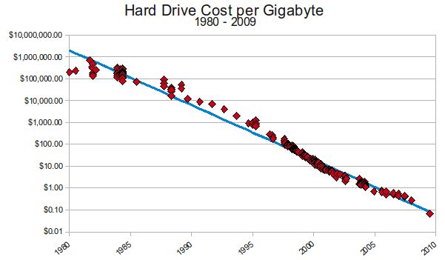
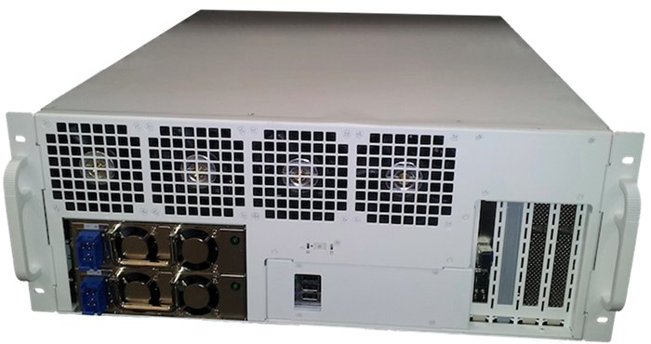
Driver: storage cost
Netflix OpenConnect: 100 TB
of disk, 1 TB of flash

Slide 11
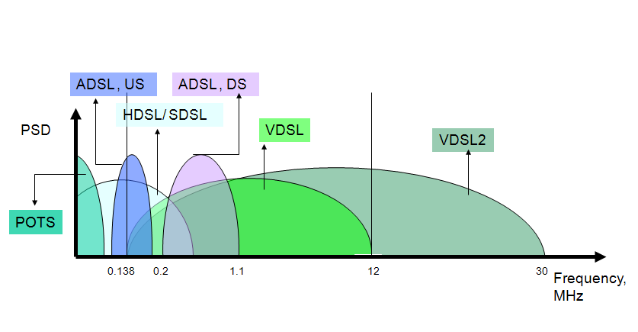
Shared vs. non-shared networks
Need per-user 7-20 Mb/s bandwidth during early evening hours
Capacity limits most pronounced for shared parts of networks → spectrum limits
  DSL: < 30 MHz
  Cellular: 500 MHz total
  CATV: 800 MHz → theoretically, 4.8 Gb/s total capacity
  Fiber: 16 THz
Digital
Upstream
Digital Channels
HDTV
VOD, interactive
services, etc
54 MHz
870 MHz

Slide 12
Cable Band Plans
Standard
Upstream
Analog Channels
Digital Channels
HDTV
VOD, etc
54 MHz
870 MHz
Digital Simulcast of Analog Tier
Hybrid
Upstream
Analog Channels
Digital Channels
HDTV
VOD,
etc
54 MHz
870 MHz
Digital
Upstream
Digital Channels
HDTV
VOD, interactive
services, etc
54 MHz
870 MHz

Slide 13
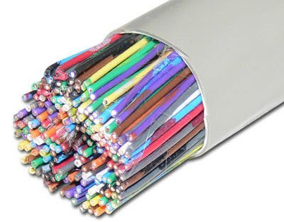
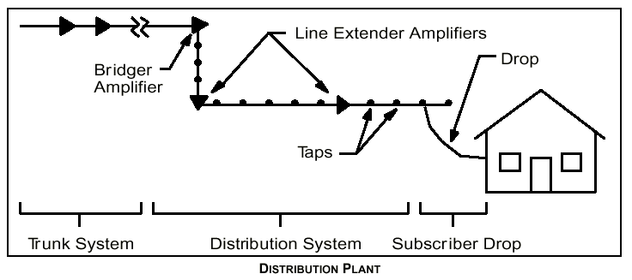
What parts of the network are shared?
Classical DSL
1k-10k
middle mile - shared
< 3 mi
FTTN
< 1 mi
CATV
< 500 homes

Slide 14
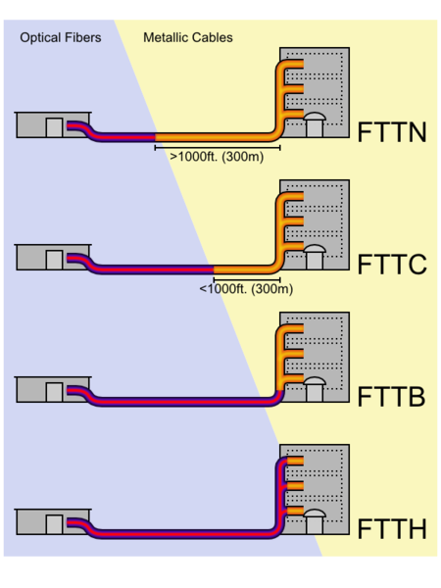
FTTx

Slide 15
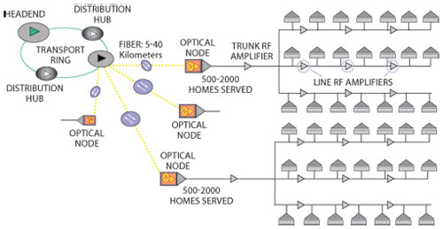
Digital CATV architecture

Slide 16
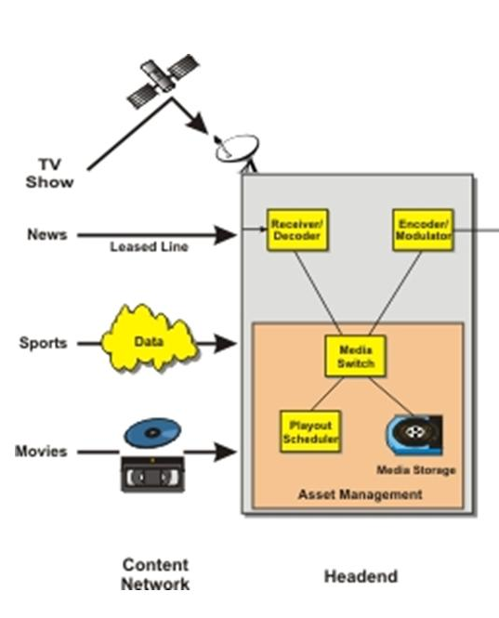

Local IP networks vs. OTT
MSO
backbone
separate DOCSIS service flow
Internet or
CDN backbone

Slide 17

Other MVPD obligations
Obligation | MVPD (Title VI) | Non Title VI
Emergency alerting |  | Twitter?
Local content (city council meeting, news, niche) | PEG | livestream.com?
Local TV stations | must carry | ?
Local franchise authority | agreement, 5% fee | ?
(list very incomplete)

Slide 18

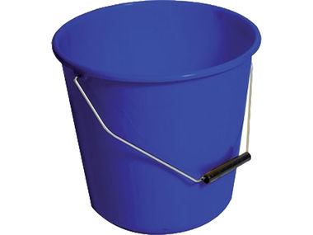

Fitting into OI policy buckets
non-IP (radio, OTA TV, digital
CATV, …)
IP-based services
Broadband Internet
Access Services (BIAS)
Specialized
services
BIAS: A mass-market retail service by wire or radio that provides the capability to transmit
data to and receive data from all or substantially all Internet endpoints, including any
capabilities that are incidental to and enable the operation of the communications
service, but excluding dial-up Internet access service.

Slide 19
Other policy challenges
Bandwidth-based charging (caps, metering, …)
  competitive effects on OTT providers?
  vs. market differentiation (light vs. heavy users)
  possible consumer confusion
    “How many GB was that movie again?”
    “Who wasted 10 GB on Toddlers in Tiaras?”
    “Why did my usage go up when I switched to 4G?”
Competition
  content owner vs. content carriage

Slide 20
Future proof networks
What speeds do we need to support?
Broadband networks & universal service
  future-proofing network builds
    build & pay once (every 25 years), upgrade electronics only
    → success model for copper, coax and fiber
How far can you push DSL?
  remote electronics vs. fiber builds

Slide 21
Conclusions
All-IP (HD) video won’t break the Internet
… but it may break classical regulatory categories
Raises a number of public policy issues
  competition
  consumer confusion on gaps and bandwidth charges
  universal access to scalable bandwidth

