Slide 1
It’s all about spectrum
2nd Annual MobileGov Summit
Feb. 23, 2012
Federal Communications Commission
Office of Strategic Planning
Note: The views expressed in this presentation are those of the author and may not necessarily represent the views of the Federal Communications Commission
Henning Schulzrinne
CTO
Office of Strategic Planning, FCC
  with slides by Julie Knapp

Slide 2
Overview
What’s the problem?
How much data & spectrum is there?
Can we make better use of it?
  Better technology
  General-purpose technology
  Better sharing in time and space

Slide 3

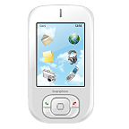

You’ve heard the statistics…
Mobile phone subscriptions now top the number of people - - 328 million subscriptions
90% of us keep our mobile device within arms length 24 hours a day, 7 days a week
Smartphone sales have eclipsed PC sales
Mobile broadband is being adopted faster than any computing platform in history
A typical smartphone places 24 times as much demand on spectrum as an old feature phone
Tablets demand 120 times as much
Multiple experts expect that mobile demand for spectrum will increase more than 35x in the next few years (3,500%)
24/7
24X
120X

Slide 4
Monthly fixed consumption
North America | Mean | Median | Mean : Median
Upstream | 4.5 GB | 600 MB | 7.33
Downstream | 18.6 GB | 6.0 GB | 3.06
Aggregate | 23.0 GB | 7.0 GB | 3.28
top 1% →
  49.7% of upstream traffic
  25% of downstream traffic
Europe | Mean | Median | Mean : Median
Upstream | 8.2 GB | 1.2 GB | 6.87
Downstream | 31.3 GB | 12.7 GB | 2.47
Aggregate | 39.6 GB | 14.7 GB | 2.69
Notes:
Sandvine, Global Internet Phenomena Report Spring 2011

Slide 5
Spectral efficiency
b/s/Hz
but also total spectral efficiency
  guard bands
data efficiency
  e.g., H.264 is twice as good as MPEG-2/ATSC

Slide 6
A 2016 thought experiment
2016: 71% of (consumer) bandwidth is video
Average monthly TV consumption (US): 154 hours
Netflix: 1 GB/hour (SD) … 2.3 GB/hour (HD)
  → 300 GB/month/person
  more if people in household watch different content
→ 0.9 Mb/s (averaged over 24 hours)
Cisco VINI: 150 MB/month → 2.7 GB/month
LTE: need 600 kHz/user (typical 1.5 b/s/Hz)
  → 500 MHz per cell sector → about 800 users/cell sector

Slide 7
What can we do?
end system caching
better audio & video codecs
efficient apps
IP multicast
WiFi offload
small cells = better spectral efficiency + more re-use
spectral efficiency (LTE-A)
directional antennas
general purpose spectrum
dense cells
white spaces & sharing
LTE: 1.5 b/s/Hz
GSM: 0.1 b/s/Hz

Slide 8

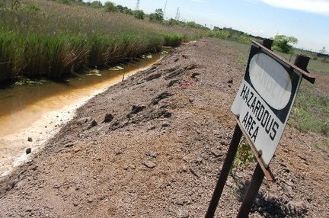
From beachfront spectrum to brownfield spectrum

Slide 9
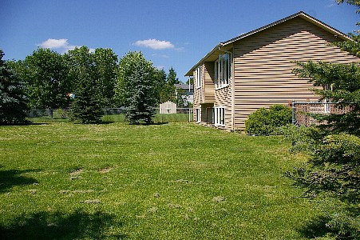
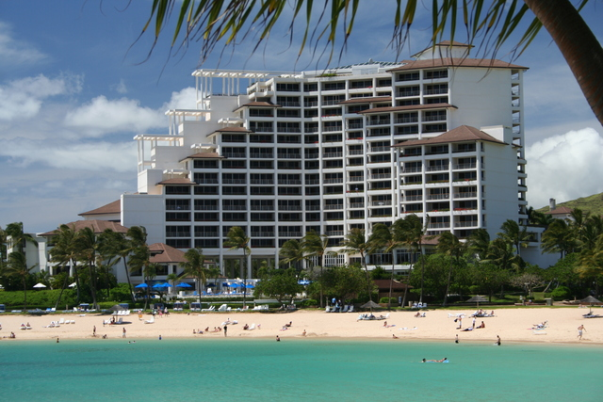
From empty back yard to time share condo

Slide 10
cellular = about 500 MHz in total

Slide 11
Unlicensed & lightly-licensed bands (US)
2.4 GHz (73 MHz) – 802.11b/g
3.6 GHz (100 MHz) – for backhaul & WISPs
4.9 GHz (50 MHz) – public safety
5.8 GHz (400 MHz) – 802.11 a/n
  much less crowded than 2.4 GHz
  supported by many laptops, few smartphones

Slide 12
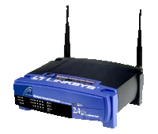
5.8 GHz expansion: sharing with incumbents
Device detects radar
and moves to an unoccupied channel
50 mW
Indoor Use Only
250 mW
250 mW
1 W
DFS
DFS
Existing
Existing
New
Existing
5150
5250
5350
5470
5725
5825
Frequency (MHz)

Slide 13
Freeing spectrum: incentive auctions
Incentive auctions will share auction proceeds with the current occupant to motivate voluntary relocation of incumbents
  Otherwise, no incentive for current occupant to give back spectrum
  Stations keep current channel numbers
    via DTV map
Adjacent Channel
Interference
TV
TV
BB
TV
BB
TV
Without Realignment:
Reduced Broadband Bandwidth
Adjacent Channel
Interference
TV
TV
TV
TV
BB
With Realignment: Accommodates Increased Broadband Bandwidth

Slide 14

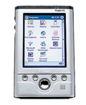

Small cell alternatives
Femto cells
  use existing spectrum
  need additional equipment
WiFi off-load
  use existing residential equipment
  5G networks = heterogeneous networks?
Distributed antenna systems
Cellular
Femto-cells
Distributed Antenna Systems
Signals are distributed throughout the
Building via amplifiers/antennas

Slide 15


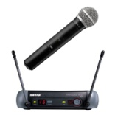

TV White Spaces
TV channels are “allotted” to cities to serve the local area
Other licensed and unlicensed services are also in TV bands
“White Spaces” are the channels that are “unused” at any
given location by licensed devices
2
4
Non-
Broadcast
spectrum
5
7
9
White
Space
Low
Power TV
Wireless
Microphones
New York City
Full Power
TV Stations
Etc.
Only for illustrative purposes
3
Non-
Broadcast
spectrum
6
8
10
White
Space
White
Space
White
Space
Low
Power TV
Wireless
Microphones
Philadelphia
Full Power
TV Stations
Etc.

Slide 16
TVWS Spectrum Availability
Available spectrum varies by location
In rural areas many channels are available
In big cities only a few channels may be available at some locations
Examples of availability in UHF channels 21 – 51 (Illustrative):
New York
21 | 22 | 23 | 24 | 25 | 26 | 27 | 28 | 29 | 30 | 31 | 32 | 33 | 34 | 35 | 36 | 37 | 38 | 39 | 40 | 41 | 42 | 43 | 44 | 45 | 46 | 47 | 48 | 49 | 50 | 51
Washington, DC
21 | 22 | 23 | 24 | 25 | 26 | 27 | 28 | 29 | 30 | 31 | 32 | 33 | 34 | 35 | 36 | 37 | 38 | 39 | 40 | 41 | 42 | 43 | 44 | 45 | 46 | 47 | 48 | 49 | 50 | 51
Full Service DTV Station
Low Power TV Station
Channel Open/ Adjacent to TV
Channel Open/ Not Adjacent to TV
In less dense areas many channels are available.
For example: Wilmington, NC: 25 channels = 150 MHz
Harrisburg, PA: 19 channels = 114 MHz
16
Notes:
16

Slide 17

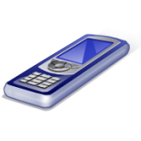
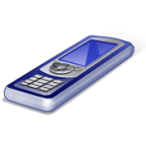
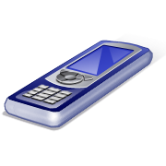
TV White Spaces
Final rules adopted Sept. 2010:
  New spectrum for unlicensed
  Based on geolocation & data base of protected services
  Also allows for spectrum sensing with rigorous review & authorization process
Services protected in the data base:
  TV digital and analog Class A, low power, translator & booster stations
  Broadcast auxiliary (wireless mikes)
  Cable head-ends and TV translators
  Land mobile
  Sites with significant wireless microphone use
Data Base
Mode 1: Portable device obtains
location/channels from fixed device
Mode 2: Portable device uses its
own geolocation/data base access capability
17
Notes:
17

Slide 18
Benefits of TV White Space
Prime spectrum
  Great propagation & coverage
  High amounts in much of the USA
  Close to spectrum used by commercial wireless services → potential synergy
New IEEE 802.22™ standard:
  Broadband wireless access over a large area up to 100 km
  Up to 29 Mb/s per TV channel
  Can increase data rate through use of multiple channels
WiFi & TVWS complementary:
  Wi-Fi has greater bandwidth but usage density is increasing
Notes:
18

Slide 19
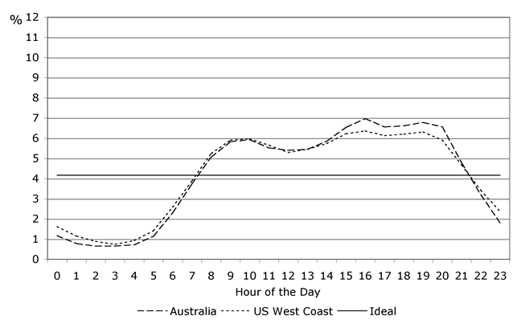
New options to reduce traffic
Download video content during off-hours
  or defer software updates until WiFi is available
Peer-to-peer distribution of popular content
IP multicast (1-to-many) of live content
Make apps less chatty

Slide 20

Conclusion
No single solution:
  reduce spectrum usage
    caching & better modulation
  re-use spectrum
  re-cycle old spectrum

