Slide 1
SIGCOMM Community feedback Session
August 14, 2012

Slide 2
Agenda
Overview of 2011-12 SIGCOMM activities (Tilman)
Publication model of SIGCOMM conference (Henning)
Open Discussion
Notes:
Note: the SIG is not the Conference!!

Slide 3
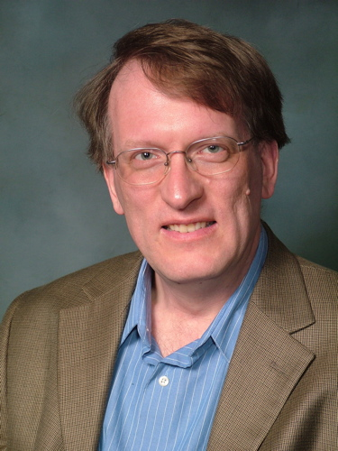
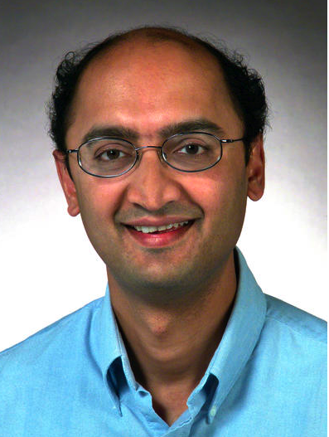
SIG Officers
Bruce Davie
Chair
Henning Schulzrinne
Vice-Chair
Tilman Wolf
Secretary/Treasurer
Mark Crovella
Past Chair
S. Keshav➔Dina Papagiannaki
EIC, CCR
See http://www.sigcomm.org/about/what-does-the-ec-do/

Slide 4
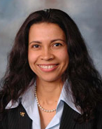
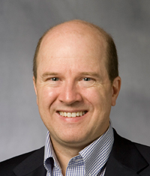
SIG Officers (cont’d)
Jau de Oliveira
Conference Coordinator
Olivier Bonaventure
Education Chair
Bruce Maggs
Awards Chair
Neil Spring
Information Director

Slide 5
SIG Total Membership: 1631
Downward trend common to majority of SIGs
Stable since 2005 (variation in affiliate memberships)
Membership included in SIGCOMM conf. registration since 2009
New this year: online-only option (professional: $20 instead of $30)
Notes:
1994 – bsd joins – also big push from SIG (see annual report)
1995 – Netscape IPO, cover of Time etc etc

Slide 6
SIG Finances
The SIG’s budget is healthy
Conferences, Digital Library, membership bring profits
Need to maintain a minimum “fund balance” to offset risk of conferences (approx. $430k)
Funds used for SIG activities (e.g., awards, geodiversity grants, regional conference support, travel grants, publications, etc.)
This year we have spent more than taken in! (Good thing, because the community gets funds back)

Slide 7
SIGCOMM and Conferences
Sponsored events (SIGCOMM has financial interest)
CoNEXT
Internet Measurement Conference
HotNets Workshop
Architectures for Networking and Communication Systems (ANCS)
Networked Sensor Systems (SenSys)
Latin America Networking Conference (LANC)
In-cooperation events (no financial interest)
NSDI, COMSNETS, MMSYS, NOSSDAV, CNSM, AINTEC, IPTComm, E-Energy, NetGames

Slide 8
SIGCOMM Conference Locations
3-year cycle: North America, Europe, and “Wild Card”
Future SIGCOMM Locations
2013: Hong Kong, China
2014: North America
Currently seeking 2-page site proposals: due October 31
See www.sigcomm.org
2015: Europe
SIGCOMM conference dates
One week between mid August & first Monday in Sept
Rotating dates to avoid scheduling collisions

Slide 9
Awards
SIGCOMM Award for Lifetime Contribution
Test of Time Paper Award
SIGCOMM Best Paper Award
SIGCOMM Best Student Paper Award
SIGCOMM Doctoral Dissertation Award
First awards given this year
SIGCOMM Rising Star Award (given at CoNEXT)
Sylvia Ratnasamy in 2011

Slide 10
Education Activities
Education chair: Olivier Bonaventure
http://education.sigcomm.org
Resources for educators: textbook information, slides, labs, etc.
Contribute material!
Involved in ACM/IEEE CS Curriculum effort
Shadow TPC at CoNEXT

Slide 11
Advanced networking ebook
Motivation
Various undergraduate networking textbooks but
Few graduate-level advanced textbooks
Project goal
Create an open-source ebook suitable for advanced networking courses
Edited ebook composed of contributed chapters + labs/exercises/slides/…
Next steps
Call for expression of interests (ext. abstracts) +- Oct 2012
Chapter submission early 2013
Reviews and revisions
Target eBook publication : Spring 2013

Slide 12
SIGCOMM Community Projects
Special funds (up to $20k) to support projects that could benefit the entire SIGCOMM community
Software, data sets, educational material, studies, etc.
First round of funding:
CRAWDAD (Kotz, Dartmouth & Henderson, St. Andrews)
Network emulation tools (Rizzo, Pisa)
Education material repository (Haddadi, QMUL)
Next deadline: October 20, 2012

Slide 13
Computer Communication Review
New! Best of CCR session
Wednesday, 17:30-18:30
New CCR Editor
Dina Pagagiannaki, Telefonica Research, Spain

Slide 14
Communication
Desire for “transparency” of EC
Attempting to address that through all communication means at our disposal
CCR, print and online
http://www.sigcomm.org
Minutes of monthly EC meetings posted
Annual report for 2012 available
http://www.sigcomm.org/news/RSS
Email discussion: sigcomm@postel.org
SIGCOMM members mailing list: SIGCOMM-MEMBERS@LISTSERV.ACM.ORG

Slide 15
Get involved in SIGCOMM
More than an annual conference!
Submit papers to our other sponsored or in-coop conferences
Contribute to CCR and ToN
Editorial section of CCR
Comment online on CCR
Offer to review submissions
Share resources on http://education.sigcomm.org, get involved in curriculum development
Propose workshops at SIGCOMM, CoNEXT, or standalone
Contact any EC member for more ideas

Slide 16
Publication Model
Three related questions:
What can authors do with their papers?
Who can access the papers in the DL?
Who pays for access?

Slide 17
Publication: What can authors do?
Green Open Access:
self-archiving of post-print
home page (see ACM Authorizer)
repository (institutional, arXive)
SIGCOMM conference papers
Related: pre-print
IEEE allows
Gold Open Access:
Open access journal or conference proceedings
Typically, author pays (e.g., $3000 for IEEE)
Incentivizes publishing papers nobody reads…
$1750
Notes:
http://www.ieee.org/documents/ieee_open_access_faq_2011.pdf
reduced to $1750 August 13, 2012

Slide 18
Publication: Copyright transfer vs. license
Traditional: author transfers copyright to publisher
retains certain rights
e.g., re-use of material as derivative work
post pre-publication on home page
patent rights
questions regarding e.g., inclusion in software packages
Alternative: license model
Can be exclusive or non-exclusive
Author retains copyright
Publisher is granted license to publish (in any medium)
Issues:
can publisher sue infringers?
transfer?
plagiarism and self-plagiarism persecution?

Slide 19
Publishing: Who can access the papers?
Open access:
centralized (DL) or
distributed (author home pages + Google Scholar)
likely incomplete and transient
incomplete meta data
By subscription
individual
institution

Slide 20
Publishing: Money - ACM
Pay for publishing
editing (e.g., journal editorial assistants), archiving, access
Pay for non-publishing costs: 1/3 of ACM revenue

Slide 21
Publishing: Money - SIG
SIGs get money from “their” papers
FY12 SIGCOMM: $78,084 based on 230,514 downloads
= ~51 % of total SIG non-conference revenue
(interest, membership dues)
~25% of total SIG revenue

Slide 22
Publishing: Options
License vs. copyright
import for some cases, but marginal effect on most authors?
Consensus: want to retain ACM DL
31,000 papers added per year, 2,650 institutions
will libraries continue to pay if most papers are free?
Options:
Publication windows (like DVD releases?) – see PubMed
SIG foregoes DL revenue for OA papers
could be part of conference budget → $590 per paper!
Author pays OA

Slide 23
Q&A
Please share your thoughts with us!

