Slide 1
SECE: Connecting VoIP and Location with the Physical World
Henning Schulzrinne
Omer Boyaci
Jan Janak
Victoria Beltran
Jae Woo Lee
Hyunwoo Nam
Suman Srinivasan
Eric Liu
Zachary Salzbank
Jiawen Sun

Slide 2
Overview
Motivation and (brief) history
Programming in-network services → NetServ
Combining web and telecom services → SECE

Slide 3
A Pyramid of programmers
Clocks at home blink 12:00
Can program a DVR
Writes Excel formulas
Creates simple HTML
Writes script in PHP or Ruby
Java programmer
C & kernel code
Firmware
JAIN

Slide 4
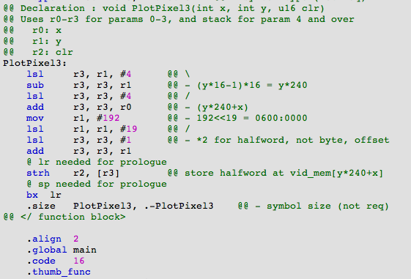
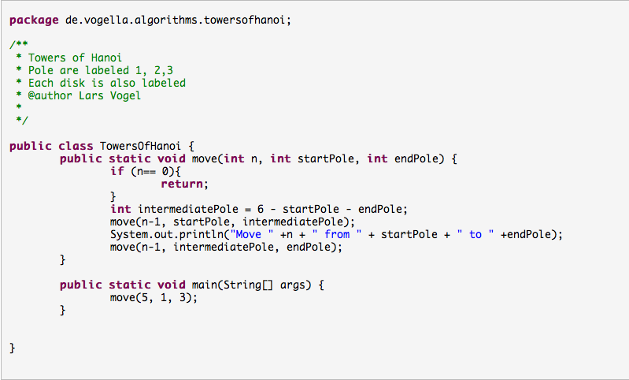
Old-style programming
Lars Vogel (2009)
Notes:
http://www.vogella.de/articles/JavaAlgorithmsTowersOfHanoi/article.html

Slide 5
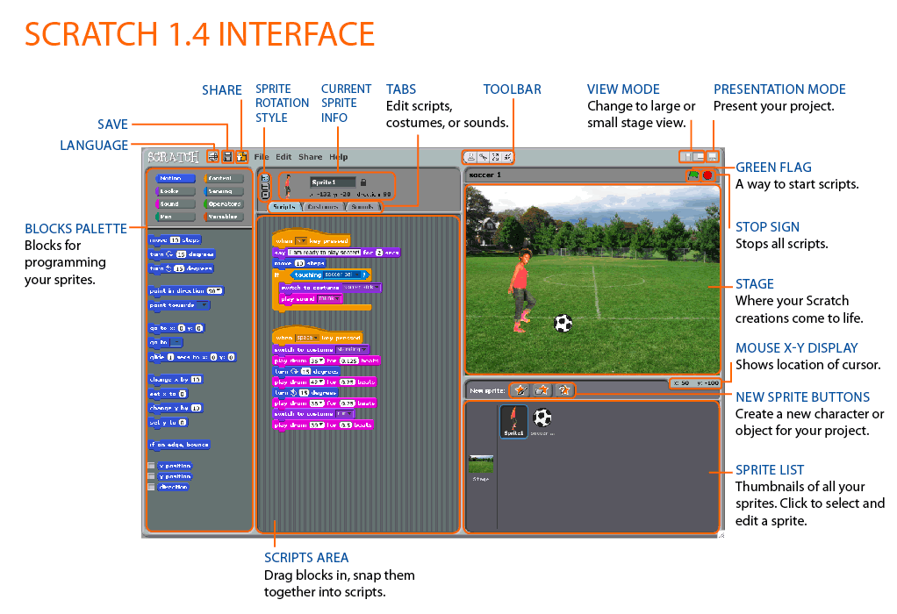
Example: Scratch

Slide 6
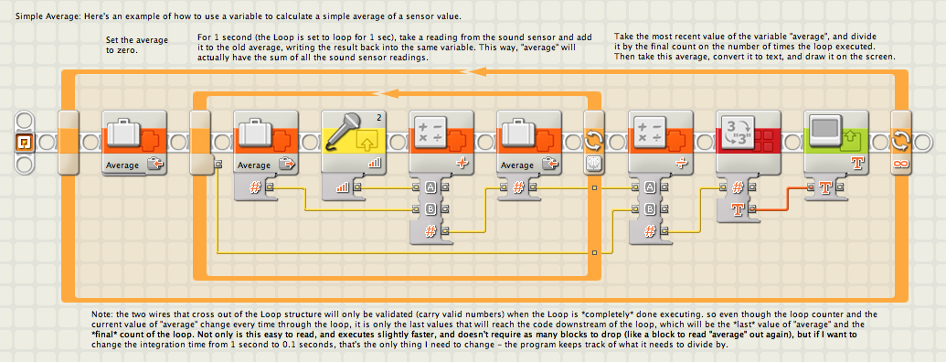
Is this programming?
<html>
<body>
<h1>My First Heading</h1>
<p>My first paragraph.</p>
</body>
</html>
Sub CopyRange() Range("A1:A3").Copy Destination:=ActiveCell End Sub

Slide 7
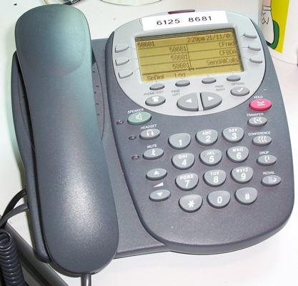

Old view of (telecom) services
call redirect
voice interaction (IVR)
call center distribution

Slide 8





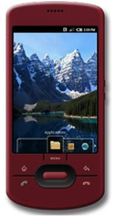

Consumer view 2010
social network services
calendars
text messaging

Slide 9
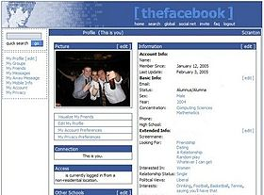
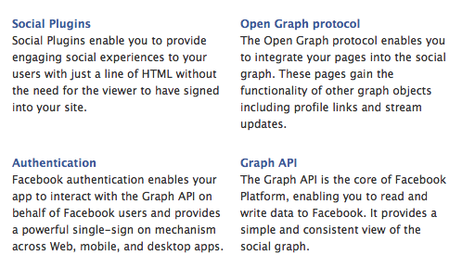
From web pages to APIs

Slide 10
Levels of programming
Combination of services
Services (CPL)
Application protocols (Java JSR xxx)
Transport protocols, with names (Java)
Transport protocols (sockets)

Slide 11





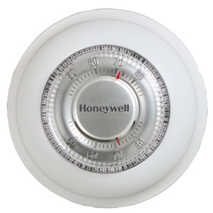
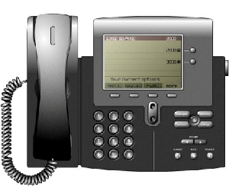
The silos

Slide 12
SECE
Real world
(location & sensors)
Communication
(VoIP, SMS, email)
Web services
(SNs, calendar, contacts, ..)
SECE

Slide 13
Overview
SECE allows non-technical users to create services that combine
  communication
  calendaring
  location
  devices in the physical world
SECE: event-driven system
  uses high-level event languages
  to trigger action scripts, written in Tcl
and other languages in the future

Slide 14
Events & actions
Events
Actions
Presence updates
Incoming calls
Email
Calendar entries
Sensor inputs
Location updates
Control the delivery of email
Route phone calls
Update social network status
Control actuators such as lights
Reminders (email, voice call, SMS)
Interact with Internet services

Slide 15
Related Work
Systems | User rules | User actions | Communications | Time | Location | Presence | Sensors | Web services | Actuators
SECE | NL-like rules | Tcl scripts | Call, email, IM | ✔ | User & buddies | ✔ | ✔ | ✔ | ✔
CPL | XML tree | Fixed XML actions | Call | ✖ | ✖ | ✖ | ✖ | ✖ | ✖
LESS | XML tree | XML actions | Call | ✔ | ✖ | ✔ | ✖ | ✖ | X10, vcr
SPL | script | Signaling actions | Call | ✖ | ✖ | ✖ | ✖ | ✖ | ✖
VisuCom | Graphical UI | Signaling actions | Call | ✖ | ✖ | ✖ | ✖ | ✖ | ✖
DiaSpec | Java | Java | ✔✖ | ✖✔ | ✖✔ | ✖✔ | ✖✔ | ✖✔ | ✖✔
CybreMinder | Form based | Reminder | ✖ | ✔ | ✔ | ✖ | ✔ | ✖ | ✖
Task.fm | Time rule | Reminder | ✖ | ✔ | ✖ | ✖ | ✖ | ✖ | ✖

Slide 16
Saving energy
every sunrise {
lights off
}
every sunset {
lights on
}
me within 2 miles of home {
thermostat 68
}
me outside of “Columbia University” {
turn off 720CEPSR
}

Slide 17
Making the phone more polite
incoming call {
if {[my activity] == “performance"} forward voicemail
schedule "call received from [incoming origin]”
sound mute
turn on lights
sleep 1
turn off lights
}
incoming call from Anne {
if {[my location] != "office"} auto_answer away.mp3 –record
}

Slide 18
“Don’t forget the milk”
me near a grocery store {
sms me “don’t forget the milk”
}
every Anne’s birthday {
sms me “Remember to call Anne”
}
when 30 minutes before ”weekly meeting” {
if {me not within 3 miles of campus} {
email [even participants] ”Running late” ”I’m at [me location]”
}
}

Slide 19
Overview of events & actions
Context | Event | Action
Facebook | incoming wallmessage incoming newsmessage incoming direct | facebook
Twitter | incoming twitter direct incoming twitter wallmessage | tweet
Phone calls | incoming calls incoming voicemail missed call outgoing call | call calltts accept reject forward
SMS | incoming SMS | sms
IM | incoming im outgoing im | im

Slide 20
Overview of events & actions
Context | Event | Action
Email | incoming email | email
Presence | if person is available | presence
Calendar | when time before event when event begins | schedule
Flickr |  | flickr
Translate |  | to_en, to_fr, …
Location | near landmark near person within distance of landmark in landmark outside of landmark

Slide 21
Overview of events & actions
Context | Event | Action
Time | on time every time
Contextual Sensors | if context-variable operator | turn on|off device

Slide 22
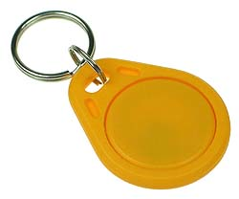
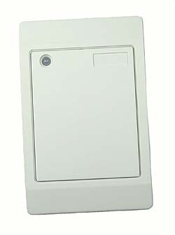





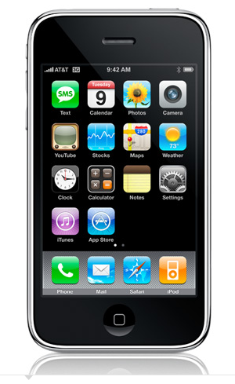

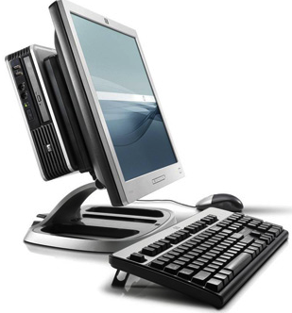
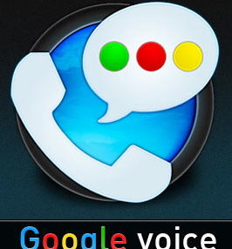


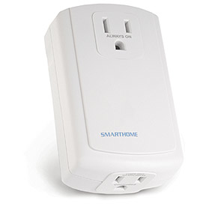
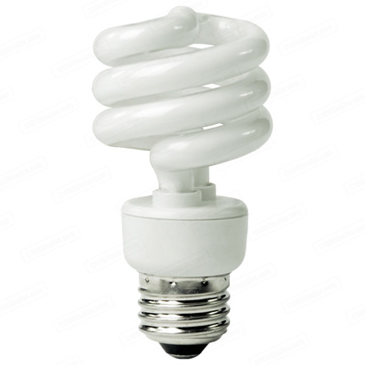
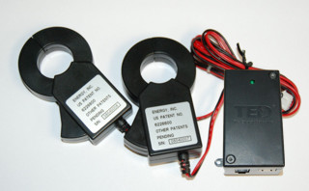
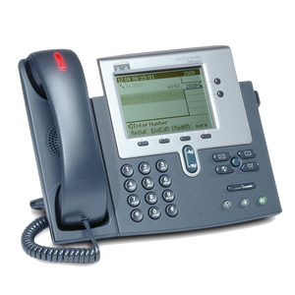
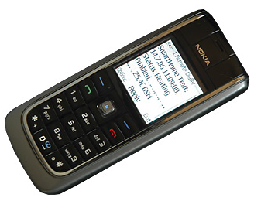
SECE: The glue for Internet applications
GW
next appt.
RFID
Alice → a@b.com,
+1 212 555 1234
geocoding
travel time
SUB/NOT
PIDF-LO, RPID,
others
SECE
PUBLISH
PIDF-LO
update SNs, , email…
GW
GW
call state
Call events, VM, SMS
monitor energy
usage
B2BUA
control appliances

Slide 23
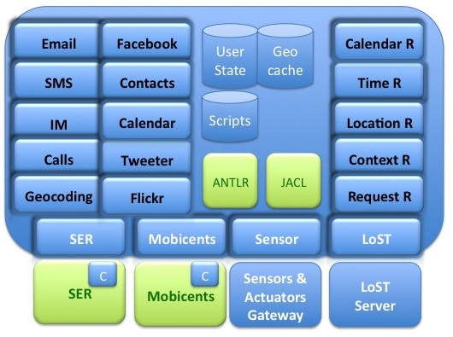
Software Modules

Slide 24
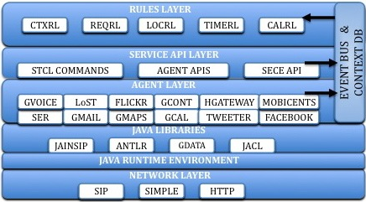
Software architecture

Slide 25
Adding a new action command to the SECE
public boolean executeCode(Service service, String code) {
//Creates a new Tcl interpreter
Interp interp = new Interp();
try {
    //Add new actions commands to the Tcl interpreter
    interp.createCommand("email", new EmailCmd(emailEventProducer));
    interp.createCommand("status", new StatusCmd(this));
    interp.createCommand("tweet", new TweetCmd(this));
    interp.createCommand("flickr", new FlickrCmd(this));
    interp.createCommand("facebook", new FacebookCmd(this));
    interp.createCommand("sms", new SMSCmd(googleVoice, service));
    interp.createCommand("im", new ImCmd(this));
    interp.createCommand("call", new CallCmd(null,googleVoice, service));
    interp.createCommand("incoming", new IncomingCmd(service));
    interp.createCommand("my", new MyCmd(this));
    interp.createCommand("accept", new AcceptCmd(service));
    interp.createCommand("reject", new RejectCmd(service));
    interp.createCommand("event", new EventCmd(service));
    interp.createCommand("schedule", new ScheduleCmd(this.googleCalendarHandler));
    TranslatorCmd st = new TranslatorCmd();
    for (final Language language : Language.values()) {
    interp.createCommand("to_"+language.toString(), st);
    }
    // runs the user's Tcl script
    interp.eval(code);
} catch (Exception ex) {
return false;
} finally {
interp.dispose();
}
return true;
}

Slide 26
Adding a new action command to the SECE
package edu.columbia.lucs.tcl;
import com.restfb.DefaultFacebookClient;
import com.restfb.FacebookClient;
import com.restfb.Parameter;
import com.restfb.exception.FacebookException;
import com.restfb.types.FacebookType;
import edu.columbia.lucs.Manager;
import java.util.logging.Level;
import java.util.logging.Logger;
import tcl.lang.*;
public class FacebookCmd implements Command {
Manager man;
  public FacebookCmd(Manager man) {
  this.man = man;
  }
  public void cmdProc(
  Interp interp, // Current interpreter.
  TclObject objv[]) // Arguments to "lsearch" command.
  throws TclException
  {
  String token = man.reg.getRegistryAttribute("me.conf.facebook.acc1.token");
  if (token != null) {
      FacebookClient facebookClient = new DefaultFacebookClient(t);
      try {
      FacebookType publishMessageResponse =
      facebookClient.publish("me/feed", FacebookType.class,Parameter.with("message", objv[1].toString()));
      } catch (FacebookException ex) {
      Logger.getLogger(FacebookCmd.class.getName()).log(Level.SEVERE, null, ex);
      }
  }
  }
}

Slide 27
User information registry
root
me
Bob
Alice
office
location
presence
phone
presence
location
presence
location
temperature
lights
mobile
office
home

Slide 28
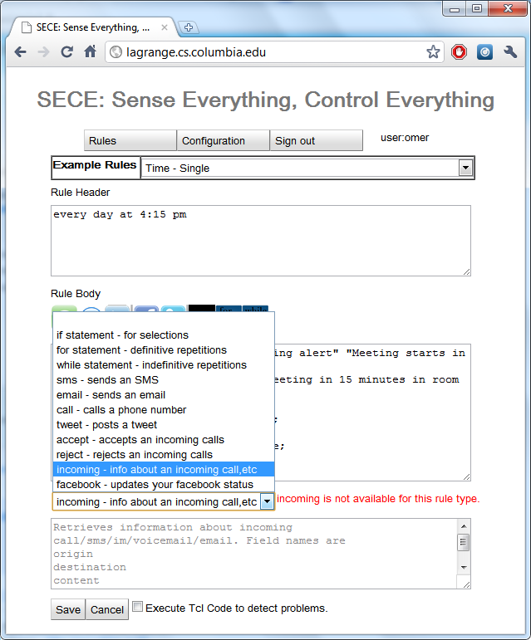
GUI- Action command assistant

Slide 29
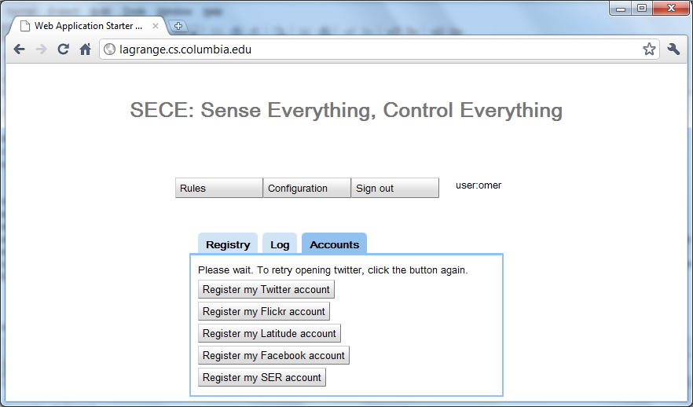
GUI- Registration of third-party services

Slide 30
Deployment Scenarios
Can be deployed in a home device
  protects privacy and security by keeping the rules and
  details of sensors and actuators within home boundaries.
  it is more difficult to update the rules from anywhere.
Can be provided as a cloud service
  controlling in-home devices can be challenging, given NATs.

Slide 31
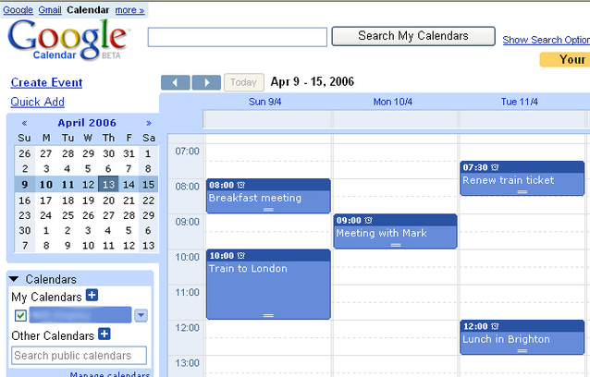
Time-based events
Every day at 12:00 from 01/01/2010 until 04/01/2010 {
email employees “lunch time” “Location: 5th floor Dinning Room, Time: 12:30”
}
BEGIN:VCALENDAR
BEGIN:VEVENT
DTSTART;TZID=America/New_York:20100101T120000 RRULE:FREQ=DAILY;BYHOUR=12;
UNTIL=20100401T120000
END:VEVENT
END:VCALENDAR
SECE
Export / Import

Slide 32
Time: single events
on dateExpr (at timeExpr ) (in timezone) { body }
on Anne's birthday at 12:00 am in anne.location{sms anne "Happy Birthday!"}
2011-12-31, 12/31/2011
December 31, 2011
31th day of December, 2011
300th day, 2011
2th MO of May, 2011
May 2th Monday, 2001
Last Sunday in 52th week, 2011
Christmas Day, 2011
Thanksgiving Day, 2011
1 day before Thanksgiving Day, 2011
e.g Europe/Zurich
sunrise
sunset
evening twilight
morning twilight
first working hour
last working hour
lunch break

Slide 33
Time: recurrences
every freq (on dateExpr) (at timeExpr ) (in timezone) (from dateExpr ) (until dateExpr ) (for num times| timeUnits) (during period) (except dateExprList) (including dateExprList) { body }
every sunset { homelights on; } → “every day at sunset”
every year on last Friday of January, March, June at last working hour except August { backup; }
every day at 10 minutes before lunch break from September 1, 2010 until Dec 24, 2010 { sms group-list "Lunch time! Let’s meet in 5 minutes";}
every last monthly day { email me "Reminder: Check the students’ monthly reports”;}
every WE at 6:00 PM from 10/1/09 until May 12, 2010 except 3th WE of Feb, including first day of June, 2010 { email irt-list "reminder: weekly meeting today at 6:00 PM"; }

Slide 34
Calendar events
when meeting-name begins|finishes { body }
when time time-units before|after meeting-name { body }
when ”weekly meeting” begins {
status activity busy;
sms [event participants] ”Please, switch your cell phone off or set silent mode”;
}
when 30 minutes before ”weekly meeting” {
email [event participants] “”[event title]" “The event [event title] will start is 30 minutes and will last [event duration] minutes. Description: [event description]. Start time: [event start]."
if {me not within 3 miles of campus } {
email [status bob.email] ”I’m away” ”Please, head the conference room and prepare everything for the weekly meeting. Not sure if I will be on time.”;
}
}

Slide 35
Location-based events
bob near "Columbia University”
me near 40.807,-73.963
tom within 5 miles of me
me within 3 miles of ”2960 Broadway, New York, 10027”
tom in “Rockefeller center”
Me outside of “Manhattan”
bob moved 1.5 miles
Place types and user-defined locations:
me near a post office
Anne in a museum
me near my tennis club
user operator location { body }

Slide 36
Location-based events
(user, op, location)
SECE
Server
LoST
Server
Location rule
LOST REPLY
Geographical
database
LOST QUERY
location=civic info
geo-cache
PUBLISH
Presence
Server
NOTIFY
SECE
Server
LOST REPLY
LoST
Server
LOST QUERY
location=place type
location=user
location=civic info
geo-cache
Presence database
SECE User

Slide 37
Handling location updates
User
  publishes his/her location periodically (e.g., every 5 min) to a presence server or to a location service such as Google Latitude
Presence server
  notifies changes in location to SECE server
Google Latitude (or similar service)
  SECE retrieves user’s location periodically
SECE server
  depending on user’s defined rules, queries LoST server
LoST server
  replies with current information on user’s surroundings
SECE server
  Takes action based on rules and contextual location information
SECE
Server
LoST
Server
LoST reply
LoST query
NOTIFY
POLL
Presence
Server
Google
Latitude
PUBLISH
SECE User

Slide 38
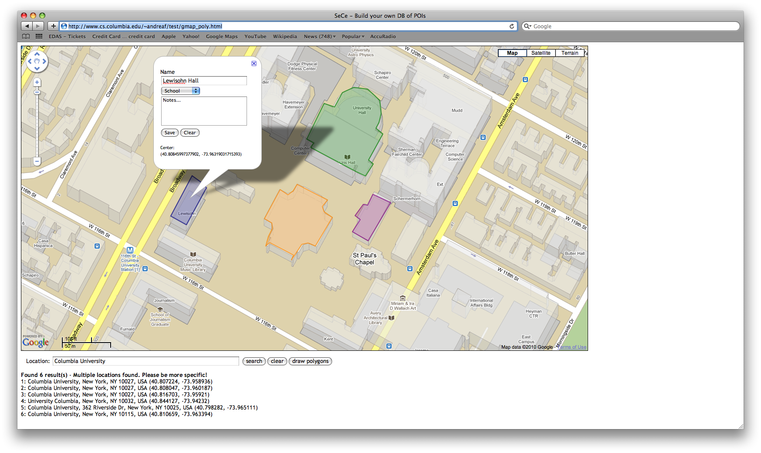
Location-based rules
(Geographical database)

Slide 39
Social network events
Incoming social_network message_type
facebook
twitter
linkedin
wallmesssage
newsmessage
direct
social_network status_update
facebook
twitter
linkedin

Slide 40
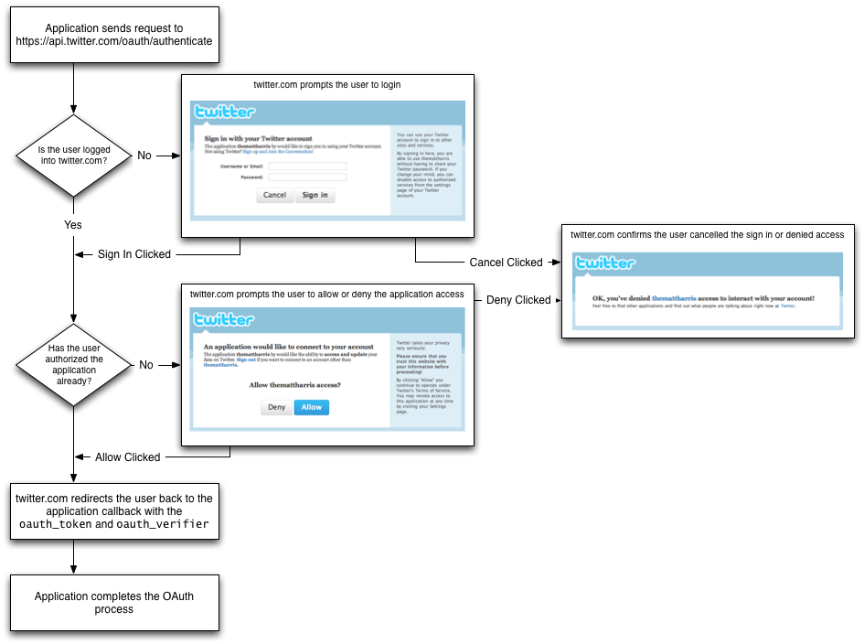
OAuth

Slide 41
Context-based rules
  What’s context?
    Presence information → IETF SIMPLE specifications
    Sensor information
if bob's activity is idle { call bob }
If bob@domain.com’s status equals working { alarm me }
If bob.placetype is home { sms bob “water the plants”; }
if my stock.google > 14 {sms me "google stock:"+[stock google] }
If me.office.temperature < 50 { ac off; }
If anne.location.civic changed { email me “Anne’s civic location:”+[status anne location.civic]
if context operator (value) { body }

Slide 42
Context as a tree
bob
placeis
status
activity
office
phone
bob.activity
temperature
home
work
video
text
audio
bob.phone.work
bob.placeis.audio

Slide 43
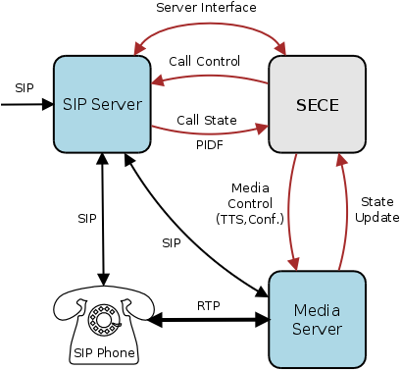
Automated Call Handling
Control: Accept, reject, redirect, forward calls based on variety of SECE signals
Integration: Calendar, address book, PSTN, Google Voice, SMS, location, Text-to-speech, voicemail)
Simplicity: Natural, easy to learn scripting language
Flexibility: Input from a variety of SECE components involved in call handling
Automation: Scripts for recurring tasks (setup a conf. call based on calendar)
“On mom's birthday, call mom when I am home and near phone.”
“Setup a conference call, enter password, invite people, ring desk phone.”
“If driving and incoming call, play “user driving” and redirect to voicemail.”
“If desk phone ringing and not in room, send SMS with caller's number.”

Slide 44
Communication-based events
incoming|outgoing event from user|address to address { body }
missed call from user|address to address { body }
Event: call, im, sms*, voicemail*, email (*only incoming)
received call from user|address to address { body }
incoming call {
if { [my activity] == "on-the-phone"} forward sip:bob@example.com
}
outgoing call {
if {[outgoing destination] == "18003456789"} modify_call destination 12129397054
}
incoming call from Anne {
if {[my location] != "office"} auto_answer audio no_office.au –record
}
incoming im {
sms me [incoming from]+" sent an im:"+[incoming content]
}
incoming call {
schedule "call received from [incoming origin]"
}

Slide 45
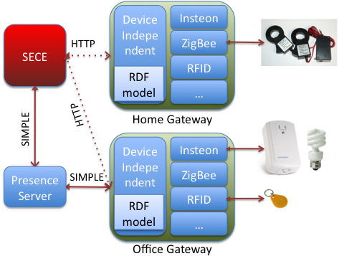
Sensors and actuators
Sensors : smoke, light, humidity, motion, temperature and RFID Readers
Actuators: networked devices and actuators such as lights, cameras, sprinklers, heaters, and air conditioners.
Sensor description: basic RDF ontology
(Resource Description Framework)
if my warehouse.motion equals true {
sms me "person in the warehouse."
}
if my office.smoke equals true {
sprinklers on;
sms me "fire in the office";
call_tts fire-department "fire in the "+[get me.office.address];
electrical-appliances off;
}

Slide 46
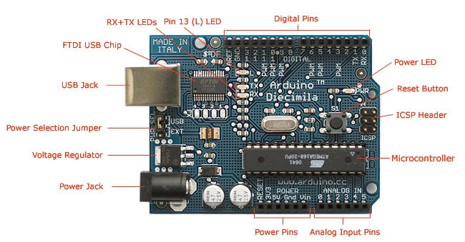
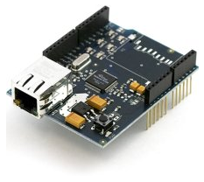

The Arduino
• $21
• Programming Environment
(C language) or AVR-Studio
• Easy to start with
• Phidgets, X10, Zigbee available
• Huge community
• Software development on
Mac OS-X and Windows
• How to connect to the Internet?
TCP/IP stack built in
Microcontroller: ATmega328
Operating voltage: 5v
Flash memory: 32KB
SRAM: 2KB
EEPROM: 1KB
“ Arduino Ethernet shield (stackable) ”
Internet Real Time Lab
I
R
T

Slide 47
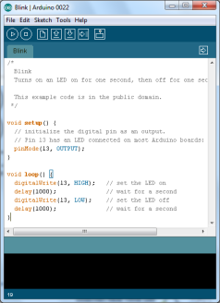
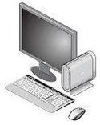

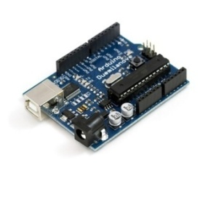

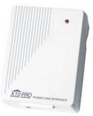
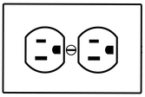



Appliances controlled by Arduino
“ Control Lamp using Arduino ”
Arduino
USB/Serial
Arduino IDE
X10 PLC Controller
X10 Lamp Module
RJ11 Cable
X10 power line signal
Internet Real Time Lab
I
R
T

Slide 48
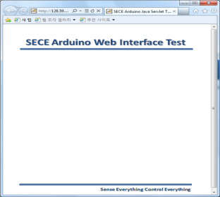


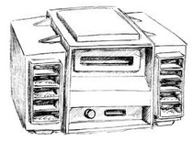
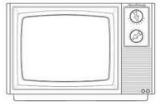


Appliances controlled by Arduino (continue)
SECE server
“ Control IR Electronics ”
-SAMSUNG:
TV, AUDIO..
-LG:
TV, PROJECTOR..
IR standard table
SECE users
LG
- TV_ON:0x8A75F20D
- TV_OFF:0x5A63B203
SAMSUNG
- AUDIO_ON:0x8A75F20D
AUDIO_OFF:0x5A63B203
..
0x8A75F20D
The Internet
IR Electronics
0x8A75F20D
IR LED
Arduino
Internet Real Time Lab
I
R
T

Slide 49
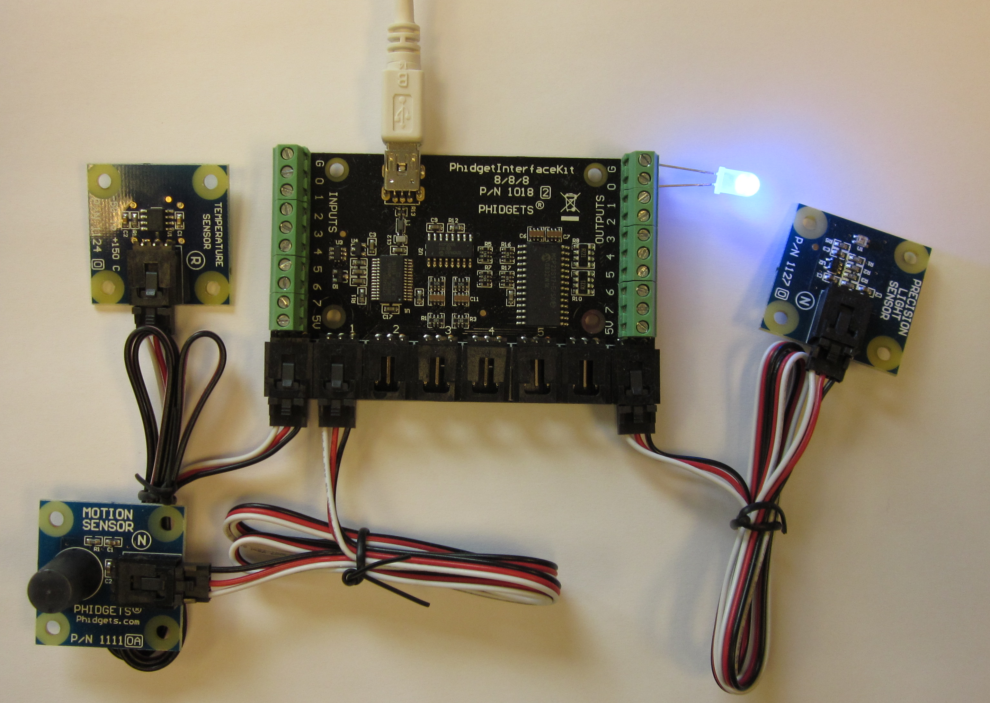
Building a POI database

Slide 50

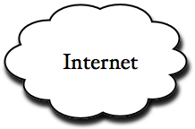
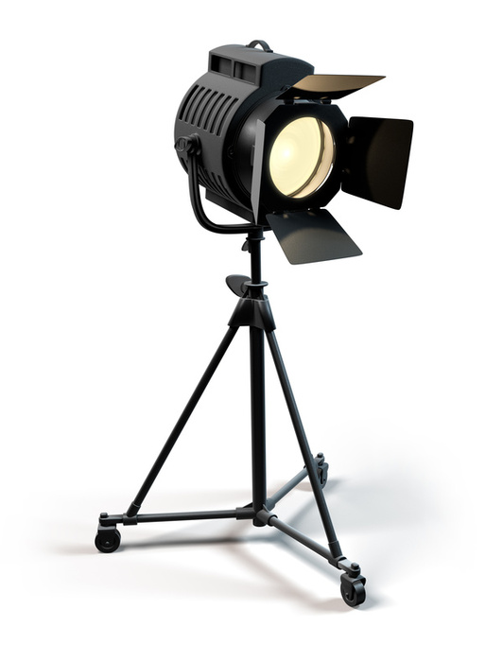
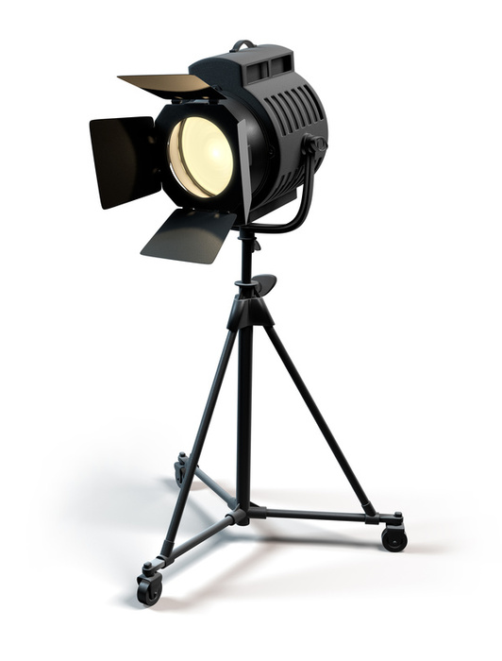




Automatic spot light
If my.position is left
turn on light1
turn off light2
SECE
ZigBee tag reports location of the speaker to SECE over the Internet
SECE controls individual lights using remote power switches
SECE turns lights ON/OFF depending on speaker's position on stage
If my.position is right
turn on light1
turn off light2
speaker
position
Light 1
Light 2
Location tag
Left Beacon
Right Beacon

Slide 51
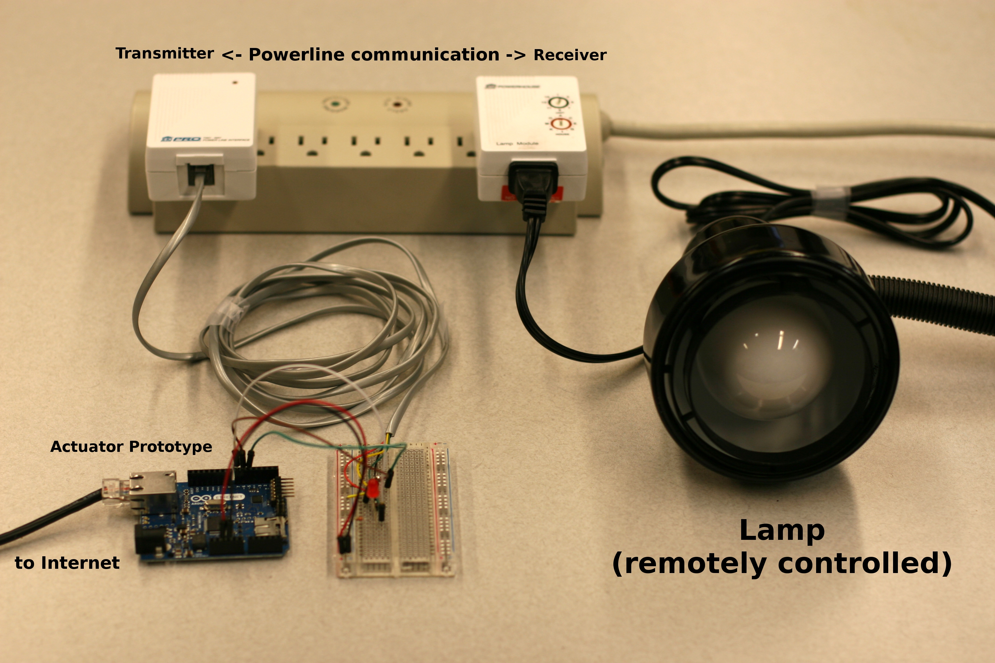
Light controller

Slide 52
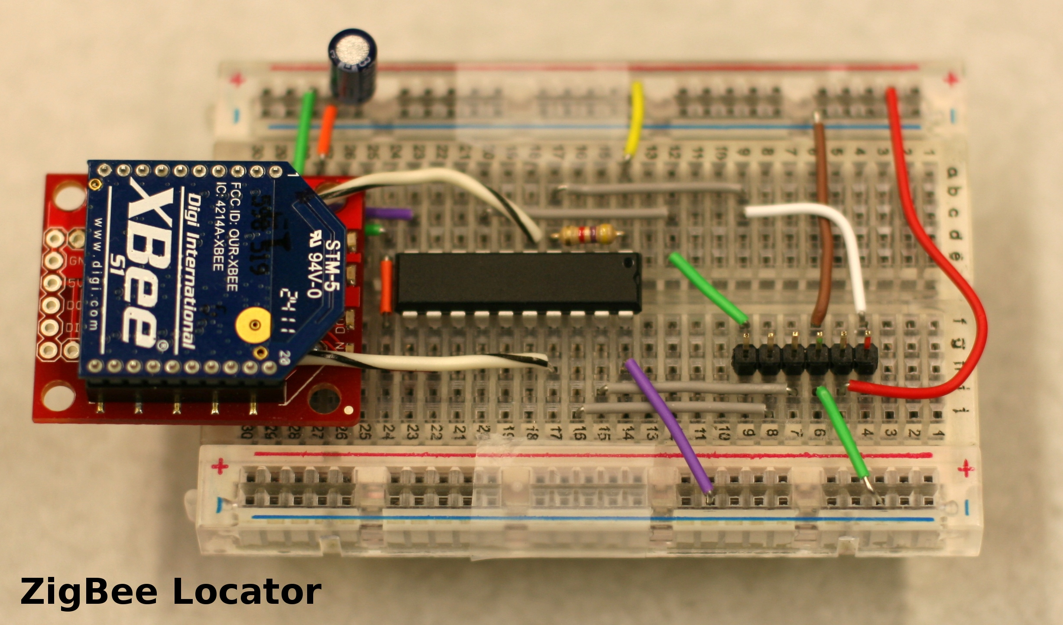
ZigBee Locator

Slide 53
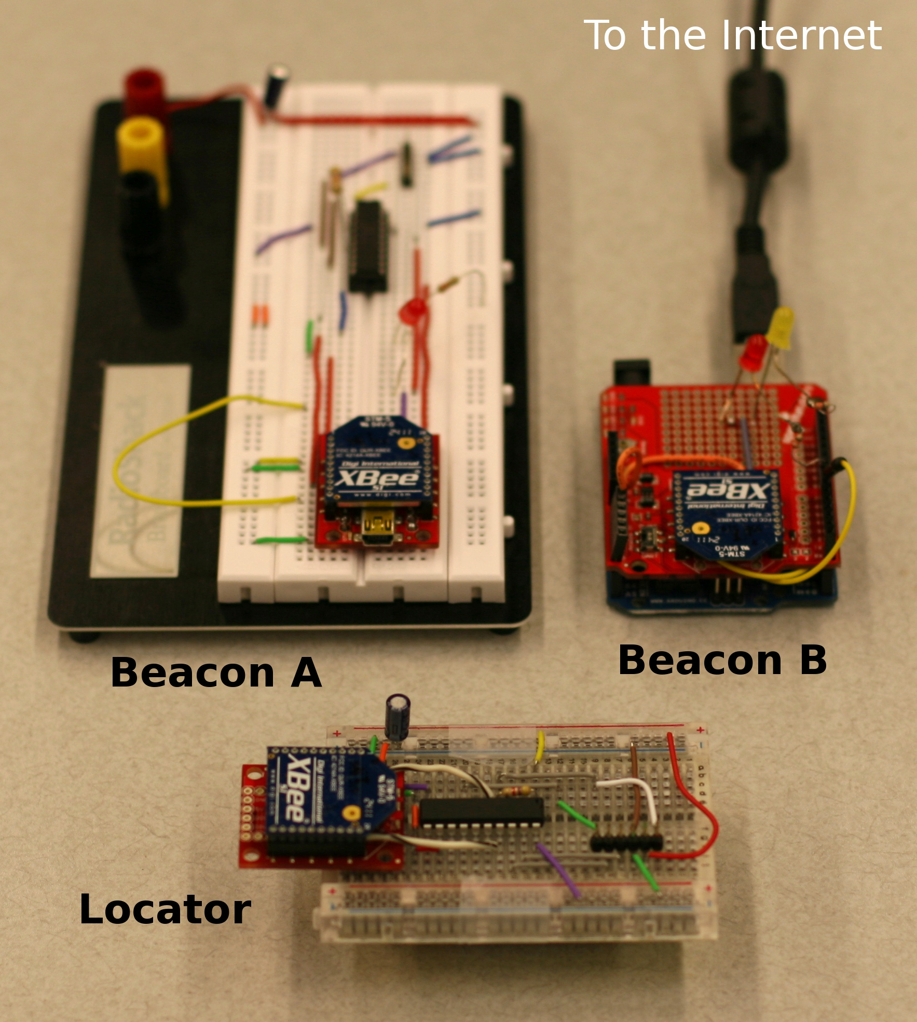
ZigBee location setup

Slide 54



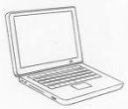
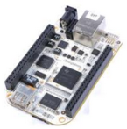


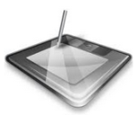

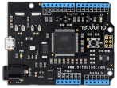
SECE SYSTEM
How do people use SECE service?
: register & download SECE software
1
2
: installation & bootstrapping
SECE SERVER
3
: controlling sensors
ELECTRICAL APPLIANCES
CONNECTED TO MICROCONTROLLER
2
1
3
INTERNET
…
…
…
Internet Real Time Lab
I
R
T

Slide 55
SECE SYSTEM
SECE SERVER
BLUETOOTH
X10
ZIGBEE
INTERNET
Home gateway
…
INFRARED
OTHERS
Internet Real Time Lab
I
R
T

Slide 56












SECE: Multi-Protocol Architecture
SECE SERVER
Internet protocol suite
Ethernet IP TCP/UDP DHCP DNS mDNS HTTP
Microcontroller: Arduino
Internal Comm.
(wired & wireless)
…
Sensors & Actuators
Electrical Appliances
…
Internet Real Time Lab
I
R
T

Slide 57

SECE: How to verify user authentication and authorization?”
SECE SERVER
USER LIST
SERVICE LIST
Control electrical appliances
Location tracking system
Social networks facebook & twitter
Email, calendar and so on
Authentication
Is the user X ?
Authorization
What can the user X do ?
INTERNET
CLIENTS
Internet Real Time Lab
I
R
T

Slide 58






SECE: Tree topology + Circles
Office
Tree topology: permission hierarchy
Who gets a permission to control the sensor?
G1
Circle system:
Who has higher priority? (G1 > G2)
G2
Room 1
Room 2
Light 1
Internet Real Time Lab
I
R
T

Slide 59











SECE: How to create events?
How to create events?
Ex) Ifttt (if this then that)
Task – Triggers – Actions - Channels
HOME
OFFICE
Internet Real Time Lab
I
R
T

Slide 60






SECE: Can I turn off the lights in the house? - 1
SECE SERVER
:Wired / Wireless
INTERNET
Can I turn off
the lights?
denied
1. SECE server combines all information such as
  Requester’s permission status
  TV, Radio, Heater current ON/OFF status
  Temperature measurement from digital thermometer
  locations of family members and so on
2. SECE server decides that there are people in the house.
3. The request is denied.
Internet Real Time Lab
I
R
T

Slide 61
SECE: Can I turn off the lights in the house? - 2
SECE SERVER
:Wired / Wireless
INTERNET
Can I turn off
the lights?
denied
Use one of available communications
from smart phone (3G/WIFI/Bluetooth)to send
a request to SECE server. Bluetooth verifies that
a user is inside the house. WIFI connection can be also
used to compare IP addresses for the authorization.
allowed
Internet Real Time Lab
I
R
T

Slide 62




SECE: Fire alarm system
SECE SERVER
How to implement fire alarm button in SECE?
Report user location
INTERNET
Break Glass
Push the button
SECE FIRE
ALARM
APPLICATION
X10
Push button ten times
to activate fire alarm
Internet Real Time Lab
I
R
T

Slide 63
SECE: Indoor Location Tracking System
SECE SERVER
B
: Beacon
G
: Gateway
INTERNET
G
B
B
Zigbee
CLIENTS
B
Plus,
- Temperature, light and motion sensors on beacons
periodically report measurements to SECE server
B
B
B
Internet Real Time Lab
I
R
T

Slide 64
Next steps
Functionality:
  Integrate SER server
  Integrate LoST server and geo database
  Finish address book functionality
  Finish request-based incoming rules
  Implement request-based outgoing rules
  State + events
Usability:
  graphical interface
  natural language interface?
  evaluation: can “normal” users create services?

Slide 65
Conclusion
Real world
(location & sensors)
Communication
(VoIP, SMS, email)
Web services
(SNs, calendar, contacts, ..)
SECE

