Slide 1
Large-Scale Internet Measurements for Diagnostics and public policy
Henning Schulzrinne
(+ Walter Johnston & James Miller)
FCC & Columbia University

Slide 2
Overview
Quick overview
What does MBA measure?
Can we build measurement into the infrastructure
Security and privacy issues

Slide 3


The role of network measurements
Measurement infrastructure
ISP diagnostics
“my Interwebs are just beach balls”
User diagnostics & validation
hard failures → soft failures
Public policy
BB evolution?
Informed consumer choice
Universal service

Slide 4

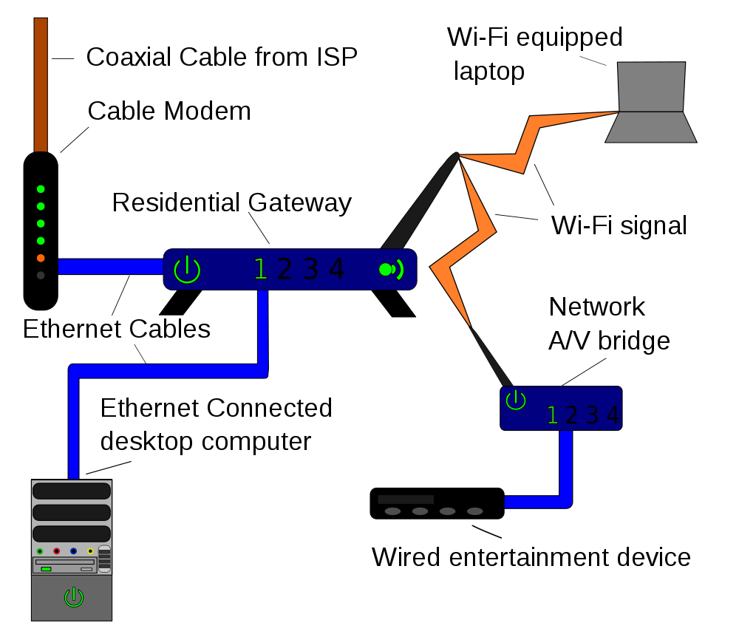
Measurement architecture
broadband Internet
access provider (ISP)
backbone
ISP
Measuring Broadband America 2011 & 2012
Measuring Broadband America future?
Lucid
Notes:
http://commons.wikimedia.org/wiki/File:Homenet.svg

Slide 5
What was measured
Sustained Download | Burst Download
Sustained Upload | Burst Upload
Web Browsing Download | UDP Latency
UDP Packet Loss | Video Streaming Measure
VoIP Measure | DNS Resolution
DNS Failures | ICMP Latency
ICMP Packet Loss | Latency Under Load
Total Bytes Downloaded | Total Bytes Uploaded

Slide 6
L3/L4 measurements
Metric | Description
ICMP latency | Throughput in Megabits per second (Mbps) utilizing three concurrent TCP connections
ICMP packet loss | Percentage of packets lost in the ICMP latency test
UDP latency | Average round trip time of a series of randomly transmitted UDP packets distributed over a long timeframe
UDP packet loss | Fraction of UDP packets lost from UDP latency test
TCP download speed | Throughput in Megabits per second (Mbps) utilizing three concurrent TCP connections
TCP upload speed | Throughput in Mbps utilizing three concurrent TCP connections
Latency under load | Average round trip time for a series of regularly spaced UDP packets sent during downstream/upstream sustained tests

Slide 7
DNS measurements
Metric | Description
DNS resolution | Time taken for the ISP’s recursive DNS resolver to return an A record for a popular website domain name
DNS failures | Percentage of DNS requests performed in the DNS resolution test that failed

Slide 8
Application measurements
Metric | Description
Web browsing | Total time to fetch a page and all of its resources from a popular website
Video streaming | Initial time to buffer, number of buffer under-runs and total time for buffer delays
Voice over IP | Upstream packet loss, downstream packet loss, upstream jitter, downstream jitter, round trip latency
Availability | Total time the connection was deemed unavailable for any purpose, which could include a network fault or unavailability of a measurement point
Consumption | A simple record of the total bytes downloaded and uploaded by the router

Slide 9
Application measurements
Goal: rough estimate of consumer experience
  relative ordering: “if metric is significantly better for ISP A than B, consumer experience should be similarly ordered”
Non-goal: predict performance of specific browser or video viewer
Try to capture latency and variability effects on QoE

Slide 10
Example: VoIP
The Voice over IP (VoIP) test operated over UDP and, unlike the video streaming test, utilized bi-directional traffic, as is typical for voice calls.
The Whitebox would handshake with the server, and each would initiate a UDP stream with the other. The test used a 64 kbps stream with the same characteristics and properties (i.e., packet sizes, delays, bitrate) as the G.711 codec. The test measured jitter, delay and loss. These metrics were measured by subdividing the stream into blocks, and measuring the time taken to receive each block (as well as the difference between consecutive times).
Jitter was calculated using the PDV approach described in section 4.2 of RFC5481. The 99th percentile was recorded and used in all calculations when deriving the PDV.

Slide 11
Example: Web browsing
The test recorded the averaged time taken to sequentially download the HTML and referenced resources for the home page of each of the target websites, the number of bytes transferred, and the calculated rate per second. The primary measure for this test was the total time taken to download the HTML front page for each web site and all associated images, JavaScript, and stylesheet resources. This test did not test against the centralized testing nodes; instead it tested against real websites, ensuring that the effects of content distribution networks and other performance enhancing factors could be taken into account.
Each Whitebox tested against the following 9 websites:
  http://www.cnn.com
  http://www.youtube.com
  http://www.msn.com
  http://www.amazon.com
  http://www.yahoo.com
  http://www.ebay.com
  http://www.wikipedia.org
  http://www.facebook.com
  http://www.google.com
The results include the time taken for DNS resolution. The test used up to eight concurrent TCP connections to fetch resources from targets. The test pooled TCP connections and utilized persistent connections where the remote HTTP server supports them.
The client advertised the user agent as Microsoft Internet Explorer 8. Each website was tested in sequence and the results summed and reported across all sites.

Slide 12

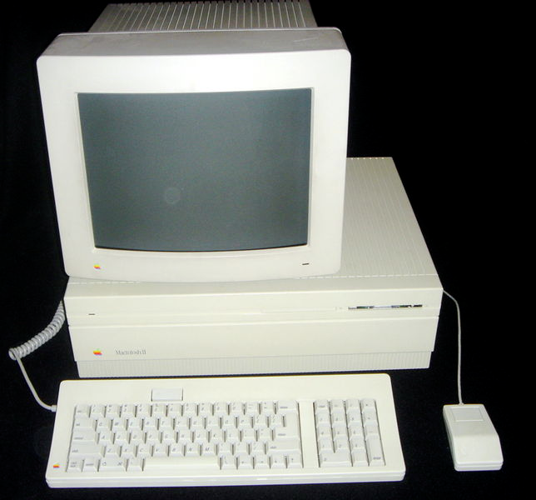

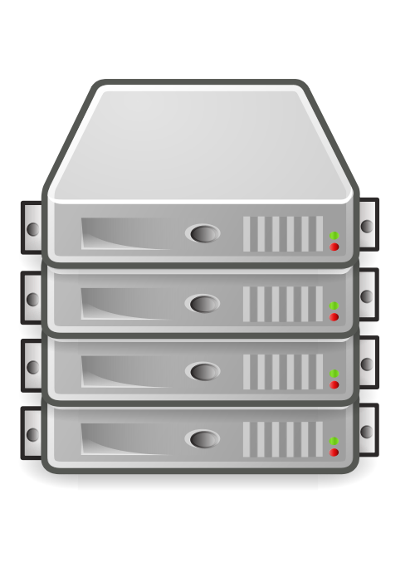

LMAP proposed architecture
network parameter server
Host | Tier
2001:db8::1 | 10/2
2001:db8::2 | 25/5
What is my tier?
measurement
clients
measurement
server
e.g., UDP echo
measurement
samples
Start metrics 17 & 42!
measurement
controller
data collector

Slide 13
What’s needed?
Define higher-layer “QoE” metrics
  active measurements for privacy
Protocols for overall architecture
  See also TR-69

Slide 14
Security and privacy issues
Security
  Prevent massive bot nets → authentication of controller
  Logging and disclosure to consumers
  Permission architecture – legal issue as much as technical:
    explicit permission: “fcc.gov may request measurements”
      measurement volunteers
      informed consent standard
    ISP contract: “You agree to let our service technician run tests”
    explicit consumer request: “test my performance”
Privacy concerns
  Active measurements relatively safe
  Do not measure when user traffic is active

Slide 15
Conclusion
Measurements: from sometime experiment to built-in facility
Good telecom policy needs good data
  not just counting lines
  PSTN transition to IP → there is no second network
Re-use measurement for three purposes:
  ISP diagnostics and planning
  Consumer diagnostics
  Public policy data gathering

Slide 16
BACKUP

