Slide 1
Large-Scale Internet Measurements for data-driven public policy
Henning Schulzrinne
(+ Walter Johnston & James Miller)
FCC & Columbia University

Slide 2
Overview
Why measure?
Results of FCC MBA 2011 and 2012
The challenge of mobile measurements
Baking measurements into the infrastructure

Slide 3
Why measure?
Whole conferences on measurement
  often driven by lost-key method
Long history of IETF measurement work
  RFC 2330: 1998
  focused on specific metrics, not so much overall architecture
Performance measurements don’t work well
  Individual consumers:
    not statistically reliable (geek-heavy)
    no ground truth data
    confounding factors (e.g., home networks)
    data generally not published → hard to compare metrics
  Service providers:
    limited infrastructure → hard to scale

Slide 4
FCC measurement history
FCC has acquired and analyze data on legacy PSTN
More recent and evolving broadband interest
  Section 706 of 1996 Telecommunications Act ➔ annual report on availability of advanced telecommunications services to all Americans
    Resulted in information on deployment of broadband technology (“Form 477”)
    but not its performance
  FCC’s National Broadband Plan – March 2010
    Proposed performance measurements of broadband services delivered to consumer households
    Work plan evolved from recommendations of National Broadband Plan

Slide 5


The role of network measurements
Measurement infrastructure
ISP diagnostics
“my Interwebs are just beach balls”
User diagnostics & validation
hard failures → soft failures
Public policy
BB evolution?
Informed consumer choice
Universal service

Slide 6
Principles
The FCC Measuring Broadband America program is based on principles of openness, transparency and partnership with diverse stakeholders.
We are committed to:
  Ensuring that commonly accepted principles of scientific research, good engineering practices, and transparency guide the program;
  Encouraging collaboration of industry, academia and government;
  Publishing the comprehensive technical methodology used to collect the data, including the source code for the tests as open source;
  Releasing data used to produce each report coincident with the report’s release, and releasing all data for each collection cycle within one year of collection.

Slide 7

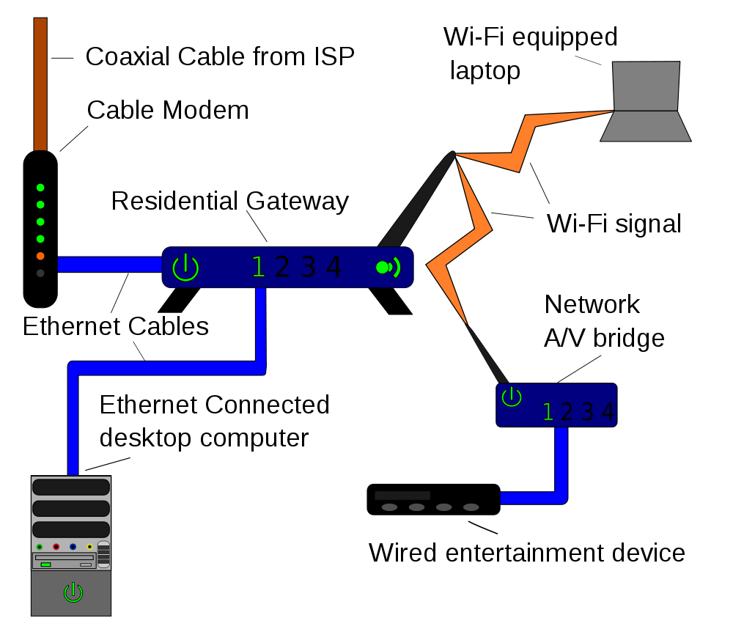
Measurement architecture
broadband Internet
access provider (ISP)
backbone
ISP
Measuring Broadband America 2011 & 2012
Measuring Broadband America future?
Lucid
Notes:
http://commons.wikimedia.org/wiki/File:Homenet.svg

Slide 8
The MBA project - logistics
Enlisted cooperation:
  13 ISPs covering 86% of US population
  vendors, trade groups, universities and consumer groups
Reached agreement reached on what to measure and how to measure it
Enrolled roughly 9,000 consumers as participants
  6,800 (7,782) active during March 2011 (April 2012)
  A total of 9,000 active over the data collection period

Slide 9
What was measured
Sustained Download | Burst Download
Sustained Upload | Burst Upload
Web Browsing Download | UDP Latency
UDP Packet Loss | Video Streaming Measure
VoIP Measure | DNS Resolution
DNS Failures | ICMP Latency
ICMP Packet Loss | Latency Under Load
Total Bytes Downloaded | Total Bytes Uploaded

Slide 10
What was released
Measuring Broadband America reports
  Main section describing conclusions and major results
  Technical appendix describing tests and survey methodology
Spreadsheet providing standard statistical measures of all tests for all ISPs and speed tiers measured
Report period data set with 4B data elements from over 100M tests
  Data set presented as used with anomalies removed
  Documentation provided on how data set was processed
  All data, as recorded
Geocoded data on test points recently released
Information available at http://www.fcc.gov/measuring-broadband-america

Slide 11
2011: Most ISPs deliver close to advertised during peak hours

Slide 12
2012: You improve what you measure…

Slide 13
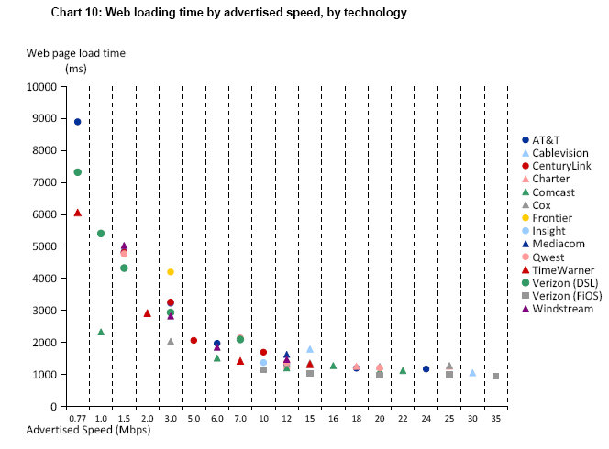
Web page downloading

Slide 14
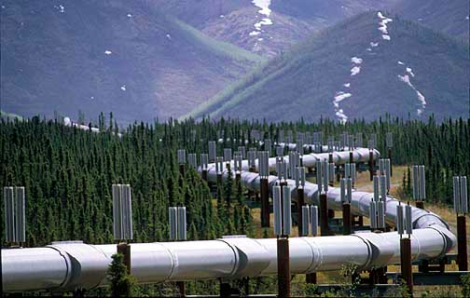
The Internet is not a series of (fixed-width) tubes
Some cable companies advertise burst speed
  Quota based technique providing temporary speed increase of < 15 seconds
    Also affected by other household activity
  Can’t be applied generally to DSL where sync rate often limiting factor
  Marginal value to fiber where each subscriber has potentially available 37 Mb/s to 75 Mb/s provisioned bandwidth
  → Links are no longer constant-size bit pipes
Measured both burst and sustained speed

Slide 15
Broadband 2012
Deployment
  USF: Connect America Fund
Performance
  Measuring Broadband America
  mobile project announced
Significant progress:
  wider availability of 100 Mb/s
  fiber available to 46 million homes (FiOS, U-verse)
  community/non-traditional broadband (Chattanooga, Kansas City)
  LTE networks

Slide 16
Mobile performance
Announced effort with 4 largest wireless providers
Options available
  structured drive testing → expensive
  semi-formal drive testing → snapshot, limited coverage
  passive measurements → privacy concerns, limited sampling
➔ Smartphone app + volunteers + existing infrastructure
Challenges:
  how to capture variation in time, space and device?
  how to ensure location privacy?
  impact of bandwidth usage for metered & capped plans?

Slide 17
What can’t we measure?
Small providers
  may be more infrastructure- & engineering-challenged
Anchor institutions
Network reliability
  large-scale outages gathered by “Part 4” outage reporting, but not public
  small-scale outages?
Network features
  Who has access to DNSsec? IPv6? Which ports are being blocked?
Which country has the cheapest broadband?
  And why?
What drives consumer adoption of higher speeds & new applications?
  Speed → applications OR applications → speed?
Why does 1/3 of US not use the Internet?
  Relative importance of availability, affordability, relevance?

Slide 18

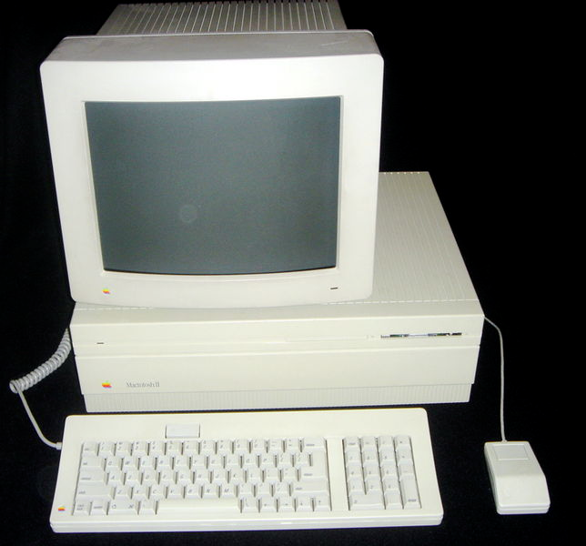



LMAP proposed architecture
network parameter server
Host | Tier
2001:db8::1 | 10/2
2001:db8::2 | 25/5
What is my tier?
measurement
clients
measurement
server
e.g., UDP echo
measurement
samples
Start metrics 17 & 42!
measurement
controller
data collector

Slide 19
Conclusion
Measurements: from sometime experiment and LAN to built-in capability
Good telecom policy needs good data
  not just counting lines
  PSTN transition to IP → there is no second network
Re-use measurement for three purposes:
  ISP diagnostics and planning
  Consumer diagnostics
  Public policy data gathering
Dear IETF: We need your help!

Slide 20
BACKUP

Slide 21
FCC
Chairman (D)
4 Commissioners (2 D, 2 R)
Consumer and Governmental Affairs
Enforcement
International
Media
Public Safety & Homeland Security
Wireless Telecommunications
Wireline Competition
Independent federal agency
About 1,600 employees

Slide 22
Process
NOI
NPRM
R&O
Notice of Inquiry
Notice of Proposed Rule Making
Report & Order
comments & ex parte

Slide 23
Performance varies
ISPs seem to impose network wide performance standards
However, there can be exceptions by speed tier

Slide 24
2011: some don’t

Slide 25
Burst speed increase
Most impact of burst speed seen between 6 and 12 Mb/s
Note: This chart not in report and shows calculated difference between burst and sustained performance

Slide 26
Latency by technology

Slide 27
Data usage

Slide 28
Reliability
Packet loss rate < 1%
Correlation between peak periods and packet loss
  Higher loss during peak hours
Most companies during peak experience < .4% packet loss
Worst case seen during March: .8%
Data from other periods may have numbers in excess of 1% (Georgia Tech)
1% packet loss often cited as video threshold

Slide 29
Web page downloading: Canary in the Coal Mine?
Performance seems to top out after 10 Mb/s
Many possible explanations
  Latency, TCP issues, server loading, household platform limitations, …
However, discussions with Georgia Tech indicate that they have seen similar performance issues
Discussion with Ofcom and others suggest that globally, full benefits of higher line rates not being realized
Higher ISP speed may challenge industry to examine performance bottlenecks
More data needed

Slide 30
International comparison: fixed
3rd International Broadband Data Report (IBDR), August 2012

Slide 31
International comparison: mobile
3rd International Broadband Data Report (IBDR), August 2012

Slide 32
2012 Upload speeds

Slide 33
2012 peak period actual vs. advertised

Slide 34
Advertised vs. actual

Slide 35
Burst download vs. sustained download

Slide 36
Web page loading time

Slide 37
Cumulative distribution of download speeds

Slide 38
CDF of sustained download speed

Slide 39
Throughput predictability

Slide 40
Actual download speeds: 2011 vs. 2012

