Slide 1
Transitioning to a VoIP PSTN
        Henning Schulzrinne (FCC)
Any opinions are those of the author and do not necessarily reflect the views
of the Federal Communications Commission.

Slide 2
Overview
What features have we come to appreciate?
What are the technical challenges we need to address?
  reliability & quality
  numbering
  universal
  beyond voice?
See FCC TAC PSTN working groups

Slide 3
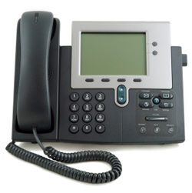
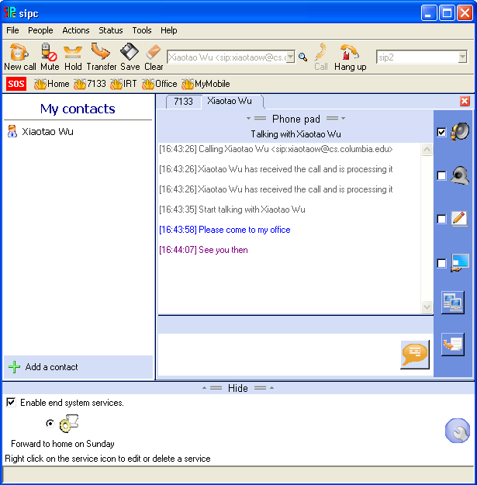
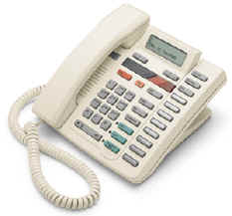

Evolution of VoIP
“Can it really replace the phone system?”
“How can I make it stop ringing?”
long-distance calling,
ca. 1930
“does it do
call transfer?”
replacing the
global phone system
“amazing – the phone rings”
going beyond
the black phone
catching up
with the digital PBX
1996-2000
2000-2003
2004-2005
2006-

Slide 4
The fall of the circuit-switched empire
mobile replacement
SIP trunking
VoLTE
IMS
more text
less voice
VoIP over DSL
2011
2015
2018
2020+

Slide 5
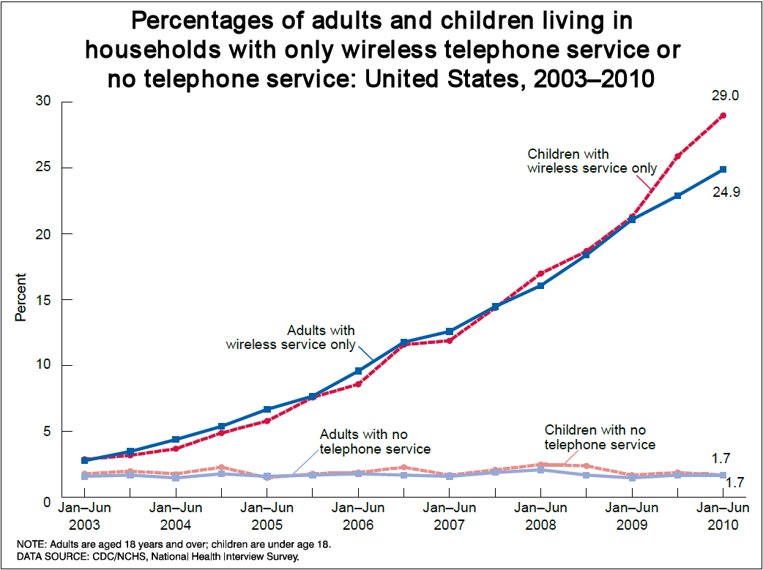

Mobile-only households and demographics (CDC data)
High Wireless Substitution:
Young adults (esp. those ages 24-29)
Renters
Low income (poverty line or below)
Latino/Hispanic
Mobile Phone Trends
4/28/2011
5

Slide 6
Real-time: voice → non-voice
1950—2005: real-time ≡voice
Now: real-time = web interaction + text + voice
Displacement:
  teenage 2-hour chat → Facebook, IM
  coordination & transaction calls → web
    schedule appointments, travel agency, airline, …
  business calls → messaging
  “I’m heading home” → Google Latitude

Slide 7
PSTN: The good & the ugly
The good | The ugly
Global Connectivity (across devices and providers) | Minimalist service
High reliability (engineering, power) | Limited quality (4 kHz)
Ease of use | Hard to control reachability (ring at 2 am)
Emergency usage | Operator trunks!
Universal access (HAC, TTY, VRS) | No universal text & video
Mostly private (protected content & CPNI) | Limited authentication Security more legal than technical (“trust us, we’re a carrier”)
Relatively cheap (c/minute) | Relatively expensive ($/MB)

Slide 8
Telephone Social Policies
Universal service (Lifeline, high cost, …) | Necessary to function (call doctor, call school, …)
Basic service price regulation | Ensure widespread availability
911 | Report emergencies for self and others
Power backup | Ensure emergency communications
Outage reporting | Ensure reliability
Lawful intercept (CALEA) | Phone as tool for criminals
Disability access (ringers, HAC) | Ensure participation in society
CPNI | Phone as private medium

Slide 9
Now: the Internet
Universal service | USF reform (Connect America Fund)
911 | NG911
Power backup | Cell phones? Responsibility moves to household (UPS)
Outage reporting | FCC Part 4 NPRM multiple access modes
Lawful intercept (CALEA) | Encryption?
Disability access | Twenty-First Century Communications and Video Accessibility Act of 2010?
CPNI | Uncertain privacy rights

Slide 10
Open Internet Principles
Transparency. Fixed and mobile broadband providers must disclose the network management practices, performance characteristics, and terms and conditions of their broadband services;
No blocking. Fixed broadband providers may not block lawful content, applications, services, or non-harmful devices; mobile broadband providers may not block lawful websites, or block applications that compete with their voice or video telephony services
No unreasonable discrimination. Fixed broadband providers may not unreasonably discriminate in transmitting lawful network traffic.

Slide 11
It’s just a number
Number | Type | Problem
201 555 1212 | E.164 | same-geographic different dial plans (1/no 1, area code or not) text may or may not work
#250, #77, *677 | voice short code | mobile only, but not all no SMS
12345 | SMS short code | SMS only country unclear
211, 311, 411, 911 | N11 codes | Distinct call routing mechanism Mostly voice-only May not work for VoIP or VRS
800, 855, 866, 877, 888 | toll free | not toll free for cell phone may not work internationally
900 | premium | voice only unpredictable cost

Slide 12
Numbers
Administered in blocks by NANPA
  funded by carriers: $5.9M/year
Separate processes for each number type
  Regular E.164 numbers by 1k blocks
Complicated LNP and porting technology
  often takes several phone calls to provider
  takes, at best, several hours
  limited wireline ⇔ wireless porting
  limited wireline out-of-area porting

Slide 13
Numbers vs. DNS & IP addresses
 | Phone # | DNS | IP address
Role | identifier + locator | identifier | locator (+ identifier)
Country-specific | mostly | optional | no
# of devices / name | 1 (except Google Voice) | any | 1 (interface)
# names /device | 1 for mobile | any | any
ownership | carrier, but portability unclear (800#) | property, with trademark restrictions | ISP
who can obtain? | geographically-constrained, carrier only | varies (e.g., .edu & .mil, vs. .de) | enterprise, carrier
porting | complex, often manual; wireline-to-wireless may not work | about one hour (DNS cache) | if entity owns addresses
delegation | companies (number range) | anybody | subnets
identity information | wireline, billing name only | WHOIS data (spotty) | RPKI, whois
Notes:
http://www.nanpa.com/reports/faq.html#g1

Slide 14


Future numbers
Should numbers be treated as names?
  see “Identifier-Locator split” in Internet architecture
Should numbers have a geographic component?
  Is this part of a state’s cultural identity?

Slide 15
More number questions…
Should numbers become personal property?
  Separate service from number
  Simplify number portability
  Can you put a 212 number in your will?
Divorce device from number
  any-to-any, dynamic mapping
Separate user identity & number

Slide 16
Security (trustworthiness)
Practically, mostly about identity, not content
Old model: “trust us, we’re the phone company”
New reality: spoofed numbers & non-carrier entities
  both domestic and international
  → SMS and voice spam
Need cryptographically-verifiable information
  Is the caller authorized to use this number?
  Has the caller ID name been verified?
    cf. TLS

Slide 17
VoIP Interconnection
“IP-IP interconnection” → don’t confuse with IP peering
  VoIP interconnect
Are there technical stumbling blocks?
  SIP features?
    IMS vs. non-IMS?
  Media codecs & conversion?
Separation application layer & transport
$0.000048 / minute for IP transport ($0.10/GB)

Slide 18
Public Safety (NG911)
Transition to NG911 underway
Key issues:
  Indoor location for wireless
    location accuracy of 50/150m may not be sufficient
    need apartment-level accuracy, including floor
    Civic (Apt. 9C, 5 W Glebe), not geo
  Avoid protracted transition
    maintain two infrastructures for decade+?
  Only local & regional → national infrastructure?

Slide 19
More than voice
VoIP = Voice + Video + Vowels (text)
→ Real-time communication as base-level service?
Accommodate new media codecs (e.g., AMR)
See also CVAA “advanced communication systems”
Point-to-point? or multipoint?

Slide 20
Reliability
How do we measure reliability & QoS?
  E.g., MBA project?
Can consumers know how well their voice service will perform?
Can we improve power robustness?
  e.g., DOCSIS modem consumes ~7W (idle)
  Li-Ion battery = 2.5 Wh/$ ➔ 3$/hour of standby time
Can we simplify multihoming to make new PSTN more reliable than old?
  e.g., cable + 4G

Slide 21
Conclusion
Solid engineering, not rocket science
Maintain established qualities of circuit-switched PSTN → consumer expectations
Fix legacy technical restrictions
  more than voice
  trustworthiness
  reliability
  clean up numbering

Slide 22


