Slide 1
Mesh networks (for public safety) – a taxonomy
Henning Schulzrinne
FCC & Columbia University

Slide 2
Overview
A taxonomy of nodes, relationships and devices
Efficiency and capacity
Technical background
Alternatives for public safety

Slide 3
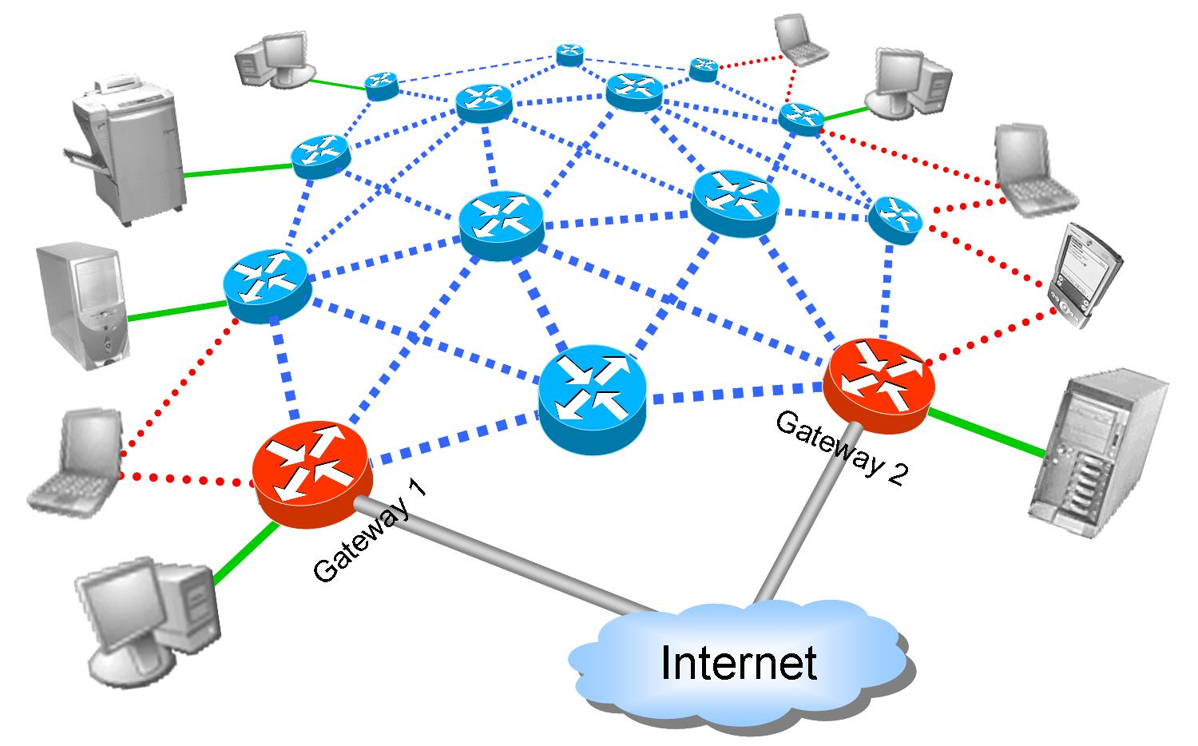
Mesh components
Node Types
Link Types
Wireless routers
Gateways
Printers, servers
Mobile clients
Stationary clients
Intra-mesh wireless links
Stationary client access
Mobile client access
Internet access links
Mihail L. Sichitiu, NCSU
Notes:
Mihail L. Sichitiu, NCSU, 2005/2006

Slide 4
Mesh requirements
Need symmetric radio links
  802.11 in “ad-hoc” mode
  LTE does not currently support direct mode
    without eNodeB
Stand-alone operation → more than just links
  no HSS
  no remote authentication (HSS, RADIUS/DIAMETER server)
  built-in support infrastructure
    DNS
    DHCP
    SIP proxy
    service discovery
Notes:
http://urgentcomm.com/networks_and_systems/news/direct-mode-lte-study-20110928/

Slide 5
Store-forward vs. Store-carry-forward
store packet for < 100 ms
~stationary while transmitting
disk
store data
& move
store-carry-forward
disruption tolerant
delay tolerant
mesh networks

Slide 6
Taxonomy
Wireless
Networking
Single
Hop
Multi-hop
Infrastructure-based
(hub&spoke)
Infrastructure-less
(ad-hoc)
Infrastructure-based
(Hybrid)
Infrastructure-less
(MANET)
802.11
802.16
802.11
Bluetooth
Cellular
Networks
Wireless Sensor
Networks
Wireless Mesh
Networks
Car-to-car
Networks
(VANETs)
Mihail L. Sichitiu, NCSU

Slide 7
Taxonomy, cont’d.
Mesh
infrastucture
in-home (Zigbee)
backup (netBlazr)
temporary
local area (1-2 hops)
wide area (3+ hops)
access (municipial)

Slide 8

Relationships: Local mesh vs. funnel
Internet
GW

Slide 9
Mobility
Mobility
Nomadic
(discontinuous)
Vehicular
stationary
dense urban, pedestrian
extent of mobility
relative speed

Slide 10
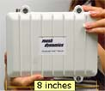
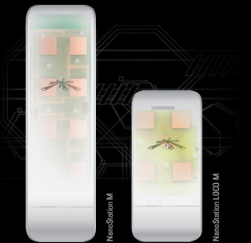
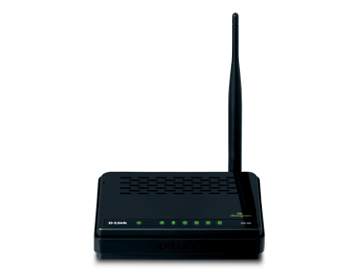
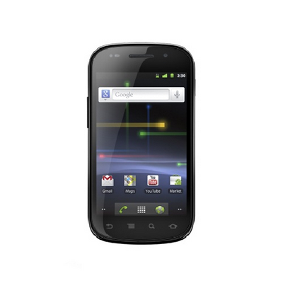
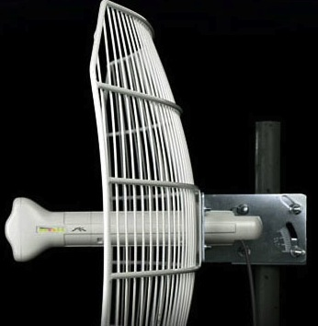
Three kinds of mesh nodes
 | Mobile handset | ad-hoc | infrastructure
Radio | 1 (802.11) | 1-2 | 2-4
Antenna | omni | omni | directional
Power | battery | utility | utility, solar, …
Range | 100’ | 100’-200’ | 100’ … 40 miles

Slide 11
Mesh network capacity
Does adding nodes add per-node capacity?
Depends strongly on assumptions:
  locality of traffic (local vs. funnel to Internet)
  interference → power control, directional antennas
  node distribution
  traffic distribution (uniform vs. hot spot)
Simplified assumptions
per-user throughput < c₂W/√(n log n) for link rate W and n nodes
can be as low as W/n
Notes:
Plextek 2006: Final Report - Study of Efficient Mobile Mesh Networks
http://stakeholders.ofcom.org.uk/binaries/research/technology-research/mesh.pdf

Slide 12
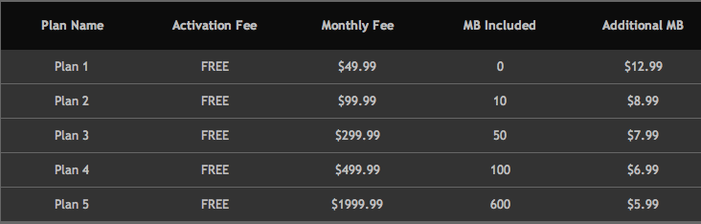
Example alternative: Inmarsat BGAN
Examples for illustration only

Slide 13
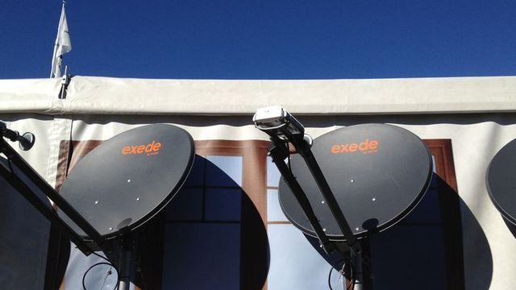
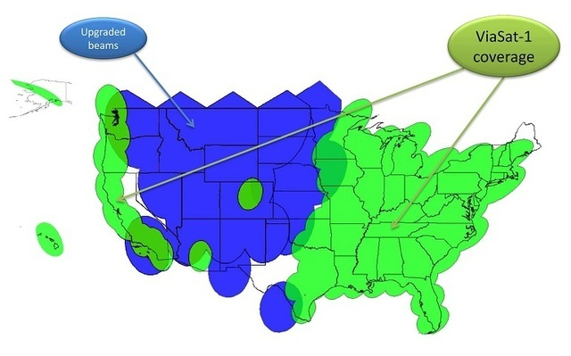
Example alternative: Viasat (Exede)
26”
“up to 12 Mb/s upstream -
up to 3 Mb/s downstream”
15 GB for $80/month

Slide 14
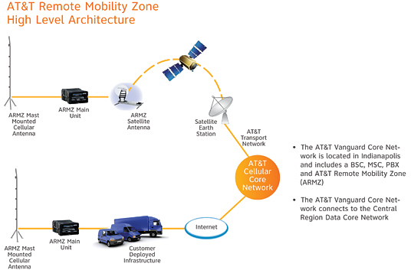
Example: AT&T remote mobility zone
coverage: ½ mile radius
Notes:
http://www.wireless.att.com/businesscenter/business-programs/mid-large/remote-mobility-zone.jsp

Slide 15
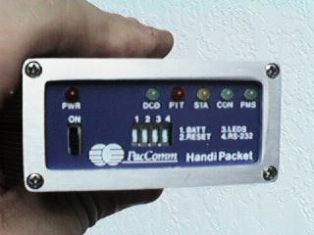
Example: Amateur radio
HF & VHF
low bandwidth

Slide 16
Conclusion
There is no single “mesh” network
What are the requirements?
  instantaneous setup (auto-configuration) by non-techies
  capacity?
  resiliency?
  low cost

