Slide 1
Machine-TO-MACHINE or the INTERNET of THINGS
Henning Schulzrinne
FCC & Columbia University
with slides from Harish Viswanathan, Alcatel-Lucent

Slide 2
Overview
What is M2M precisely?
What is it good for?
A taxonomy
Technical challenges for M2M
Research examples: SECE and EnHANTS

Slide 3
What is M2M?
Machine-to-machine:
  “Machine to machine (M2M) refers to technologies that allow both wireless and wired systems to communicate with other devices of the same ability.” (Wikipedia)
  sensors and actuators
    often within a control loop
    long history: telemetry, SCADA, industrial automation, building HVAC and security (e.g., BACnet)
    difference: IP-based protocols and/or Internet
  no direct human consumer or producer
  IoT → from custom communication to common stack
No single dominant application, but thousands of embedded applications
  → need low cost to develop & deploy

Slide 4
Key enablers
IoT
Cheap SOCs
Mature Internet protocols
Cellular connectivity
Unlicensed
Analytics
(“big data”)
Applications

Slide 5
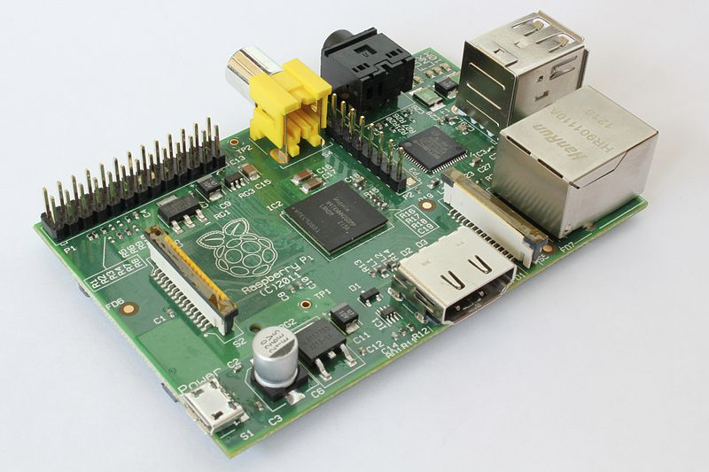
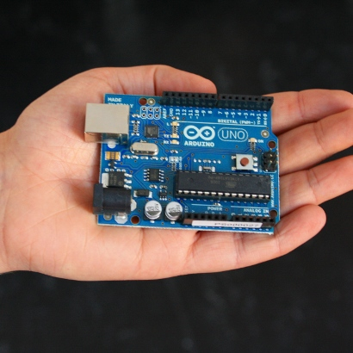

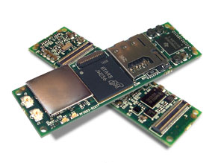
IoT = cheap microcontrollers + network interfaces
Raspberry PI ($35)
Arduino Uno, €20
Gumstix (WiFi, BT): 58 mm, $199

Slide 6
Major market segments
external hardware, sensors, and RFID, end point devices
fixed or wireless networking connectivity
to connect these devices and sensors to a central server and transmit
information about the objects
to collect data and monitor status
service layer infrastructure and associated services
Application services and system integration
to address the common needs across multiple vertical domains
to seamlessly integrate the disparate M2M solution components
Harish Viswanathan, Alcatel-Lucent, 2012
Notes:
| Presentation Title | Month 2010 | 6

Slide 7
M2M is not…
does not always uses cellular networks
is not always energy-constrained
is not always cost-constrained
only uses puny microcontrollers
is not always run by large organizations
  many small & mid-sized providers
  usually embedded into other products

Slide 8
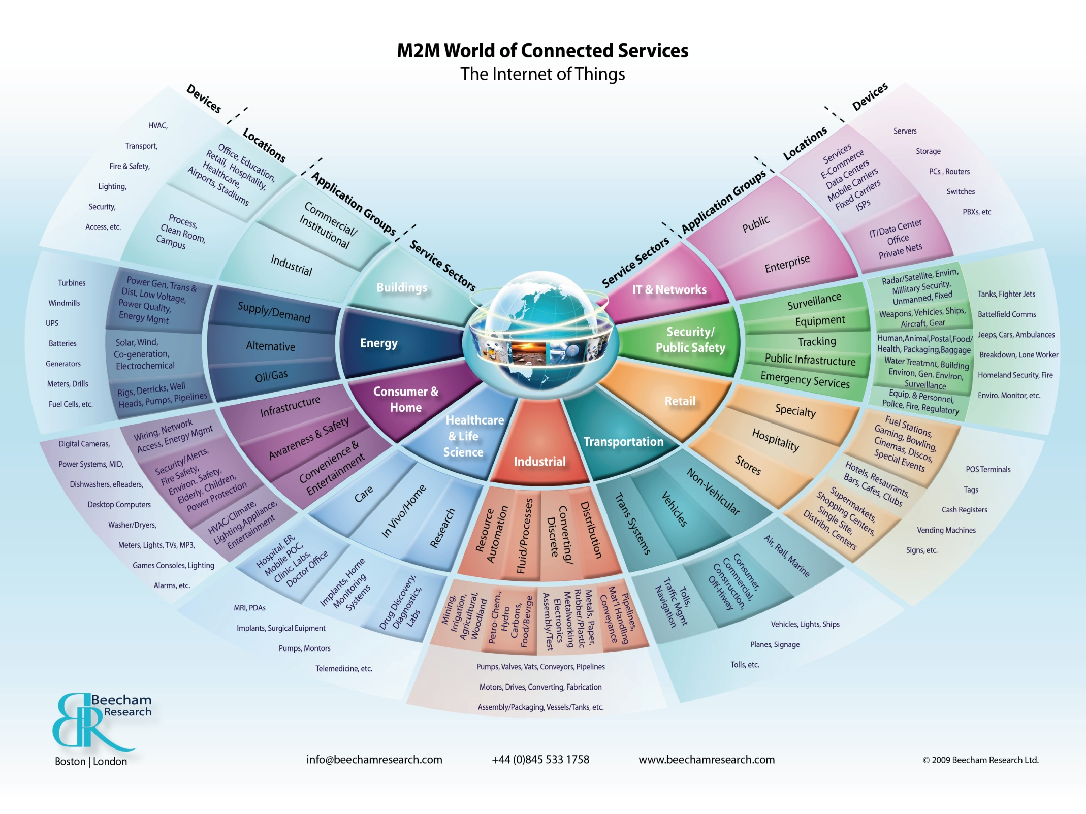

Slide 9
A taxonomy of selected M2M applications
Application |  | Energy-constrained | Processor or memory constrained (= $) | Reliability | Unsupervised | Cellular, unlicensed?
Automotive | V2I, I2V |  |  |  |  | C
 | V2V |  |  | ✔ | ✔ | U
Agriculture | environmental sensors | ✔ | ✔ | ✔ | ✔ | C, U
Industrial | plant monitoring & control | ✔? | ✔? | ✔ | ? | C, U
Infrastructure | utility monitoring | - | ✔ | ✔ | ✔ | C, U?
 | traffic | - | ✔ | ✔ | ✔ | C, U?
Medical | physio | ✔ | ✔ | ✔ | ? | C, U

Slide 10
Market size by vertical
2012 Application Services Revenue in $B
Source: Beecham Report, 2008

Slide 11
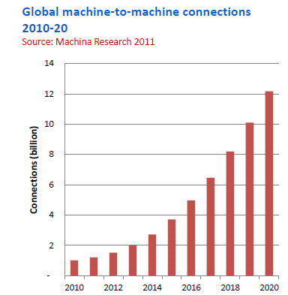
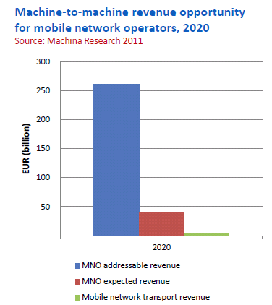

Connections and revenue
Energy
Signage
Tourism
Automotive
Environment
Home
Healthcare
Industry
Security
Transportation
Notes:
**

Slide 12
M2M communication models
dispersed | Smart grid, meter, city Remote monitoring | Car automation eHealth Logistics Portable consumer electronics
concentrated | smart home factory automation eHealth | on-site logistics
 | fixed | mobile
Source: OECD (2012), “Machine-to-Machine Communications: Connecting Billions of Devices”, OECD Digital Economy Papers, No. 192, OECD Publishing. http://dx.doi.org/10.1787/5k9gsh2gp043-en

Slide 13
M2M networking technologies
dispersed | PSTN Broadband 2G/3G/4G Power line communications | 2G/3G/4G satellite
concentrated | wireless personal area networks wired networks indoor electrical wiring WiFi | WiFi WPAN
 | fixed | mobile
Source: OECD (2012), “Machine-to-Machine Communications: Connecting Billions of Devices”, OECD Digital Economy Papers, No. 192, OECD Publishing. http://dx.doi.org/10.1787/5k9gsh2gp043-en

Slide 14
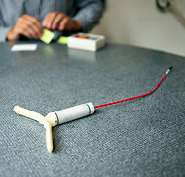
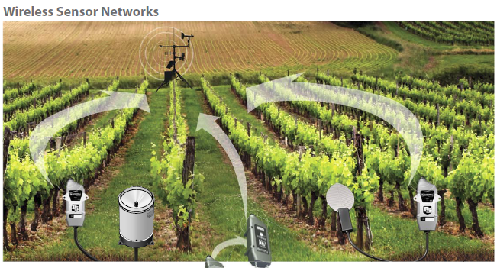
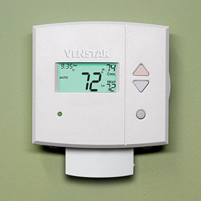
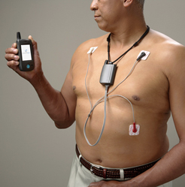
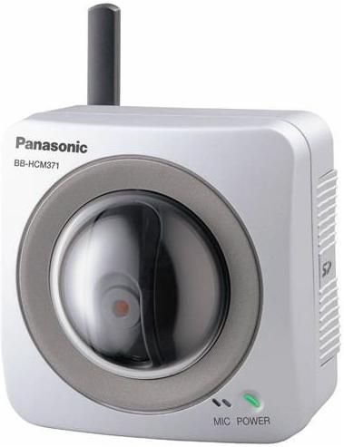
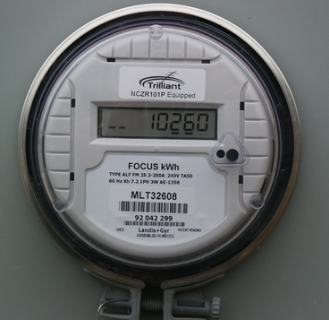
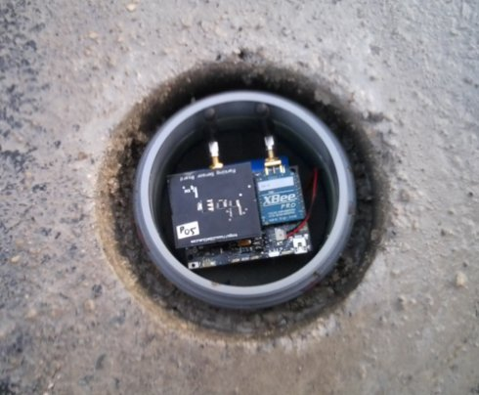

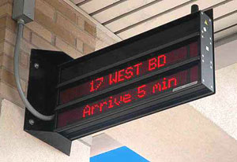
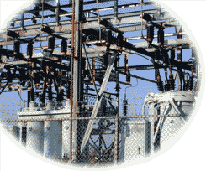
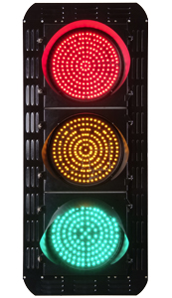
M2M varies in communication needs
sensors
1/hour
1/minute
1/second
10/second
actuators
Notes:
http://www.nytimes.com/2012/10/02/world/europe/device-sends-message-to-swiss-farmer-when-cow-is-in-heat.html?pagewanted=all

Slide 15

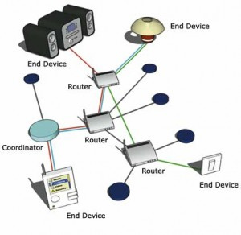

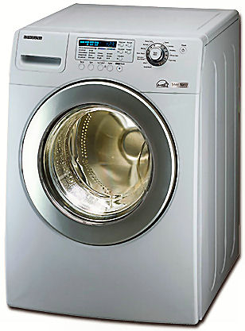
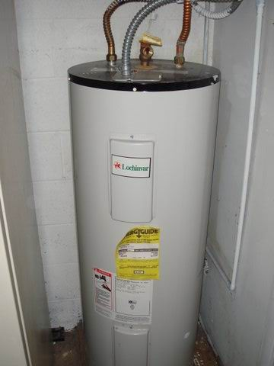
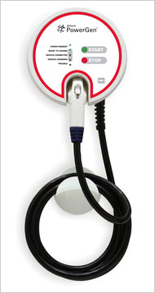
Not just cellular or unlicensed

Slide 16
Technical challenges
Application
secure upgrades
software quality
XML
SensorML
Zigbee profile
HTTP,
CoAP,
SIP,
XMPP
Session, control
event notification (pub/sub)?
common abstractions?
firewalls & NATs
UDP
TCP
SCTP
Transport
reliability
complexity (SCTP)
IPv4,
IPv6
6LowPAN
ROLL
Network
IPv4 address exhaustion
security?
resource control
802.15.4
802.11
GSM
LTE
PHY & L2
E.164 numbers
signaling load
authentication
radio diversity

Slide 17
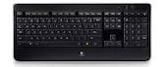
Network challenges
Unlicensed
  How do I attach and authenticate a device to a (home) network?
  Credentials?
Licensed
  Reliability → multiple simultaneous providers
  Mobility → different providers in different regions
  Charging → often low, intermittent usage, sometimes deferrable (“Whispernet”)
    From $50/device/month → < $1/month?
Authentication
  Which devices can be used by whom and how?
    “Any employee can monitor the room temperature in any public space, but only Facilities staff can change it”

Slide 18
Signaling increases 30-50% faster than data
Data Plane
Isolate M2M traffic from regular traffic
Flexible scaling requirements because of bulk contracts
Signaling traffic management
Low Power, short payloads, bursty traffic
Low cost but also low performance requirements
In network monitoring
< 1% of data plane capacity is consumed by M2M but more than 30% of signaling capacity is consumed
Control Plane
33 %
M2M traffic modeling shows disproportionately large signaling
5 %
Cellular capacity
M2M peak (hourly) traffic
Harish Viswanathan, Alcatel-Lucent, 2012
Notes:
**

Slide 19
FCC TAC preliminary recommendations
R1: Additional M2M unlicensed band (1.2 – 1.4, 2.7 – 3.1 GHz)
R2: M2M service registration
R3: Numbering and addressing plan
  IPv4 → IPv6
R4: M2M center-of-excellence at FCC
R5: Certification lite
R6: 2G sunset roadmap
  2G re-farming, security issues → LTE with IPv6
R7: Encourage 3G/4G module building

Slide 20
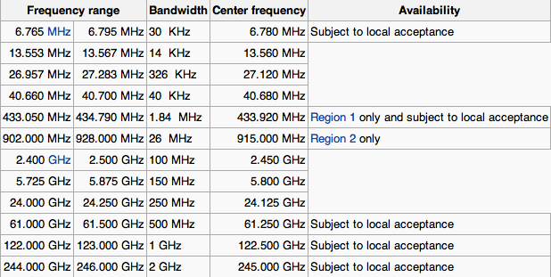
Current unlicensed spectrum
+ TV white spaces (in 476-692 MHz range) – availability varies

Slide 21
FCC actions for (M2M) spectrum
More than 300 MHz of additional spectrum in pipeline
Encourage unlicensed & lightly-licensed spectrum
  TV white spaces: geographical databases
  3.5 GHz & 4.9 GHz
  incentive auction guard bands as new unlicensed UHF spectrum (600 MHz)
Experimental licensing review

Slide 22
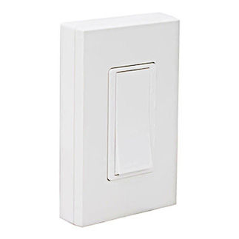
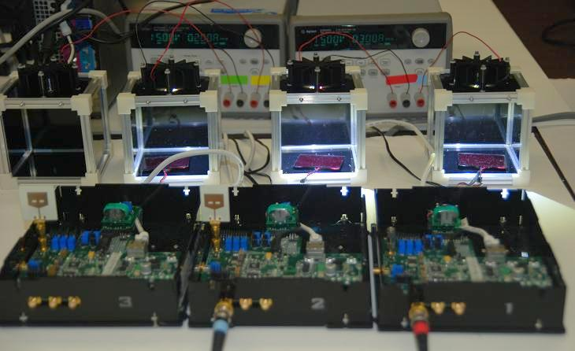
Extreme M2M: self-powered devices
Leviton WSS0S - Remote Switch
EnHANT project (Columbia U.)
indoor lighting → 10 kb/s

Slide 23
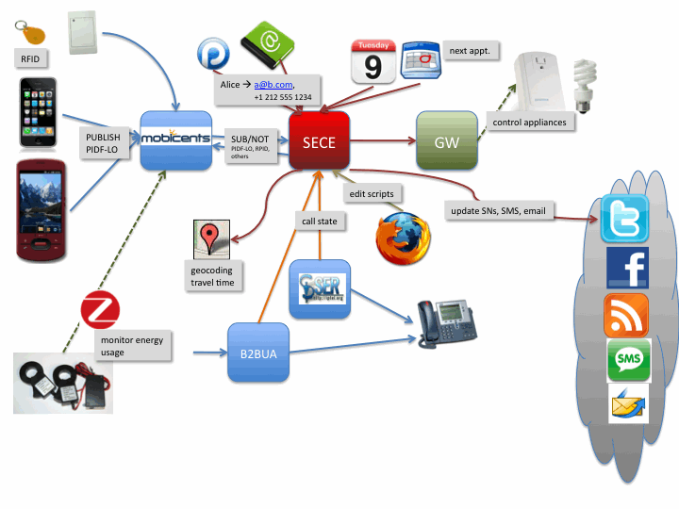
Example: SECE (Sense Everything, Control Everything)
Web-based user interface
Rules in domain specific language
Interface to online services
Interface to communication devices
Sensor and actuator infrastructure

Slide 24
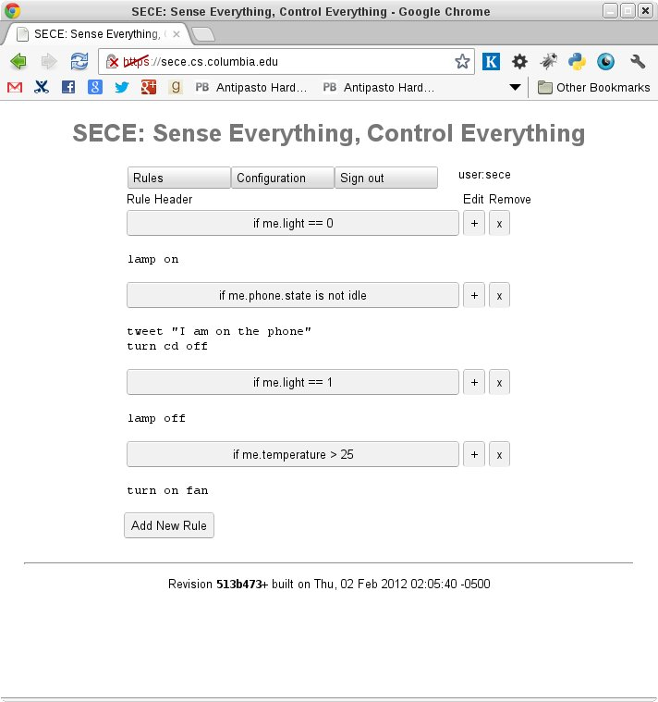
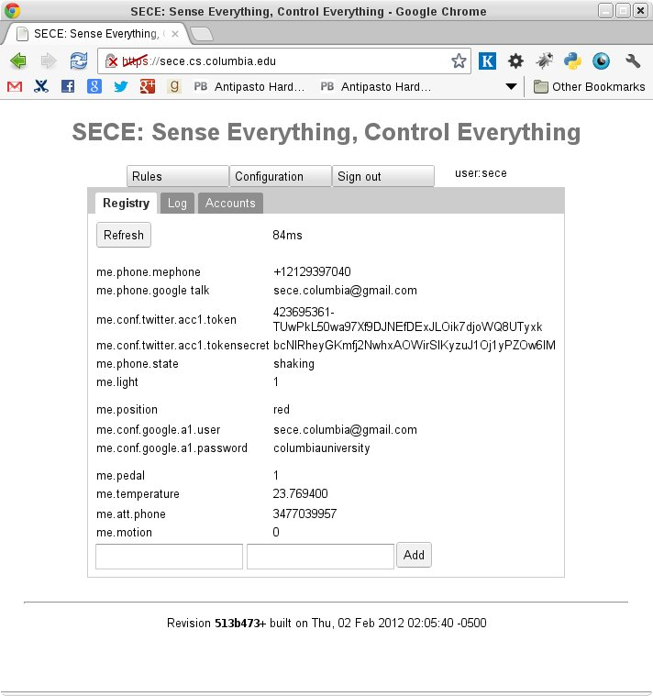
SECE User Interface

Slide 25
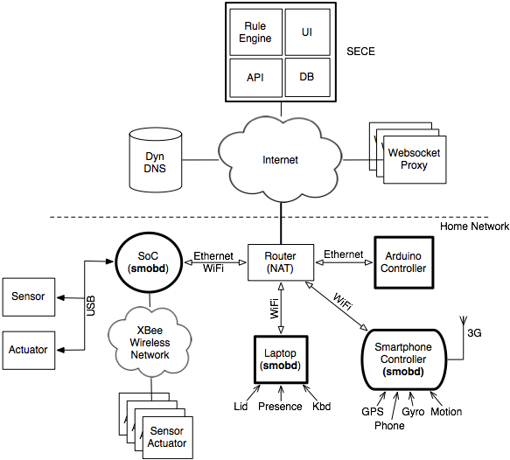
Infrastructure for Sensors and Actuators
Conventional Devices
USB (Phidgets)
Wireless (XBee)
Tiny (Arduino)
Communication
VoIP phone
Skype
Legacy (X10)

Slide 26
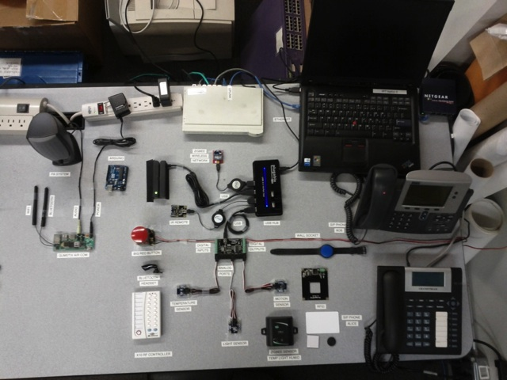
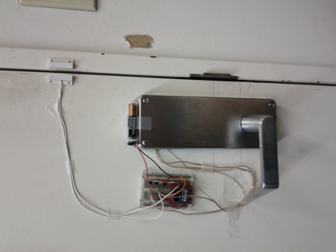
Sensors and Actuators in IRT lab
What it really looks like
Sensor and actuator testbed
XBee door lock

Slide 27
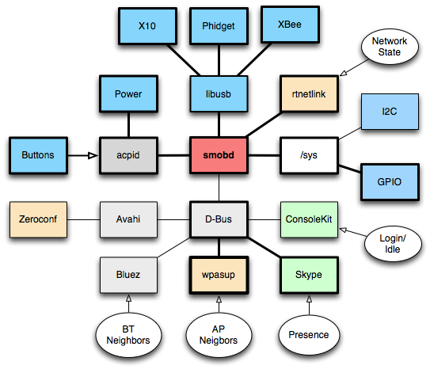
smobd: Subsystems & Interfaces on Linux

Slide 28
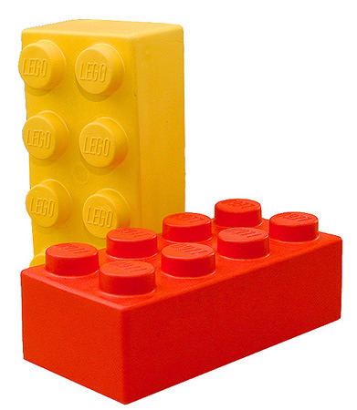
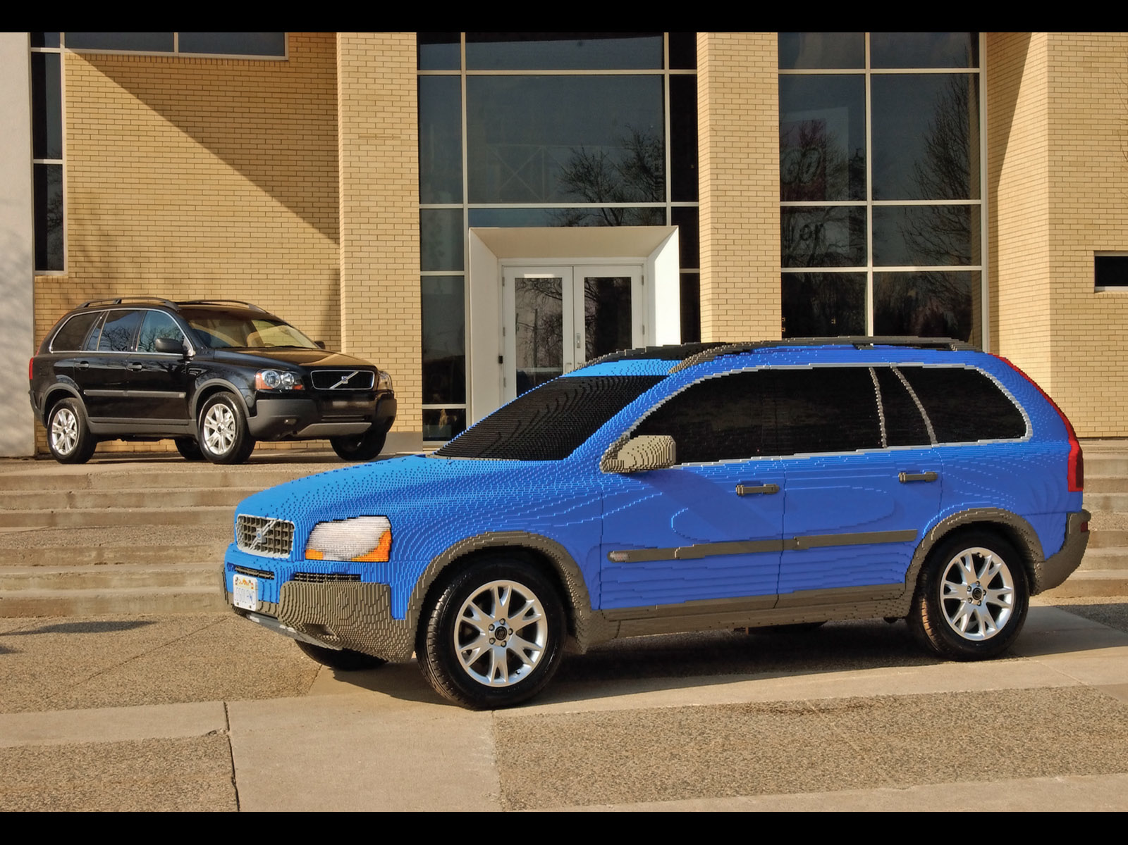
Conclusion
M2M is not a single technology → technology enabler
Build on secret of Internet: simple protocol building blocks that can be combined
  accommodate wide
Address key infrastructure challenges:
  flexible network access
  in-field upgrades
  scalable security models

