Slide 1
IP interconnect
Henning Schulzrinne
March 2012

Slide 2
Overview
Layers & interconnection
What do we need to connect?
Architectures

Slide 3
Protocol roles
RTP (+ RTCP)
  media (audio) transport
  same for audio & video
SIP
  session setup and control
  used in IMS and PacketCable, as well as by Vonage
    used by Skype for PSTN interconnect
  contains SDP (session description)
    negotiates codecs
  same for audio & video

Slide 4
SIP message format
request
response
request line
INVITE sip:bob@there.com SIP/2.0
SIP/2.0 200 OK
Via: SIP/2.0/UDP here.com:5060
From: Alice <sip:alice@here.com>
To: Bob <tel:12024181544>
Call-ID: 1234@here.com
CSeq: 1 INVITE
Subject: just testing
Contact: sip:alice@pc.here.com
Content-Type: application/sdp
Content-Length: 147
Via: SIP/2.0/UDP here.com:5060
From: Alice <sip:alice@here.com>
To: Bob <tel:120241815144>
Call-ID: 1234@here.com
CSeq: 1 INVITE
Subject: just testing
Contact: sip:alice@pc.here.com
Content-Type: application/sdp
Content-Length: 134
header fields
v=0
o=alice 2890844526 2890844526 IN IP4 here.com
s=Session SDP
c=IN IP4 100.101.102.103
t=0 0
m=audio 49172 RTP/AVP 0
a=rtpmap:0 PCMU/8000
v=0
o=bob 2890844527 2890844527 IN IP4 there.com
s=Session SDP
c=IN IP4 110.111.112.113
t=0 0
m=audio 3456 RTP/AVP 0
a=rtpmap:0 PCMU/8000
message body
SDP

Slide 5
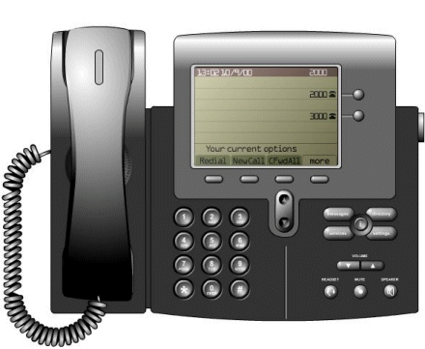
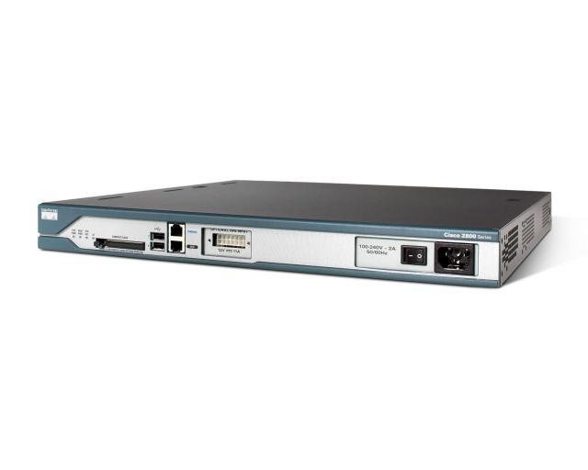
Review: VoIP stack
codec
codec
codec
SIP
RTP
SIP
RTP
SIP
RTP
UDP
UDP
UDP
L3
(IP)
L3
(IP)
L3
(IP)
L3
(IP)
L2.5
(MPLS)
L2.5
(MPLS)
L2.5
(MPLS)
L2.5
(MPLS)
MAC
(Ethernet)
MAC
(Ethernet)
MAC
(Ethernet)
MAC
(Ethernet)
PHY
(fiber)
PHY
(fiber)
PHY
(fiber)
PHY
(fiber)
Comcast
Level3
IntelePeer
Xconnect

Slide 6
Components & standards
E.164 phone number → IP address (+ carrier)
  ENUM: uses DNS
  new IETF effort (TERQ)
RTP exchange
  what codecs?
SIP exchange
  features and assumptions

Slide 7
Physical architecture 1: Internet
no POI
no circuits
E.164 -> IP
Comcast
66.179.53.44
+1 202 418 1544
→ voip.att.net
Internet
Vonage
69.59.253.143
AT&T
216.77.188.73

Slide 8
Physical architecture 2: POIs
E.164 -> IP
POIs
circuits or POPs
Comcast
66.179.53.44
+1 202 418 1544
→ voip.att.net
POI SF
POI Miami
MPLS circuit
or part of carrier network
Vonage
69.59.253.143
AT&T
216.77.188.73

Slide 9
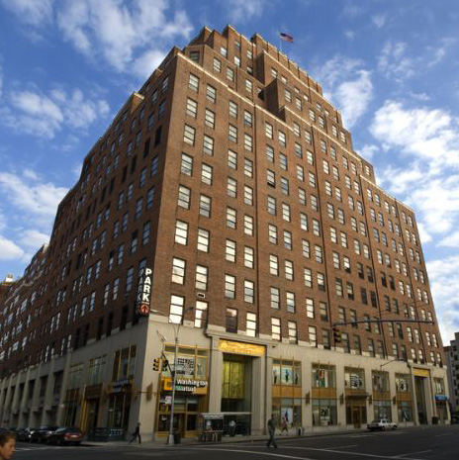
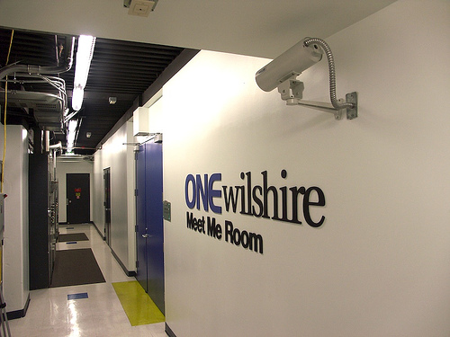
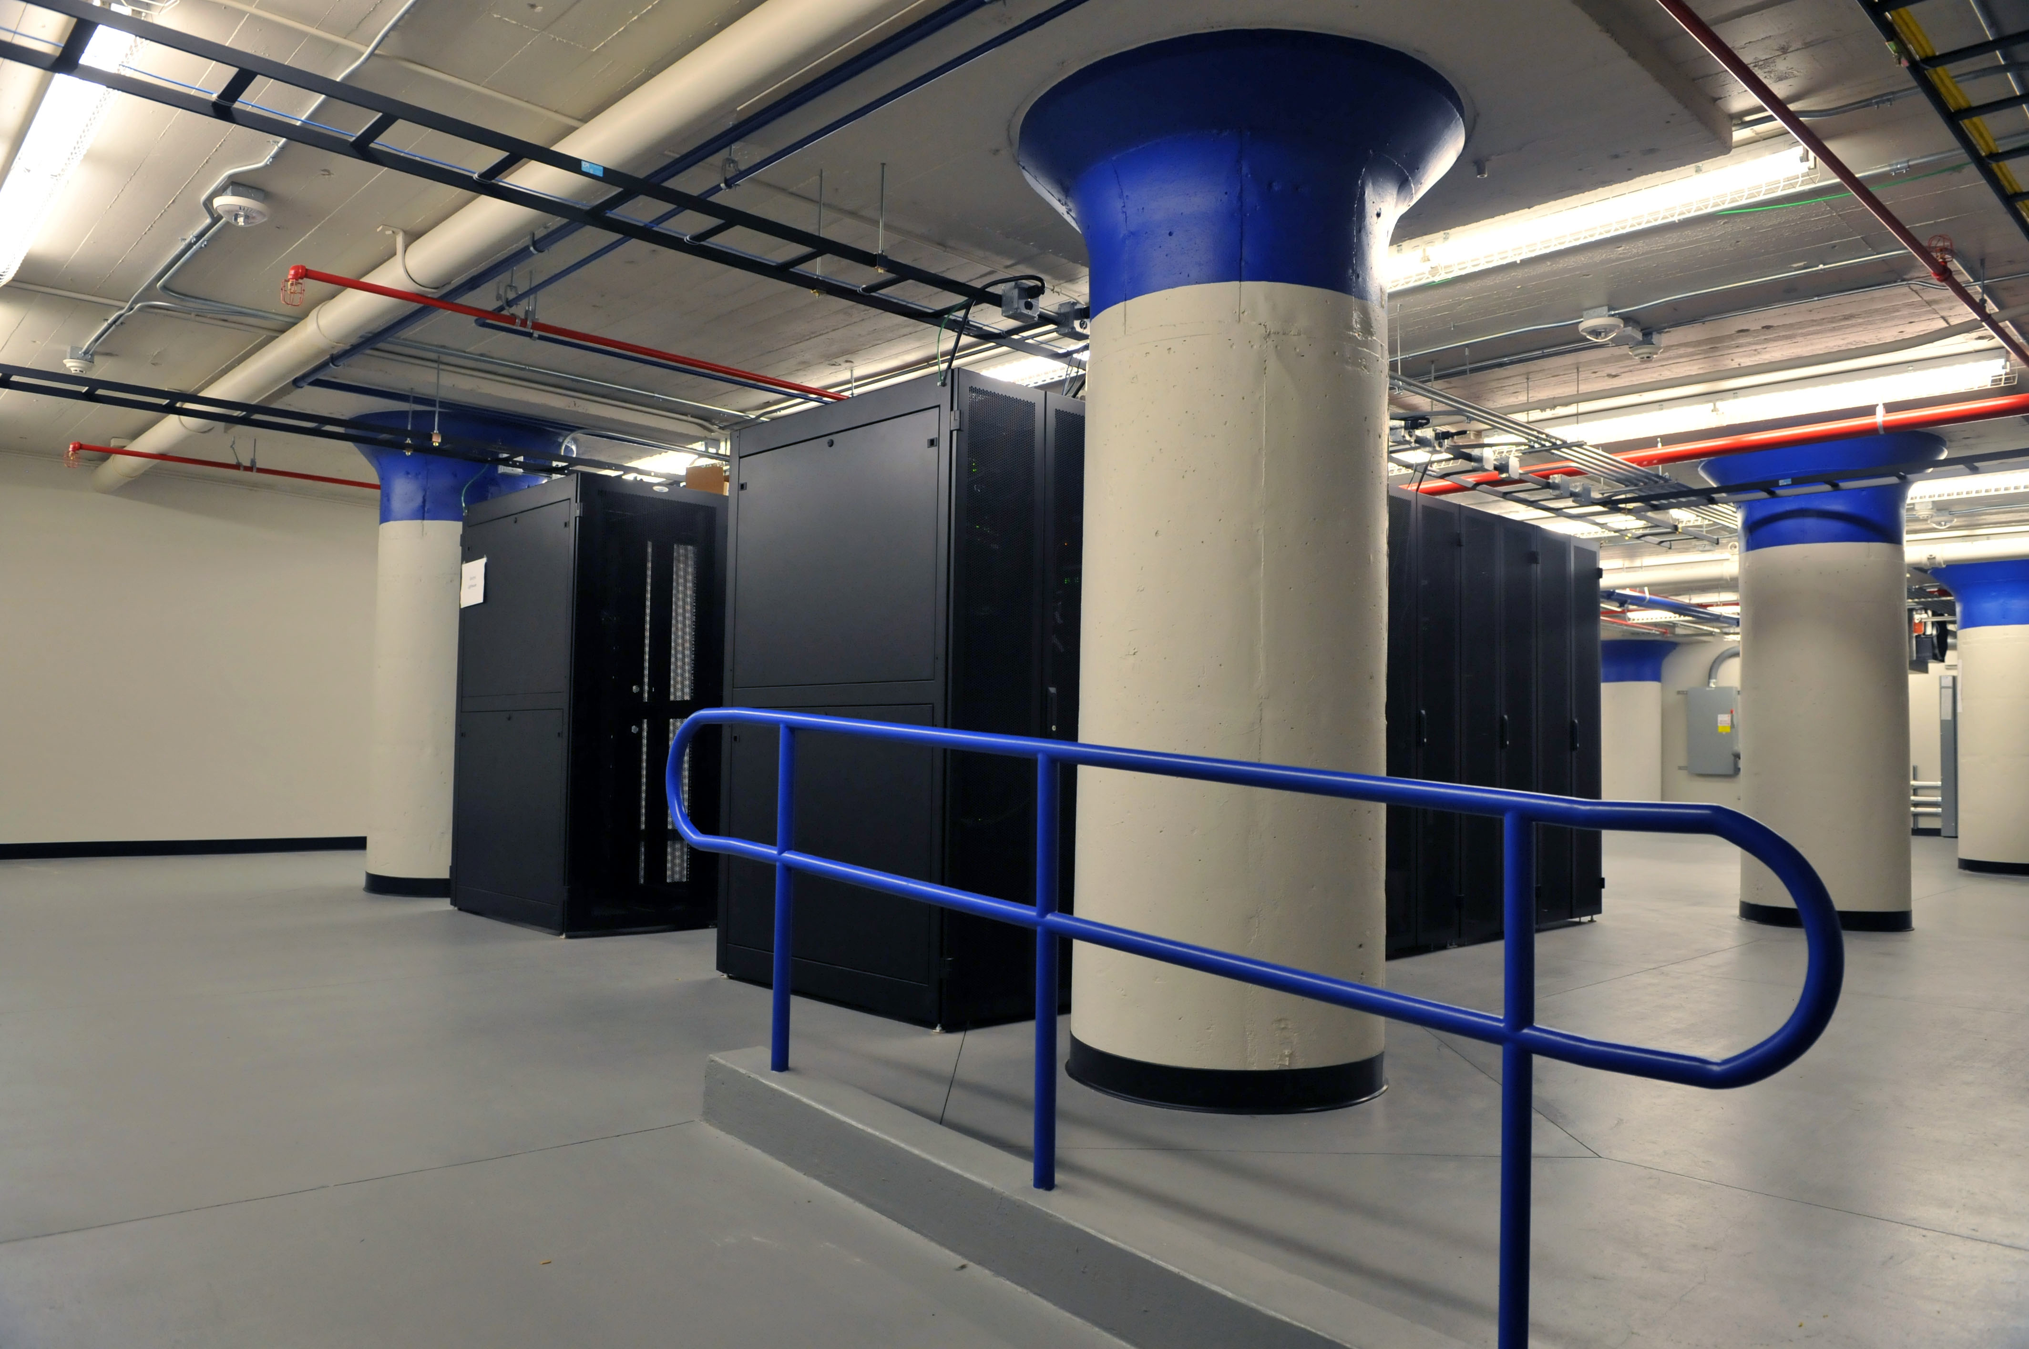
Carrier hotels
111 8th Avenue in Manhattan

Slide 10
Big IXPs
Ashburn, VA
Atlanta
Boston
Chicago
Dallas
Kansas City
Los Angeles
New York
Palo Alto
San Jose
Seattle
Tampa
Vienna, VA

Slide 11
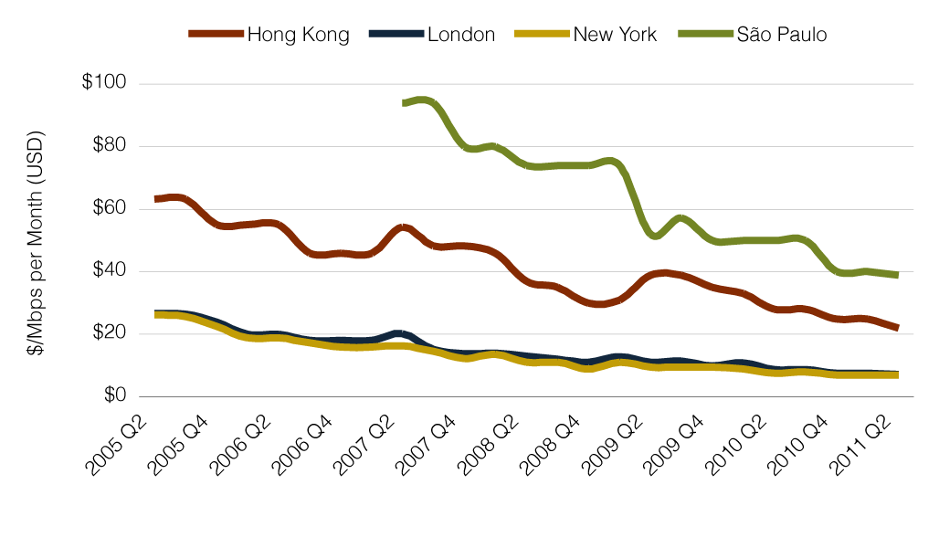
The cost of transport
Cogent: 4.51 $/Mb/s/month (2010) → 1.4 c / GB
Voice (G.711)
  64 kb/s nominal one-way
  200 kb/s with protocol headers, duplex
  = 0.0015 GB/min
  = 0.0021 c/min
Notes:
http://www.telegeography.com/research-services/global-internet-geography/index.html
http://dslprime.com/dslprime/42-d/4148-costs-and-caps
http://seekingalpha.com/instablog/329338-kurt-b-feierabend/57157-cogent-communication-s-ever-falling-bandwidth-pricing: $4.51 Mb/s ->
1 Mb/s → 324 GB/month
thus, $4.51 Mb/s → 1.4 c / GB
voice call

