Slide 1
Protecting the Open Internet: Experience and Future Challenges
Henning Schulzrinne
FCC & Columbia University
with slides by Julie Knapp, Walter Johnston, Karen Peltz-Strauss, and others

Slide 2
What is network neutrality?
“The principle advocates no restrictions by Internet service providers and governments on content, sites, platforms, the kinds of equipment that may be attached, and the modes of communication.” (Wikipedia)
2005 FCC statement:
  “access the lawful Internet content of their choice.
  run applications and use services of their choice, subject to the needs of law enforcement.
  connect their choice of legal devices that do not harm the network.
  competition among network providers, application and service providers, and content providers.”
= Any lawful content, any lawful application, any lawful device, any provider

Slide 3
Two views
Open Internet advocates
Free market advocates
no prioritization
flat rates
all networks
no real problem
allow any business arrangement
“it’s my network”
use anti-monopoly laws if needed

Slide 4
Why?
Civic considerations
  freedom to read (passive)
  freedom to discuss & create (active)
Economic opportunity
  edge economy >> telecom economy
    Telecom revenue (US): $330B
    Content, etc. not that large, however
      Google: $8.44B
    others that depend on ability to provide services
  content, application, service providers
Technical motivation
  avoid network fragmentation
  reduce work-around complexity

Slide 5
Broadband virtuous cycle
fixed broadband
cellular broadband
applications
(e-learning, telemedicine, telework, …)
adoption
(relevance)
broadband availability

Slide 6
State of competition (US)
FCC: Internet Access Services Status as of December 31, 2009
Notes:
http://www.fcc.gov/Daily_Releases/Daily_Business/2010/db1208/DOC-303405A1.pdf: Internet Access Services: Status as of December 31, 2009

Slide 7
How to be non-neutral
deep packet inspection
block Skype
application
block transport protocol
block ports
insert RST
transport
block IP addresses
QoS discrimination
network

Slide 8
Some high-profile US cases
Madison River (2005)
  DSL provider blocked SIP ports
  fined $15,000 by FCC
Comcast (late 2007)
  insert TCP RST into BitTorrent traffic
  later overturned on appeal in DC Circuit Court
RCN (2009): P2P
Various mobile operators
Comcast vs. Level 3 (2010, in dispute)
  Level-3
Notes:
http://hraunfoss.fcc.gov/edocs_public/attachmatch/DA-05-543A1.pdf
http://www.zeropaid.com/news/88573/comcast-prevails-in-bittorrent-throttling-case/

Slide 9
Network neutrality & freedom of speech
1st amendment: Congress shall make no law abridging the freedom of speech
Applies only to U.S. government, not private entities
  Example: soap box in city park vs. mall
  private vs. public universities
Freedom to speak + no forced speech
  demise of “fairness doctrine” (1949-1987)

Slide 10
Which Internet are you connected to?
port 80 + 25
IPv4
NAT
multicast
QoS
IPv4
DHCP
IPv6
IPv4
PIA

Slide 11
New name, old concept: Common carrier
Since 1600s: A common carrier in common-law countries … is a person or company that transports goods or people for any person or company and that is responsible for any possible loss of the goods during transport. A common carrier offers its services to the general public under license or authority provided by a regulatory body. (Wikipedia)
e.g., FedEx, Greyhound, telecommunications providers, Disneyland

Slide 12
Network transparency
RFC 1958: “Architectural Principles of the Internet”
However, in very general terms, the community believes that the goal is connectivity, the tool is the Internet Protocol, and the intelligence is end to end rather than hidden in the network.
RFC 2275: “Internet Transparency”
  NATs, firewalls, ALGs, relays, proxies, split DNS
RFC 3724: “The Rise of the Middle and the Future of End-to-End: Reflections on the Evolution of the Internet Architecture”
RFC 4924: “Reflections on Internet Transparency”
  A network that does not filter or transform the data that it carries may be said to be "transparent" or "oblivious" to the content of packets. Networks that provide oblivious transport enable the deployment of new services without requiring changes to the core. It is this flexibility that is perhaps both the Internet's most essential characteristic as well as one of the most important contributors to its success.

Slide 13
Network transparency and neutrality
neutral
transparent
QoS discrimination
pay for priority
block protocol features

Slide 14
Means, motive and opportunity
Political motivation
  suppress undesirable opinion
    e.g., union web site, abortion SMS
Economic advantage
  prevent competition in related services
    e.g., VoIP or over-the-top VoD
  leverage pricing power
    OTT content provider has to offer service to everyone
  market segmentation
    consumer vs. business customers
Non-tariff barriers
  e.g., special (undocumented) APIs
Notes:
http://en.wikipedia.org/wiki/Means,_motive,_and_opportunity

Slide 15
BEREC report
BEREC findings on traffic management practices in Europe

Slide 16
Example: VoIP restrictions

Slide 17
Who is covered?
Broadband Internet Access Service = A mass-market retail service by wire or radio that provides the capability to transmit data to and receive data from all or substantially all Internet endpoints, including any capabilities that are incidental to and enable the operation of the communications service, but excluding dial-up Internet access service. This term also encompasses any service that the Commission finds to be providing a functional equivalent of the service described in the previous sentence, or that is used to evade the protections set forth in this Part.
excludes
dial-up
coffee shops, bookstores, airlines (premise operators)
“edge providers”: CDNs, search engines, …

Slide 18
Principles
Transparency. Fixed and mobile broadband providers must disclose the network management practices, performance characteristics, and terms and conditions of their broadband services;
No blocking. Fixed broadband providers may not block lawful content, applications, services, or non-harmful devices; mobile broadband providers may not block lawful websites, or block applications that compete with their voice or video telephony services
No unreasonable discrimination. Fixed broadband providers may not unreasonably discriminate in transmitting lawful network traffic.

Slide 19
47 CFR 8
§ 8.1 Purpose.
  The purpose of this Part is to preserve the Internet as an open platform enabling consumer choice, freedom of expression, end-user control, competition, and the freedom to innovate without permission.
§ 8.3 Transparency.
  A person engaged in the provision of broadband Internet access service shall publicly disclose accurate information regarding the network management practices, performance, and commercial terms of its broadband Internet access services sufficient for consumers to make informed choices regarding use of such services and for content, application, service, and device providers to develop, market, and maintain Internet offerings.

Slide 20
Disclosure (Transparency) – Network Practices
Congestion management: congestion management practices; types of traffic; purposes; practices’ effects on end users’ experience; criteria used in practices, such as indicators of congestion that trigger a practice, and the typical frequency of congestion; usage limits and the consequences of exceeding them; and references to engineering standards, where appropriate.
Application-Specific Behavior
Device Attachment Rules
Security

Slide 21
Disclosure (Transparency) – Performance
Service description: A general description of the service, including the service technology, expected and actual access speed and latency, and the suitability of the service for real-time applications.
Impact of specialized services: If applicable, what specialized services, if any, are offered to end users, and whether and how any specialized services may affect the last-mile capacity available for, and the performance of, broadband Internet access service.

Slide 22
Disclosure (Transparency) – Commercial Terms
Pricing: For example, monthly prices, usage-based fees, and fees for early termination or additional network services.
Privacy Policies: For example, whether network management practices entail inspection of network traffic, and whether traffic information is stored, provided to third parties, or used by the carrier for non-network management purposes.
Redress Options: Practices for resolving end-user and edge provider complaints and questions.

Slide 23

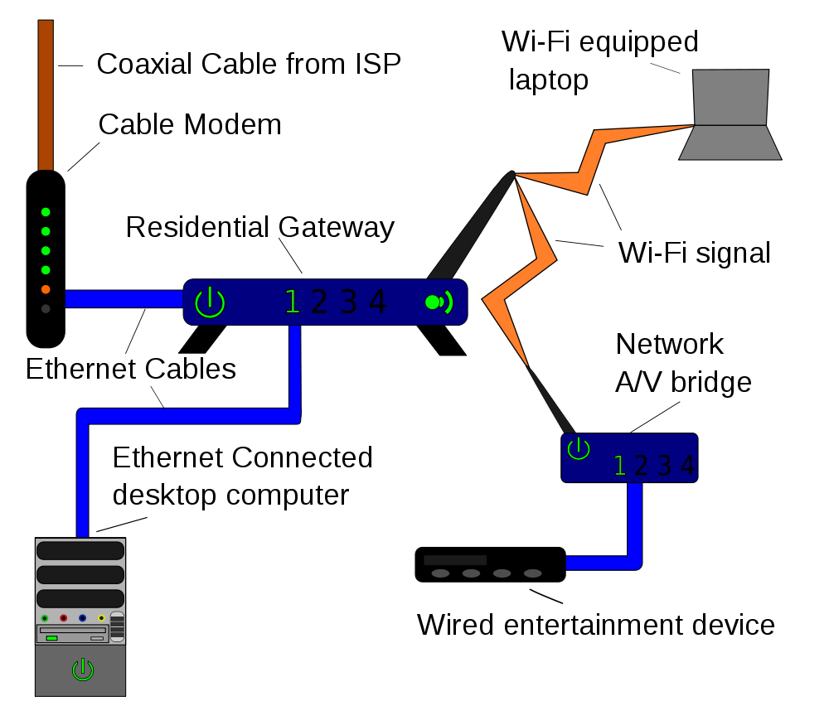
Measurement Broadband America
broadband Internet
access provider (ISP)
backbone
ISP
Measuring Broadband America 2011 & 2012
Measuring Broadband America future?
Lucid
Notes:
http://commons.wikimedia.org/wiki/File:Homenet.svg

Slide 24
The MBA project - logistics
Enlisted cooperation:
  13 ISPs covering 86% of US population
  vendors, trade groups, universities and consumer groups
Reached agreement reached on what to measure and how to measure it
Enrolled roughly 9,000 consumers as participants
  6,800 (7,782) active during March 2011 (April 2012)
  A total of 9,000 active over the data collection period

Slide 25
What was measured
Sustained Download | Burst Download
Sustained Upload | Burst Upload
Web Browsing Download | UDP Latency
UDP Packet Loss | Video Streaming Measure
VoIP Measure | DNS Resolution
DNS Failures | ICMP Latency
ICMP Packet Loss | Latency Under Load
Total Bytes Downloaded | Total Bytes Uploaded

Slide 26
2011: Most ISPs deliver close to advertised during peak hours

Slide 27
2012: You improve what you measure…

Slide 28
Open Internet & QoS
Principle of end user control
E.g., DiffServ bits or signaling
  RSVP or NSIS
  or out-of-band (“please prioritize UDP port 5050”)
Together with rate or volume limits
  “Includes 1,000 minutes of VoIP priority”
Technical difficulties
  DSCP bit re-marking
  Symmetric treatment for incoming traffic

Slide 29
ETNO
WCIT proposal
  For this purpose, and to ensure an adequate return on investment in high bandwidth infrastructures, operating agencies shall negotiate commercial agreements to achieve a sustainable system of fair compensation for telecommunications services and, where appropriate, respecting the principle of sending party network pays.
Problems:
  what is QoS?
    5% packet loss: ok for voice, 500 kb/s data
  encourages scarcity
  discourages CDNs
  may make content unavailable
  transaction costs
  terminating access monopoly
http://files.wcitleaks.org/public/ETNO%20C109.pdf

Slide 30
Internet money flows today
CDN
backbone (transit)
content
eyeball ISP
$0
or $0
“bill & keep”

Slide 31
Conclusion
Fundamental debate about the nature of the Internet
Internet as economic input, not another video distribution channel
Competition may not ensure openness
  and competition is uneven
Need for consumer information
  performance
  network characteristics

