Slide 1
Cheaper, Faster, Safer: Research and Public Policy for the Internet
Henning Schulzrinne
FCC & Columbia University
Any opinions are those of the author and do not necessarily reflect the views or policies
of Columbia University or the FCC.
with slides by Julie Knapp, Walter Johnston, Karen Peltz-Strauss, and others

Slide 2
Overview
Telecom regulation (in the US)
Regulation as technology enabler
Case studies:
  Open Internet
  Spectrum
  Access for people with disabilities
  Network measurements
Challenges for research

Slide 3
The US hierarchy of laws
Constitution
Commerce clause
Law
Telecom Act 1934 & 1996
47 CFR
Narrative
reasonable network management
Section 8: To regulate Commerce with foreign Nations, and among the several States, and with the Indian Tribes (1787)
SEC. 706. ADVANCED TELECOMMUNICATIONS INCENTIVES. (a) IN GENERAL- The Commission … shall encourage the deployment on a reasonable and timely basis of advanced telecommunications capability to all Americans (including, in particular, elementary and secondary schools and classrooms) by utilizing, in a manner consistent with the public interest, convenience, and necessity, …, or other regulating methods that remove barriers to infrastructure investment.

Slide 4

Example: CFR 47
§ 15.5 General conditions of operation.
(a) Persons operating intentional or unintentional radiators shall not be deemed to have any vested or recognizable right to continued use of any given frequency by virtue of prior registration or certification of equipment, or, for power line carrier systems, on the basis of prior notification of use pursuant to §90.35(g) of this chapter.
(b) Operation of an intentional, unintentional, or incidental radiator is subject to the conditions that no harmful interference is caused and that interference must be accepted that may be caused by the operation of an authorized radio station, by another intentional or unintentional radiator, by industrial, scientific and medical (ISM) equipment, or by an incidental radiator.

Slide 5
47 CFR content
Part | Content
0 | Commission organization
1 | Practice and procedure
2 | Frequency allocations and radio treaty matter
3 | Authorization and administration of accounting authorities in maritime and maritime mobile radio services
4 | Disruptions to Communications
5 | Experimental Radio Service
6 | Access to Telecommunications Service, Telecommunications Equipment and Customer Premises Equipment by Persons with Disabilities
7 | Access to Voicemail and Interactive Menu Services and Equipment by People with Disabilities

Slide 6
47 CFR content
Part | Content
9 | Interconnected Voice over Internet Protocol Services
10 | Commercial Mobile Alert System
11 | Emergency Alert System (EAS)
12 | Redundancy of Communications Systems
13 | Commercial Radio Operators
15 | Radio Frequency Devices
17 | Construction, Marking and Lighting of Antenna Structures
18 | Industrial, Scientific and Medical Equipment (ISM)

Slide 7
47 CFR content
Part | Content
19 | Employee Responsibilities and Conduct
20 | Commercial Mobile Radio Services (= cellular)
22 | Public Mobile Services
24 | Personal Communications Services
25 | Satellite Communications
27 | Miscellaneous Wireless Communication Services
32 | Uniform System of Accounts for Telecommunications Companies
36 | Jurisdictional Separations Procedures; Standard Procedures for Separating Telecommunications Property Costs, Revenues, Expenses, Taxes and Reserves for Telecommunications Companies

Slide 8
47 CFR content
Part | Content
42 | Preservation of Records for Communication Common Carriers
43 | Reports of Communication Common Carriers and Certain Affiliates
51 | Interconnection
52 | Numbering
53 | Special Provisions Concerning Bell Operating Companies
54 | Universal Service
59 | Infrastructure Sharing
61 | Tariffs
68 | Connection of Terminal Equipment to the Telephone Network
69 | Access Charges

Slide 9
47 CFR content
Part | Content
73 | Radio broadcast services
74 | Experimental Radio, Auxiliary, Special Broadcast and Other Program Distributional Services
51 | Multichannel Video and Cable Television Services
78 | Cable Television Relay Services
79 | Closed Captioning and Video Description of Video Programming

Slide 10
47 CFR content
Part | Content
80 | Stations in the Maritime Services
87 | Aviation Services
90 | Private Land Mobile Radio Services
95 | Personal Radio Services
97 | Amateur Radio Services
101 | Fixed Microwave Services

Slide 11
Telecom regulation
Local, state and federal
  local: CATV franchise agreements
  state: Public Utility Commission
    responsible for all utilities – gas, water, electricity, telephone
  federal: FCC, FTC (privacy), DOJ (monopoly)
Elsewhere: gov’t PTT → competition
  vs. US: regulated private monopolies
Based on 1934 Telecommunications Act
Amended in 1996
Divides the world into
  Title I: Telecommunications Services
  Title II: Broadcast Services
  Title III: Cable Services
  Title V: Obscenity and Violence

Slide 12
Process
NOI
NPRM
R&O
Notice of Inquiry
Notice of Proposed Rule Making
Report & Order
comments & ex parte

Slide 13
FCC
Chairman (D)
4 Commissioners (2 D, 2 R)
Consumer and Governmental Affairs
Enforcement
International
Media
Public Safety & Homeland Security
Wireless Telecommunications
Wireline Competition
Independent federal agency
About 2,000 employees

Slide 14
EXAMPLE 1: Open Internet

Slide 15
What is network neutrality?
“The principle advocates no restrictions by Internet service providers and governments on content, sites, platforms, the kinds of equipment that may be attached, and the modes of communication.” (Wikipedia)
2005 FCC statement:
  “access the lawful Internet content of their choice.
  run applications and use services of their choice, subject to the needs of law enforcement.
  connect their choice of legal devices that do not harm the network.
  competition among network providers, application and service providers, and content providers.”
= Any lawful content, any lawful application, any lawful device, any provider

Slide 16
Two views
Open Internet advocates
Free market advocates
no prioritization
flat rates
all networks
no real problem
allow any business arrangement
“it’s my network”
use anti-monopoly laws if needed

Slide 17
Why?
Civic considerations
  freedom to read (passive)
  freedom to discuss & create (active)
Economic opportunity
  edge economy >> telecom economy
    Telecom revenue (US): $330B
    Content, etc. not that large, however
      Google: $8.44B
    others that depend on ability to provide services
  content, application, service providers
Technical motivation
  avoid network fragmentation
  reduce work-around complexity

Slide 18
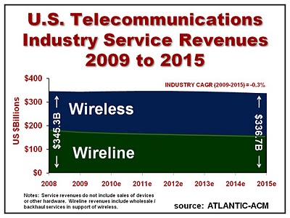
Telecom revenue

Slide 19
How to be non-neutral
deep packet inspection
block Skype
application
block transport protocol
block ports
insert RST
transport
block IP addresses
QoS discrimination
network

Slide 20
Are these neutrality issues?
Redirect DNS NXDOMAIN to ISP web site
Content translation
  e.g., reduce image resolution for cellular data
Blocking transport protocols other than UDP + TCP
Prohibit web servers
Reset DSCP (ToS bits)
Not allow IPv6
3GPP: only make non-BE available to carrier

Slide 21
Some high-profile cases
Madison River (2005)
  DSL provider blocked SIP ports
  fined $15,000 by FCC
Comcast (late 2007)
  insert TCP RST into BitTorrent traffic
  later overturned on appeal in DC Circuit Court
RCN (2009): P2P
Various mobile operators
Comcast vs. Level 3 (2010, in dispute)
  Level-3
Notes:
http://hraunfoss.fcc.gov/edocs_public/attachmatch/DA-05-543A1.pdf
http://www.zeropaid.com/news/88573/comcast-prevails-in-bittorrent-throttling-case/

Slide 22
Network neutrality & freedom of speech
1st amendment: Congress shall make no law abridging the freedom of speech
Applies only to U.S. government, not private entities
  Example: soap box in city park vs. mall
  private vs. public universities
Freedom to speak + no forced speech
  demise of “fairness doctrine” (1949-1987)

Slide 23
Which Internet are you connected to?
port 80 + 25
IPv4
NAT
multicast
QoS
IPv4
DHCP
IPv6
IPv4
PIA

Slide 24
New name, old concept: Common carrier
Since 1600s: A common carrier in common-law countries … is a person or company that transports goods or people for any person or company and that is responsible for any possible loss of the goods during transport. A common carrier offers its services to the general public under license or authority provided by a regulatory body. (Wikipedia)
e.g., FedEx, Greyhound, telecommunications providers, Disneyland

Slide 25
Network transparency
RFC 1958: “Architectural Principles of the Internet”
However, in very general terms, the community believes that the goal is connectivity, the tool is the Internet Protocol, and the intelligence is end to end rather than hidden in the network.
RFC 2275: “Internet Transparency”
  NATs, firewalls, ALGs, relays, proxies, split DNS
RFC 3724: “The Rise of the Middle and the Future of End-to-End: Reflections on the Evolution of the Internet Architecture”
RFC 4924: “Reflections on Internet Transparency”
  A network that does not filter or transform the data that it carries may be said to be "transparent" or "oblivious" to the content of packets. Networks that provide oblivious transport enable the deployment of new services without requiring changes to the core. It is this flexibility that is perhaps both the Internet's most essential characteristic as well as one of the most important contributors to its success.

Slide 26
Network transparency and neutrality
neutral
transparent
QoS discrimination
pay for priority
block protocol features

Slide 27
Means, motive and opportunity
Political motivation
  suppress undesirable opinion
    e.g., union web site, abortion SMS
Economic advantage
  prevent competition in related services
    e.g., VoIP or over-the-top VoD
  leverage pricing power
    OTT content provider has to offer service to everyone
  market segmentation
    consumer vs. business customers
Non-tariff barriers
  e.g., special (undocumented) APIs
Notes:
http://en.wikipedia.org/wiki/Means,_motive,_and_opportunity

Slide 28
Network economics
Monopolies
  economies of scale (cost ~ 1/size)
  “exists when a specific individual or an enterprise has sufficient control over a particular product or service to determine significantly the terms on which other individuals shall have access to it.” (Wikipedia)
Natural monopoly
  no motivation for second provider
    road, water, gas, electricity
  Landline telephone & broadband
  Wireless
    limited spectrum
    high cost of entry → spectrum auctions

Slide 29
Why are monopolies bad?
Market power
Pricing power
  perfectly competitive market: price = marginal cost
Product differentiation
  no available substitute
Excess profits
Price discrimination
  same product, different prices
  capture consumer surplus
Notes:
see Wikipedia

Slide 30


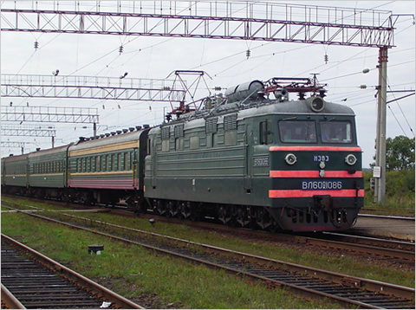
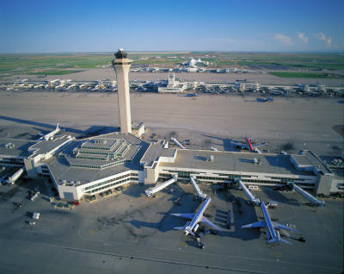
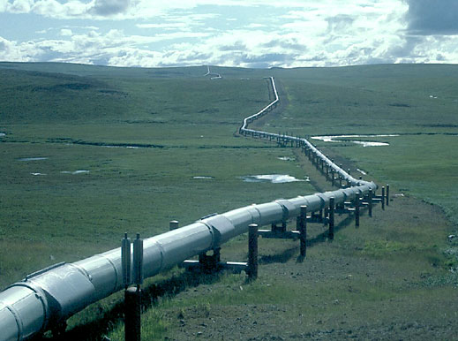
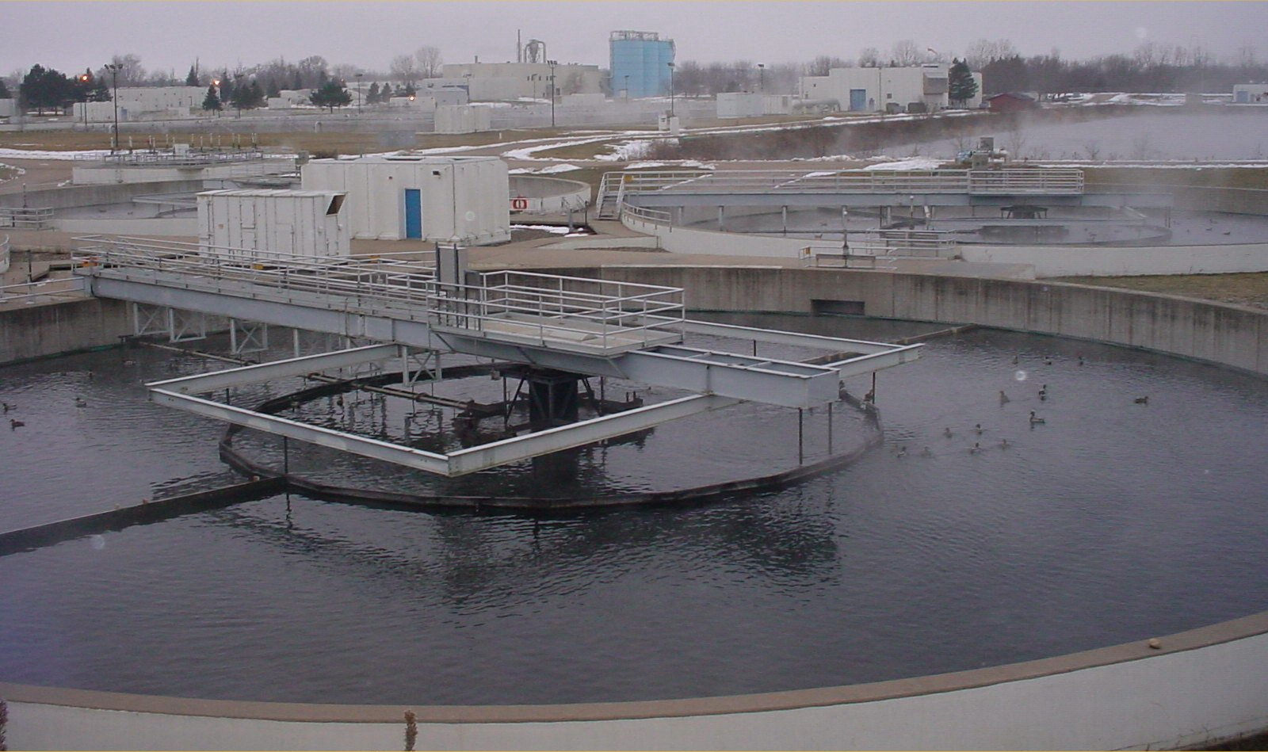

The monopoly infrastructures
Technical structures that support a society → “civil infrastructure”
  Large
  Constructed over generations
  Not often replaced as a whole system
  Continual refurbishment of components
  Interdependent components with well-defined interfaces
  High initial cost
water
energy
transportation

Slide 31
Remedies
Functional separation
  separate entities for L2 and upper layers
  e.g., “dry loops” copper
  e.g., UK (BT Wholesale)
Multiple infrastructures → competition
  e.g., DSL, cable, wireless
  but substitutability?
  may not prevent abuse (e.g., Skype blocking for French mobile operators)
    not likely to protect small customer groups with specialized needs

Slide 32
Competition (US)
if lucky, incumbent LEC + cable company
  DSL: cheaper, but low speed
    mean: 2.5 – 3.5 Mb/s
  FTTH (FiOS): only 3.3M households
    10-15 Mb/s
  Cable: > $50/month, higher speeds
    8-11 Mb/s
often, high switching costs ($200 early termination fee)
  or tied to bundles (TV, mobile)
can’t easily predict whether problem would be different
Notes:
http://s.ftthcouncil.org/files/RVA.FTTH_.Apr09.060109.pdf

Slide 33
FTTH
mostly Verizon: 3.3 mio

Slide 34
FTTH penetration
Notes:
FTTH Council, Fiber-to-the-Home: North American Market Update, April 2009
http://www.ftthcouncil.org/en/knowledge-center/publications/reports/ftth-north-american-market-update-april-2009

Slide 35
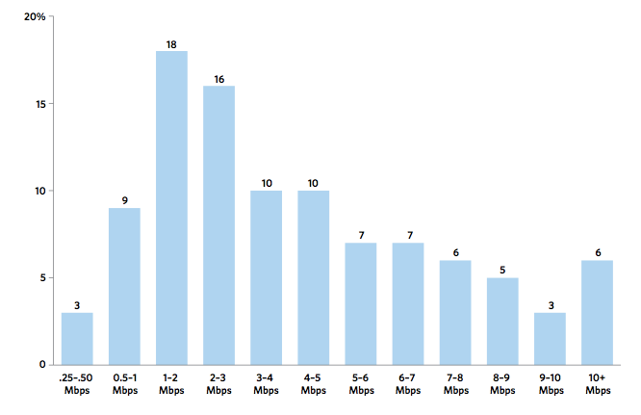
US broadband speeds
FCC OBI Report #4
Notes:
OBI #4 pg. 15

Slide 36
Residential broadband
FCC: Internet Access Services Status as of December 31, 2009

Slide 37
Residential broadband technologies
FCC: Internet Access Services Status as of December 31, 2009

Slide 38
State of competition (US)
FCC: Internet Access Services Status as of December 31, 2009
Notes:
http://www.fcc.gov/Daily_Releases/Daily_Business/2010/db1208/DOC-303405A1.pdf: Internet Access Services: Status as of December 31, 2009

Slide 39
Wireless as substitute
Speed range
Speed predictability
Indoor usability
Volume limits
Still relies on ILEC or CATV back-haul to cell sites and femtocells

Slide 40
Cisco’s traffic prediction
Ambient video = nannycams, petcams, home security cams, and other persistent video streams
Notes:
http://www.cisco.com/en/US/solutions/collateral/ns341/ns525/ns537/ns705/ns827/white_paper_c11-481360_ns827_Networking_Solutions_White_Paper.html

Slide 41
The value of bits
Technologist: A bit is a bit is a bit
Economist: Some bits are more valuable than other bits
  e.g., $(email) >> $(video)
Application | Volume | Cost per unit | Cost / MB
Voice (13 kb/s GSM) | 97.5 kB/minute | 10c | $1.02
Mobile data | 5 GB | $40 | $0.008
MMS (pictures) | < 300 KB, avg. 50 kB | 25c | $5.00
SMS | 160 B | 10c | $625
Notes:
T-Mobile 2010
AT&T data
http://www.nowsms.com/discus/messages/12/8500.html

Slide 42



Bandwidth costs
Amazon EC2
  $100/TB in, $100/TB out
CDN (Internet radio)
  $600/TB (2007)
  $100/TB (Q1 2009 – CDNpricing.com)
NetFlix (7 GB DVD)
  postage $0.70 round-trip → $100/TB
FedEx – 2 lb disk
  5 business days: $6.55
  Standard overnight: $43.68
  Barracuda disk: $91 - $116/TB
Notes:
FedEx and EC2 prices as of 09/15/09
CDN: http://www.mindbranch.com/listing/product/R678-29.html
http://www.cdnpricing.com/

Slide 43
Flat rate & heavy tails
2009: median 2 GB, mean 9 GB
AT&T wireless: 65% of smartphone < 200 MB, 98% < 2 GB
Notes:
http://www.slate.com/id/2281841/ “AT&T says that 65 percent of its smartphone customers consume less than 200 MB of broadband per month and 98 percent use less than 2 GB.”
FCC OBI technical paper #4

Slide 44
Residential broadband use
Notes:
FCC OBI #4

Slide 45
Cost of broadband
Access | Price per month | Median (average) usage | $/GB
DSL (3 MB/s + 768 kb/s) | $30 | 1.7 GB (9.2 GB) | $17.65 ($3.26)
Smartphone | $25 | 250 MB | $100
Wireless data retail | $40 |  | $10
Web hosting |  |  | $1-2
CDN pricing (*) |  |  | $0.10
* strongly depends on volume: $0.25 GB/resale, high volume (500 TB/month): $0.05/GB
Notes:
http://www.newamerica.net/publications/policy/price_of_the_pipe
http://blogs.gartner.com/phillip-redman/2010/11/09/wireless-data-pricing-reaches-a-new-low/

Slide 46
Open Internet FCC history
2004: “four freedoms” (Powell)
2005: Internet policy statement (Martin)
9/2009: Genachowski speech
  non-discrimination, transparency
12/2009/: NPRM
9/2010: PN
12/2010: Open Internet rules
10,000+ short comments, hundreds of long comments
Notes:
http://www.openinternet.gov/
http://www.openinternet.gov/read-speech.html

Slide 47
Who is covered?
Broadband Internet Access Service = A mass-market retail service by wire or radio that provides the capability to transmit data to and receive data from all or substantially all Internet endpoints, including any capabilities that are incidental to and enable the operation of the communications service, but excluding dial-up Internet access service. This term also encompasses any service that the Commission finds to be providing a functional equivalent of the service described in the previous sentence, or that is used to evade the protections set forth in this Part.
excludes
dial-up
coffee shops, bookstores, airlines (premise operators)
“edge providers”: CDNs, search engines, …

Slide 48
Principles
Transparency. Fixed and mobile broadband providers must disclose the network management practices, performance characteristics, and terms and conditions of their broadband services;
No blocking. Fixed broadband providers may not block lawful content, applications, services, or non-harmful devices; mobile broadband providers may not block lawful websites, or block applications that compete with their voice or video telephony services
No unreasonable discrimination. Fixed broadband providers may not unreasonably discriminate in transmitting lawful network traffic.

Slide 49
FCC Open Internet order
 | Wired | Wireless
Disclosure | yes | yes
Non-blocking | every protocol | “web”, “VoIP”
Non-discrimination | reasonable network management | “monitor”

Slide 50
FCC Open Internet order
CFR text: 1 page
Main content: 85 pages
  with 500 footnotes
Regulatory Flexibility Analysis
5 commissioner statements: 60 pages

Slide 51
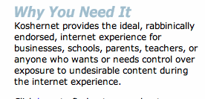
Some corner cases
Parental protection
  user (paying subscriber…) choice
KosherNet
Spam
  would only affect IP-level blocking
DOS
  classified as unwanted traffic
Notes:
http://www.koshernet.com/

Slide 52
47 CFR 8
§ 8.1 Purpose.
  The purpose of this Part is to preserve the Internet as an open platform enabling consumer choice, freedom of expression, end-user control, competition, and the freedom to innovate without permission.
§ 8.3 Transparency.
  A person engaged in the provision of broadband Internet access service shall publicly disclose accurate information regarding the network management practices, performance, and commercial terms of its broadband Internet access services sufficient for consumers to make informed choices regarding use of such services and for content, application, service, and device providers to develop, market, and maintain Internet offerings.

Slide 53
Disclosure (Transparency) – Network Practices
Congestion management: congestion management practices; types of traffic; purposes; practices’ effects on end users’ experience; criteria used in practices, such as indicators of congestion that trigger a practice, and the typical frequency of congestion; usage limits and the consequences of exceeding them; and references to engineering standards, where appropriate.
Application-Specific Behavior
Device Attachment Rules
Security

Slide 54
Disclosure (Transparency) – Performance
Service description: A general description of the service, including the service technology, expected and actual access speed and latency, and the suitability of the service for real-time applications.
Impact of specialized services: If applicable, what specialized services, if any, are offered to end users, and whether and how any specialized services may affect the last-mile capacity available for, and the performance of, broadband Internet access service.

Slide 55
Disclosure (Transparency) – Commercial Terms
Pricing: For example, monthly prices, usage-based fees, and fees for early termination or additional network services.
Privacy Policies: For example, whether network management practices entail inspection of network traffic, and whether traffic information is stored, provided to third parties, or used by the carrier for non-network management purposes.
Redress Options: Practices for resolving end-user and edge provider complaints and questions.

Slide 56
What about congestion?
Open Internet rules allow charging by
  access rate
  traffic volume
Content-neutral mechanisms
  normal TCP
  Bob Briscoe’s fair allocation
  e.g., Columbia University bandwidth policy:
    Each host computer on the Columbia network is assigned two quotas. One quota affects outbound usage, i.e., data sent to the Internet. The second affects inbound usage, i.e., data downloaded from the Internet. A host exceeding either limit in a given hour will have its bandwidth in that direction restricted to a lower rate for the remainder of the hour and the hour following if excessive bandwidth use continues. Quotas are 1 GB/hr download and 400 MB/hr upload (10 am to midnight).

Slide 57
Open Internet & QoS
Principle of end user control
E.g., DiffServ bits or signaling
  RSVP or NSIS
  or out-of-band (“please prioritize UDP port 5050”)
Together with rate or volume limits
  “Includes 1,000 minutes of VoIP priority”
Technical difficulties
  DSCP bit re-marking
  Symmetric treatment for incoming traffic

Slide 58
Pay for Priority (P4P)
“Dear Google: We’ll mark your packets as high priority for just $9.95/GB! Hurry, offer ends soon!”
May not matter (much) in practice
  assumes QoS problems and local congestion
  but related to paid peering (later)

Slide 59
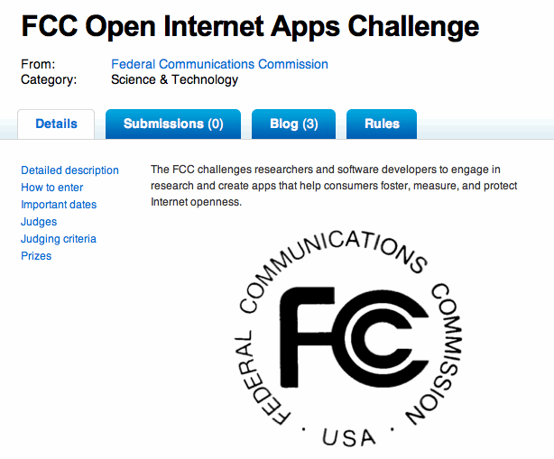

FCC challenge
Difficult to determine state of openness
  blocking, content discrimination

Slide 60
Example tests
May contribute to ossification of Internet
E.g., Reddit comments on FCC challenge
  SCTP, DCCP, UDP Lite
  UDP path MTU detection
  NXDOMAIN
  VPN protocols
  ICMP echo
  TCP vs. non-TCP fairness
  TCP window scaling
  TCP ECN
  modification of HTTP requests
Notes:
http://www.reddit.com/r/programming/comments/ewy18/the_fcc_has_launched_a_competition_to_create/

Slide 61
The future, version 2: airline
Same basic service (get human cargo from A to B)
but vastly different prices
  economy vs. economy first vs. first class
  revenue management
  restrictions
    flexibility & cancellation risk
  additional services
Internet version:
  pay extra for VPN (see iBahn service)
  consumer web sites vs. IMAP access
  except only 1-2 choices

Slide 62
2 Internet futures
content and applications
content production (*)
content distribution
CDN
broadband access
local infrastructure
regional and national backbone
Google
Chatroulette
IP
Level 3
vs.
fiber or copper loop
(“Homes with tails”)
RCN
AT&T
Comcast/NBC (*)
Verizon
Notes:
see old MCI functional separation

Slide 63
Overview
What’s the problem?
How much data & spectrum is there?
Can we make better use of it?
  Better technology
  General-purpose technology
  Better sharing in time and space

Slide 64
EXAMPLE 2: SPECTRUM

Slide 65



You’ve heard the statistics…
Mobile phone subscriptions now top the number of people - - 328 million subscriptions
90% of us keep our mobile device within arms length 24 hours a day, 7 days a week
Smartphone sales have eclipsed PC sales
Mobile broadband is being adopted faster than any computing platform in history
A typical smartphone places 24 times as much demand on spectrum as an old feature phone
Tablets demand 120 times as much
Multiple experts expect that mobile demand for spectrum will increase more than 35x in the next few years (3,500%)
24/7
24X
120X

Slide 66
Monthly fixed consumption
North America | Mean | Median | Mean : Median
Upstream | 4.5 GB | 600 MB | 7.33
Downstream | 18.6 GB | 6.0 GB | 3.06
Aggregate | 23.0 GB | 7.0 GB | 3.28
top 1% →
  49.7% of upstream traffic
  25% of downstream traffic
Europe | Mean | Median | Mean : Median
Upstream | 8.2 GB | 1.2 GB | 6.87
Downstream | 31.3 GB | 12.7 GB | 2.47
Aggregate | 39.6 GB | 14.7 GB | 2.69
Notes:
Sandvine, Global Internet Phenomena Report Spring 2011

Slide 67
Spectral efficiency
b/s/Hz
but also total spectral efficiency
  guard bands
data efficiency
  e.g., H.264 is twice as good as MPEG-2/ATSC

Slide 68
A 2016 thought experiment
2016: 71% of (consumer) bandwidth is video
Average monthly TV consumption (US): 154 hours
Netflix: 1 GB/hour (SD) … 2.3 GB/hour (HD)
  → 300 GB/month/person
  more if people in household watch different content
→ 0.9 Mb/s (averaged over 24 hours)
Cisco VINI: 150 MB/month → 2.7 GB/month
LTE: need 600 kHz/user (typical 1.5 b/s/Hz)
  → 500 MHz per cell sector → about 800 users/cell sector

Slide 69
What can we do?
end system caching
better audio & video codecs
efficient apps
IP multicast
WiFi offload
small cells = better spectral efficiency + more re-use
spectral efficiency (LTE-A)
directional antennas
general purpose spectrum
dense cells
white spaces & sharing
LTE: 1.5 b/s/Hz
GSM: 0.1 b/s/Hz

Slide 70

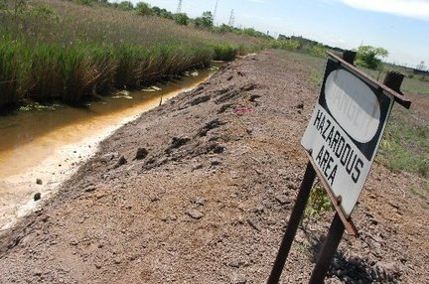
From beachfront spectrum to brownfield spectrum

Slide 71
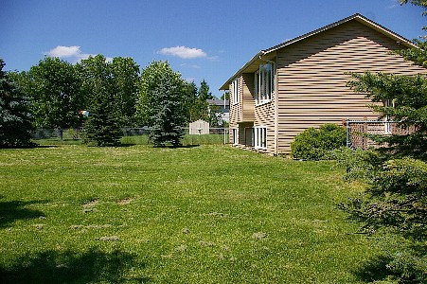
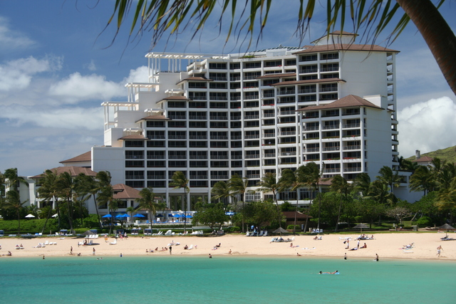
From empty back yard to time share condo

Slide 72
cellular = about 500 MHz in total

Slide 73
Unlicensed & lightly-licensed bands (US)
2.4 GHz (73 MHz) – 802.11b/g
3.6 GHz (100 MHz) – for backhaul & WISPs
4.9 GHz (50 MHz) – public safety
5.8 GHz (400 MHz) – 802.11 a/n
  much less crowded than 2.4 GHz
  supported by many laptops, few smartphones

Slide 74
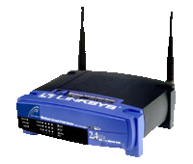
5.8 GHz expansion: sharing with incumbents
Device detects radar
and moves to an unoccupied channel
50 mW
Indoor Use Only
250 mW
250 mW
1 W
DFS
DFS
Existing
Existing
New
Existing
5150
5250
5350
5470
5725
5825
Frequency (MHz)

Slide 75
Freeing spectrum: incentive auctions
Incentive auctions will share auction proceeds with the current occupant to motivate voluntary relocation of incumbents
  Otherwise, no incentive for current occupant to give back spectrum
  Stations keep current channel numbers
    via DTV map
Adjacent Channel
Interference
TV
TV
BB
TV
BB
TV
Without Realignment:
Reduced Broadband Bandwidth
Adjacent Channel
Interference
TV
TV
TV
TV
BB
With Realignment: Accommodates Increased Broadband Bandwidth

Slide 76

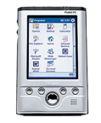

Small cell alternatives
Femto cells
  use existing spectrum
  need additional equipment
WiFi off-load
  use existing residential equipment
  5G networks = heterogeneous networks?
Distributed antenna systems
Cellular
Femto-cells
Distributed Antenna Systems
Signals are distributed throughout the
Building via amplifiers/antennas

Slide 77


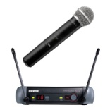

TV White Spaces
TV channels are “allotted” to cities to serve the local area
Other licensed and unlicensed services are also in TV bands
“White Spaces” are the channels that are “unused” at any
given location by licensed devices
2
4
Non-
Broadcast
spectrum
5
7
9
White
Space
Low
Power TV
Wireless
Microphones
New York City
Full Power
TV Stations
Etc.
Only for illustrative purposes
3
Non-
Broadcast
spectrum
6
8
10
White
Space
White
Space
White
Space
Low
Power TV
Wireless
Microphones
Philadelphia
Full Power
TV Stations
Etc.

Slide 78
TVWS Spectrum Availability
Available spectrum varies by location
In rural areas many channels are available
In big cities only a few channels may be available at some locations
Examples of availability in UHF channels 21 – 51 (Illustrative):
New York
21 | 22 | 23 | 24 | 25 | 26 | 27 | 28 | 29 | 30 | 31 | 32 | 33 | 34 | 35 | 36 | 37 | 38 | 39 | 40 | 41 | 42 | 43 | 44 | 45 | 46 | 47 | 48 | 49 | 50 | 51
Washington, DC
21 | 22 | 23 | 24 | 25 | 26 | 27 | 28 | 29 | 30 | 31 | 32 | 33 | 34 | 35 | 36 | 37 | 38 | 39 | 40 | 41 | 42 | 43 | 44 | 45 | 46 | 47 | 48 | 49 | 50 | 51
Full Service DTV Station
Low Power TV Station
Channel Open/ Adjacent to TV
Channel Open/ Not Adjacent to TV
In less dense areas many channels are available.
For example: Wilmington, NC: 25 channels = 150 MHz
Harrisburg, PA: 19 channels = 114 MHz
78
Notes:
78

Slide 79




TV White Spaces
Final rules adopted Sept. 2010:
  New spectrum for unlicensed
  Based on geolocation & data base of protected services
  Also allows for spectrum sensing with rigorous review & authorization process
Services protected in the data base:
  TV digital and analog Class A, low power, translator & booster stations
  Broadcast auxiliary (wireless mikes)
  Cable head-ends and TV translators
  Land mobile
  Sites with significant wireless microphone use
Data Base
Mode 1: Portable device obtains
location/channels from fixed device
Mode 2: Portable device uses its
own geolocation/data base access capability
79
Notes:
79

Slide 80
Benefits of TV White Space
Prime spectrum
  Great propagation & coverage
  High amounts in much of the USA
  Close to spectrum used by commercial wireless services → potential synergy
New IEEE 802.22™ standard:
  Broadband wireless access over a large area up to 100 km
  Up to 29 Mb/s per TV channel
  Can increase data rate through use of multiple channels
WiFi & TVWS complementary:
  Wi-Fi has greater bandwidth but usage density is increasing
Notes:
80

Slide 81
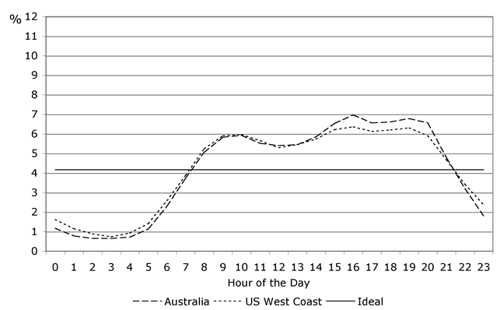
New options to reduce traffic
Download video content during off-hours
  or defer software updates until WiFi is available
Peer-to-peer distribution of popular content
IP multicast (1-to-many) of live content
Make apps less chatty

Slide 82

Spectrum Outlook
No single solution:
  reduce spectrum usage
    caching & better modulation
  re-use spectrum
  re-cycle old spectrum

Slide 83
EXAMPLE 3: Measurements

Slide 84
Measurement History
FCC has an evolved schema in place to acquire and analyze data on legacy PSTN
  Broadband networks and the Internet have not been general focus of these study efforts
More recent and evolving broadband interest
  Section 706 of Telecommunications Act, 1996, required annual report on availability of advanced telecommunications services to all Americans
    Resulted in information on deployment of broadband technology but not its performance
  FCC’s National Broadband Plan – March 2010
    Proposed performance measurements of broadband services delivered to consumer household
    Work plan evolved from recommendations of National Broadband Plan

Slide 85
Broadband Measurement Study
First effort for Commission
Sought high level of voluntary participation from stakeholders
  ISPs, academia, others
Interactions shaped initial study
Broadband measurement still work in progress

Slide 86
What Was Done
Enlisted cooperation of 13 ISPs covering 86% of US Population
Enlisted cooperation of vendors, trade groups, universities and consumer groups
Agreement reached on what to measure and how to measure it
Enrolled 9,000 consumers as participants
  6,800 active during report period
  A total of 9,000 active over the data collection period
Issued report on August 2, 2010

Slide 87
What Was Released
Measuring Broadband America Report
  Main Section describing conclusions and major results
  Technical Appendix describing tests and survey methodology
Spreadsheet providing standard statistical measures of all tests for all ISPs and speed tiers measured
March data set (report period) with 4B data elements from over 100M tests
  Data set presented as used with anomalies removed
  Documentation provided on how data set was processed
Data set from February thru June
  All data, as recorded
Geocoded data on test points recently released
Information available at http://www.fcc.gov/measuring-broadband-america

Slide 88
What Was Measured
Sustained Download | Burst Download
Sustained Upload | Burst Upload
Web Browsing Download | UDP Latency
UDP Packet Loss | Video Streaming Measure
VoIP Measure | DNS Resolution
DNS Failures | ICMP Latency
ICMP Packet Loss | Latency Under Load
Total Bytes Downloaded | Total Bytes Uploaded

Slide 89
Most ISPs Deliver Close to Advertised during Peak Hours

Slide 90
Some Don’t

Slide 91
Performance Varies
ISPs seem to impose network wide performance standards
However, there can be exceptions by speed tier

Slide 92
Cable/Telco Tussle
Some Cable companies advertise burst speed
  Quota based technique providing temporary speed increase of < 15 seconds
    Also affected by other household activity
  Can’t be applied generally to DSL where sync rate often limiting factor
  Marginal value to fiber where each subscriber has potentially available 37 Mb/s to 75 Mb/s provisioned bandwidth
Compromise to measure both burst and sustained speed
Burst speed does have some potential to improve browsing, gaming and like applications

Slide 93
Burst Speed Increase
Most impact of burst speed seen between 6 and 12 Mb/s
Note: This chart not in report and shows calculated difference between burst and sustained performance

Slide 94
Upload Speeds
Upload speeds appear not to be congested
Download and not upload speeds seen as present limiting factor

Slide 95
Reliability
Packet loss rate < 1%
Correlation between peak periods and packet loss
  Higher loss during peak hours
Most companies during peak experience < .4% packet loss
Worst case seen during March .8%
Data from other periods may have numbers in excess of 1% (Georgia Tech)
1% packet loss often cited as video threshold

Slide 96
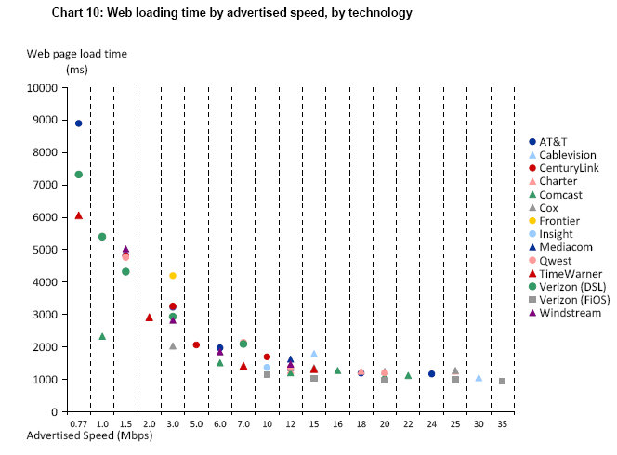
Web Page Downloading

Slide 97
Web Page Downloading
Canary in the Coal Mine?
Performance seems to top out after 10 Mbps
Many possible explanations
  Latency, server loading, household platform limitations, etc.
However, discussions with Georgia Tech indicate that they have seen similar performance issues
Discussion with Ofcom and others suggest that globally, full benefits of higher line rates not being realized AT PRESENT
Higher ISP speed may challenge industry to examine performance bottlenecks
More data needed

Slide 98
How Much Speed Is Needed and for What?
Surveyed ISPs and prominent industry leaders for advice
Answer was a mean opinion with an infinite variance
ISPs urged consideration of application need and household, emphasized complexity and need to encourage upward evolution
Industry advice ranged from “buy as much as you an afford” to “needs of video < 5 Mbps and will possibly decrease”

Slide 99
Interesting Observations
It’s a moving target and this must be conveyed to consumer
Higher performance speeds not presently realizable by consumer end to end, due to technical issues associated with network
CDNs are necessary solution to higher performance, content must be close to consumer
Cloud computing services is changing and will continue change demand for upload speed
Latency is increasingly important, from human factors there is a cliff effect around 100 ms
DNS resolution is also limiting factor (measured in report)
Reliability of connection is important

Slide 100
Unknowns
Report measured ISP performance and not end to end
In-home contributions unknown but being looked at elsewhere (France)
Contributions of other network elements not correlated

Slide 101
Future Directions
Open Internet: Transparency
  ISPs must disclose typical performance to consumers
Looking at:
  Continuing SamKnows on interim basis
  Automating measurement process
    Build into modems
    Produce reports with no/little manual intervention
  Re-looking at mobile initiative
  Address rural environment
    13 ISPs -> 1000s
  Other end to end measurement points?

Slide 102
EXAMPLE 4: Accessibility

Slide 103

Access to Telecommunications and Technology Means:
Jobs
Education
Information
Recreation
Marketplace
Transportation
Independence
Privacy

Slide 104
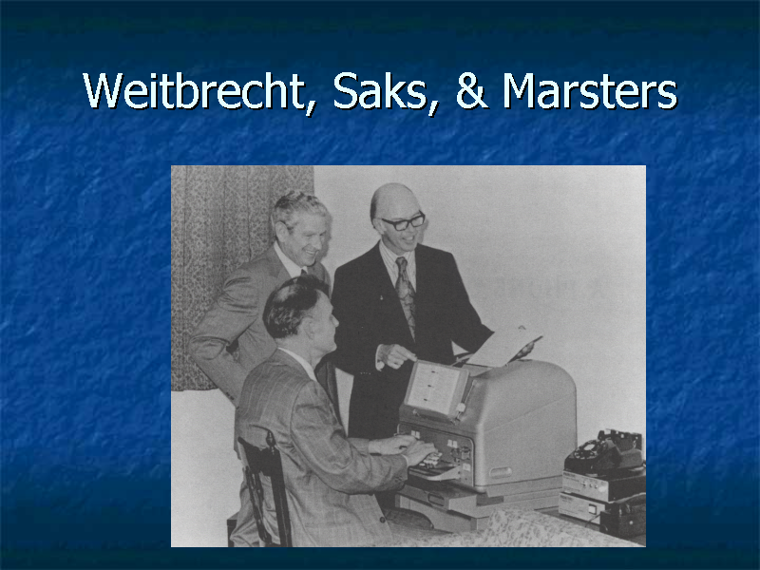

Slide 105
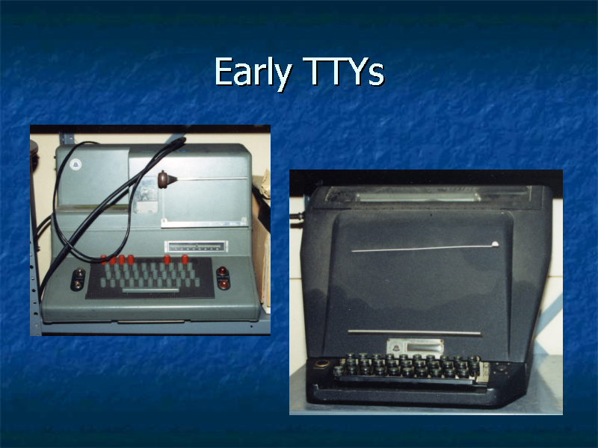

Slide 106
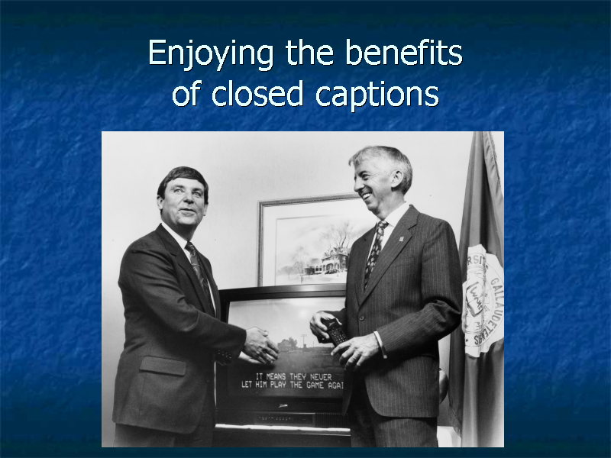

Slide 107
Improved Relay Services
Video Relay (2000)
Speech-to-Speech (2000)
Spanish Relay (2000)
Internet Relay (2001)
Access to audiotext (IVR) systems
Typing speed – 60 wpm
Captioned Telephone (2003)

Slide 108
Turn of Century: Many Gaps in Laws
No coverage of Internet-based communication services or video programming
No mandates for video description
Limited captioning capability on television devices (screens up to 13 inches)
No specific protections for deaf-blind population
No guarantee of emergency access or accessible user interfaces on video devices for people who are blind or visually impaired

Slide 109
Twenty-First Century Communications and Video Accessibility Act
Public Law 111-260; Public Law 111-25
Need for the Legislation: Disability protections enacted by Congress and implemented by the FCC had not kept up with emerging technologies
    Prior focus was on telecommunications
    Prior laws applied to legacy technologies
CVAA addresses accessibility challenges of 21st century technologies

Slide 110
Market Forces: Past failures to Achieve access
  Each disability market is too small
  Lower incomes mean less purchasing power
  Need for adaptive equipment discourages purchases
Government steps in where market has failed
Addresses accessibility needs to promote innovation and not overly burden industry: Goal is to incorporate access at design stages
Accessibility achieves access for all – goes beyond disability community

Slide 111
Title II – Video Description
Required for:
  4 national broadcast networks in top 25 markets
  Top 5 cable channels
Amount of programming: 4 hours of prime time or children’s programming per week
FCC must conduct additional inquires on availability, benefits, uses, and costs: 1 year after rule phase-in
CVAA authorizes expansion to 7 hours of video description per week and eventually all market areas

Slide 112
FCC Implementation of CVAA
Creation of Advisory Committees (directed by CVAA to achieve consumer-industry balance)
    Emergency Access Advisory Committee
    Video Programming Accessibility Advisory Committee
Adoption of Rules
Creation of Accessibility Clearinghouse:
  http://apps.fcc.gov/accessibilityclearinghouse/
Biennial Reports to Congress
Handling of Complaints

Slide 113

How can researchers participate?
Write relevant papers
  what’s technologically possible?
  what are real-world problems?
  economic + technology analysis
Submit filings for the record
  during comment periods
Ex-parte visits
Presentations to educate FCC staff

Slide 114
Conclusion
Regulator as critical part of technology eco system
  technology enabler
  manager of the “common”
  consumer protection
  maintain or enhance competition
  deal with market failures
Challenges
  outdated laws
  technology transition:
Open Internet: motivated by civic and economic concerns
  Competition or regulation?

