Slide 1
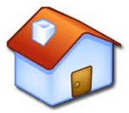
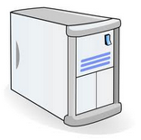
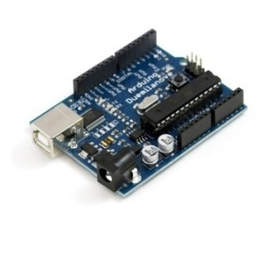
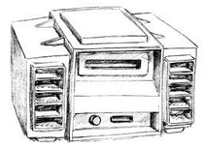
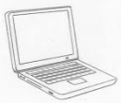
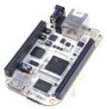
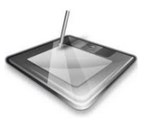
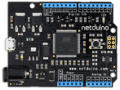
SECE SYSTEM
How do people use SECE service?
: register & download SECE software
1
2
: installation & bootstrapping
SECE SERVER
3
: controlling sensors
ELECTRICAL APPLIANCES
CONNECTED TO MICROCONTROLLER
2
1
3
INTERNET
…
…
…
Internet Real Time Lab
I
R
T

Slide 2
SECE SYSTEM
SECE SERVER
BLUETOOTH
X10
ZIGBEE
INTERNET
Home gateway
…
INFRARED
OTHERS
Internet Real Time Lab
I
R
T

Slide 3
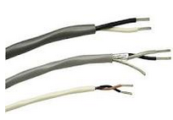
SECE: Multi-Protocol Architecture
SECE SERVER
Internet protocol suite
Ethernet IP TCP/UDP DHCP DNS mDNS HTTP
Microcontroller: Arduino
Internal Comm.
(wired & wireless)
…
Sensors & Actuators
Electrical Appliances
…
Internet Real Time Lab
I
R
T

Slide 4
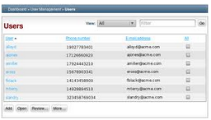
SECE: How to verify user authentication and authorization?”
SECE SERVER
USER LIST
SERVICE LIST
Control electrical appliances
Location tracking system
Social networks facebook & twitter
Email, calendar and so on
Authentication
Is the user X ?
Authorization
What can the user X do ?
INTERNET
CLIENTS
Internet Real Time Lab
I
R
T

Slide 5
SECE: Tree topology + Circles
Office
Tree topology: permission hierarchy
Who gets a permission to control the sensor?
G1
Circle system:
Who has higher priority? (G1 > G2)
G2
Room 1
Room 2
Light 1
Internet Real Time Lab
I
R
T

Slide 6
SECE: How to create events?
How to create events?
Ex) Ifttt (if this then that)
Task – Triggers – Actions - Channels
HOME
OFFICE
Internet Real Time Lab
I
R
T

Slide 7
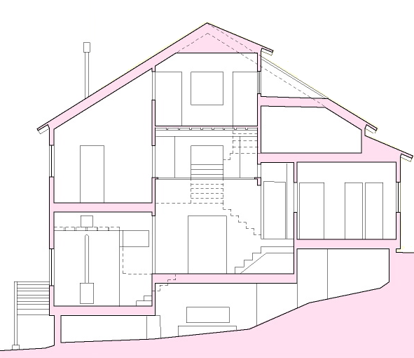
SECE: Can I turn off the lights in the house? - 1
SECE SERVER
:Wired / Wireless
INTERNET
Can I turn off
the lights?
denied
1. SECE server combines all information such as
Requester’s permission status
TV, Radio, Heater current ON/OFF status
Temperature measurement from digital thermometer
locations of family members and so on
2. SECE server decides that there are people in the house.
3. The request is denied.
Internet Real Time Lab
I
R
T

Slide 8
SECE: Can I turn off the lights in the house? - 2
SECE SERVER
:Wired / Wireless
INTERNET
Can I turn off
the lights?
denied
Use one of available communications
from smart phone (3G/WIFI/Bluetooth)to send
a request to SECE server. Bluetooth verifies that
a user is inside the house. WIFI connection can be also
used to compare IP addresses for the authorization.
allowed
Internet Real Time Lab
I
R
T

Slide 9
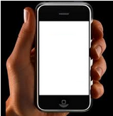
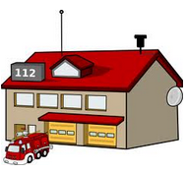
SECE: Fire alarm system
SECE SERVER
How to implement fire alarm button in SECE?
Report user location
INTERNET
Break Glass
Push the button
SECE FIRE
ALARM
APPLICATION
X10
Push button ten times
to activate fire alarm
Internet Real Time Lab
I
R
T

Slide 10
SECE: Indoor Location Tracking System
SECE SERVER
B
: Beacon
G
: Gateway
INTERNET
G
B
B
Zigbee
CLIENTS
B
B
B
Plus,
- Temperature, light and motion sensors on beacons
periodically report measurements to SECE server
B
Internet Real Time Lab
I
R
T

Slide 11
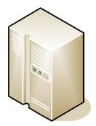
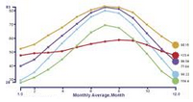
SECE: Device Diagnosis System
SECE SERVER
: Qualcomm product
INTERNET
LOCAL (A)
LOCAL (C)
LOCAL (B)
Internet Real Time Lab
I
R
T

