Slide 1
Easing the PSTN into the 21st century
        Henning Schulzrinne
Any opinions are those of the author and do not necessarily reflect the views
of the Federal Communications Commission.

Slide 2
Overview
Infrastructure
  Measuring Broadband America
  The state of competition
  International comparison
What do we need to keep?
Numbering
  Rethinking identifiers
  Maintaining (restoring?) caller ID trustworthiness
Databases: from many to few?
Interconnection
Quality

Slide 3
Network measurements

Slide 4
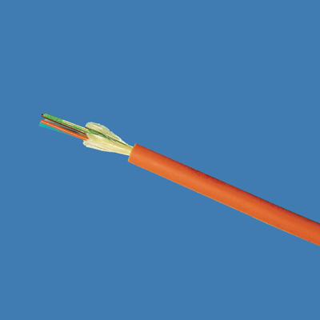
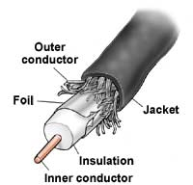

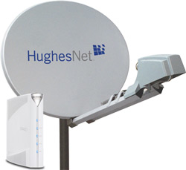

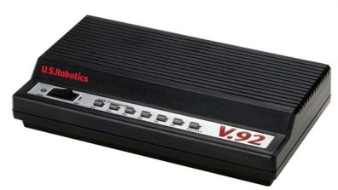
Available access speeds
100 Mb/s
marginal VOIP
20 Mb/s
5 Mb/s
2 Mb/s
1 Mb/s
avg. sustained
throughput
18%
60%
95%
97%
100%
of households

Slide 5
Measurement History
FCC has an evolved schema in place to acquire and analyze data on legacy PSTN
  Broadband networks and the Internet have not been general focus of these study efforts
More recent and evolving broadband interest
  Section 706 of Telecommunications Act, 1996, required annual report on availability of advanced telecommunications services to all Americans
    Resulted in information on deployment of broadband technology but not its performance
  FCC’s National Broadband Plan – March 2010
    Proposed performance measurements of broadband services delivered to consumer household
    Work plan evolved from recommendations of National Broadband Plan
Walter Johnston, FCC

Slide 6
What Was Done
Enlisted cooperation of 13 ISPs covering 86% of US population
Enlisted cooperation of vendors, trade groups, universities and consumer groups
Agreement reached on what to measure and how to measure it
Enrolled 9,000 consumers as participants
  6,800 active during report period
  A total of 9,000 active over the data collection period
Issued report on August 2, 2011 and 2012
Walter Johnston, FCC

Slide 7
What Was Released
Measuring Broadband America Report
  Main section describing conclusions and major results
  Technical appendix describing tests and survey methodology
Spreadsheet providing standard statistical measures of all tests for all ISPs and speed tiers measured
March data set (report period) with 4B data elements from over 100M tests
  Data set presented as used with anomalies removed
  Documentation provided on how data set was processed
Data set from February thru June
  All data, as recorded
Geocoded data on test points recently released
Information available at http://www.fcc.gov/measuring-broadband-america
Walter Johnston, FCC

Slide 8
What was measured
Sustained Download | Burst Download
Sustained Upload | Burst Upload
Web Browsing Download | UDP Latency
UDP Packet Loss | Video Streaming Measure
VoIP Measure | DNS Resolution
DNS Failures | ICMP Latency
ICMP Packet Loss | Latency Under Load
Total Bytes Downloaded | Total Bytes Uploaded
Walter Johnston, FCC

Slide 9
MBA architecture

Slide 10
Advertised vs. actual

Slide 11
Latency by technology

Slide 12
Data usage

Slide 13
Web page downloading canary in the coal mine?
Performance seems to top out after 10 Mb/s
Many possible explanations
  Latency, server loading, household platform limitations, etc.
However, discussions with Georgia Tech indicate that they have seen similar performance issues
Discussion with Ofcom and others suggest that globally, full benefits of higher line rates not being realized AT PRESENT
Higher ISP speed may challenge industry to examine performance bottlenecks
More data needed
Speed demand may be motivated more by video (multiple streams) and uploading (photos)
Walter Johnston, FCC

Slide 14
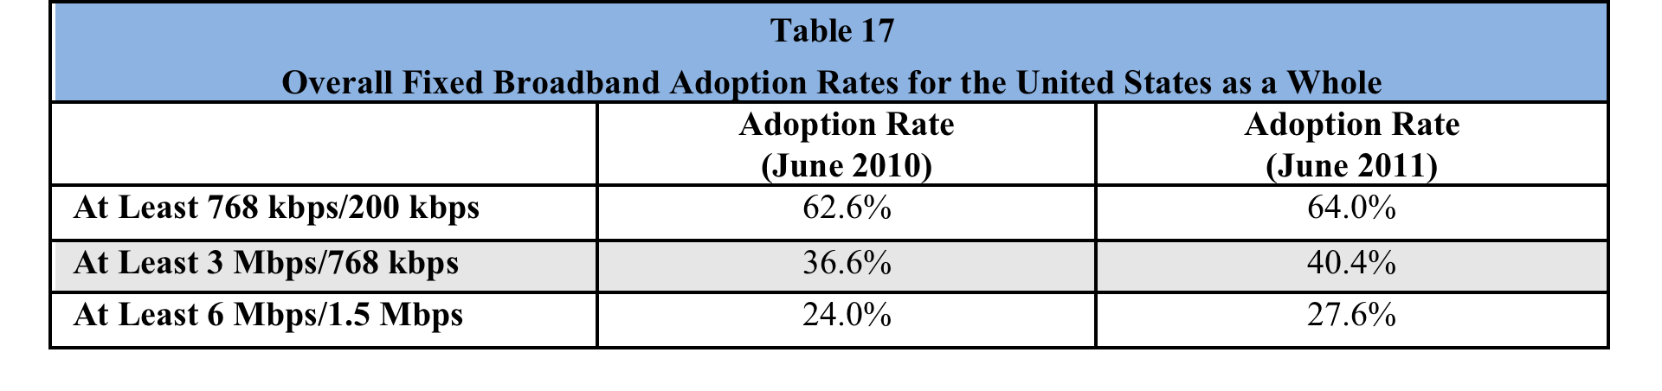
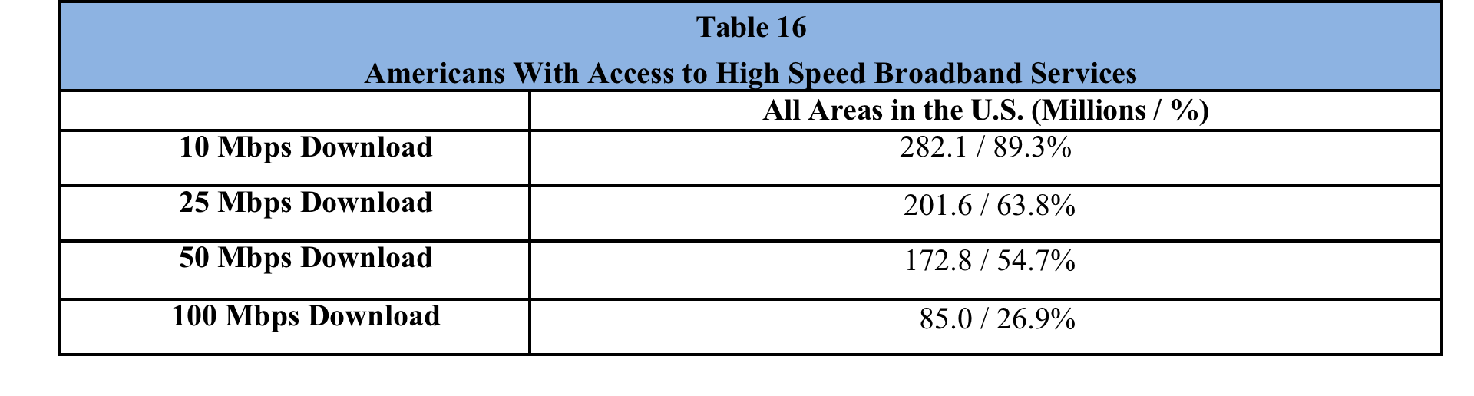
Broadband adoption
Eighth Broadband Progress Report, August 2012

Slide 15
Access to broadband
Eighth Broadband Progress Report, August 2012

Slide 16
International comparison: fixed
3rd International Broadband Data Report (IBDR), August 2012

Slide 17
International comparison: mobile
3rd International Broadband Data Report (IBDR), August 2012

Slide 18
PSTN transition

Slide 19
PSTN: The good & the ugly
The good | The ugly
Global Connectivity (across devices and providers) | Minimalist service
High reliability (engineering, power) | Limited quality (4 kHz)
Ease of use | Hard to control reachability (ring at 2 am)
Emergency usage | Operator trunks!
Universal access (HAC, TTY, VRS) | No universal text & video
Mostly private (protected content & CPNI) | Limited authentication Security more legal than technical (“trust us, we’re a carrier”)
Relatively cheap (c/minute) | Relatively expensive ($/MB)

Slide 20
The fall of the PSTN empire
mobile replacement
SIP trunking
VoLTE
IMS
more text
less voice
VoIP over DSL
2011
2015
2018
2020+

Slide 21
What are key attributes?
Universality
  reachability → global numbering & interconnection
  media → video, text
  availability → universal service regardless of
    geography
    income
    disability
Public safety
  citizen-to-authority: emergency services (911)
  authority-to-citizen: alerting
  law enforcement
  survivable (robust architecture, load, power outages)
Quality
  media (voice + …) quality
  assured identity
  assured privacy (CPNI)
  accountable reliability

Slide 22
What is less important?
Technology
  wired vs. wireless
    but: maintain quality if substitute rather than supplement
  packet vs. circuit
  “facilities-based” vs. “over-the-top”
Economic organization
  “telecommunication carrier”
Legal framework
  may be combination: Title I, Title II, VoIP rules, CVAA, CALEA, ADA, privacy laws, …

Slide 23
Numbers vs. DNS & IP addresses
 | Phone # | DNS | IP address
Role | identifier + locator | identifier | locator (+ identifier)
Country-specific | mostly | optional | no
# of devices / name | 1 (except Google Voice) | any | 1 (interface)
# names /device | 1 for mobile | any | any
ownership | carrier, but portability unclear (800#) | property, with trademark restrictions | ISP
who can obtain? | geographically-constrained, carrier only | varies (e.g., .edu & .mil, vs. .de) | enterprise, carrier
porting | complex, often manual; wireline-to-wireless may not work | about one hour (DNS cache) | if entity owns addresses
delegation | companies (number range) | anybody | subnets
identity information | wireline, billing name only | WHOIS data (spotty) | RPKI, whois
Notes:
http://www.nanpa.com/reports/faq.html#g1

Slide 24
Communication identifiers
Property | URL owned | URL provider | E.164 | Service-specific
Example | alice@smith.name sip:alice@smith.name | alice@gmail.com sip:alice@ilec.com | +1 202 555 1010 | www.facebook.com/alice.example
Protocol-independent | no | no | yes | yes
Multimedia | yes | yes | maybe (VRS) | maybe
Portable | yes | no | somewhat | no
Groups | yes | yes | bridge number | not generally
Trademark issues | yes | unlikely | unlikely | possible
Privacy | Depends on name chosen (pseudonym) | Depends on naming scheme | mostly | Depends on provider “real name” policy
Notes:
http://findmyfacebookid.com

Slide 25
Number usage
FCC 12-46

Slide 26
Area codes (NPAs)
634

Slide 27
1k blocks
nationalpooling.com
September 2012

Slide 28
The dialing plan mess
NANPA report 2011

Slide 29

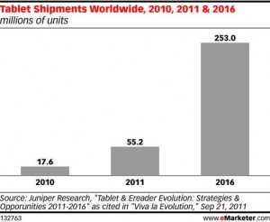

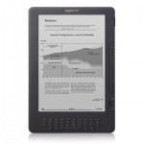
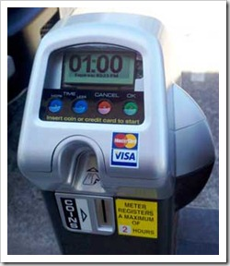
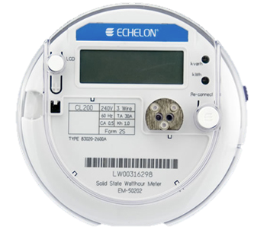
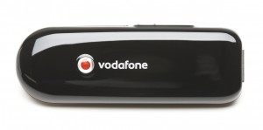
Phone numbers for machines?
< 2010
212 555 1212
500 123 4567
500 123 4567
533, 544
now: one 5XX code a year…
(8M numbers)
see Tom McGarry, Neustar
Notes:
http://blog.neustar.biz/neustar-insights/telephone-numbers-are-for-people-not-machines/

Slide 30


Future numbers
Should numbers be treated as names?
  see “Identifier-Locator split” in Internet architecture
Should numbers have a geographic component?
  Rate centers?
    meaningless for cell phones
  Is this part of a state’s cultural identity?

Slide 31
More number questions…
Should numbers become personal property?
  Separate service from number
  Simplify number portability
  But: Can you put a 212 number in your will?
  But: Will somebody buy up all the local numbers?
    How do you constrain number hoarding?
Divorce device from number
  any-to-any, dynamic mapping
Separate user identity & number

Slide 32
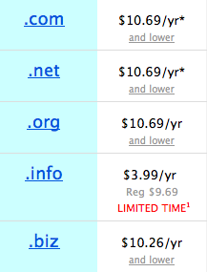
Phone numbers: hoarding
How to prevent hoarding?
  By pricing
    DNS-like prices ($6.69 - $10.69/year for .com)
      takes $100M to buy up (212)…
      1626: 60 guilders
    e.g., USF contribution proposals
      $8B/year, 750 M numbers → $10.60/year
      but significant trade-offs
  By demonstrated need
    see IP address assignment
    1k blocks
    difficult to scale to individuals
15c/month
Notes:
Manhattan purchase Peter Minuit

Slide 33
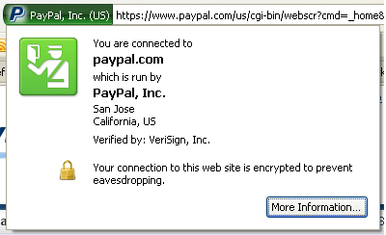
Who assures identity?
Web:
  plain-text → rely on DNS, path integrity
    requires on-path intercept
  X.509 certificate: email ownership
    no attributes
  EV (“green”) certificate
PSTN
  caller ID
  display name: CNAM database, based on caller ID
Notes:
http://www.cnamcallerid.com
https://www.opencnam.com
Truth in Caller ID Act of 2009

Slide 34
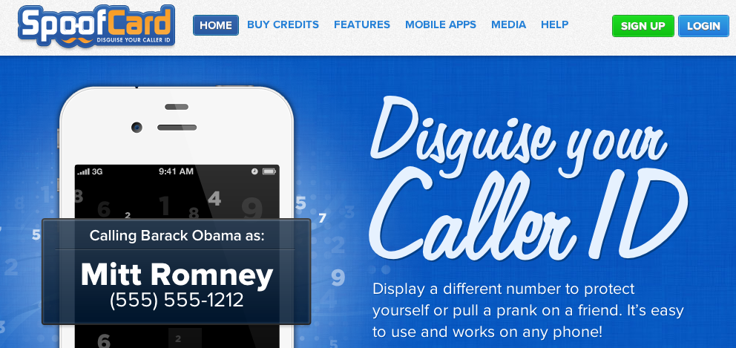
Caller ID spoofing
Caller ID Act of 2009: Prohibit any person or entity for transmitting misleading or inaccurate caller ID information with the intent to defraud, cause harm, or wrongfully obtain anything of value.

Slide 35



VoIP spoofing
A. Panagia, AT&T
PSTN
VoIP Application
Switch
A
Switch
B
STP
IP
CNAM
SPOOFER
SPOOFEE

Slide 36
Caller ID spoofing
A. Panagia, AT&T
enhances theft and sale customer information through pretexting
harass and intimidate (bomb threats, disconnecting services)
enables identity theft and theft of services
compromises and can give access to voice mail boxes
can result in free calls over toll free dial-around services
facilitates identification of the name (CNAM) for unlisted numbers
activate stolen credit cards
causes incorrect billing because the jurisdiction is incorrect
impairs assistance to law enforcement in criminal and anti-terrorist investigations

Slide 37
We’re running out of phone numbers*
8 M available numbers in each NPA →
  300 M population, 2.6 numbers each
  2.73 B available for 345 existing codes (→ 27% assigned)
    45% of 1k blocks are assigned
  5.02 B available for 643 likely geographic codes
2050: 439 million US residents
  2.5 numbers/person → 1.1 B numbers
RFC 1715
* in 2042, maybe

Slide 38
USF expenditures

Slide 39
Interstate switched access minutes

Slide 40






Caller identification
known caller
previous calls
sent her emails
what’s your SSN?
name unimportant
bank ✔
credit card office ✔
can you recommend student X?
name unimportant
IEEE ✔
known university ✔

Slide 41
Attribute validation
For unknown callers, care about attributes, not name
SIP address-of-record (AOR) → attributes
  employment (bank, registered 501c3)
  membership (professional)
  age (e.g., for mail order of restricted items)
  geographic location
Privacy
  → selective disclosure
  no need to disclose identity

Slide 42




Attribute Validation Service
Attribute Validation Server (AVS): Issuer
e.g., members.ieee.org
Attribute Reference ID
(ARID)
e.g.,
https://members.ieee.org/arid/4163
c78e9b8d1ad58eb3f4b5344a4c0d5a
35a023
{Alice’s username, credentials, user ID, role}
3. Establishes the validity of the
ARID with access code and retrieves selected attributes e.g., Alice’s role
1. Requests an ARID,
selecting attributes to disclose
HTTP over TLS
SIP over TLS
2. Makes a call with the ARID and part of access code
Caller: Principal
Alice
Student member in ieee.org
tel:+12345678
Callee: Relying Party
Bob
Accepts calls from members in ieee.org;
does not know Alice’s phone number
sips:bob@example.com
42

Slide 43
Using ARID vs. SIP-SAML
 | Using ARID | SIP-SAML
Trust model | Alice ⇔ Issuer Bob ⇒ Issuer | Alice ⇔ Issuer Bob ⇒ Issuer Authentication server for Alice ⇔ Issuer
Need for binding to user’s AoR | No | Yes
How to protect confidentiality | Sending over TLS
How to protect integrity | Sending over TLS | Attaching a digital signature & TLS
Selective disclosure | Yes | Possible, but not defined
Restricting verifiers with protecting user’s privacy | Yes, by hashing user’s AoR with a salt | Possible, but needs a minor modification in SAML for privacy
How to convey in SIP | By reference: the Issuer’s URL in a new Sender-References header along with parameters for privacy | By reference: the Issuer’s URL in a new token-info URI parameter of From header
 |  | By value: attached in the message body

Slide 44


“Public” PSTN databases
Now: LIDB & CNAM, LERG, LARG, CSARG, NNAG, SRDB, SMS/800 (toll free), do-not-call, …
Future:
1 202 555 1234
carrier code or SIP URL
type of service (800, …)
owner
public key
…
extensible set of fields

Slide 45
Interconnection
PSTN: general interconnection duty
  § 251: duty to negotiate; interconnect at any technically feasible point in network
  requires physical TDM trunks and switch ports
VoIP:
  VPN-like arrangements
  MPLS
  general Internet
  may require fewer points-of-interconnect
  transport cost (1 MB/minute): 10c/GB → 0.01c/minute
  only relatively small number of NAPs
  transition to symmetric billing (cellular minutes, flat-rate) rather than caller-pays

Slide 46
FCC USF/ICC reform
Federal Communications Commission FCC 11-161
42. IP-to-IP Interconnection. We recognize the importance of interconnection to competition and the associated consumer benefits. We anticipate that the reforms we adopt will further promote the deployment and use of IP networks, and seek comment in the accompanying FNPRM regarding the policy framework for IP-to-IP interconnection. We also make clear that even while our FNPRM is pending, we expect all carriers to negotiate in good faith in response to requests for IP-to-IP interconnection for the exchange of voice traffic
Technical problem
  where and how
  just voice?
Money problem
  who pays for what (conversion, transport, …)
John Barnhill, GenBand

Slide 47
Intercarrier Compensation Reform
Eliminate traffic stimulation (aka traffic pumping)
  All Carriers move to Bill and Keep (eventually)
  Access charges at uniformly low rate
  CLECs must file new tariffs at new rates
Eliminate phantom Traffic (aka theft)
  All providers interconnecting to PSTN must include DN or charge number
  SS7 rules extended to all traffic
Requires carriers to support IP-IP interconnect
Easing the pain
  Can apply to CAF to offset access charge losses for period of time
  Can add a subscriber line fee
Price Cap Carriers phase to $.0007 by 7/1/2016 and Bill and Keep by 7/1/2017
Rate of Return Carriers phase to $.0007 by 7/1/2019 and Bill and Keep by 7/1/2020
John Barnhill, GenBand

Slide 48
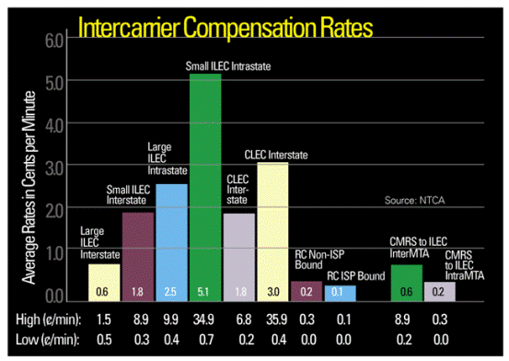
Intercarrier rates today

Slide 49
QoS is not just an Internet problem…
7400 test calls to 115 locations
NECA ExParte 05/21/2012

Slide 50
Rural call completion
Problems:
  manual error tracing
  complicated least-cost routing arrangements
  termination charge incentives
Requirements for new PSTN:
  automated call flow tracing
  end-to-end call quality evaluation (→ MBA)

Slide 51
Conclusion
Transition well under way
But key areas still open:
  regulatory and policy implications for consumer protection and competition
  voice-only or more
  back-fitting or opportunity for re-thinking
  role of over-the-top applications
Need your participation → standards, policy, technology

