Slide 1

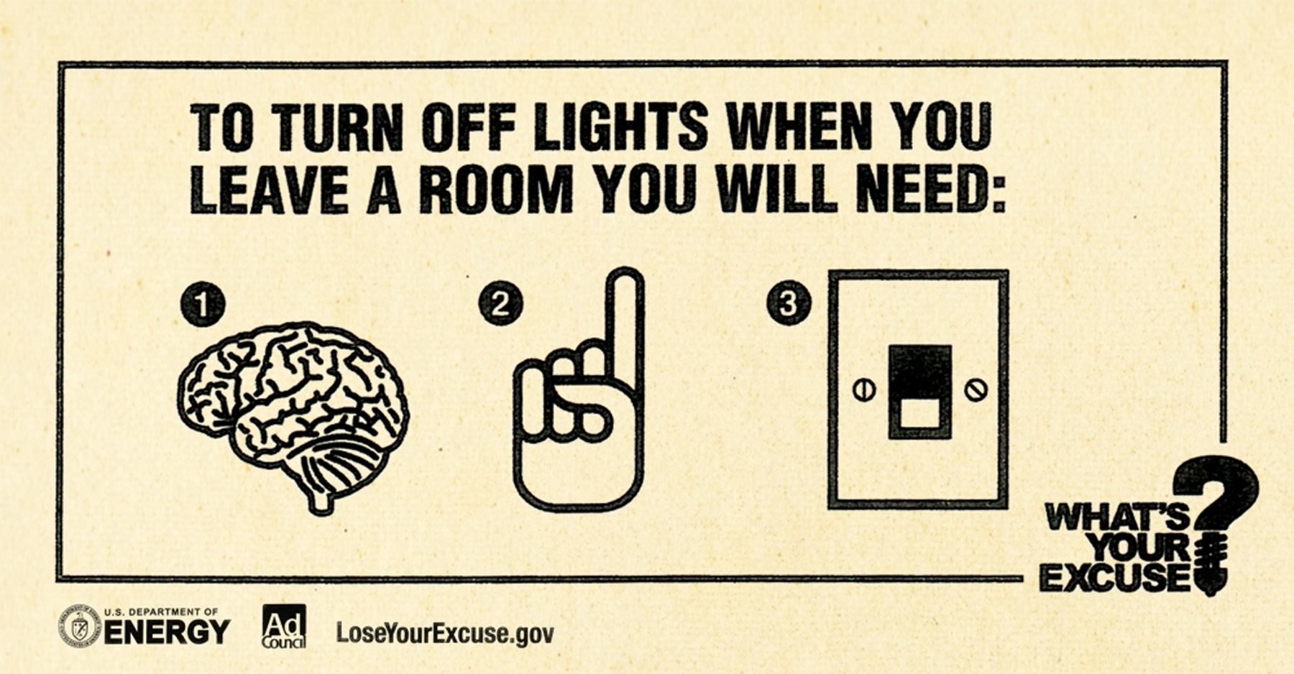
Transitioning to a VoIP PSTN – the Intersection of Technology, Economics and Regulation or
Will the Last Phone User Please Turn Off the Dial Tone?
        Henning Schulzrinne (Columbia University & FCC)
Any opinions are those of the author and do not necessarily reflect the views
of the Federal Communications Commission.

Slide 2
Overview
The PSTN is dying
  *1876 ✞2018?
… but real-time communications continues
Issues:
  numbering, security, reliability
  public policy issues
    911 & location
Open Internet as enabler of competitive VoIP

Slide 3
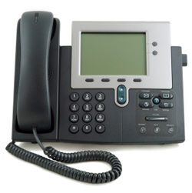
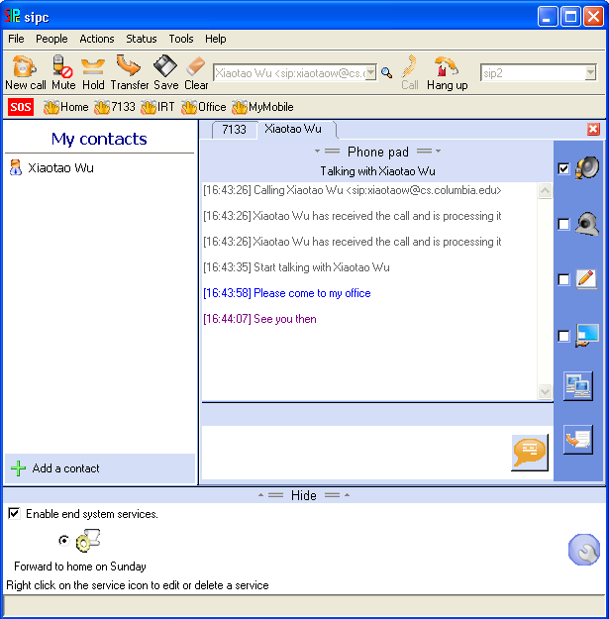
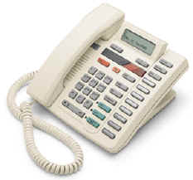

Evolution of VoIP
“Can it really replace the phone system?”
“How can I make it stop ringing?”
long-distance calling,
ca. 1930
“does it do
call transfer?”
replacing the
global phone system
“amazing – the phone rings”
going beyond
the black phone
catching up
with the digital PBX
1996-2000
2000-2003
2004-2005
2006-

Slide 4
The fall of the PSTN empire
mobile replacement
SIP trunking
VoLTE
IMS
more text
less voice
VoIP over DSL
2011
2015
2018
2020+

Slide 5
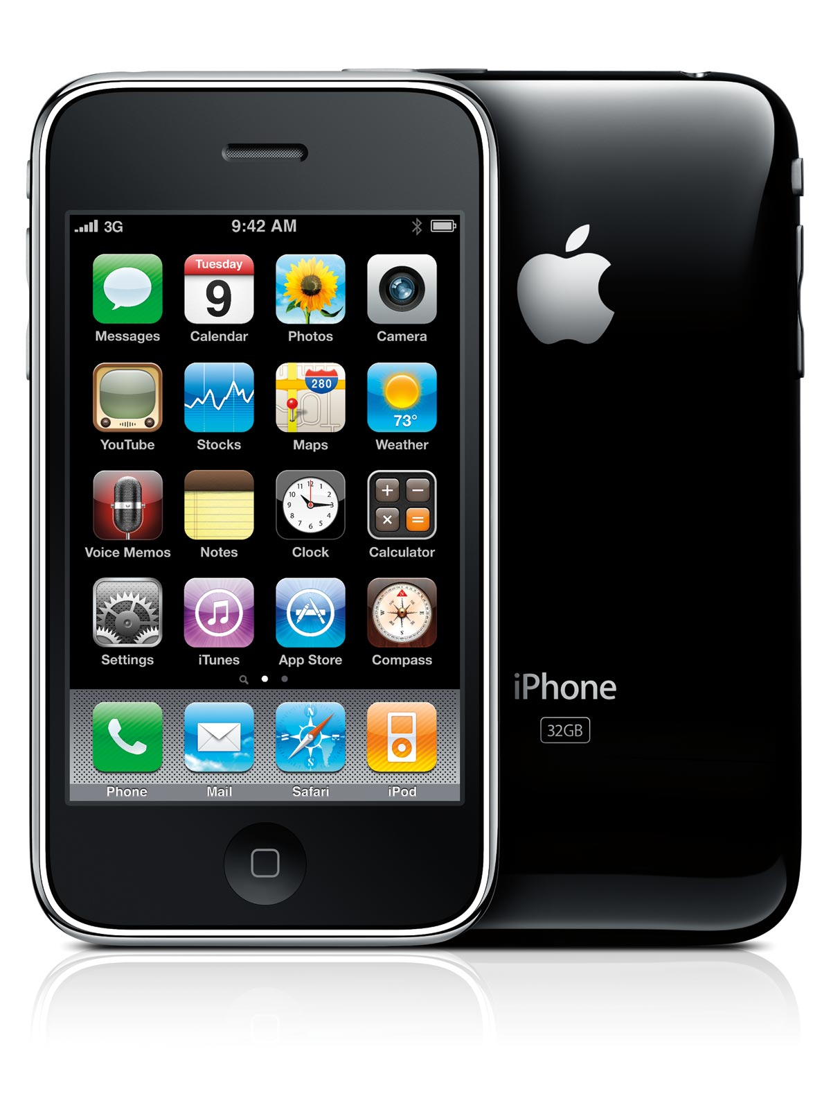


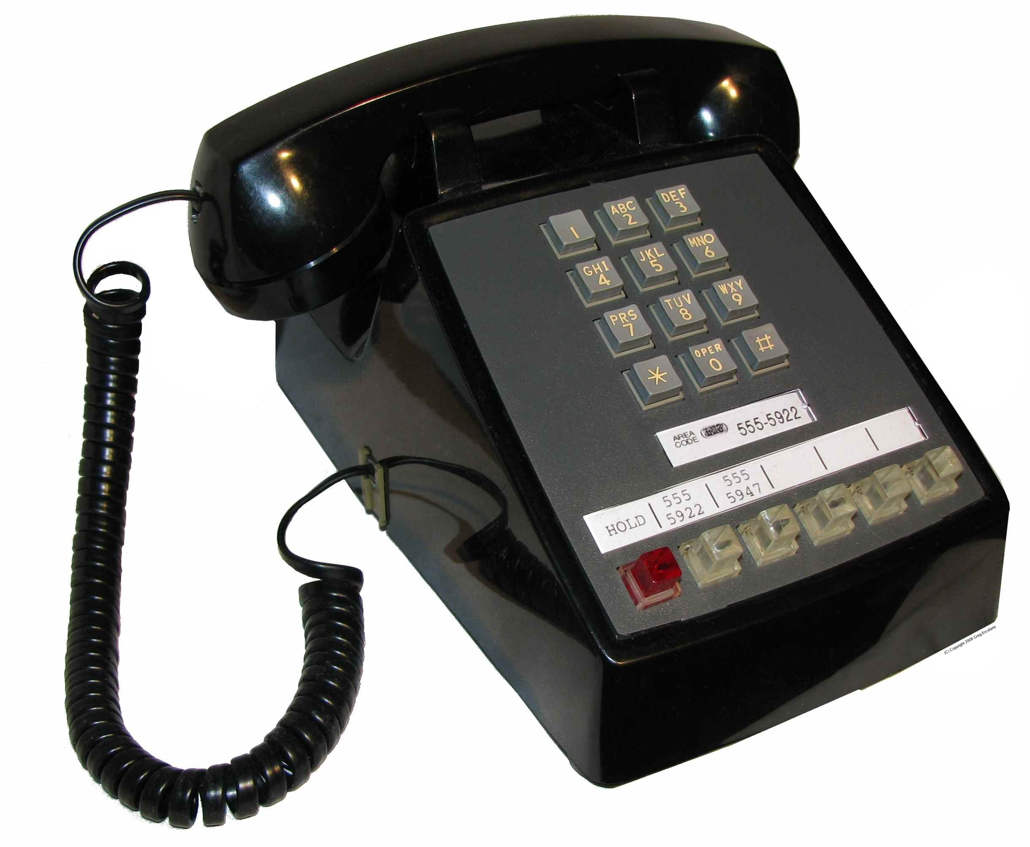

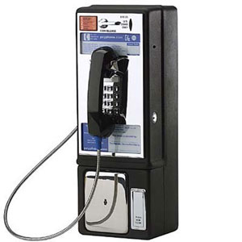

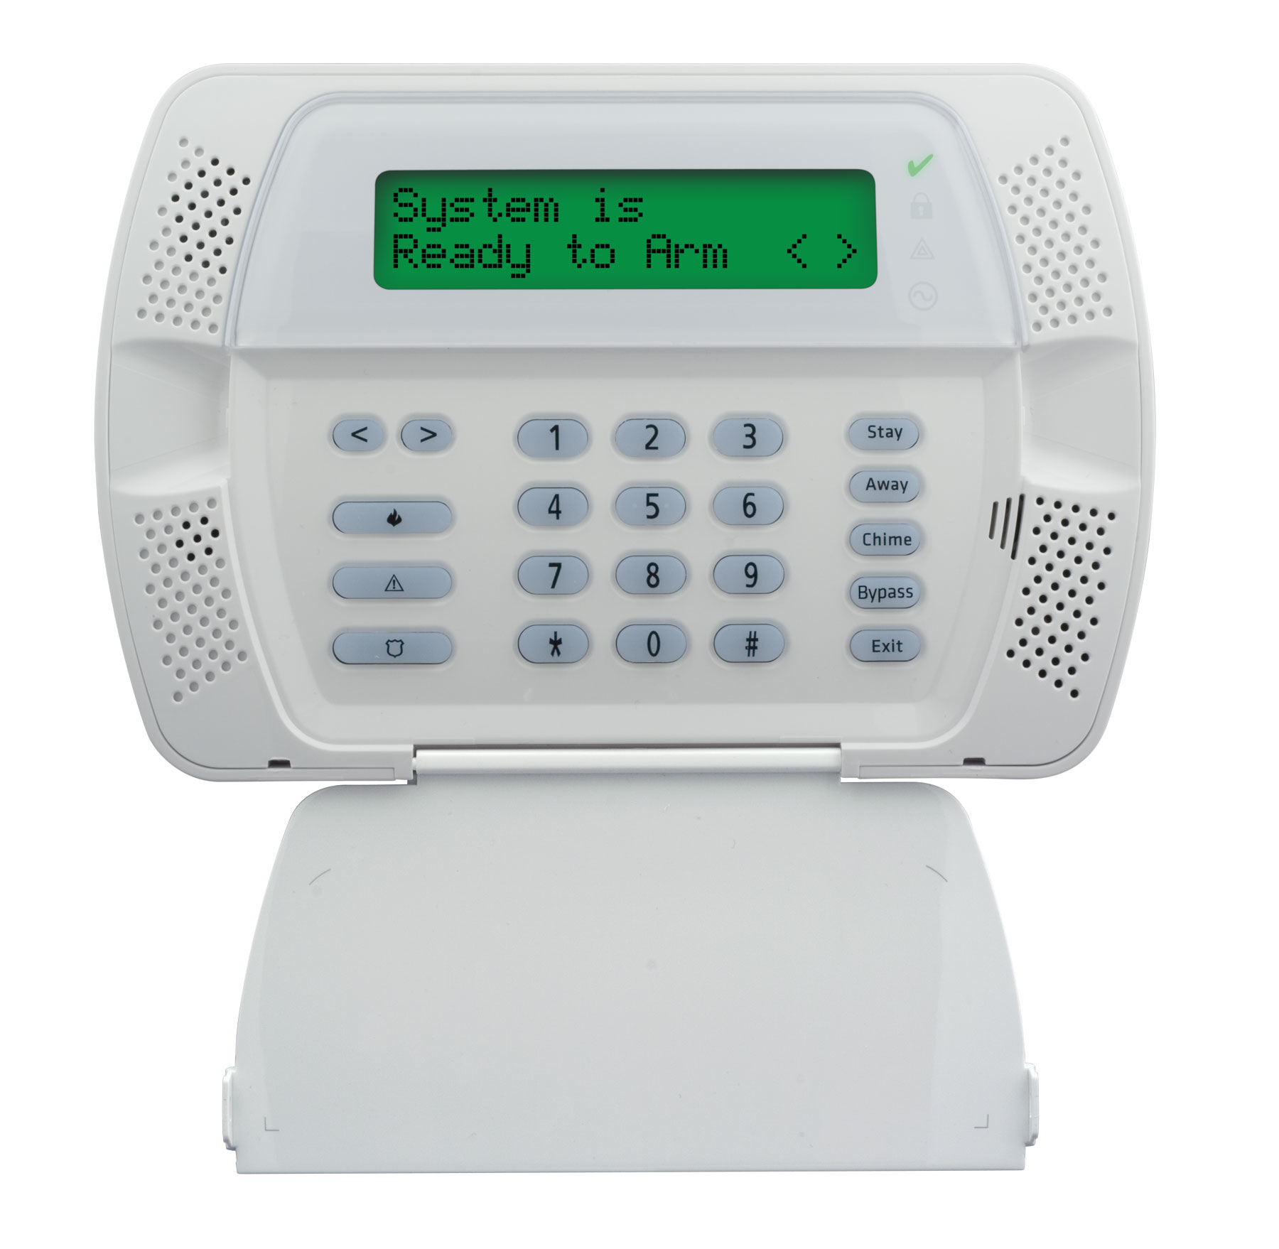
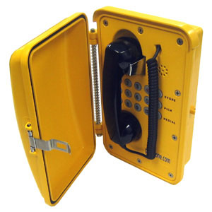
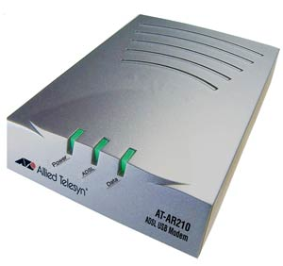
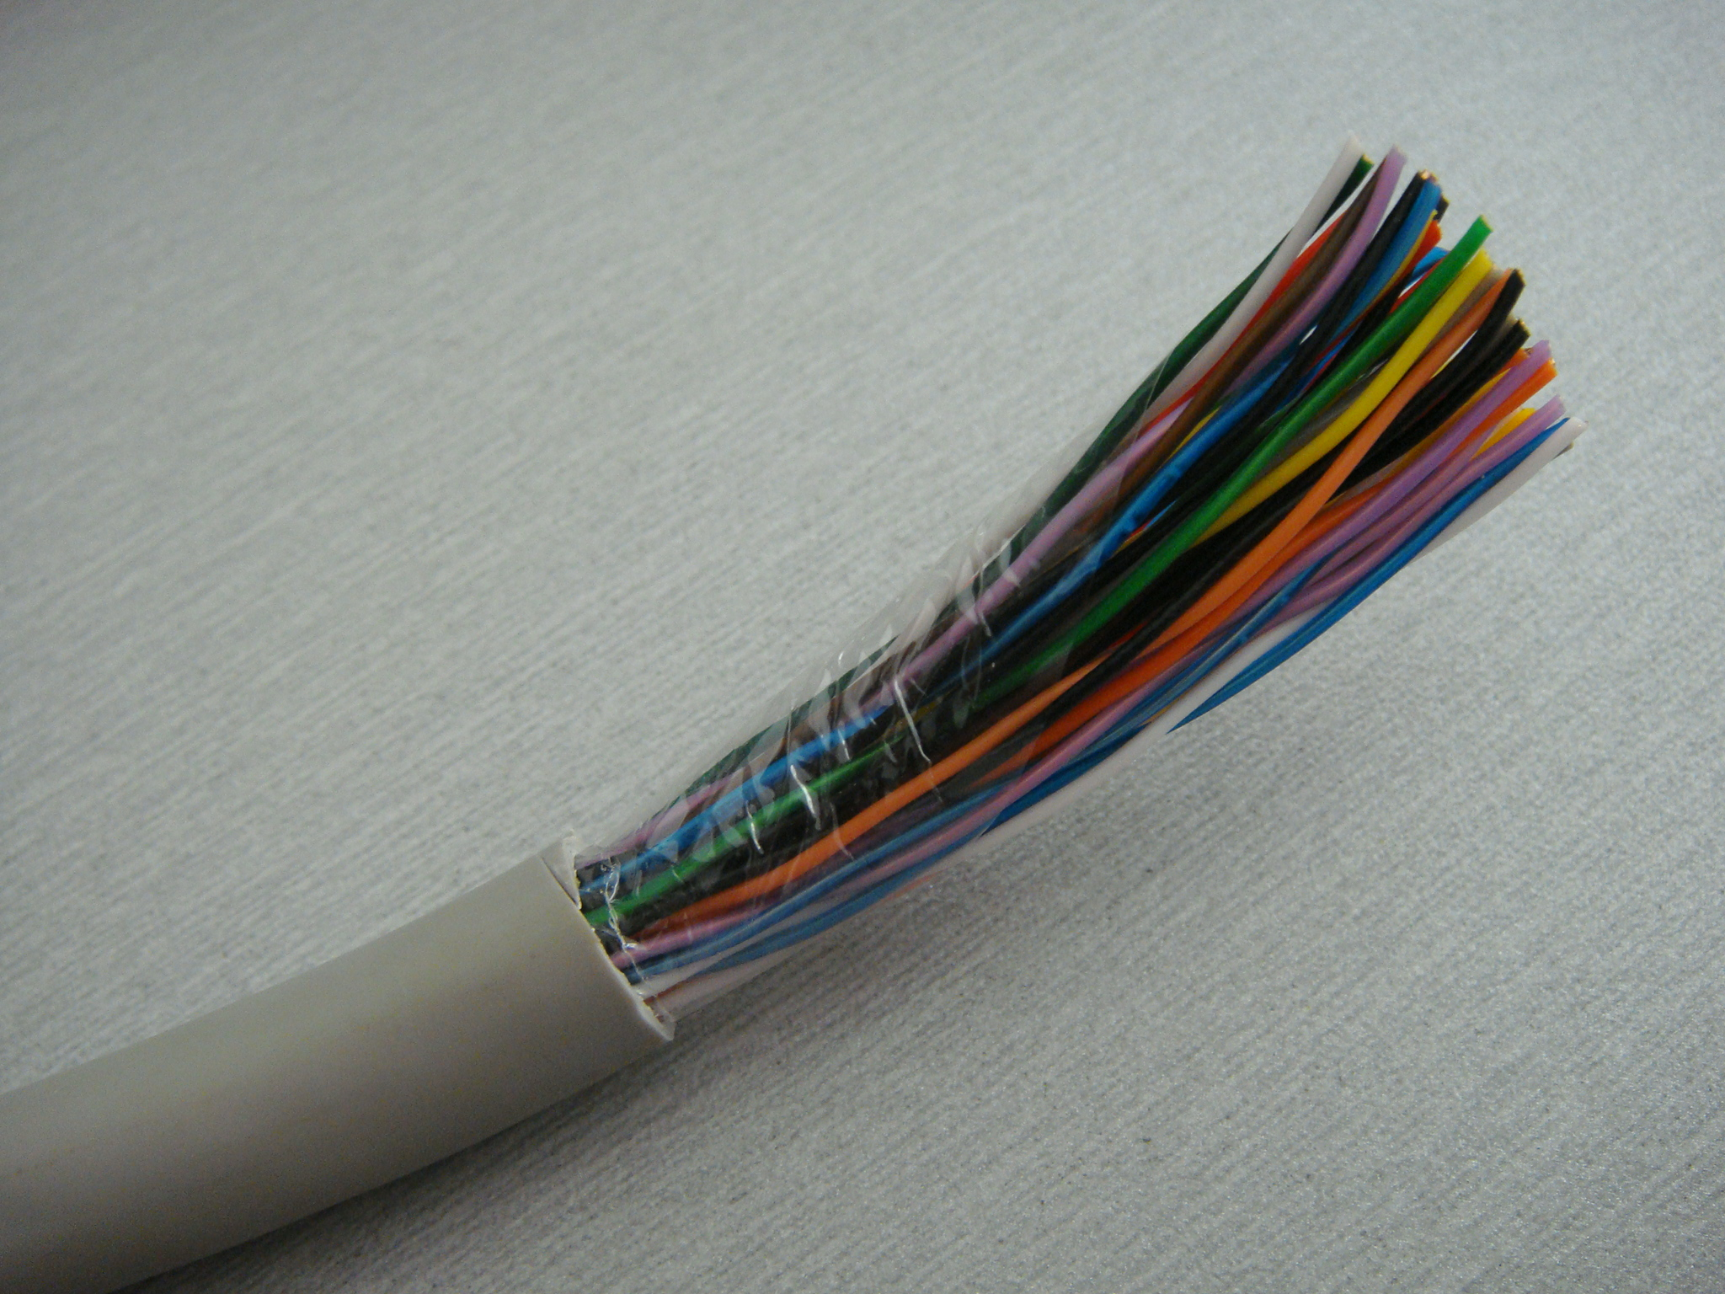
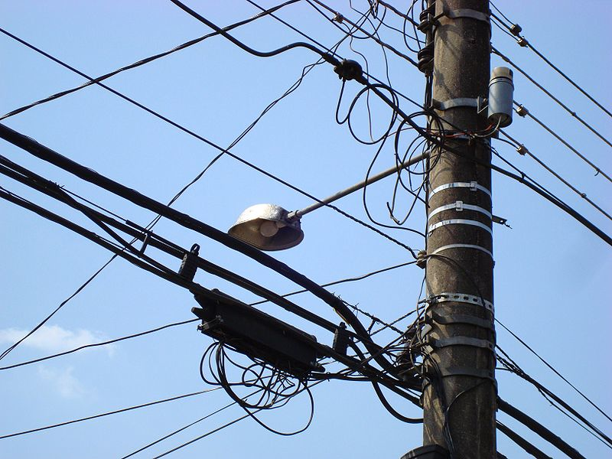
Four separate components
?

Slide 6
Real-time: voice → non-voice
1950—2005: real-time ≡voice
Now: real-time = web interaction + text + voice
Displacement:
  teenage 2-hour chat → Facebook, IM
  coordination & transaction calls → web
    schedule appointments, travel agency, airline, …
  business calls → messaging
  “I’m heading home” → Google Latitude

Slide 7
Time of transition
Old | New
IPv4 | IPv6
circuit-switched voice | VoIP + text
separate mobile voice & data | LTE + LTE-VoIP
911, 112 | NG911, NG112
digital cable (QAM) | IPTV
analog & digital radio | Pandora, Internet radio, satellite radio
credit cards, keys | NFC
end system, peers | client-server v2 aka cloud
all the energy into transition → little new technology

Slide 8
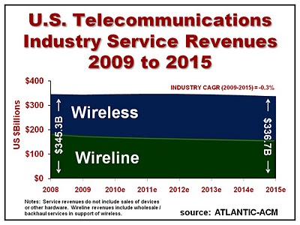
Telecom revenue

Slide 9
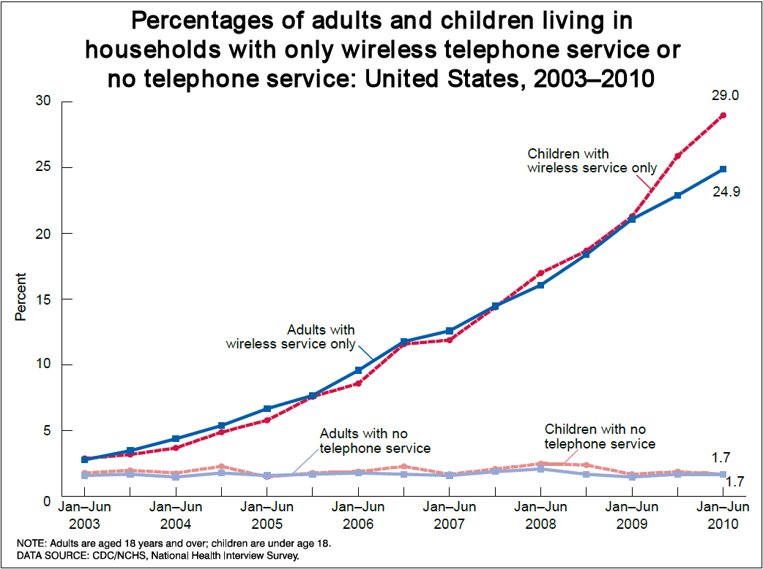

Mobile-only households and demographics (CDC data)
High Wireless Substitution:
Young adults (esp. those ages 24-29)
Renters
Low income (poverty line or below)
Latino/Hispanic
Mobile Phone Trends
4/28/2011
9

Slide 10
Household spending on telecom
→ new services must displace old services
Notes:
Bernstein Research
Source: Bureau of Economic Analysis

Slide 11
Wireless + Internet replace voice

Slide 12
Telephone Social Policies
Universal service (Lifeline, high cost, …) | Necessary to function (call doctor, call school, …)
Basic service price regulation | Ensure widespread availability
911 | Report emergencies for self and others
Power backup | Ensure emergency communications
Outage reporting | Ensure reliability
Lawful intercept (CALEA) | Phone as tool for criminals
Disability access (ringers, HAC) | Ensure participation in society
CPNI | Phone as private medium

Slide 13
PSTN: The good & the ugly
The good | The ugly
Global Connectivity (across devices and providers) | Minimalist service
High reliability (engineering, power) | Limited quality (4 kHz)
Ease of use | Hard to control reachability (ring at 2 am)
Emergency usage | Operator trunks!
Universal access (HAC, TTY, VRS) | No universal text & video
Mostly private (protected content & CPNI) | Limited authentication Security more legal than technical (“trust us, we’re a carrier”)
Relatively cheap (c/minute) | Relatively expensive ($/MB)

Slide 14
Now: the Internet
Universal service | USF reform? (Connect America Fund)
Price | Unregulated, competition?
911 | NG911
Power backup | Cell phones? Responsibility moves to household (UPS)
Outage reporting | FCC Part 4 NPRM multiple access modes
Lawful intercept (CALEA) | Encryption?
Disability access | Twenty-First Century Communications and Video Accessibility Act of 2010?
CPNI | Uncertain privacy rights

Slide 15
It’s just a number
Number | Type | Problem
201 555 1212 | E.164 | same-geographic different dial plans (1/no 1, area code or not) text may or may not work
#250, #77, *677 | voice short code | mobile only, but not all no SMS
12345 | SMS short code | SMS only country unclear
211, 311, 411, 911 | N11 codes | Distinct call routing mechanism Mostly voice-only May not work for VoIP
800, 855, 866, 877, 888 | toll free | not toll free for cell phone may not work internationally
900 | premium | voice only unpredictable cost

Slide 16
Numbers
Administered in blocks by NANPA
  funded by carriers: $5.9M/year
Separate processes for each number type
  Regular E.164 numbers by 1k blocks
Complicated LNP and porting technology
  often takes several phone calls to provider
  takes, at best, several hours
  limited wireline ⇔ wireless porting
  limited wireline out-of-area porting

Slide 17
Numbers vs. DNS & IP addresses
 | Phone # | DNS | IP address
Role | identifier + locator | identifier | locator (+ identifier)
Country-specific | mostly | optional | no
# of devices / name | 1 (except Google Voice) | any | 1 (interface)
# names /device | 1 for mobile | any | any
ownership | carrier, but portability unclear (800#) | property, with trademark restrictions | ISP
who can obtain? | geographically-constrained, carrier only | varies (e.g., .edu & .mil, vs. .de) | enterprise, carrier
porting | complex, often manual; wireline-to-wireless may not work | about one hour (DNS cache) | if entity owns addresses
delegation | companies (number range) | anybody | subnets
identity information | wireline, billing name only | WHOIS data (spotty) | RPKI, whois
Notes:
http://www.nanpa.com/reports/faq.html#g1

Slide 18


Future numbers
Should numbers be treated as names?
  see “Identifier-Locator split” in Internet architecture
Should numbers have a geographic component?
  Is this part of a state’s cultural identity?

Slide 19
More number questions…
Should numbers become personal property?
  Separate service from number
  Simplify number portability
  Can you put a 212 number in your will?
Divorce device from number
  any-to-any, dynamic mapping
Separate user identity & number

Slide 20
Security (trustworthiness)
Practically, mostly about identity, not content
Old model: “trust us, we’re the phone company”
New reality: spoofed numbers & non-carrier entities
  both domestic and international
  → SMS and voice spam
Need cryptographically-verifiable information
  Is the caller authorized to use this number?
  Has the caller ID name been verified?
    cf. TLS

Slide 21
VoIP Interconnection
“IP-IP interconnection” → don’t confuse with IP peering
  VoIP interconnect
Are there technical stumbling blocks?
  SIP features?
    IMS vs. non-IMS?
  Media codecs & conversion?
Separation application layer & transport
$0.000048 / minute for IP transport ($0.10/GB)

Slide 22
Reliability
How do we measure reliability & QoS?
  E.g., MBA project?
Can consumers know how well their voice service will perform?
Can we improve power robustness?
  e.g., DOCSIS modem consumes ~7W (idle)
  Li-Ion battery = 2.5 Wh/$ ➔ 3$/hour of standby time
Can we simplify multihoming to make new PSTN more reliable than old?
  e.g., cable + 4G

Slide 23
Cost issues
VoIP: $8-$25/month
Notes:
FCC Report #1
http://www.census.gov/compendia/statab/2011/tables/11s1147.pdf

Slide 24
The curse of fixed costs
Subscribers decrease → fewer subscribers for same fixed costs
But: switching equipment is written off

Slide 25
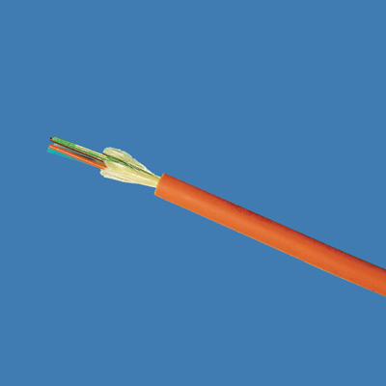
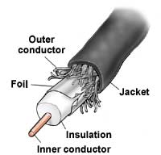

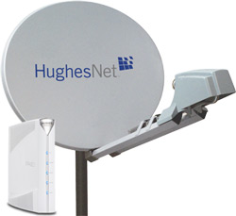

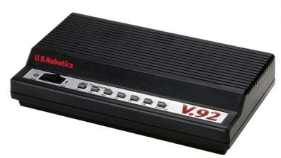
Available access speeds
20 Mb/s
marginal VOIP
10 Mb/s
5 Mb/s
2 Mb/s
1 Mb/s
avg. sustained
throughput
10%
60%
90%
97%
100%
of households

Slide 26
Legacy applications
“Dry” copper loop
Alarm systems
  → transition to cellular (can’t cut wire)
ATMs → wireless, DSL

Slide 27
Public Safety (911 & 112)
Transition to NG911/NG112 underway
Main issues:
  Indoor location for wireless
    location accuracy of 50/150m not sufficient
    need apartment-level accuracy, including floor
    Civic (Apt. 9C, 5 W Glebe), not geo
  Avoid protracted transition
    maintain two infrastructures for decade+?
  National infrastructure →LoST hierarchy

Slide 28
PSTN = more than voice
VoIP = Voice + Video + Vowels (text)
→ Real-time communication as base-level service?
Accommodate new media codecs (e.g., AMR)
See also CVAA “advanced communication systems”
Point-to-point? or multipoint?
Twenty-First Century Communications and Video Accessibility Act

Slide 29
COLR (Carrier of Last Resort)
Must offer service in covered area
No direct equivalent for IP
→ USF

Slide 30
A layered model for regulation
Service layers, not technology
Applications
Enhanced
Services
Unregulated
Applications
ISPs
TCP / IP
Dial Up
Basic Service
Regulated
1980
Notes:
Another way of looking at this.
Examples of title II regulations: interconnection, universal service, access charges, privacy, filing, disabled access, interoperability, disclosure, CALEA, and anti-discrimination requirements.
When the FCC says that the Internet is unregulated, this is largely what it is talking about. You, as ISPs, are not certified by the FCC. You do not have your rates approved by the FCC. And you have no obligations like interconnection or universal service.
I might note that the Telecom Act of 1996 introduced a new legal term: Information service providers. This means essentially the same thing as “Enhanced Service Providers.”
The layers are fully separate.
They are provisioned by separate service providers.
I can point to the the different equipment. Different equipment services the different layers.
And of course, the different layers represent separate (though dependent) markets.

Slide 31
Voice, transport and access
1880s-1980s
1980s-2000s
Now - future
Voice
Apps
Apps
Enhanced
IP
IP
Voice
Voice
Basic
Transport
Transport
Transport
Notes:
Bob Cannon

Slide 32

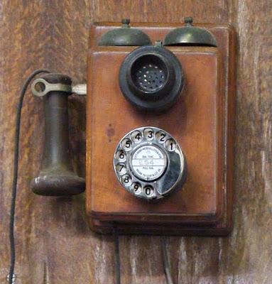
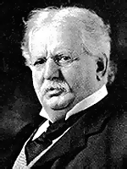
Evolution of competition
Assumption: competition desirable and efficient
voice
CLEC
OTT
VoIP
CLEC
OTT
VoIP
transport
ILEC/CMRS
CATV
Theodore Vail
AT&T
ILEC
ILEC
1876
1930
1984
1996
2003
2010-

Slide 33
2 Internet futures
content and applications
content production (*)
content distribution
CDN
broadband access
local infrastructure
regional and national backbone
Google
Chatroulette
IP
Level 3
vs.
fiber or copper loop
(“Homes with tails”)
RCN
AT&T
Comcast/NBC (*)
Verizon
Notes:
see old MCI functional separation

Slide 34
Scenario 1: max. competition
content & application providers
consumers
applications
(Netflix, Pandora, your blog)
web browser
(Firefox, IE, Chrome, …)
OS
(Windows Server, Linux, MacOS)
OS
(Windows, Android, MacOS)
data centers
(Equinix, Amazon, …)
system platform
(Intel, ARM, …)
wide area network
(Qwest, Sprint, VZ, TeliaSonera, NTT, DTAG, Level 3, AT&T)
ISP
(competing)
fiber, radio
(regulated monopoly)
conduit
(public)

Slide 35
Scenario 2: vertically integrated
4 Mb/s
100 Mb/s to consumer
classical Internet
(web)
Internet
interactive multimedia (IMS)
video
(live, VOD)
small operators
Google
incumbent operator (e.g., AT&T, Verizon)
cable company (sometimes)

Slide 36
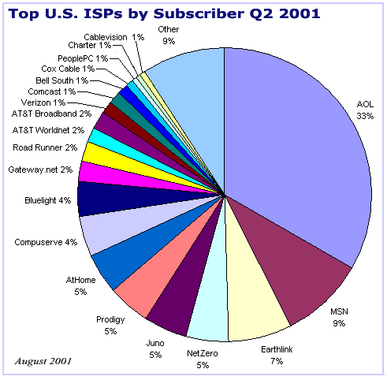
Eyeball ISPs: 2001 vs. 2010
Notes:
AT&T: http://www.everythingdsl.com/att/: 7.8 M; http://www.att.com/Investor/Financial/Earning_Info/docs/Supp_IB_4Q10.xls: 14.3M
Comcast: http://files.shareholder.com/downloads/CMCSA/1209582425x0x441905/918e0cf1-4a90-4575-9535-0c51452950da/Comcast_Q4Trending_2.15.11.pdf: 16.988
TW: http://phx.corporate-ir.net/External.File?item=UGFyZW50SUQ9NzkxMTJ8Q2hpbGRJRD0tMXxUeXBlPTM=&t=1: 9.469 + 0.349 = 9.803M
VZ: http://investor.verizon.com/financial/annual/2010/mda03_02.html: 8.392 BB + 4.082 FiOS = 12.474M
Windstream: http://www.snl.com/Cache/10782778.pdf?O=3&IID=4121400&OSID=9&FID=10782778 = 1.3M
Charter: http://phx.corporate-ir.net/External.File?item=UGFyZW50SUQ9ODM2ODl8Q2hpbGRJRD0tMXxUeXBlPTM=&t=1 = 3.24M
Qwest: http://investor.qwest.com/download/4Q.2010.Q.Profile.FINAL.pdf = 2.9 M
Cablevision: http://phx.corporate-ir.net/External.File?item=UGFyZW50SUQ9ODE3NjZ8Q2hpbGRJRD0tMXxUeXBlPTM=&t=1 = 2.892M
CenturyLink: http://phx.corporate-ir.net/External.File?item=UGFyZW50SUQ9NDEzODgyfENoaWxkSUQ9NDI1MjcxfFR5cGU9MQ==&t=1 = 2.394M
Mediacom: 838,000

Slide 37
What is network neutrality?
“The principle advocates no restrictions by Internet service providers and governments on content, sites, platforms, the kinds of equipment that may be attached, and the modes of communication.” (Wikipedia)
2005 FCC statement:
  “access the lawful Internet content of their choice.
  run applications and use services of their choice, subject to the needs of law enforcement.
  connect their choice of legal devices that do not harm the network.
  competition among network providers, application and service providers, and content providers.”
= Any lawful content, any lawful application, any lawful device, any provider

Slide 38
Two views
Open Internet advocates
Free market advocates
no prioritization
flat rates
all networks
no real problem
allow any business arrangement
“it’s my network”
use anti-monopoly laws if needed

Slide 39
Why?
Civic considerations
  freedom to read (passive)
  freedom to discuss & create (active)
Economic opportunity
  edge economy >> telecom economy
    Telecom revenue (US): $330B
    Content, etc. not that large, however
      Google: $8.44B
    others that depend on ability to provide services
  content, application, service providers
Technical motivation
  avoid network fragmentation
  reduce work-around complexity

Slide 40
How to be non-neutral
deep packet inspection
block Skype
application
block transport protocol
block UDP & TCP ports
insert TCP RST
transport
all affect
VoIP
block IP addresses
QoS discrimination
network

Slide 41
Are these neutrality issues?
Redirect DNS NXDOMAIN to ISP web site
Content translation
  e.g., reduce image resolution for cellular data
Blocking transport protocols other than UDP + TCP
Prohibit web servers
Reset DSCP (ToS bits)
Not allow IPv6
3GPP: only make non-BE available to carrier

Slide 42
Some high-profile cases
Madison River (2005)
  DSL provider blocked SIP ports
  fined $15,000 by FCC
Comcast (late 2007)
  insert TCP RST into BitTorrent traffic
  later overturned on appeal in DC Circuit Court
RCN (2009): P2P
Various mobile operators
Comcast vs. Level 3 (2010, in dispute)
  Level-3
Notes:
http://hraunfoss.fcc.gov/edocs_public/attachmatch/DA-05-543A1.pdf
http://www.zeropaid.com/news/88573/comcast-prevails-in-bittorrent-throttling-case/

Slide 43
Network neutrality & freedom of speech
1st amendment: Congress shall make no law abridging the freedom of speech
Applies only to U.S. government, not private entities
  Example: soap box in city park vs. mall
  private vs. public universities
Freedom to speak + no forced speech
  demise of “fairness doctrine” (2011 final)

Slide 44
Network transparency
RFC 1958: “Architectural Principles of the Internet”
However, in very general terms, the community believes that the goal is connectivity, the tool is the Internet Protocol, and the intelligence is end to end rather than hidden in the network.
RFC 2275: “Internet Transparency”
  NATs, firewalls, ALGs, relays, proxies, split DNS
RFC 3724: “The Rise of the Middle and the Future of End-to-End: Reflections on the Evolution of the Internet Architecture”
RFC 4924: “Reflections on Internet Transparency”
  A network that does not filter or transform the data that it carries may be said to be "transparent" or "oblivious" to the content of packets. Networks that provide oblivious transport enable the deployment of new services without requiring changes to the core. It is this flexibility that is perhaps both the Internet's most essential characteristic as well as one of the most important contributors to its success.

Slide 45
Network transparency and neutrality
neutral
transparent
QoS discrimination
pay for priority
block protocol features

Slide 46
Means, motive and opportunity
Political motivation
  suppress undesirable opinion
    e.g., union web site, abortion SMS
Economic advantage
  prevent competition in related services
    e.g., VoIP or over-the-top VoD
  leverage pricing power
    OTT content provider has to offer service to everyone
  market segmentation
    consumer vs. business customers
Non-tariff barriers
  e.g., special (undocumented) APIs
Notes:
http://en.wikipedia.org/wiki/Means,_motive,_and_opportunity

Slide 47
Open Internet FCC history
2004: “four freedoms” (Powell)
2005: Internet policy statement (Martin)
9/2009: Genachowski speech
  non-discrimination, transparency
12/2009/: NPRM
9/2010: PN
12/2010: Open Internet rules
10,000+ short comments, hundreds of long comments
Notes:
http://www.openinternet.gov/
http://www.openinternet.gov/read-speech.html

Slide 48
Who is covered?
Broadband Internet Access Service = A mass-market retail service by wire or radio that provides the capability to transmit data to and receive data from all or substantially all Internet endpoints, including any capabilities that are incidental to and enable the operation of the communications service, but excluding dial-up Internet access service. This term also encompasses any service that the Commission finds to be providing a functional equivalent of the service described in the previous sentence, or that is used to evade the protections set forth in this Part.
excludes
dial-up
coffee shops, bookstores, airlines (premise operators)
“edge providers”: CDNs, search engines, …

Slide 49
Principles
Transparency. Fixed and mobile broadband providers must disclose the network management practices, performance characteristics, and terms and conditions of their broadband services;
No blocking. Fixed broadband providers may not block lawful content, applications, services, or non-harmful devices; mobile broadband providers may not block lawful websites, or block applications that compete with their voice or video telephony services
No unreasonable discrimination. Fixed broadband providers may not unreasonably discriminate in transmitting lawful network traffic.

Slide 50
FCC Open Internet order
 | Wired | Wireless
Disclosure | yes | yes
Non-blocking | every protocol | “web”, “VoIP”
Non-discrimination | reasonable network management | “monitor”

Slide 51
FCC Open Internet order
CFR text: 1 page
Main content: 85 pages
  with 500 footnotes
Regulatory Flexibility Analysis
5 commissioner statements: 60 pages

Slide 52
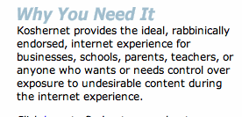
Some corner cases
Parental protection
  user (paying subscriber…) choice
KosherNet
Spam
  would only affect IP-level blocking
DOS
  classified as unwanted traffic
Notes:
http://www.koshernet.com/

Slide 53
47 CFR 8
§ 8.1 Purpose.
  The purpose of this Part is to preserve the Internet as an open platform enabling consumer choice, freedom of expression, end-user control, competition, and the freedom to innovate without permission.
§ 8.3 Transparency.
  A person engaged in the provision of broadband Internet access service shall publicly disclose accurate information regarding the network management practices, performance, and commercial terms of its broadband Internet access services sufficient for consumers to make informed choices regarding use of such services and for content, application, service, and device providers to develop, market, and maintain Internet offerings.

Slide 54
Disclosure (Transparency) – Network Practices
Congestion management: congestion management practices; types of traffic; purposes; practices’ effects on end users’ experience; criteria used in practices, such as indicators of congestion that trigger a practice, and the typical frequency of congestion; usage limits and the consequences of exceeding them; and references to engineering standards, where appropriate.
Application-Specific Behavior
Device Attachment Rules
Security

Slide 55
Disclosure (Transparency) – Performance
Service description: A general description of the service, including the service technology, expected and actual access speed and latency, and the suitability of the service for real-time applications.
Impact of specialized services: If applicable, what specialized services, if any, are offered to end users, and whether and how any specialized services may affect the last-mile capacity available for, and the performance of, broadband Internet access service.

Slide 56
Disclosure (Transparency) – Commercial Terms
Pricing: For example, monthly prices, usage-based fees, and fees for early termination or additional network services.
Privacy Policies: For example, whether network management practices entail inspection of network traffic, and whether traffic information is stored, provided to third parties, or used by the carrier for non-network management purposes.
Redress Options: Practices for resolving end-user and edge provider complaints and questions.

Slide 57
Conclusion
Multi-pronged attack on PSTN
  transition to mobile for consumers
  cable VoIP
  less voice, more text
  Ethernet phones + IP PBX + SIP trunking for business
Separate PSTN vs. copper infrastructure
Challenges mostly in retaining PSTN policy goals
  reliability, affordability, accessibility, ubiquity

