Slide 1
Faster, Cheaper, Safer: Public Policy for the Internet
Henning Schulzrinne
FCC (& Columbia University)
Any opinions are those of the author and do not necessarily reflect the views or policies
of Columbia University or the FCC.
with slides by Julie Knapp, Walter Johnston, Karen Peltz-Strauss, and others

Slide 2
Overview
Public policy as technology enabler
Broadband: faster, cheaper, safer
Transitioning the PSTN to the 21st century

Slide 3
Time of transition
Old | New
IPv4 | IPv6
circuit-switched voice | VoIP + text
separate mobile voice & data | LTE + LTE-VoIP
911, 112 | NG911, NG112
digital cable (QAM) | IPTV
analog & digital radio | Pandora, Internet radio, satellite radio
credit cards, keys | NFC
end system, peers | client-server v2 aka cloud
all the energy into transition → little new technology

Slide 4
Public policy as technology enabler
Classical public policy goals
  market failures
  consumer protection (e.g., bill shock, robocalls)
  safety (e.g., RF limits)
  universal availability (geography, income, disability)
Spreading technology
  enable at scale
  make mandatory → scale, ecosystems
  new uses

Slide 5

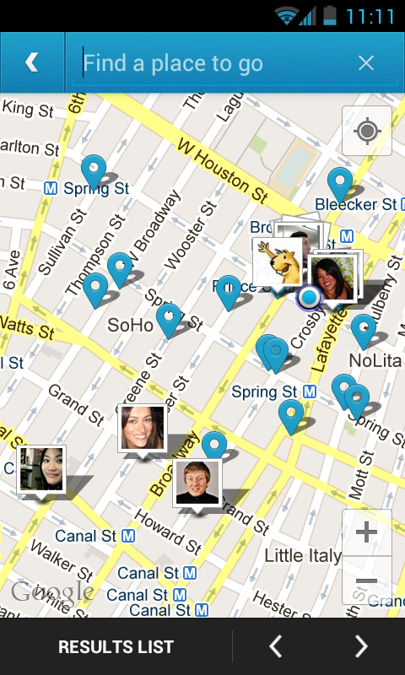
Policy → technology
Part 15 (“unlicensed”)
  since 1938
  major revision 1989
    higher frequencies
    unintentional, incidental, intentional
    authorized devices
  → WiFi
GPS in cell phones
  E911 rules
  → location-based services
Notes:
http://papers.ssrn.com/sol3/papers.cfm?abstract_id=1120465

Slide 6

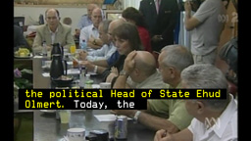
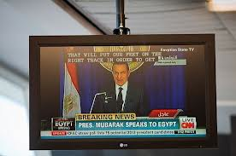

Policy → technology
Closed captioning
  initially, for Deaf and Hard of Hearing
  migrated to
    airports
    doctor’s offices
    sports bars
  enables text-based retrieval

Slide 7
Policy → technology
Future opportunities:
  indoor location
  Video relay service = first multimedia phone-number-based interoperable real-time communication solution
  dynamic spectrum access (“TV white spaces”)

Slide 8
Cisco’s traffic prediction
Ambient video = nannycams, petcams, home security cams, and other persistent video streams
Notes:
http://www.cisco.com/en/US/solutions/collateral/ns341/ns525/ns537/ns705/ns827/white_paper_c11-481360_ns827_Networking_Solutions_White_Paper.html

Slide 9



Bandwidth costs
Amazon EC2
  $50 - $120/TB out, $0/TB in
CDN (Internet radio)
  $600/TB (2007)
  $10-30/TB (Q1 2012 – CDNpricing.com)
NetFlix (7 GB DVD)
  postage $0.70 round-trip → $100/TB
FedEx – 2 lb disk
  5 business days: $6.55
  Standard overnight: $43.68
  Barracuda disk: $91 - $116/TB
Notes:
FedEx and EC2 prices as of 09/15/09
CDN: http://www.mindbranch.com/listing/product/R678-29.html
http://www.cdnpricing.com/

Slide 10
The value of bits
Technologist: A bit is a bit is a bit
Economist: Some bits are more valuable than other bits
  e.g., $(email) >> $(video)
Application | Volume | Cost per unit | Cost / MB | Cost / TB
Voice (13 kb/s GSM) | 97.5 kB/minute | 10c | $1.02 | $1M
Mobile data | 5 GB | $40 | $0.008 | $8,000
MMS (pictures) | < 300 KB, avg. 50 kB | 25c | $5.00 | $5M
SMS | 160 B | 10c | $625 | $625M
Notes:
T-Mobile 2010
AT&T data
http://www.nowsms.com/discus/messages/12/8500.html

Slide 11
Principles
Transparency. Fixed and mobile broadband providers must disclose the network management practices, performance characteristics, and terms and conditions of their broadband services;
No blocking. Fixed broadband providers may not block lawful content, applications, services, or non-harmful devices; mobile broadband providers may not block lawful websites, or block applications that compete with their voice or video telephony services
No unreasonable discrimination. Fixed broadband providers may not unreasonably discriminate in transmitting lawful network traffic.

Slide 12
Spectrum

Slide 13

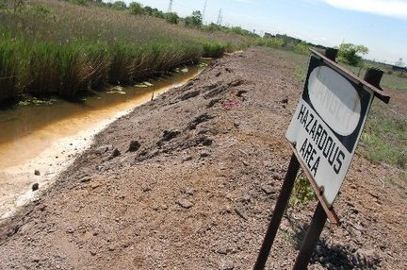
From beachfront spectrum to brownfield spectrum

Slide 14
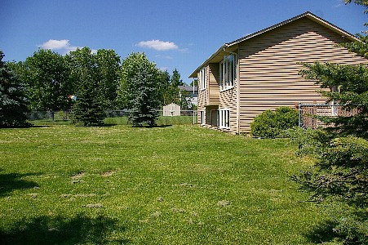
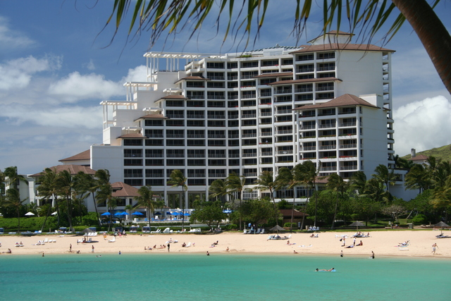
From empty back yard to time share condo

Slide 15
Spectral efficiency
b/s/Hz: modulation, FEC, MIMO, …
but also total spectral efficiency
  guard bands
  restrictions on adjacent channel usage
  “high power, high tower” → small cells → higher b/s/Hz
data efficiency
  e.g., H.264 is twice as good as MPEG-2/ATSC
  and maybe H.265 twice as good as H.264
distribution efficiency
  unicast vs. multicast
protocol efficiency
  avoid polling → need server mode
mode efficiency
  caching
  side loading
  pre-loading

Slide 16
What can we do?
end system caching
better audio & video codecs
efficient apps
IP multicast
WiFi offload
small cells = better spectral efficiency + more re-use
spectral efficiency (LTE-A)
directional antennas
general purpose spectrum
dense cells
white spaces & sharing
LTE: 1.5 b/s/Hz
GSM: 0.1 b/s/Hz

Slide 17
cellular = about 500 MHz in total

Slide 18
Unlicensed & lightly-licensed bands (US)
UHF (476-700 MHz) – incentive auctions (licensed) + some unlicensed
2.4 GHz (73 MHz) – 802.11b/g
3.6 GHz (100 MHz) – for backhaul & WISPs
4.9 GHz (50 MHz) – public safety
5.8 GHz (400 MHz) – 802.11 a/n
  much less crowded than 2.4 GHz
  supported by many laptops, few smartphones

Slide 19

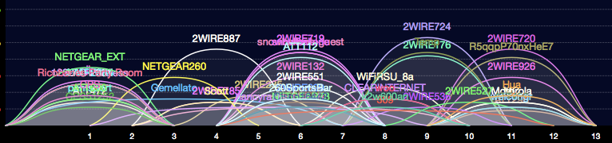
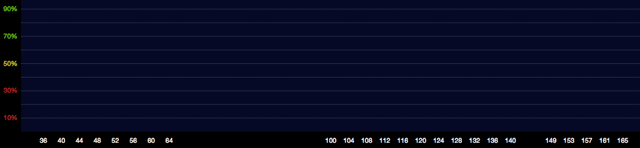
2.4 vs. 5.8 GHz

Slide 20
Freeing spectrum: incentive auctions
Incentive auctions will share auction proceeds with the current occupant to motivate voluntary relocation of incumbents
  Otherwise, no incentive for current occupant to give back spectrum
  Stations keep current channel numbers
    via DTV map
Adjacent Channel
Interference
TV
TV
BB
TV
BB
TV
Without Realignment:
Reduced Broadband Bandwidth
Adjacent Channel
Interference
TV
TV
TV
TV
BB
With Realignment: Accommodates Increased Broadband Bandwidth

Slide 21

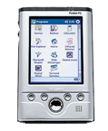

Small cell alternatives
Femto cells
  use existing spectrum
  need additional equipment
WiFi off-load
  use existing residential equipment
  5G networks = heterogeneous networks?
Distributed antenna systems
Cellular
Femto-cells
Distributed Antenna Systems
Signals are distributed throughout the
Building via amplifiers/antennas

Slide 22


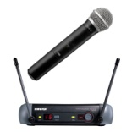

TV white spaces
TV channels are “allotted” to cities to serve the local area
Other licensed and unlicensed services are also in TV bands
“White Spaces” are the channels that are “unused” at any
given location by licensed devices
2
4
Non-
Broadcast
spectrum
5
7
9
White
Space
Low
Power TV
Wireless
Microphones
New York City
Full Power
TV Stations
Etc.
Only for illustrative purposes
3
Non-
Broadcast
spectrum
6
8
10
White
Space
White
Space
White
Space
Low
Power TV
Wireless
Microphones
Philadelphia
Full Power
TV Stations
Etc.

Slide 23

Spectrum Outlook
No single solution:
  reduce spectrum usage
    caching & better modulation
  re-use spectrum
  re-cycle old spectrum

Slide 24
Broadband

Slide 25
Broadband
Deployment
  USF: Connect America Fund
Performance
  Measuring Broadband America
  mobile tba
Significant progress:
  wider availability of 100 Mb/s
  fiber available to 46 million homes (FiOS, Uverse)
  community/non-traditional broadband (Chattanooga, KC)
  LTE networks

Slide 26
What Was Measured
Sustained Download | Burst Download
Sustained Upload | Burst Upload
Web Browsing Download | UDP Latency
UDP Packet Loss | Video Streaming Measure
VoIP Measure | DNS Resolution
DNS Failures | ICMP Latency
ICMP Packet Loss | Latency Under Load
Total Bytes Downloaded | Total Bytes Uploaded

Slide 27
Advertised vs. actual 2012

Slide 28
Significantly better than 2011

Slide 29
Latency by technology

Slide 30
Data usage

Slide 31
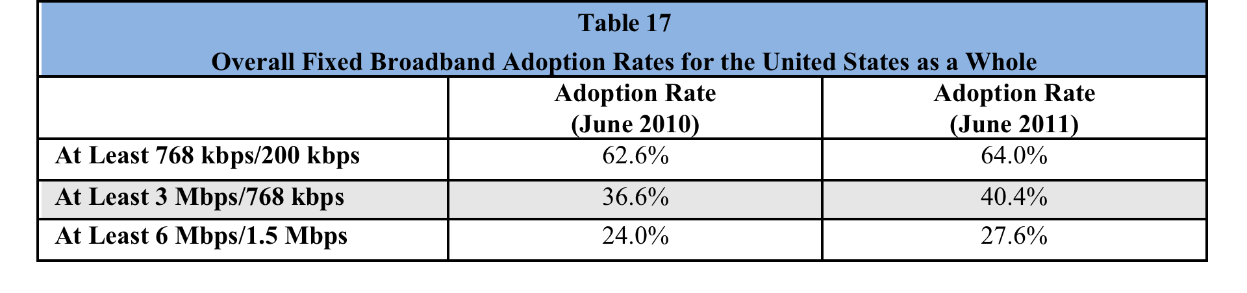
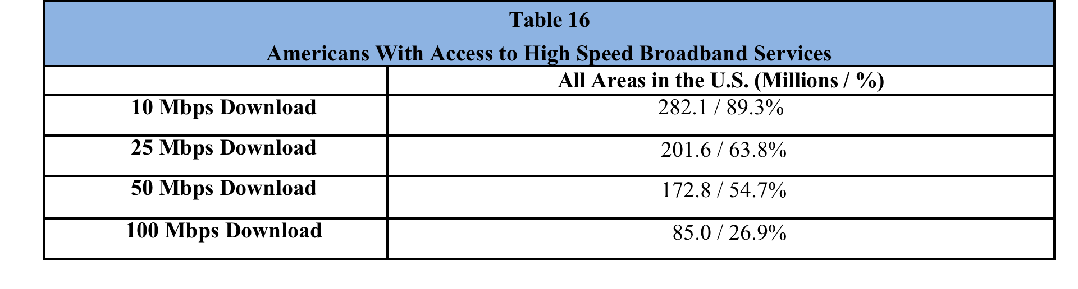
Broadband adoption
Eighth Broadband Progress Report, August 2012

Slide 32
Access to broadband
Eighth Broadband Progress Report, August 2012

Slide 33
Competition (US)
if lucky, incumbent LEC + cable company
  DSL: cheaper, but low speed
    mean: 2.5 – 3.5 Mb/s
  FTTH (FiOS): 21M households
    10-100 Mb/s
  Cable: > $50/month, higher speeds
    8-50 Mb/s
often, high switching costs ($200 early termination fee)
  or tied to bundles (TV, mobile)
can’t easily predict whether problems would be different
Notes:
http://s.ftthcouncil.org/files/RVA.FTTH_.Apr09.060109.pdf

Slide 34
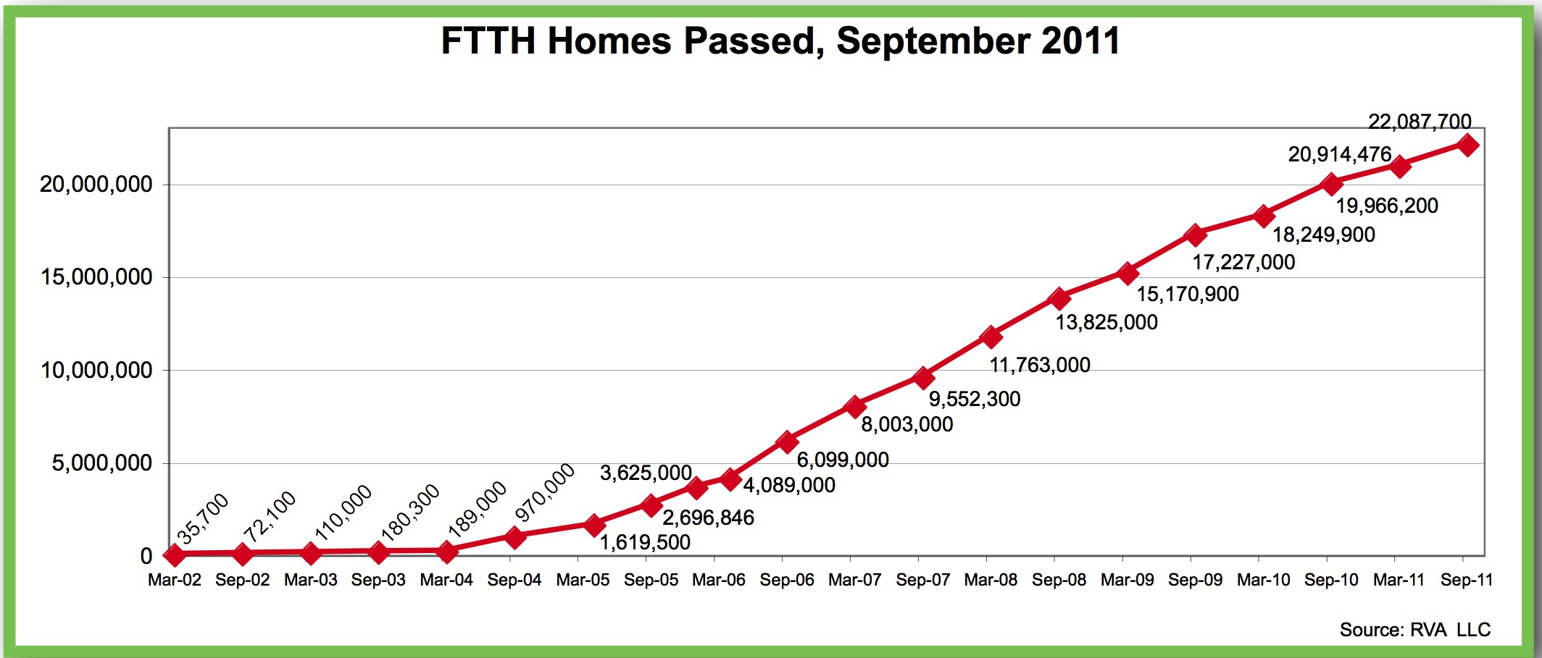
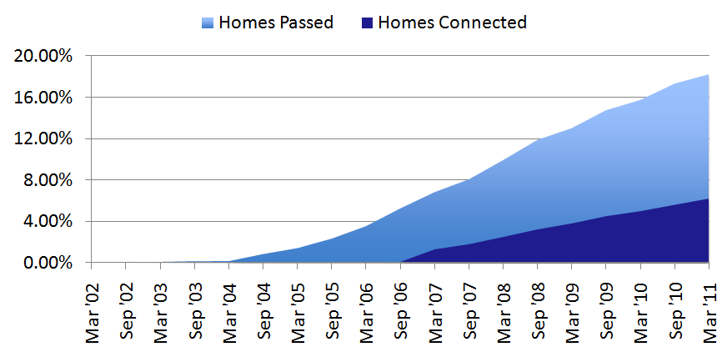
FTTH

Slide 35
State of competition (US)
FCC: Internet Access Services Status as of December 31, 2009
Notes:
http://www.fcc.gov/Daily_Releases/Daily_Business/2010/db1208/DOC-303405A1.pdf: Internet Access Services: Status as of December 31, 2009

Slide 36
International comparison: fixed
3rd International Broadband Data Report (IBDR), August 2012

Slide 37
International comparison: mobile
3rd International Broadband Data Report (IBDR), August 2012

Slide 38
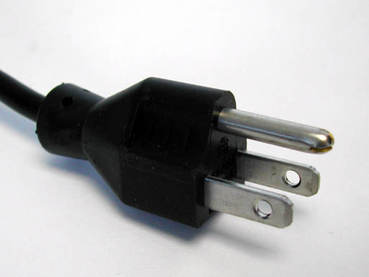
Need for speed
Networks should be transparent →
  don’t interfere with application
  don’t limit performance
Peak speed + upstream bandwidth → important for productive rather than consumptive appliations
Local area networks: 100 Mb/s or 1 Gb/s
Cost of hybrid fiber-X networks largely independent of peak speed
  wide-area traffic: $2-5/month for 100 GB

Slide 39

Broadband challenges
Engineering
  simplify deployment: “fiberhoods”, self installation, on-pole wireless, …
Economical
  cost is driven by homes passed, not homes served
  cost mostly independent of speed → single price point?
  built-in broadband, not bolted on
    pay via mortgage → lower ROI expectations
Policy
  FCC: “dig once”, pole attachments, Federal buildings and lands
  encourage municipal conduit deployment

Slide 40
Broadband virtuous cycle
fixed broadband
cellular broadband
applications
(e-learning, telemedicine, telework, …)
adoption
(relevance)
broadband availability

Slide 41

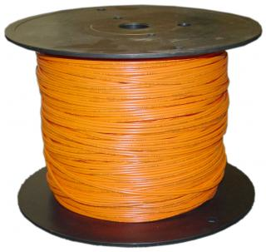
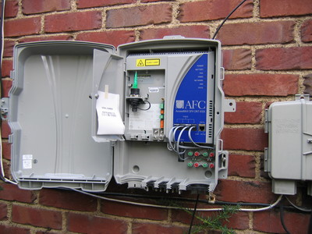
Broadband cost
30%
70%

Slide 42
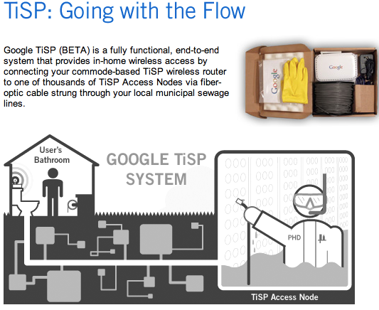
Maybe revisit?
Google
April 1, 2007

Slide 43
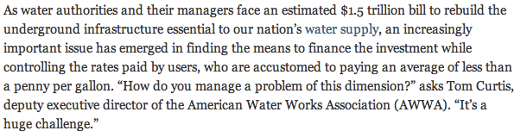
Water + broadband
Notes:
http://americancityandcounty.com/infrastructure/financing-long-term-water-infrastructure-needs-remains-fluid-situation

Slide 44
Easing the PSTN into the 21st century
        Henning Schulzrinne

Slide 45
PSTN: The good & the ugly
The good | The ugly
Global Connectivity (across devices and providers) | Minimalist service
High reliability (engineering, power) | Limited quality (4 kHz)
Ease of use | Hard to control reachability (ring at 2 am)
Emergency usage | Operator trunks!
Universal access (HAC, TTY, VRS) | No universal text & video
Mostly private (protected content & CPNI) | Limited authentication Security more legal than technical (“trust us, we’re a carrier”)
Relatively cheap (c/minute) | Relatively expensive ($/MB)

Slide 46
What are key attributes?
Universality
  reachability → global numbering & interconnection
  media → HD audio, video, text
  availability → universal service regardless of
    geography
    income
    disability
  affordability → service competition + affordable standalone broadband
Public safety
  citizen-to-authority: emergency services (911)
  authority-to-citizen: alerting
  law enforcement
  survivable (facilities redundancy, power outages)
Quality
  media (voice + …) quality
  assured identity
  assured privacy (CPNI)
  accountable reliability

Slide 47
What is less important?
 | Signaling | Media
Analog | circuit (A) | circuit (A)
Digital | circuit (D) | circuit (D)
AIN | packet (SS7) | circuit (D)
VoIP | packet (SIP) | packet (RTP)
Technology
  wired vs. wireless
    but: maintain quality if substitute rather than supplement
  packet vs. circuit
  “facilities-based” vs. “over-the-top”
    distinction may blur if QoS as a separable service
Economic organization
  “telecommunication carrier”
Legal framework
  may be combination: Title I, Title II, VoIP rules, CVAA, CALEA, ADA, privacy laws, …

Slide 48
Going forward
In progress
  Intercarrier compensation: IP interconnection encouragement + transition to bill-and-keep
  NG911, video relay services
To do
  numbering & databases
  security model (robocalls, text spam, vishing)
  interconnection model

Slide 49
Conclusion
Dramatic transition of technology
  special purpose → general purpose
  stove pipes → IP
  narrowband → broadband
  digital PSTN → IP PSTN
Wireline + wireless deployment
Regulator as technology enabler

