Slide 1
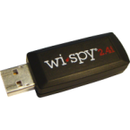
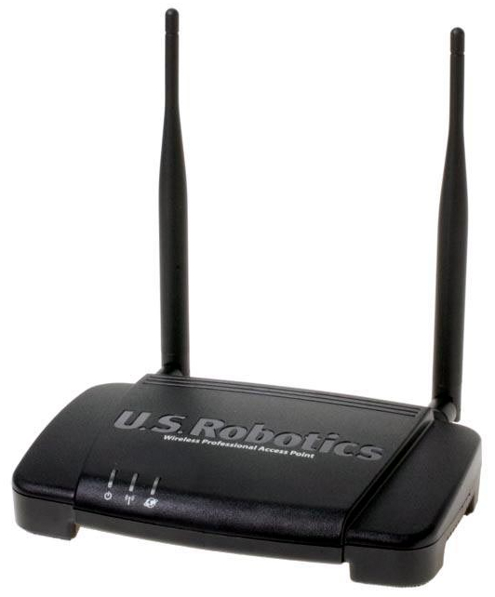
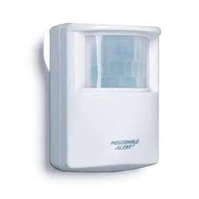
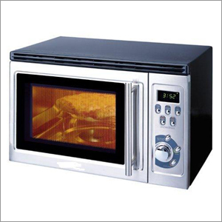
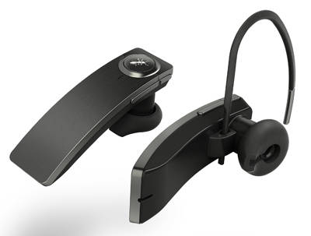
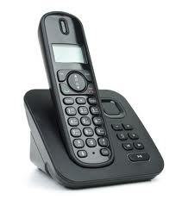
Identifying Wi-Fi Interference by End-Users
Richard Meng, Xiang Ying Qian, Kyung-Hwa Kim, Henning Schulzrinne
Dept. of CS and EE, Columbia University in the City of New York
Motivation & Background
Goal
Architecture
Identifying causes of WLAN performance degradation is nontrivial
Most access points (IEEE 802.11b / IEEE 802.11g) are deployed in the 2.4GHz wireless band, which causes network interference
Most significant interference sources:
Difficult for end-users to identify the devices that cause Wi-Fi interference
Existing solution:
  Spectrum Analysis
    Additional hardware is required (e.g., Wi-Spy)
  Monitors RF activity within a given frequency range
  (Wi-Spy by Metageek, $84, metageek.net)
Our goal is to identify the source of Wi-Fi interference without any hardware support.
  Monitor and analyze the patterns of various parameters related to Wi-Fi performance.
  Obtain data from other collaborative nodes to see whether others also observe the same interference
  Train the pattern analyzer with the dataset obtained from different environments and nodes
  Provide users the best matched devices that are supposed to cause the interference
Is there a microwave oven nearby your laptop?
Is there a Bluetooth device nearby your wireless router?
  Channel Contention
  Neighboring
  Channels
  Non-WiFi interference
Implementation & Experiment
Preliminary Measurement
Results & Future work
Interference measurement
  Existing waves makes measuring interference difficult
  We measured network throughput, SNR, 802.11 retry counter, and other variables to infer a characteristic of current interference.
Implementation
  On Linux: Analyze the information of Radiotap 802.11 header in the data link frames captured by integrating Wireshark, Jpcap, and Alpacka library.
  On Windows: Analyze built-in parameters in network systems collected by Windows Native Wi-Fi API.
Experiment setup
  802.11g Cisco Linksys AP (Channel 1,6,7)
  Measurement on laptops
  Experiment with and without microwave ovens / Bluetooth devices
  Sharing information using DYSWIS^{[1]} framework
In our experiment, Bluetooth devices and microwave ovens showed different patterns (e.g., the magnitude of standard deviation of retry count, percentage of ACK failures, i.e. microwave oven tends to cause more unstable network condition)
This result enables to identify some interference sources.
  However, the patterns are difficult to be resolved by human.
A Machine learning method is needed to achieve more accurate identification of interference sources
References
[1] DYSWIS, Collaborative network fault diagnosis,
Kyung-Hwa Kim, Vishal Singh, Henning Shulzrinne

