Slide 1
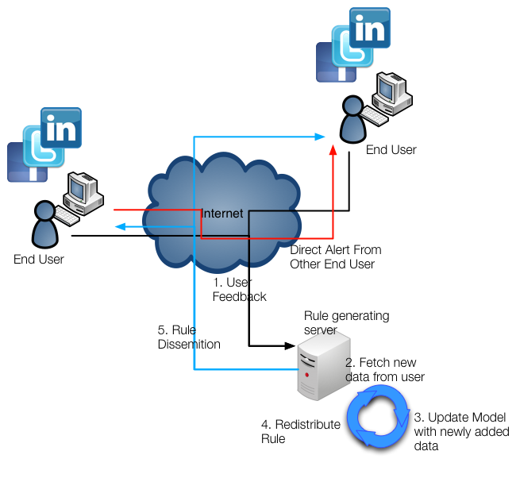
An Architecture of Crowdsourced Intrusion Detection System
Daniel Song, Kyung Hwa Kim, Henning Schulzrinne
Dept. of CS, Columbia University in the City of New York
Motivation
Goal
Collaborative Intrusion Detection
Firewalls focus on intrusion from outside.
What about the malicious attempt from the inside?
It is difficult to detect whether an outgoing traffic is a malicious traffic, so we suggest a system that
  asks the user about the traffic.
  collects the data and learns from it.
Collaborative method can strengthen the IDS but different people have different knowledge on computer.
Detect suspicious outbound traffic of a host to find out whether the host is compromised.
Use users’ feedbacks as a training set of a supervised anomaly detection.
Differentiate the user using Social Network services like linked-in.
Different user will have different trust factor based on Social Network profile. (e.g network experts will have higher initial tf)
Rule Engine
Supervised Machine Learning
Trust Factor
Trust factor (tf) is first determined by social network profile.
tf will change overtime based on the quality of the data. (e.g if the user continuously create noise data, lower the tf)
Data from the network admin has higher tf.
Social Network
User
Rule Engine
Gather user
Feedbacks
Anomaly Detector
Alert user for unusual traffic
Data from different
user have different trust factor
Alert
Future Work
DYSWIS (Traffic Capture)
Experiment using simple linux program like nmap.
Experiment using real malware.
Deploy tools and gather real data.
Network Traffic
Internet
Anomaly Detector
Generate rule from the collected data

