Slide 1
Cheaper, Faster, Safer: Research and Public Policy for the Internet
Henning Schulzrinne
FCC & Columbia University
Any opinions are those of the author and do not necessarily reflect the views or policies
of Columbia University or the FCC.
with slides by Julie Knapp, Walter Johnston, Karen Peltz-Strauss, and others

Slide 2
Overview
Telecom regulation (in the US)
Regulation as technology enabler
Case studies:
  Open Internet
  Spectrum
  Network measurements
  Access for people with disabilities
  PSTN transition
Challenges for research

Slide 3
Laws & regulation as technology enabler
Classical regulatory goals
  market failures
  consumer protection (e.g., bill shock, robocalls)
  safety (e.g., RF limits)
  universal availability (geography, income, disability)
Spreading technology
  make mandatory → scale, ecosystems
  new uses

Slide 4

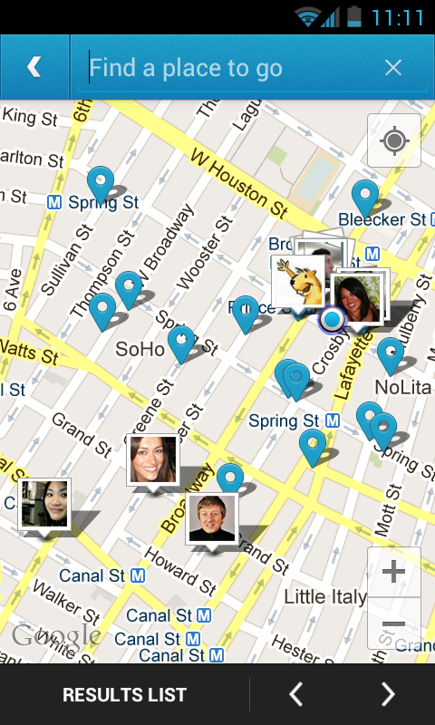
Examples
Part 15 (“unlicensed”)
  since 1938
  major revision 1989
    higher frequencies
    unintentional, incidental, intentional
    authorized devices
  → WiFi
GPS in cell phones
  E911 rules
  → location-based services
Notes:
http://papers.ssrn.com/sol3/papers.cfm?abstract_id=1120465

Slide 5


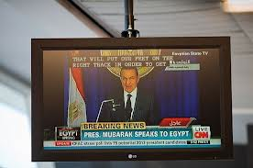
Examples
Closed captioning
  initially, for Deaf and Hard of Hearing
  migrated to
    airports
    doctor’s offices
    sports bars
  enables text-based retrieval

Slide 6
The US hierarchy of laws
Constitution
Commerce clause
Law
Telecom Act 1934 & 1996
47 CFR
Narrative
reasonable network management
Section 8: To regulate Commerce with foreign Nations, and among the several States, and with the Indian Tribes (1787)
SEC. 706. ADVANCED TELECOMMUNICATIONS INCENTIVES. (a) IN GENERAL- The Commission … shall encourage the deployment on a reasonable and timely basis of advanced telecommunications capability to all Americans (including, in particular, elementary and secondary schools and classrooms) by utilizing, in a manner consistent with the public interest, convenience, and necessity, …, or other regulating methods that remove barriers to infrastructure investment.

Slide 7

Example: CFR 47
§ 15.5 General conditions of operation.
(a) Persons operating intentional or unintentional radiators shall not be deemed to have any vested or recognizable right to continued use of any given frequency by virtue of prior registration or certification of equipment, or, for power line carrier systems, on the basis of prior notification of use pursuant to §90.35(g) of this chapter.
(b) Operation of an intentional, unintentional, or incidental radiator is subject to the conditions that no harmful interference is caused and that interference must be accepted that may be caused by the operation of an authorized radio station, by another intentional or unintentional radiator, by industrial, scientific and medical (ISM) equipment, or by an incidental radiator.

Slide 8
Selected 47 CFR
Part | Content
4 | Disruptions to Communications
5 | Experimental Radio Service
6 | Access to Telecommunications Service, Telecommunications Equipment and Customer Premises Equipment by Persons with Disabilities
9 | Interconnected Voice over Internet Protocol Services
15 | Radio Frequency Devices
20 | Commercial Mobile Radio Services (= cellular)
68 | Connection of Terminal Equipment to the Telephone Network
79 | Closed Captioning and Video Description of Video Programming
97 | Amateur Radio Services

Slide 9
Telecom regulation
Local, state and federal
  local: CATV franchise agreements
  state: Public Utility Commission
    responsible for all utilities – gas, water, electricity, telephone
  federal: FCC, FTC (privacy), DOJ (monopoly)
Elsewhere: gov’t PTT → competition
  vs. US: regulated private monopolies
Based on 1934 Telecommunications Act
Amended in 1996
Divides the world into
  Title I: Telecommunications Services
  Title II: Broadcast Services
  Title III: Cable Services
  Title V: Obscenity and Violence

Slide 10
Process
NOI
NPRM
R&O
Notice of Inquiry
Notice of Proposed Rule Making
Report & Order
comments & ex parte

Slide 11
FCC
Chairman (D)
4 Commissioners (2 D, 2 R)
Consumer and Governmental Affairs
Enforcement
International
Media
Public Safety & Homeland Security
Wireless Telecommunications
Wireline Competition
Independent federal agency
About 2,000 employees

Slide 12
Open Internet

Slide 13
Two views
Open Internet advocates
Free market advocates
no prioritization
flat rates
all networks
no real problem
allow any business arrangement
“it’s my network”
use anti-monopoly laws if needed

Slide 14
Why?
Civic considerations
  freedom to read (passive)
  freedom to discuss & create (active)
Economic opportunity
  edge economy >> telecom economy
    Telecom revenue (US): $330B
    Content, etc. not that large, however
      Google: $8.44B
    others that depend on ability to provide services
  content, application, service providers
Technical motivation
  avoid network fragmentation
  reduce work-around complexity

Slide 15
How to be non-neutral
deep packet inspection
block Skype
application
block transport protocol
block ports
insert RST
transport
block IP addresses
QoS discrimination
network

Slide 16
Some high-profile cases
Madison River (2005)
  DSL provider blocked SIP ports
  fined $15,000 by FCC
Comcast (late 2007)
  insert TCP RST into BitTorrent traffic
  later overturned on appeal in DC Circuit Court
RCN (2009): P2P
Various mobile operators
Comcast vs. Level 3 (2010, in dispute)
  Level-3
Notes:
http://hraunfoss.fcc.gov/edocs_public/attachmatch/DA-05-543A1.pdf
http://www.zeropaid.com/news/88573/comcast-prevails-in-bittorrent-throttling-case/

Slide 17
Which Internet are you connected to?
port 80 + 25
IPv4
NAT
multicast
QoS
IPv4
DHCP
IPv6
IPv4
PIA

Slide 18
Cisco’s traffic prediction
Ambient video = nannycams, petcams, home security cams, and other persistent video streams
Notes:
http://www.cisco.com/en/US/solutions/collateral/ns341/ns525/ns537/ns705/ns827/white_paper_c11-481360_ns827_Networking_Solutions_White_Paper.html

Slide 19



Bandwidth costs
Amazon EC2
  $50 - $120/TB out, $0/TB in
CDN (Internet radio)
  $600/TB (2007)
  $10-30/TB (Q1 2012 – CDNpricing.com)
NetFlix (7 GB DVD)
  postage $0.70 round-trip → $100/TB
FedEx – 2 lb disk
  5 business days: $6.55
  Standard overnight: $43.68
  Barracuda disk: $91 - $116/TB
Notes:
FedEx and EC2 prices as of 09/15/09
CDN: http://www.mindbranch.com/listing/product/R678-29.html
http://www.cdnpricing.com/

Slide 20
The value of bits
Technologist: A bit is a bit is a bit
Economist: Some bits are more valuable than other bits
  e.g., $(email) >> $(video)
Application | Volume | Cost per unit | Cost / MB | Cost / TB
Voice (13 kb/s GSM) | 97.5 kB/minute | 10c | $1.02 | $1M
Mobile data | 5 GB | $40 | $0.008 | $8,000
MMS (pictures) | < 300 KB, avg. 50 kB | 25c | $5.00 | $5M
SMS | 160 B | 10c | $625 | $625M
Notes:
T-Mobile 2010
AT&T data
http://www.nowsms.com/discus/messages/12/8500.html

Slide 21
Principles
Transparency. Fixed and mobile broadband providers must disclose the network management practices, performance characteristics, and terms and conditions of their broadband services;
No blocking. Fixed broadband providers may not block lawful content, applications, services, or non-harmful devices; mobile broadband providers may not block lawful websites, or block applications that compete with their voice or video telephony services
No unreasonable discrimination. Fixed broadband providers may not unreasonably discriminate in transmitting lawful network traffic.

Slide 22
Spectrum

Slide 23
Overview
What’s the problem?
How much data & spectrum is there?
Can we make better use of it?
  Better technology
  General-purpose technology
  Better sharing in time and space

Slide 24



You’ve heard the statistics…
Mobile phone subscriptions now top the number of people - - 328 million subscriptions
90% of us keep our mobile device within arms length 24 hours a day, 7 days a week
Smartphone sales have eclipsed PC sales
Mobile broadband is being adopted faster than any computing platform in history
A typical smartphone places 24 times as much demand on spectrum as an old feature phone
Tablets demand 120 times as much
Multiple experts expect that mobile demand for spectrum will increase more than 35x in the next few years (3,500%)
24/7
24X
120X

Slide 25
Monthly fixed consumption
North America | Mean | Median | Mean : Median
Upstream | 4.5 GB | 600 MB | 7.33
Downstream | 18.6 GB | 6.0 GB | 3.06
Aggregate | 23.0 GB | 7.0 GB | 3.28
top 1% →
  49.7% of upstream traffic
  25% of downstream traffic
Europe | Mean | Median | Mean : Median
Upstream | 8.2 GB | 1.2 GB | 6.87
Downstream | 31.3 GB | 12.7 GB | 2.47
Aggregate | 39.6 GB | 14.7 GB | 2.69
Notes:
Sandvine, Global Internet Phenomena Report Spring 2011

Slide 26
Spectral efficiency
b/s/Hz: modulation, FEC, MIMO, …
but also total spectral efficiency
  guard bands
  restrictions on adjacent channel usage
  “high power, high tower” → small cells → higher b/s/Hz
data efficiency
  e.g., H.264 is twice as good as MPEG-2/ATSC
  and maybe H.265 twice as good as H.264
distribution efficiency
  unicast vs. multicast
protocol efficiency
  avoid polling → need server mode
mode efficiency
  caching
  side loading
  pre-loading

Slide 27
A 2016 thought experiment
2016: 71% of (consumer) bandwidth is video
Average monthly TV consumption (US): 154 hours
Netflix: 1 GB/hour (SD) … 2.3 GB/hour (HD)
  → 300 GB/month/person
  more if people in household watch different content
→ 0.9 Mb/s (averaged over 24 hours)
Cisco VINI: 150 MB/month → 2.7 GB/month
LTE: need 600 kHz/user (typical 1.5 b/s/Hz)
  → 500 MHz per cell sector → about 800 users/cell sector

Slide 28
What can we do?
end system caching
better audio & video codecs
efficient apps
IP multicast
WiFi offload
small cells = better spectral efficiency + more re-use
spectral efficiency (LTE-A)
directional antennas
general purpose spectrum
dense cells
white spaces & sharing
LTE: 1.5 b/s/Hz
GSM: 0.1 b/s/Hz

Slide 29

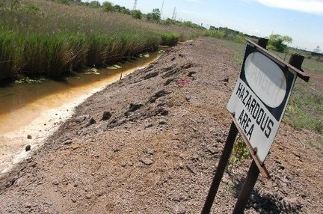
From beachfront spectrum to brownfield spectrum

Slide 30
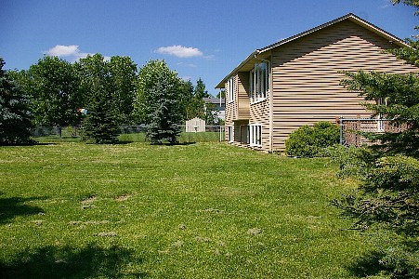
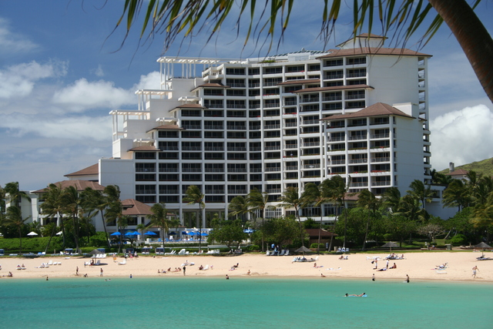
From empty back yard to time share condo

Slide 31
cellular = about 500 MHz in total

Slide 32
Unlicensed & lightly-licensed bands (US)
UHF (476-700 MHz) – incentive auctions (licensed) + some unlicensed
2.4 GHz (73 MHz) – 802.11b/g
3.6 GHz (100 MHz) – for backhaul & WISPs
4.9 GHz (50 MHz) – public safety
5.8 GHz (400 MHz) – 802.11 a/n
  much less crowded than 2.4 GHz
  supported by many laptops, few smartphones

Slide 33

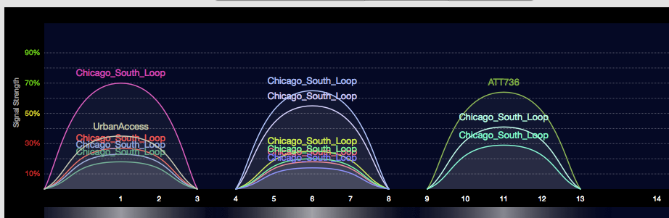
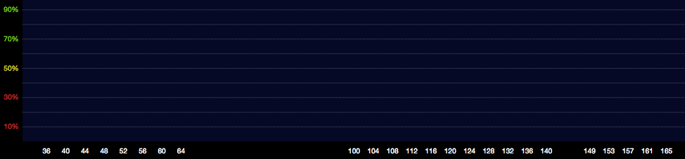
2.4 vs. 5.8 GHz

Slide 34
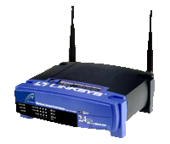
5.8 GHz expansion: sharing with incumbents
Device detects radar
and moves to an unoccupied channel
50 mW
Indoor Use Only
250 mW
250 mW
1 W
DFS
DFS
Existing
Existing
New
Existing
5150
5250
5350
5470
5725
5825
Frequency (MHz)

Slide 35
Freeing spectrum: incentive auctions
Incentive auctions will share auction proceeds with the current occupant to motivate voluntary relocation of incumbents
  Otherwise, no incentive for current occupant to give back spectrum
  Stations keep current channel numbers
    via DTV map
Adjacent Channel
Interference
TV
TV
BB
TV
BB
TV
Without Realignment:
Reduced Broadband Bandwidth
Adjacent Channel
Interference
TV
TV
TV
TV
BB
With Realignment: Accommodates Increased Broadband Bandwidth

Slide 36

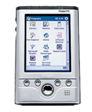

Small cell alternatives
Femto cells
  use existing spectrum
  need additional equipment
WiFi off-load
  use existing residential equipment
  5G networks = heterogeneous networks?
Distributed antenna systems
Cellular
Femto-cells
Distributed Antenna Systems
Signals are distributed throughout the
Building via amplifiers/antennas

Slide 37


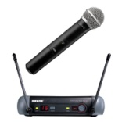

TV white spaces
TV channels are “allotted” to cities to serve the local area
Other licensed and unlicensed services are also in TV bands
“White Spaces” are the channels that are “unused” at any
given location by licensed devices
2
4
Non-
Broadcast
spectrum
5
7
9
White
Space
Low
Power TV
Wireless
Microphones
New York City
Full Power
TV Stations
Etc.
Only for illustrative purposes
3
Non-
Broadcast
spectrum
6
8
10
White
Space
White
Space
White
Space
Low
Power TV
Wireless
Microphones
Philadelphia
Full Power
TV Stations
Etc.

Slide 38
TVWS Spectrum Availability
Available spectrum varies by location
In rural areas many channels are available
In big cities only a few channels may be available at some locations
Examples of availability in UHF channels 21 – 51 (Illustrative):
New York
21 | 22 | 23 | 24 | 25 | 26 | 27 | 28 | 29 | 30 | 31 | 32 | 33 | 34 | 35 | 36 | 37 | 38 | 39 | 40 | 41 | 42 | 43 | 44 | 45 | 46 | 47 | 48 | 49 | 50 | 51
Washington, DC
21 | 22 | 23 | 24 | 25 | 26 | 27 | 28 | 29 | 30 | 31 | 32 | 33 | 34 | 35 | 36 | 37 | 38 | 39 | 40 | 41 | 42 | 43 | 44 | 45 | 46 | 47 | 48 | 49 | 50 | 51
Full Service DTV Station
Low Power TV Station
Channel Open/ Adjacent to TV
Channel Open/ Not Adjacent to TV
In less dense areas many channels are available.
For example: Wilmington, NC: 25 channels = 150 MHz
Harrisburg, PA: 19 channels = 114 MHz
38
Notes:
38

Slide 39




TV White Spaces
Final rules adopted Sept. 2010:
  New spectrum for unlicensed
  Based on geolocation & data base of protected services
  Also allows for spectrum sensing with rigorous review & authorization process
Services protected in the data base:
  TV digital and analog Class A, low power, translator & booster stations
  Broadcast auxiliary (wireless mikes)
  Cable head-ends and TV translators
  Land mobile
  Sites with significant wireless microphone use
Data Base
Mode 1: Portable device obtains
location/channels from fixed device
Mode 2: Portable device uses its
own geolocation/data base access capability
39
Notes:
39

Slide 40
Benefits of TV White Space
Prime spectrum
  Great propagation & coverage
  High amounts in much of the USA
  Close to spectrum used by commercial wireless services → potential synergy
New IEEE 802.22™ standard:
  Broadband wireless access over a large area up to 100 km
  Up to 29 Mb/s per TV channel
  Can increase data rate through use of multiple channels
WiFi & TVWS complementary:
  Wi-Fi has greater bandwidth but usage density is increasing
Notes:
40

Slide 41
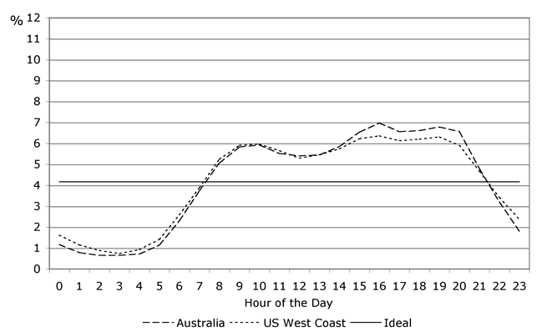
New options to reduce traffic
Download video content during off-hours
  or defer software updates until WiFi is available
Peer-to-peer distribution of popular content
IP multicast (1-to-many) of live content
Make apps less chatty

Slide 42

Spectrum Outlook
No single solution:
  reduce spectrum usage
    caching & better modulation
  re-use spectrum
  re-cycle old spectrum

Slide 43
Measurements

Slide 44
Measurement History
FCC has an evolved schema in place to acquire and analyze data on legacy PSTN
  Broadband networks and the Internet have not been general focus of these study efforts
More recent and evolving broadband interest
  Section 706 of Telecommunications Act, 1996, required annual report on availability of advanced telecommunications services to all Americans
    Resulted in information on deployment of broadband technology but not its performance
  FCC’s National Broadband Plan – March 2010
    Proposed performance measurements of broadband services delivered to consumer household
    Work plan evolved from recommendations of National Broadband Plan

Slide 45
Broadband Measurement Study
First effort for Commission
Sought high level of voluntary participation from stakeholders
  ISPs, academia, others
Interactions shaped initial study
Broadband measurement still work in progress

Slide 46
What Was Done
Enlisted cooperation of 13 ISPs covering 86% of US Population
Enlisted cooperation of vendors, trade groups, universities and consumer groups
Agreement reached on what to measure and how to measure it
Enrolled 9,000 consumers as participants
  6,800 (7,782) active during (2012) report period
  A total of 9,000 active over the data collection period
Issued report August 2011 and July 2012

Slide 47
What Was Released
Measuring Broadband America Report
  Main Section describing conclusions and major results
  Technical Appendix describing tests and survey methodology
Spreadsheet providing standard statistical measures of all tests for all ISPs and speed tiers measured
March data set (report period) with 4B data elements from over 100M tests
  Data set presented as used with anomalies removed
  Documentation provided on how data set was processed
Data set from February thru June
  All data, as recorded
Geocoded data on test points recently released
Information available at http://www.fcc.gov/measuring-broadband-america

Slide 48
What Was Measured
Sustained Download | Burst Download
Sustained Upload | Burst Upload
Web Browsing Download | UDP Latency
UDP Packet Loss | Video Streaming Measure
VoIP Measure | DNS Resolution
DNS Failures | ICMP Latency
ICMP Packet Loss | Latency Under Load
Total Bytes Downloaded | Total Bytes Uploaded

Slide 49
MBA architecture

Slide 50
Advertised vs. actual

Slide 51
Latency by technology

Slide 52
Data usage

Slide 53
Cable/Telco Tussle
Some Cable companies advertise burst speed
  Quota based technique providing temporary speed increase of < 15 seconds
    Also affected by other household activity
  Can’t be applied generally to DSL where sync rate often limiting factor
  Marginal value to fiber where each subscriber has potentially available 37 Mb/s to 75 Mb/s provisioned bandwidth
Compromise to measure both burst and sustained speed
Burst speed does have some potential to improve browsing, gaming and like applications

Slide 54
Reliability
Packet loss rate < 1%
Correlation between peak periods and packet loss
  Higher loss during peak hours
Most companies during peak experience < .4% packet loss
Worst case seen during March .8%
Data from other periods may have numbers in excess of 1% (Georgia Tech)
1% packet loss often cited as video threshold

Slide 55
Web Page Downloading
Canary in the Coal Mine?
Performance seems to top out after 10 Mbps
Many possible explanations
  Latency, server loading, household platform limitations, etc.
However, discussions with Georgia Tech indicate that they have seen similar performance issues
Discussion with Ofcom and others suggest that globally, full benefits of higher line rates not being realized AT PRESENT
Higher ISP speed may challenge industry to examine performance bottlenecks
More data needed

Slide 56
Unknowns
Report measured ISP performance and not end to end
In-home contributions unknown but being looked at elsewhere (France)
Contributions of other network elements not correlated

Slide 57
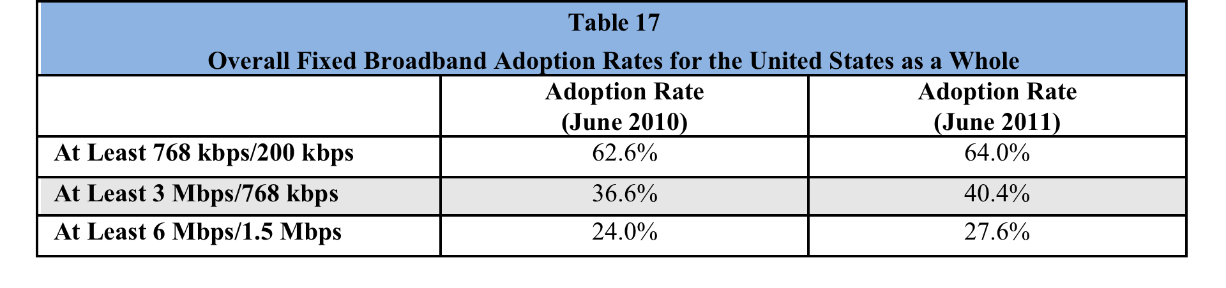
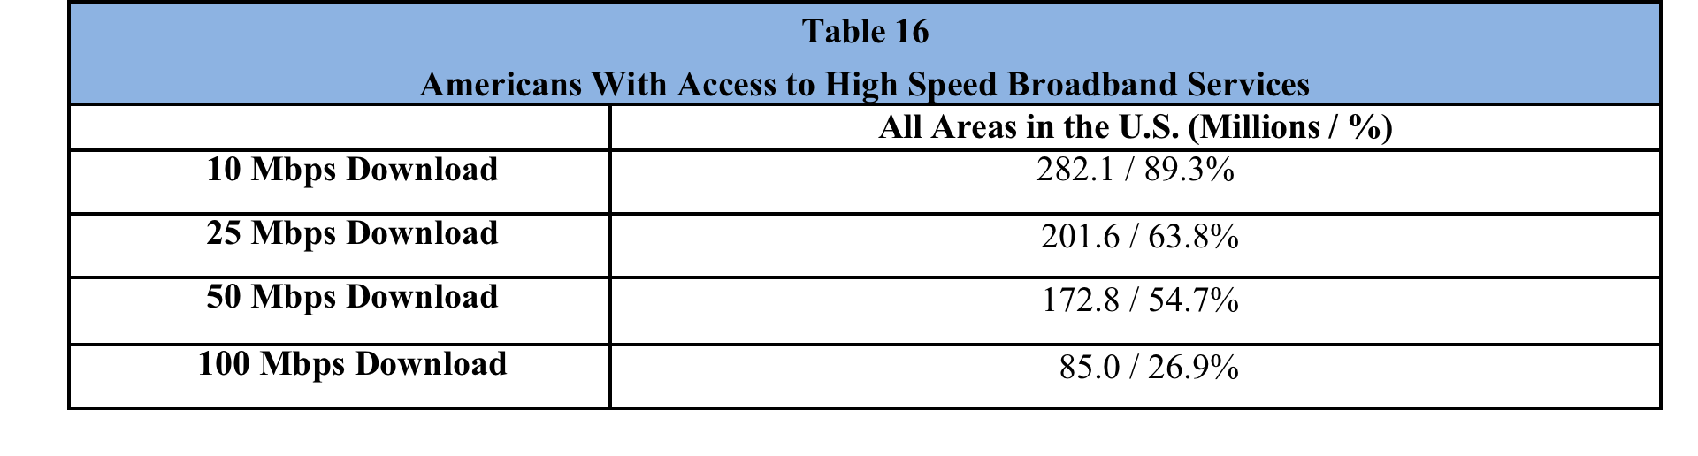
Broadband adoption
Eighth Broadband Progress Report, August 2012

Slide 58
Access to broadband
Eighth Broadband Progress Report, August 2012

Slide 59
Competition (US)
if lucky, incumbent LEC + cable company
  DSL: cheaper, but low speed
    mean: 2.5 – 3.5 Mb/s
  FTTH (FiOS): 21M households
    10-100 Mb/s
  Cable: > $50/month, higher speeds
    8-50 Mb/s
often, high switching costs ($200 early termination fee)
  or tied to bundles (TV, mobile)
can’t easily predict whether problem would be different
Notes:
http://s.ftthcouncil.org/files/RVA.FTTH_.Apr09.060109.pdf

Slide 60
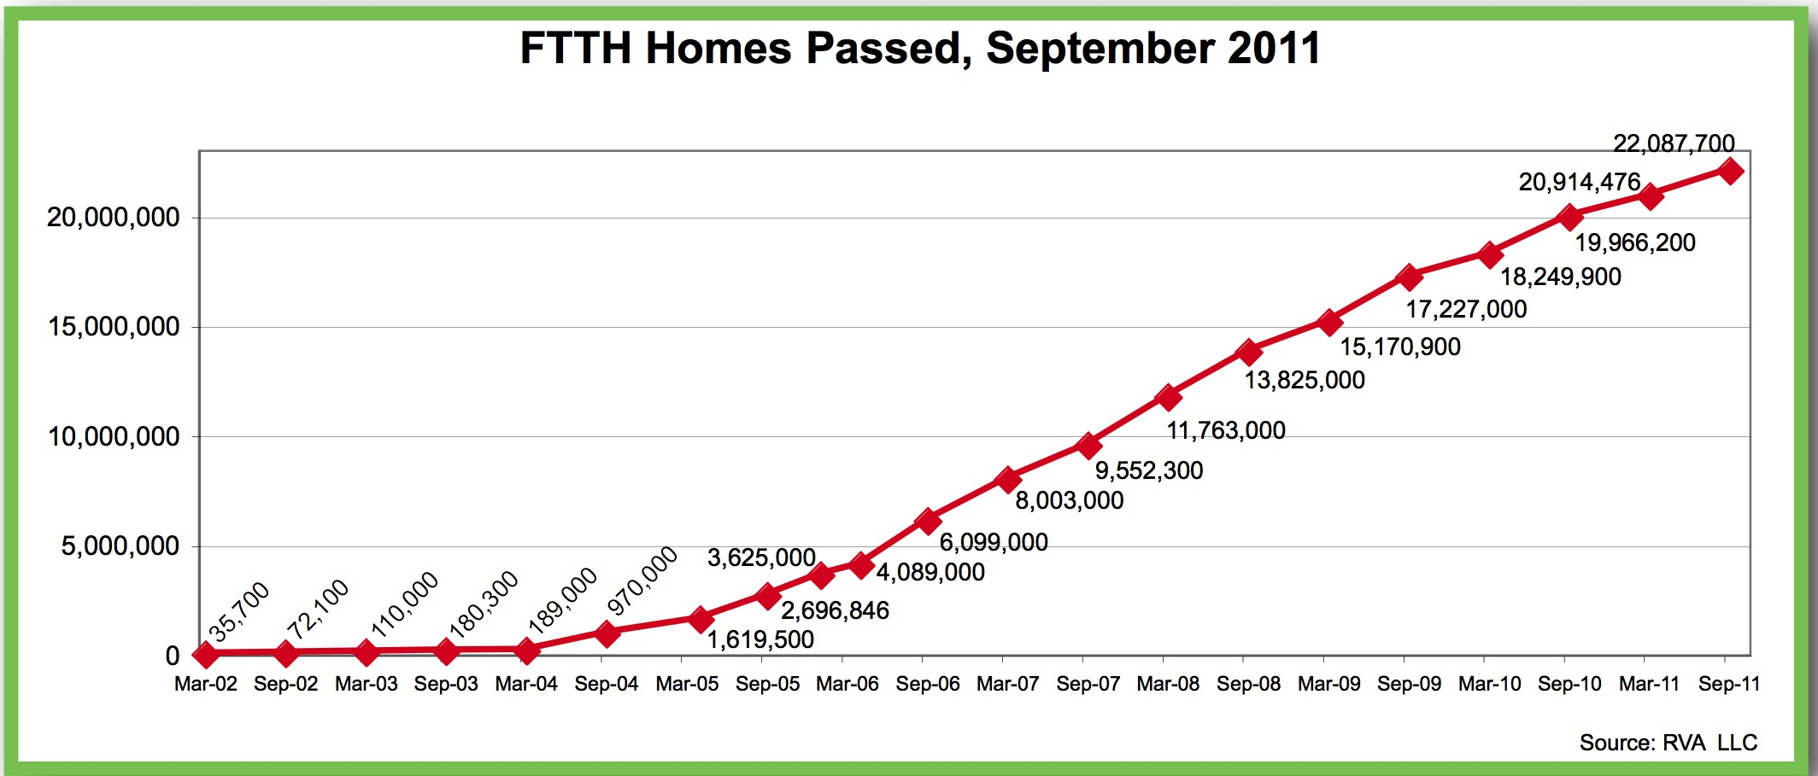
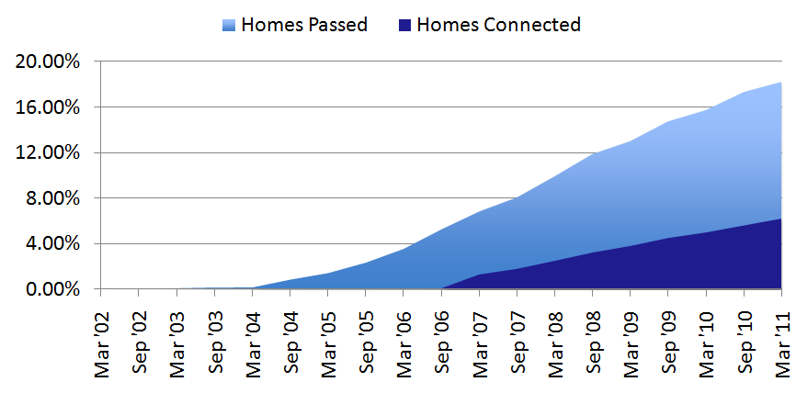
FTTH

Slide 61
State of competition (US)
FCC: Internet Access Services Status as of December 31, 2009
Notes:
http://www.fcc.gov/Daily_Releases/Daily_Business/2010/db1208/DOC-303405A1.pdf: Internet Access Services: Status as of December 31, 2009

Slide 62
International comparison: fixed
3rd International Broadband Data Report (IBDR), August 2012

Slide 63
International comparison: mobile
3rd International Broadband Data Report (IBDR), August 2012

Slide 64
Accessibility

Slide 65

Access to Telecommunications and Technology Means:
Jobs
Education
Information
Recreation
Marketplace
Transportation
Independence
Privacy

Slide 66
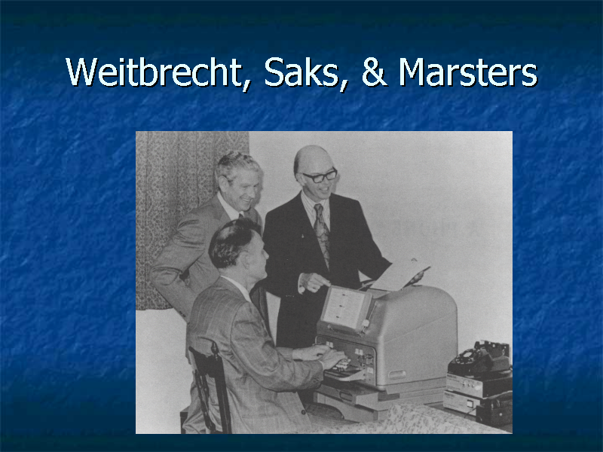

Slide 67
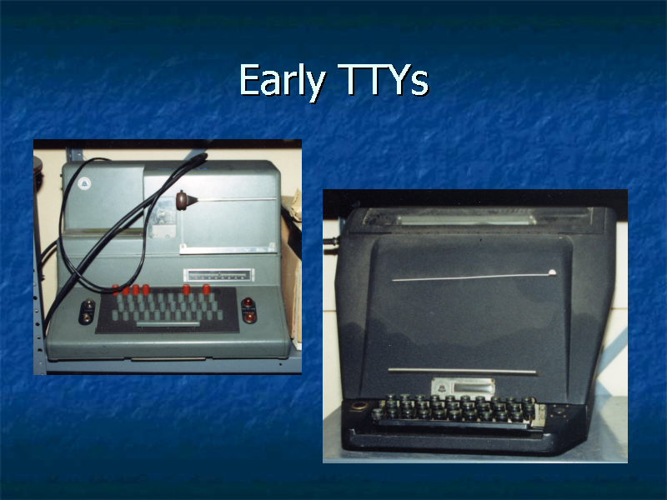

Slide 68
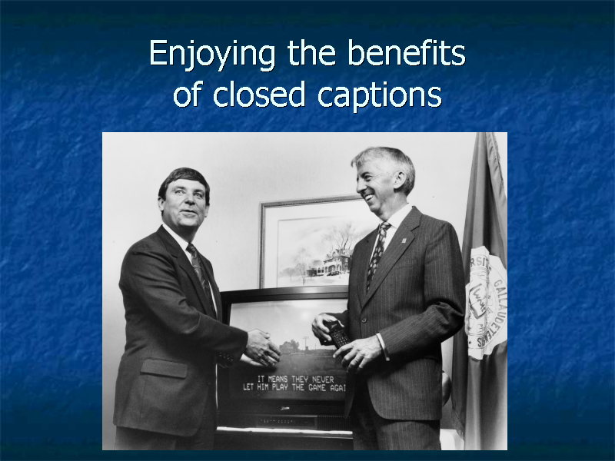

Slide 69
Improved Relay Services
Video Relay (2000) – first E.164 IP-based multimedia system
  initially H.323, transitioning to SIP
Speech-to-Speech (2000)
Spanish Relay (2000)
Internet Relay (2001)
Access to audiotext (IVR) systems
Typing speed – 60 wpm
Captioned Telephone (2003)

Slide 70
Turn of Century: Many Gaps in Laws
No coverage of Internet-based communication services or video programming
No mandates for video description
Limited captioning capability on television devices (screens up to 13 inches)
No specific protections for deaf-blind population
No guarantee of emergency access or accessible user interfaces on video devices for people who are blind or visually impaired

Slide 71
Twenty-First Century Communications and Video Accessibility Act
Public Law 111-260; Public Law 111-25
Need for the Legislation: Disability protections enacted by Congress and implemented by the FCC had not kept up with emerging technologies
    Prior focus was on telecommunications
    Prior laws applied to legacy technologies
CVAA addresses accessibility challenges of 21st century technologies

Slide 72
Market Forces: Past failures to Achieve access
  Each disability market is too small
  Lower incomes mean less purchasing power
  Need for adaptive equipment discourages purchases
Government steps in where market has failed
Addresses accessibility needs to promote innovation and not overly burden industry: Goal is to incorporate access at design stages
Accessibility achieves access for all – goes beyond disability community

Slide 73
Title II – Video Description
Required for:
  4 national broadcast networks in top 25 markets
  Top 5 cable channels
Amount of programming: 4 hours of prime time or children’s programming per week
FCC must conduct additional inquires on availability, benefits, uses, and costs: 1 year after rule phase-in
CVAA authorizes expansion to 7 hours of video description per week and eventually all market areas

Slide 74
FCC Implementation of CVAA
Creation of Advisory Committees (directed by CVAA to achieve consumer-industry balance)
    Emergency Access Advisory Committee
    Video Programming Accessibility Advisory Committee
Adoption of Rules
Creation of Accessibility Clearinghouse:
  http://apps.fcc.gov/accessibilityclearinghouse/
Biennial Reports to Congress
Handling of Complaints

Slide 75
RESEARCH

Slide 76

How can researchers participate?
Write relevant papers
  what’s technologically possible?
  what are real-world problems?
  economic + technology analysis
Submit filings for the record
  during comment periods
Ex-parte visits
Presentations to educate FCC staff

Slide 77
Conclusion
Regulator as critical part of technology eco system
  technology enabler
  manager of the “common”
  consumer protection
  maintain or enhance competition
  deal with market failures
Challenges
  outdated laws
  technology transition: waiting for last one to turn off lights…

