Slide 1
Identifying and Categorizing POIs
Henning Schulzrinne
Columbia University

Slide 2
Use cases in draft
Where is a 4 star Italian restaurant near me that is still open?
Where can I find a new battery for my phone?
What movies are playing now near me?
Where is the cheapest available parking near the theater?
What are the specials at nearby restaurants?
What kind of businesses are in this building?

Slide 3
Not to be solved here
Properties of service/POI vs. category
e.g., “restaurant accept AmEx”, “Zagat gave it a rating of 20”
Distinction can be somewhat arbitrary
is “Italian cuisine” an attribute of a restaurant or a classification?
Basic notion: non-interchangeable services = category
gas station vs. restaurant
synagogue vs. Christian church
Pragmatic distinctions supporting consumer use, not census statistics

Slide 4
Categorization possibilities: NAICS
“The North American Industry Classification System (NAICS) is the standard used by Federal statistical agencies in classifying business establishments for the purpose of collecting, analyzing, and publishing statistical data related to the U.S. business economy.”
Example: “restaurant”

Slide 5
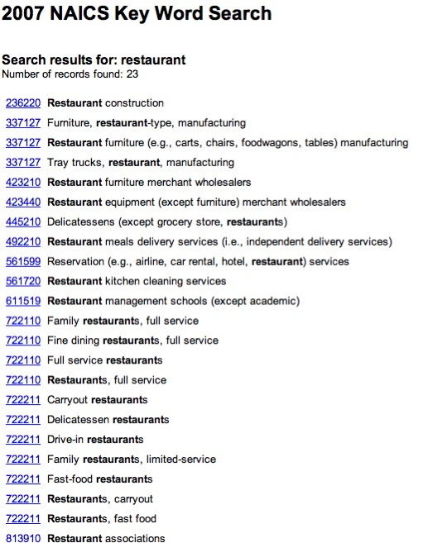
NAICS “restaurant”
of limited interest to most
AR applications
only two classifications:
722110 full-service
722111 limited service

Slide 6
NAICS – what about…
ATMs?
bus stops?
public schools?
monuments?
public restrooms?
police station?
library?
WiFi hotspot?

Slide 7
Other alternatives
Free-form text
hard to translate into other languages
same service, many names
ATM, automated teller machine, cash machine
restaurant, diner, café, coffee shop, …
library, public library, university library
service hierarchy
restaurant, French vs. French restaurant
Open Street Map (OSM)
Map overlay labels
topographical features, not services
GPS POI labels
don’t appear to be standardized, but good starting point
Yellow Pages directory labels
no obvious standard, but good guideline
Notes:
http://www.openstreetmap.org/

Slide 8
Service URN
Idea: Identifiers to denote emergency calls
and other generic (communication) services
Described in IETF ECRIT RFC 5031
Emergency service identifiers:
sos General emergency services
sos.animal-control Animal control
sos.fire Fire service
sos.gas Gas leaks and gas emergencies
sos.marine Maritime search and rescue
sos.mountain Mountain rescue
sos.physician Physician referral service
sos.poison Poison control center
sos.police Police, law enforcement

Slide 9
Extension to non-emergency services
On-going work:
http://tools.ietf.org/html/draft-forte-ecrit-service-classification-03
Extensible hierarchy designed for location-based services
urn:service:business
urn:service:communication
urn:service:cultural
urn:service:education
urn:service:entertainment
urn:service:financial
urn:service:food
urn:service:fuel
urn:service:government
urn:service:medical
urn:service:religious
urn:service:retail
urn:service:transportation

Slide 10
urn:service:transportation
transportation.airport
transportation.bycicle-rental
transportation.bus-stop
transportation.car-rental
transportation.mechanic
transportation.parking
transportation.port
transportation.subway
transportation.taxi-stand
transportation.train-station

Slide 11
Issues & to-do’s
Is there some existing classification we can borrow?
Registration through IANA or other body (delegated)?
Maintenance?
small editorial group? mailing list?
similar to (Olson) time zone database

