Slide 1
VoIP Tutorial not for geeks
Henry Sinnreich
Alan Johnston

Slide 3
Overview
What the tutorial is about:
Basic, for Internet use
References for more
What the tutorial is not:
Recipe for software coding
For specific solutions
Complex telephony: See Refs
Other interesting stuff…
About this tutorial (it’s about Internet SIP)
Standards for VoIP
Internet
SIP VoIP
Topics and examples for SIP VoIP
Voice and video over the Internet
RTP and SDP and examples
VoIP infrastructure and complexity
NAT and firewall traversal
Peer-to-peer VoIP
Combining VoIP and RIA
VoIP in the browser
Innovations after VoIP
Transformative changes
Q&A - please prepare your questions

Slide 4
Standards organizations supporting SIP VoIP
IETF | Internet Engineering Task Force
ITU-T | International Telecommunication Union - Telecommunication
ETSI | European Telecommunications Standards Institute
3GPP | 3rd Generation Partnership Project for International Mobile Communications
OMA | Open Mobile Alliance for the mobile phone industry
Also the SIP Forum, it sponsors the regular SIPit events

Slide 5
SIP on the iPhone
Codecs
IETF standards discussed in this tutorial

Slide 6
The Internet Architecture
Protocols
Addressing
Routing
Any application¹
Security
The end to end principle
Best effort
Internet transparency
Privacy, user information and consent
“the stupid network²”
RFC 1958 | Architectural Principles of the Internet
RFC 2775 | Internet Transparency
RFC 4924 | Reflections on Internet Transparency
RFC 3724 | The Rise of the Middle and the Future of End-to-End
How to find RFCs: http://www.rfc-editor.org/rfcsearch.html
¹ Vint Cerf: “Internet is the license for innovation”
² http://www.isen.com/stupid.html

Slide 7
Key standard protocols for real-time applications
Over 6,000 RFCs in October 2010: How much time can anyone invest?
An overview of the basics
 | Purpose | Name | Standards
Application protocols | Multimedia signaling | SIP | RFC 3261
 | Media packet transport | RTP | RFC 3550/3551
 | Hypertext transport* | HTTP 1.1 | RFC 2616
Transport security | Secure reliable transport | TLS 1.2 | RFC 5246
 | Secure best effort transport | DTLS | RFC 4347
IP resolution | Domain names and resources | DNS | RFC 1034
IP routing and addressing | Endpoint identifier-locator split | HIP | RFC 5201
 | Reliable transport | TCP | RFC 1180
 | Best effort transport | UDP | RFC 0768
* All rich Internet applications (RIA) on the Web use only HTTP/HTTPS

Slide 8
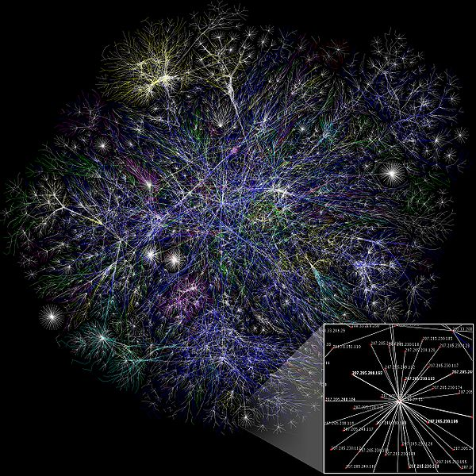
Visualization of Internet routes
http://en.wikipedia.org/wiki/Internet

Slide 9
The Internet End-to-End Argument
Apps in intermediaries are expensive and an obstacle to innovation
…only the endpoint(s) knows its application and its state…
CLIENT or SERVER
CLIENT
Intermediary
Intermediary
Internet: Stateless, connectionless IP routing
Transparent e2e Internet transport: Application & stream agnostic
Intermediary ex: Net Address Translator (NAT), Firewalls, App Level Gateways (ALG), SBC,...
(the good, the bad and the ugly)
Saltzer, J., Reed, D., and Clark, D.D. End-to-End Arguments in System Design, 1981
D. Isenberg: “Rise of the Stupid Network”, 1997
RFC 1958, B. Carpenter: “Architectural Principles of the Internet”, 1996
Blumenthal, M.S. Clark, D.D., Rethinking the Design of the Internet: The end to end arguments vs. the brave new world, 2001

Slide 10
Basic Concepts
Internet vs internet
The Internet is the worldwide global network
An internet is a network that connects two networks together.
TCP/IP (Transmission Control Protocol / Internet Protocol)
The protocol suite that the Internet uses
Private IP networks can use TCP/IP without being part of Internet.
Internet Communications
Real-time communication between humans using the Internet involving media types including voice, video, text, etc.
Standards
Protocols, specifications, interfaces which allow interconnection, interoperation, and exchange of information

Slide 11
Impairments on the Internet
Latency - packet delivery delay
Packetization - time taken to collect data into a datagram
Serialization - time taken to transmit a datagram over a serial link
Buffering - time datagram is held before sending or before rendering
Queuing - time spent in a router buffer waiting for route selection
Packet Loss or Drop
Under congestion, routers empty buffers
Jitter or Delay Variation
variation in latency in a packet flow
Corruption
Very rare - usually corrupted packets are dropped
Out of Order Receipt
Due to different routes
Route Flaps
Sudden changes in IP routing tables that can cause spikes of congestion and packet loss
Quality of Service (QoS) as opposed to Best Effort delivery – topic for Q&A
Engineering the network to improve quality of a particular flow, usually at the expense of another flow (“DOS attack on competitor”)
“QoS does not create bandwidth”

Slide 12
IP Protocol Stack
Applications are not standardized but use other standards*
Layer 5: Application
HTTP
SIP
RTP
DNS
DHCP
Layer 4: Transport
TCP
UDP
SCTP
Layer 3: Network
IP
Current version is IPv4, but IPv6 is the future
Ethernet
...
PPP
Layer 2: Data/Link
Layer 1: Physical
Copper
Fiber
...
Wireless
*Languages (W3C), data formats, metadata, etc. API’s are NOT standards

Slide 13
RFC 3261
Session Initiation Protocol

Slide 14
Session Initiation Protocol Overview
Application Layer Signaling Protocol
“Rendezvous” Protocol
Used to establish, modify, and terminate multimedia sessions
Part of Internet Multimedia Architecture
Can use a variety of transports
UDP, TCP, TLS, SCTP, etc.
Was initially based on HTTP (Web)
Similar text-based structure
Uses URIs (Uniform Resource Indicators)
Applications include (but not limited to):
Voice, video, gaming, instant messaging, presence, call control, etc.
Notes:
SIP is a key component of the Internet Multimedia Architecture. Other protocols including SDP, RTP, DNS, etc are needed to implement a complete service.
SIP was designed based on one of the most scalable and deployed Internet protocols Hyper Text Transport Protocol (HTTP) the underlying protocol of the World Wide Web (WWW).
SIP is about much more than just voice – supports all media.

Slide 15
A Short History of SIP
Internet Engineering Task Force (IETF) protocol
Inventors: M. Handley, H. Schulzrinne, E. Schooler, and J. Rosenberg
Merger of two proposals Simple Conferencing Invitation Protocol and Session Initiation Protocol in 1996
Became “Proposed Standard” and RFC 2543 in 1999 in MMUSIC WG.
Separate SIP WG established in 1999.
Now new SIPPING (applications) and SIMPLE (presence and instant messaging) WGs using SIP.
RFC2543bis-09 I-D became RFC 3261 in 2002
Added four new authors: G. Camarillo, A. Johnston, J. Peterson, and R. Sparks.
Entire spec rewritten for clarity, but some new features
Mostly backwards compatible with RFC 2543
Many other SIP extensions published as RFCs.
Notes:
SIP has been a proposed IETF standard since 1999. Initially defined by RFC 2543, it was updated to RFC 3261 in 2002. There is only one version of SIP currently deployed – version 2.0.
Always an opportunity when something new comes along, even if you didn’t invent it.

Slide 16
SIP timeline
IETF A/V multicasts
2nd SIP
RFC 3261
SIP Events
RFC 3265
P2PSIP WG
1st SIP
RFC 2543
XCON WG
BLISS WG
SIP-09 in MMUSIC
SIMPLE WG
SPEARMINT WG
IETF A/V multicasts
SIP WG
SIPCORE WG
1st IETF Audiocast
‘92
‘94
‘96
‘98
2000
‘02
‘04
‘06
‘08
J. Ott: “A Short History of SIP”, http://www.cs.columbia.edu/sip/talks/sip-short-history.pdf

Slide 17
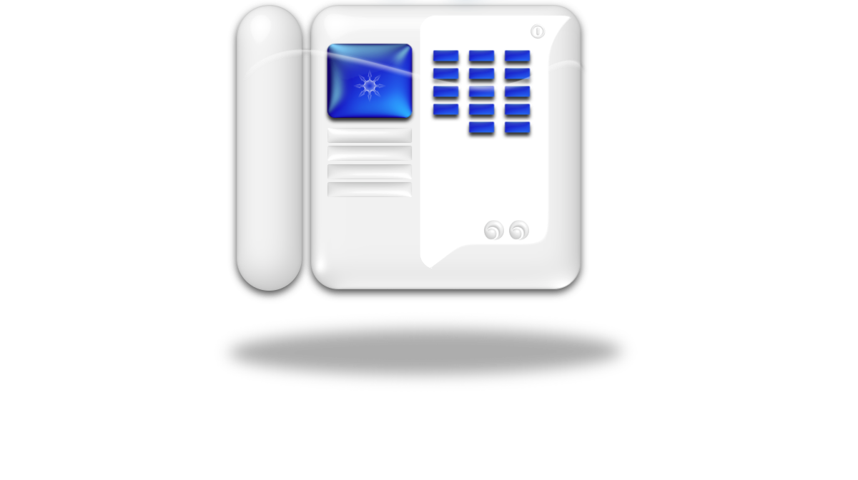
SIP User Agents (UAs)
Most important element of SIP
Only required element – all others are optional and can be left out of architecture
Originates and terminates SIP requests
Originates and terminates media, usually RTP or SRTP
Are a part of:
SIP phones
SIP/PSTN Gateways
SIP clients
Back-to-back User Agents (more on these later)
Only require a Rendezvous service to locate other UAs
Rendezvous service can be:
DNS
SIP Registrar/Proxy Server
P2P Overlay
Other distributed database

Slide 18
SIP Request Example
INVITE sip:marconi@radio.org SIP/2.0
Via: SIP/2.0/UDP lab.high-voltage.org:5060;branch=z9hG4bKw1b
Max-Forwards: 70
To: G. Marconi <sip:Marconi@radio.org>
From: Nikola Tesla <sip:n.tesla@high-voltage.org>;tag=76341
Call-ID: 123456789@lab.high-voltage.org
CSeq: 1 INVITE
Contact: <sip:n.tesla@lab.high-voltage.org>
Content-Type: application/sdp
Content-Length: 158
Shows minimum required set of headers
SDP Message Body not shown
Notes:
Branch, Tag: see 25, 26

Slide 19
SIP Response Example
SIP/2.0 200 OK
Via: SIP/2.0/UDP lab.high-voltage.org:5060;branch=z9hG4bKw1b
;received=100.101.102.103
To: G. Marconi <sip:marconi@radio.org>;tag=a53e42
From: Nikola Tesla <sip:n.tesla@high-voltage.org>;tag=76341
Call-ID: 123456789@lab.high-voltage.org
CSeq: 1 INVITE
Contact: <sip:marconi@tower.radio.org>
Content-Type: application/sdp
Content-Length: 155
Shows minimum required set of headers
SDP Message Body not shown
branch parameter is used for transaction matching
Notes:
Why (role of) received=100.101.102.103

Slide 20
SIP Requests
SIP Requests are called “methods”
Examples:

Slide 21
SIP Responses
SIP Responses have a numerical part and a reason phrase
First digit of code indicates class of response
Examples

Slide 22
SIP Call Flow Example
Schroedinger
Rendezvous
Heisenberg
Query
Response
INVITE
200 OK
ACK
Media Session
BYE
200 OK

Slide 23
SIP Dialogs
INVITE/200/ACK creates a dialog
Three way handshake
ACK is only sent for final response to INVITE
Dialog Identifier
Combination of To tag, From tag, and Call-ID
Dialog exists until BYE/200 exchange
An in-dialog request means the request is sent after an INVITE/200/ACK exchange, reusing the dialog identifier
Sending an INVITE creates a pending dialog
INVITE never times out
Sender can give up by sending a CANCEL
Provisional responses are optional but useful

Slide 24
SIP and Offer/Answer
SIP uses SDP and Offer/Answer to negotiate media sessions
SDP is carried as a message body in a SIP message
Offers/Answers can be in
INVITE/200
Normal SIP usage
No SDP in ACK
200/ACK
Used in some features
No SDP in INVITE

Slide 25
SIP Uniform Resource Indicators (URIs)
Same form as email addresses: user@domain
Two URI schemes:
sip:henry@pulver.com is a SIP URI
Most common form introduced in RFC 2543
sips:henry@pulver.com is a Secure SIP URI
New scheme introduced in RFC 3261
Requires TLS over TCP as transport for security
Two types of SIP URIs:
Address of Record (AOR) (identifies a user)
sip:henry@pulver.com (Needs DNS SRV records to locate SIP Servers for mci.com domain)
Contact (identifies a device and is usually a Fully Qualified Domain Name, FQDN)
sip:henry@127.24.45.4 or sip:henry@wisip.pulver.com (Which needs no resolution for routing)
Other URI Schemes used with SIP
Notes:
One of the most powerful features of SIP is its use of Uniform Resource Indicators (URIs), also sometimes called Uniform Resource Locators (URLs). SIP can use a variety of URI schemes, but most commonly uses sip, sips, and tel (for telephone numbers). SIP URIs can be either an Address of Record (AOR) or a Contact depending on whether it references a user or a device.

Slide 26
SIP URI Types
Address of Record URI
User, human, or service
Rarely changes
Stored in address books, callback logs, and printed on business cards
Has a set of authentication credentials associated with it
Needs to be resolved dynamically to a Contact URI at the time of the SIP request or INVITE
Contact URI
Device or endpoint
Can change IP address frequently
Should not be cached or stored for later use
Usually does not have its own authentication credentials
Needs no resolution (except perhaps DNS) to be resolved
SIP Servers help manage resolution between AOR and Contact URIs

Slide 27
SIP Transport
SIP can use either UDP or TCP for transport
Historically, UDP has been used
Lowest latency – no setup time
Highest number of users/server
SIP must handle retransmissions
SIP messages should fit inside a single IP packet (<1500 octets)
In the future, TCP should be used
SIP messages are getting larger
TCP provides congestion control and flow control
TLS security can be easily added

Slide 28
SIP Rendezvous
UAs are mobile and can change IP addresses
Dynamic IPs using DHCP
Nomadic devices
Laptops that change their point of attachment
Mobile devices
Wireless
Users can have multiple devices per user
Rendezvous helps sort this out
Sometimes necessary due to NAT/Firewall traversal
More on this when we discuss this topic in detail
Also used for Authentication/Introduction
3rd party that knows both users

Slide 29
SIP Servers for Rendezvous
Proxy Server
Receives requests from UAs and acts upon them
Performs database queries (DNS, etc.)
Signaling only – ignores message bodies (SDP) and never sees media flow (RTP)
Can implement services (forwarding, find me, voice mail, etc.)
Can be stateless, transaction stateful, or call stateful
Drops out of signaling after initial exchange unless Record-Routes
Sometimes called “Session Managers”
Redirect Server
Server queries database or implements service then returns response in 3xx
Simple query/response mechanism
Registrar Server
Receives REGISTER requests and populates Location Server database
Binds an AOR URI temporarily to a Contact URI
Location Server
Database of AOR/Contact URI binding
Consulted by proxy and redirect servers
No standard IETF protocol defined

Slide 30
SIP Proxy Call Flow Example
Schroedinger
Proxy Server
Heisenberg
INVITE
100 Trying
INVITE
180 Ringing
180 Ringing
200 OK
200 OK
ACK
Media Session
BYE
200 OK
Notes:
100 Trying is hop by hop - used to stop retransmissions
ACK and BYE bypass proxies as default behavior

Slide 31
Redirect Server Example
Schroedinger
Redirect Server
Heisenberg
INVITE
302 Moved
ACK
INVITE
200 OK
ACK
Media Session
BYE
200 OK
The Contact from the 302 is used as the Request-URI when the INVITE is resent. The same Call-ID and From tag can be used if the Via branch ID is unique each time.
Notes:
Forwarding - often needs user approval
Handout missing Media Session

Slide 32
Registration
Used to bind AOR URI to Contact URI
Soft-state - must be refreshed by UA or goes away
Can register multiple devices against the same AOR.
Populates Location Service used by Proxies in routing incoming requests
Use of expires header field or parameter to indicate refresh interval
All Contacts registered are returned in 200 OK
Expires:0 deletes this Contact (de-registration)
Only relates to incoming requests
A UA does not need to register to make outgoing requests
q value indicates relative priority
Used to order sequential searches

Slide 33
Parallel Forking Example
Forking Proxy
Agent 42
Sarkovski
Agent 7
INVITE
INVITE
100 Trying
INVITE
180 Ringing
180 Ringing
180 Ringing
180 Ringing
200 OK
200 OK
CANCEL
ACK
Media Session
200 OK
487 Request Terminated
ACK
Parallel forking can result in multiple 200 responses and hence multiple sessions. Different UAs handle this in different ways.

Slide 34
Back to Back User Agents
Not quite a proxy, but like a proxy
Breaks the SIP standards architecture
Terminates requests and dialogs on one side, originates new ones on the other side
Any type of logic can be used in between
Very common in industry
Uses
Session Border Element (next slide)
Conferencing bridge (known as a focus)
Feature server
Use SIP and RTP

Slide 35
Session Border Controller
Topology Hiding
Hiding Via, Record-Route, Contact URIs
Media Traffic Management
Changing codecs, managing bandwidth
Fixing Capability Mismatches
Proprietary or broken SIP
NAT Traversal
Access Control
Application Layer Firewall
Protocol Repair
Fix known interop problems
Media Encryption
Start/stop encryption at edge
RFC 5853

Slide 36
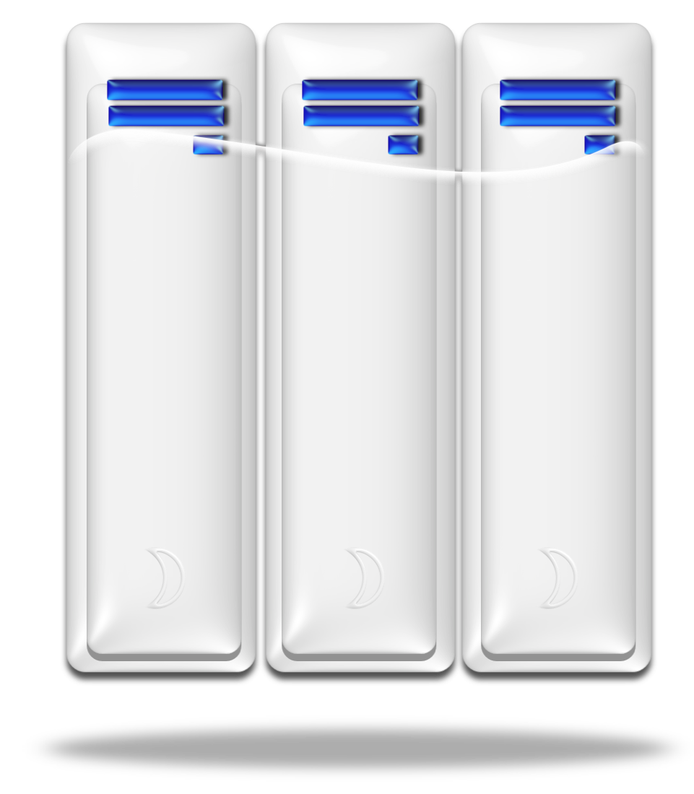
SIP Call Flow Example with B2BUAs
B2BUA #1
B2BUA #2
UA #2
UA #1
INVITE
INVITE
100 Trying
INVITE
100 Trying
180 Ringing
180 Ringing
180 Ringing
200 OK
200 OK
200 OK
ACK
ACK
ACK
Media
Media
Media
BYE
BYE
BYE
200 OK
200 OK
200 OK
There are no standards for B2BUA

Slide 37
SIP and PSTN
SIP can interoperate with telephone network
Use of Phone numbers
Can be included in SIP URIs
Can use tel URIs
Gateways interwork SIP with PSTN
Signaling Conversion: SIP to ISUP (or ISDN D-channel)
Media Conversion: RTP to PCM trunk (or B-channel)
Gateway looks like a:
Telephone Switch (Class 5) to the PSTN
User Agent to the SIP network
Early Media

Slide 38
Telephone Numbers
Dial strings
What a user dials on a keypad
Dial plan converts into a full telephone number
E.g. 93145551212
Private Number
Extension - 5 digits or 7 digits
Managed within an enterprise or campus
E.g. 6000
Local Number
Valid within a geographic area
E.g. 935-6000
Global Number
Includes Country Code, Area Code and full number
E.g. +1 314 935 6000
E.g. +44 20 7930 4832
Separators
Dot, space, dash, parentheses are common
Notes:
Dial 9 for an outside line...

Slide 39
SIP and Telephone Numbers
SIP can use telephone numbers
Can be encoded as SIP URIs or natively as Tel URIs
Tel URIs
RFC 3966
Can be used in many SIP fields but:
NOT in INVITE/200 Contact, Record-Route, or Route URIs
Can be used in To, From, 3xx Contact
Can be used in HTML
For having RFCs read aloud, call
<a href="tel:+1-555-438-3732">1-555-IETF-RFC</a>.
Global telephone numbers (E.164) use is recommended for SIP
The Internet has no geographic limitations
Notes:
Could use Tel in To, From, 3xx Contact
E.g. putting 7 digit phone numbers in your mobile phone address book
Putting country code phone numbers (E.164) in your mobile phone address book

Slide 40
Telephone Number URI Examples
Tel URI Examples
tel:+13149352000
tel:8005558355;phone-context=+1
tel:2000;phone-context=wustl.edu
tel:+44-20-7930-4832
Tel URI Converted to SIP URI Examples
sip:+13149352000@provider.example.com;user=phone
sip:8005558355;phone-context=+1@fw.example.net;user=phone
sip:2000;phone-context=wustl.edu@gw.wustl.edu;user=phone
sip:+44-44-20-7930-4832@royal.gov.uk

Slide 41
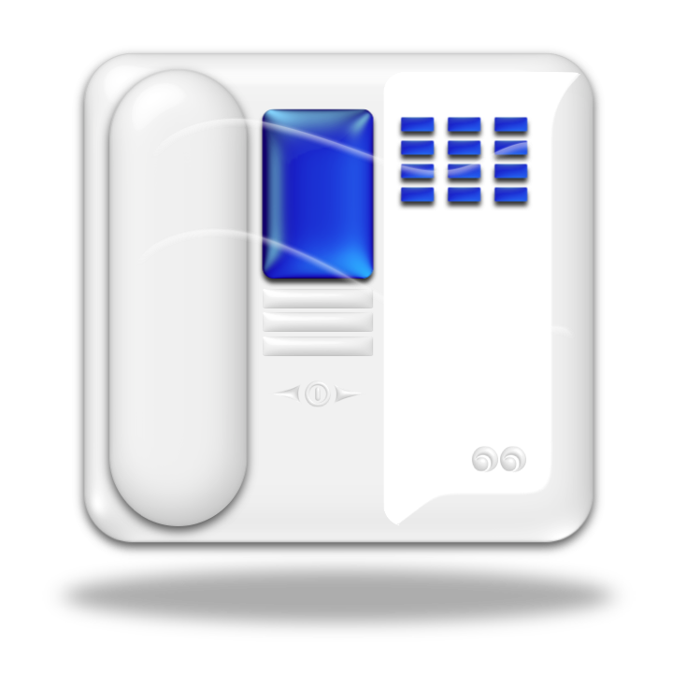
SIP and PSTN Interworking
SIP Phone
Proxy Server
SIP/PSTN Gateway
PSTN Switch
PSTN Phone
Setup
INVITE
INVITE
180 Ringing
180 Ringing
Alerting
Ringback Tone
200 OK
200 OK
Answer
ACK
ACK
Media RTP
PCM
Notes:
Call 485 4520 for Gizmo client.
SIP/PSTN interworking has been around almost as long as SIP. This example shows how SIP maps to ISUP (ISDN User Part), the signaling protocol of PSTN SS7 networks.

Slide 42
SIP and PSTN Interworking
UA2
Proxy Server
SIP/PSTN Gateway
INVITE
INVITE
The 183 Session Progress response is used along with “early media” RTP packets to provide “inband” call progress indicators.
100 Trying
183 Session Progress
183 Session Progress
RTP Early Media Session
Early media sent from the PSTN can be ringback tone or recorded announcements
Any early media received is played to user.
200 OK
200 OK
ACK
ACK
RTP Media Session
Details in “ISUP to SIP Mapping” RFC 3398 by G. Camarillo et al.
SIP/PSTN Call flows in RFC 3666 by A. Johnston et al.
Notes:
+442079304832
SIP/PSTN interworking has been around almost as long as SIP. This example shows how SIP maps to ISUP (ISDN User Part), the signaling protocol of PSTN SS7 networks.
In case in-band ringing or announcements, so called “early media”, is used in the PSTN, the 183 Session Progress response is used to establish a SIP early media session.

Slide 43
PSTN Call Flow Example
ISDN Telephone Switch
SIP/PSTN Gateway
Proxy Server
Database
SIP Phone
Setup CdPn=+6512345 M1
INVITE sip:+6512345@gw.carrier.com M2
+6512345? M4
100 M3
sipphone@home.com M5
INVITE sipphone@home.com M6
180 M7
180 M8
200 M10
Alerting M9
200 M11
Connect M12
ACK M13
PCM Speech
RTP Media

Slide 44
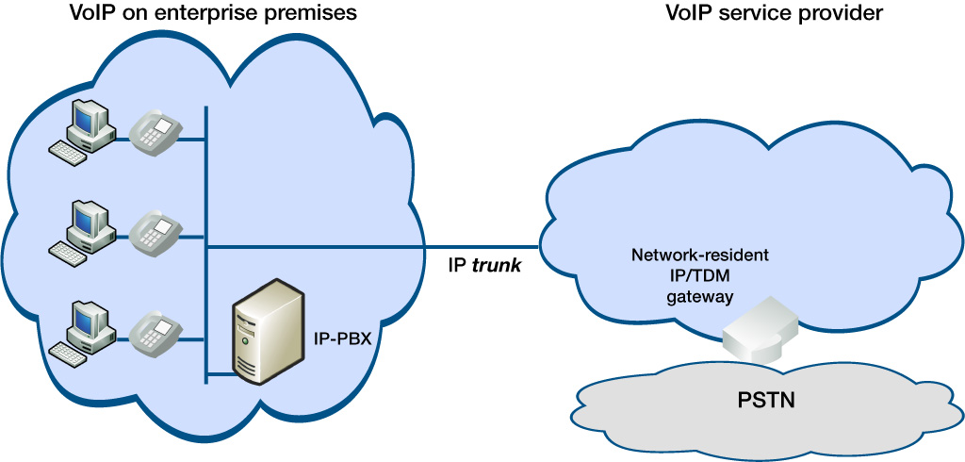
VoIP innovations: SIP Trunking
Connecting IP PBXs directly to VoIP service providers provides significant advantages: More features, less cost

Slide 45
Features
SIP Connect is a interface recommendation and covers areas such as:
Use of TLS transport for SIP
Phone number representation (E.164 SIP URI or Tel URI)
Authentication (SIP Digest or TLS certificate validation)
Codec support (G.711 mu and A law)
DTMF transport (telephone events and in-band)
Identity and Privacy – use of P-Asserted-Identity and Privacy header fields
Version 1.0 was published in 2008.
Version 1.1 has just been finished and is in the process of being approved by the SIP Forum Board of Directors
http://www.sipforum.org/sipconnect

Slide 46
Voice Processing Steps
Coding (Codec)
A/D conversion - How many bits per sample?
Low Pass Filtering - What is the frequency spectrum?
Sampling - How often do you sample?
Packetization
How many samples do you carry in a datagram?
Add Real-time Transport Protocol (RTP) header
Transport over Internet
User Datagram Protocol (UDP)
Depacketization
Remove RTP header
Buffering - How long do you hold samples before beginning playback?
Decoding (Codec) D/A conversion
Playback

Slide 47
Voice and video delays for RTC
For interactive communications, end to end delay needs to be less than 150ms
Many sources of delay
Codec delay
At least one sampling or frame interval
Audio packetization delay
At least one packet interval
Typically 20ms
Transport delay
Due to router buffering and forwarding
Buffering delay
Delay introduced at receiver to deal with jitter
Lip synchronization requires similar delays for video

Slide 48
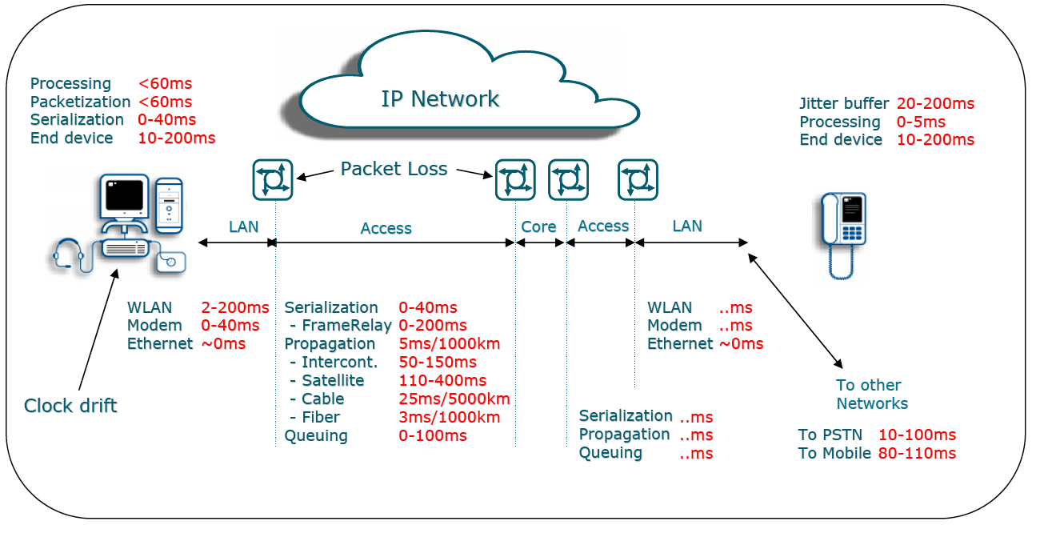
Delay & Packet Loss Sources
http://portal.etsi.org/stq/workshop2003/presentations2003/06HenrikAstromPresentation%20.pdf

Slide 49
Audio Impairments
Clipping
Due to incorrect level control during A/D
Can be due to microphone levels - good software adjusts automatically (AGC)
“Tinnyness”
Band-limited signals
Due to low pass filtering and/or sampling rate
Breakup
Packet burst loss
Packets discarded by routers in the Internet, wireless
Packet discard
Discarded by receiver due to out of order or late arrival of packets

Slide 50
PSTN Codecs used in VoIP
Standardized by ITU
Lots of IPR
Designed for circuit-switched networks where packet loss is not present
Designated G.7xx
Examples
G.711 (PCM)
G.729A
G.723
Mobile phones
GSM

Slide 51
Audio Codec Approaches
Simple sampling - PCM - Pulse Coded Modulation
8 bits per sample, 8000 Hz sampling
64kb/s
Uses non-linear filtering (companding) to expand dynamic range
Known as G.711 with two companding algorithms
μ law - used in North America & Japan
A law - used in the rest of the world
Codec used throughout PSTN
Linear Prediction Codecs (LPC)
Model of vocal tract and excitation used
Parameters of model sent
Error between prediction and actual sent
CELP - Code Excited Linear Prediction

Slide 52
High quality (“HD”) voice codecs
“CD Quality” is 10bits at 44kHz sampling: 440kb/s!
Wide band audio codecs can use higher sampling rates and additional bits
G.722 uses 16kHz and 8 bits
Can use more advanced encoding
Based on model of how hearing works (MP3)
Based on known limitations of jitter and packet loss on Internet (iLBC)
Opus Codec being standardized in IETF in CODEC Working Group

Slide 53
Voice codec “tricks”
Voice Activity Detection (VAD)
Usually only one party talks at a time
Can reduce bandwidth by 50% but risk clipping
Comfort Noise Generation (CNG)
Used when VAD is activated
Silence makes user think phone is “dead”
Packet Loss Concealment (PLC)
Interpolation
Replay of previous packet
Silence insertion
Variable Bit Rate (VBR)
Change bit rate based on conditions
Forward Error Correction (FEC)
Send additional information that allows reconstruction of missing packets
Adaptive Jitter Buffer
Changing size of buffers with conditions
Adaptive codecs have an embedded control channel (ex: AMR-WB)

Slide 54
Voice and Video on the Internet
NVP (Network Voice Protocol)
1977
RTP (Real-time Tranport Protocol) developed in 1992
First published as RFC in 1996
Still used today for VoIP and with SIP
Mbone - Internet multicast backbone
A/V multicast of IETF meetings starting in early ‘90s
SAP (Session Announcement Protocol)
TV Guide for broadcast media
Led to development of SIP
ITU H.323 video telephony standard
Used RTP for media
RTSP - Real Time Streaming Protocol

Slide 55
RFC 3550
Real time Transport Protocol (RTP)

Slide 56
Real-time Transport Protocol RTP
RFC 3550
Obsoletes RFC 1880
Bit encoded header
Provides a container for media
Voice
Video
Text
RTP streams are unidirectional and single media.
A bi-directional voice and video session is actually 4 RTP streams
Each RTP stream usually received on different UDP port
Requires a signaling protocol to establish and negotiate sessions
But does have a simple RTP Control Protocol (RTCP)
RTCP operates on a separate port from RTP

Slide 57
Secure Profile for RTP (SRTP)
Adds encryption and authentication to RTP
Uses efficient algorithm that does not increase packet size
Can be implemented on all devices
Uses symmetric keys which must be kept secret
Key management
Common approaches include SDES, DTLS-SRTP, ZRTP, etc.
Ref: RFC 3711

Slide 58
Media Negotiation
At start of an Internet Communications session, both sides need to agree on:
Codec to use
Sampling rate & bit rate
Use of silence suppression
Compression
Error Correction
Other optional parameters
How many samples per packet
Any options for this codec

Slide 59
Media over TCP??
Done for NAT traversal
Requires framing
RFC 4571
Need to manage retransmissions
Need to manage roles in connection
Active: opens the connection
Passive: listens for open requests

Slide 60
RFC 4566
The Session Description Protocol (SDP)

Slide 61
Session Description Protocol (SDP)
Used to describe media session
Developed and extended by MMUSIC WG
Multiparty Multimedia Session Control
Carried as a message body in SIP messages
Text-based protocol
Uses RTP/AVP Profiles for common media types
Defined by RFC 4566
Obsoletes RFC 2327
SIP use of SDP based on Offer/Answer model RFC 3264

Slide 62
SDP Usage with SIP Example
Version number: always 0
Origin:
o=<username> <sess-id> <sess-version> <nettype> <addrtype> <unicast-address>
Session ID and Version are usually NTP timestamps
Session name: usually just contains a dash or space
Connection Data: (IP Address for receiving media - 100.101.102.103)
Timing: Start and stop times for a session, set to 0 for real-time sessions
Media: (type - audio, port - 49170, protocol RTP/AVP Profile – 0, 97, 98)
m=<media> <port> <proto> <fmt> ...
Listed in order of preference
Attributes
RTP/AVP 0 is PCM μ Law (64kb/s)
RTP/AVP 97 (dynamic payload) is Internet Low Bit Rate Codec (iLBC) RFC 3952
RTP/AVP 98 (dynamic payload) is for telephone events (DTMF) RFC 2833
v=0
o=schroed5244 289084526 28904529 IN IP4 100.101.102.103
s=-
c=IN IP4 100.101.102.103
t=0 0
m=audio 49170 RTP/AVP 0 97 98
a=rtpmap:0 PCMU/8000
a=rtpmap:97 iLBC/8000
a=rtpmap:98 telephone-event/8000
Note: The line break in o= line is not allowed
Notes:
This is the SDP message body not shown in the previous example. SDP uses a terse syntax in which a strict order of lines is enforced.
SIP utilizes on a subset of the SDP information which includes the IP address (100.101.102.103) and port number (49170) at which the UA is listening for media, the media type (audio), Audio Video Profile (AVP) number (0), codec type (PCM μ-law), and sampling rate (8000 Hz).

Slide 63
Audio & Video Example
Offer
v=0
o=alice 2890844526 2890844526 IN IP4 host.atlanta.example.com
s=
c=IN IP4 host.atlanta.example.com
t=0 0
m=audio 49170 RTP/AVP 0 8 97
a=rtpmap:0 PCMU/8000
a=rtpmap:8 PCMA/8000
a=rtpmap:97 iLBC/8000
m=video 51372 RTP/AVP 31 32
a=rtpmap:31 H261/90000
a=rtpmap:32 MPV/90000
Answer
v=0
o=bob 2808844564 2808844564 IN IP4 host.biloxi.example.com
s=
c=IN IP4 host.biloxi.example.com
t=0 0
m=audio 49174 RTP/AVP 0
a=rtpmap:0 PCMU/8000
m=video 49170 RTP/AVP 32
a=rtpmap:32 MPV/90000
An audio and video session has been negotiated

Slide 64
RFC 5359
SIP Service Examples

Slide 65
SIP Service Examples
Call Hold
Music on Hold
Unattended Transfer Consultation Hold
Unconditional Call Forwarding
Attended Transfer
No Answer Call Forwarding
Busy Call Forwarding
3-way Call
Incoming Call Screening
Find-Me
Call Pickup
Call Park
Outgoing Call Screening
Automatic Redial
Click to Dial
RFC 5359

Slide 66
RFC 3665
SIP Basic Call Flows

Slide 67
SIP Basic Call Flows
Successful New Registration
Update of Contact List
Request for Current Contact List
Cancellation of Registration
Unsuccessful Registration
Successful Session Establishment
Session Establishment Through Two Proxies
Session with Multiple Proxy Authentication
Successful Session with Proxy Failure
Session Through a SIP ALG
Session via Redirect and Proxy Servers with SDP in ACK
Session with re-INVITE (IP Address Change)
Unsuccessful No Answer
Unsuccessful Busy
Unsuccessful No Response from User Agent
Unsuccessful Temporarily Unavailable
RFC 3665

Slide 68
RFC 3666
SIP PSTN Call Flows

Slide 69
SIP PSTN Call Flows
Successful SIP to ISUP PSTN call
Successful SIP to ISDN PBX call
Successful SIP to ISUP PSTN call with overflow
Session established using ENUM Query
Unsuccessful SIP to PSTN call: Treatment from PSTN
Unsuccessful SIP to PSTN: REL w/Cause from PSTN
Unsuccessful SIP to PSTN: ANM Timeout
Successful PSTN to SIP call
Successful PSTN to SIP call, Fast Answer
Successful PBX to SIP call
Unsuccessful PSTN to SIP REL, SIP error mapped to REL Unsuccessful PSTN to SIP REL, SIP busy mapped to REL
Unsuccessful PSTN->SIP, SIP error interworking to tones
Unsuccessful PSTN->SIP, ACM timeout
Unsuccessful PSTN->SIP, ACM timeout, stateless Proxy
Unsuccessful PSTN->SIP, Caller Abandonment
Successful ISUP PSTN to ISUP PSTN call
Successful FGB PBX to ISDN PBX call with overflow
RFC 3666

Slide 70
SIP Complexity and an option for ‘simple SIP’: RFC 5638

Slide 71
The Session Initiation Protocol (SIP) and the Real Time Transport Protocol (RTP)
Discover the remote (called) party
Negotiate session parameters (codecs, etc.)
Establish session
Modify session
End session
Services
Telephony (PBX-like, for agents, etc.)
Presence
IM
Conferences
Chat rooms
SIP can provide the applications (services)
“in the network” using servers, or
end-to-end
XMPP and H.323 services are only “in the network”
DNS
Loc DB
biloxi.com? IP
Bob?
IP of Bob
SIP Srv
SIP Srv
3 INVITE
2 INVITE
4 INVITE
1 REGISTER
SIP UA
5 RTP
voice, video, text
SIP UA
sip:alice@atlanta.com
sip:bob@biloxi.com

Slide 72
The ugly, later parts in SIP
DNS
Loc DB
Internet
biloxi.com? IP
Bob?
IP of Bob
SIP
SIP Srv
SBC
SBC
SIP Srv
RTP media
SBC
SBC
NAT
NAT
SIP UA
SIP UA
sip:alice@atlanta.com
sip:bob@biloxi.com
NAT impedes Internet transparency
Session border controllers breaks transparency
VoIP and IM networks are closed vertical stacks
(pay for roaming, hide from competitor, emulate telephone net)
Legend:
NAT: Network address translation
SBC: Session border controller

Slide 73
Problem: VoIP infrastructure complexity
DNS, ENUM (tel number mapping): Server operations, cost of services
SIP registrar and proxy server farms - several locations
Presence servers
Component servers:
Announcements, voice mail, media servers, conference servers
Session border controllers
Softswitches: Local switch emulation, PBX
Media servers
Network elements for QoS
Policy servers
Network management
Voice quality monitoring probes
Network engineering (there is no automatic SIP routing protocol)
System integration and regression testing after every change
VoIP network IT systems for all the above
Customer data placement in network elements (with customer churn)
The sum of all = IMS (IP Multimedia Subsystem for 3G wireless)

Slide 74
Overall carrier wire & wireless IMS architecture
Ut
Rf
/Ro
Ut
Application Servers
Rf
/Ro
Charging
Functions
Sh
Rf
/Ro
UPSF
ISC
Dh
Iw
Cx
Dx
SLF
IWF
P3
Ib
PSTN
Emulation (R2)
IMS /
PSTN
Simulation
Mw
Mw/Mk/Mm
I/S
-
CSCF
IBCF
Ic
AGCF
P2
Mi
Mk
Mw
BGCF
Mk
Mr
Mj
Gq
'
e2
P
-
CSCF
Mg
MGCF
SGF
MRFC
Ie
Other IP Networks
P1
Gq
Gq
'
Network
Gm
'
PSTN/ISDN
Attachment
SPDF
Resource &
Admission
Control
SPDF
Mp
Mn
Resource &
Admission
Control
Subsystem
A-RACF
e4
MG
Re
Ia
MRFP
T
-
MGF
UE
I
-
BGF
RCEF
BGF
IP Transport (Access and Core)
CNG
-

Slide 75
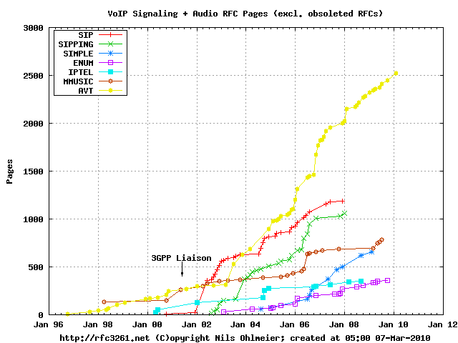
SIP & related IETF standards

Slide 76
SIP and competing protocols
Standards based | SIP | IETF, ITU-T, 3GPP, OMA, ETSI | Universally supported by service providers and IT networks High complexity to emulate legacy telephony >12 years of age, success & disappointment (apps)
 | H.323 | ITU-T | Legacy, ISDN based multimedia conferencing, replaced by SIP
 | XMPP | IETF | Successful Jabber IM, but little voice impact. Avoided by voice providers. Google voice is not XMPP compliant.
Proprietary | P2P multimedia calling | Ex: Skype | By far the world largest VoIP service, includes conference and desktop sharing
 | Voice | Example: Digium IAX | For interconnecting of open source Asterisk PBXs. Successful due to its OS code.
 | Web Conference | Acrobat Connect, GoToMeeting, Webex, etc. | Advanced multimedia conferencing and desktop collaboration. There are a large number of Web conference services and software available.

Slide 77
Simple usage scenario for SIP
An alternative to “SIP services” in the network
Tool set for implementations includes NAT traversal, ID, encryption
Applicable for CS and P2P SIP
SIP for (1) rendezvous and (2) session setup only (~10 ref’s + info’s)
All applications reside in endpoints (PSTN gateways are special endpoints)
Eliminate all “network services” (the Internet is the service)
Avoid new SIP standards & extensions to support various business models:
Are not scalable
Ever new business models may be not of interest for everyone
SIP routing (exceptions such as ACD):
Make it basically unaware of apps
No awareness of user data and the associated policies in network elements
RFC 5638

Slide 78
SIMPLE: SIP Presence and IM
Based on
RFC 3856: “A Presence Event Package for SIP” by J. Rosenberg, IETF, Aug. 2004

Slide 79
Initial presence and IM initial models
…the service provider concepts…
Presence Service
Instant Message Service
Presence Protocol
IM Protocol
IM
IM
Presentity
Watcher
Sender
Instant Inbox
Presence UA
Watcher UA
Sender UA
Inbox UA
Principal
Principal
Principal
Principal
The presence model
The instant message (IM) model

Slide 80
CS and P2P presence and IM models
Server
Server or P2P overlay
UA
UA
UA
UA
UA
UA
UA
UA
Client Server
Peer-to-peer

Slide 81
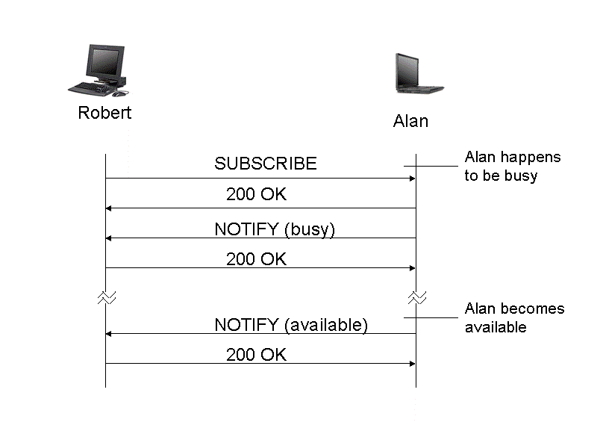
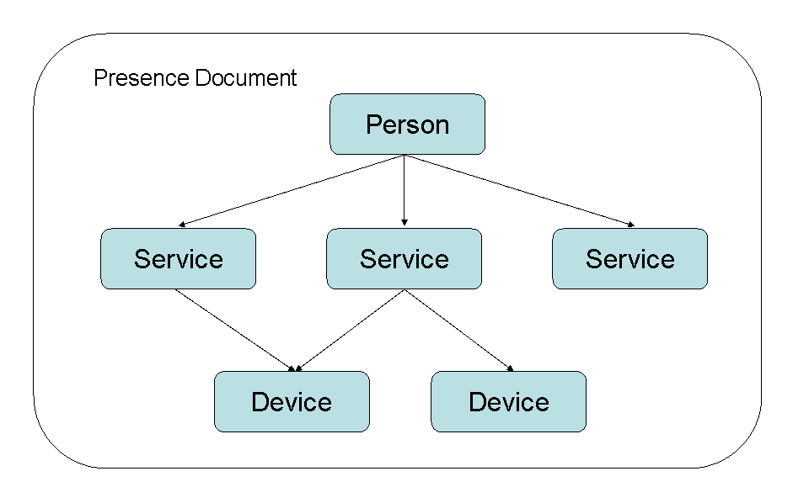
Basic presence messages and documents
Courtesy Robert Sparks: “SIP Beyond VoIP”, VON Magazine Books, July 2005

Slide 82
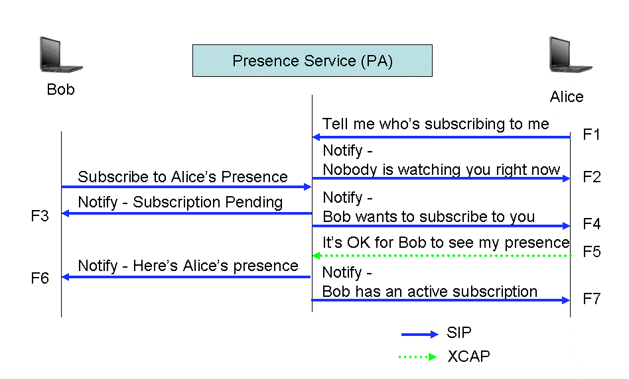
Presence service using XCAP documents
Courtesy Robert Sparks: “SIP Beyond VoIP”, VON Magazine Books, July 2005

Slide 83
NAT traversal for SIP & RTP
(for networks without SBCs)

Slide 84
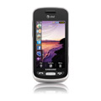
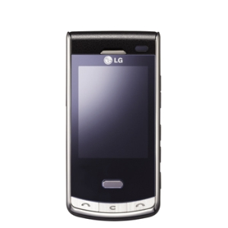
NAT traversal drives RT apps design
Internet
Public IP Address Realm
interdomain
Multi
homed
ISP NAT
NAT
NAT
NAT
NAT
ISP network
ISP network
Enterprise network
Residential
NAT
Residential
NAT
Residential
NAT
Residential
NAT
hairpin
Home network
Home network
Home network
Home network
SIP UAs must connect to each other through all NATs

Slide 85
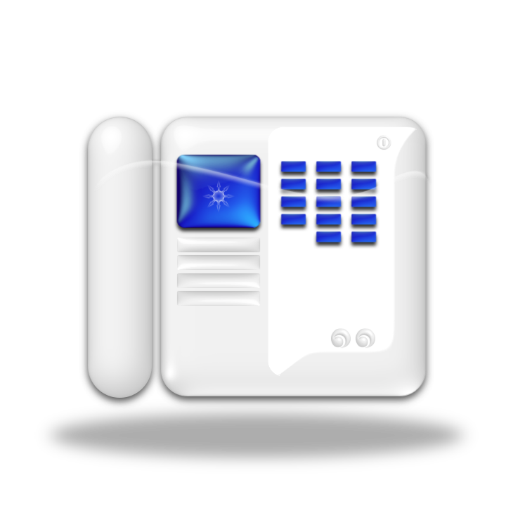
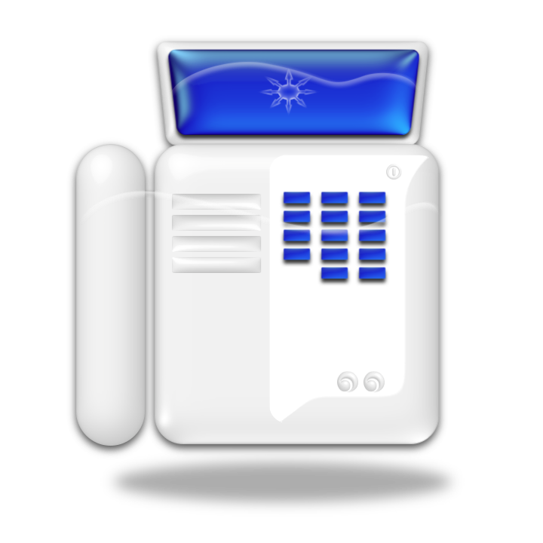
The NAT has to “Behave”
NAT behaviors for Unicast UDP
Endpoint Independent (good)
X1’:x1’ = X2’:x2’ for all Y:y
Address Depending (bad)
X1’:x1’ = X2’:x2’ only if Y2=Y1
Address & Port Depending (worst)
X1’:x1’ = X2’:x2’ only if Y2:y2=Y1:y1
Source1’ X1’:x1’ Destination1 Y1:y1
Source1 X:x Destination1 Y1:y1
Host Y1
Source2 X:x Destination2 Y2:y2
Host X
NAT X1, X2
Requirements
Endpoint independent
IP address pooling
Port assignment behavior
No port overloading
Port parity preservation
Port contiguity
Outbound mapping refresh
Source2’ X2’:x2’ Destination2 Y2:y2
Host Y2
Internal
External
Legend
X;x = IP:port (aka Transport Address)
RFC 4787, http://www.ietf.org/rfc/rfc4787.txt
85
Notes:
85

Slide 86
Tunneling for Firewall Traversal (bad or practical idea?)
Port numbers range from 0 to 65536
Examples of well known ¹ (reserved) ports: 0 to1,024, or use DNS SRV ³.
Port Number | Protocol
19-21 | File Transfer
23 | Telnet
25 | SMTP
53 | DNS
80 | HTTP
123 | Network Time Protocol
Port 80 is most often used for tunneling and should be blocked for IPSec w. Firewall ^{2.} along with other unused ports
Tunneling various protocols “under false name” (for example port 80) is a violation
Tunneling violations are a security risk that may require deep packet inspection
But deep packet inspection by service providers may be a privacy violation
Right approach: Cooperation with the IT department on firewall policy.
1. http://www.iana.org/assignments/port-numbers
2. http://www.microsoft.com/technet/prodtechnol/exchange/2003/security.mspx
3. draft-lear-iana-no-more-well-known-ports-01.txt

Slide 87
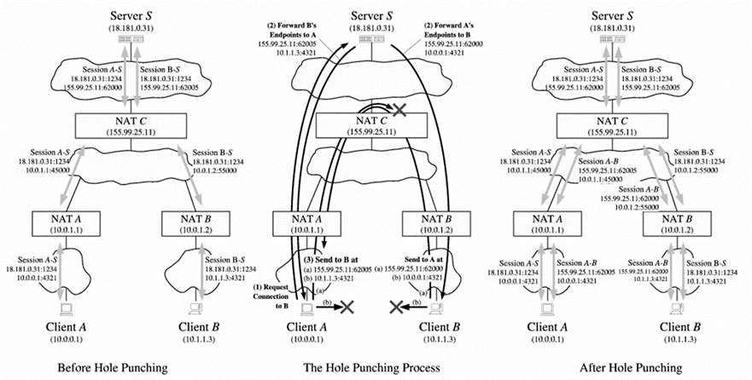
The hole punching approach (gaming)
B. Ford et al: “Peer-to-Peer Communication Across Network Address Translators”
http://www.brynosaurus.com/pub/net/p2pnat/

Slide 88
NAT check test method
Srv1
Srv2
Srv3
Test method for UDP
Ping to servers 1 and 2
OK if both report the same public IP address
Srv2 reports IP to Srv3 which pings the client. OK if ping is seen by client.
2nd UDP port to check the hairpin translation of the NAT
Test method for TCP
Similar, but using SYN and TCP timeouts
Internet
X
NAT
Private Network
1st UDP port
2nd UDP port
Client
B. Ford et al: “Peer-to-Peer Communication Across Network Address Translators”
http://www.brynosaurus.com/pub/net/p2pnat/

Slide 89
Testing for NAT traversal
Believing in a NAT traversal approach without testing is misplaced trust
RFC 4787: “NAT Behavioral Requirements for UDP” shows that several Internet IP addresses are required for testing single layer NAT
Multilayer NAT require test servers in every layer. This may be hard to implement
Several NAT test tools are available
Microsoft Internet Connectivity Evaluation Tool for basic full cone NAT test http://www.microsoft.com/windows/using/tools/igd/default.mspx
Nat Check for P2P http://midcom-p2p.sourceforge.net/
Required for proof: Large scale testing over the Internet using a web site
Required for customer support: NAT diagnostic tool
UDP testing: http://www.brynosaurus.com/pub/net/p2pnat
TCP testing: http://www.guha.cc/saikat/pub/imc05-tcpnat.pdf /
Using STUN: http://www.ietf.org/rfc/rfc5780.txt

Slide 90
STUN: Session Traversal Utilities for NAT
Binding request scenario
Client makes binding request
Server returns the external (mapped address)
The mapped address is used in SIP requests (INVITE, OK). XOR-mapped (with 16 bits of magic cookie) is used to avoid IP address changes in various intermediaries
Shared secret request scenario
Short term credentials during a session
Long term credentials; provisioned
NAT1
NAT2
Reflexive IP address/port
Internal IP address/port
STUN Client
STUN Server
Server address is provisioned or discovered w. DNS SRV
STUN can be collocated w. other servers
XOR-mapped address/port
Mechanisms:
For DNS aided STUN server discovery, redirection to alternate server, fingerprints, 2 credential modes (short/long term)
RFC 5389: “Session Traversal Utilities for NAT (STUN)” by J. Rosenberg, IETF, October 2008

Slide 91
Managing client initiated SIP connections (SIP outbound)
Outbound scenario
UA registers via SIP proxy 1
UA has the instance-id (AOR)
Flow via proxy has the reg-id
Outbound effectively makes one UAC look like two UACs to the registrar.
STUN keepalives monitor the flow
Flow has failed (UA, NAT reboots, etc.)
UA replaces old flow
Old instance-id and new reg-id
Incoming requests go to any proxy
Last registration is used first
Meets complex list of requirements
Q: How does this work in P2PSIP?
reg-id
Proxy 1
UA
Registrar
instance-id
(sip.instance)
Proxy 2
STUN bindings for keepalives
NAT/FW
Incoming request to any proxy
RFC 5626

Slide 92
STUN usages
1 | Interactive Connectivity Establishment (ICE) | http://www.rfc-editor.org/rfc/rfc5245.txt
2 | Client-initiated connections for SIP | http://www.rfc-editor.org/rfc/rfc5627.txt
3 | NAT Behavior Discovery | http://www.rfc-editor.org/rfc/rfc5780.txt
4 | STUN Utilities | http://www.rfc-editor.org/rfc/rfc5389.txt

Slide 93
Traversal Using Relays around NAT (TURN)
Only for address/port dependent “bad” NATs – relays are expensive (BW) and add delay to voice
Internal remote transport address
Internal local transport address
External local transport address
Internal remote transport address
Client requesting allocations
binding
binding
binding
STUN Client
NAT
STUN/TURN Relay
External Client
Internal 5-tuple
External 5-tuple
(over) simplified call flow has 24 messages
RFC 5766

Slide 94
Interactive Connectivity Establishment (ICE) scenario
SIP
Srvr
Relayed Candidate
Internet
STUN
Srvr
Sever Reflexive Candidate
SIP signaling
Send candidates to remote agent
NAT
NAT
Host Candidate
Agent
L
Agent
R
Note: Two servers; at app level and transport level are required
RFC 5245

Slide 95
Peer-to-peer SIP

Slide 96
Overlay Network
Back to the Internet as it was designed: e2e
Application
Transport
Network
Data link
Physical
Application
Application
Transport
Transport
Network
Application layer
Network
Data link
Data link
Physical
Physical
Nothing in the middle
IP Routing

Slide 97
SIP Session Setup Options
Query chain of SIP proxy servers (service providers)
Query another SIP peer node in P2P SIP
Query one SIP proxy server (PBX)
Discovery of remote address
Setting up the session
Query DNS for IP address
Caller
Called
Get URI of destination out of band:
Business card
E-mail
Phone call
INVITE
Caller IP/port for media and codec choices
180 Ringing (or 183 Session Progress)
200 OK
Called IP/port for media and selected codec
Legend
DNS: (Internet) Domain Name System
PBX: Private Branch Exchange
URI: Uniform Resource Identifier
SIP messages: INVITE, 180, 200 OK, ACK
ACK
RTP media packets

Slide 98
P2P SIP System
Enrollment Server
CN
CN
CN
Bootstrap Server(s)
Peer protocol
Client protocol
PN
PN
CN
P2P SIP
DNS CS SIP
CN
PN
Proxy
Virtual circle or some other geometry
CN
other
PSTN
Legend
CN: Client node
PN: Peer (various functions)
Proxy: SIP proxy server,
is another PN
PN
CN
CN
CN
“Concepts and Terminology for Peer to Peer SIP”, I-D: draft-ietf-p2psip-concepts

Slide 99
Are there servers in P2P?
No VoIP, presence and IM servers, but
Login server to monetize and control
Service delivery: Issue a crypto key pair (simplest possible)
This is the automation of service delivery
Download server for SW and updates
Gateways to PSTN and mobile providers

Slide 100
Characteristics of P2P Communications (summary)
Decentralized – resilient
Self organizing (automation)
Scalable from SOHO to Internet size
Minimal cost of ownership
The peers are the network
No VoIP infrastructure:
VoIP providers, IMS, TISPAN
No 7x24 operations payroll
No understanding is required (high usability)
No IT systems (OSS) for VoIP network elements

Slide 101
Combining Real Time Applications (RTA) with Rich Internet Applications (RIA) in the endpoint

Slide 102
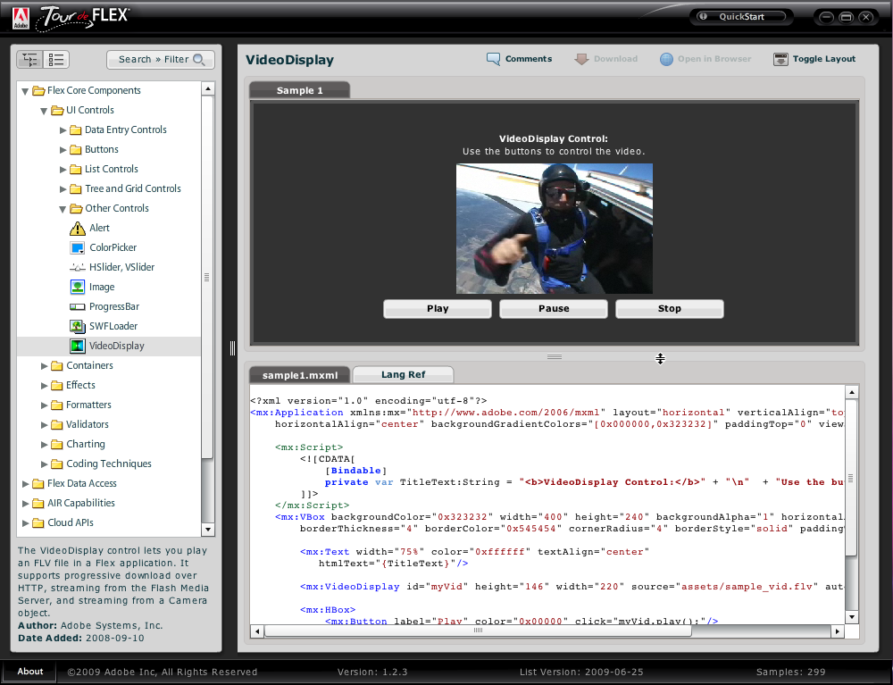
Example of a RIA component: Video Display Control
http://www.adobe.com/devnet/flex/tourdeflex/ (has also IM chat widget)

Slide 103
The REST Architecture for the Web
Resources
Three (only) standard Web components:
Address: URI, URL
App transport protocol: HTTP
Payload: HTML (XHTML, HTML5)
Proprietary payloads can be carried in HTTP and may dominate the market : Streams, players, virtual machines (VM) such as Flash, Silverlight, add-inns, etc.
Client
(browser)
Proxy
Server
Rich client:
Apps & local resources/OS,
Players & VM
(Flash, Silverlight, Java)
DB & apps
Gateway
To other networks
(ex: telecoms)
Representational State Transfer (REST)
Client-server architecture
Resource is anything meaningful that has a URI (address), provides the loose coupling*
Request-response to transfer the representation of resources (documents)
Client application state changes with response from resource (the transfer)
Caching proxies are used in content distribution networks (CDN such as Akamai)
*Note: Loose coupling can support the huge scalability of the Web

Slide 104
Since SIP has emerged as THE VoIP Standard
HIP: IPv6 conversion, mobility, multi-homing, NAT traversal for all apps
P2P: Bittorent, Skype, Distributed Hash Table (DHT)…
Cloud computing (infrastructure, platform, software; ‘as a service’)
The Darwinian web has only 3 components*: URL, HTTP, HTML
REST architecture – formal definition
Webmail to complement mail retrieval protocols
Wikis & Blogs
Social networks and media
Web conferencing and applications sharing
Voice chats without SIP
Office apps (word processing, spreadsheets, slides)
Enterprise applications (ex: http://salesforce.com)
Streaming HTTP, etc.,…
Advanced software development tools for Web applications, OOP languages, IDE, testing, etc.
Communications have changed
Outside of IETF standards
Voice is mostly missing: RIA and VoIP need each other
* VoIP must adopt the same simplicity for ~20M application developers
Notes:
HIP is vital in our opinion for SIP to survive
This deserves however a whole session by itself.

Slide 105
Web Real-Time Communications
Adds to HTML5 effort to add new functionality to web browsers
W3C API for RTC application
Extend new <audio> and <video> beyond streaming to real-time audio and video sessions
Avoid plug-ins or downloads
IETF: Media transport, NAT traversal, Codecs
Joint W3C/IETF effort
Current effort is limited to handling media
Future work could include standardizing signaling
Issues:
Licensed vs. free codecs
Native platform apps vs. Web apps
Application standards vs. flexibility and innovation
W3C history and timeline for W3C (2003 to 2022 is 19 years!)
HTML(X) and VM such as Flash or Silverlight are complementary (animation, interactivity, IDE)

Slide 106
Work is Starting!
In the IETF, discussion is underway in the DISPATCH Working Group about the formation of new WG
http://tools.ietf.org/html/draft-alvestrand-dispatch-rtcweb-protocols
Will be discussed at IETF-80 next month
Work will be focused on protocols and profiles
In the W3C, a new proposed WG is being discussed
http://rtc-web.alvestrand.com/w3c-activity
Work will be focused on APIs and tags
Research project at IIT
http://voip.itm.iit.edu/
http://kundansingh.com/project-web.html

Slide 107
Emerging standards for RTC-Web
IETF | RTC-Web: Network protocols and A/V codecs, NAT traversal
W3C | APIs for Rich Clients for use by Web developers
Server
Data
Client
NAT(s)
Client
GWY
Other networks
RT Media (A/V)
Gateways are a special type of clients:
Domain specific limitations (ex: telephony)
One or many users
STUN/TURN
Browser to browser media is the main focus
Signaling is out of scope. See the I-D: SIP API for Web Communications.
Reuse SDP, RTP, STUN, ICE, SRTP, DTLS (as is?)
Major issues: Video codec (H.264 or OS/free VP8, Theora)
Compatibility with legacy SIP VoIP and XMPP chat

Slide 108
Conclusions
VoIP ‘as is’
Emerging transformations
IETF (end 90s) SIP developed for open, e2e Internet communications multimedia, based on HTTP. Dislocates ISDN based H.323.
SIP modified by telcos/cable to monetize using telephony models. Global standard.
SIP Forum is addressing operator issues
IETF XMPP developed for chat using XML
P2P (Skype) disrupts the above
Unified Communications adds email to VoIP
VoIP is separate from Web applications
RTC in the browser uses Web technology
Social network apps on smart mobiles
VoIP integrated in Web and in social media (what happens to the VoIP “call” models and to the VoIP network infrastructure?)

Slide 109
SIPNOC Dates and Venue
April 25-27, 2011 at Hyatt Dulles Hotel, Herndon, VA
Developed for the technical and operational staff of service providers, including engineers.
Features special keynote from Doug Sicker, Chief Technologist, FCC
Dr. Eric Burger serving as Program Chair
Early-Bird Discount and Special 50% Discount for SIP Forum Full Members (min 2 registrants from Full Member company)

Slide 110
Q&A

