Slide 1
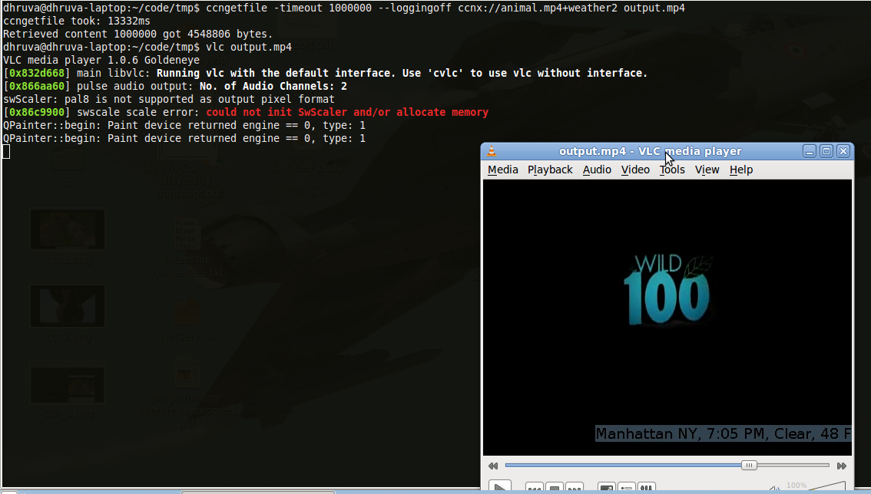
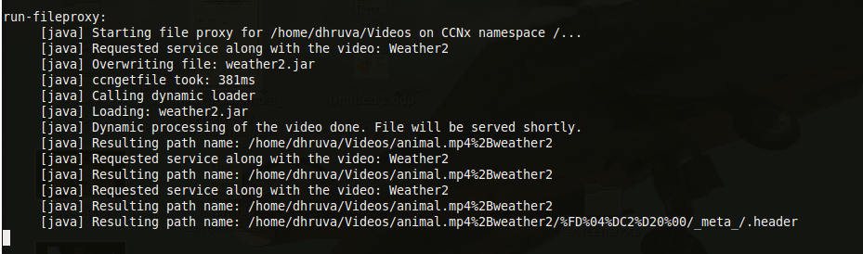
Dynamic Service Scalability in Information-Centric Networks
Suman Srinivasan ¹, Dhruva Batni ¹, Volker Hilt ² and Henning Schulzrinne ¹
¹ Columbia University, ² Alcatel-Lucent
sumans@cs.columbia.edu, dlb2155@columbia.edu, volker.hilt@alcatel-lucent.com, hgs@cs.columbia.edu
CCNx
NetServ
1
2
3
4
Receives service request
Loads service module
Installs NetServ
module
Service module invoked
5
Processed content returned to CCNx
The architecture for our CCNx dynamic service scalability implementation. When CCNx receives a content request that it interprets as a service, it loads the service module (over CCNx), processes the content using the module in NetServ, and then publishes it in CCNx space.
Screenshots
Pseudo-Code for Implementation
ccnName = “ccnx://test.mpg+weather”;
service, file = parse (ccnName);
download (“ccnx://netserv/” + service + “.jar”);
download (“ccnx://content/” + file);
loadLocalJAR (service + ".jar");
processedFile = loadClass(service). getMethod(“run”).invoke(file);
putFileIntoCCNx (processedFile);
A processed content is obtained through CCNx and played in VLC media player. There is a small watermark with weather information at the bottom right of the video, showing that this is processed video obtained from CCNx.
Currently: Our implementation interprets the service request, dynamically loads the module, invokes the service module on the original content, and publishes it back into CCNx space.
Future Work: Integrate this completely with our NetServ service virtualization platform.
Conclusion: We have a working prototype of a system that allows service processing in CCNx, thus allowing for dynamic service scalability.
When a service request is made, the service module (in addition to the content) is downloaded dynamically from CCNx, and invoked on the content.

