Slide 1
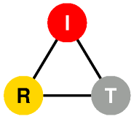

DYSWIS
(Do You See What I See)
Distributed Network Fault Diagnosis System
Kyung Hwa Kim
Henning Schulzrinne
Internet Real-Time Lab
Columbia University
2011

Slide 2
Motivation
Today’s Internet
  Wide variety of networks
  Almost every application relies on Internet connectivity
  Applications rely on the proper functioning of many parties
Professional assistance is either unavailable or expensive
  Users have no good way to know whom to call or what to try when things go wrong.
Too many possible causes
    Fault Symptom: Web access is slow
    Possible causes:
      high packet loss, an overloaded residential Internet connection, IPv6-to-IPv4 failover, wide-area network problems, a misconguration in the NAT box, or a remote server problem.
Existing approaches
  Centralized system: difficult to know exact situation of end-users
  End-user software: difficult to know what happens in network core system
  We develop “End-user based Collaborative system”
Why collaboration?
    To collect diverse information from different parts of the networks and infer the cause of failure.
Notes:
Wide variety of networks from home and office to WiFi hotspots and cellular networks.
Almost every application, from calendars to games, relies on Internet connectivity
Applications often rely on the proper functioning of up to half a dozen parties, from the local wireless network to DNS servers, CDNs and various middleboxes.
For all of these components, professional assistance is either unavailable or expensive, so that most users have to become unwilling network administrators (or rely on their children and technically-savvy friends for support).
The appropriate action differs in each case, ranging from using a third-party DNS server to simply waiting and hoping that the server recovers.

Slide 3
DYSWIS Design Overview
What is DYSWIS?
  Distributed network fault detection and diagnosis framework
    End-to-End
    Collaboration of end-users
    Crowdsourcing of diagnosis strategy
  Which faults do we detect?
    Faults on personal computing machines of end users
  How to detect a fault?
    Monitor and analyze network raw data
    Declare a fault when suspicious behavior is detected
  How to diagnose the fault?
    Dynamic diagnosis
      Self probing
      Remote probing
    Static diagnosis
      Distributed knowledge database

Slide 4
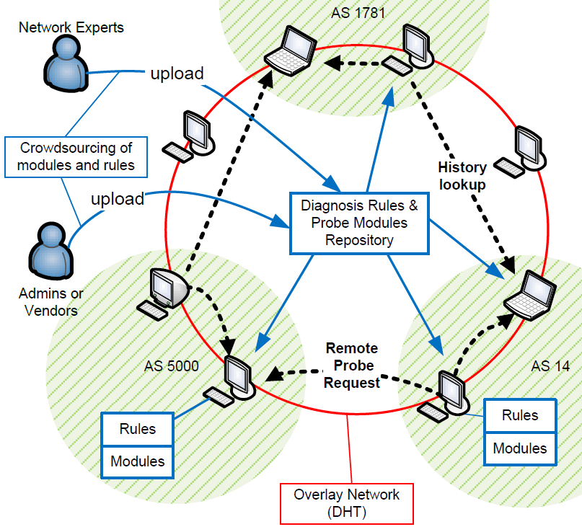
DYSWIS Design Overview
A Complete Framework
End-to-End
Collaboration
Crowdsourcing

Slide 5
Fault Detection
Packet flow data
  Session-based
  Collect flow of transaction
Create
Session
GET
-------------------
countGet = 1;
RESP
-----------
GET
---------------------
countGet = 1;
GET
-------------------------------
countGet++;
RESP
GET
RESP == 200 && countGet > 1
-------------------------------------------
countGet --;
RESP ==200 && countGet == 1
--------------------------------------------
countGet = 0;
Timeout
RESP !=200
--------------------
Create fault
Timeout
---------------
Create fault
Close
Session
Fault
Timeout
Fault
Sample FSM – HTTP Session

Slide 6
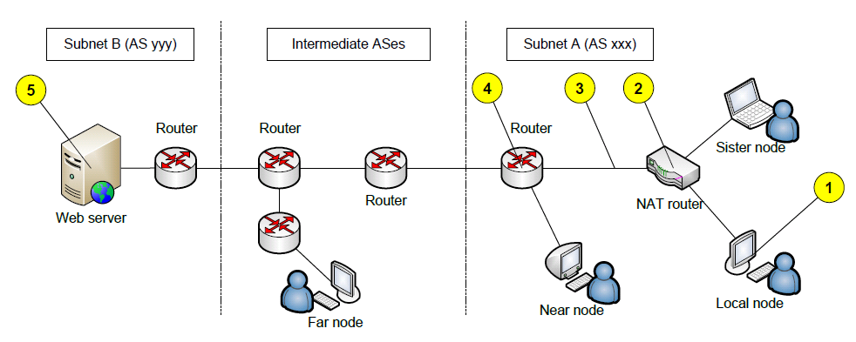
Searching Collaborative Nodes
Local Node
  A node currently diagnosing the faults
Sister Node
  A node sharing the same NAT device with the local node.
Near Node
  A node within the same subnet as the local node
Far Node
  A node located in any other subnets.

Slide 7
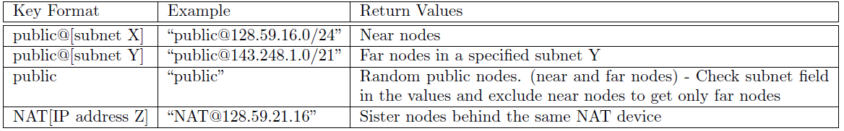
Searching Nodes
Leveraging Key-Value system of DHT
  Key
    Network type (e.g. public, NAT)
    Location (subnet information)
  Value
    IP address and port number of the collaborating node

Slide 8
Diagnosis Rule (Decision Tree)
Network connectivity?
No
Yes
Connectivity Problem
Can local nodes
Connect to the
Destination port?
No
Can far nodes
Connect to the
Destination port?
Server Problem
No
Yes
Yes
Go to another flow
Subnet Problem

Slide 9
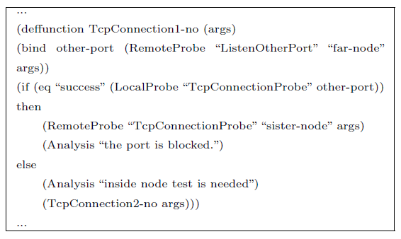
Diagnosis Rule
Using pre-defined ‘rules’ to invoke appropriate probing
  Separate the policy from the mechanism
  Create and modify diagnosis rules without re-compiling

Slide 10
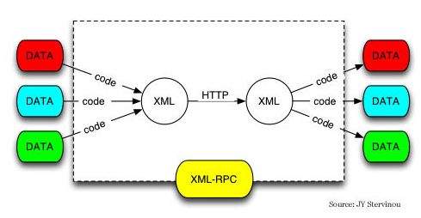
Probing
Active probing
  The pre-obtained knowledge can be stale
  Once probing is requested, the collaborative peers probe the faults dynamically in real time
Probing request via XML-RPC

Slide 11
Crowdsourcing of diagnosis strategies
Add new functionality
  Creating probing modules
    Open API
    Any software developer can build and distribute a new module that handles new protocol or application
  Need compile
Modify or add diagnosis policy
  Creating & Modifying Rules
    Open Rules
    Any user, developer, system administrators can build new customized rules for to diagnose new faults
  No compile needed

Slide 12
Crowdsourcing Process
1. Investigate the fault scenario
2. Select probing modules
3. Create a decision tree
4. Write a diagnosis rule
5. Deploy and update

Slide 13
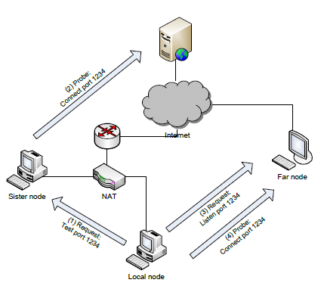
Use Cases
Port Blocking

Slide 14
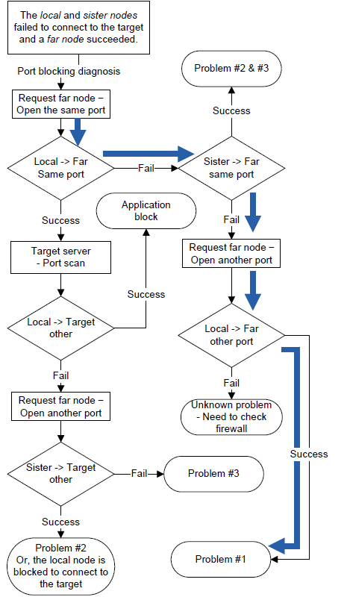
Flow Chart of Port Blocking Diagnosis
  #1. Is the outbound port blocked?
  #2. Is a local firewall running?
  #3. Does the target sever block the local node?
  #4. Other problems?

Slide 15
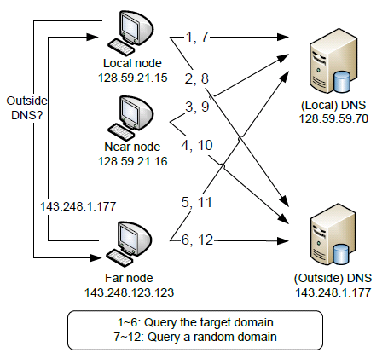
Use Cases
DNS failure

Slide 16
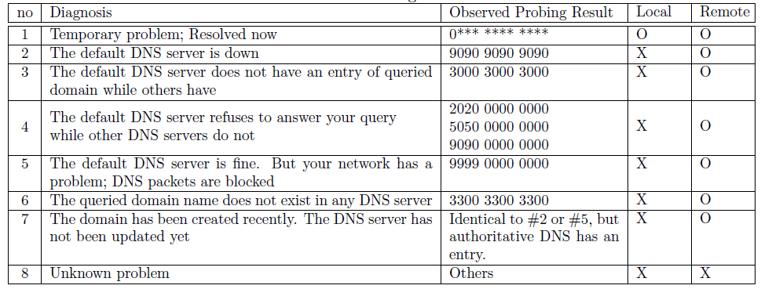
DNS Failure
  Diagnosis and Analysis

Slide 17
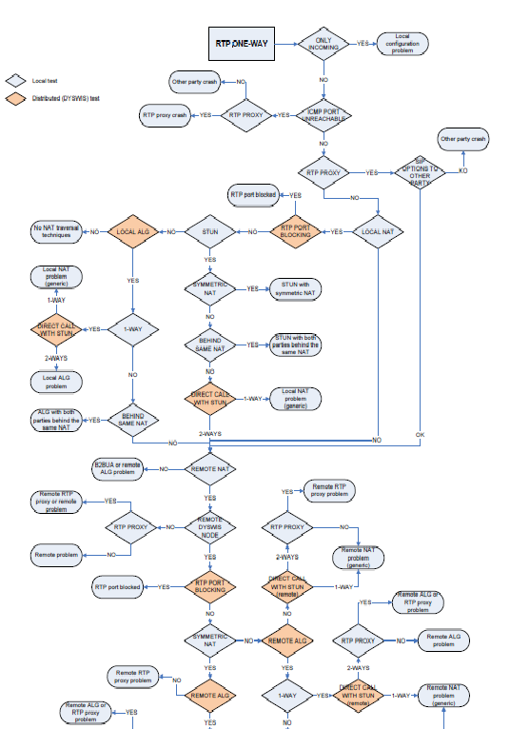
One-way RTP Diagnosis

Slide 18
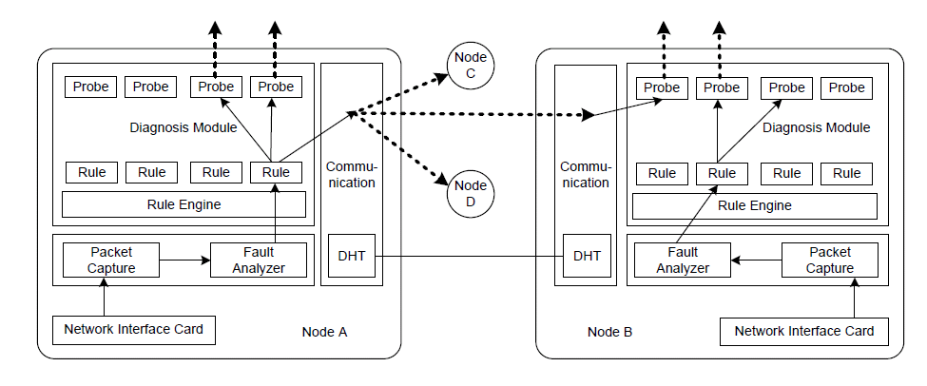
Implementation (Modules)
Java-based framework
Libraries: Jess, AzDHT, Jpcap, etc.

Slide 19
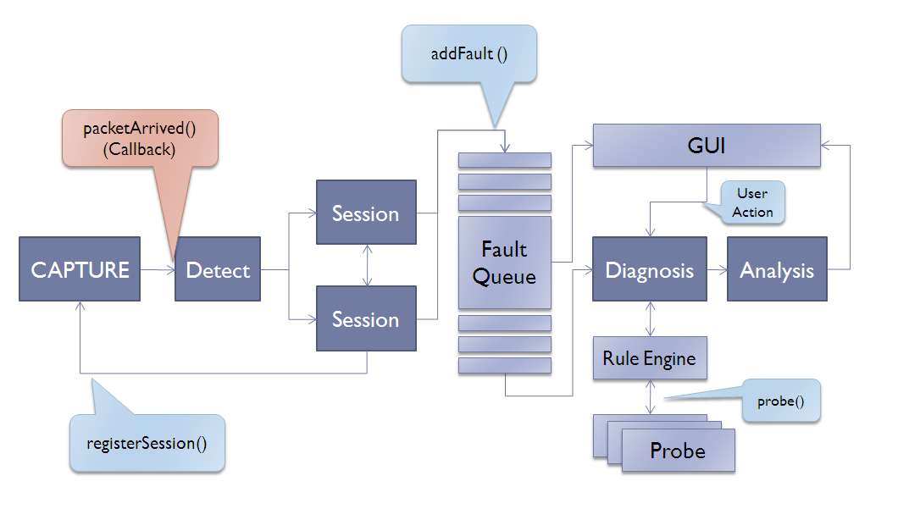
Implementation (Flow)

Slide 20
Modularity
OSGi technology
Dynamic module system for Java
  Modules loaded and unloaded at runtime
  Bundle: self-contained JAR file with specific structure
  Open-source implementations: Apache Felix, Eclipse Equinox
Security and accounting
  Security built on Java 2 Security model
    Permission-based access control
    No fine-grained control or accounting for CPU, storage, bandwidth
    Can load native code with appropriate permission
  Strict separation of bundles
    Classpath set up by Bundle class loader
    Inter-bundle communication only through published interfaces
NetServ, [IRT Talk 2009], Jae Woo Lee

Slide 21
OSGi technology
Web Server
End User
DYSWIS
Bundle
Repository
Probing
bundle
Probing
bundle
Probing
bundle
DYSWIS main bundle
Polling
DYSWIS Update bundle
OSGi Felix launcher

Slide 22
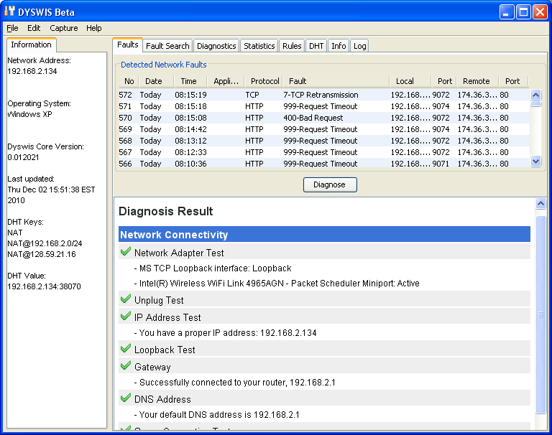
Screenshots

Slide 23
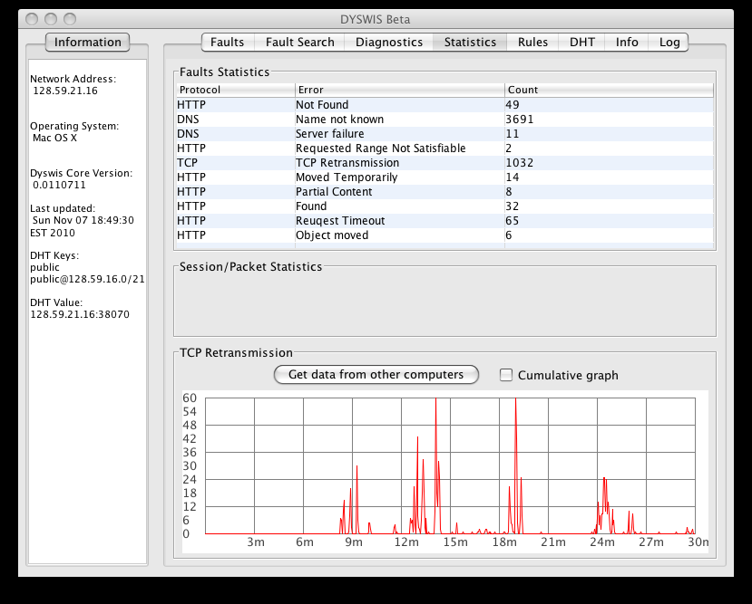
Screenshots

Slide 24
Issues
Main Issues
  Overhead of capturing packets
  Inconvenient manual development process
  How to evaluate?
  Security and Privacy
Next steps
  DYSWIS with smartphone
    Diagnose the Internet problems using mobile network
  Secure DYSWIS
  DYSWIS on Cloud Computing

Slide 25
Summary
DYSWIS
  Distributed network fault detection and diagnosis system
    End-to-End
    Automatic fault detection and diagnosis
    User-friendly interface
Collecting scenarios
  Raw data, Survey, Flow data
Implementation Design Factors
  Modularity: OSGi technology
  Separation: Rule technology
  Extensibility: Open API and Rules
Next strategies
  Apply to various network fault situations
    Cloud computing
    Smartphone
    Worm, virus, attack
    Wireless

