Slide 1
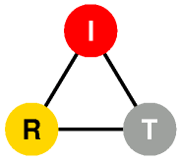

DYSWIS
(Do You See What I See)
Distributed Network Fault Diagnosis System
Kyung Hwa Kim (khkim@cs.columbia.edu)
Henning Schulzrinne (hgs@cs.columbia.edu)
Internet Real-Time Lab
Columbia University
October 2011

Slide 2
Motivation
I got a network problem.
Do you see what I see?
Web
server
End user
Internet
End user
End user
  Centralized management system: difficult to know exact situations of end-users
  End-user diagnostic software: difficult to know what happens in network core
  We develop “End-user based Collaborative system”
  Why collaboration?
    To collect diverse information from different parts of the networks and infer the root cause of network failure.
Notes:
We often encounter network problems whenever we use Internet, email, voice and video chat.
However, it is difficult for network managers diagnose every problem that each end-user is suffering from.
Because today, there are a lot different devices that used by end-users also they have very different environments, different OS different machines..
So, what we suggest is diagnosing the problem by end-users. As you may know there is already some tools on Windows, or Mac diagnosing network problems.
But the functionality is very limited. It only check network connectivity and tries to connect to well-known servers. That’s it. I
It is because there is nothing for end-users do..
So, we was thinking about the real-world situation. When we have an Internet problem,, what do we do first. It is definitely asking a question to your friends or colleagues.
For example, hey I cannot send my email. Or cannot connect to facebook.com. What about you? Do you also see the same problem? He will try to send email, try to
Our idea is doing this probing automatically instead of manual probing.

Slide 3
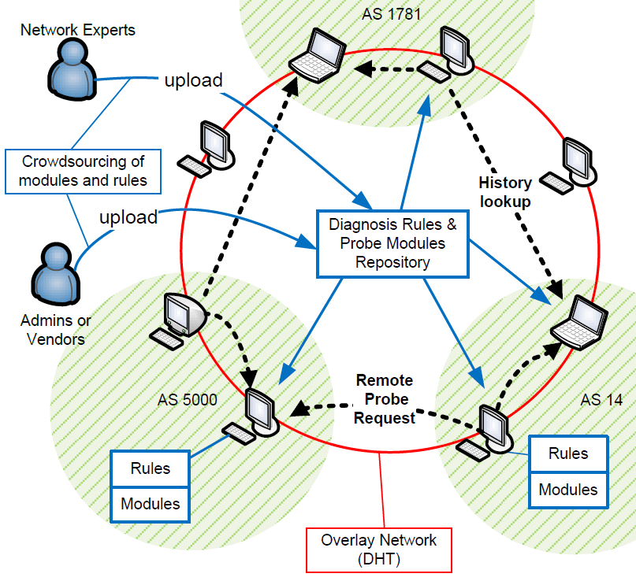
DYSWIS Design Overview
End-to-End
diagnosis
Collaboration
Crowdsourcing
A framework
Notes:
Not only simple software, beyond software -> framework

Slide 4
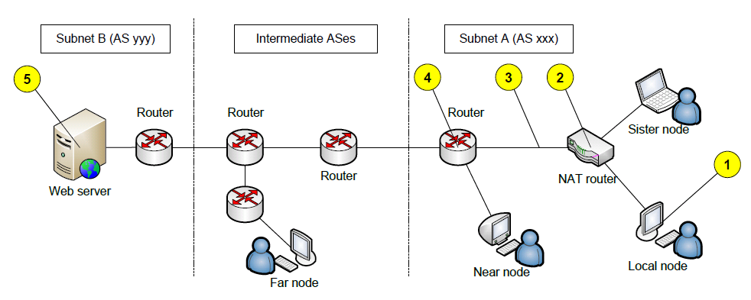
Searching Collaborative Nodes
Local Node
  A node currently diagnosing the faults
Sister Node
  A node sharing the same NAT device with the local node.
Near Node
  A node within the same subnet as the local node
Far Node
  A node located in any other subnets.

Slide 5
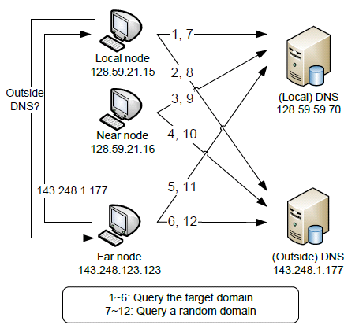
Use Cases
DNS failure

Slide 6
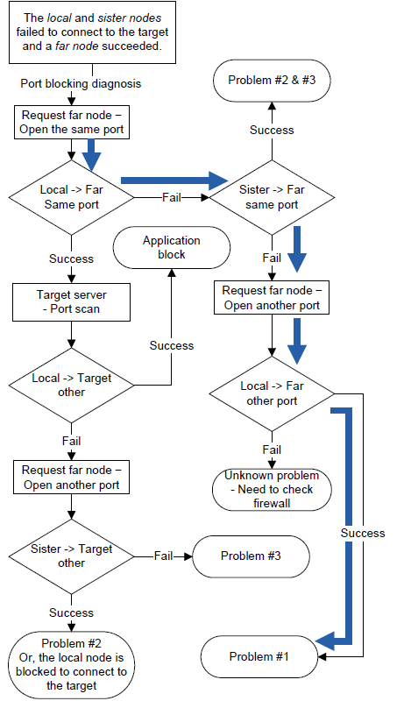
Port Blocking Diagnosis
  #1. Is the outbound port blocked?
  #2. Is a local firewall running?
  #3. Does the target sever block the local node?
  #4. Other problems?

Slide 7
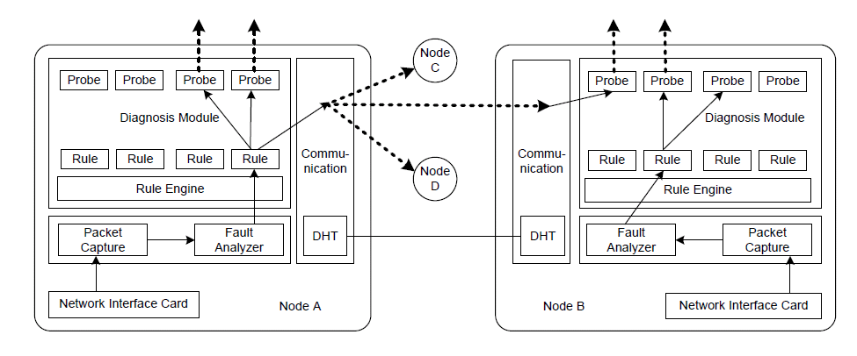
Implementation
Java-based framework
OSGi modules (Crowdsourcing)

Slide 8
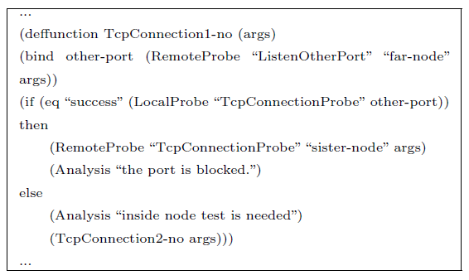
Diagnosis Rules
Using pre-defined ‘rules’ to invoke appropriate probing
  * Separate the policy from the mechanism
  Create and modify diagnosis rules without re-compiling
  Enables crowdsourcing from multiple experts

Slide 9
OSGi technology
Web Server
End User
DYSWIS
Bundle
Repository
Probing
bundle
Probing
bundle
Probing
bundle
DYSWIS main bundle
DYSWIS Update bundle
OSGi framework launcher

Slide 10
Demo
DYSWIS download:
http://www.cs.columbia.edu/irt/project/dyswis

