Slide 1
High Performance Multimedia Tools for
Application Sharing,
Measuring Capture-to-display Latency, and
User Created Services
Omer Boyaci
Advisor: Prof. Henning Schulzrinne
PhD Thesis Defense
July 12, 2011

Slide 2
Outline
BASS
Application Sharing System
Performance of Video Chat
Applications under Congestion
vDelay
A Tool to Measure Capture-to-Display Latency and frame rate
SECE
Sense Everything, Control Everything

Slide 3
Background information on Internet speeds
According to the Federal Communication Commission (FCC) report*,
  at mid-year 2010,
  63% of reportable connections were slower than 768 kbps in the upstream direction,
  18% were at least 768 kb/s in the upstream direction but slower than 1.5 Mb/s, and
  19% were at least 1.5 Mb/s in the upstream direction.
Sharing the limited uplink with
  other applications such as BitTorrent
    running on the same computer or
    on the other users’ computers (sharing the same connection)
  makes things a lot harder.
*http://transition.fcc.gov/Daily_Releases/Daily_Business/2011/db0520/DOC-305296A1.pdf

Slide 4
BASS Application Sharing System
Omer Boyaci, and Henning Schulzrinne
[1] BASS Application Sharing System
Omer Boyaci, Henning Schulzrinne.
International Symposium on Multimedia (ISM2008), December, 2008, Berkeley, CA
[2] BASS Application Sharing System.
Omer Boyaci, Henning Schulzrinne
International Symposium on Multimedia (ISM2008), Demo paper, December, 2008, Berkeley, CA
[3] Application and Desktop Sharing
Omer Boyaci, Henning Schulzrinne
ACM CoNEXT 2007, student workshop, December, 2007, New york, NY

Slide 5
BASS Application Sharing System
True application sharing (improves privacy and security)
Supports multiple users
  Reliable Multicast
  Participants with different bandwidths
  Floor Control
Multimedia Support
  Flash animations and videos

Slide 6
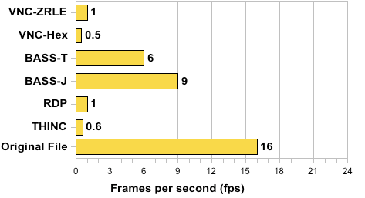
BASS Application Sharing System
Performance results for video (3 Mb/s bandwidth)

Slide 7
Performance of video chat applications under congestion
Omer Boyaci, Andrea Forte and Henning Schulzrinne
[4] Performance of video chat applications under congestion
Omer Boyaci, Andrea Forte, Henning Schulzrinne
International Symposium on Multimedia, short paper, December, 2009, San Diego, CA

Slide 8
Experiment 1. Step 10sec10kbit
Skype
L1. Fine-tunable encoder

Slide 9
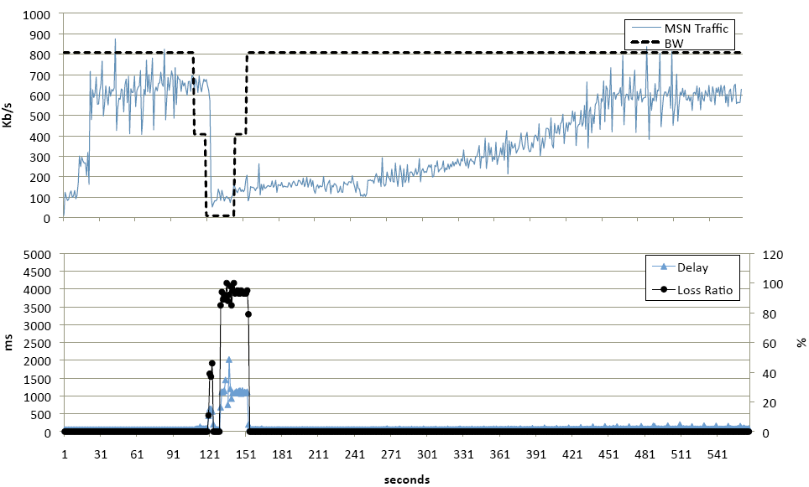
Experiment 2. Step 10sec50kbit
Live
L2. Fast recovery

Slide 10
Experiment 4. Bittorrent
Skype
L3. Giving up does not help

Slide 11
Experiment 5. Random Loss
Skype
L4. Differentiate losses

Slide 12
vDelay: A tool to measure Capture-to-Display Latency (CDL) and frame rate
Omer Boyaci, Andrea Forte, Salman Abdulbaset and Henning Schulzrinne
[5] vDelay: A Tool to Measure Capture-to-Display Latency and Frame-rate
Omer Boyaci, Andrea Forte, Salman Abdul Baset, Henning Schulzrinne
International Symposium on Multimedia, December, 2009, San Diego, CA
[6] Demonstration of vDelay: A Tool to Measure Capture-to-Display Latency and Frame-rate
Omer Boyaci, Andrea Forte, Salman Abdul Baset, Henning Schulzrinne
International Symposium on Multimedia, Demo paper, December, 2009, San Diego, CA

Slide 13
vDelay: A tool to measure Capture-to-Display Latency (CDL) and frame rate
Measures CDL and FPS of any video chat session
Useful tool for comparing video chat clients
Black-box testing
Does not require access to source code or protocol messages
Does not require extra hardware (except an external webcam)
Java – works in all operating systems

Slide 14
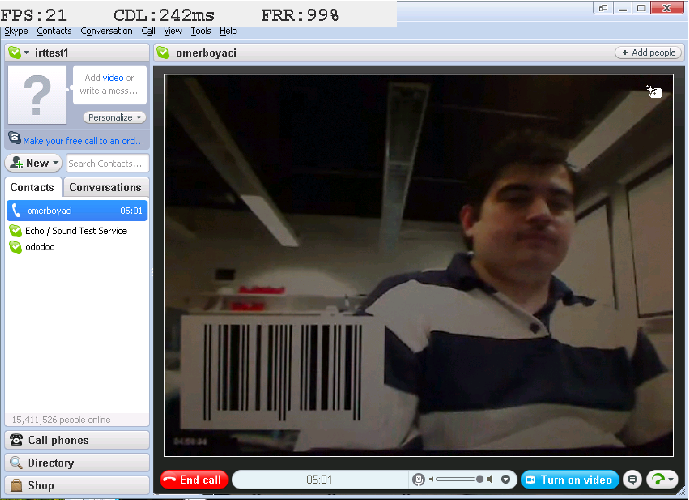
vDelay: A tool to measure Capture-to-Display Latency (CDL) and frame rate
  Screenshot of the receiver side vDelay application.
  FPS, CDL, and FRR statistics are shown at the top of the image.
  The barcode received from the caller agent is also visible.

Slide 15
SECE: Sense Everything,
Control Everything
Omer Boyaci, Victoria Beltran and Henning Schulzrinne
[7] Bridging communications and the physical world: Sense Everything, Control Everything
Omer Boyaci, Victoria Beltran, Henning Schulzrinne
IPTComm'11, August 2011, Chicago, IL
[8] Bridging communications and the physical world: Sense Everything, Control Everything
Omer Boyaci, Victoria Beltran, Henning Schulzrinne
IEEE Globecom 2010 Workshop on Ubiquitous Computing and Networks, Dec 10, 2010 , Miami, FL
[9] Demonstration of Bridging communications and the physical world: Sense Everything, Control Everything
Omer Boyaci, Victoria Beltran, Henning Schulzrinne

Slide 16
Overview
SECE allows non-technical users to create services that combine
  communication
  calendaring
  location
  devices in the physical world
SECE: event-driven system
  uses high-level event languages
  to trigger action scripts, written in Tcl
and other languages in the future

Slide 17
Events & actions
Events
Actions
Presence updates
Incoming calls
Email
Calendar entries
Sensor inputs
Location updates
Control the delivery of email
Route phone calls
Update social network status
Control actuators such as lights
Reminders (email, voice call, SMS)
Interact with Internet services

Slide 18
Event language syntax
every sunset {
homelights on;
}
every week on WE at 6:00 PM{
email irt_list “Pizza talk at 6:00 PM today.”;
}
if stock.google > 580 {
sms me "google stock: [stock google]";
}

Slide 19
Event Rules: More Examples
Extensible set of small languages
Time
  Single on February 16, 2010 at 6:00 PM
  Recurring every day at 12:00 until April
Location
  Tom within 5 miles of me
Context
  if my office.temperature > 80
Communication requests
  incoming call

Slide 20
Related Work
Systems | User rules | User actions | Communications | Time | Location | Presence | Sensors | Web services | Actuators
SECE | NL-like rules | Tcl scripts | Call, email, IM | ✔ | User & buddies | ✔ | ✔ | ✔ | ✔
CPL | XML tree | Fixed XML actions | Call | ✖ | ✖ | ✖ | ✖ | ✖ | ✖
LESS | XML tree | XML actions | Call | ✔ | ✖ | ✔ | ✖ | ✖ | X10, vcr
SPL | script | Signaling actions | Call | ✖ | ✖ | ✖ | ✖ | ✖ | ✖
VisuCom | Graphical UI | Signaling actions | Call | ✖ | ✖ | ✖ | ✖ | ✖ | ✖
DiaSpec | Java | Java | ✔✖ | ✖✔ | ✖✔ | ✖✔ | ✖✔ | ✖✔ | ✖✔
CybreMinder | Form based | Reminder | ✖ | ✔ | ✔ | ✖ | ✔ | ✖ | ✖
Task.fm | Time rule | Reminder | ✖ | ✔ | ✖ | ✖ | ✖ | ✖ | ✖

Slide 21
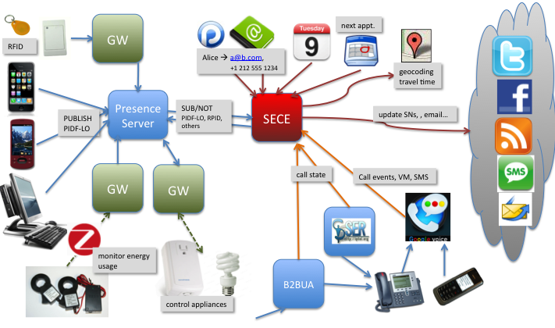
The big picture

Slide 22
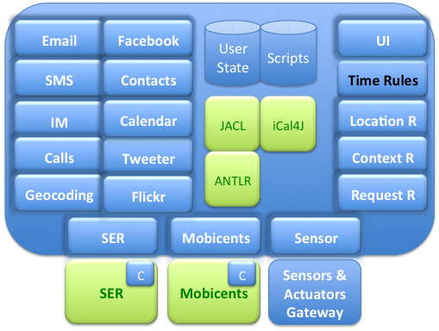
Software architecture

Slide 23
User information registry
root
me
Bob
Alice
office
location
presence
phone
presence
location
presence
location
temperature
lights
mobile
office
home

Slide 24
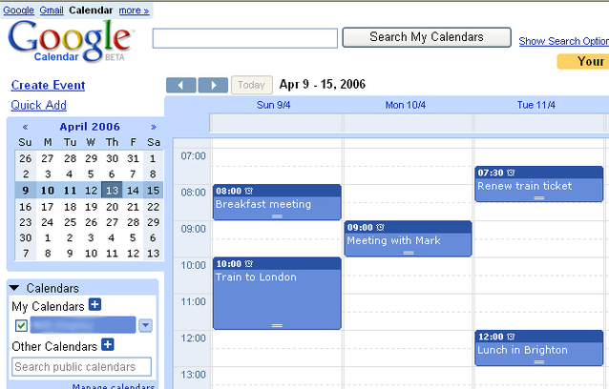
SECE: Time-based rules
Every day at 12:00 from 01/01/2010 until 04/01/2010 {
email employees “lunch time” “Location: 5th floor Dinning Room, Time: 12:30”
}
BEGIN:VCALENDAR
BEGIN:VEVENT
DTSTART;TZID=America/New_York:20100101T120000 RRULE:FREQ=DAILY;BYHOUR=12;
UNTIL=20100401T120000
END:VEVENT
END:VCALENDAR
SECE
Export / Import

Slide 25
SECE: Location-based rules
bob near "Columbia University”
me near 40.807,-73.963
tom within 5 miles of me
me within 3 miles of ”2960 Broadway, New York, 10027”
tom in “Rockefeller center”
Me outside of “Manhattan”
bob moved 1.5 miles
Place types and user-defined locations:
me near a post office
Anne in a museum
me near my tennis club
user operator location { body }

Slide 26
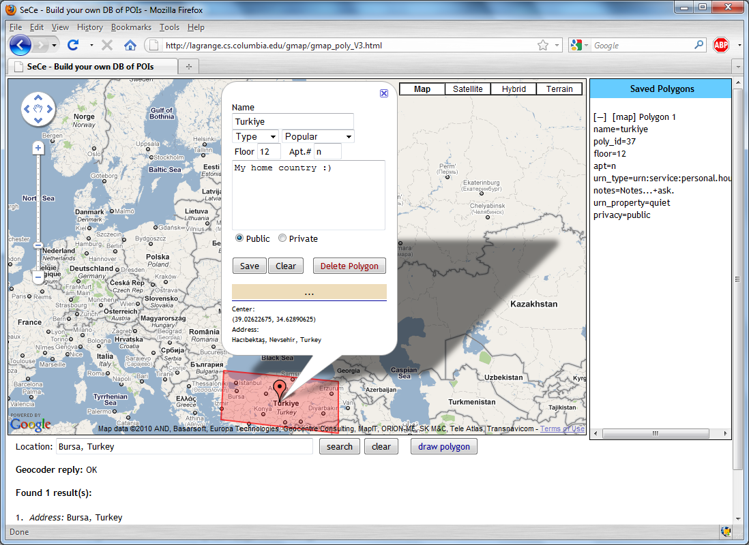
Building a POI database

Slide 27
Handling location updates
User
  publishes his/her location periodically (e.g., every 5 min) to a presence server or to a location service such as Google Latitude
Presence server
  notifies changes in location to SECE server
Google Latitude (or similar service)
  SECE retrieves user’s location periodically
SECE server
  depending on user’s defined rules, queries LoST server
LoST server
  replies with current information on user’s surroundings
SECE server
  Takes action based on rules and contextual location information
SECE
Server
LoST
Server
LoST reply
LoST query
NOTIFY
POLL
Presence
Server
Google
Latitude
PUBLISH
SECE User

Slide 28
SECE: Communication-based rules
Event: call, im, sms*, voicemail*, email (*only incoming)
incoming|outgoing event from user|address to address { body }
missed call from user|address to address { body }
received call from user|address to address { body }
incoming call {
if { [my activity] == "on-the-phone"} forward sip:bob@example.com
}
outgoing call {
if {[outgoing destination] == "18003456789"} modify_call destination 12129397054
}
incoming call from Anne {
if {[my location] != "office"} auto_answer audio no_office.au –record
}
incoming im {
sms me [incoming from] + " sent an im:“ + [incoming content]
}

Slide 29
SECE: Social Network Integration
Incoming social_network message_type
facebook
twitter
linkedin
wallmesssage
newsmessage
direct
social_network status_update
facebook
twitter
linkedin

Slide 30
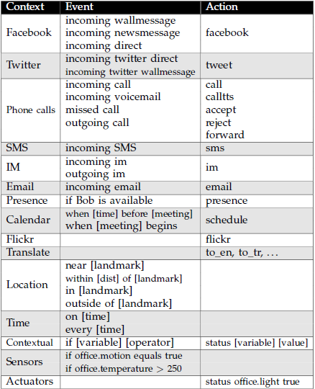
SECE Events and Actions

Slide 31
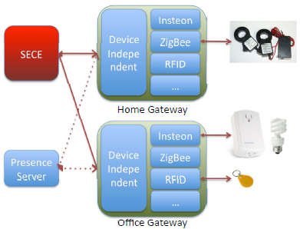
Sensors and Actuators
Sensors: smoke, light, humidity, motion, temperature and RFID readers
Actuators: networked devices and actuators such as lights, cameras, sprinklers, heaters, and air conditioners
if my office.temperature > 80 {
ac on;
}
if my office.smoke equals true {
sprinklers on;
sms me "fire in the office";
call_tts fire-department "fire in the "+[get me.office.address];
electrical-appliances off;
}
if my warehouse.motion equals true {
sms me "person in the warehouse."
}

Slide 32
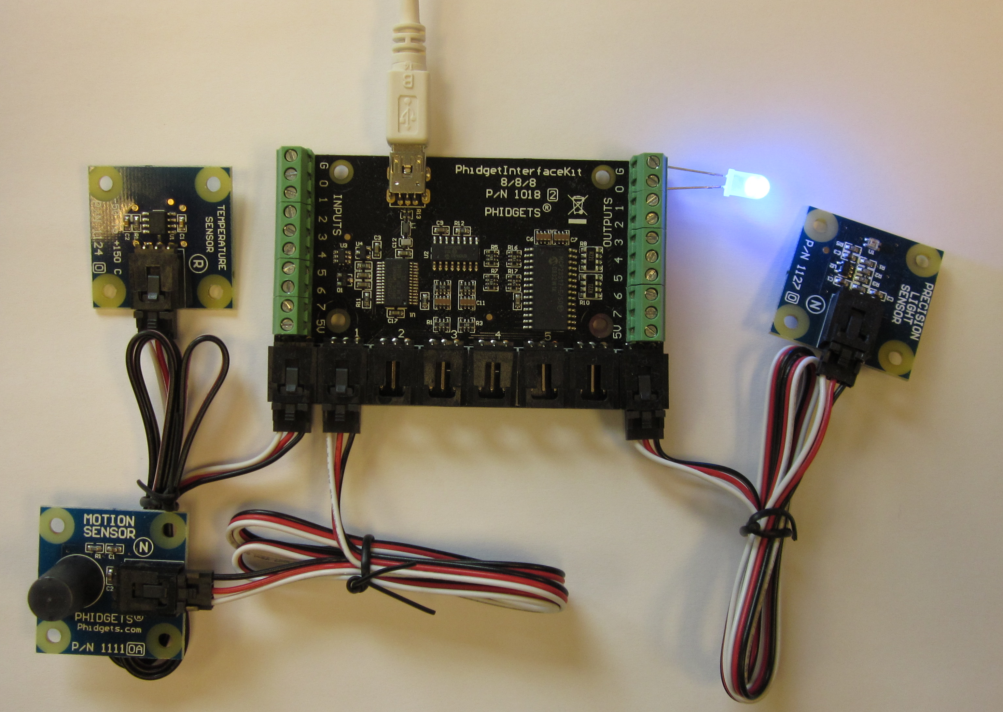
Building a POI database

Slide 33
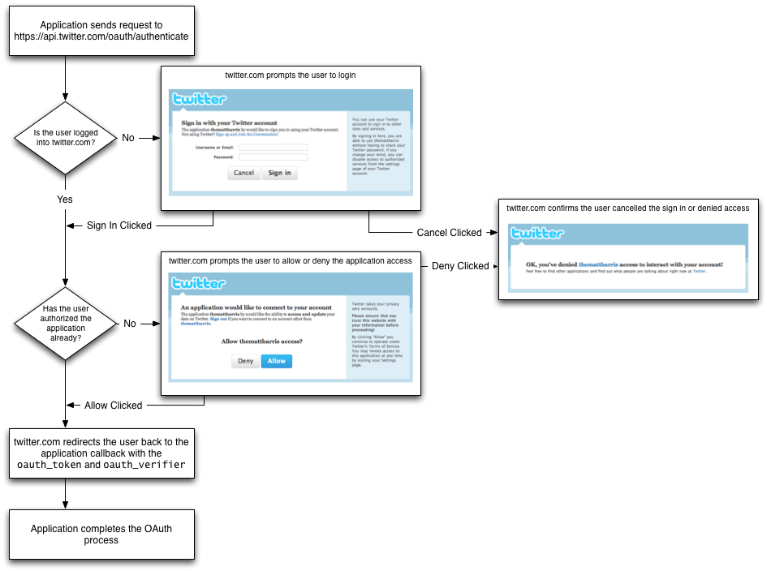
OAuth

Slide 34
GUI (Google Web Toolkit - GWT)

Slide 35
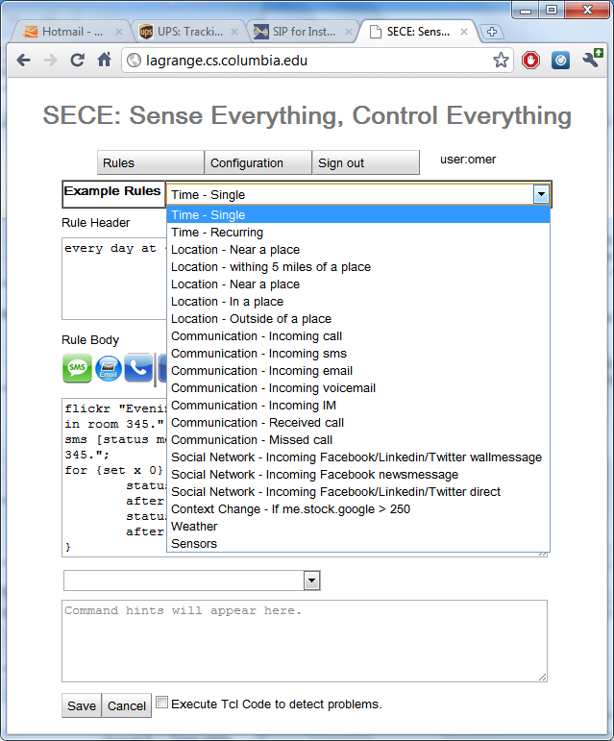
GUI- Example Rules

Slide 36
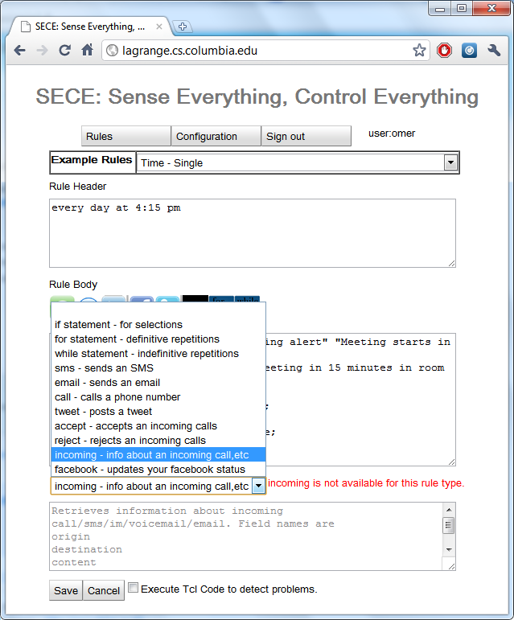
GUI- Action command assistant

Slide 37
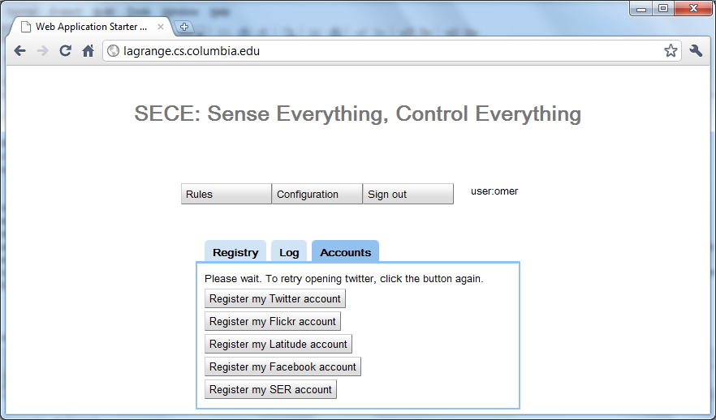
GUI- Registration of third-party services

Slide 38
Deployment Scenarios
Can be deployed in a home device
  protects privacy and security by keeping the rules and
  details of sensors and actuators within home boundaries.
  it is more difficult to update the rules from anywhere.
Can be provided as a cloud service
  controlling in-home devices can be challenging, given NATs.

Slide 39
Conclusion
Real world
(location & sensors)
Communication
(VoIP, SMS, email)
Web services
(SNs, calendar, contacts, ..)
SECE

Slide 40
Peer-reviewed conference publications
[1] Bridging communications and the physical world: Sense Everything, Control Everything
Omer Boyaci, Victoria Beltran, Henning Schulzrinne
IPTComm'11, August 2011, Chicago, IL
[2] Bridging communications and the physical world: Sense Everything, Control Everything
Omer Boyaci, Victoria Beltran, Henning Schulzrinne
IEEE Globecom 2010 Workshop on Ubiquitous Computing and Networks, Dec 10, 2010 , Miami, FL
[3] Demonstration of Bridging communications and the physical world: Sense Everything, Control Everything
Omer Boyaci, Victoria Beltran, Henning Schulzrinne
IPTComm'10, Demo session, August 2, 2010, Munich, Germany
[4] Performance of video chat applications under congestion
Omer Boyaci, Andrea Forte, Henning Schulzrinne
International Symposium on Multimedia, short paper, December, 2009, San Diego, CA
[5] vDelay: A Tool to Measure Capture-to-Display Latency and Frame-rate
Omer Boyaci, Andrea Forte, Salman Abdul Baset, Henning Schulzrinne
International Symposium on Multimedia, December, 2009, San Diego, CA (Acceptance rate:19%)
[6] Demonstration of vDelay: A Tool to Measure Capture-to-Display Latency and Frame-rate
Omer Boyaci, Andrea Forte, Salman Abdul Baset, Henning Schulzrinne
International Symposium on Multimedia, Demo paper, December, 2009, San Diego, CA
[7] BASS Application Sharing System
Omer Boyaci, Henning Schulzrinne.
International Symposium on Multimedia (ISM2008), December, 2008, Berkeley, CA (Acceptance rate:24%)
[8] BASS Application Sharing System.
Omer Boyaci, Henning Schulzrinne
International Symposium on Multimedia (ISM2008), Demo paper, December, 2008, Berkeley, CA
[9] Application and Desktop Sharing
Omer Boyaci, Henning Schulzrinne
ACM CoNEXT 2007, student workshop, December, 2007, New york, NY

Slide 41
Backup slides

Slide 42
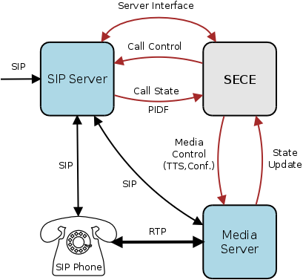
Automated Call Handling
Control: Accept, reject, redirect, forward calls based on variety of SECE signals
Integration: Calendar, address book, PSTN, Google Voice, SMS, location, Text-to-speech, voicemail)
Simplicity: Natural, easy to learn scripting language
Flexibility: Input from a variety of SECE components involved in call handling
Automation: Scripts for recurring tasks (setup a conf. call based on calendar)
“On mom's birthday, call mom when I am home and near phone.”
“Setup a conference call, enter password, invite people, ring desk phone.”
“If driving and incoming call, play “user driving” and redirect to voicemail.”
“If desk phone ringing and not in room, send SMS with caller's number.”

Slide 43
Adding a new action command to the SECE
public boolean executeCode(Service service, String code) {
//Creates a new Tcl interpreter
Interp interp = new Interp();
try {
    //Add new actions commands to the Tcl interpreter
    interp.createCommand("email", new EmailCmd(emailEventProducer));
    interp.createCommand("status", new StatusCmd(this));
    interp.createCommand("tweet", new TweetCmd(this));
    interp.createCommand("flickr", new FlickrCmd(this));
    interp.createCommand("facebook", new FacebookCmd(this));
    interp.createCommand("sms", new SMSCmd(googleVoice, service));
    interp.createCommand("im", new ImCmd(this));
    interp.createCommand("call", new CallCmd(null,googleVoice, service));
    interp.createCommand("incoming", new IncomingCmd(service));
    interp.createCommand("my", new MyCmd(this));
    interp.createCommand("accept", new AcceptCmd(service));
    interp.createCommand("reject", new RejectCmd(service));
    interp.createCommand("event", new EventCmd(service));
    interp.createCommand("schedule", new ScheduleCmd(this.googleCalendarHandler));
    TranslatorCmd st = new TranslatorCmd();
    for (final Language language : Language.values()) {
    interp.createCommand("to_"+language.toString(), st);
    }
    // runs the user's Tcl script
    interp.eval(code);
} catch (Exception ex) {
return false;
} finally {
interp.dispose();
}
return true;
}

Slide 44
Adding a new action command to the SECE
package edu.columbia.lucs.tcl;
import com.restfb.DefaultFacebookClient;
import com.restfb.FacebookClient;
import com.restfb.Parameter;
import com.restfb.exception.FacebookException;
import com.restfb.types.FacebookType;
import edu.columbia.lucs.Manager;
import java.util.logging.Level;
import java.util.logging.Logger;
import tcl.lang.*;
public class FacebookCmd implements Command {
Manager man;
  public FacebookCmd(Manager man) {
  this.man = man;
  }
  public void cmdProc(
  Interp interp, // Current interpreter.
  TclObject objv[]) // Arguments to "lsearch" command.
  throws TclException
  {
  String token = man.reg.getRegistryAttribute("me.conf.facebook.acc1.token");
  if (token != null) {
      FacebookClient facebookClient = new DefaultFacebookClient(t);
      try {
      FacebookType publishMessageResponse =
      facebookClient.publish("me/feed", FacebookType.class,Parameter.with("message", objv[1].toString()));
      } catch (FacebookException ex) {
      Logger.getLogger(FacebookCmd.class.getName()).log(Level.SEVERE, null, ex);
      }
  }
  }
}

