Slide 1
Technology & Regulation
Henning Schulzrinne
Columbia University
Any opinions are those of the author and do not necessarily reflect the views
of Columbia University or the Federal Communications Commission.
with material from Bob Cannon (FCC)

Slide 2
Overview
Why regulation?
About the FCC
Intersection of IETF WGs and regulation
Providing input into the rule making process
Who are you speaking for?
The “can’t do, won’t do, can’t make us” ex-partes

Slide 3
Why regulation & regulators?
Market failure
  private monopoly (e.g., pre-divestiture AT&T as phone company)
  competitive market failures (e.g., duopoly, consumer rights)
  social policy objectives (e.g., disability rights, universal access)
Law enforcement
  illegal conduct (consumer/subsidy fraud, misrepresentation, …)
  unsafe conduct (“no fence around antenna”)
Consumer education
  information asymmetry (e.g., “lemon laws”)
Economic development
  “public goods” (research, education, …)

Slide 4
Policy goals & means
innovation (new products)
satisfaction of consumer demands
  low cost
  high quality
  availability to all
Goals
Competition
Regulation

Slide 5
Telephone Policy - “Why”
Common Carriage
Market power
Anti-competitive Behavior
Market failure
  Universal service
Value of information
  Value of thing carried
Social Concerns
Lifeline
911
Resilience (power)
Lawful intercept (CALEA)
Disability access
Privacy (CPNI)
Two separate sets of concerns

Slide 6
Telephone Social Policies
Universal service (Lifeline, high cost, …) | Necessary to function (call doctor, call school, …)
Basic service price regulation | Ensure widespread availability
911 | Report emergencies for self and others
Power backup | Ensure emergency communications
Outage reporting | Ensure reliability
Lawful intercept (CALEA) | Phone as tool for criminals
Disability access (ringers, HAC) | Ensure participation in society
CPNI | Phone as private medium

Slide 7
Telecom regulation
Local, state and federal
  local: CATV franchise agreements
  state: Public Utility Commission
    responsible for all utilities – gas, water, electricity, telephone
  federal: FCC, FTC (privacy), DOJ (monopoly)
Elsewhere: gov’t PTT → competition
  vs. US: regulated private monopolies
Based on 1934 Telecommunications Act
Amended in 1996

Slide 8

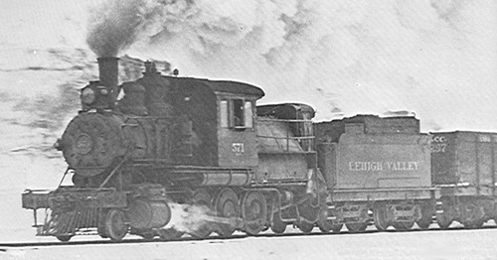
Before the Internet, Before the Phone… Common Carrier
Content
Coal
Common Carrier
Trains
Right-of-way

Slide 9
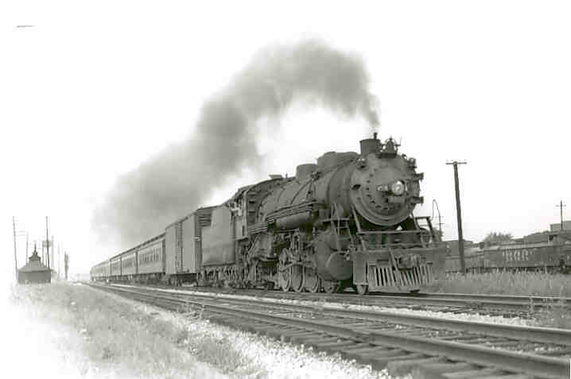
Communications Carriers
Characteristics:
  Carrier of third parties’ goods / Bailment
  Market power / infrastructure
  Vital economic Input: goods carried are important
Policy:
  Non-discrimination
  Just & reasonable rates
  Liability
    Not liable for what content is
    Liable for damage to content
  Benefit from sovereign
    Access to right of way
  Privacy / security
Importance and value of information – stocks, elections, agriculture.
Notes:
In typical western dialectic – the literature struggles with an either / or. Either it is market power – or it is bailment.
Since each justification on its own is vulnerable to criticism – we oscillate between the two without a firm policy foundation for common carriage.
I would suggest rather that it is both / and. It is both market power and bailment. A truly competitive market is one where, if the bailor harms us, we can switch to another service – the bailor loses for the bailor’s negligence.
However, the bailor carrier remains in a power position in the market as a carrier and can easily put us in harms way. I think a little market power is amplified by the ability of the bailor to use that market power.
My take is that both of these are important to understanding the WHY of common carriage.
(Liability for damaged to goods while in care; But no liability for damaged caused by goods - Trains not liable for transporting Al Capone)
Telegraph
Importance and Value of transmitted information – stocks, elections, agriculture. Importance to the economy and to the country well recognized.
Access, reliability, non discrimination
States
Granted access to Right of Way
Imposed Common Carrier Obligations
Serve all customers without discrimination
Transmit messages in order received
Keep content of messages private
Interconnection between networks
Telephone
Precedent: telephone is just voice telegraph; therefore common carrier
State and local authority
Authorize Service and grant access to Rights of Way and eminent domain
Impose Common Carriage Obligations
Ban discrimination in line installations
Rate regulation
Interconnection
Non Discrimination
Originally regulated by the US Interstate Commerce Commission
Regulated all common carriers: Railroads, shipping, telegraph, telephone

Slide 10
The US hierarchy of laws
Constitution
Commerce clause
Law
Telecom Act 1934 & 1996
47 CFR
Narrative
reasonable network management
Section 8: To regulate Commerce with foreign Nations, and among the several States, and with the Indian Tribes (1787)
SEC. 706. ADVANCED TELECOMMUNICATIONS INCENTIVES. (a) IN GENERAL- The Commission … shall encourage the deployment on a reasonable and timely basis of advanced telecommunications capability to all Americans (including, in particular, elementary and secondary schools and classrooms) by utilizing, in a manner consistent with the public interest, convenience, and necessity, …, or other regulating methods that remove barriers to infrastructure investment.

Slide 11
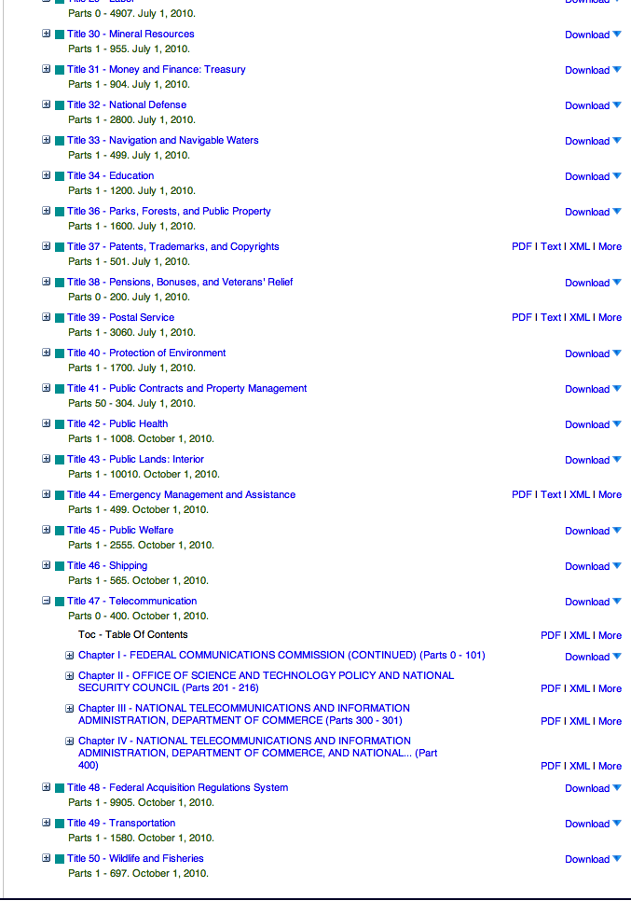
Code of Federal Regulations
http://www.gpo.gov/fdsys/

Slide 12
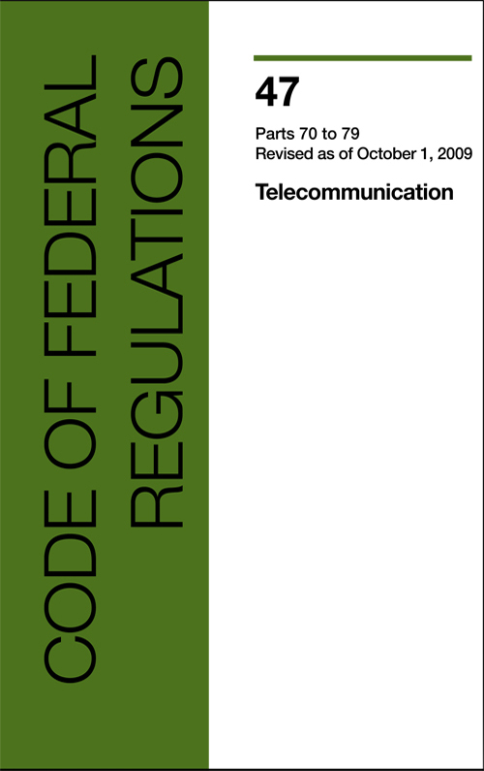
Example: CFR 47
§ 15.5 General conditions of operation.
(a) Persons operating intentional or unintentional radiators shall not be deemed to have any vested or recognizable right to continued use of any given frequency by virtue of prior registration or certification of equipment, or, for power line carrier systems, on the basis of prior notification of use pursuant to §90.35(g) of this chapter.
(b) Operation of an intentional, unintentional, or incidental radiator is subject to the conditions that no harmful interference is caused and that interference must be accepted that may be caused by the operation of an authorized radio station, by another intentional or unintentional radiator, by industrial, scientific and medical (ISM) equipment, or by an incidental radiator.

Slide 13
47 CFR content
Part | Content
0 | Commission organization
1 | Practice and procedure
2 | Frequency allocations and radio treaty matter
3 | Authorization and administration of accounting authorities in maritime and maritime mobile radio services
4 | Disruptions to Communications
5 | Experimental Radio Service
6 | Access to Telecommunications Service, Telecommunications Equipment and Customer Premises Equipment by Persons with Disabilities
7 | Access to Voicemail and Interactive Menu Services and Equipment by People with Disabilities

Slide 14
47 CFR content
Part | Content
0 | Commission organization
1 | Practice and procedure
2 | Frequency allocations and radio treaty matter
3 | Authorization and administration of accounting authorities in maritime and maritime mobile radio services
4 | Disruptions to Communications
5 | Experimental Radio Service
6 | Access to Telecommunications Service, Telecommunications Equipment and Customer Premises Equipment by Persons with Disabilities
7 | Access to Voicemail and Interactive Menu Services and Equipment by People with Disabilities

Slide 15
47 CFR content
Part | Content
9 | Interconnected Voice over Internet Protocol Services
10 | Commercial Mobile Alert System
11 | Emergency Alert System (EAS)
12 | Redundancy of Communications Systems
13 | Commercial Radio Operators
15 | Radio Frequency Devices
17 | Construction, Marking and Lighting of Antenna Structures
18 | Industrial, Scientific and Medical Equipment (ISM)

Slide 16
47 CFR content
Part | Content
19 | Employee Responsibilities and Conduct
20 | Commercial Mobile Radio Services (= cellular)
22 | Public Mobile Services
24 | Personal Communications Services
25 | Satellite Communications
27 | Miscellaneous Wireless Communication Services
32 | Uniform System of Accounts for Telecommunications Companies
36 | Jurisdictional Separations Procedures; Standard Procedures for Separating Telecommunications Property Costs, Revenues, Expenses, Taxes and Reserves for Telecommunications Companies

Slide 17
47 CFR content
Part | Content
42 | Preservation of Records for Communication Common Carriers
43 | Reports of Communication Common Carriers and Certain Affiliates
51 | Interconnection
52 | Numbering
53 | Special Provisions Concerning Bell Operating Companies
54 | Universal Service
59 | Infrastructure Sharing
61 | Tariffs
68 | Connection of Terminal Equipment to the Telephone Network
69 | Access Charges

Slide 18
47 CFR content
Part | Content
73 | Radio broadcast services
74 | Experimental Radio, Auxiliary, Special Broadcast and Other Program Distributional Services
51 | Multichannel Video and Cable Television Services
78 | Cable Television Relay Services
79 | Closed Captioning and Video Description of Video Programming

Slide 19
47 CFR content
Part | Content
80 | Stations in the Maritime Services
87 | Aviation Services
90 | Private Land Mobile Radio Services
95 | Personal Radio Services
97 | Amateur Radio Services
101 | Fixed Microwave Services

Slide 20
The world by titles
Divides the world into
  Title I: General Provisions
    Act applies “to all interstate and foreign communications by wire or radio” but generally not to “intrastate communications” by wire.
  Title II: Telecommunications Services
    common carriers “engaged in interstate or foreign communications by wire or radio…”
  Title III: Broadcast Services
    radio stations, television stations, satellite operators, wireless communications companies, and private wireless providers.
  Title IV: Cable Services
  Title V: Obscenity and Violence

Slide 21
Process
NOI
NPRM
R&O
Notice of Inquiry
Notice of Proposed Rule Making
Report & Order
Petition for reconsideration
Federal court review
comments,
replies & ex parte
rarely

Slide 22
Administrative Procedures Act
Comment
  Every interested party
  Comments can take any form (very informal)
    Meet deadlines
    Include docket number (or other identification)
    Submit via web page
  (Almost) all comments are public
  After comment period closes: visit the FCC & talk to staff
    Ex Parte Presentations
Notes:
Everyone gets to comment. There is no concept of “standing” like there was with the Supreme Court. Regardless of who you are, you can express your views.
You used to have to hire an attorney who would but your comments
in the proper form
with the proper citations and
the proper “whereas’s”
Now commenting is as easy as e-mail or filing out a form.
Most agencies now accept e-mailed comments and provide an e-mail address for each proceeding. Some agencies like the FCC provide online forms where you can come, fill them out and rant and rave with ease.
You have to file your comments by a set deadline but you should not let that stop you. Many agencies will accept comments after the close of the comment period. At the FCC this is called the ex parte period.

Slide 23
Administrative Procedures Act
Notice and Comment
  Notice of Inquiry
  Notice of Proposed Rulemaking
  Notice
    Federal Register
    Websites
    Public Notices (i.e., FCC Daily Digest)
    Trade associations and other groups
Notes:
We have found Democracy in Washington.
Unlike Congress where you have a strong vote but from then on out they do not have to listen to you.
Unlike the Supreme Court where you do not get to vote for them and they do not have to listen to you.
In the Executive Branch, you get to vote for the President (who then names all the agency heads) and the agencies HAVE TO listen to you.
ØThese agencies operate under something known as the Administrative Procedures Act.
§ This act requires in essence, two things: Notice and Comment.
§ When an Agency is set on making a decision, like how to implement a new law, it must give notice to the world that it is about to make this decision and provide an opportunity for everyone to file comments.
§ Notice in the past was provided through the federal register - a bible-like-daily which keeps many attorneys employed in Washington, simply reading the fed reg each day to make sure they know what is in it.
§ Al Gore has directed that the federal government move online and this initiative has been quite successful.
§ Every agency now has a website and notice of their proceedings are generally posted on those sites.
§ Also some agencies, like the FCC, have daily bulletins which, like the fed reg, are the joy of communications lawyers
§ All of this remains cumbersome and a bit of a barrier between you and participation. That is where the Internet comes in. There are a lot of groups out there, from trade associations to public interest groups such as the Center for Democracy and Tech, that track this stuff and provide information on their websites. So if you find a like minded group, you can join and they will end up feeding you information on subjects of mutual interest.

Slide 24
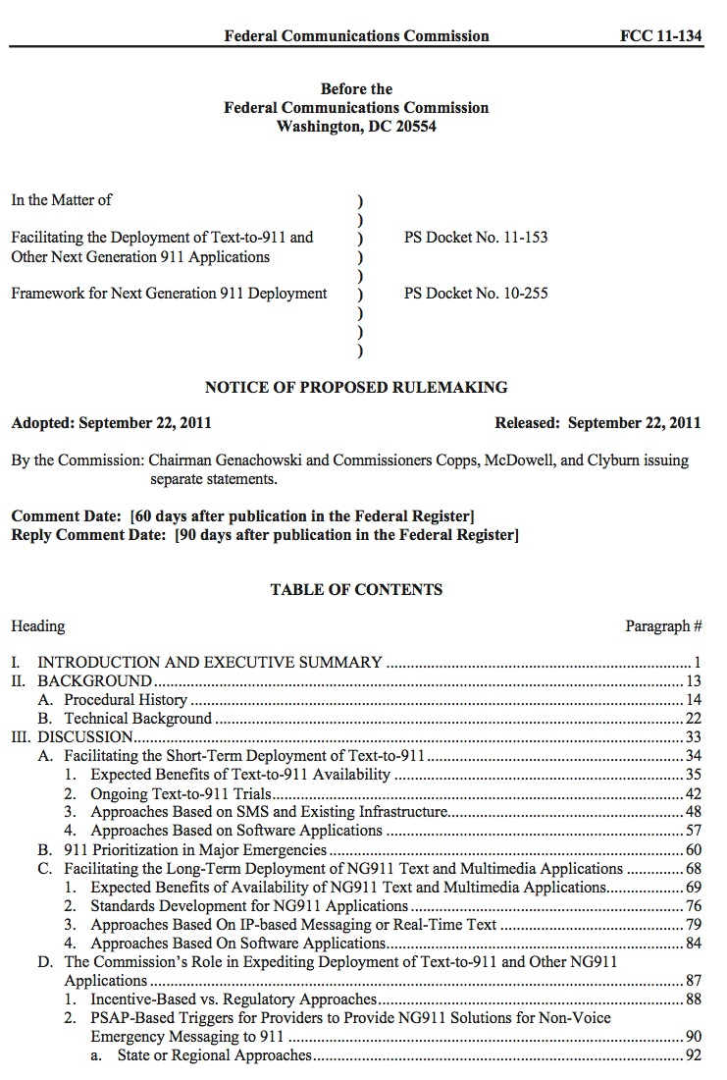
Sample NPRM

Slide 25
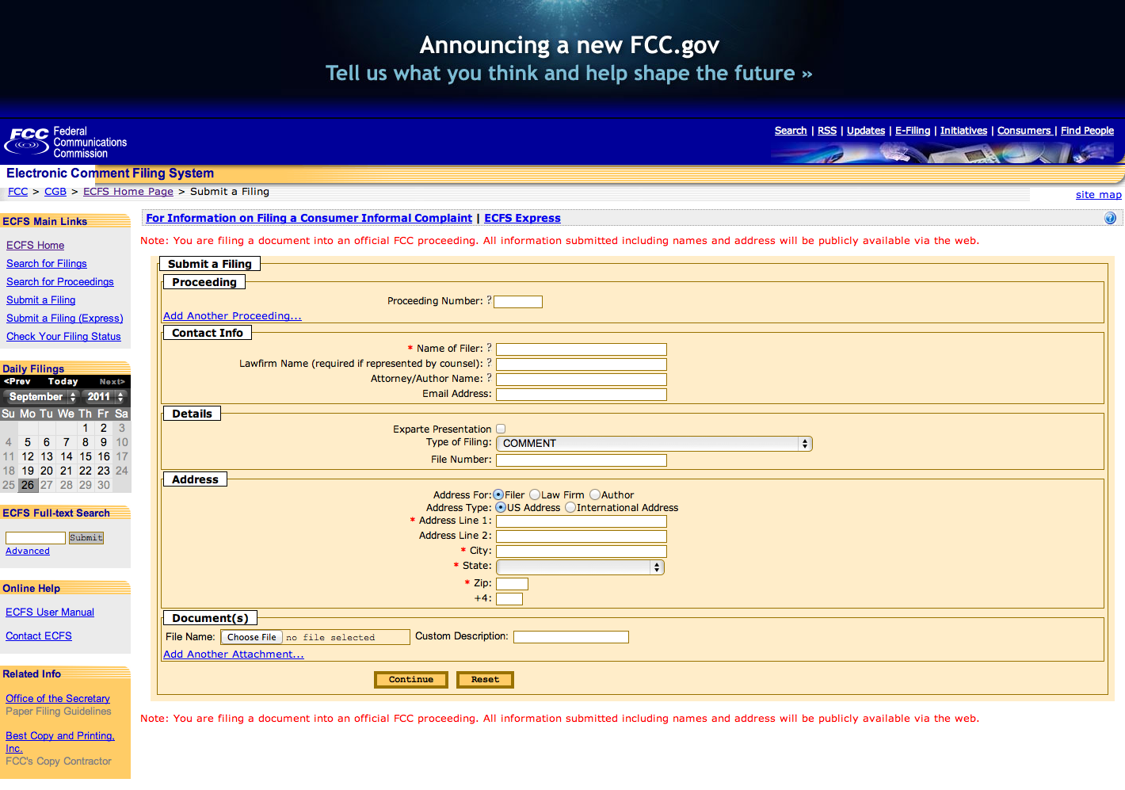
Filing comments

Slide 26
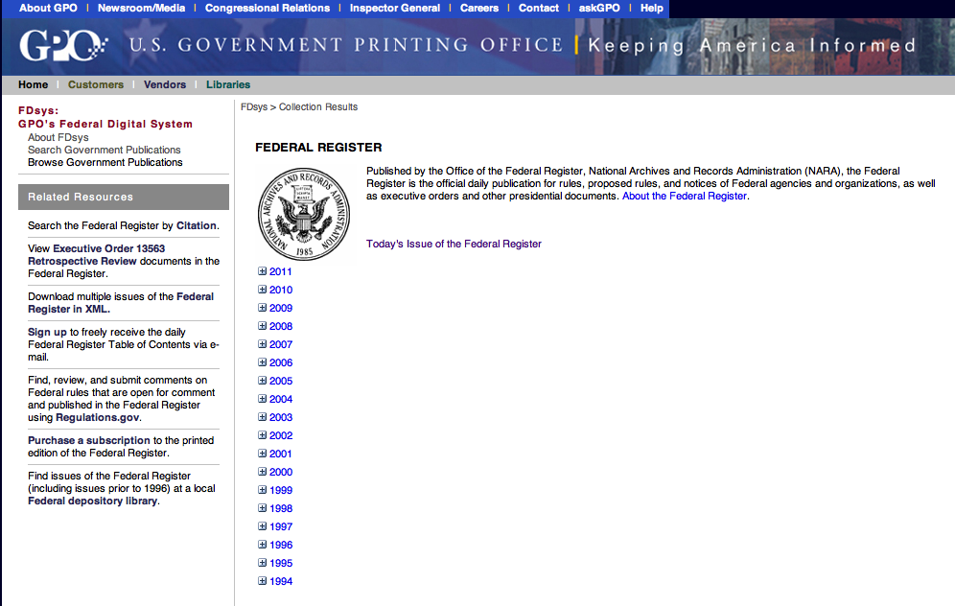
Federal Register
http://www.gpo.gov/fdsys/

Slide 27

FCC 101
Independent United States government agency
  not part of a cabinet-level agency (Department of …)
Directly responsible to Congress
Established by the Communications Act of 1934
Charged with regulating interstate and international communications by radio, television, wire, satellite and cable.
Directed by 5 Commissioners
  appointed by the President and confirmed by the Senate for 5-year terms.
  President designates one of the Commissioners to serve as Chairperson.
  Only 3 Commissioners may be members of the same political party.
Notes:
Communications Act of 1934 - Set up the FCC. Jurisdiction over radio and wireline communications - pretty much covers everything
Independent
Leadership of the FCC does not serve the President. Appointed for terms and once appointed, cannot be removed at the will of the President. No cabinet chair for the FCC.
What this means is that FCC is very responsive to Congress and spends a great deal of time interacting with the Congressional Commerce committees with jurisdiction over communications.
1887 – Interstate Commerce Comm. (ICC), the first independent regulatory agency, was created to regulate railroads.
1910 – Mann-Elkins Act brought interstate telecommunications within the jurisdiction of the ICC.
1912 – Radio Act gave Secretary of Commerce and Labor authority to issue spectrum licenses and control broadcasting
1927 – Radio Act created Federal Radio Commission with authority to issue radio licenses and assign specific frequencies.
1934 – Communications Act created the Federal Communications Commission
1982 – Judge Green approves Modification of Final Judgment (MFJ) providing for divestiture of AT&T
1984 – Cable Communications Policy Act preempted local rate regulation where the FCC found effective competition.
1992 – Cable Television Consumer Protection and Competition Act required cable companies to offer a basic tier and allowed local authorities to regulate rates in certain circumstances.
1996 – Telecommunications Act substantially revised the Communications Act to promote competition (particularly in local telephone markets) and deregulation.

Slide 28
FCC
Chairman (D)
4 Commissioners (2 D, 2 R)
Consumer and Governmental Affairs
Enforcement
International
Media
Public Safety & Homeland Security
Wireless Telecommunications
Wireline Competition
Independent federal agency
About 2,000 employees

Slide 29
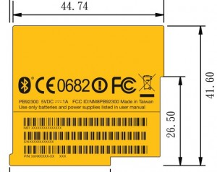
What is regulated?
Responsible for
Not
Radio spectrum & interference
Cable TV (retransmission)
Disability issues
  e.g., closed captioning, video relay service
9-1-1
  e.g., location accuracy
Universal service
  high-cost, low income, schools & libraries, rural health care
Do-Not-Call (with FTC)
Privacy – for telecom-related aspects
TV content
  “seven dirty words”
  was: “fairness doctrine”
Internet content & applications
Intrastate phone service
  → local public utility commission
Cable TV rates (mostly)
Rates
Technology choices (mostly)
Privacy – for non-telecom
  banking, health, most web sites

Slide 30
A Layered Model
Service Layers, Not Technology
Applications
Enhanced
Services
Unregulated
Applications
ISPs
TCP / IP
Dial Up
Basic Service
Regulated
1980
Notes:
Another way of looking at this.
Examples of title II regulations: interconnection, universal service, access charges, privacy, filing, disabled access, interoperability, disclosure, CALEA, and anti-discrimination requirements.
When the FCC says that the Internet is unregulated, this is largely what it is talking about. You, as ISPs, are not certified by the FCC. You do not have your rates approved by the FCC. And you have no obligations like interconnection or universal service.
I might note that the Telecom Act of 1996 introduced a new legal term: Information service providers. This means essentially the same thing as “Enhanced Service Providers.”
The layers are fully separate.
They are provisioned by separate service providers.
I can point to the the different equipment. Different equipment services the different layers.
And of course, the different layers represent separate (though dependent) markets.

Slide 31
Voice, transport and access
1880s-1980s
1980s-2000s
Now - future
Voice
Apps
Apps
Enhanced
IP
IP
Voice
Voice
Basic
Transport
Transport
Transport
Notes:
Bob Cannon

Slide 32
IETF WGs with regulatory impact
Regulatory issue | Area or WGs
Emergency calling | ECRIT, GEOPRIV
Emergency alerting | ATOCA
Universal service/intercarrier compensation | RAI
PSTN transition | RAI
Accessibility, video relay services | RAI
White spaces, spectrum | PAWS
Cybersecurity | DNSEXT
Competition | IPv6, MIF
Open Internet (network neutrality) | MPLS, DiffServ, email operations
Network measurement | IPPM

Slide 33
Open Internet Principles
Transparency. Fixed and mobile broadband providers must disclose the network management practices, performance characteristics, and terms and conditions of their broadband services;
No blocking. Fixed broadband providers may not block lawful content, applications, services, or non-harmful devices; mobile broadband providers may not block lawful websites, or block applications that compete with their voice or video telephony services
No unreasonable discrimination. Fixed broadband providers may not unreasonably discriminate in transmitting lawful network traffic.

Slide 34
Example: OI
Standard Practices. The conformity or lack of conformity of a practice with best practices and technical standards adopted by open, broadly representative, and independent Internet engineering, governance initiatives, or standards-setting organizations is another factor to be considered in evaluating reasonableness. Recognizing the important role of such groups is consistent with Congress’s intent that our rules in the Internet area should not “fetter[]” the free market with unnecessary regulation, and is consistent with broadband providers’ historic reliance on such groups. We make clear, however, that we are not delegating authority to interpret or implement our rules to outside bodies.
Broadband providers’ practices historically have relied on the efforts of such groups, which follow open processes conducive to broad participation. See, e.g., William Lehr et al. Comments at 24; Comcast Comments at 53–59; FTTH Comments at 12; Internet Society (ISOC) Comments at 1–2; OIC Comments at 50–52; Comcast Reply at 5–7. Moreover, Internet community governance groups develop and encourage widespread implementation of best practices, supporting an environment that facilitates innovation. See supra Part II.A (discussing the benefits of edge providers having access to a uniform service interface, consisting of a core set of Internet standards and conventions); CDT Comments at 43–44.

Slide 35
Providing input
Comments and reply comments
  as company, individual or organization (e.g., ISOC or IETF)
  make clear whom you are representing!
In-person or phone meetings with bureau staff and commissioners
participate in advisory committees
  examples:
    TAC (technical advisory committee)
      e.g., 911, PSTN transition
    CSRIC (communications security, reliability and interoperability council)
    EAAC (emergency access advisory committee)
      NG911 accessibility
    VPAAC (Video Programming Accessibility Advisory Committee)

Slide 36
Helpful comments & ex-partes
answer (a subset of) the questions posed
clearly identify the question answered
in the order asked
  makes summarizing them a lot easier
use paragraph or page numbers
  to allow precise citations
back up every claim with evidence
  peer-reviewed scientific literature
  own measurements or experiments
  can get confidentiality protection for proprietary data (ask!)
Provide numerical data
  performance data
  cost & benefit analysis
don’t dumb down technical material
  people with engineering degrees read ex-parte’s, too
provide constructive alternatives that achieve same or similar goals

Slide 37
Unhelpful, unconvincing → potentially useful
Can’t do
  i.e., technically impossible or extremely difficult
  just today, with today’s equipment, for next year or forever?
  physical impossibility (“would require perpetual motion machine”) vs. “there are still multiple standards”
Won’t do
  why not?
  too expensive? are there cheaper alternatives (in total, not just you) that work?
Maybe later
  “appoint another advisory committee” – which one? how will its process and output differ from the previous 7 that also recommended another committee?
Can’t make us
  i.e., no legal authority
  leave that to lawyers

Slide 38
Conclusion
Most countries have telecom regulation
  competition & social goals
Increasingly, Internet/IP-related issues
  from phone to spectrum
  from accessibility to openness
Regulators (generally) want to “do the right thing”
  but need helpful input, not sideline carping
  but more than technology
    economics (“cost-benefit analysis” + who pays?)
    legacy issues
    political trade-offs
    outdated legal environment

