Slide 1

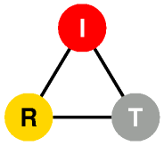
Fast NetServ Data Path:
OpenFlow integration
Emanuele Maccherani
Visitor PhD Student
DIEI - University of Perugia, Italy
IRT - Columbia University, USA

Slide 2
What is NetServ?
In-network service container
Active networking concept
Java-programmable, signal-driven router
Processing modules deployed on path

Slide 3
NetServ node architecture
Module download
Signaling message
to install module
Signaling message
forwarded to next hop
NetServ controller
Module install
Service modules
Service modules
Service modules
Building block layer
Building block layer
Building block layer
Virtual execution
environment
Virtual execution
environment
Virtual execution
environment
Data packets processed
by service modules
NetServ packet transport

Slide 4
NetServ current prototype
Server
modules
Client-
Server
data
packets
NSLP
daemon
OSGi control sockets
OSGi
Service
Container
UNIX
socket
NetServ
Controller
Packet
processing
modules
NetServ Control
Protocol (TCP)
GIST
daemon
Transport layer
OSGi
OSGi
Service
Container
Service
Container
Raw
socket
iptables
command
Forwarded
data packets
Netfilter
NFQUEUE #1
NFQUEUE #2
Signaling
packets
Linux kernel

Slide 5
NetServ Data Path
Currently: Linux Kernel
  Pass packets to user-level service container processes
  Use Netfilter queues
  Problem:
  Slow Performances compared to hardware routers

Slide 6
NetServ Data Path
Currently: Linux Kernel
  Pass packets to user-level service container processes
  Use Netfilter queues
Future: OpenFlow Switch
  Packet forwarding hardware
  Wire speed data path

Slide 7


What is OpenFlow?
OpenFlow is an API
Control how packets are forwarded
Implemented on hardware switch
Controller
OpenFlow Firmware
Software Layer
OpenFlow Switch
PC
Flow Table
MAC
src
MAC
dst
IP
Src
IP
Dst
TCP
sport
TCP
dport
Action
OF
Protocol
Hardware Layer
*
*
*
5.6.7.8
*
*
port 1
following packets
routing
1st packet
routing
port 1
port 2
port 3
port 4
PKT
PKT
IP dst: 5.6.7.8
5.6.7.8
1.2.3.4

Slide 8
OpenFlow integration
Openflow controller as a NetServ service module
  Runs inside the OSGi Service Container
  Modified version of the Beacon OF Controller (Java)
  Listens for signaling commands through JSON-RPC (sent by NetServ Controller or external services)
  Sends commands to OF-enabled hardware (OpenFlow protocol)

Slide 9
1st step: NetServ/OpenFlow prototype
UDPEcho used as a test service module
  intercepts UDP packets in a specific port
  sends them back to the sender, switching the src/dst IP/Port
Topology: Single OF Switch
  Attached: NetServ host, 2 normal host
  OF Switch emulation: Open vSwitch
  Topology emulation: Mininet

Slide 10
NetServ/OpenFlow prototype
NetServ Host
Signaling packet:
NetServ Controller
OSGi Container
Install UDPEcho service.
Filter UDP
Port 2222
OpenFlow Controller
UDPEcho
service
Filter Added
JSON
RPC
Forwarded to next hop
      Linux Kernel
OF Protocol
port 1
OpenFlow Switch
PKT
Flow Table
port 2
Host 1
1.2.3.4
MAC
src
MAC
dst
IP
Src
IP
Dst
UDP
sport
UDP
dport
Action
*
*
*
*
*
2222
port 1
port 3
Host 2
5.6.7.8
aa:bb:cc
dd:ee:ff
5.6.7.8
1.2.3.4
2222
3333
port 2

Slide 11
2nd step: expand NetServ/OpenFlow capabilities
NetServ Node
OSGi
NetServ
Controller
OpenFlow Controller
Signaling packets
OpenFlow Switch
First packet of a flow
Subsequent packets
PU (NetServ Node)
PU (NetServ Node)
PU (NetServ Node)
NetServ
Controller
OSGi
NetServ
Controller
OSGi
NetServ
Controller
OSGi
Service
Container
Service
Container
Service
Container

Slide 12



Signaling flow inside a NetServ/OpenFlow node
Other networks
OF Switch
PU
OF Controller
NetServ
Controller
Data
OF Protocol
JSON-RPC
Hello
NetServ starts
NetServ SETUP packet arrives
Add_filter
Processing module installed
1° Packet arrives
Packet_IN
Flow Mod
Packet
processing time
FlowMod Actions
MAC address rewrite:
PU NIC MAC address
Output packet to port
connected to PU
1° Packet gets routed
Packet_IN
Flow Mod
Following Packets path
Packet processing
time

Slide 13
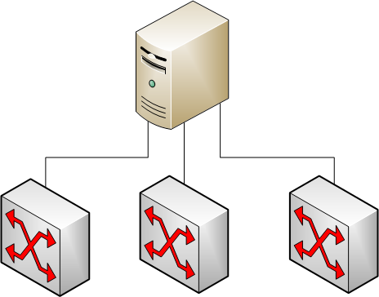
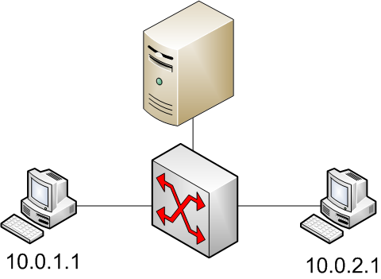
OF Controller for the NetServ/OpenFlow Node
Handle multiple switch
  Controlled by the same OF controller (OFC)
  Separate configuration parameters
Routing module
  OF switch acts as a router
    Forwarding to different subnet
    ARP table
    ARP request and replies
    Routing table
    Assign IPs to the OF switch port

Slide 14

OF Controller for the NetServ/OpenFlow Node
Handle multiple Processing Units (WIP)
  Control NetServ nodes attached to an OF switch as PUs (no OFC runs inside of it)
  Parallel packet processing
  Splitting packet flow through several PUs
OpenFlow Switch
Flow Split method:
Not possible with the current OFPv1.1 (will be with v1.2)
Current implementation replicate the flow to all PUs. Every PU drops unwanted packets (using netfilter u32 matching module)
Other networks
Other networks
PU1
OpenFlow Switch
NetServ
PU2
OpenFlow Controller
PU3
OpenFlow-enabled NerServ Nodes (PUs)

Slide 15
OF Controller for the NetServ/OpenFlow Node
OF controller deployed as a NetServ service (WIP)
  Deployable not only inside a PU, but in every reachable NetServ node
  Can be dynamically installed/remove/moved through NetServ nodes
Current implementation:
  Beacon is statically deployed inside a NetServ node
  NetServ-related modules can be installed with NSIS
  Switch and PUs configuration specified inside the NSIS SETUP “properties” field

Slide 16
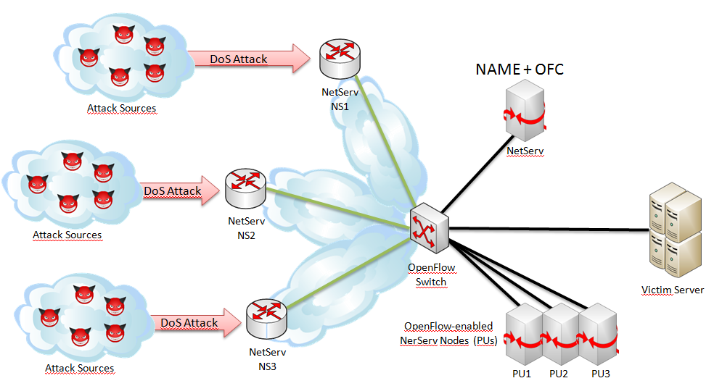
DoS experiment on GENI
Autonomic network management
  Self protecting from a SIP DoS attack (similar to NetServ Overload demo)
  Use of IP flow-based IDS (netmonitor service)
  Use of rate limiter (throttle service)

Slide 17


DoS experiment on GENI
NetServ Node (NS1)
NAME + OFC
SIP messages
OSGi
NetServ Node
Replicated packets
NetServ
Controller
OSGi
DoS Attack
Throttle
NetServ
Controller
OpenFlow
Controller
NAME
Attack Sources
Linux Kernel
Victim Server
DoS Attack
OpenFlow Switch
NetServ NS2
Attack Sources
OpenFlow-enabled NerServ Nodes (PUs)
DoS Attack
NetServ Node
NetServ Node
NetServ Node
OSGi
OSGi
OSGi
NetServ NS3
NetServ
Controller
Net
monitor
NetServ
Controller
Net
monitor
NetServ
Controller
Net
monitor
Throttle
Attack Sources
PU1
PU2
PU3
SIP messages NS1 node OF switch
OF switch SIP server
        PU1 (replicating)

Slide 18
DoS experiment on GENI
NetServ Node (NS1)
NAME + OFC
SIP messages
OSGi
NetServ Node
Replicated packets
NetServ
Controller
OSGi
DoS Attack
Throttle
NetServ
Controller
OpenFlow
Controller
NAME
Attack Sources
Linux Kernel
Victim Server
DoS Attack
OpenFlow Switch
NetServ NS2
Attack Sources
OpenFlow-enabled NerServ Nodes (PUs)
DoS Attack
NetServ Node
NetServ Node
NetServ Node
OSGi
OSGi
OSGi
NetServ NS3
NetServ
Controller
Net
monitor
NetServ
Controller
Net
monitor
NetServ
Controller
Net
monitor
Throttle
Attack Sources
PU1
PU2
PU3
Attack arrives
Net monitor NAME (attack detected) Throttle @ NS1

Slide 19
DoS experiment on GENI
NetServ Node (NS1)
NAME + OFC
SIP messages
OSGi
NetServ Node
Replicated packets
NetServ
Controller
OSGi
DoS Attack
Throttle
NetServ
Controller
OpenFlow
Controller
NAME
Attack Sources
Linux Kernel
Victim Server
Throttle
DoS Attack
OpenFlow Switch
NetServ NS2
Attack Sources
OpenFlow-enabled NerServ Nodes (PUs)
Throttle
DoS Attack
NetServ Node
NetServ Node
NetServ Node
OSGi
OSGi
OSGi
NetServ NS3
NetServ
Controller
Net
monitor
NetServ
Controller
Net
monitor
NetServ
Controller
Net
monitor
Throttle
Attack Sources
PU1
PU2
PU3
Attack increases
NAME (to prevent PU1 overload) Net monitor@PU2-PU3
NAME Throttle@NS2-NS3

Slide 20
DoS experiment on GENI - Results
The autonomic system takes few seconds to recognize and defeat it

Slide 21
DoS experiment on GENI - Results
Ir = additional traffic upon an attack beyond the background traffic
1st attack = Ir
2nd attack = 2 * Ir
Reaction time is insensitive to increasing values of traffic intensity

Slide 22
Future improvements
Processing optimized architecture
NetServ Node (NS1)
NAME + OFC
Packets inspected by DPI module deployed in NS1
OSGi
NetServ Node
Packets forwarded only by NS1 and VLAN tagged
NetServ
Controller
OSGi
DoS Attack
DPI
NetServ
Controller
OpenFlow
Controller
NAME
Packets inspected by PU3
Attack Sources
Linux Kernel
Victim Server
DoS Attack
OpenFlow Switch
NetServ NS2
Attack Sources
OpenFlow-enabled NerServ Nodes (PUs)
DoS Attack
OpenFlow Switch
NetServ Node
NetServ Node
NetServ Node
OSGi
OSGi
OSGi
NetServ NS3
NetServ
Controller
Flow
based
IDS
NetServ
Controller
Flow
based
IDS
NetServ
Controller
Flow
based
IDS
DPI
Attack Sources
PU1
PU2
PU3

Slide 23
TODO / Future Work
Create standard APIs for service modules that wants to interact with the data path (it can be either the linux kernel or an OF Switch)
Extend NetServ signaling sintax in order to expose OF Switch features
Utilize NetFPGA card as Hardware Processing Unit (so both the routing and the packet elaboration could be done at wire speed)

