Slide 1
Network neutrality: where technology meets policy
Henning Schulzrinne
Columbia University
Any opinions are those of the author and do not necessarily reflect the views
of Columbia University or the FCC.

Slide 2
Overview
What is network neutrality?
  History
  Why does it matter?
Network economics
Telecom regulation (in the US)
Means, motive and opportunity
Challenges

Slide 3
What is network neutrality?
“The principle advocates no restrictions by Internet service providers and governments on content, sites, platforms, the kinds of equipment that may be attached, and the modes of communication.” (Wikipedia)
2005 FCC statement:
  “access the lawful Internet content of their choice.
  run applications and use services of their choice, subject to the needs of law enforcement.
  connect their choice of legal devices that do not harm the network.
  competition among network providers, application and service providers, and content providers.”
= Any lawful content, any lawful application, any lawful device, any provider

Slide 4
Two views
Open Internet advocates
Free market advocates
no prioritization
flat rates
all networks
no real problem
allow any business arrangement
“it’s my network”
use anti-monopoly laws if needed

Slide 5
Why?
Civic considerations
  freedom to read (passive)
  freedom to discuss & create (active)
Economic opportunity
  edge economy >> telecom economy
    Telecom revenue (US): $330B
    Content, etc. not that large, however
      Google: $8.44B
    others that depend on ability to provide services
  content, application, service providers
Technical motivation
  avoid network fragmentation
  reduce work-around complexity

Slide 6
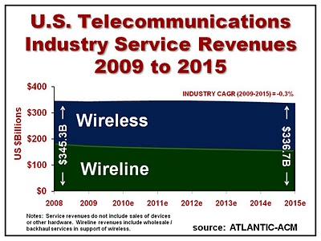
Telecom revenue

Slide 7
How to be non-neutral
deep packet inspection
block Skype
application
block transport protocol
block ports
insert RST
transport
block IP addresses
QoS discrimination
network

Slide 8
Are these neutrality issues?
Redirect DNS NXDOMAIN to ISP web site
Content translation
  e.g., reduce image resolution for cellular data
Blocking transport protocols other than UDP + TCP
Prohibit web servers
Reset DSCP (ToS bits)
Not allow IPv6
3GPP: only make non-BE available to carrier

Slide 9
Some high-profile cases
Madison River (2005)
  DSL provider blocked SIP ports
  fined $15,000 by FCC
Comcast (late 2007)
  insert TCP RST into BitTorrent traffic
  later overturned on appeal in DC Circuit Court
RCN (2009): P2P
Various mobile operators
Comcast vs. Level 3 (2010, in dispute)
  Level-3
Notes:
http://hraunfoss.fcc.gov/edocs_public/attachmatch/DA-05-543A1.pdf
http://www.zeropaid.com/news/88573/comcast-prevails-in-bittorrent-throttling-case/

Slide 10
Network neutrality & freedom of speech
1st amendment: Congress shall make no law abridging the freedom of speech
Applies only to U.S. government, not private entities
  Example: soap box in city park vs. mall
  private vs. public universities
Freedom to speak + no forced speech
  demise of “fairness doctrine” (19xx)

Slide 11
Which Internet are you connected to?
port 80 + 25
IPv4
NAT
multicast
QoS
IPv4
DHCP
IPv6
IPv4
PIA

Slide 12
New name, old concept: Common carrier
Since 1600s: A common carrier in common-law countries … is a person or company that transports goods or people for any person or company and that is responsible for any possible loss of the goods during transport. A common carrier offers its services to the general public under license or authority provided by a regulatory body. (Wikipedia)
e.g., FedEx, Greyhound, telecommunications providers, Disneyland

Slide 13
Network transparency
RFC 1958: “Architectural Principles of the Internet”
However, in very general terms, the community believes that the goal is connectivity, the tool is the Internet Protocol, and the intelligence is end to end rather than hidden in the network.
RFC 2275: “Internet Transparency”
  NATs, firewalls, ALGs, relays, proxies, split DNS
RFC 3724: “The Rise of the Middle and the Future of End-to-End: Reflections on the Evolution of the Internet Architecture”
RFC 4924: “Reflections on Internet Transparency”
  A network that does not filter or transform the data that it carries may be said to be "transparent" or "oblivious" to the content of packets. Networks that provide oblivious transport enable the deployment of new services without requiring changes to the core. It is this flexibility that is perhaps both the Internet's most essential characteristic as well as one of the most important contributors to its success.

Slide 14
Network transparency and neutrality
neutral
transparent
QoS discrimination
pay for priority
block protocol features

Slide 15
Means, motive and opportunity
Political motivation
  suppress undesirable opinion
    e.g., union web site, abortion SMS
Economic advantage
  prevent competition in related services
    e.g., VoIP or over-the-top VoD
  leverage pricing power
    OTT content provider has to offer service to everyone
  market segmentation
    consumer vs. business customers
Non-tariff barriers
  e.g., special (undocumented) APIs
Notes:
http://en.wikipedia.org/wiki/Means,_motive,_and_opportunity

Slide 16
Network economics
Monopolies
  economies of scale (cost ~ 1/size)
  “exists when a specific individual or an enterprise has sufficient control over a particular product or service to determine significantly the terms on which other individuals shall have access to it.” (Wikipedia)
Natural monopoly
  no motivation for second provider
    road, water, gas, electricity
  Landline telephone & broadband
  Wireless
    limited spectrum
    high cost of entry → spectrum auctions

Slide 17
Why are monopolies bad?
Market power
Pricing power
  perfectly competitive market: price = marginal cost
Product differentiation
  no available substitute
Excess profits
Price discrimination
  same product, different prices
  capture consumer surplus
Notes:
see Wikipedia

Slide 18


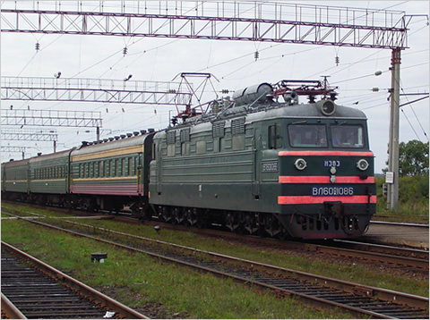
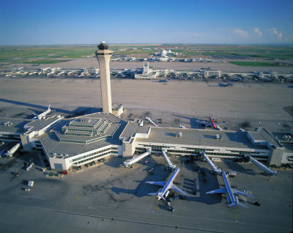
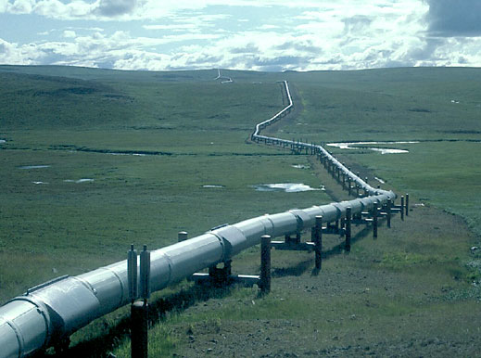
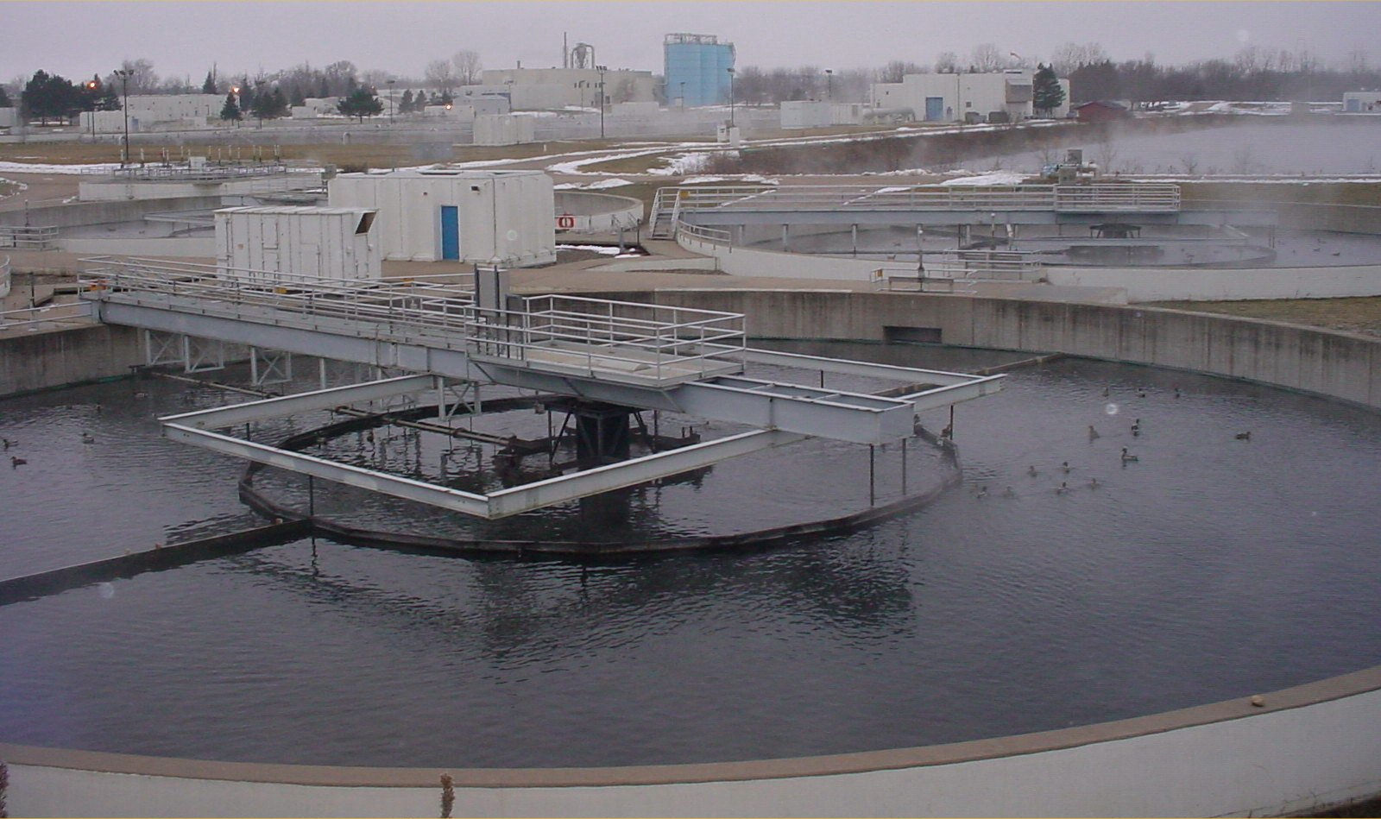
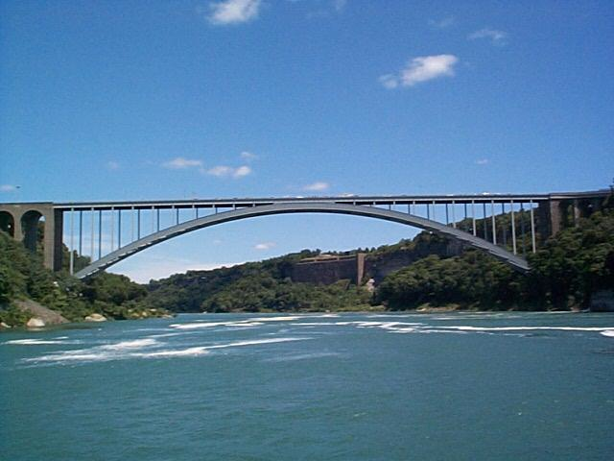
The monopoly infrastructures
Technical structures that support a society → “civil infrastructure”
  Large
  Constructed over generations
  Not often replaced as a whole system
  Continual refurbishment of components
  Interdependent components with well-defined interfaces
  High initial cost
water
energy
transportation

Slide 19
Remedies
Functional separation
  separate entities for L2 and upper layers
  e.g., “dry loops” copper
  e.g., UK (BT Wholesale)
Multiple infrastructures → competition
  e.g., DSL, cable, wireless
  but substitutability?
  may not prevent abuse (e.g., Skype blocking for French mobile operators)
    not likely to protect small customer groups with specialized needs

Slide 20
Competition (US)
if lucky, incumbent LEC + cable company
  DSL: cheaper, but low speed
    mean: 2.5 – 3.5 Mb/s
  FTTH (FiOS): only 3.3M households
    10-15 Mb/s
  Cable: > $50/month, higher speeds
    8-11 Mb/s
often, high switching costs ($200 early termination fee)
  or tied to bundles (TV, mobile)
can’t easily predict whether problem would be different
Notes:
http://s.ftthcouncil.org/files/RVA.FTTH_.Apr09.060109.pdf

Slide 21
FTTH
mostly Verizon: 3.3 mio

Slide 22
FTTH penetration
Notes:
FTTH Council, Fiber-to-the-Home: North American Market Update, April 2009
http://www.ftthcouncil.org/en/knowledge-center/publications/reports/ftth-north-american-market-update-april-2009

Slide 23
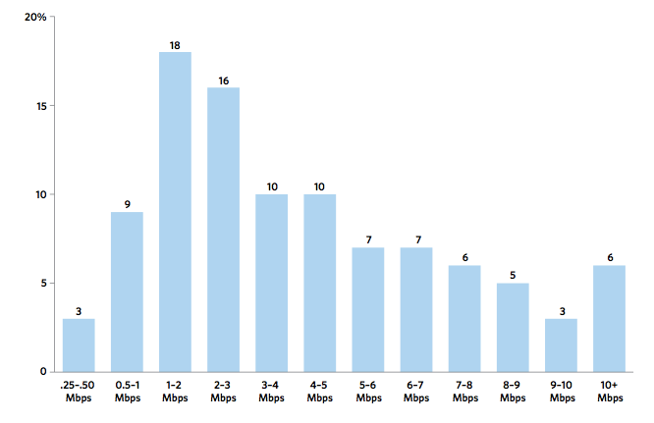
US broadband speeds
FCC OBI Report #4
Notes:
OBI #4 pg. 15

Slide 24
Residential broadband
FCC: Internet Access Services Status as of December 31, 2009

Slide 25
Residential broadband technologies
FCC: Internet Access Services Status as of December 31, 2009

Slide 26
State of competition (US)
FCC: Internet Access Services Status as of December 31, 2009
Notes:
http://www.fcc.gov/Daily_Releases/Daily_Business/2010/db1208/DOC-303405A1.pdf: Internet Access Services: Status as of December 31, 2009

Slide 27
Wireless as substitute
Speed range
Speed predictability
Indoor usability
Volume limits
Still relies on ILEC or CATV back-haul to cell sites and femtocells

Slide 28
Cisco’s traffic prediction
Ambient video = nannycams, petcams, home security cams, and other persistent video streams
Notes:
http://www.cisco.com/en/US/solutions/collateral/ns341/ns525/ns537/ns705/ns827/white_paper_c11-481360_ns827_Networking_Solutions_White_Paper.html

Slide 29
The value of bits
Technologist: A bit is a bit is a bit
Economist: Some bits are more valuable than other bits
Application | Volume | Cost per unit | Cost / MB
Voice (13 kb/s GSM) | 97.5 kB/minute | 10c | $1.02
Mobile data | 5 GB | $40 | $0.008
MMS (pictures) | < 300 KB, avg. 50 kB | 25c | $5.00
SMS | 160 B | 10c | $625
Notes:
T-Mobile 2010
AT&T data
http://www.nowsms.com/discus/messages/12/8500.html

Slide 30



Bandwidth costs
Amazon EC2
  $100/TB in, $100/TB out
CDN (Internet radio)
  $600/TB (2007)
  $100/TB (Q1 2009 – CDNpricing.com)
NetFlix (7 GB DVD)
  postage $0.70 round-trip → $100/TB
FedEx – 2 lb disk
  5 business days: $6.55
  Standard overnight: $43.68
  Barracuda disk: $91 - $116/TB
Notes:
FedEx and EC2 prices as of 09/15/09
CDN: http://www.mindbranch.com/listing/product/R678-29.html
http://www.cdnpricing.com/

Slide 31
Flat rate & heavy tails
2009: median 2 GB, mean 9 GB
AT&T wireless: 65% of smartphone < 200 MB, 98% < 2 GB
Notes:
http://www.slate.com/id/2281841/ “AT&T says that 65 percent of its smartphone customers consume less than 200 MB of broadband per month and 98 percent use less than 2 GB.”
FCC OBI technical paper #4

Slide 32
Residential broadband use
Notes:
FCC OBI #4

Slide 33
Cost of broadband
Access | Price per month | Median (average) usage | $/GB
DSL (3 MB/s + 768 kb/s) | $30 | 1.7 GB (9.2 GB) | $17.65 ($3.26)
Smartphone | $25 | 250 MB | $100
Wireless data retail | $40 |  | $10
Web hosting |  |  | $1-2
CDN pricing (*) |  |  | $0.10
* strongly depends on volume: $0.25 GB/resale, high volume (500 TB/month): $0.05/GB
Notes:
http://www.newamerica.net/publications/policy/price_of_the_pipe
http://blogs.gartner.com/phillip-redman/2010/11/09/wireless-data-pricing-reaches-a-new-low/

Slide 34
The US hierarchy of laws
Constitution
Commerce clause
Law
Telecom Act 1934 & 1996
47 CFR
Narrative
reasonable network management
Section 8: To regulate Commerce with foreign Nations, and among the several States, and with the Indian Tribes (1787)
SEC. 706. ADVANCED TELECOMMUNICATIONS INCENTIVES. (a) IN GENERAL- The Commission … shall encourage the deployment on a reasonable and timely basis of advanced telecommunications capability to all Americans (including, in particular, elementary and secondary schools and classrooms) by utilizing, in a manner consistent with the public interest, convenience, and necessity, …, or other regulating methods that remove barriers to infrastructure investment.

Slide 35

Example: CFR 47
§ 15.5 General conditions of operation.
(a) Persons operating intentional or unintentional radiators shall not be deemed to have any vested or recognizable right to continued use of any given frequency by virtue of prior registration or certification of equipment, or, for power line carrier systems, on the basis of prior notification of use pursuant to §90.35(g) of this chapter.
(b) Operation of an intentional, unintentional, or incidental radiator is subject to the conditions that no harmful interference is caused and that interference must be accepted that may be caused by the operation of an authorized radio station, by another intentional or unintentional radiator, by industrial, scientific and medical (ISM) equipment, or by an incidental radiator.

Slide 36
47 CFR content
Part | Content
0 | Commission organization
1 | Practice and procedure
2 | Frequency allocations and radio treaty matter
3 | Authorization and administration of accounting authorities in maritime and maritime mobile radio services
4 | Disruptions to Communications
5 | Experimental Radio Service
6 | Access to Telecommunications Service, Telecommunications Equipment and Customer Premises Equipment by Persons with Disabilities
7 | Access to Voicemail and Interactive Menu Services and Equipment by People with Disabilities

Slide 37
47 CFR content
Part | Content
9 | Interconnected Voice over Internet Protocol Services
10 | Commercial Mobile Alert System
11 | Emergency Alert System (EAS)
12 | Redundancy of Communications Systems
13 | Commercial Radio Operators
15 | Radio Frequency Devices
17 | Construction, Marking and Lighting of Antenna Structures
18 | Industrial, Scientific and Medical Equipment (ISM)

Slide 38
47 CFR content
Part | Content
19 | Employee Responsibilities and Conduct
20 | Commercial Mobile Radio Services (= cellular)
22 | Public Mobile Services
24 | Personal Communications Services
25 | Satellite Communications
27 | Miscellaneous Wireless Communication Services
32 | Uniform System of Accounts for Telecommunications Companies
36 | Jurisdictional Separations Procedures; Standard Procedures for Separating Telecommunications Property Costs, Revenues, Expenses, Taxes and Reserves for Telecommunications Companies

Slide 39
47 CFR content
Part | Content
42 | Preservation of Records for Communication Common Carriers
43 | Reports of Communication Common Carriers and Certain Affiliates
51 | Interconnection
52 | Numbering
53 | Special Provisions Concerning Bell Operating Companies
54 | Universal Service
59 | Infrastructure Sharing
61 | Tariffs
68 | Connection of Terminal Equipment to the Telephone Network
69 | Access Charges

Slide 40
47 CFR content
Part | Content
73 | Radio broadcast services
74 | Experimental Radio, Auxiliary, Special Broadcast and Other Program Distributional Services
51 | Multichannel Video and Cable Television Services
78 | Cable Television Relay Services
79 | Closed Captioning and Video Description of Video Programming

Slide 41
47 CFR content
Part | Content
80 | Stations in the Maritime Services
87 | Aviation Services
90 | Private Land Mobile Radio Services
95 | Personal Radio Services
97 | Amateur Radio Services
101 | Fixed Microwave Services

Slide 42
Telecom regulation
Local, state and federal
  local: CATV franchise agreements
  state: Public Utility Commission
    responsible for all utilities – gas, water, electricity, telephone
  federal: FCC, FTC (privacy), DOJ (monopoly)
Elsewhere: gov’t PTT → competition
  vs. US: regulated private monopolies
Based on 1934 Telecommunications Act
Amended in 1996
Divides the world into
  Title I: Telecommunications Services
  Title II: Broadcast Services
  Title III: Cable Services
  Title V: Obscenity and Violence

Slide 43
Process
NOI
NPRM
R&O
Notice of Inquiry
Notice of Proposed Rule Making
Report & Order
comments & ex parte

Slide 44
FCC
Chairman (D)
4 Commissioners (2 D, 2 R)
Consumer and Governmental Affairs
Enforcement
International
Media
Public Safety & Homeland Security
Wireless Telecommunications
Wireline Competition
Independent federal agency
About 2,000 employees

Slide 45
Open Internet FCC history
2004: “four freedoms” (Powell)
2005: Internet policy statement (Martin)
9/2009: Genachowski speech
  non-discrimination, transparency
12/2009/: NPRM
9/2010: PN
12/2010: Open Internet rules
10,000+ short comments, hundreds of long comments
Notes:
http://www.openinternet.gov/
http://www.openinternet.gov/read-speech.html

Slide 46
Who is covered?
Broadband Internet Access Service = A mass-market retail service by wire or radio that provides the capability to transmit data to and receive data from all or substantially all Internet endpoints, including any capabilities that are incidental to and enable the operation of the communications service, but excluding dial-up Internet access service. This term also encompasses any service that the Commission finds to be providing a functional equivalent of the service described in the previous sentence, or that is used to evade the protections set forth in this Part.
excludes
dial-up
coffee shops, bookstores, airlines (premise operators)
“edge providers”: CDNs, search engines, …

Slide 47
Principles
Transparency. Fixed and mobile broadband providers must disclose the network management practices, performance characteristics, and terms and conditions of their broadband services;
No blocking. Fixed broadband providers may not block lawful content, applications, services, or non-harmful devices; mobile broadband providers may not block lawful websites, or block applications that compete with their voice or video telephony services
No unreasonable discrimination. Fixed broadband providers may not unreasonably discriminate in transmitting lawful network traffic.

Slide 48
FCC Open Internet order
 | Wired | Wireless
Disclosure | yes | yes
Non-blocking | every protocol | “web”, “VoIP”
Non-discrimination | reasonable network management | “monitor”

Slide 49
FCC Open Internet order
CFR text: 1 page
Main content: 85 pages
  with 500 footnotes
Regulatory Flexibility Analysis
5 commissioner statements: 60 pages

Slide 50
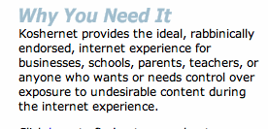
Some corner cases
Parental protection
  user (paying subscriber…) choice
KosherNet
Spam
  would only affect IP-level blocking
DOS
  classified as unwanted traffic
Notes:
http://www.koshernet.com/

Slide 51
47 CFR 8
§ 8.1 Purpose.
  The purpose of this Part is to preserve the Internet as an open platform enabling consumer choice, freedom of expression, end-user control, competition, and the freedom to innovate without permission.
§ 8.3 Transparency.
  A person engaged in the provision of broadband Internet access service shall publicly disclose accurate information regarding the network management practices, performance, and commercial terms of its broadband Internet access services sufficient for consumers to make informed choices regarding use of such services and for content, application, service, and device providers to develop, market, and maintain Internet offerings.

Slide 52
Disclosure (Transparency) – Network Practices
Congestion management: congestion management practices; types of traffic; purposes; practices’ effects on end users’ experience; criteria used in practices, such as indicators of congestion that trigger a practice, and the typical frequency of congestion; usage limits and the consequences of exceeding them; and references to engineering standards, where appropriate.
Application-Specific Behavior
Device Attachment Rules
Security

Slide 53
Disclosure (Transparency) – Performance
Service description: A general description of the service, including the service technology, expected and actual access speed and latency, and the suitability of the service for real-time applications.
Impact of specialized services: If applicable, what specialized services, if any, are offered to end users, and whether and how any specialized services may affect the last-mile capacity available for, and the performance of, broadband Internet access service.

Slide 54
Disclosure (Transparency) – Commercial Terms
Pricing: For example, monthly prices, usage-based fees, and fees for early termination or additional network services.
Privacy Policies: For example, whether network management practices entail inspection of network traffic, and whether traffic information is stored, provided to third parties, or used by the carrier for non-network management purposes.
Redress Options: Practices for resolving end-user and edge provider complaints and questions.

Slide 55
What about congestion?
Open Internet rules allow charging by
  access rate
  traffic volume
Content-neutral mechanisms
  normal TCP
  e.g., Columbia University: “XXX”

Slide 56
Open Internet & QoS
Principle of end user control
E.g., DiffServ bits or signaling
  RSVP or NSIS
  or out-of-band (“please prioritize UDP port 5050”)
Together with rate or volume limits
  “Includes 1,000 minutes of VoIP priority”
Technical difficulties
  DSCP bit re-marking
  Symmetric treatment for incoming traffic

Slide 57
Pay for Priority (P4P)
“Dear Google: We’ll mark your packets as high priority for just $9.95/GB! Hurry, offer ends soon!”
May not matter (much) in practice
  assumes QoS problems and local congestion
  but related to paid peering (later)

Slide 58
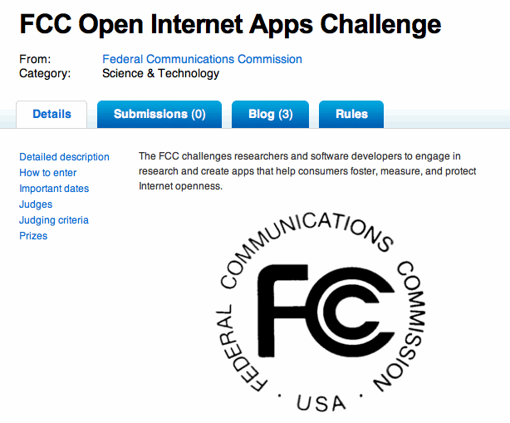

FCC challenge
Difficult to determine state of openness
  blocking, content discrimination

Slide 59
Example tests
May contribute to ossification of Internet
E.g., Reddit comments on FCC challenge
  SCTP, DCCP, UDP Lite
  UDP path MTU detection
  NXDOMAIN
  VPN protocols
  ICMP echo
  TCP vs. non-TCP fairness
  TCP window scaling
  TCP ECN
  modification of HTTP requests
Notes:
http://www.reddit.com/r/programming/comments/ewy18/the_fcc_has_launched_a_competition_to_create/

Slide 60
Peering – the next NN battle

Slide 61
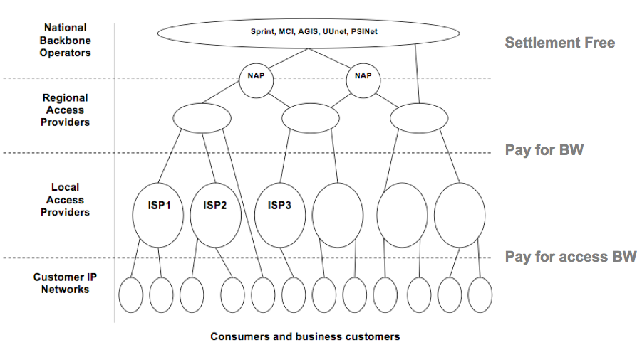
The old Internet
Craig Labovitz, “Internet Traffic and Content Consolidation”, IETF March 2010.

Slide 62
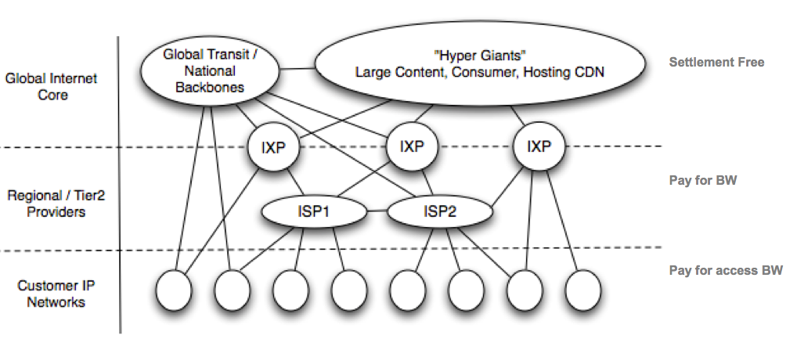
A denser Internet
Craig Labovitz, “Internet Traffic and Content Consolidation”, IETF March 2010.

Slide 63
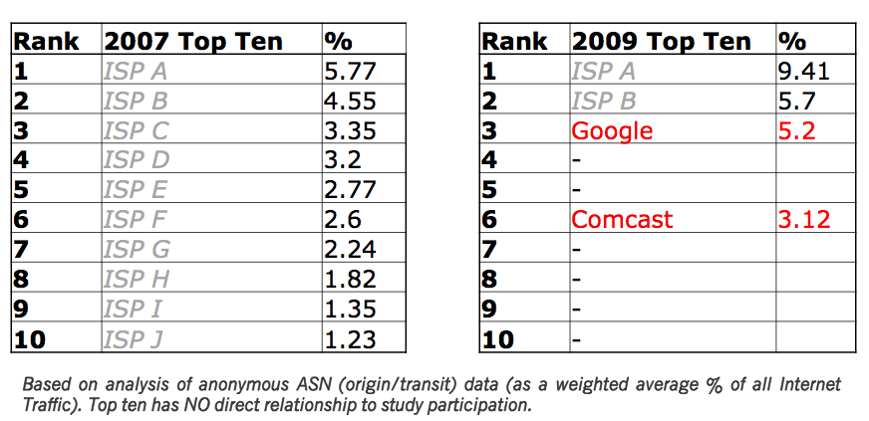
New network providers
Craig Labovitz, “Internet Traffic and Content Consolidation”, IETF March 2010.

Slide 64
Internet traffic flows today
ratio 16:1?
CDN
backbone (transit)
content
eyeball ISP
CDN

Slide 65
Internet money flows today
CDN
backbone (transit)
content
eyeball ISP
$0
or $0
“bill & keep”

Slide 66
Future Internet money flows?
CDN
backbone (transit)
content
eyeball ISP
$0
termination charges
cf. existing telephone network

Slide 67
Paid vs. non-paid peering
Reflects value added and market power
E.g.,
  number of customers served
  distance carried (fiber route miles)
Market power
  eyeball ISP only allows direct peering
  content providers have to reach (almost) all customers
  but there are lots of transit providers
Economic models just emerging

Slide 68
Paid vs. non-paid peering
Traffic ratios traditionally used between transit ISPs
  but not exclusively
Thought experiment:
  replace YouTube with Skype
  now, traffic symmetric
  but exact some impact on consumer ISP

Slide 69

The future, version 2: postal service
Private or semi-private company
Tariffed service
Based on weight and speed, not content
(Somewhat) regulated
  US Postal Rate Commission

Slide 70
The future, version 2: airline
Same basic service (get human cargo from A to B)
but vastly different prices
  economy vs. economy first vs. first class
  revenue management
  restrictions
    flexibility & cancellation risk
  additional services
Internet version:
  pay extra for VPN (see iBahn service)
  consumer web sites vs. IMAP access
  except only 1-2 choices

Slide 71
2 Internet futures
content and applications
content production (*)
content distribution
CDN
broadband access
local infrastructure
regional and national backbone
Google
Chatroulette
IP
Level 3
vs.
fiber or copper loop
(“Homes with tails”)
RCN
AT&T
Comcast/NBC (*)
Verizon
Notes:
see old MCI functional separation

Slide 72
MetroPCS example

Slide 73
Optus (Australia) example

Slide 74
Conclusion
Open Internet: motivated by civic and economic concerns
Competition or regulation?
Restrict allowable economic models?
Vertical integration
  Comcast (cable) + NBC (content)
“See you in court”: Verizon, January 2011

