Slide 1
A tale of two networks – network neutrality and other topics
Henning Schulzrinne
Columbia University
Any opinions are those of the author and do not necessarily reflect the views
of Columbia University or the Federal Communications Commission.

Slide 2
The typical Internet keynote
Unlimited bandwidth for everyone
Getting cheaper every year
Everyone uses the Internet
Millions of apps produced by thousands of companies
The big jukebox in the sky
A single Internet for all applications
IPv6 everywhere (next year)

Slide 3
But…
Not necessarily wrong
but not guaranteed, either
Non-technology forces
  competition and market concentration
  limited financial resources
  spectrum shortages

Slide 4
Time of transition

Slide 5
Time of transition
Old | New
IPv4 | IPv6
circuit-switched voice | VoIP
separate mobile voice & data | LTE + LTE-VoIP
911, 112 | NG911, NG112
digital cable (QAM) | IPTV
analog & digital radio | Pandora, Internet radio, satellite radio
credit cards, keys | NFC
end system, peers | client-server v2 aka cloud
all the energy into transition → little new technology

Slide 6
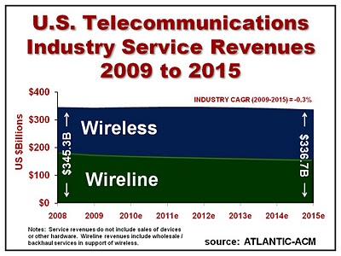
Telecom revenue

Slide 7
Household spending on telecom
→ new services must displace old services
Notes:
Bernstein Research
Source: Bureau of Economic Analysis

Slide 8
Wireless + Internet replace voice

Slide 9
Residential broadband penetration (US)

Slide 10
Net broadband additions (2010)
Notes:
World Broadband Statistics: Short report Q4 2010; Point Topic Ltd (March 2011)

Slide 11
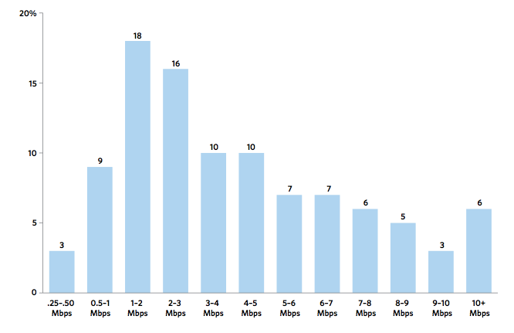
US broadband speeds
FCC OBI Report #4
Notes:
OBI #4 pg. 15

Slide 12
Residential broadband
FCC: Internet Access Services Status as of December 31, 2009

Slide 13
Residential broadband technologies
FCC: Internet Access Services Status as of December 31, 2009

Slide 14
Network infrastructure in 2015
FTTH build-out essentially complete (15%)
likely outcome:
  FTTH in dense, rich parts of the country
  cable and FTTN in suburban areas
  LTE in semi-rural areas
  satellite everywhere else

Slide 15
Wireless as substitute?
Speed range
Speed predictability
Indoor usability
Volume limits
Still relies on ILEC or CATV back-haul to cell sites and femtocells

Slide 16
Consumer network costs
Notes:
OECD (2011), “Broadband Bundling: Trends and Policy Implications”, OECD Digital Economy Papers, No. 175, OECD Publishing. doi: 10.1787/5kghtc8znnbx-en

Slide 17
Network traffic

Slide 18
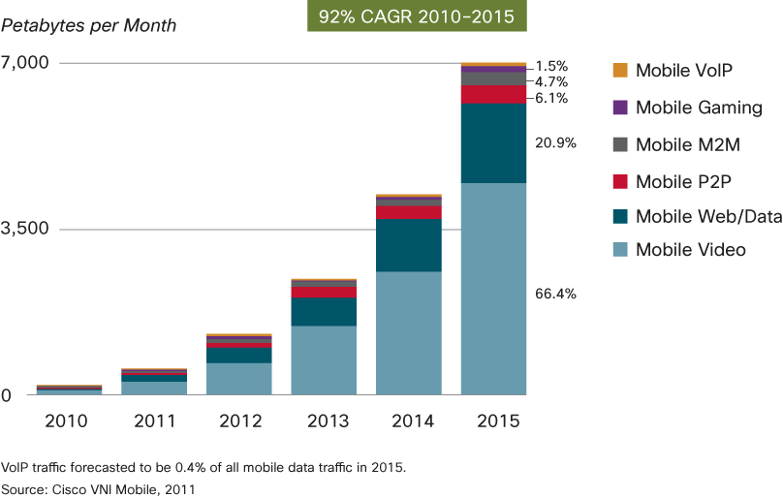
Traffic distribution

Slide 19
Traffic forecast 2015
Exabytes/month | Consumer (incl. university, Internet cafés) | Business & gov’t. | Total
Internet | 53.3 | 6.1 | 59.4
Managed IP (corporate WAN, IP VoD, IPTV) | 11.8 | 3.0 | 14.8
Mobile data | 4.9 | 1.3 | 6.3
Total | 70.0 | 10.4 | 80.5

Slide 20
Global Consumer Internet Traffic, 2010-2015

Slide 21
Monthly Consumption
North America | Mean | Median | Mean : Median
Upstream | 4.5 GB | 600 MB | 7.33
Downstream | 18.6 GB | 6.0 GB | 3.06
Aggregate | 23.0 GB | 7.0 GB | 3.28
top 1% →
  49.7% of upstream traffic
  25% of downstream traffic
Europe | Mean | Median | Mean : Median
Upstream | 8.2 GB | 1.2 GB | 6.87
Downstream | 31.3 GB | 12.7 GB | 2.47
Aggregate | 39.6 GB | 14.7 GB | 2.69
Notes:
Sandvine, Global Internet Phenomena Report Spring 2011

Slide 22
Video, video and more video
Upstream |  | Downstream |  | Aggregate
BitTorrent | 52.01 | Netflix | 29.70% | Netflix | 24.71%
HTTP | 8.31% | HTTP | 18.36% | BitTorrent | 17.23%
Skype | 3.81% | YouTube | 11.04% | HTTP | 17.18%
Netflix | 3.59% | BitTorrent | 10.37% | YouTube | 9.85%
PPStream | 2.92% | Flash Video | 4.88% | Flash Video | 3.62%
MGCP | 2.89% | iTunes | 3.25% | iTunes | 3.01%
RTP | 2.85% | RTMP | 2.92% | RTMP | 2.46%
SSL | 2.75% | Facebook | 1.91% | Facebook | 1.86%
Gnutella | 2.12% | SSL | 1.43% | SSL | 1.68%
Facebook | 2.00% | Hulu | 1.09% | Skype | 1.29%
Top 10 | 83.25% | Top 10 | 84.95% | Top 10 | 82.89%
Notes:
Sandvine Spring 2011

Slide 23
Average monthly usage
Average monthly TV consumption (US): 154 hours
Netflix: 1 GB/hour (SD) … 2.3 GB/hour (HD)
  → 300 GB/month
  more if people in household watch different content
monthly usage | overage cost (AT&T Uverse) | 2010 | 2012 | 2015
> 50 GB | $0 | 9.4% | 14.1% | 21.5%
> 100 GB | $0 | 5.3% | 8.2% | 15.3%
> 200 GB | $10 | 1.4% | 4.4% | 8.8%
> 500 GB | $50 | 0.4% | 0.8% | 2.6%
> 1 TB | $150 | 0.0% | 0.2% | 0.7%
Notes:
Nielsen State of Media, Q4 2010
http://blog.netflix.com/2011/03/netflix-lowers-data-usage-by-23-for.html

Slide 24
Average usage by speed tier
Notes:
FCC, Broadband Performance, OBI TechnIcal Paper No. 4

Slide 25
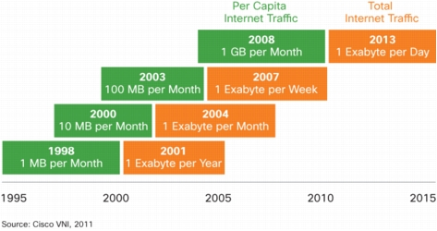
Bandwidth generations

Slide 26
Industry structure

Slide 27
Which Internet are you connected to?
port 80 + 25
IPv4
NAT
multicast
QoS
IPv4
DHCP
IPv6
IPv4
PIA

Slide 28
2 Internet futures
content and applications
content production (*)
content distribution
CDN
broadband access
local infrastructure
regional and national backbone
Google
Chatroulette
IP
Level 3
vs.
fiber or copper loop
(“Homes with tails”)
RCN
AT&T
Comcast/NBC (*)
Verizon
Notes:
see old MCI functional separation

Slide 29
Scenario 1: max. competition
content & application providers
consumers
applications
(Netflix, Pandora, your blog)
web browser
(Firefox, IE, Chrome, …)
OS
(Windows Server, Linux, MacOS)
OS
(Windows, Android, MacOS)
data centers
(Equinix, Amazon, …)
system platform
(Intel, ARM, …)
wide area network
(Qwest, Sprint, VZ, TeliaSonera, NTT, DTAG, Level 3, AT&T)
ISP
(competing)
fiber, radio
(regulated monopoly)
conduit
(public)

Slide 30
Scenario 2: vertically integrated
4 Mb/s
100 Mb/s to consumer
classical Internet
(web)
Internet
interactive multimedia (IMS)
video
(live, VOD)
small operators
Google
incumbent operator (e.g., AT&T, Verizon)
cable company (sometimes)

Slide 31
Network economics
Monopolies
  economies of scale (cost ~ 1/size)
  “exists when a specific individual or an enterprise has sufficient control over a particular product or service to determine significantly the terms on which other individuals shall have access to it.” (Wikipedia)
Natural monopoly
  no motivation for second provider
    road, water, gas, electricity
  Landline telephone & broadband
  Wireless
    limited spectrum
    high cost of entry → spectrum auctions

Slide 32
Why are monopolies bad?
Market power
Pricing power
  perfectly competitive market: price = marginal cost
Product differentiation
  no available substitute
Excess profits
Price discrimination
  same product, different prices
  capture consumer surplus
Notes:
see Wikipedia

Slide 33

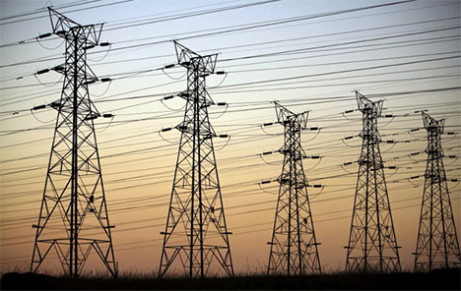
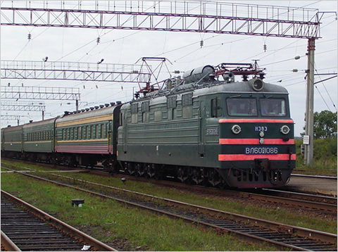
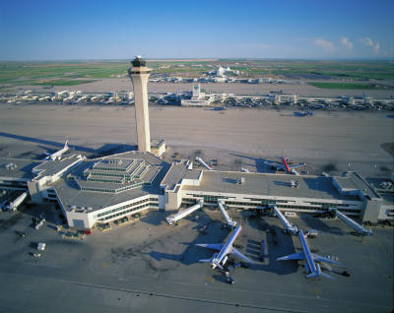
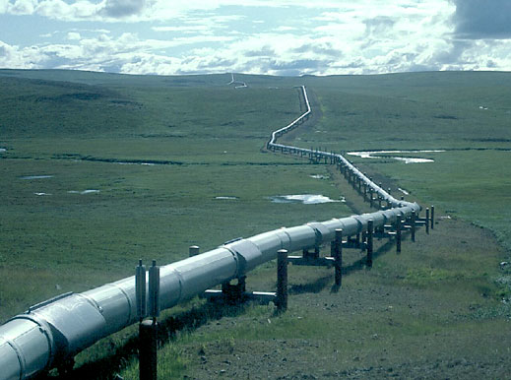
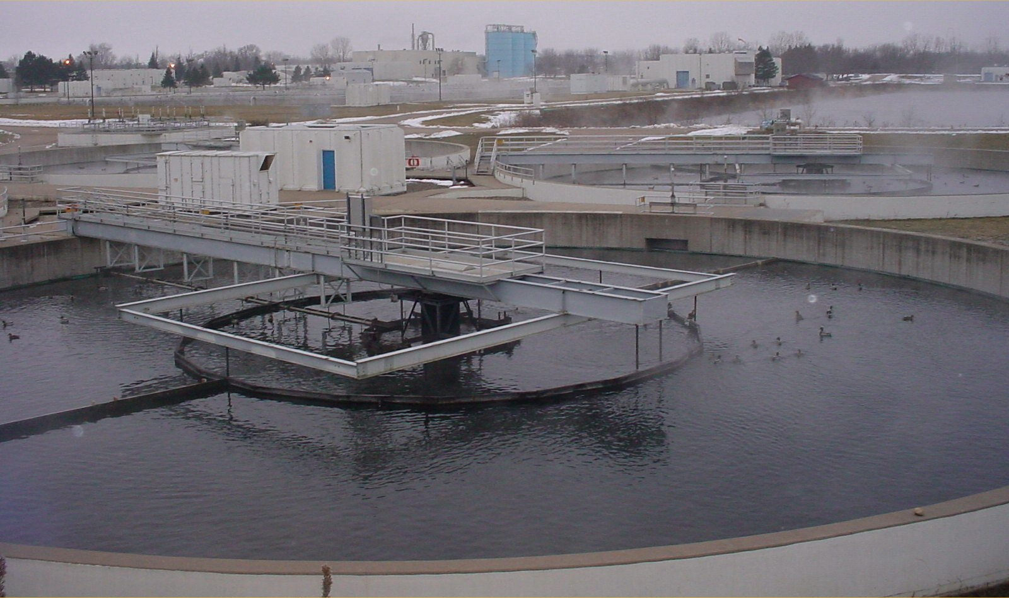
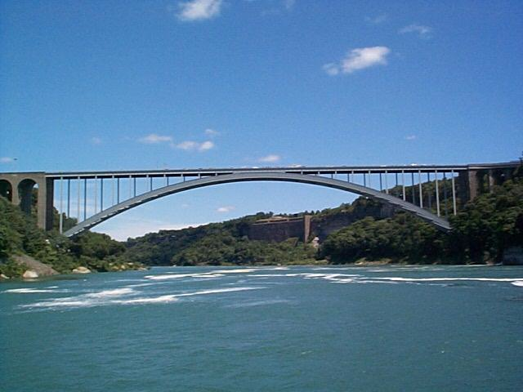
The monopoly infrastructures
Technical structures that support a society → “civil infrastructure”
  Large
  Constructed over generations
  Not often replaced as a whole system
  Continual refurbishment of components
  Interdependent components with well-defined interfaces
  High initial cost
water
energy
transportation

Slide 34
Competition (US)
if lucky, incumbent LEC + cable company
  DSL: cheaper, but low speed
    mean: 2.5 – 3.5 Mb/s
  FTTH (FiOS): only 3.3M households
    10-15 Mb/s
  Cable: > $50/month, higher speeds
    8-11 Mb/s
often, high switching costs ($200 early termination fee)
  or tied to bundles (TV, mobile)
Notes:
http://s.ftthcouncil.org/files/RVA.FTTH_.Apr09.060109.pdf

Slide 35
State of competition (US)
FCC: Internet Access Services Status as of December 31, 2009
Notes:
http://www.fcc.gov/Daily_Releases/Daily_Business/2010/db1208/DOC-303405A1.pdf: Internet Access Services: Status as of December 31, 2009

Slide 36
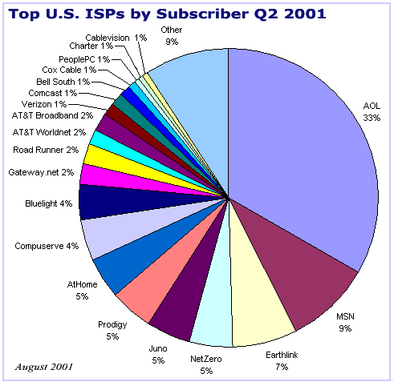
Eyeball ISPs: 2001 vs. 2010
Notes:
AT&T: http://www.everythingdsl.com/att/: 7.8 M; http://www.att.com/Investor/Financial/Earning_Info/docs/Supp_IB_4Q10.xls: 14.3M
Comcast: http://files.shareholder.com/downloads/CMCSA/1209582425x0x441905/918e0cf1-4a90-4575-9535-0c51452950da/Comcast_Q4Trending_2.15.11.pdf: 16.988
TW: http://phx.corporate-ir.net/External.File?item=UGFyZW50SUQ9NzkxMTJ8Q2hpbGRJRD0tMXxUeXBlPTM=&t=1: 9.469 + 0.349 = 9.803M
VZ: http://investor.verizon.com/financial/annual/2010/mda03_02.html: 8.392 BB + 4.082 FiOS = 12.474M
Windstream: http://www.snl.com/Cache/10782778.pdf?O=3&IID=4121400&OSID=9&FID=10782778 = 1.3M
Charter: http://phx.corporate-ir.net/External.File?item=UGFyZW50SUQ9ODM2ODl8Q2hpbGRJRD0tMXxUeXBlPTM=&t=1 = 3.24M
Qwest: http://investor.qwest.com/download/4Q.2010.Q.Profile.FINAL.pdf = 2.9 M
Cablevision: http://phx.corporate-ir.net/External.File?item=UGFyZW50SUQ9ODE3NjZ8Q2hpbGRJRD0tMXxUeXBlPTM=&t=1 = 2.892M
CenturyLink: http://phx.corporate-ir.net/External.File?item=UGFyZW50SUQ9NDEzODgyfENoaWxkSUQ9NDI1MjcxfFR5cGU9MQ==&t=1 = 2.394M
Mediacom: 838,000

Slide 37
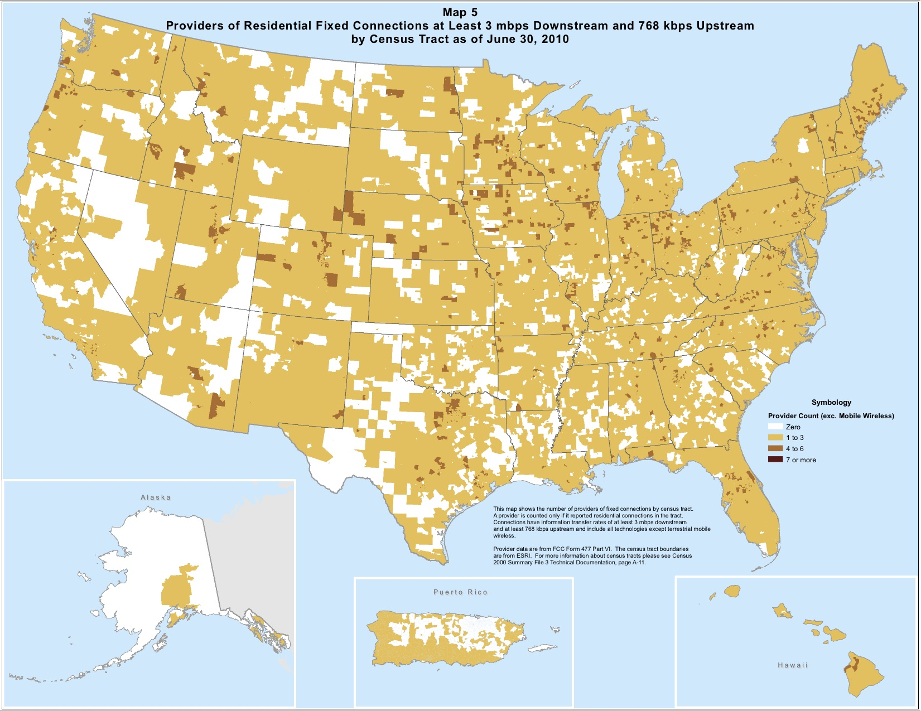
Market power: eye ball vs. transit
Notes:
FCC Internet Access Services 3/2011

Slide 38
Remedies
Functional separation
  separate entities for L2 and upper layers
  e.g., “dry loops” copper
  e.g., UK (BT Wholesale)
Multiple infrastructures → competition
  e.g., DSL, cable, wireless
  but substitutability?
  may not prevent abuse (e.g., Skype blocking for French mobile operators)
    not likely to protect small customer groups with specialized needs

Slide 39

The future, version 2: postal service
Private or semi-private company
Tariffed service
Based on weight and speed, not content
(Somewhat) regulated
  US Postal Rate Commission

Slide 40
The future, version 2: airline
Same basic service (get human cargo from A to B)
but vastly different prices
  economy vs. economy first vs. first class
  revenue management
  restrictions
    flexibility & cancellation risk
  additional services
Internet version:
  pay extra for VPN (see iBahn service)
  consumer web sites vs. IMAP access
  except only 1-2 choices

Slide 41
Network neutrality

Slide 42
Network neutrality
What is network neutrality?
  History
  Why does it matter?
Network economics
Telecom regulation (in the US)
Means, motive and opportunity
Challenges

Slide 43
What is network neutrality?
“The principle advocates no restrictions by Internet service providers and governments on content, sites, platforms, the kinds of equipment that may be attached, and the modes of communication.” (Wikipedia)
2005 FCC statement:
  “access the lawful Internet content of their choice.
  run applications and use services of their choice, subject to the needs of law enforcement.
  connect their choice of legal devices that do not harm the network.
  competition among network providers, application and service providers, and content providers.”
= Any lawful content, any lawful application, any lawful device, any provider

Slide 44
Two views
Open Internet advocates
Free market advocates
no prioritization
flat rates
all networks
no real problem
allow any business arrangement
“it’s my network”
use anti-monopoly laws if needed

Slide 45
Why?
Civic considerations
  freedom to read (passive)
  freedom to discuss & create (active)
Economic opportunity
  edge economy >> telecom economy
    Telecom revenue (US): $330B
    Content, etc. not that large, however
      Google: $8.44B
    others that depend on ability to provide services
  content, application, service providers
Technical motivation
  avoid network fragmentation
  reduce work-around complexity

Slide 46
How to be non-neutral
deep packet inspection
(block Skype)
application
block transport protocol
(block ports
insert RST)
transport
block IP addresses
QoS discrimination
(favor own content)
network

Slide 47
Are these neutrality issues?
Redirect DNS NXDOMAIN to ISP web site
Content translation
  e.g., reduce image resolution for cellular data
Blocking transport protocols other than UDP + TCP
Prohibit web servers
Reset DSCP (ToS bits)
Not allow IPv6
3GPP: only make non-BE available to carrier

Slide 48
Some high-profile cases
Madison River (2005)
  DSL provider blocked SIP ports
  fined $15,000 by FCC
Comcast (late 2007)
  insert TCP RST into BitTorrent traffic
  later overturned on appeal in DC Circuit Court
RCN (2009): P2P
Various mobile operators
Comcast vs. Level 3 (2010, in dispute)
  Level-3
Notes:
http://hraunfoss.fcc.gov/edocs_public/attachmatch/DA-05-543A1.pdf
http://www.zeropaid.com/news/88573/comcast-prevails-in-bittorrent-throttling-case/

Slide 49
Network neutrality & freedom of speech
1st amendment: Congress shall make no law abridging the freedom of speech
Applies only to U.S. government, not private entities
  Example: soap box in city park vs. mall
  private vs. public universities
Freedom to speak + no forced speech
  demise of “fairness doctrine” (19xx)

Slide 50
New name, old concept: Common carrier
Since 1600s: A common carrier in common-law countries … is a person or company that transports goods or people for any person or company and that is responsible for any possible loss of the goods during transport. A common carrier offers its services to the general public under license or authority provided by a regulatory body. (Wikipedia)
e.g., FedEx, Greyhound, telecommunications providers, Disneyland

Slide 51
Network transparency
RFC 1958: “Architectural Principles of the Internet”
However, in very general terms, the community believes that the goal is connectivity, the tool is the Internet Protocol, and the intelligence is end to end rather than hidden in the network.
RFC 2275: “Internet Transparency”
  NATs, firewalls, ALGs, relays, proxies, split DNS
RFC 3724: “The Rise of the Middle and the Future of End-to-End: Reflections on the Evolution of the Internet Architecture”
RFC 4924: “Reflections on Internet Transparency”
  A network that does not filter or transform the data that it carries may be said to be "transparent" or "oblivious" to the content of packets. Networks that provide oblivious transport enable the deployment of new services without requiring changes to the core. It is this flexibility that is perhaps both the Internet's most essential characteristic as well as one of the most important contributors to its success.

Slide 52
Network transparency and neutrality
neutral
transparent
QoS discrimination
pay for priority
block protocol features

Slide 53
Means, motive and opportunity
Political motivation
  suppress undesirable opinion
    e.g., union web site, abortion SMS
Economic advantage
  prevent competition in related services
    e.g., VoIP or over-the-top VoD
  leverage pricing power
    OTT content provider has to offer service to everyone
  market segmentation
    consumer vs. business customers
Non-tariff barriers
  e.g., special (undocumented) APIs
Notes:
http://en.wikipedia.org/wiki/Means,_motive,_and_opportunity

Slide 54
The US hierarchy of laws
Constitution
Commerce clause
Law
Telecom Act 1934 & 1996
47 CFR
Narrative
reasonable network management
Section 8: To regulate Commerce with foreign Nations, and among the several States, and with the Indian Tribes (1787)
SEC. 706. ADVANCED TELECOMMUNICATIONS INCENTIVES. (a) IN GENERAL- The Commission … shall encourage the deployment on a reasonable and timely basis of advanced telecommunications capability to all Americans (including, in particular, elementary and secondary schools and classrooms) by utilizing, in a manner consistent with the public interest, convenience, and necessity, …, or other regulating methods that remove barriers to infrastructure investment.

Slide 55

Example: CFR 47
§ 15.5 General conditions of operation.
(a) Persons operating intentional or unintentional radiators shall not be deemed to have any vested or recognizable right to continued use of any given frequency by virtue of prior registration or certification of equipment, or, for power line carrier systems, on the basis of prior notification of use pursuant to §90.35(g) of this chapter.
(b) Operation of an intentional, unintentional, or incidental radiator is subject to the conditions that no harmful interference is caused and that interference must be accepted that may be caused by the operation of an authorized radio station, by another intentional or unintentional radiator, by industrial, scientific and medical (ISM) equipment, or by an incidental radiator.

Slide 56
Telecom regulation
Local, state and federal
  local: CATV franchise agreements
  state: Public Utility Commission
    responsible for all utilities – gas, water, electricity, telephone
  federal: FCC, FTC (privacy), DOJ (monopoly)
Elsewhere: gov’t PTT → competition
  vs. US: regulated private monopolies
Based on 1934 Telecommunications Act
Amended in 1996
Divides the world into
  Title I: Telecommunications Services
  Title II: Broadcast Services
  Title III: Cable Services
  Title V: Obscenity and Violence

Slide 57
Process
NOI
NPRM
R&O
Notice of Inquiry
Notice of Proposed Rule Making
Report & Order
comments & ex parte

Slide 58
FCC
Chairman (D)
4 Commissioners (2 D, 2 R)
Consumer and Governmental Affairs
Enforcement
International
Media
Public Safety & Homeland Security
Wireless Telecommunications
Wireline Competition
Independent federal agency
About 2,000 employees

Slide 59
Open Internet FCC history
2004: “four freedoms” (Powell)
2005: Internet policy statement (Martin)
9/2009: Genachowski speech
  non-discrimination, transparency
12/2009/: NPRM
9/2010: PN
12/2010: Open Internet rules
10,000+ short comments, hundreds of long comments
Notes:
http://www.openinternet.gov/
http://www.openinternet.gov/read-speech.html

Slide 60
Who is covered?
Broadband Internet Access Service = A mass-market retail service by wire or radio that provides the capability to transmit data to and receive data from all or substantially all Internet endpoints, including any capabilities that are incidental to and enable the operation of the communications service, but excluding dial-up Internet access service. This term also encompasses any service that the Commission finds to be providing a functional equivalent of the service described in the previous sentence, or that is used to evade the protections set forth in this Part.
excludes
dial-up
coffee shops, bookstores, airlines (premise operators)
“edge providers”: CDNs, search engines, …

Slide 61
Principles
Transparency. Fixed and mobile broadband providers must disclose the network management practices, performance characteristics, and terms and conditions of their broadband services;
No blocking. Fixed broadband providers may not block lawful content, applications, services, or non-harmful devices; mobile broadband providers may not block lawful websites, or block applications that compete with their voice or video telephony services
No unreasonable discrimination. Fixed broadband providers may not unreasonably discriminate in transmitting lawful network traffic.

Slide 62
FCC Open Internet order
 | Wired | Wireless
Disclosure | yes | yes
Non-blocking | every protocol | “web”, “VoIP”
Non-discrimination | reasonable network management | “monitor”

Slide 63
FCC Open Internet order
CFR text: 1 page
Main content: 85 pages
  with 500 footnotes
Regulatory Flexibility Analysis
5 commissioner statements: 60 pages

Slide 64
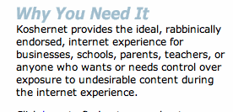
Some corner cases
Parental protection
  user (paying subscriber…) choice
KosherNet
Spam
  would only affect IP-level blocking
DOS
  classified as unwanted traffic
Notes:
http://www.koshernet.com/

Slide 65
47 CFR 8
§ 8.1 Purpose.
  The purpose of this Part is to preserve the Internet as an open platform enabling consumer choice, freedom of expression, end-user control, competition, and the freedom to innovate without permission.
§ 8.3 Transparency.
  A person engaged in the provision of broadband Internet access service shall publicly disclose accurate information regarding the network management practices, performance, and commercial terms of its broadband Internet access services sufficient for consumers to make informed choices regarding use of such services and for content, application, service, and device providers to develop, market, and maintain Internet offerings.

Slide 66
Disclosure (Transparency) – Network Practices
Congestion management: congestion management practices; types of traffic; purposes; practices’ effects on end users’ experience; criteria used in practices, such as indicators of congestion that trigger a practice, and the typical frequency of congestion; usage limits and the consequences of exceeding them; and references to engineering standards, where appropriate.
Application-Specific Behavior
Device Attachment Rules
Security

Slide 67
Disclosure (Transparency) – Performance
Service description: A general description of the service, including the service technology, expected and actual access speed and latency, and the suitability of the service for real-time applications.
Impact of specialized services: If applicable, what specialized services, if any, are offered to end users, and whether and how any specialized services may affect the last-mile capacity available for, and the performance of, broadband Internet access service.

Slide 68
Disclosure (Transparency) – Commercial Terms
Pricing: For example, monthly prices, usage-based fees, and fees for early termination or additional network services.
Privacy Policies: For example, whether network management practices entail inspection of network traffic, and whether traffic information is stored, provided to third parties, or used by the carrier for non-network management purposes.
Redress Options: Practices for resolving end-user and edge provider complaints and questions.

Slide 69
What about congestion?
Open Internet rules allow charging by
  access rate
  traffic volume
Content-neutral mechanisms
  normal TCP
  e.g., Columbia University: “XXX”

Slide 70
Open Internet & QoS
Principle of end user control
E.g., DiffServ bits or signaling
  RSVP or NSIS
  or out-of-band (“please prioritize UDP port 5050”)
Together with rate or volume limits
  “Includes 1,000 minutes of VoIP priority”
Technical difficulties
  DSCP bit re-marking
  Symmetric treatment for incoming traffic

Slide 71
Pay for Priority (P4P)
“Dear Google: We’ll mark your packets as high priority for just $9.95/GB! Hurry, offer ends soon!”
May not matter (much) in practice
  assumes QoS problems and local congestion
  but related to paid peering (later)

Slide 72
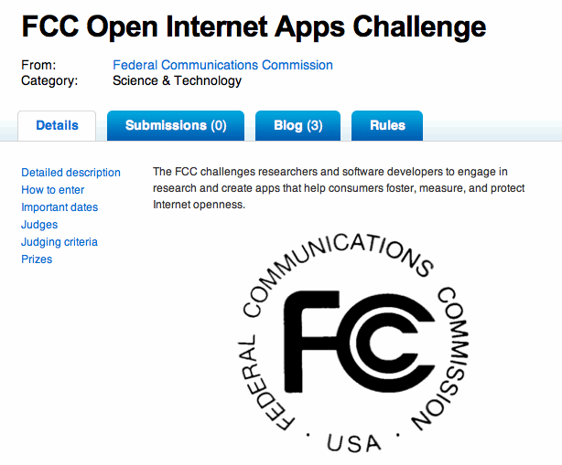

FCC challenge
Difficult to determine state of openness
  blocking, content discrimination

Slide 73
Example tests
May contribute to ossification of Internet
E.g., Reddit comments on FCC challenge
  SCTP, DCCP, UDP Lite
  UDP path MTU detection
  NXDOMAIN
  VPN protocols
  ICMP echo
  TCP vs. non-TCP fairness
  TCP window scaling
  TCP ECN
  modification of HTTP requests
Notes:
http://www.reddit.com/r/programming/comments/ewy18/the_fcc_has_launched_a_competition_to_create/

Slide 74
the next NN battle
Peering – the next network neutrality challenge

Slide 75
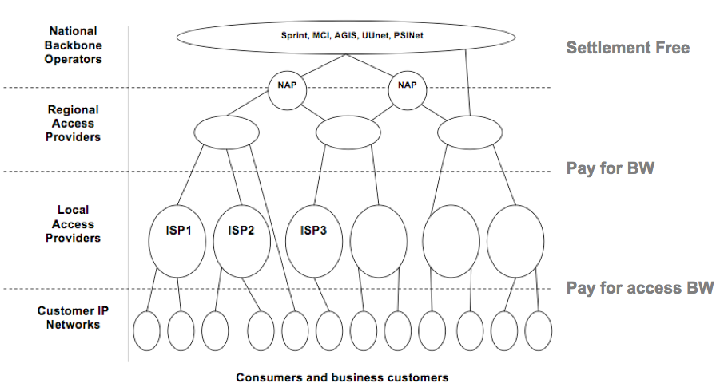
The old Internet
Craig Labovitz, “Internet Traffic and Content Consolidation”, IETF March 2010.

Slide 76
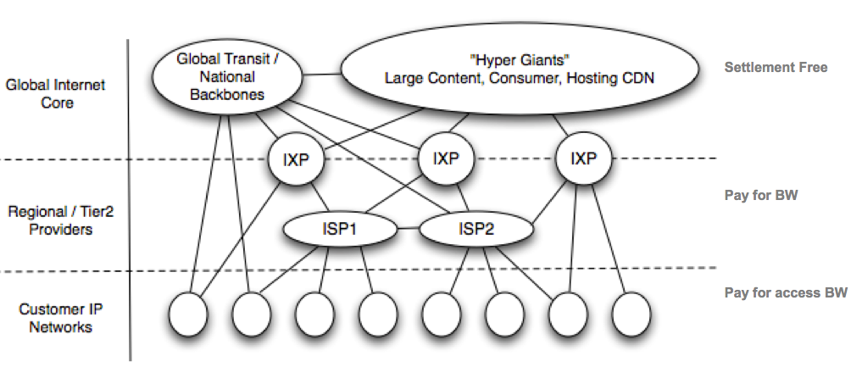
A denser Internet
Craig Labovitz, “Internet Traffic and Content Consolidation”, IETF March 2010.

Slide 77
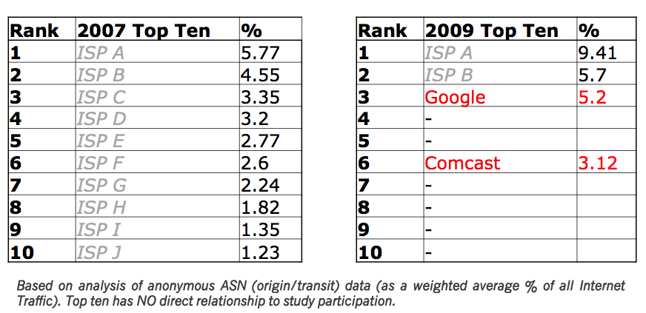
New network providers
Craig Labovitz, “Internet Traffic and Content Consolidation”, IETF March 2010.

Slide 78
Internet traffic flows today
ratio 16:1?
CDN
backbone (transit)
content
eyeball ISP
CDN

Slide 79
Internet money flows today
CDN
backbone (transit)
content
eyeball ISP
$0
or $0
“bill & keep”

Slide 80
Future Internet money flows?
CDN
backbone (transit)
content
eyeball ISP
$0
termination charges
cf. existing telephone network

Slide 81
Paid vs. non-paid peering
Reflects value added and market power
E.g.,
  number of customers served
  distance carried (fiber route miles)
Market power
  eyeball ISP only allows direct peering
  content providers have to reach (almost) all customers
  but there are lots of transit providers
Economic models just emerging

Slide 82
Paid vs. non-paid peering
Traffic ratios traditionally used between transit ISPs
  but not exclusively
Thought experiment:
  replace YouTube with Skype
  now, traffic symmetric
  but exact some impact on consumer ISP

Slide 83
The “classic” Internet – ca. 1995
MAE-East
NYSERnet
traffic
money
flow
Sprint
FCC
Craig Labovitz, “Internet Traffic and Content Consolidation”, IETF March 2010.

Slide 84
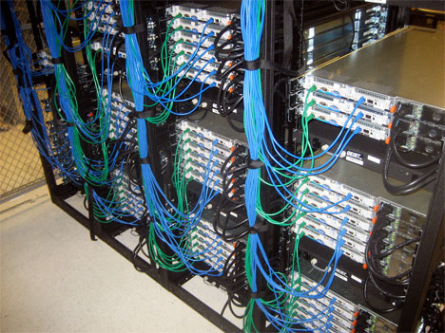
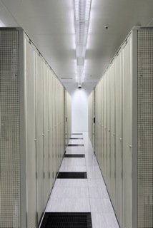
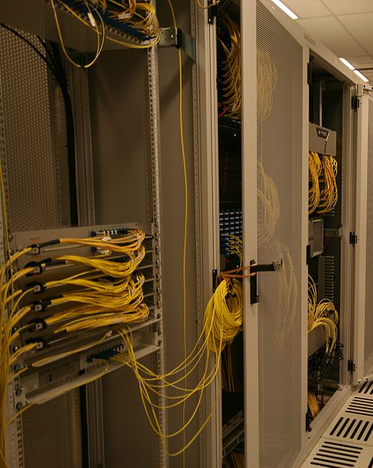

Role of the IXPs (inter-exchange points)
IXP
  As NAPs congested, IXPs emerged (including overseas)
  IXPs → private peering and secondary peering
  IXPs
    reduced tromboning
    provided cost reductions
    improved performance and
    occurred mostly without regulatory oversight
About 85 IXPs in US
Notes:
Developing countries –most traffic goes abroad
IXP evolution – figure
Secondary peering –peering between non-backbones
Changing traffic patterns has resulted in changes in the hierarchy, which has put pressure on transit prices
Content providers have built out networks, putting pressure on backbone providers

Slide 85
The players & their roles
Role | Examples | AT&T | Comcast
End user | residential … GM
Eyeball ISP | WISP … Comcast, AT&T | x | x
Content & application hosting | GoDaddy, Layered Technologies | x | x
Content providers and aggregators | Netflix, YouTube, Vimeo |  | x
CDNs (content distribution networks) | Akamai, Limelight, Edgecast | x | x
IXPs | Equinix
Transit ISPs | Verizon Business (UUnet), Level 3, GlobalCrossing, Tata | x (tier 1) | x
Notes:
Largest Backbone Networks:
AT&T
Global Crossing
Level 3 Communications
NTT Communications
Qwest Communications International
Sprint
Verizon Business (formerly MCI/UUNET)

Slide 86
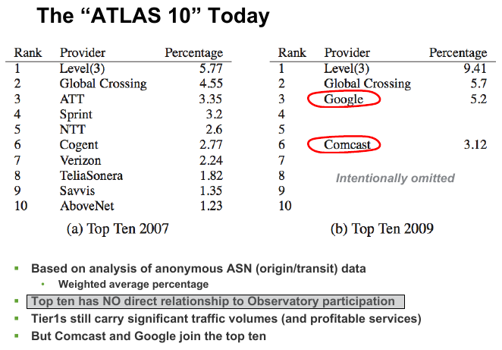
New network providers
Craig Labovitz, “Internet Traffic and Content Consolidation”, IETF March 2010.
Notes:
http://www.telco2.net/blog/2009/10/perhaps_the_most_important_cha_1.html

Slide 87

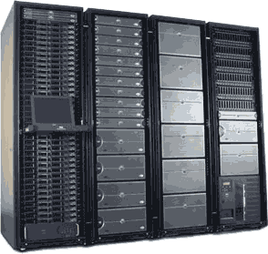
Internet traffic flows in the 1990s
ratio 4:1?
local
access network
backbone (transit)
UUnet
eyeball ISP
AOL
Altavista
Yahoo
GeoCities
pets.com
server farm
87

Slide 88


Internet traffic flows today
ratio 16:1?
CDN
content
access network
(data center provider)
backbone (transit)
Level3
eyeball ISP
Google
Facebook
YouTube
Yahoo
Live
Baidu
Comcast
CDN
Akamai
video
conferencing
server farm
88

Slide 89
Internet money flows today
CDN
backbone (transit)
content
eyeball ISP
Level3
Tata
Comcast
$0
or $0
“bill & keep”
server farm
89

Slide 90
Future Internet money flows?
CDN
new
backbone (transit)
Comcast
content
eyeball ISP
Level3
Tata
$0
Google
Netflix
two-sided market
90

Slide 91
The end of infinite
Same packets, different value

Slide 92
The value of bits
Technologist: A bit is a bit is a bit
Economist: Some bits are more valuable than other bits
Application | Volume | Cost per unit | Cost / MB
Voice (13 kb/s GSM) | 97.5 kB/minute | 10c | $1.02
Mobile data | 5 GB | $40 | $0.008
MMS (pictures) | < 300 KB, avg. 50 kB | 25c | $5.00
SMS | 160 B | 10c | $625
Notes:
T-Mobile 2010
AT&T data
http://www.nowsms.com/discus/messages/12/8500.html

Slide 93
Service separation
Deep packet inspection
Block or charge for competing services
  voice (Skype, Fring, … vs. IMS)
  SMS (WhatsApp)
  video (payTV: $77, NetFlix: $7.99)
See KPN and other European carriers
  → NL net neutrality law

Slide 94
MetroPCS example

Slide 95



Bandwidth costs
Amazon EC2
  $100/TB in, $100/TB out
CDN (Internet radio)
  $600/TB (2007)
  $100/TB (Q1 2009 – CDNpricing.com)
NetFlix (7 GB DVD)
  postage $0.70 round-trip → $100/TB
FedEx – 2 lb disk
  5 business days: $6.55
  Standard overnight: $43.68
  Barracuda disk: $91 - $116/TB
Notes:
FedEx and EC2 prices as of 09/15/09
CDN: http://www.mindbranch.com/listing/product/R678-29.html
http://www.cdnpricing.com/

Slide 96
Cost of broadband
Access | Price per month | Median (average) usage | $/GB
DSL (3 MB/s + 768 kb/s) | $30 | 1.7 GB (9.2 GB) | $17.65 ($3.26)
AT&T UVerse |  |  | $0.20 beyond 150 GB
Smartphone | $25 | 250 MB | $100
Wireless data retail | $40 |  | $10
Web hosting |  |  | $1-2
CDN pricing (*) |  |  | $0.10
* strongly depends on volume: $0.25 GB/resale, high volume (500 TB/month): $0.05/GB
Notes:
http://www.newamerica.net/publications/policy/price_of_the_pipe
http://blogs.gartner.com/phillip-redman/2010/11/09/wireless-data-pricing-reaches-a-new-low/

Slide 97
Bandwidth limits
Label | Description | Cap exceeded | Motivation | Consumer impact
Usage cap | Subscriber limited to monthly bandwidth quota (e.g., 100 GB/month) | Reduced speed email warning contract termination | reduce impact of small number of very heavy users reduce P2P usage | depends on cap more and more consumers
Tiered service | caps by tier | same | Market segmentation light vs. heavy users | less transparency
Metered service | Monthly base + linear fee ($/GB) | metered bandwidth billing | Usage-induced revenue Protection again competing services | Priced in excess of cost bill shock

Slide 98


Examples

Slide 99
Optus (Australia) example

Slide 100
Spectrum

Slide 101
Spectrum
100+ years of legacy use
  is this like land ownership?
  why would anybody move?
  see FCC white spaces effort
Fragmentation – end systems need multiple RF front ends
  often limited by chip design
Receiver standards – dealing with OOBE

Slide 102

Spectrum policies
There’s no more open space
Increase efficiency
  modulation
  narrow-banding
  analog → digital → packet
  special purpose → general purpose
Increase spatial re-use
No good research data on spectrum usage and possibilities

Slide 103
US spectrum approaches
Narrow-banding by January 1, 2013
  150-512 MHz band: 25 kHz → 12.5 kHz or better
White spaces in TV band (512 – 692 MHz)
  query database for incumbents
  10 database operators
  space mostly available in rural areas
Incentive auctions
  only about 10% use over-the-air TV
  TV channels → data

Slide 104
Challenges for research

Slide 105
The grand (real-world) challenges
Getting from 60 to 95% broadband usage & coverage
  cost, societal issues
Spectrum challenges
  availability, fragmentation, co-existence
Bandwidth challenges
  QoS does not help (much)
    allows VoIP at 90% vs. 60% load
  video compression not quite maxed out
    MPEG-2 → H.264 got us factor 2 → H.265

Slide 106
The grand (real world) challenges
Understanding privacy
  vague conceptions of harms & risks
  see Google, Apple, …
The role of competition in a natural monopoly world
How to make research relevant
  not obvious which results in the last 10 years have had major impact on practice

Slide 107
The not-so-grand challenges
Sensor networks
QoS
➔ 90-10 problems (= 90% of solution with 10% of the effort)

Slide 108
Conclusion
Time of transition, not innovation
Industry moving from start-up to infrastructure commodity
Cannot assume that technology will force positive outcomes
  interplay of economics, regulation, technology
Have limited insights into alternatives
  what can we contribute?

