Slide 1
SipCloud: Dynamically Scalable SIP Proxies in the Cloud
Jong Yul Kim, Henning Schulzrinne
Internet Real-Time Lab
Columbia University, USA

Slide 2
Contents
1. Dynamically scalable SIP services (~30 slides)
  What is the problem we’re addressing?
  Our context and approach
  Architecture implementation and design
  Test results
2. Failures and how to recover from them (work-in-progress, 4 slides)
3. Messaging system (1 slide)

Slide 3
Nation-wide => Kobe
legend
Earthquake of Jan.
17, 1995
regular day
800
Traffic increased rapidly just after the earthquake at 5:50
about 20 times higher than normal day of average calls in an hour to Kobe from nation-wide
< 50 calls/hour → 800 calls/hour in 4 hours
= Compounded 2x increase per hour
600
About 20times of normal day
400
200
About 7 times of normal day
Capacity of
NTT facility
(max usage of normal days)
4am 8am 12pm 4pm 8pm 12am 4am 8am 12pm 4pm 8pm 12am 4am 8am
Jan 17 Jan 18 Jan 19
10am
Earthquake happened at 5:46am, Jan. 17, 1995
Courtesy of NTT

Slide 4
That’s a problem
Capacity planning is not ideal because of:
  Overprovisioning for normal operation
    Smooth operation but some resources are idle
  Underprovisioning for unexpected events
    Hard to predict how much traffic to expect
Can we do better?

Slide 5
Nation-wide => Kobe
legend
Earthquake of Jan.
17, 1995
regular day
800
Traffic increased rapidly just after the earthquake at 5:50
about 20 times higher than normal day of average calls in an hour to Kobe from nation-wide
< 50 calls/hour → 800 calls/hour in 4 hours
= Compounded 2x increase per hour
600
400
200
Capacity of
NTT facility
4am 8am 12pm 4pm 8pm 12am 4am 8am 12pm 4pm 8pm 12am 4am 8am
Jan 17 Jan 18 Jan 19
10am
Courtesy of NTT

Slide 6
Nation-wide => Kobe
legend
Earthquake of Jan.
17, 1995
regular day
800
Traffic increased rapidly just after the earthquake at 5:50
about 20 times higher than normal day of average calls in an hour to Kobe from nation-wide
< 50 calls/hour → 800 calls/hour in 4 hours
= Compounded 2x increase per hour
600
About 20times of normal day
400
200
About 7 times of normal day
Capacity of
NTT facility
(max usage of normal days)
4am 8am 12pm 4pm 8pm 12am 4am 8am 12pm 4pm 8pm 12am 4am 8am
Jan 17 Jan 18 Jan 19
10am
Earthquake happened at 5:46am, Jan. 17, 1995
Courtesy of NTT

Slide 7
If we can do that…
The system can become more :
  Reliable
  Users are not disrupted by overload situations.
  Economical
  There are less idle resources.
  Energy efficient
  Resources are used only as much as needed.

Slide 8
Context of our research
An internet-based voice service provider
  No PSTN interconnection
  Uses SIP for signaling
Study on the scalability of signaling plane
  → “How do we automatically scale the system based on incoming load?”

Slide 9
Our approach
  Use Infrastructure-as-a-Service (IaaS) cloud platforms as enabling technology.
    Allows clients to add or remove VM instances on demand using the service provider’s API.
    Platform users can pre-configure an appliance (OS + application) and run it as a VM instance.
    “Auto-scaling” is only for HTTP traffic.
    Let’s apply it to SIP traffic as well.

Slide 10
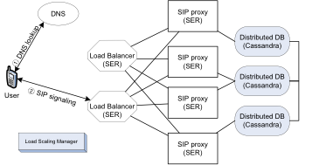
SipCloud Architecture
Notes:
LB: hash value of Call-ID
Cassandra: for reliability and scalability
No HA.

Slide 11
Load Scaling Manager (LSM)
Has global knowledge of the cluster
Monitors load
Creates / terminates VM instances
Configures VM instance as either a load balancer, proxy, or a Cassandra node
  Handles reconfiguration of running nodes as well.
Even if LSM is killed, cluster continues operation.
  But does not scale.

Slide 12
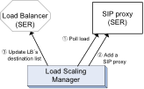
LSM adds a proxy
1 Monitor load
Load > threshold !!
2 Launch a VM
(2~3 mins), configure proxy,
start proxy
3 Update LB’s destination list

Slide 13
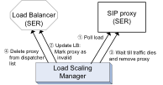
LSM removes a proxy
1 Monitor load
Load < threshold !!
2 Select remove candidate &
update LB:
mark proxy as
invalid
3 Terminate proxy VM
4 Update LB:
reconfigure
destination file

Slide 14
SipCloud Architecture
Notes:
LB: hash value of Call-ID
Cassandra: for reliability and scalability
No HA.

Slide 15
Designed for scalability
SipCloud is designed to utilize dynamic scalability to the fullest based on three principles:
Highly scalable tiers
Independently scalable tiers
Scalable database tier

Slide 16
Designed for scalability
Highly scalable tiers
  Each tier may be able to support an unbounded* number of components if a component does not rely on another in the same tier to perform its function.
  e.g. if load balancers use a hash function to distribute load, it can operate independently from other load balancers.
* has not been tested.

Slide 17
Designed for scalability
Independently scalable tiers
  Each tier scales independently from other tiers.
    Proxy tier scales on incoming load.
    DB tier scales on number of subscribers.
  Scaling logic is simplified to a tier-local decision.

Slide 18
Designed for scalability
Scalable database
Node ID: 50
Range: 41~50
Node ID: 10
Range: 1~10
Key-value store
Each node
  is a single cassandra instance
  is a P2P node (simply add/remove node)
  contains keys < node ID
  replicates to N-1 successive nodes
Key query: hash(key)
hash(key)
Node ID: 20
Range: 11~20
Node ID: 40
Range: 31~40
Node ID: 30
Range: 21~30

Slide 19
SQL vs. Key-value store
SQL
  SELECT contact FROM db.location WHERE user=‘jk’
Cassandra
  Keyspace = ‘db’
  ColumnFamily = ‘location’
  Column = ‘contact’
  Key = ‘jk’
  No query language. Only function call, e.g. get()

Slide 20
SQL vs. Key-value store
SQL
  SELECT pw FROM db.credentials WHERE user=‘jk’ and realm=‘cs.columbia.edu’
Cassandra
  Keyspace = ‘db’
  ColumnFamily = ‘credentials’
  Column = ‘pw’
  Key = ‘jk’ → ‘jk@cs.columbia.edu’
  Design of ColumnFamily revolves around keys.

Slide 21
ColumnFamily for SER proxy
Credentials
username@realm | password | ha1 | flags
Location
userID | AOR | contact | expires | received

Slide 22
Designed for scalability
Due to the three principles, it is easy to add or remove components in the SipCloud system.

Slide 23
Testing dynamic scaling
On Amazon EC2, M1.Large instance
  One dual-core processor
  7.5 GB memory
  64-bit linux operating system
We could only perform a limited test on Amazon EC2
  1 load balancer, 1~4 proxies, 1 Cassandra
  Up to 800 calls per second for the whole cluster

Slide 24
Abuse Case 13633844695
Hello,
We have detected that your instance(s):i-4aeda025 have been behaving in the following way that is against our AWS Customer Agreement:
Port Scanning
Please be aware that in terms of the Web Services License Agreement http://aws.amazon.com/agreement/ if your instance(s) continue such abusive behavior, your account may be subject to termination.
EC2 has taken the following administrative action(s) against your instance(s):
BLOCKED OUTBOUND PORT 5060

Slide 25
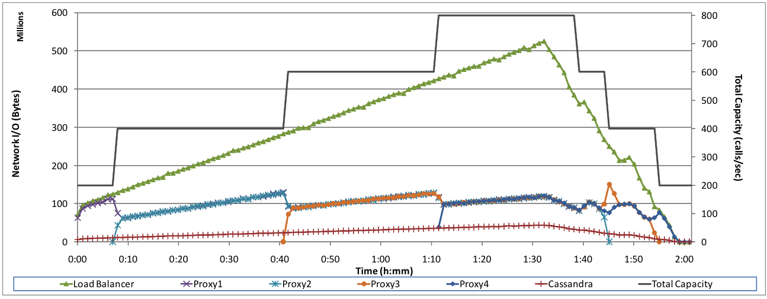
Total cluster capacity (calls per second) and
Network I/O (bytes) of each VM instance
Notes:
At startup, the load generated by the UAC is 140 cps. The load is increased automatically at a rate of 10 cps every 90 seconds until it reaches 760 cps. At that point, the load is reduced at a rate of 60 cps every 90 seconds until the total load reaches zero.

Slide 26
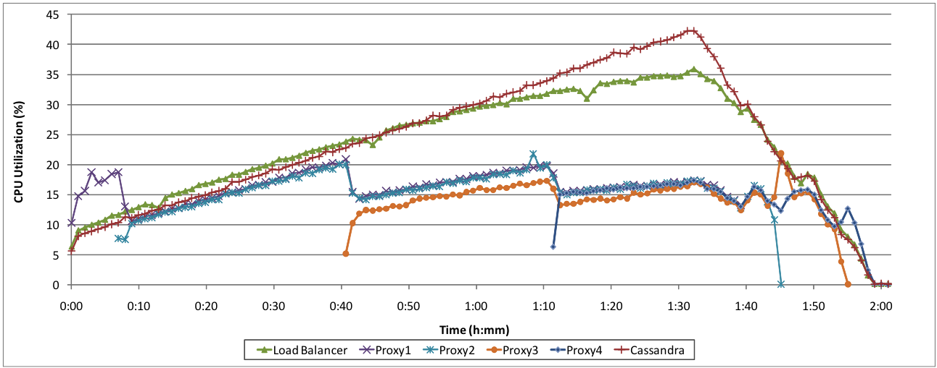
CPU utilization of VM instances

Slide 27
Conclusion
IaaS platforms provide dynamic scaling, which can be used by SIP service providers.
But using the feature properly requires a lot of work.
  SIP level load monitoring
  VM creation / termination
  Configuration/reconfiguration on the fly
We’ve had success with limited proxy scaling tests, but whether it can scale better still remains to be seen.

Slide 28
Current work on failures in the system

Slide 29
Failures
Why do they happen?
  HW failures
    CPU, memory, disk, motherboard, network card, etc.
  SW failures
    Parallelism (locks)
    Missing input validation (malformed packets)
    Cannot adapt to changes in environment (disk full)
    Software update failures (introduce new bugs)
  Infrastructure failures
    Network failure, DNS failure
    Power failure
Small scale
failure
Large scale
failure

Slide 30
Testing strategy
For small scale failures
  terminate whole VMs component-wise
    Load balancer, SER proxy, Cassandra etc.
  collect data
    from Load Scaling Manager’s monitoring subsystem
    Types of data:
      Changes in VM stats: CPU utilization, network I/O
      Changes in application: DNS record changes, proxy load changes
  deduce correlation between component failures and service failures

Slide 31
Example of a correlation result
LB is down
DNS record is stale
Client cannot make call
This is a timing problem.
However,
99.999% = 5.26 minutes of down time in a year.

Slide 32
Possible countermeasures
Failure monitoring
  Need faster monitoring for 5-nines and beyond
  Application monitoring vs. VM monitoring
Recovery mechanisms
  Create new VM every time there’s a failure.
  Create new VM every time there’s a failure?
    Not helpful if a malformed packet is sent.
Long term management of the system
  Deal with SW updates
  Use of heterogeneous components to build system

Slide 33
Scalable and reliable messaging system

Slide 34
Can we reuse SipCloud to build a messaging system?
SIP INVITE
SIP MESSAGE
Stateful operation
  Real-time text (RTP)
  MSRP (TCP)
Will face the same advantages and problems as SipCloud for voice service.
  Will lose state if proxy fails.
Stateless operation
  “Page mode” or “SMS mode”
Will have better reliability as long as proxies are recovered quickly.
Either way, SipCloud can be a possible candidate.

Slide 35
Really, it’s the end
We’re looking at failures and how to recover from them in a dynamically scalable system.
A scalable, reliable messaging system based on SIP will probably face similar challenges as SipCloud.

